Slide 1

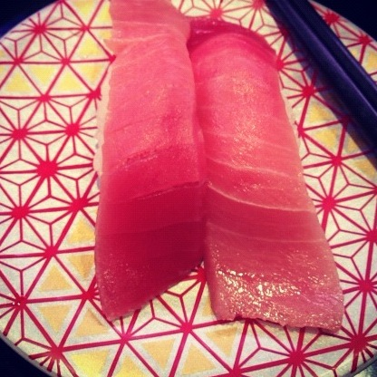
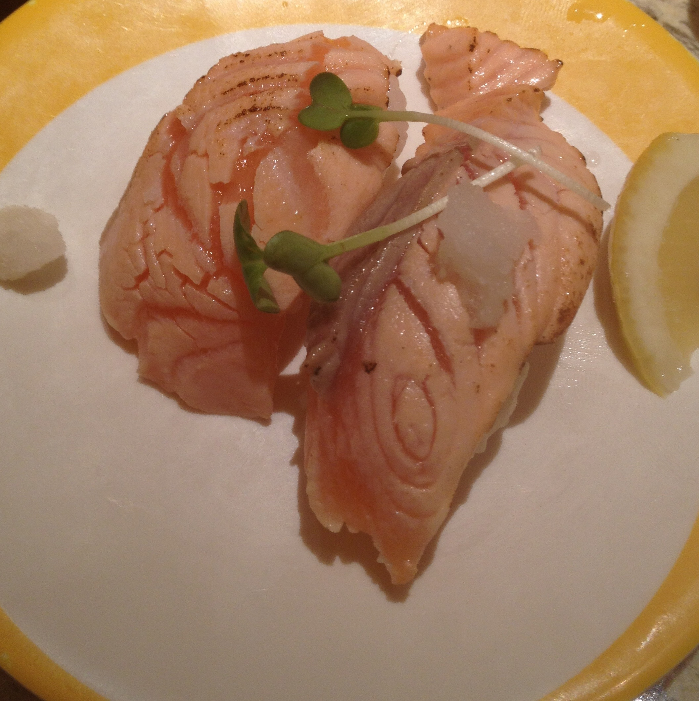
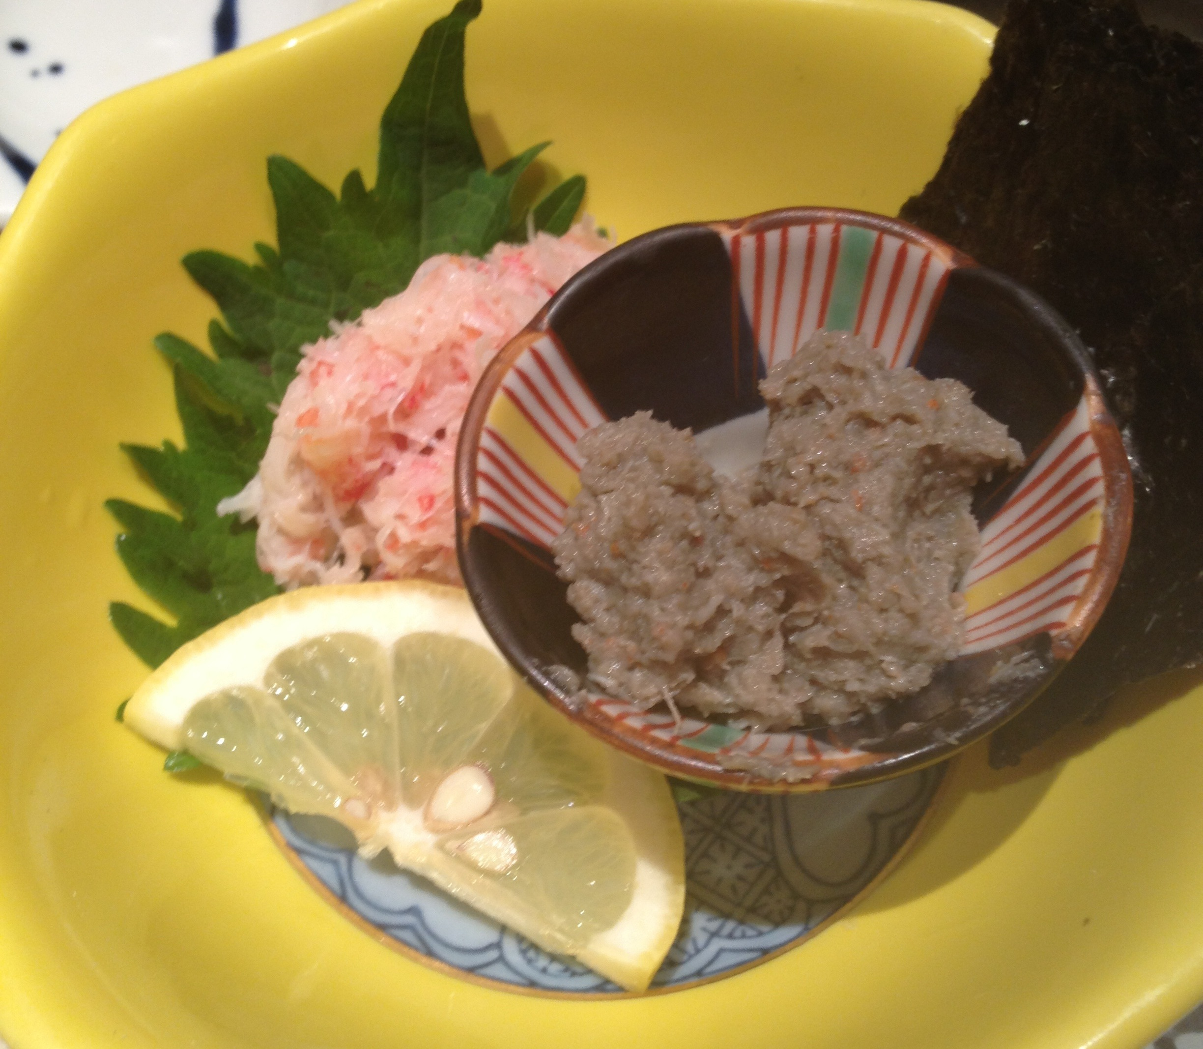
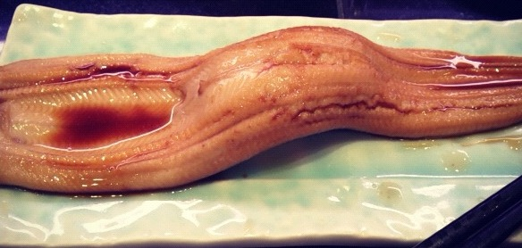

Support vector comparison machines
TD Hocking, S Spanurattana, M Sugiyama
T-16
Tokyo Institute of Technology Department of Computer Science
Chu-toro is better than salmon
Kani-miso is as good as anago
東京工業大学
Tokyo Institute of Technology
Photo credit: S Spanurattana
Notes:
<number>

