Slide 1

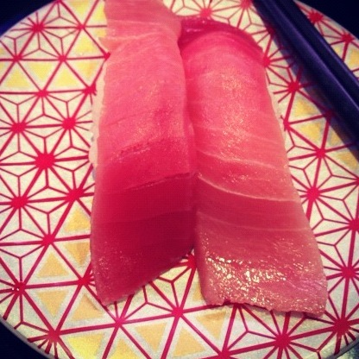
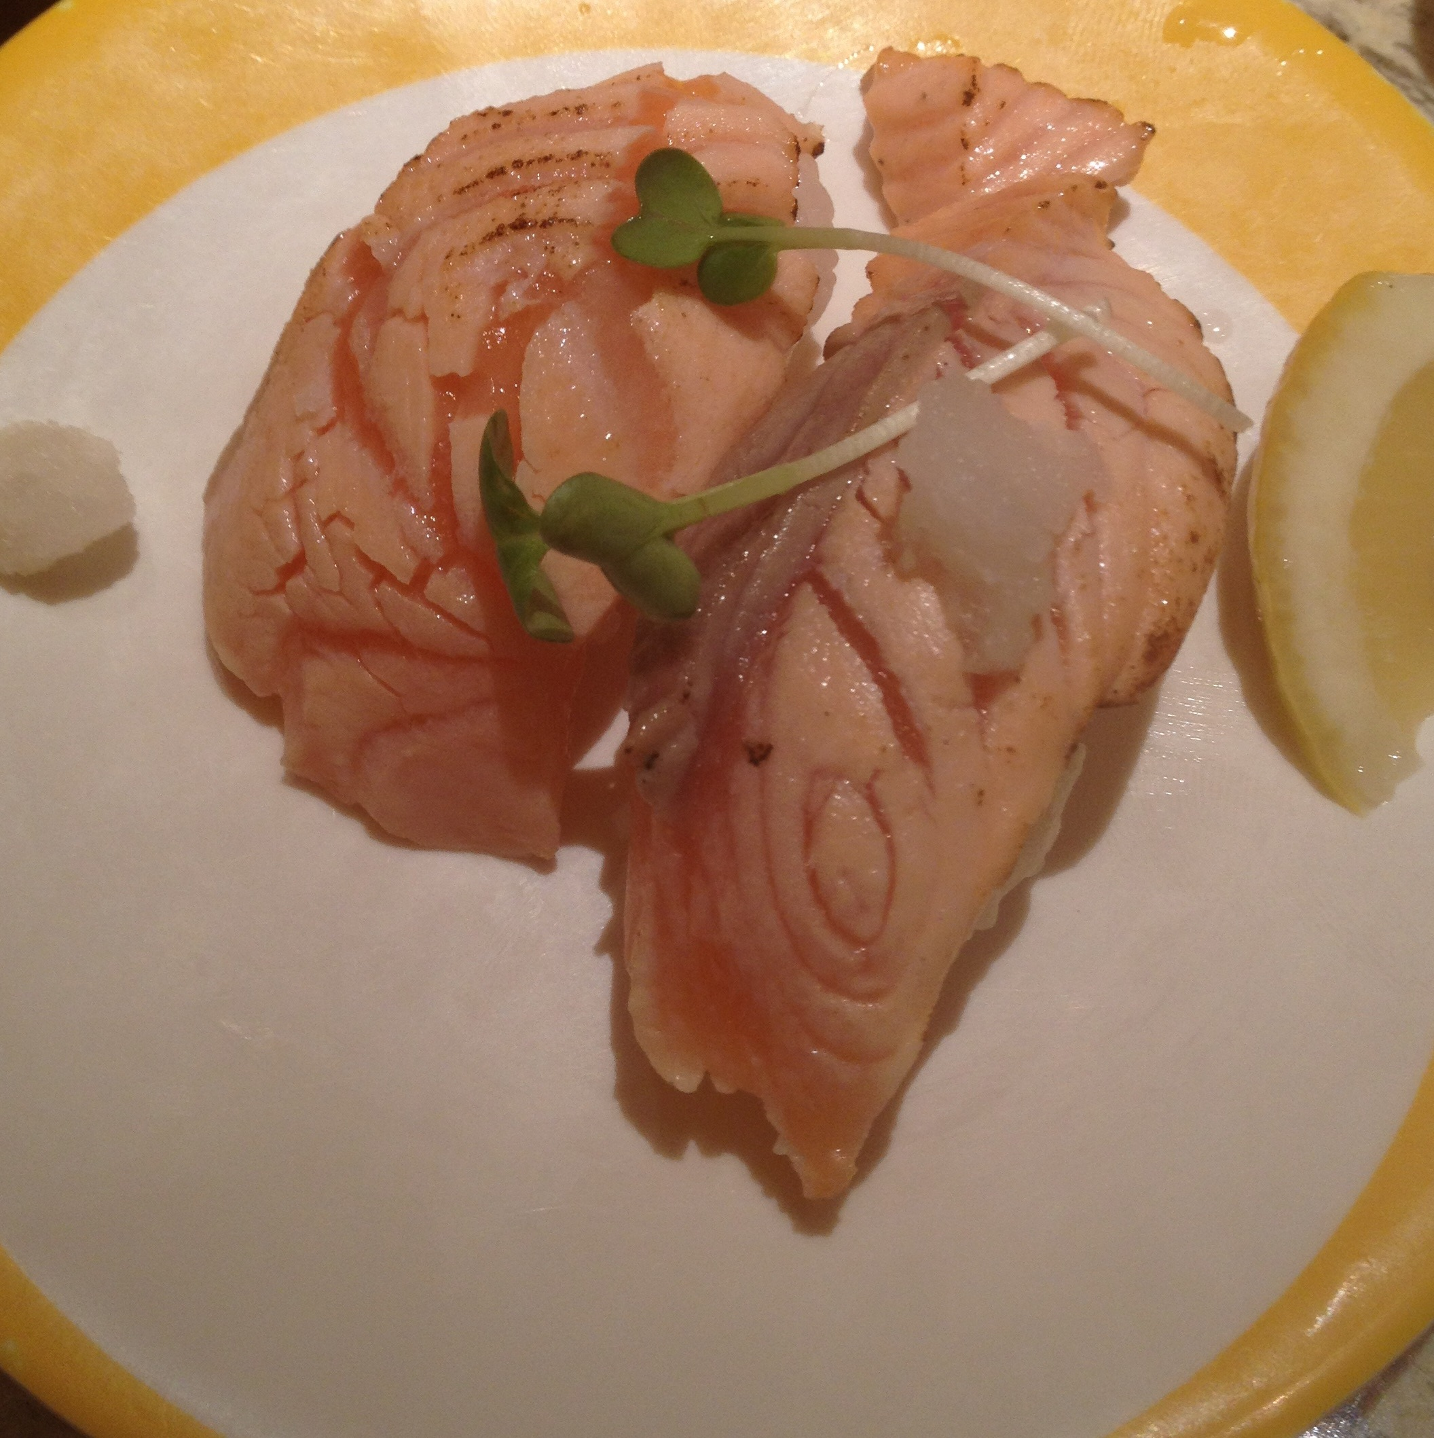
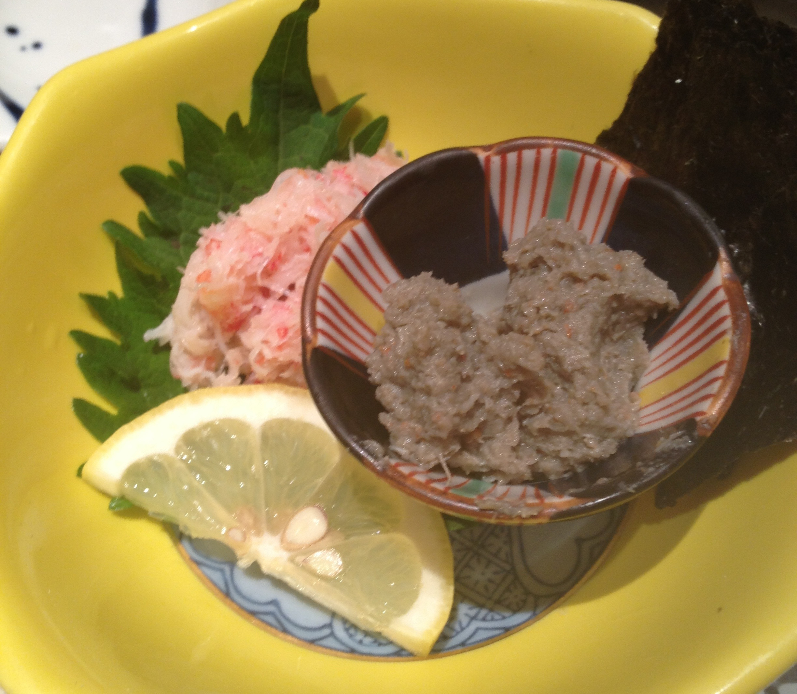
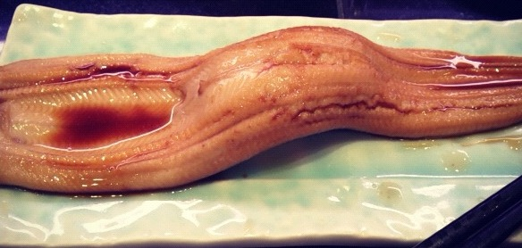

Support vector comparison machines
TD Hocking, S Spanurattana, M Sugiyama
Tokyo Institute of Technology computer science
T-16
Chu-toro is better than salmon
Kani-miso is as good as anago
東京工業大学
Tokyo Institute of Technology
Photo credit: S Spanurattana
Notes:
<number>

