Slide 1

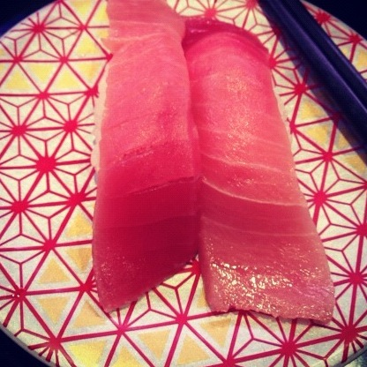
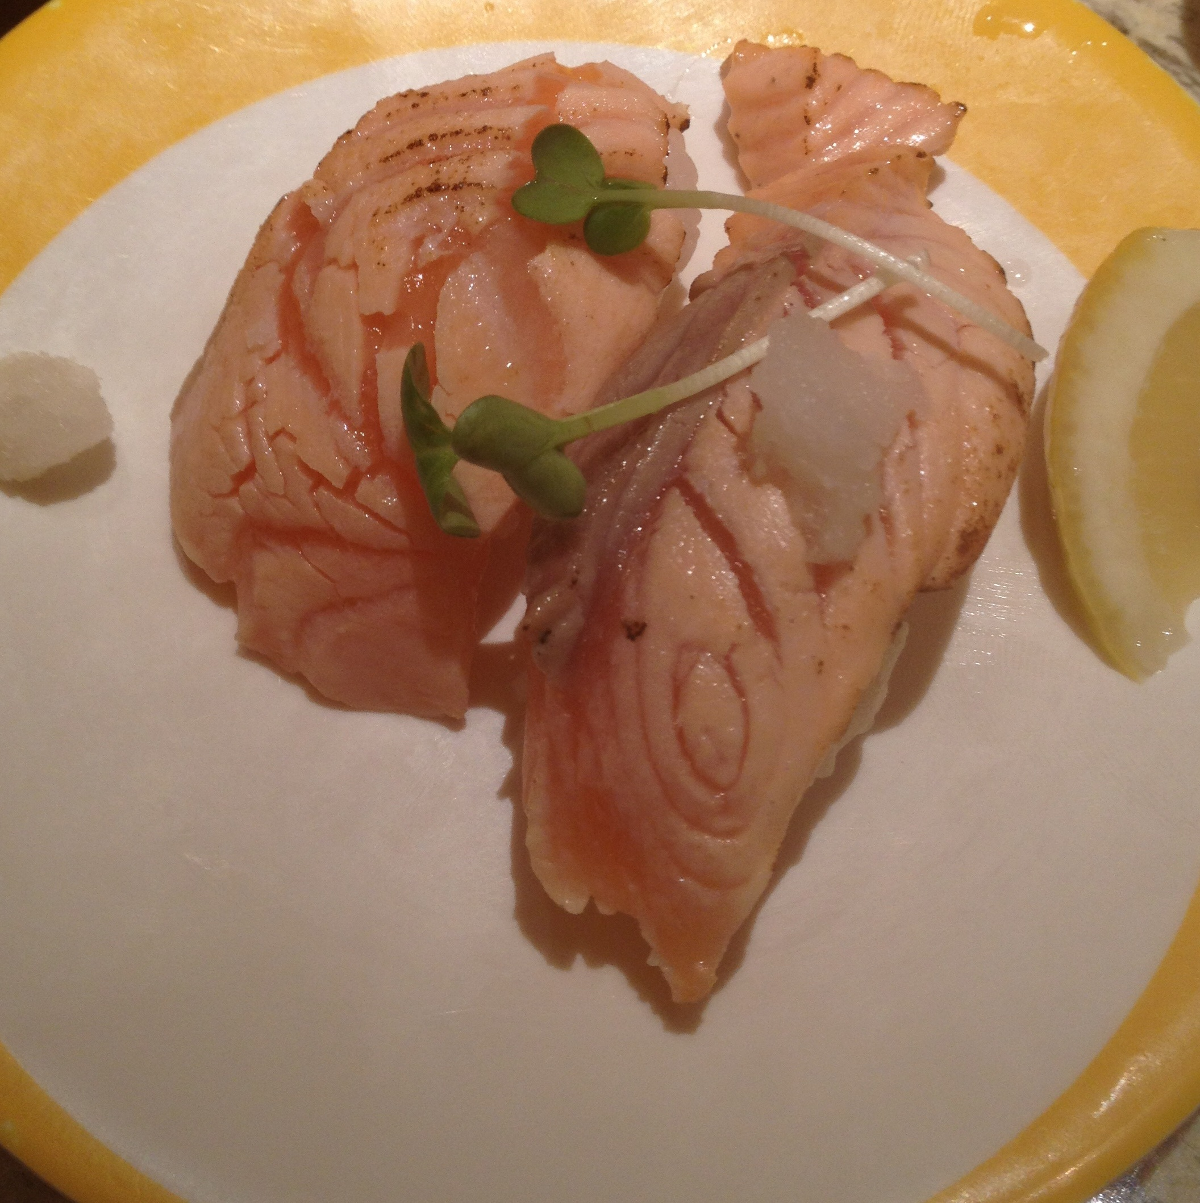
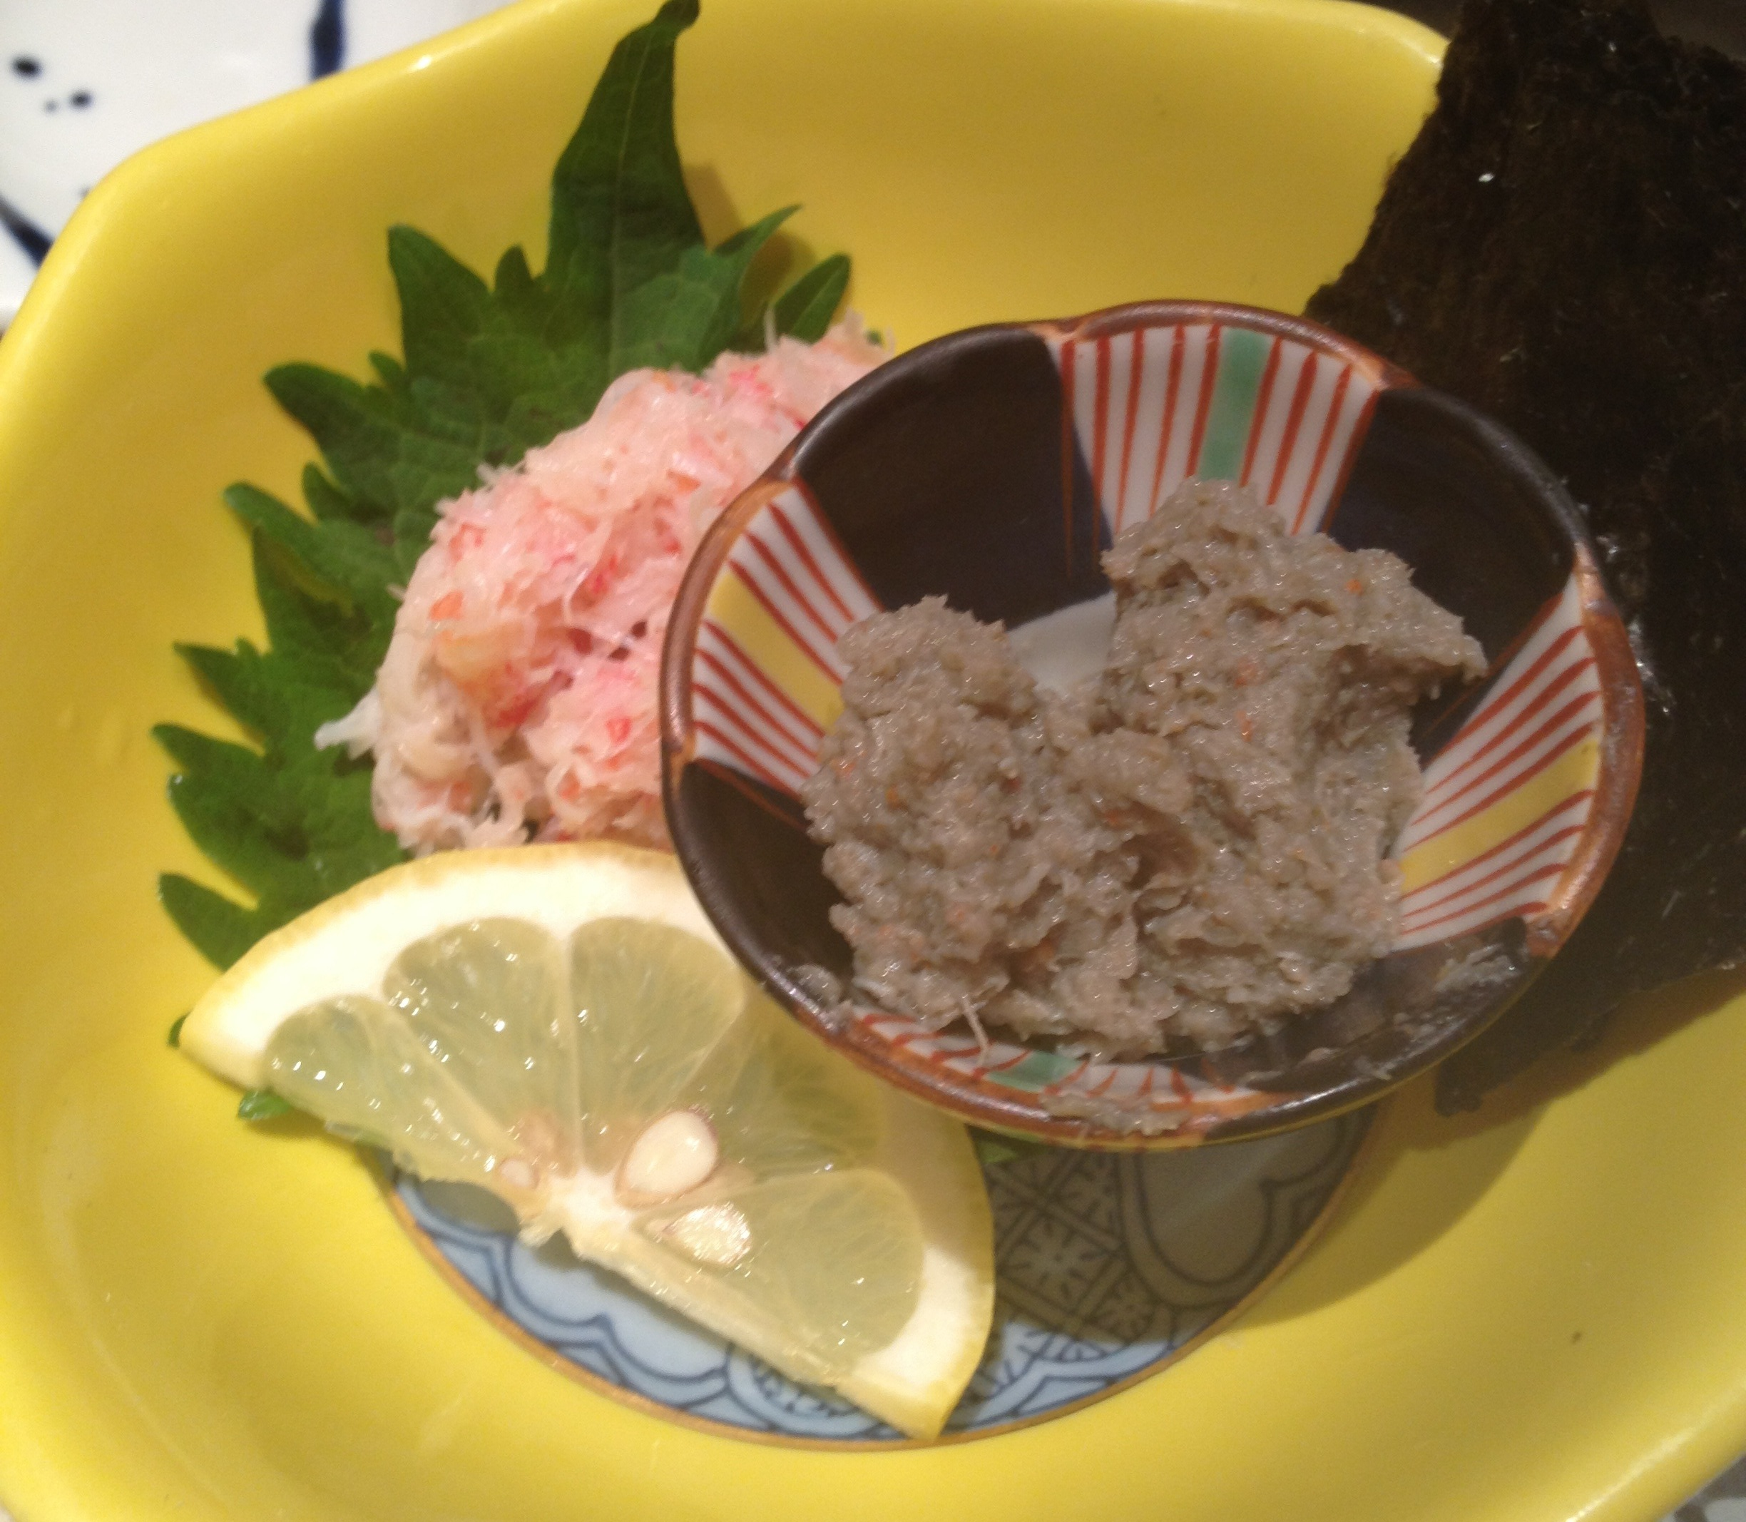
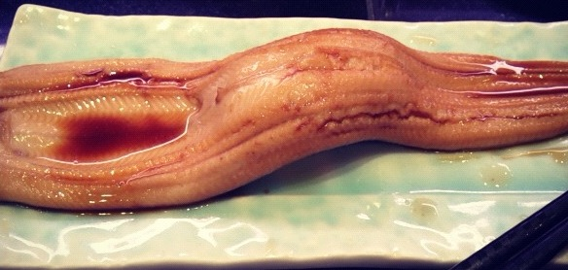

T-16
Support vector comparison machines
TD Hocking, S Spanurattana, M Sugiyama
Chu-toro is better than salmon
Kani-miso is as good as anago
東京工業大学
Photo credit: S Spanurattana
Tokyo Institute of Technology
Notes:
<number>

