Slide 1
Artificial Intelligence
Chapter 1
(Some slides adapted from Eck Doerry, Stuart Russel, Dan Klein, and others. Thanks guys!)
<number>

Slide 2
Chapter Outline
Motivations to study AI…
What is AI anyway?
A brief history of the field
The state of the art
<number>

Slide 3
So you wanna do AI?
Why are you interested in AI personally? Why are you here?
Because I think Artificial Insemination is key to our nation’s agricultural success? (fail)
I need another class to graduate
???
Why you should be interested…
Intelligence defines us, as human, as a species…
Opportunity…
AI will be huge…
AI vs Physics as a field…
Physics
Known
Unknown
AI
Known

Slide 4
What is Artificial Intelligence?
We could start by looking at (supposed) areas of application…
… and there are plenty…
Knowledge Representation
Social Networks
Analysis
Deep Q&A systems
Graph Analysis
Audio/Speech Analytics
IOT, Smart homes
Simulation and Modeling
Visualization
Virtual Personal Assistants
Soft Robotics
Natural Language Generation
Machine Learning
Image Analytics
Smart Vehicles
Natural Language Processing
Recommender Systems
Deep Learning

Slide 5
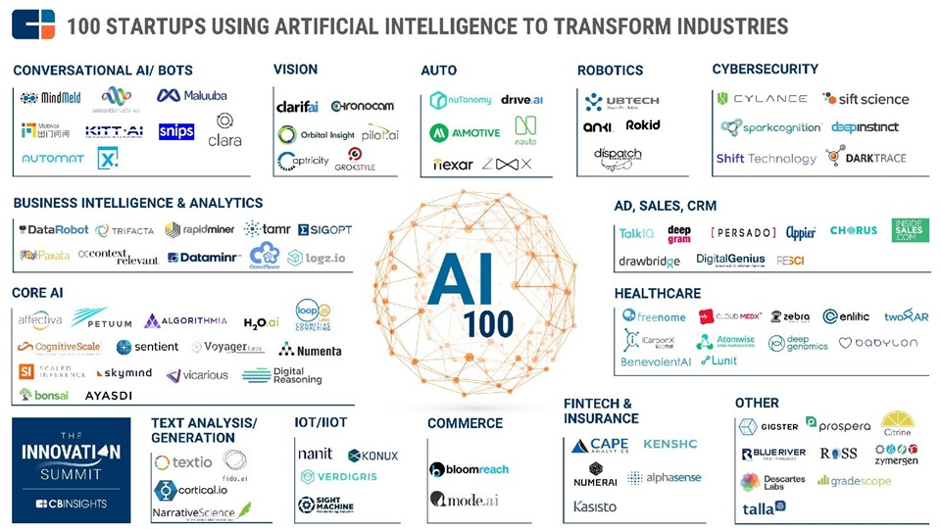
What is Artificial Intelligence?
Or maybe see what sorts of companies are working on what…
Credit: http://www.techforkorea.com

Slide 6
What is Artificial Intelligence?
Hmmm, or maybe we could boil this down to some key “topic areas”…
Neural
Networks
Robotics
Planning
Artificial Intelligence
Machine
Learning
Knowledge
Representation
Natural
Language
Processing
Computer
Vision

Slide 7
What is Artificial Intelligence?
We’re still not at the heart of it…
WHAT IS INTELLIGENCE REALLY?
Uhh…well…ya know…thinking. Too vague!

Slide 8
What is AI?
At the core, it’s about software systems that…behave in a certain way.
Historically, we can discern four different perspectives
Similar functionally…but quite different philosophically
“performance” (fidelity)
“competence” (fidelity)
Reasoning
Systems that think like humans Systems that think rationally
Systems that act like humans Systems that act rationally
Acting
<number>

Slide 9
Acting humanly: The Turing test
Turing (1950) “Computing machinery and intelligence”:
“Can machines think?” −→ “Can machines behave intelligently?”
Operational test for intelligent behavior: the Imitation Game
HUMAN
HUMAN INTERROGATOR
?
AI SYSTEM
Predicted that by 2000, a machine might have a 30% chance of fooling a lay person for 5 minutes
Anticipated all major arguments against AI in following 50 years
Suggested major components of AI: knowledge representation, reasoning, language understanding, learning
Problem: Turing test is not reproducible, constructive, or amenable to mathematical analysis
<number>

Slide 10
Thinking humanly: Cognitive Science
1960s “cognitive revolution”: information-processing psychology replaced prevailing orthodoxy of behaviorism
Requires scientific theories of internal activities of the brain
What level of abstraction? “Knowledge” or “circuits”?
How to validate? Requires either:
Predicting and testing behavior of human subjects (top-down)
Direct identification from neurological data (bottom-up)
… plus, ideally, modeling findings in software!
Both approaches (roughly, Cognitive Science and Cognitive Neuroscience) are now distinct from AI
Both share with AI the following characteristic:
the available theories do not explain (or engender) anything resembling human-level general intelligence
Hence, all three fields share one principal direction: focus on understanding intelligent behavior
<number>

Slide 11
Thinking rationally: Laws of Thought
Normative (or prescriptive) rather than descriptive approach
Aristotle: what are correct arguments/thought processes?
Several Greek schools developed various forms of logic:
notation and rules of derivation for thought
Will see more when we look at reasoning agents.
may or may not have proceeded the idea of mechanization
i.e. pure philosophy versus application orientation.
Direct line through mathematics and philosophy to modern AI
Problems:
Not all intelligent behavior is mediated by logical deliberation
Not goal driven. What is the purpose of thinking? What thoughts should I have out of all the thoughts (logical or otherwise) that I could have?
<number>

Slide 12
Acting rationally: doing the “right” thing
Rational behavior: doing "the right thing”
Don’t worry about how humans perform it
Don’t worry about logical truth
Focus on results:
The right thing: that which is expected to
maximize goal achievement, given the available
information.
Doesn’t necessarily involve thinking
e.g., blinking reflex…but thinking should be in the service of rational action
This course in AI is about engineering
About how to build it, how to make it happen
Not about philosophy…or even theory of cognition
Thus: we will focus on this practical view of AI.
How can we make the machine intelligently solve problems?
Formally: Designing agents that act rationally
<number>

Slide 13
Rational agents
An agent is an entity that perceives and acts
This course is about designing rational agents
Defn: a software agent that acts to achieve best expected outcome modulo:
Available knowledge at that moment
Uncertainty of knowledge that it does have
Or often, realistically: Limited rationality: take the most rational action given some time limit to act.
Abstractly, an agent is a function from percept histories to actions:
f : P∗ → A
For any given class of environments and tasks, we seek the agent (or class of agents) with the best performance
Caveat: computational limitations make perfect rationality unachievable
→ design best program for given machine/situational resources
<number>

Slide 14
AI prehistory: Influences
Philosophy | logic, methods of reasoning, mind as physical system foundations of learning, language, rationality
Mathematics | formal representation and proof, concept of algorithms, computation, (un)decidability, (in)tractability, probability
Psychology | Adaptation, phenomena of perception and motor control experimental techniques (psychophysics, etc.)
Economics | formal theory of rational decisions (decision theory), Game theory, Max-Min strategies, Adversarial reasoning
Linguistics | knowledge representation, grammar (for NLP)
Neuroscience | Model of plastic physical substrate for mental activity
Control Theory | homeostatic systems, stability, simple optimal agent designs
<number>

Slide 15
Brief glance: history of AI
1943 | McCulloch & Pitts: Boolean circuit model of brain
1950 | Turing’s “Computing Machinery and Intelligence”
1952-69 | Look Ma, no hands! Early automatons…
1950s | Early AI programs, including Samuel’s checkers program, Newell & Simon’s Logic Theorist, Gelernter’s Geometry Engine
1956 | Dartmouth meeting: “Artificial Intelligence” adopted
1965 | Universal solver: Robinson’s complete algorithm for logical reasoning
1966-74 | AI discovers computational complexity Neural network research almost disappears
1969-79 | Early development of knowledge-based systems
1980-1988 | Expert systems industry booms
1988-93 | Expert systems industry busts: “AI Winter”
1985-95 | Neural networks concepts resuscitated…a new way forward
1988- | Resurgence of probability; general increase in technical depth “Nouvelle AI”: ALife, GAs, soft computing
1995- | Agents, agents, everywhere . . .
2003- | Human-level AI back on the agenda (the next bubble?)
<number>

Slide 16
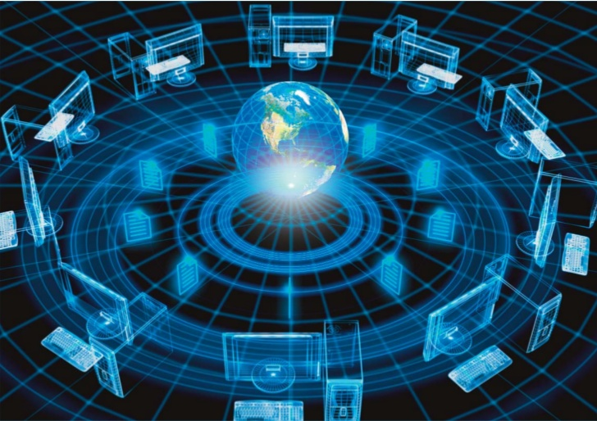
Quick quiz: How much do you know about AI?
Which of the following can be done at present?
Play a decent game of table tennis
Drive safely along a curving mountain road
Drive safely in rush downtown phoenix
Buy a week’s worth of groceries on the web
Buy a week’s worth of groceries at Bashas
Play a decent game of bridge
Beat world champions in GO
Discover and prove a new mathematical theorem
Design and execute a research program in molecular biology
Give competent legal advice in a specialized area of law
Converse successfully with another person for an hour
Perform a complex surgical operation
Unload any dishwasher and put everything away
Write an intentionally funny story
<number>

Slide 17
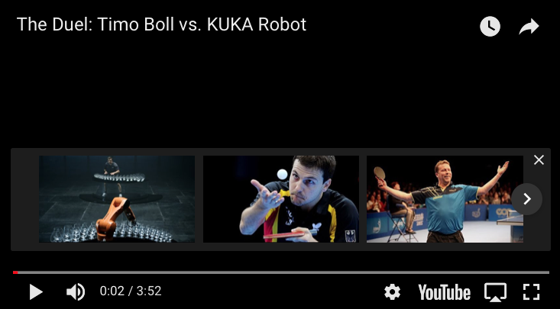
State of the art
Which of the following can be done at present?
Play a decent game of table tennis (Kuka Robotics, 2014)
Truth: No, it can’t really beat Timo Boll. But robots can play decent parlor ping-pong…and are getting better. See: https://spectrum.ieee.org/automaton/robotics/industrial-robots/robots-playing-ping-pong-whats-real-and-whats-not
<number>

Slide 18
State of the art
Which of the following can be done at present?
Play a decent game of table tennis
Drive safely along a curving mountain road
Drive safely in rush downtown phoenix
Buy a week’s worth of groceries on the web
Buy a week’s worth of groceries at Bashas
Play a decent game of bridge
Beat world champions in GO
Discover and prove a new mathematical theorem
Design and execute a research program in molecular biology
Give competent legal advice in a specialized area of law
Converse successfully with another person for an hour
Perform a complex surgical operation
Unload any dishwasher and put everything away
Write an intentionally funny story
<number>

Slide 19
Unintentionally funny stories: The best AI can do…
One day Joe Bear was hungry. He asked his friend Irving Bird where some honey was. Irving told him there was a beehive in the oak tree. Joe threatened to hit Irving if he didn’t tell him where some honey was. The End.
Henry Squirrel was thirsty. He walked over to the river bank where his good friend Bill Bird was sitting. Henry slipped and fell in the river. Gravity drowned. The End.
Once upon a time there was a dishonest fox and a vain crow. One day the crow was sitting in his tree, holding a piece of cheese in his mouth. He noticed that he was holding the piece of cheese. He became hungry, and swallowed the cheese. The fox walked over to the crow. The End.
<number>

Slide 20
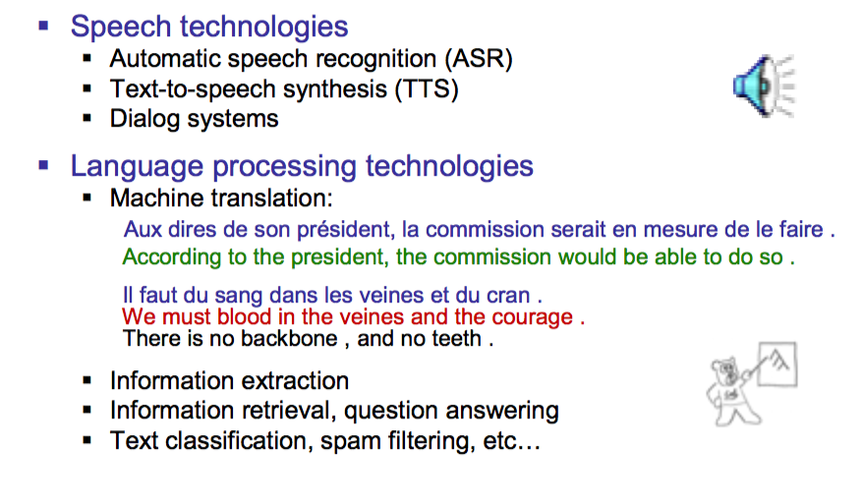
Natural Language Processing

Slide 21
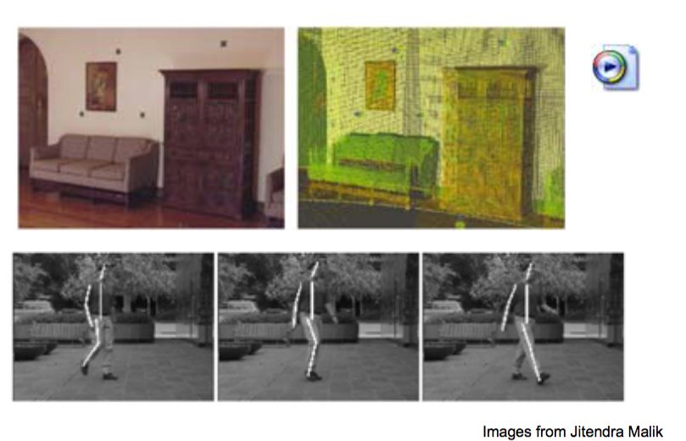
Computer Vision

Slide 22
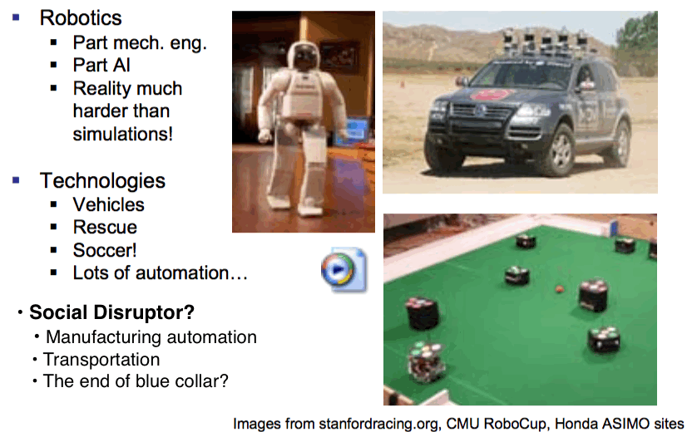
Robotics

Slide 23

Logic and Decision Making
Logical Systems
Theorem Provers
NASA Fault diagnosis
Question answering (Prolog +++)
Ex: Proved Robbins Conjecture, unsolved for decades.
Solution Methods:
Deduction Systems
Constraint satisfaction models
Satisfaction solvers (huge advances!)
Decision Support, Planning
Scheduling (e.g. airline routing, military)
Ex: During 1991 Gulf War, US forces deployed AI logistics planning/scheduling for 50k vehicles, cargos, etc.
Route planning (Google Maps)
Medical Diagnosis (e.g. Pathfinder sys)
Automated help desks
Fraud detection

Slide 24
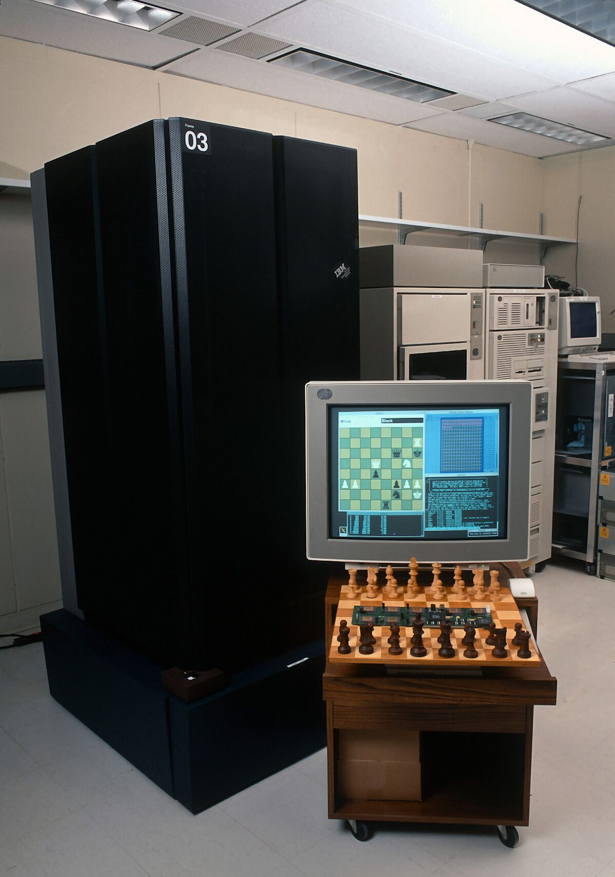
Game Playing
May 1997: IBM Deep Blue rules chess
Beats Gary Kasparov, world champion
First match won against a world champion
Integrates “intelligent creative play”
Examines 2M boards…per second.
Humans understood 99.9% of Deep Blue’s moves.
Can do about the same with decent cluster today…
2005: Machines can’t play GO
Several orders of magnitude harder than chess computationally
Human experts scoff at machines chances. Very weak play.
2016: IBMs GO spanks world champions
Secretly entered in online tournament
Beats the world champion…four times in a row.
Open questions:
How can human compete at all? How does “slow” human cognition do it?

Slide 25
The new Difficult Ethics of AI
AI will pose some hard questions for us all … soon…
Who is liable if a robot driver has an accident?
“Self-Driving Tesla Was Involved in Fatal Crash, U.S. Says”, NY-Times, 6/30/2016
Will you like the decisions that machines make? Is rational always right?
“Self-driving cars programmed to decide who dies in a crash”, USA Today, 11/23/17
Societal effects of…well… “human obsolescence”?
What will large people do when the work is done by machines?
How will it re-distribute social power structures?
Colossal restructuring of human life. Whole model is built around work…
Will machines surpass human intelligence? What will we do with superintelligent machines?
the “singularity”
Make Terminators? Save the human race?
Would intelligent machines have conscious existence? Legal rights?
Do human rights attach to biology… or cognition?

Slide 26
Thought experiment: Rationality wins? Always?
It’s a bright, sunny day and you’re zooming along alone in your spanking new self-driving vehicle. You’re looking at the window at the great scenery…because you can!
As you approach a rise in the road, heading south, a school bus appears, driving north, one driven by a human, and it veers sharply toward you. There is no time to stop safely, and no time for you to take control of the car. Does the car:
Swerve sharply into the trees, possibly killing you but possibly saving the bus and its occupants?
Perform a sharp evasive maneuver around the bus and into the oncoming lane, possibly saving you, but sending the bus and its driver swerving into the trees, killing her and some of the children on board?
Hit the bus, possibly killing you as well as the driver and kids on the bus?
The existential question:
Who dies when the car is forced into a no win situation?
It’s unaddressed…even as legislation to allow masses of autonomous vehicles onto the road is moving through Congress.
Fun quote:
Daimler: “our its autonomous vehicles would prioritize the lives of its passengers over anyone outside the car.” Market cars based on their selfish life preservation algos?!
Adapted from: https://www.usatoday.com/story/money/cars/2017/11/23/self-driving-cars-programmed-decide-who-dies-crash/891493001/
Notes:
<number>

Slide 27
Summary: So where are we headed in the future?
For sure: Better task-specific agents
Focus on one fairly narrow aspect of AI puzzle:
Speech recognition (e.g. Siri, Alexa, etc.)
Handwriting recognition (tons of note-taking apps)
Search engines (Google, Amazon, etc.)
”Smart” data aggregators (content-based news aggregators)
Vision systems (Kinect, Facial recognition, security)
Games (self-adapting, automatic generation. The holodeck…)
Continues clear trend of application-specific improvement in two decades
Human level AI (HLAI) ??
Many wizened AI gurus (McCarthy, Minsky, Winston, etc.) have complained
“these dog-n-pony tricks are not “real” AI
Need to return to broad goal of integrated, flexible, thinking machines
Ex: Siri
Speech recognition
Intelligent search
Good speech production
Terrible “intelligence”!!!

Slide 28


