Slide 1
Intelligent Agents
Chapter 2
(Adapted from Eck Doerry, Stuart Russel, Dan Klein, and others. Thanks guys!)
<number>

Slide 2
Outline
♦ Agents and environments
♦ Rationality
♦ PEAS (Performance measure, Environment, Actuators, Sensors)
♦ Environment types
♦ Agent types
<number>

Slide 3
Agents and Environments
Agents include:
Humans
Robots
Softbots
Thermostats
More…
The agent function represents the “intelligence”
Map from percept histories to actions:
f : P∗ → A
An agent program running on physical architecture implements the agent function
The line between agent and environment depends on the level of abstraction.
Agent
Sensors
Percepts
Environment
?
Actuators
Actions
Environment considered as a black box, completely external to the agent
even if it’s simulated by local code.
Agent has accept to world only via percepts.

Slide 4

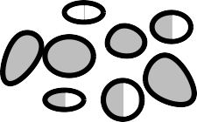

Vacuum-cleaner world
A B
Percepts: location and contents, e.g., [A, Dirty]
Actions: Left, Right, Suck, NoOp
So: super simple world!
1-D environment, just two locations
Only four possible actions, uniformly available in all locations
<number>

Slide 5

A (reflex) vacuum-cleaner agent
function Reflex-Vacuum-Agent( [location,status]) returns an action
if status = Dirty then return Suck
else if location = A then return Right
else if location = B then return Left
Percept sequence
[A, Clean]
[A, Dirty]
[B, Clean]
[B, Dirty]
[A, Clean], [A, Clean]
[A, Clean], [A, Dirty]
.
.
.
Action
Right Suck Left Suck Right Suck
. . .
What is the right function?
<number>

Slide 6
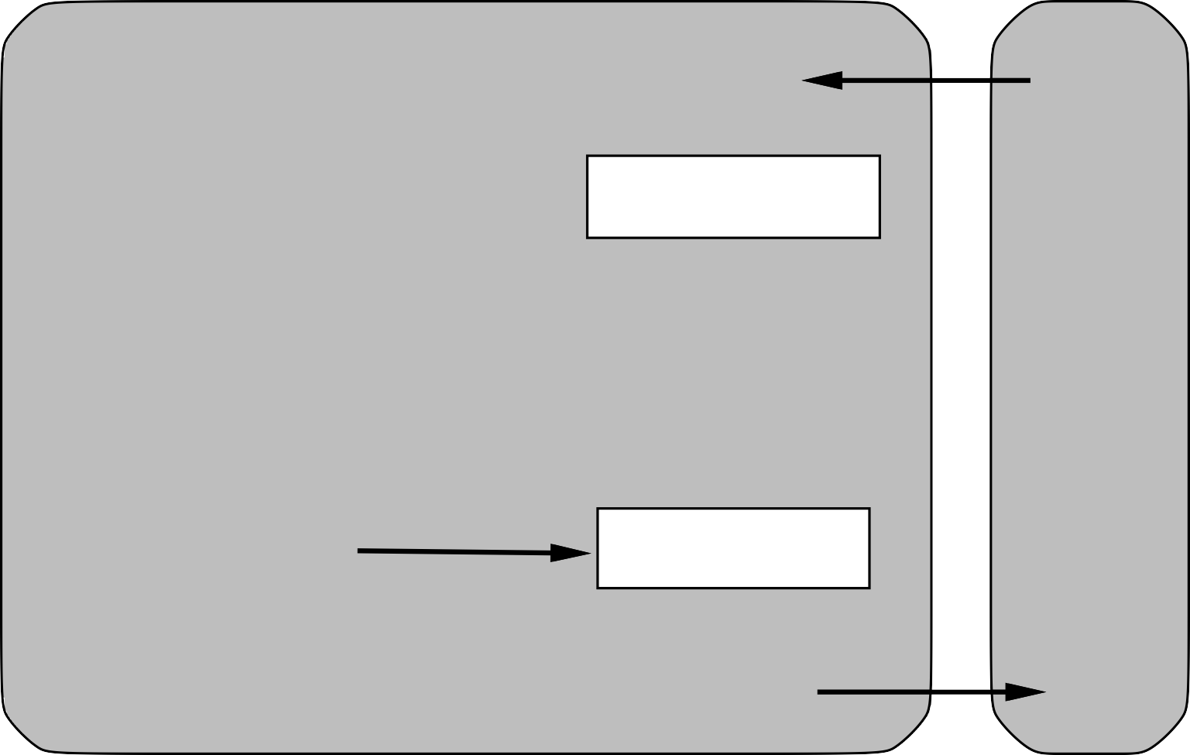

A first example: Simple reflex agents
Agent
Sensors
What the world is like now
Environment
Condition−action rules
What action I should do now
Actuators
Focus on now. No state, no history. Just reacts. True Zen machine!
Does this ever make sense as a design?
<number>
Notes:
<number>

Slide 7
Reflex Agents = Table-lookup?
Could express as table instead of function.
Complete map from percept (histories) to actions
Actions “computed” by simply looking up appropriate action in table
Drawbacks:
Huge table!
Rigid, no autonomy, flexibility
Even with learning, need a long time to ”learn” all entries in complex world.
Better agent programs: produce complex behaviors from compact specifications (programs)
Percept sequence
[A, Clean]
[A, Dirty]
[B, Clean]
[B, Dirty]
[A, Clean], [A, Clean]
[A, Clean], [A, Dirty]
..
Action
Right Suck Left Suck Right Suck
..

Slide 8
Rationality
Fixed performance measure evaluates the environment sequence
one point per square cleaned up in time T ?
one point per clean square per time step, minus one per move?
penalize for > k dirty squares?
More?
A rational agent chooses whichever action maximizes the expected value of the performance measure given current knowledge
Knowledge = initial knowledge + the percept sequence to date
Rational != omniscient
percepts may not supply all relevant information
Rational != clairvoyant about action efficacy
action outcomes may not be as expected
Hence, rational != guaranteed successful
Rationality motivates
⇒ exploration, learning, autonomy
<number>
Notes:
<number>

Slide 9

Rationality and Goals
”to maximize expected outcome”. What does that mean?
Rationality is inherently based on having some goal that we want to achieve
Performance measure: expresses extend of satisfaction, progress towards
Suppose: We have a game:
Flip a biased coin (probability of heads is h…not necessarily 50%)
Tails = lose $1; Heads= win $1
What is the expected winnings in a series of flips?
(1)h + (-1)(1-h) = 2h-1
Rational to play? Depends…
What if performance measure is total money?
What if performance measure is spending rate?
Why might a human play this game at expected loss?
Vegas, baby!

Slide 10
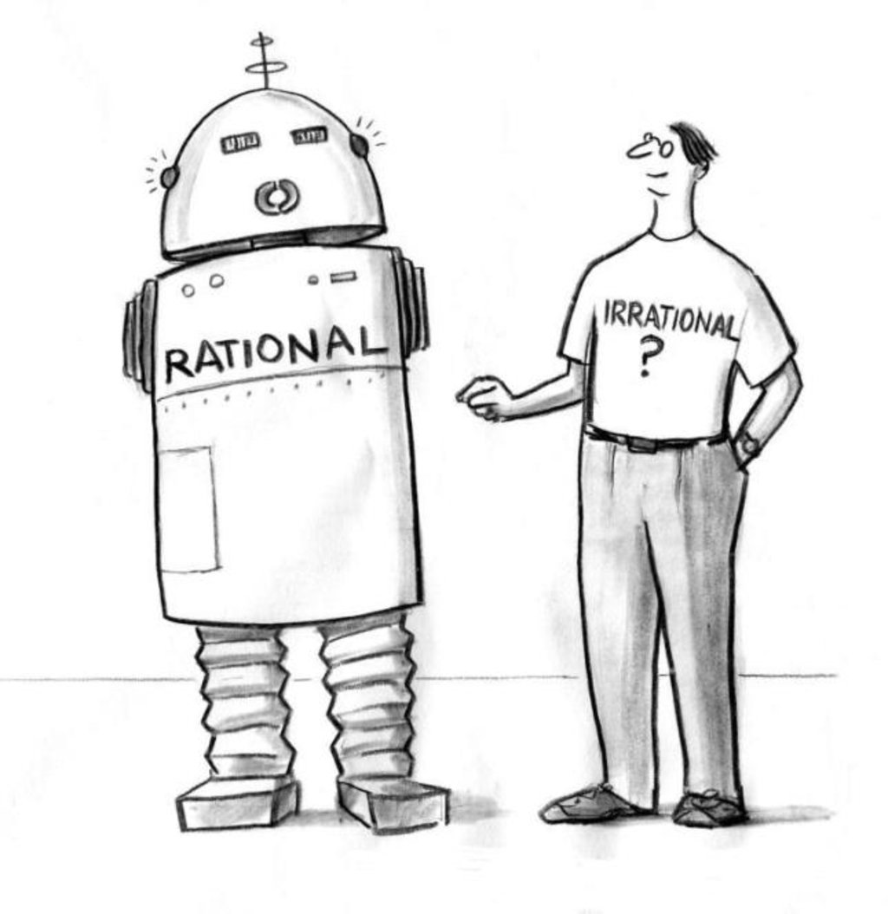
Summary: Rationality
Remember: rationality is ultimately defined by:
Performance measure
Agent’s prior (initial) knowledge of world
Agent’s percepts to date (updates to world)
Available actions
Some thought questions:
Is it rational to inspect the street before crossing?
Is it rational to try new things?
Is it rational to update beliefs?
Is it rational to construct conditional plans of action in advance?
Could now go into:
empirical risk minimization (statistical classification)
Expected return maximization (reinforcement learning)
Wait till later! Let’s get clearer concept of agents first!

Slide 11
PEAS: Specifying Task Environments
To design a rational agent, we must specify the task environment
We’ve done this informally so far…vague
The characteristics of the task environment determine much about agents!
Need to formalize…
PEAS: Dimensions for specifying task environments
Performance measure: metrics to measure performance
Environment: Descr. of areas/context agent operates in
Actuators: Ways that agent can intervene/act in the world
Sensors: Information channels through which agent gets info about world
Consider, e.g., the task of designing an automated taxi:
Performance measure??
Environment??
Actuators??
Sensors??

Slide 12
PEAS: Specifying Task Environments
To design a rational agent, we must specify the task environment
We’ve done this informally so far…vague
The characteristics of the task environment determine much about agents!
Need to formalize…
PEAS: Dimensions for specifying task environments
Performance measure: metrics to measure performance
Environment: Descr. of areas/context agent operates in
Actuators: Ways that agent can intervene/act in the world
Sensors: Information channels through which agent gets info about world
Consider, e.g., the task of designing an automated taxi:
Performance measure?? safety, destination, profits, legality, comfort...
Environment?? US streets/freeways, traffic, pedestrians,weather...
Actuators?? steering, accelerator, brake, horn, speaker/display...
Sensors?? video, accelerometers, gauges, engine sensors,keyboard, GPS...

Slide 13
PEAS: Internet shopping agent
Performance measure??
Environment??
Actuators??
Sensors??

Slide 14
PEAS: Spam filtering agent
Performance measure?? binary classification metrics, total error rate = sum of false positives (regular email classified as spam) and false negatives (spam email classified as regular), ROC curve, Area Under the Curve = AUC, ...
Environment??
Actuators??
Sensors??

Slide 15
Environments: A more concise framework
PEAS gave us a framework for outlining key agent features
One of those was environment…but we just had a general description
Much more useful to think about the kind of environment it represents
Need a concise, formal framework classifying kinds of environments!
Based on six dimensions of difference:
Observability: Full vs. Partial
Fully: An agent's sensors give it access to the complete state of the environment at each point in time.
Partially observable: An agent's sensors give it access to only some partial slice of the environment at each point in time.
Determinism: Deterministic vs. stochastic
Deterministic: The next state of the environment is completely determined by the current state and the action executed by the agent.
Stochastic: State and actions are known/succeed based on some statistical model. Knowledge is fallible, as are action outcomes (from the perspective of the agent).
Contiguity: Episodic vs. sequential
Episodic: The agent's experience is divided into independent atomic "episodes”; each episode consists of the agent perceiving and then performing a single action
Sequential: The agent’s experience is a growing series of states; new action is based not only on actual state, but on state/action in previous episodes.

Slide 16
Environments: A more concise framework
Stability: Static vs. Dynamics
Static: Environment is unchanging while the agent is deliberating
Dynamic: Environment is fluid, keeps evolving while agent plans action
Continuity: Discrete vs. Continuous
Discrete: A limited number of distinct, pre-defined percepts and actions possible.
Continuous: An unlimited number of actions are possible, infinite percepts readings possible.
Actors: Single vs. multi-agent
Single: Agent is operating solo in environment. Sole agent of change
Multi-agent: There are other agents/actors to consider, take into account, coordinate with…compete against.
What is the real world like?
Depends on how you frame the world
What your “world” is. How much detail of it you represent.

Slide 17
Thinking about Environment types
Room IDs = 1,5,9,… 2,6,…. 3,7,… 4,8,….
Solitaire Taxi Poker Internet shopping
Observable?? partial partial partial fully
Deterministic?? deter stoch stoch deter
Episodic?? seq. Seq. Seq. episodic
Static?? static dynamic. Static dynamic
Discrete?? discrete contin. Discrete discrete
Single-agent?? single single multi multi
<number>

Slide 18
Characterizing capabilities: Agent Types
The bare basics: The simple Reflex Agent we examined before…
Agent
?
Sensors
What the world is like now
Environment
Condition−action rules
What action I should do now
Actuators
Reflex Agent: No state, no history. Just reacts. Table lookup…
Adding functionality leads to new (more flexible) agent types:
Reflex agents with state
Goal-based agents
Utility-based agents
All can be turned into learning agents
Focus on dynamically improving the components agent contains
<number>
Notes:
<number>

Slide 19
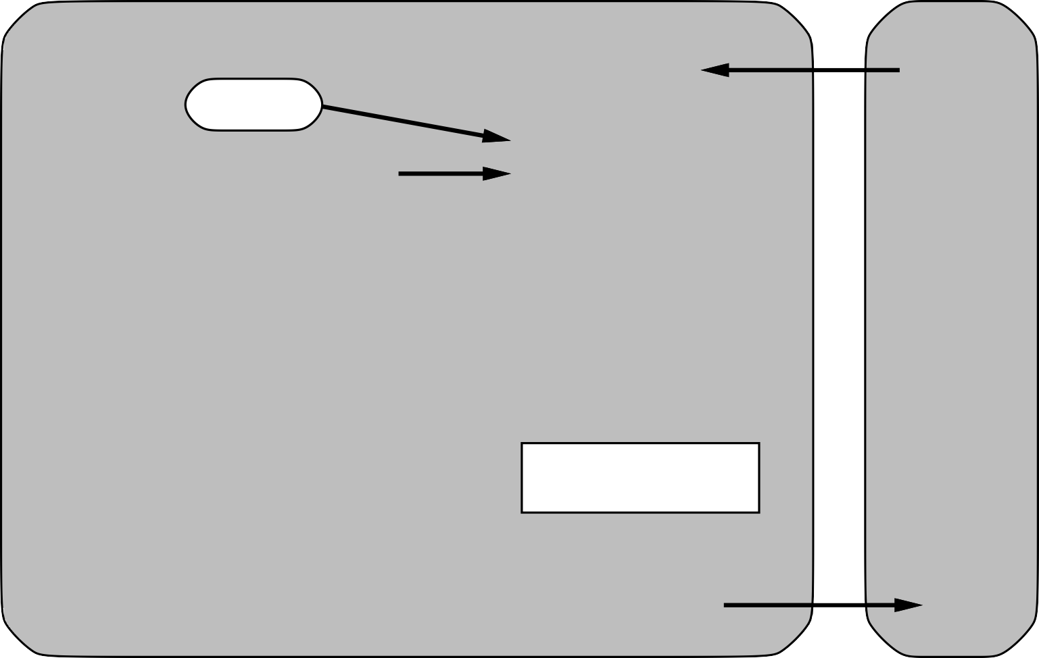


Reflex agents with state
Sensors
State
How the world evolves
What the world is like now
Environment
What my actions do
Condition−action rules
What action I should do now
Agent
Actuators
Add internal model of world:
Current state not just “current sensor read”. Percept history
Models aspects beyond sensors: world model could deduce added info
Action is still just table lookup: based on configurations of world state
<number>

Slide 20
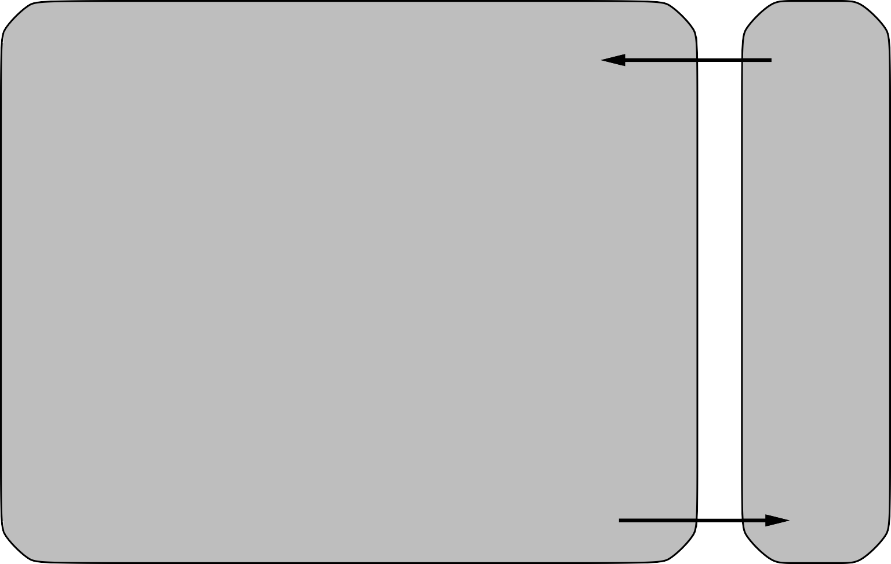

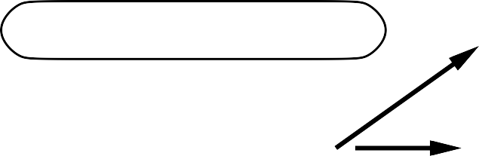

Goal-based agents
Sensors
State
How the world evolves
What my actions do
What the world is like now
Environment
What it will be like if I do action A
Goals
Agent
What action I should do now
Actuators
Not just reacting, but trying to change state towards some goal:
Get percepts, add to state
Allow world model to deduce new knowledge…comes to quiescence
Use a planning module to reason about possible future states
Choose action to lead to desired future goal states
<number>
Notes:
<number>

Slide 21


Utility-based agents
Sensors
State
How the world evolves
What my actions do Utility
What the world is like now
Environment
What it will be like if I do action A
How happy I will be in such a state
What action I should do now
Agent
Actuators
Goal states alone are too simplistic:
Some goal states are “more satisfying” than others.
Goal state is not unique/defined/attainable
“Happiness” often more continuous function based on many factors
“goal” = get to strongest possible state
Action is uncertain: get to strongest expected state…based on probability
<number>

Slide 22
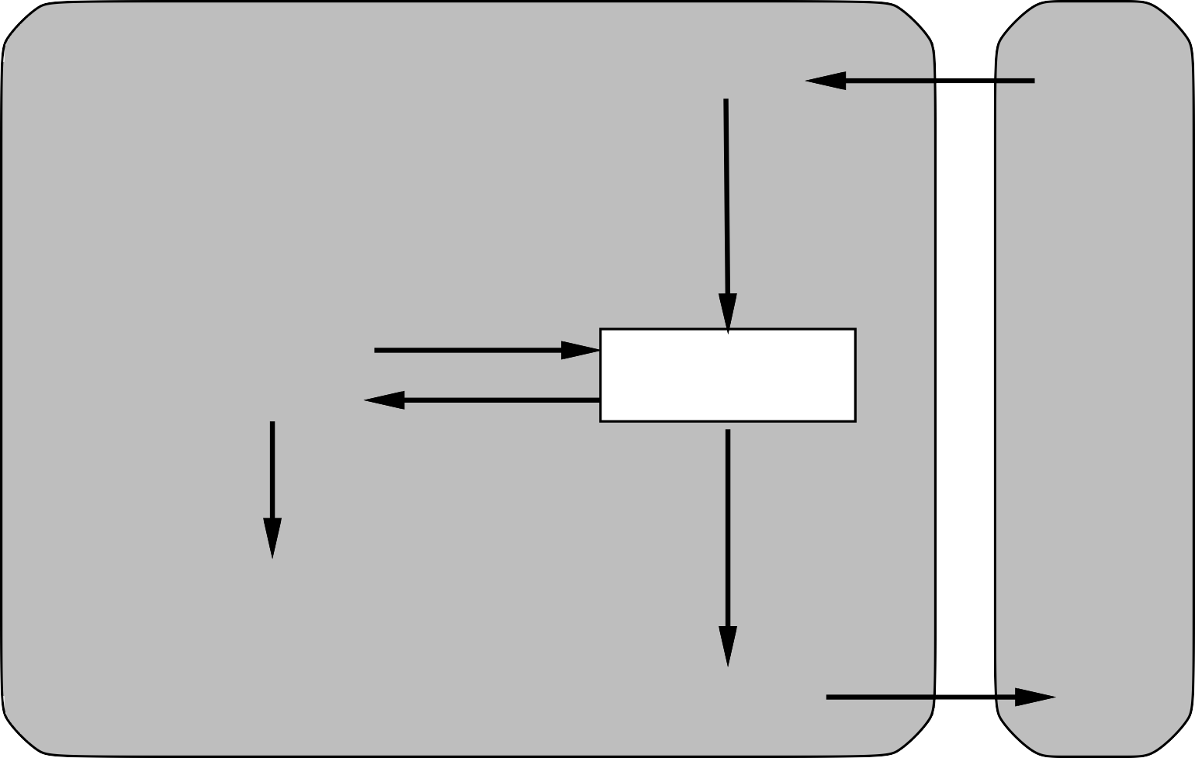
Learning: Any agent may be self-improving
Performance standard
Critic
Sensors
Existing
Agent
feedback
Environment
changes
Learning element
Performance element
knowledge
learning goals
Problem generator
Agent
Actuators
Learning ability is orthogonal to agent type: can be applied to any agent!
Modules above added on top of any basic agent description
Essentially rewrites/improves any element of existing agent dynamically
<number>
Notes:
<number>

Slide 23
Summary
Agents interact with environments through actuators and sensors
PEAS descriptions outline task environment and agent’s access to it
The agent function describes what the agent does in all circumstances
f: (initial state + P*) -> A
For non-reflex agents: Some sort of performance measure
evaluates the current (P* -> current state)
Boolean goal function vs. Utility function
A perfectly rational agent maximizes expected performance
Agent programs implement (some) agent functions
Environments are categorized along several dimensions:
observable? deterministic? episodic? static? discrete? single-agent?
Several basic agent architectures exist:
reflex, reflex with state, goal-based, utility-based
Learning can be added to any agent type
<number>
Notes:
<number>

Slide 24


