Slide 1
Informed search algorithms
Chapter 3,
Sections 3.5 to end
(Adapted from Stuart Russel, Dan Klein, and others. Thanks guys!)

Slide 2
Outline
♦ Best-first search
♦ A∗ search (and variants)
♦ Heuristics

Slide 3
Review: Tree and Graph search
function Tree-Search( problem, frontier) returns a solution, or failure
frontier ← Insert(Make-Node(Initial-State[problem]), frontier)
loop do
if frontier is empty then return failure
node ← Remove-Front(frontier)
if Goal-Test[problem] applied to State(node) succeeds return node
frontier ← InsertAll(Expand(node, problem), frontier)
function Graph-Search( problem, frontier) returns a solution, or failure
closed ← an empty set
frontier ← Insert(Make-Node(Initial-State[problem]), frontier)
loop do
if frontier is empty then return failure
node ← Remove-Front(frontier)
if Goal-Test(problem, State[node]) then return node
if State[node] is not in closed then
add State[node] to closed
frontier ← InsertAll(Expand(node, problem), frontier)
end
A strategy is defined by picking the order of node expansion

Slide 4



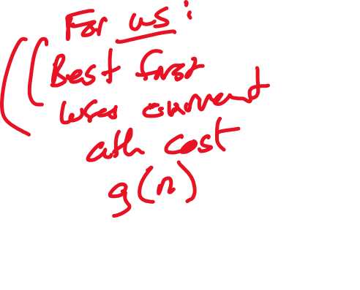
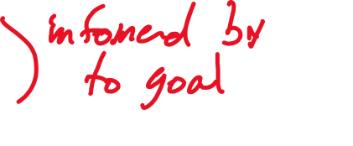

Best-first search
Plan: use an evaluation function for each node
– estimate of “desirability”
⇒ Expand most desirable unexpanded node
Implementation:
frontier is a queue sorted in decreasing order of desirability
Special cases:
greedy search
A∗ search

Slide 5
Example: Romania with step costs in km
Oradea
Straight−line distance to Bucharest (SLD)
71
Arad
Bucharest
Craiova
Dobreta
Eforie
Fagaras
Giurgiu
Hirsova
Iasi
Lugoj
Mehadia
Neamt
Oradea
Pitesti
RimnicuVilcea
Sibiu
Timisoara
Urziceni
Vaslui
Zerind
Neamt
366
0
160
242
161
178
77
151
226
244
241
234
380
98
193
253
329
80
199
374
Zerind
151
87
75
Iasi
Arad
140
92
Sibiu
99
Fagaras
118
Vaslui
80
Timisoara
Rimnicu Vilcea
111
211
142
Lugoj
97
Pitesti
70
98
Mehadia
146
101
85
Urziceni
Hirsova
75
138
86
120
Bucharest
90
Giurgiu
Dobreta
Craiova
Eforie
Greedy search
Evaluation function h(n) (heuristic)
= estimate of cost from n to the closest goal
E.g., h_{SLD}(n) = straight-line distance from n to Bucharest
Greedy search expands the node that appears to be closest to goal

Slide 6
Properties of greedy search
Complete??
Time??
Space??
Optimal??

Slide 7
A* Search
Idea:
avoid expanding paths that are already expensive
Work on paths that are “most promising”
A∗ search uses an admissible heuristic
Theorem: A∗ search is optimal

Slide 8
A* Search Example
Arad 366=0+366

Slide 9

search example
_{A}∗
Arad
Sibiu 393=140+253
Timisoara 447=118+329
Zerind 449=75+374

Slide 10

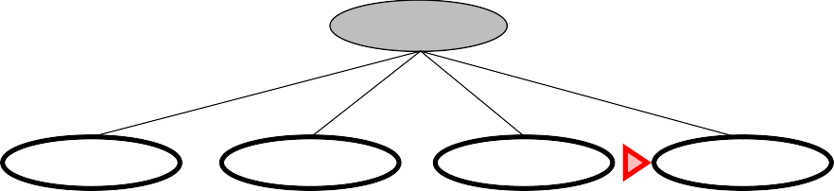
search example
_{A}∗
Arad
Sibiu
Timisoara 447=118+329
Zerind 449=75+374
Arad Fagaras Oradea
Rimnicu Vilcea
646=280+366 415=239+176 671=291+380 413=220+193

Slide 11
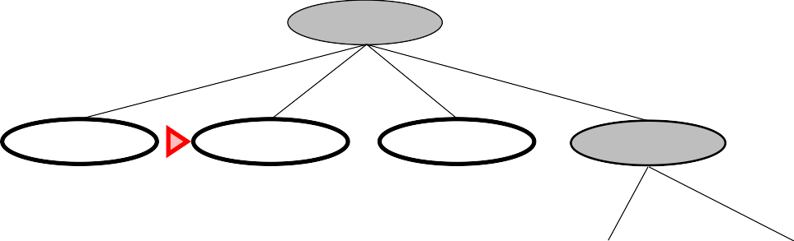
search example
_{A}∗
Arad
Sibiu
Timisoara 447=118+329
Zerind 449=75+374
Arad Fagaras Oradea 646=280+366 415=239+176 671=291+380
Rimnicu Vilcea
Craiova Pitesti Sibiu 526=366+160 417=317+100 553=300+253

Slide 12
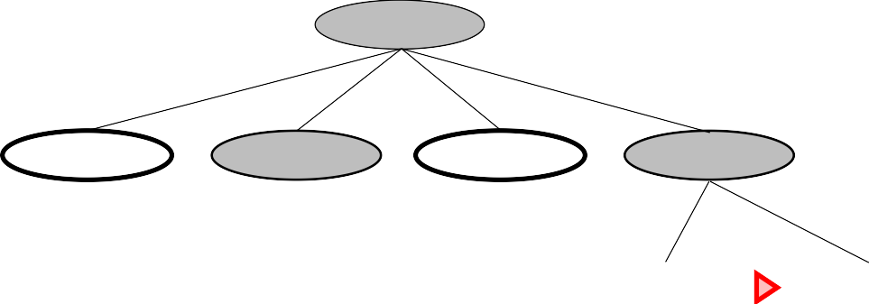
search example
_{A}∗
Arad
Sibiu
Timisoara 447=118+329
Zerind 449=75+374
Arad 646=280+366
Fagaras
Oradea 671=291+380
Rimnicu Vilcea
Sibiu 591=338+253
Bucharest 450=450+0
Craiova Pitesti 526=366+160 417=317+100
Sibiu 553=300+253

Slide 13
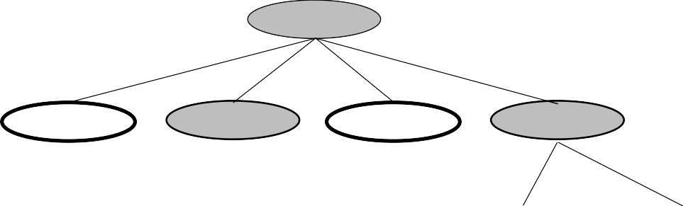
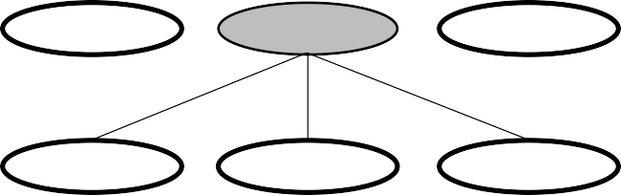
A* Search Example
Arad
Sibiu
Timisoara 447=118+329
Zerind 449=75+374
Arad 646=280+366
Fagaras
Oradea 671=291+380
Rimnicu Vilcea
Sibiu 591=338+253
Bucharest 450=450+0
Craiova 526=366+160
Pitesti
Sibiu 553=300+253
Bucharest 418=418+0
Craiova 615=455+160
Rimnicu Vilcea
607=414+193

Slide 14

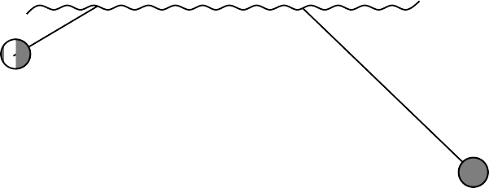
Optimality of A∗
Suppose some suboptimal goal G₂ has been generated and is in the queue.
Let n be an unexpanded node on a shortest path to an optimal goal G₁.
Start
n
G₁
G₂
f (G₂) = > | g(G₂) g(G₁) | since h(G₂) = 0 since G₂ is suboptimal
≥ | f (n) | since h is admissible
Since f (G₂) > f (n), A∗ will never select G₂ for expansion

Slide 15
Optimality of A∗
Lemma: A∗ expands nodes in order of increasing f-value∗
O
Z
N
A
I
380
S
F
V
400
T
R
L
P
M
H
U
420
B
D
E
C
G

Slide 16
Properties of A∗
Complete??
Time??
Space??
Optimal??
expands all nodes with f (n) < C∗
A∗ expands some nodes with f (n) = C∗
A∗ expands no nodes with f (n) > C∗

Slide 17
Admissible heuristics
E.g., for the 8-puzzle:
h₁(n) = number of misplaced tiles
h₂(n) = total Manhattan distance
(i.e., no. of squares from desired location of each tile)
7
2
4
1
2
3
5
6
4
5
6
8
3
1
7
8
Start State
Goal State
h₁(S) =??
6
4+0+3+3+1+0+2+1 = 14
h₂(S) =??

Slide 18
Dominance
If h₂(n) ≥ h₁(n) for all n (both admissible)
then h₂ dominates h₁ and is better for search
Typical search costs:
d = 14 IDS = 3,473,941 nodes
A∗(h₁) = 539 nodes
A∗(h₂) = 113 nodes
d = 24 IDS ≈ 54,000,000,000 nodes
A∗(h₁) = 39,135 nodes
A∗(h₂) = 1,641 nodes
Given any admissible heuristics h_{a}, h_{b},
h(n) = max(h_{a}(n), h_{b}(n))
is also admissible and dominates h_{a}, h_{b}

Slide 19
Relaxed problems
Admissible heuristics can be derived from the exact solution cost of a relaxed version of the problem
E.g.:
If the rules of the 8-puzzle are relaxed so that a tile can move anywhere, then h₁(n) gives the shortest solution
If the rules are relaxed so that a tile can move to any adjacent square, then h₂(n) gives the shortest solution
Key point: Cost (optimal solution to relaxed prob) <= Cost(actual problem)

Slide 20
Summary
Heuristic functions estimate costs of shortest paths
Good heuristics can dramatically reduce search cost
Greedy best-first search expands lowest h
incomplete and not always optimal
A∗ search expands lowest g + h
complete and optimal
also optimally efficient (up to tie-breaks, for forward search)
Admissible heuristics can be derived from exact solution of relaxed problems

Slide 21


