Slide 1
Credit Card Customer Segmentation
Timothy Divoll
Insight Data Science
Boston, MA

Slide 2
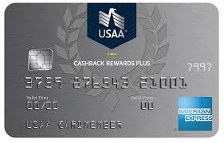

The problem
We want to target different segments of our 8950 customer base with more targeted marketing. A generalized first approach is to target Low-, Mid- and High-Value customers using an RFM clustering approach.
R = Recency
F = Frequency
M = Monetary Value

Slide 3
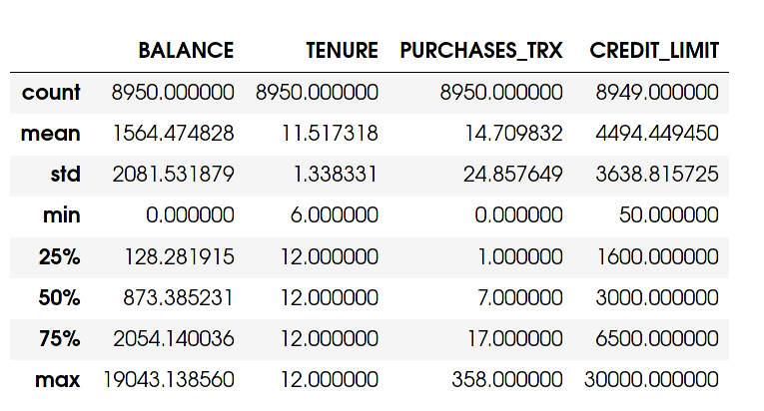
Data Cleaning and EDA
Need to first engineer proxies for RFM
Activity proxy = # of purchases / months of spending
Frequency score = sum of one-off, installment, cash adv purchase freqs
Revenue = balance on card + purchase total

Slide 4
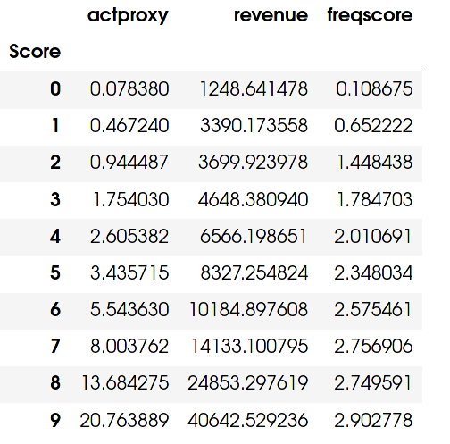
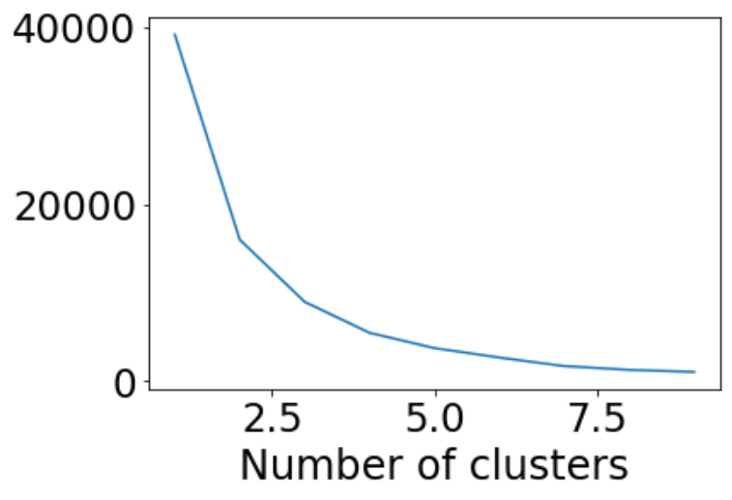

K-means clustering
Cluster into four groups based on elbow plot then score

Slide 5
K-means clustering
Cluster into four groups based on elbow plot then score

Slide 6
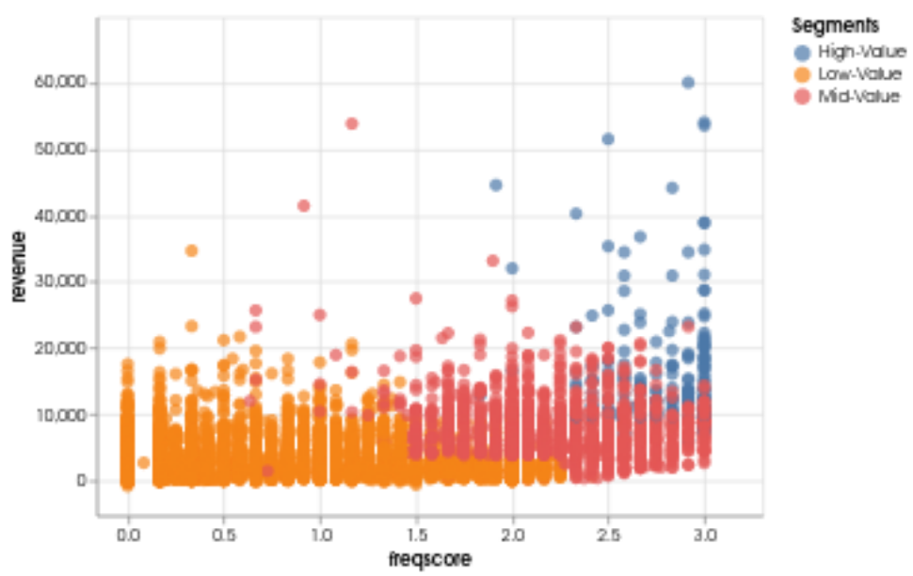
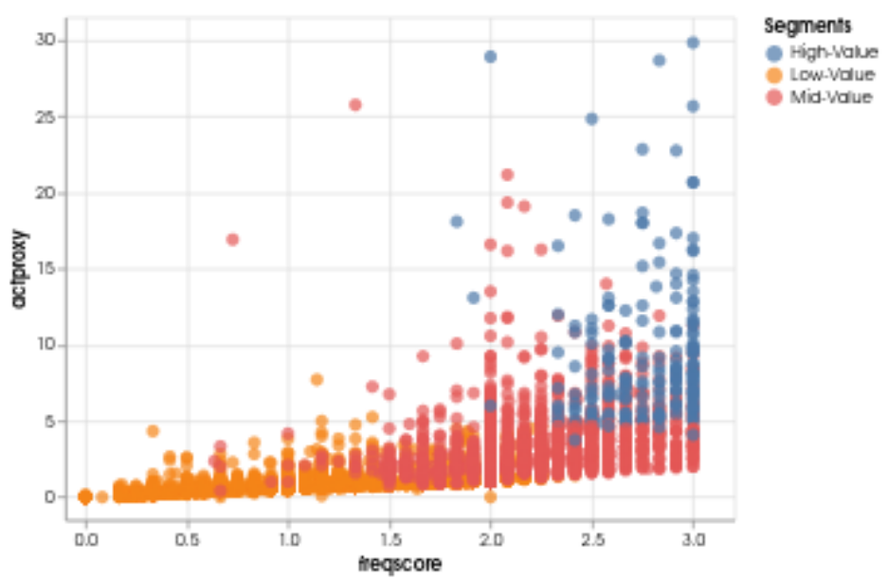
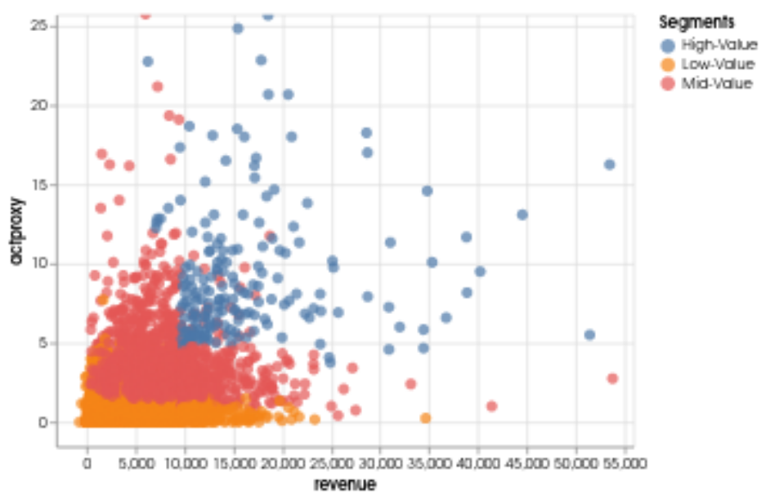
Low-, Mid-, High-Value Customers

Slide 7

Targeted Marketing Strategies
Low-Value : try to increase frequency of card use
Mid-Value : try to balance frequency and retention
High-Value : focus on retaining these high spenders!

