Slide 1
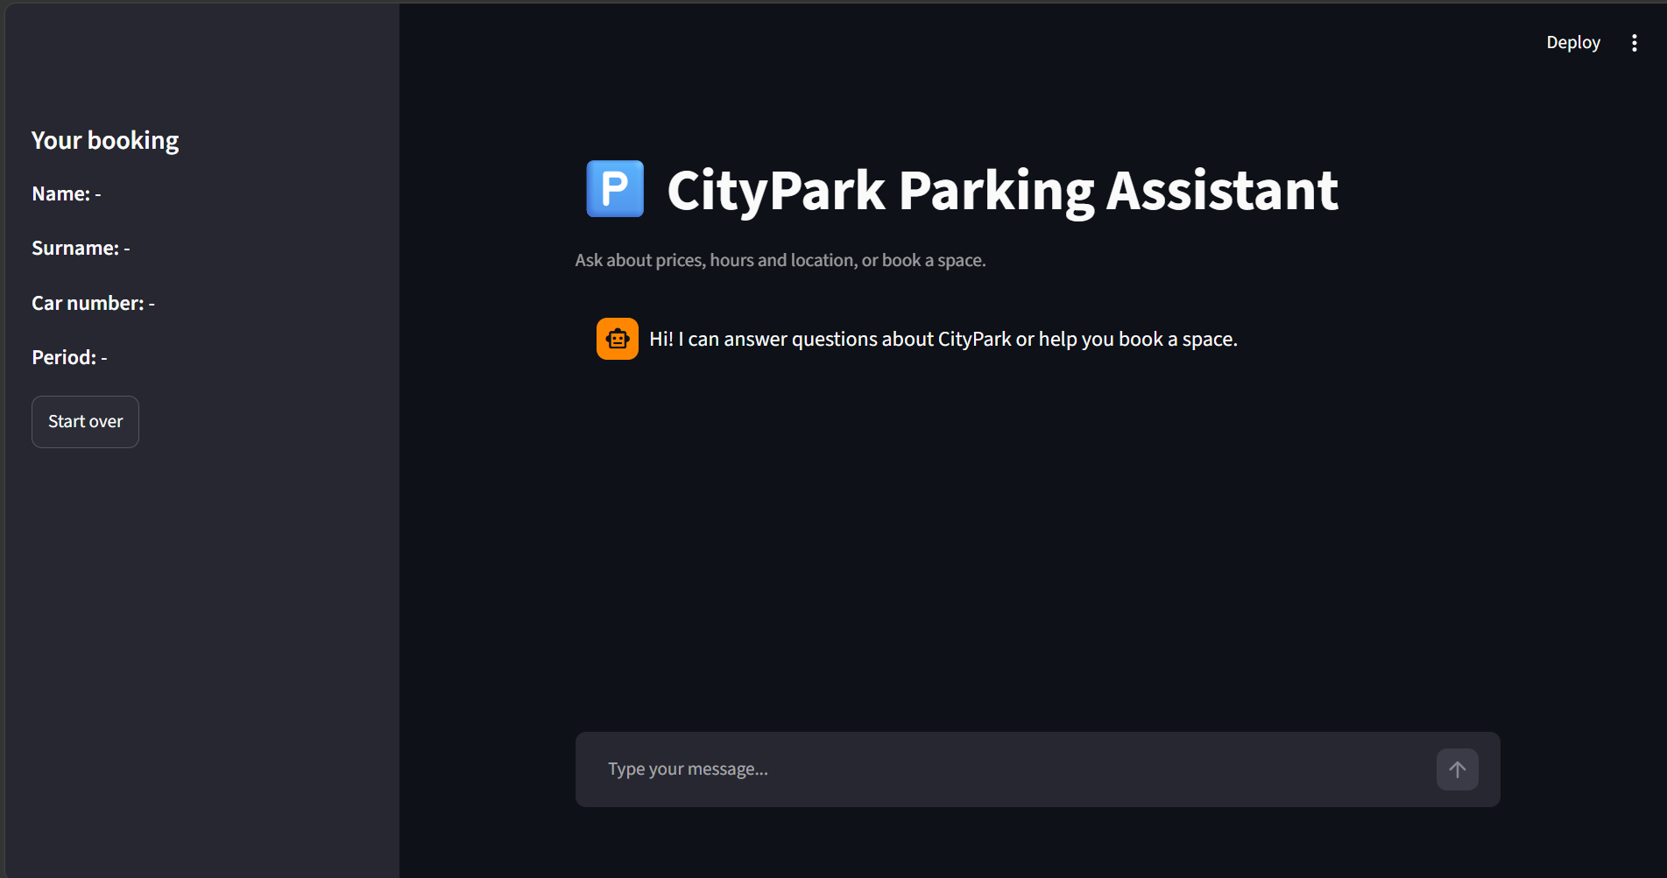
CityPark Parking Reservation Chatbot
RAG · Human-in-the-loop · MCP · LangGraph
Streamlit chat UI with live booking panel
Divya Anandan
Notes:
Introduce the project: an intelligent parking assistant that answers questions, collects reservations, asks a human administrator for approval, and saves approved bookings through an MCP server. Everything is orchestrated with LangGraph.

Slide 2




What the system does
OVERVIEW
Answers questions
Collects bookings
Asks a human
Saves securely
Prices, hours, location and free spaces, grounded in the parking data.
Asks for name, surname, car number and period, one item at a time.
A second agent sends the request to the administrator to approve or refuse.
Approved bookings are written to file by a token-protected MCP server.
1 RAG chatbot
2 Admin agent
3 MCP server
4 LangGraph
Notes:
Four capabilities, built in four stages. Each stage adds one component, and Stage 4 connects them all into one pipeline.

Slide 3
How the pieces fit together
ARCHITECTURE
LangGraph state machine
User
Chat node
Admin node
Record node
Streamlit / CLI
Agent 1 · RAG
Agent 2 · approval
MCP client
Data flows left to right; the graph decides which node runs next.
Vector DB: static info
SQL: prices, hours, spots
Guardrails: PII filter
DIAL LLM + embeddings
Admin inbox: FastAPI REST
Human approves or refuses
Agent 2 polls for the result
MCP server (local stdio)
Token + input validation
Writes reservations.txt
Notes:
Walk the flow left to right. The user talks to the chat node, which uses a vector database for static facts, SQL for live data, and guardrails to protect sensitive information. When a booking is complete, the admin node escalates to a human via a REST inbox. If approved, the record node calls the MCP server, which writes the line to file.

Slide 4


RAG chatbot
STAGE 1
1
Classify
Static data → vector DB
Is the message a question or a booking?
General info, location, booking process and rules. Rarely changes, so it is chunked and embedded.
2
Retrieve
Top 3 matching chunks from the vector DB
3
Add live data
Prices, hours and spaces from SQL
Dynamic data → SQL
Working hours, prices and free spaces change often, so they are read live from SQL.
4
Answer safely
Reply only from context, with PII redacted
Notes:
The optional improvement from the task: splitting data by how often it changes. Static knowledge lives in the vector database; dynamic facts live in SQL so answers never show stale prices or availability.

Slide 5
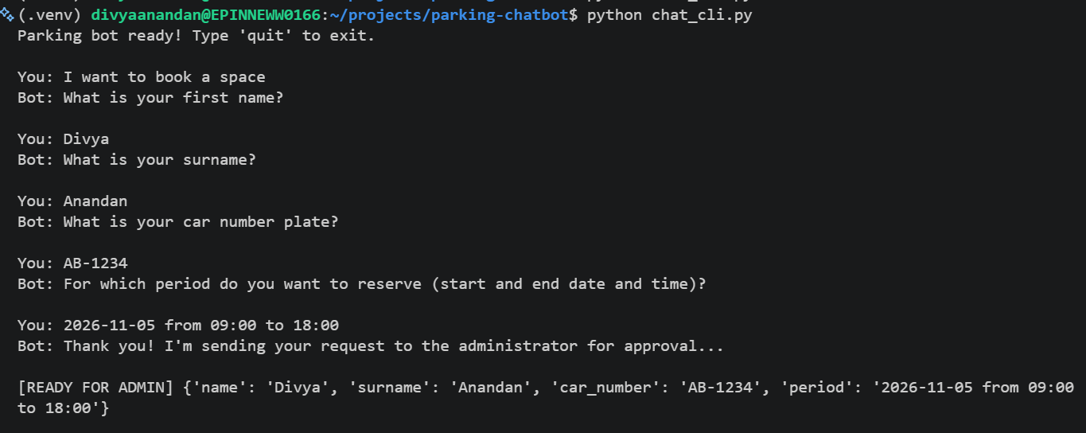
Chatbot in action
STAGE 1
Web UI with a live “Your booking” panel
Terminal chat asks for one missing field at a time
The bot remembers what it has collected and only asks for what is missing.
Notes:
Two front ends over the same logic. The booking panel on the left of the web UI fills in as the user answers. The terminal shows the same slot filling: name, surname, car number, period.

Slide 6

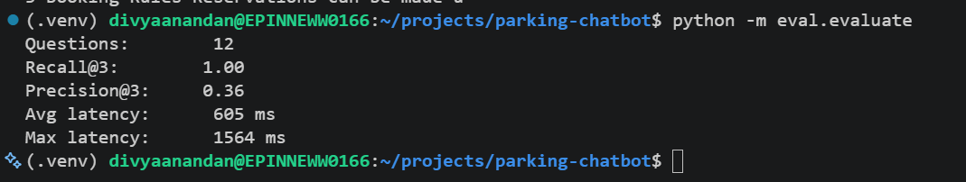
Guardrails and evaluation
STAGE 1
Guardrails
1.00
0.36
Recall@3
Precision@3
Prompt-injection phrases are blocked before the LLM
Emails, phones and card numbers are redacted from retrieved text and replies
Unknown questions get an honest “I don't know”
605 ms
1564 ms
Avg latency
Max latency
Precision@3 is capped near 0.33 when one chunk is relevant and K = 3, so 0.36 is expected.
Output of python -m eval.evaluate (12 test questions)
Notes:
Retrieval was evaluated on 12 questions with known relevant chunks. Recall@3 is 1.00, meaning the right chunk is always in the top three. Precision@3 is 0.36 because most questions have a single relevant chunk, so the maximum is about 0.33 to 0.4. Average latency is about 0.6 seconds.

Slide 7
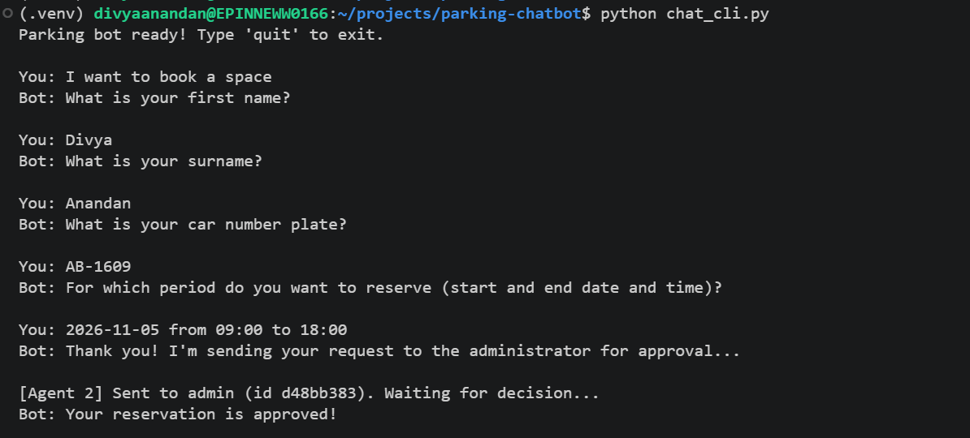
Human-in-the-loop agent
STAGE 2
Collect
1
Agent 1 gathers name, surname, car number and period.
Escalate
2
Agent 2 writes a polite approval request and posts it to the admin inbox.
Decide
3
Agent 2 sends the request, waits, and the bot reports “approved”
The administrator approves or refuses. Agent 2 polls and returns the answer.
Notes:
The second LangChain agent talks to the administrator over a REST API. It generates a clear, polite message, posts the request, and waits for the human decision. The chat then continues based on that decision.

Slide 8
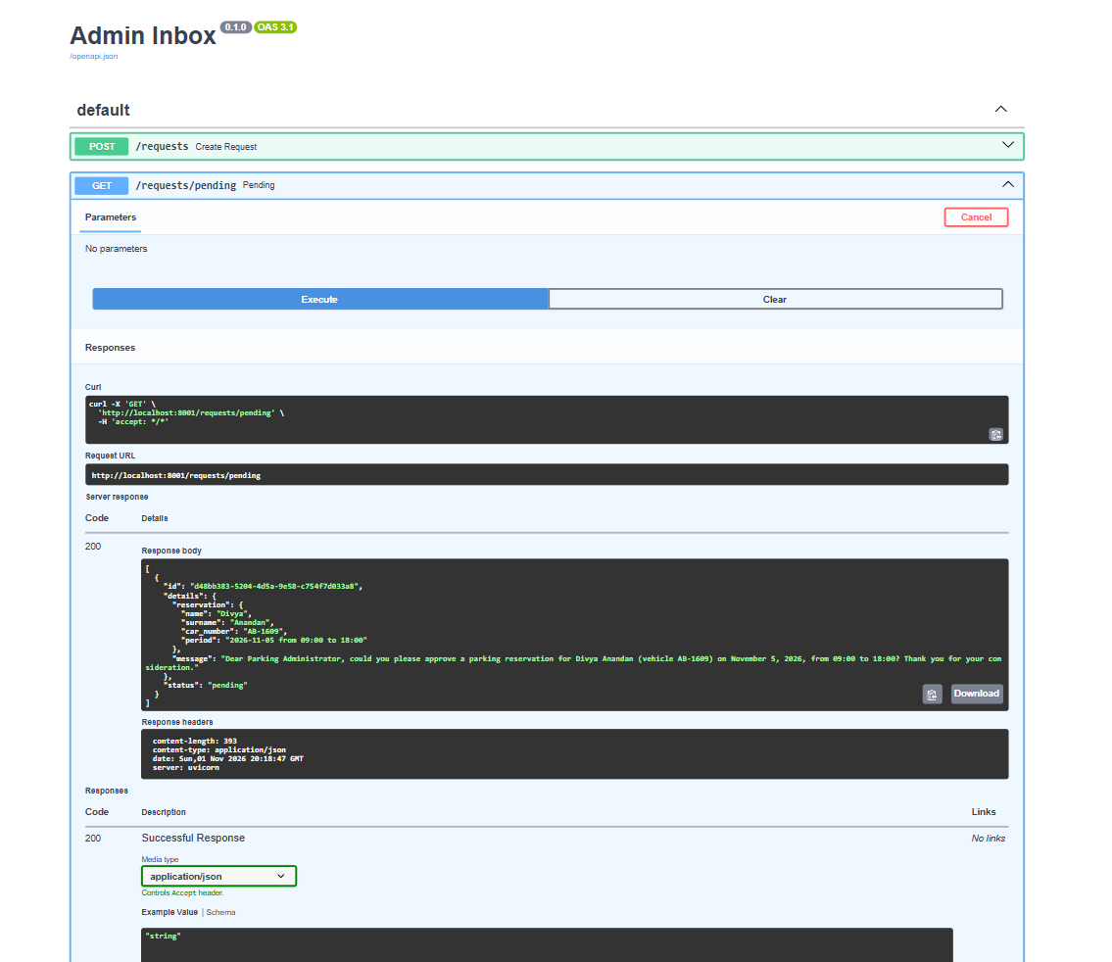
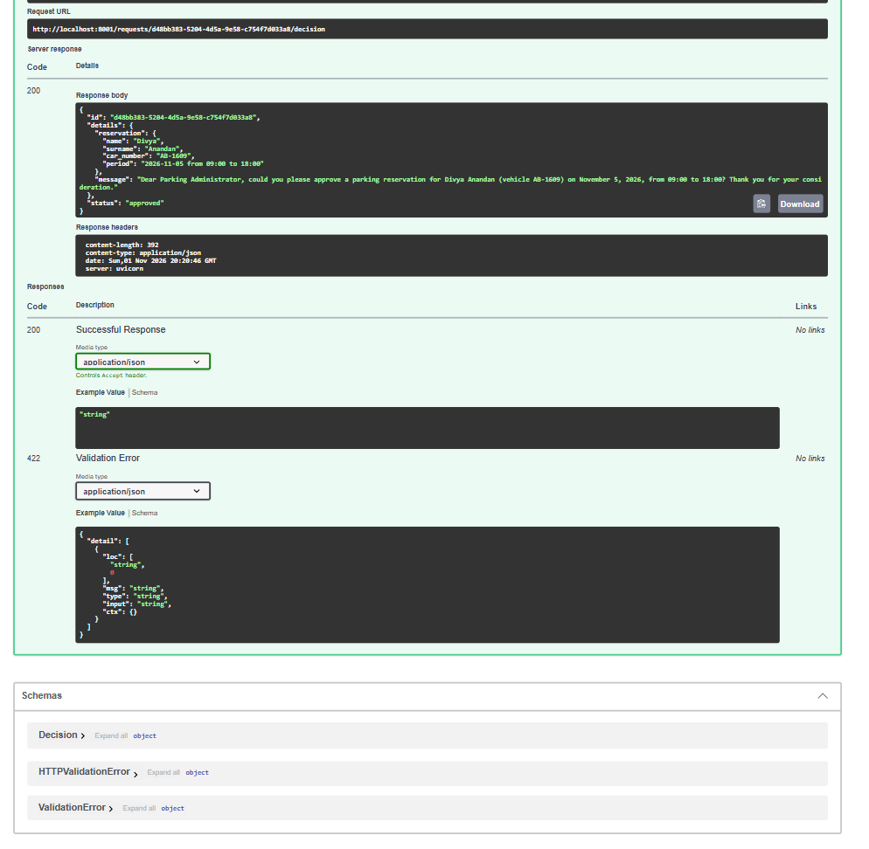
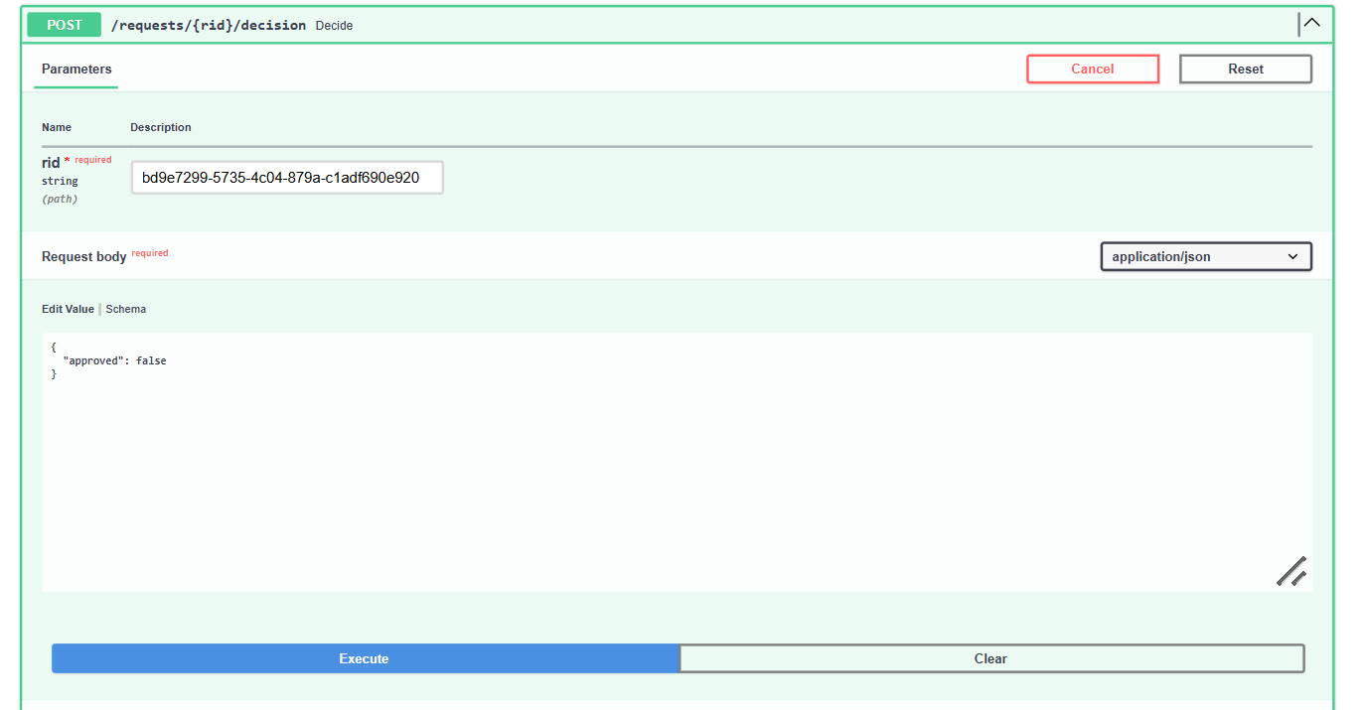
The admin inbox
STAGE 2
3 Refuse path
Sending approved: false sets the status to refused, and the graph routes to the refused node.
1 Pending request appears
2 Admin approves, status changes
Notes:
The admin inbox is a small FastAPI service. The admin sees the pending request with the reservation details and the generated message, then approves or refuses through the Swagger page. No custom front end is needed.

Slide 9




MCP server
STAGE 3
Name | Car Number | Reservation Period | Approval Time
Local only
Secret token
Runs as a stdio child process, so no network port is exposed.
Every call must carry the token or it is rejected as unauthorized.
Input validation
Sanitised text
The car number must match a strict pattern before anything is saved.
Separators and line breaks are stripped to block injected rows.
Notes:
Once the administrator approves, the record node calls the MCP server tool. The server is secured four ways: it only runs locally, it needs a secret token, it validates the car number, and it sanitises text so nobody can inject extra columns or lines. The unit tests cover the wrong-token and bad-car-number cases.

Slide 10
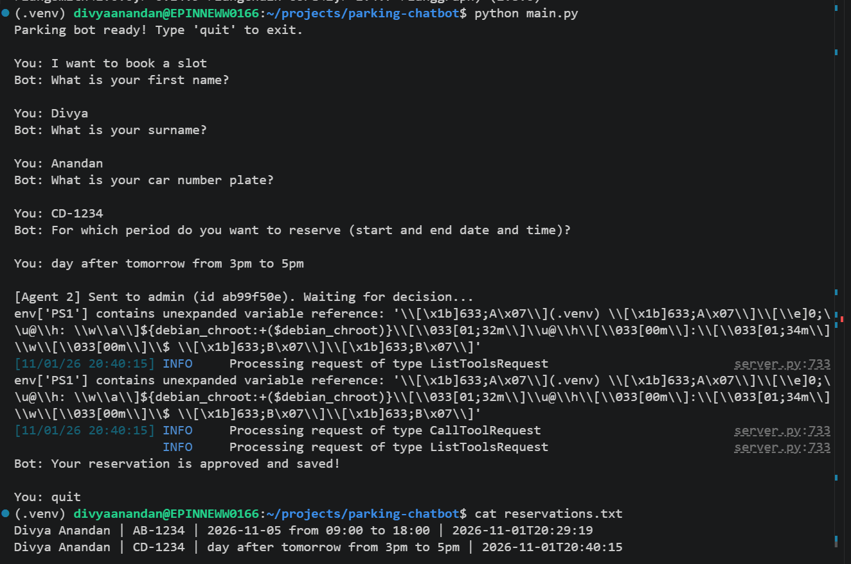



End-to-end proof
STAGE 3
Bot confirms
“Approved and saved!” after the admin accepts.
MCP call logged
The server log shows the tool request being processed.
File written
reservations.txt gets a line in the required format.
Notes:
This single run goes from the first message to the saved file. After the cat command you can see the reservation lines with the approval timestamp at the end.

Slide 11
LangGraph orchestration
STAGE 4
record
approved
Save via MCP server, then END
chat
booking complete
admin
Talk to the user, fill the booking
Ask the human administrator
refused
Otherwise the graph ends and waits for the next message.
refused
Tell the user, then END
Shared state: user message · draft reservation · reply · ready flag · admin decision
Notes:
The graph has four nodes and two conditional edges. After chat, it goes to admin only when the booking is complete. After admin, it goes to record if approved or refused otherwise. State carries the draft reservation between turns, which is how the bot remembers what it has already collected.

Slide 12
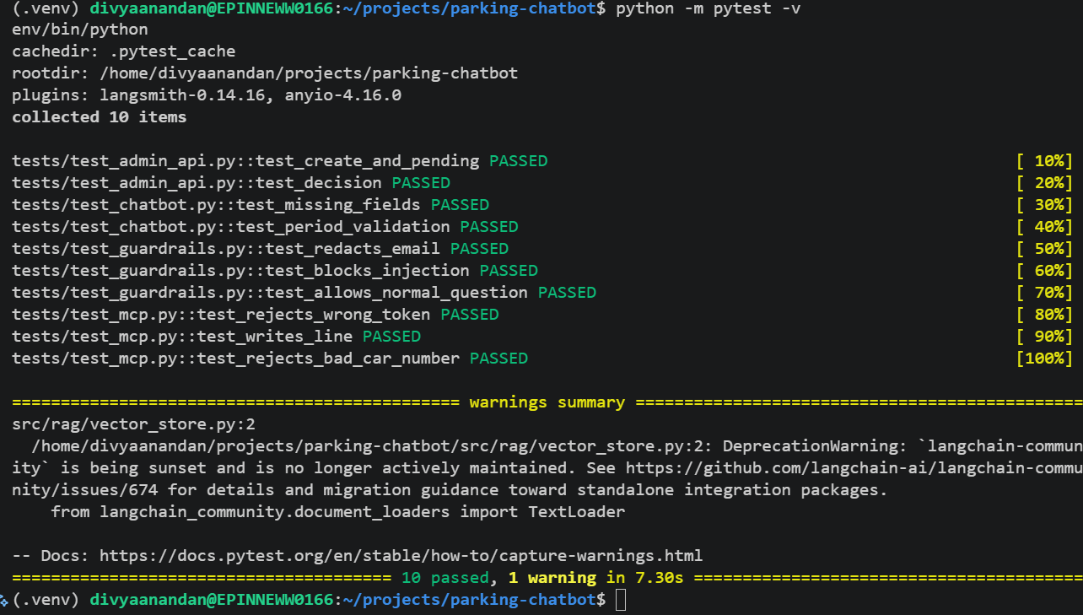
Automated testing
QUALITY
10 / 10
tests passing with pytest
Admin API: create, pending, decision
Chatbot: missing fields, period check
Guardrails: redaction, injection block
MCP: bad token, bad car number, file write
Notes:
Every module has at least two tests. The next additions are an integration test that runs the whole graph for the approved and refused paths, and load tests for the chatbot, the admin API and the MCP save.

Slide 13
Limits and next steps
NEXT STEPS
Known limitations
Next steps
Admin inbox is in memory, so a restart clears it
The chat waits while the admin decides
Injection filter uses a phrase list
Relative dates need converting to real dates
Load tests for chat, admin API and MCP
Integration test of the full graph
Store requests in a database
Model-based sensitive data checks
Notes:
Be upfront about limitations; reviewers value that. The admin inbox keeps data in memory, the wait is blocking, and the guardrail blocklist is simple. The next steps address each of these.

Slide 14

Four stages, one pipeline
RAG chatbot with guardrails
Human-in-the-loop admin agent
Secure MCP file writer
Questions?
LangGraph end-to-end flow
Notes:
Recap the four stages and invite questions. Be ready to explain RAG, chunking, embeddings, Recall@K versus Precision, LangGraph nodes and edges, human-in-the-loop and MCP.

