Slide 1
Creating Longitudinal Data Series Comparisons
New Highlights from the NACDA Portal
Kathryn Lavender – NACDA Data Project Manager
Jennifer Zeiger – ICPSR Metadata Specialist
EDDI Conference 2023
Creative Commons Attribution 4.0 International (CC BY 4.0)
Notes:
In this presentation, we plan to describe NACDA’s efforts over the last year to develop multi-series comparisons of longitudinal, nationally representative, National Institute on Aging funded data collections using DDI-Lifecycle, as well as share some lessons learned.
The National Archive of Computerized Data on Aging (NACDA, part of ICPSR) began working with DDI-Lifecycle in 2018. Since then, NACDA has made efforts to document some of our most established and frequently-used longitudinal data collections to DDI-L and display them in a Colectica Portal. In this presentation, we will discuss how our portal and the way we use it have evolved. Namely, we have built on our earliest efforts in comparing variables within a single series and across two series, to develop new methods that include the recent addition of a multi-series concordance to the portal.
NACDA is part of the Inter-university Consortium for Political and Social Research (ICPSR) and based at the Institute for Social Research (ISR) at the University of Michigan.

Slide 2
About NACDA
National Archive of Computerized Data on Aging
Funded by the National Institute on Aging (NIA)
More than 40 years of experience in data archiving and data sharing
Part of ICPSR, ISR at the University of Michigan
Preserve and share data on aging and the lifecourse to support and advance gerontological research
Mostly quantitative, public-use data
Curated and self-published data sharing options
Free to use

Slide 3
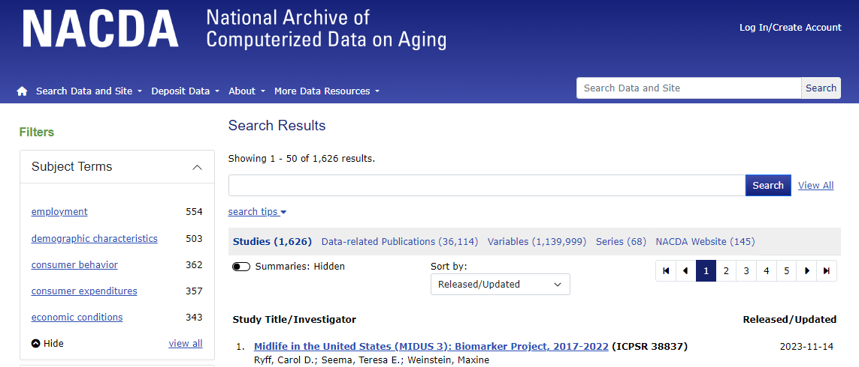
NACDA Data Archive
Notes:
NACDA site and ICPSR use DDI Codebook, but since NACDA hosts mostly longitudinal data we wanted to see what was possible with DDI-Lifecycle.

Slide 4
A Little About the NACDA Portal
Only public-use data
Mostly variable metadata; some data are available through the portal for download
“Added value” - we are investing in enhancing the discoverability (and hopefully accessibility, interoperability, and reusability) of select datasets by creating conceptual variable groups/conceptual variable metadata
We create the concordances, conceptual variables and other necessary pieces internally

Slide 5
NACDA-DDI-Portal History
+HAALSI, PSID
+CRELES, HRS multi-series
Updated NSHAP + COVID
+NSHAP-NHATS
+TILDA
+HRS
+NSHAP
Portal goes live
+NSHAP-MIDUS
+Temp staff
+FT staff
Fall 2018
2019
2020
Fall 2021
2022
Fall 2023
Began with NACDA funds
Funding - 1yr
More funding - 2yrs
More funding - 3yrs

Slide 6
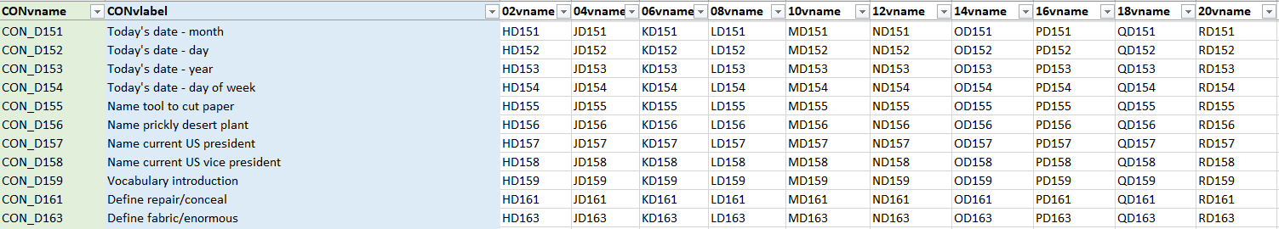
Cross-wave Concordance Creation
A concordance is documented first as a crosswalk. As we create a new or augment an existing crosswalk, we:
Assess the comparability of related instance variables across waves
Did researchers change how they approached a question over time?
Create a conceptual variable name and label for each set of comparable instance variables
Organize conceptual variables into concepts, or topical groups
HRS concordance spreadsheet, showing variables across multiple time points
Notes:
A cross-wave concordance documents variable comparability across multiple waves within a single longitudinal series. It is a complete description in and of itself, as well as the foundation on which we build cross-series and multi-series concordances.
We begin by building a detailed crosswalk with a column for each wave of the series, and a row for each set of comparable instance variables. Sometimes a series has an existing crosswalk we can work from. Otherwise, we build one from scratch. Either way, we assess comparability with one basic question: Did the researchers change how they approached a given question or concept over time? For example, does the wording of a question change from one wave to the next? If so, does that change shift the meaning so much that the question actually addresses a separate concept? Writing out the full question, “What is your current marital status,” is not that different from instead saying “Current marital status:” But going from “Current marital status” to “Marital status in past two years” is a shift in concept. In the latter case, the instance variables would need to be on separate rows in the crosswalk.
Once we’ve assessed comparability and adjusted the crosswalk, we create a new conceptual variable name and label for each set of comparable instance variables. This new conceptual variable documents a single concept as it appears across time.
From there, we organize the conceptual variables into topical groups. More on that in the next slide.

Slide 7
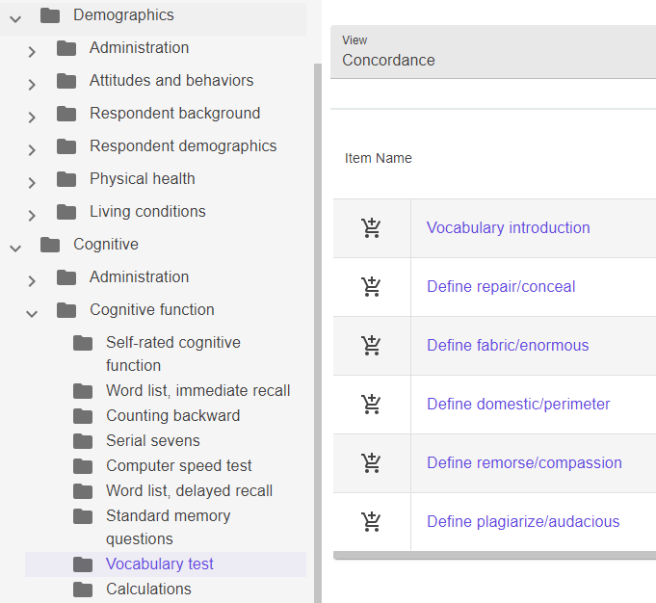
Common Concepts
Conceptual variable groups (or topics) are applied to all portal concordances
Concept names are pulled from the Common Concepts List when possible
List includes standardized topical headings
Updated with new/improved headings as needed
Provides reusable, linkable terminology, increasing the interoperability among all concordances
Notes:
[Clarify “concepts” vs “conceptual” with topics v variables
“Conceptual variable groups”]
Concepts, or conceptual groups, are separate from conceptual variables. We use conceptual groups to organize the conceptual variables by topic, which makes browsing on the Colectica portal easier. We keep track of these topics internally on a Common Concepts List. Our goal is to create a master list of standardized topical headings for use in all of the concordances on our portal. This will provide reusable, linkable terminology that improves the interoperability across the portal.
The Common Concepts List is still a work in progress, and we update it when we discover new needs or better wording in new concordances.
Once all conceptual variables are organized into conceptual groups and subgroups, we then publish the DDI-Lifecycle to the NACDA Colectica portal.
The image on the right shows how these concepts are displayed in the NACDA Colectica portal. Subgroups are nested within larger groups.

Slide 8
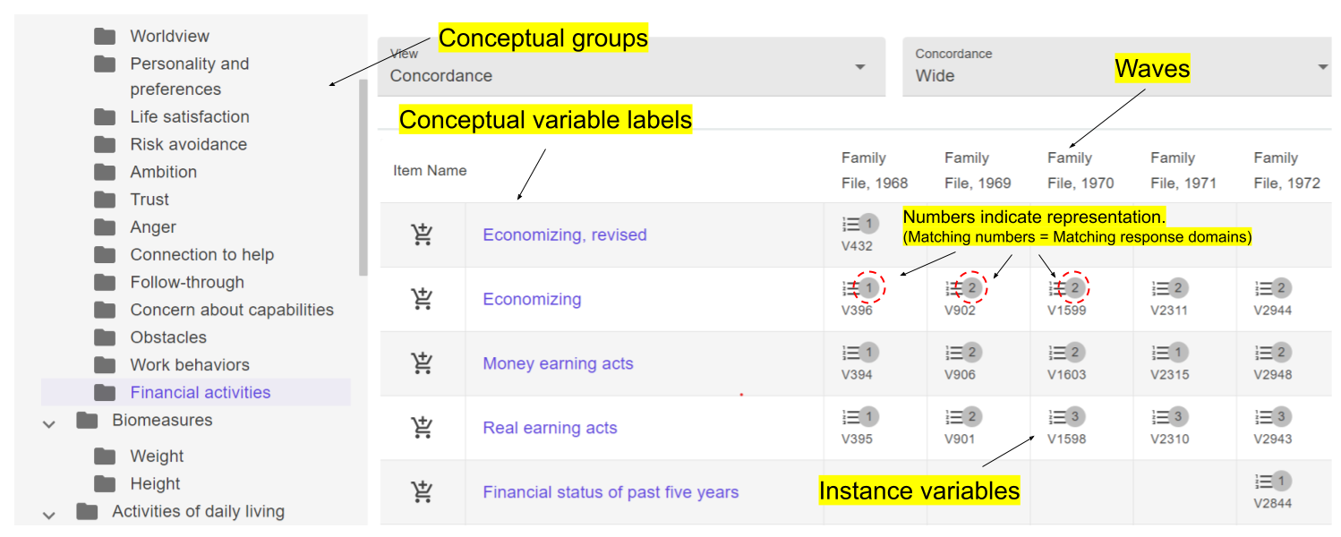
Cross-wave Concordance in the Portal
Notes:
Here is a peak at how a cross-wave concordance is displayed in the portal. Conceptual groups are listed on the left. Conceptual variable labels are displayed and linked to more detailed descriptions of the conceptual variables. You’ll see waves listed at the top of the columns, with
instance variables listed beneath.
The numbers in bubbles indicate matches or changes in variable representation.

Slide 9
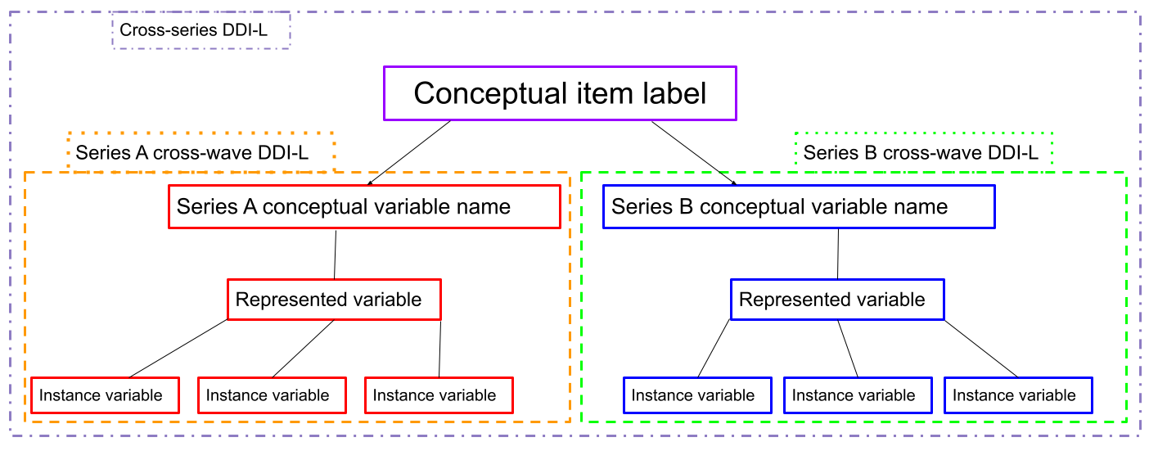
Using Cross-wave to Create Cross-series
Compare Series A conceptual variables to Series B conceptual variables
Create conceptual item label for each set of matching conceptual variables
The resulting cross-series DDI-Lifecycle links Series A DDI-L to Series B DDI-L
Notes:
The Cross-series DDI-Lifecycle is created by linking two sets of series-level cross-wave DDI-Lifecycle.
To do this, we compare conceptual variables in the first series, or series A, to the conceptual variables in series B, flagging any that are found to be comparable. For each set of comparable conceptual variables, we create a new conceptual item label to describe the shared concept.
When this is published to the portal, the conceptual item label links variables in the Series A cross-wave DDI-L to the comparable variables in the Series B cross-wave DDI-L.

Slide 10

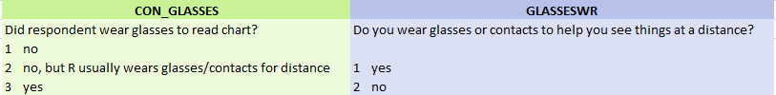

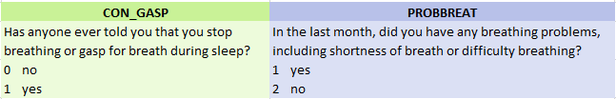
Cross-series Comparability Types
Directly Comparable No manipulation of data needed for comparison. Question phrasing and values match.
Need Harmonization Variables must be adjusted to be compared. Questions more/less match, but values differ.
One to Many / Many to One Multiple variables in one series combine to match a single variable in another.
Related Concepts Subject matter is related, but variables do not precisely measure the same concept.
Notes:
For cross-series concordances, we take the further step of documenting the type of comparability shared by each matched set of variables.
The examples here are pulled from matches found in the NSHAP-NHATS cross-series concordance.

Slide 11
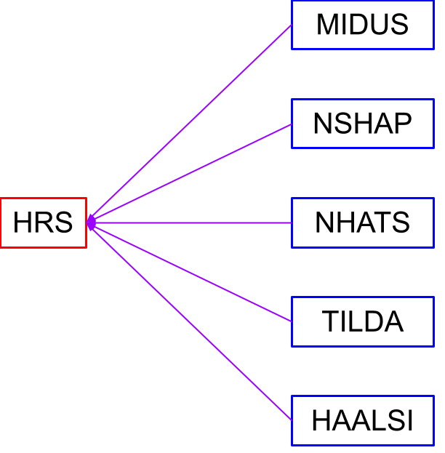
Multi-series Comparisons
Designed to compare the conceptual variables in multiple series to those in a baseline series
In our first multi-series concordance, the Health and Retirement Series (HRS) served as the baseline series
Other series included:
Midlife in the United States (MIDUS)
National Social Life, Health, and Aging Project (NSHAP)
National Health and Aging Trends Study (NHATS)
The Irish Longitudinal Study on Ageing (TILDA)
Health and Aging in Africa: A Longitudinal Study of an INDEPTH Community in South Africa (HAALSI)
Notes:
Multi-series concordances take cross-series comparisons one step further, by comparing 3 or more series.
Our first multi-series concordance used a single series, the Health and Retirement Series, as a baseline. We then compared 5 other series to variables in HRS.

Slide 12
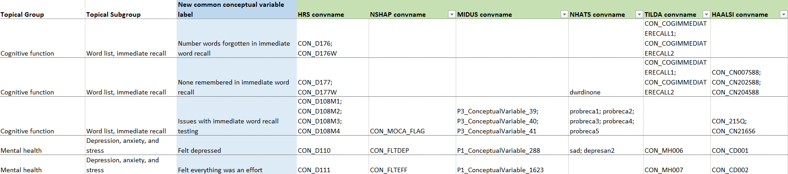
Multi-series Concordance Creation
Add comparable conceptual variables from each series’ cross-wave concordance
Create a new conceptual item (variable group) for each cluster of matched variables
Organize conceptual items into topical groups and subgroups for browsability
Notes:
Here again we create a spreadsheet to document comparable variables. We include in a single row all variables from each series that are found to address the same concept in similar ways to HRS.
Then, as with the cross-series concordance, we create a new common conceptual item (listed in this examples spreadsheet as the “New common conceptual variable label”), and organize these items into conceptual groups pulled from the Common Concepts list.

Slide 13
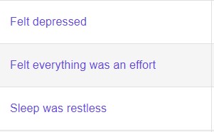
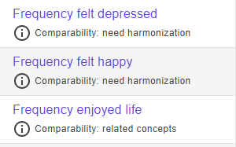
Comparability in Multi-series
The multi-series (3+ series) concordance includes the same kind of matches as a cross-series (2 series) concordance, but does not list comparability type
An HRS variable can have multiple matches that represent multiple “comparability types”
Comparability is only assessed for matches to HRS, not for the other series to one another
Users can still easily assess comparability between two variables
Question text, values, and value labels are all linked
HRS Multi-series conceptual items on the Portal
NSHAP-NHATS Cross-series conceptual items on the Portal
Notes:
Unlike the cross-series concordances we’ve created, we do not document the type of comparability for each conceptual item. The main reason being that, with multiple series in each matched cluster, there are often more than one comparability type represented.
The difference in how this is displayed in the portal can be seen in these two screenshots. On the left is the HRS multi-series concordance, which does not have a comparability description, versus the NSHAP-NHATS cross-series concordance on the right, which does.
That said, all of the information needed to determine level of comparability is still at users’ fingertips when they visit the portal.

Slide 14
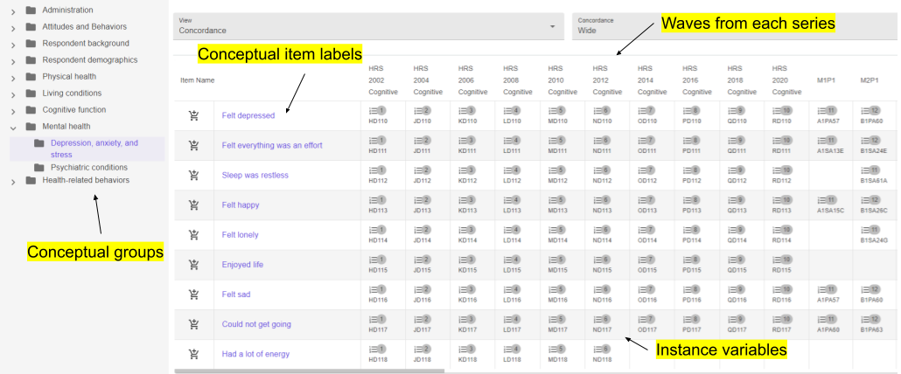
Multi-series in Colectica Portal
Notes:
Here is how the HRS multi-series concordance appears in the portal. As always, conceptual groups are listed on the left. Conceptual item labels are used at the beginning of each row, relevant waves from each series are listed at the head of the columns, and instance variables are organized in the table beneath.

Slide 15
Longitudinal Data Series in the NACDA Portal
Shortname | Title | #Rounds/Waves | Fileset structure
NSHAP | National Social Life, Health, and Aging Project | 3 | 1 DS/wave for Core public data + COVID substudy
MIDUS | Midlife in the United States Series | 4 | Imported by Colectica; multiple DS/cohort
NHATS | National Health and Aging Trends Study | 10 | Imported by Colectica
TILDA | The Irish Longitudinal Study on Ageing (HRS sister study) | 3 | 1 DS/wave
HAALSI | Health and Aging in Africa | 3 | All waves in single DS
PSID | Panel Study of Income Dynamics - Select Demography and Health Sections | 40 | 39 waves for Family + Individual each
HRS | Health and Retirement Study - Select Cognition and Demography Sections | 10 | Multiple DS per wave
CRELES | Costa Rican Longevity and Healthy Aging Study | 3 | Multiple DS per wave
NSHAP-NHATS | NSHAP-MIDUS - cross-series comparison |  | Compared at conceptual level
NSHAP-MIDUS | NSHAP NHATS - cross-series comparison |  | Compared at conceptual level
HRS Multi Series | Comparisons across HRS, NSHAP, MIDUS, NHATS, TILDA, HAALSI |  | Compared at conceptual level

Slide 16
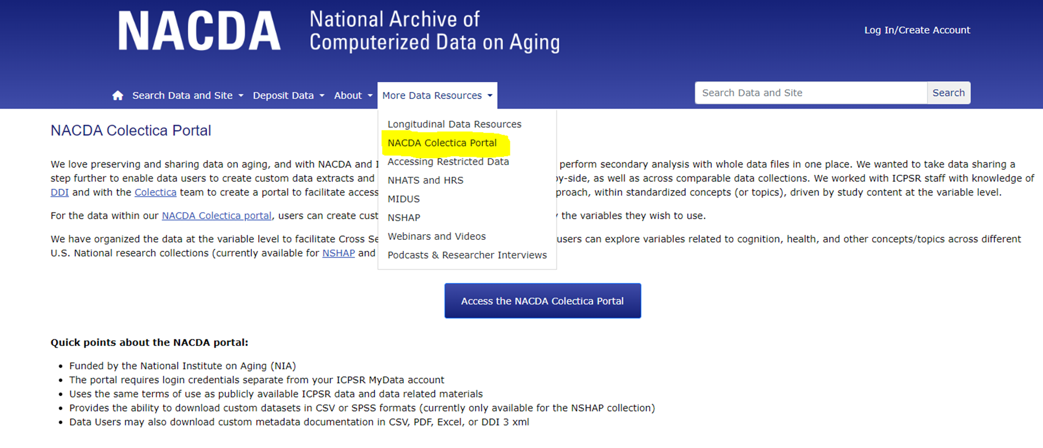
Get to the Portal from the NACDA Site
Notes:
You can also access the portal from our NACDA home page.

Slide 17
What Does it Take to Add Data to the Portal?
•Knowledgeable staff - we have two team members who complete the variable comparison work
•Complete and descriptive variable level metadata
•Crosswalks - these provide structure to multi-wave data in a consistent manner; usually a static approach
•Question Concordance - this is dynamic refinement to a crosswalk
•DDI Lifecycle Standard - Variable Cascade
•Colectica Designer and Portal

Slide 18
Advantages and Challenges
Longitudinal display of variables Variables organized by topics Custom variable extract Reuse Interoperability, potential for harmonization Potential for Common Conceptual Groups in Social Sciences | Versioning of data collections, especially active series Versioning of Colectica Software (Portal, Designer) How to archive interoperability materials (concordances, DDI-L, etc)? Incomplete variable metadata, qtext Derived/constructed variables Limited usage reporting from portal

Slide 19
Next Steps
Invest in team and tools
Expand multi-series comparison available (spans 6 series currently)
Explore cross-country common concepts (with CLOSER UK)
Update TILDA metadata in portal (from 3 to 5 waves + COVID study)
Add:
SWAN metadata (more than 10 visits)
NSHAP Round 4
Vietnam Era Twin Study of Aging (VETSA) - 3 waves currently
Add even more longitudinal data series

Slide 20
Want More Details?
"Identifying Cross Series Cognitive Data Similarities Across NSHAP and NHATS“ and more working papers forthcoming
EDDI 2022 Presentation: The NACDA Colectica Portal: DDI Lifecycle for Longitudinal Data on Aging
NADDI 2019 Presentation: Using DDI-Lifecycle to Document Variable Comparability in Longitudinal Data
Search Zenodo for “NACDA” for more

Slide 21

Thank you! Questions?
Scan this QR Code to get to our LinkTree
(​https://linktr.ee/nacdadata):
•NACDA website
•NACDA Colectica Portal
•YouTube playlist (researcher interviews and presentation recordings)
•Newsletter signup
•NIH data sharing resources

