Slide 1


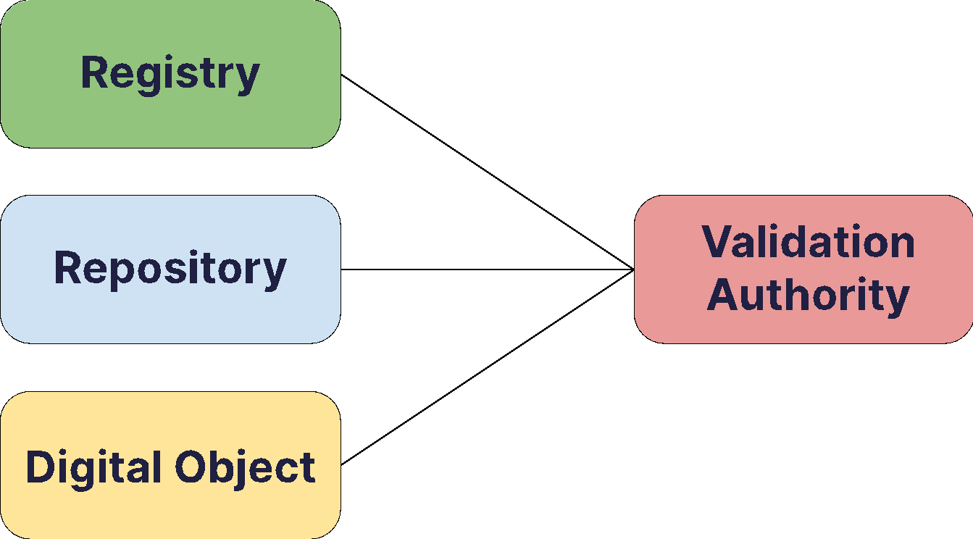

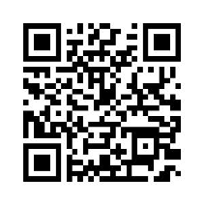


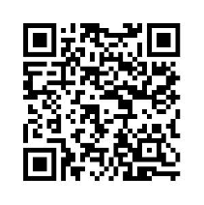



Exposing repository information to foster connections and trust:
evaluating and implementing guidelines
FAIR-IMPACT supports the implementation of FAIR-enabling practices, tools and services. Guidelines and a prototype are being developed to expose relevant information as metadata to facilitate discovery, provide context, support interoperability, and create a sense of trust in service providers and the services they offer. The collection of community input is essential to ensure the guidelines and technical implementation of them flexibly fit different use cases and scenarios that occur in the research data landscape.
Transparency & Standards
Evidence & Assessment
Linking & Validation
Information about a (meta)data service and its resources should be provided transparently following open technical standards and community recommendations in both human and machine readable forms.
(Meta)data services providing information about their functions and activities should include evidence and links to authoritative third parties, such as CoreTrustSeal or FAIR assessment services, enabling validation and assessment by human and automated processes, thus increasing trustworthiness.
The prototype schematic, in which information about digital objects and repositories is linked to registries, and this information can be validated by authorities.
Guidelines for exposing information
Relevant information should be exposed to achieve transparency
Information about the functions and characteristics of repositories and objects should be expressed in line with defined standards and criteriA
Information should be exposed by, and/or provide reference to, an originating sourc
Clarity should be provided on how information should be expressed to support humans and machines
When an assertion can be validated, the possible validation action(s) should be defined
Find all information and works on this topic on our website!
Appropriate standards should be used to expose dataset metadata, FAIR assessment results, and catalogue information towards harvesters and discovery services
The levels of care offeredby the repositories and received by digital objects should be expresse£
Multiple calibrated FAIR assessment tools should be used, embedded in a holistic FAIR consultation process that supports contextual understanding
Are you interested in becoming more FAIR- Enabling as a repository or data service provider? Check out our open calls for financial and expert support!
The final call for support will launch on September 30th and the closing date will be Nov 30th
Maaike Verburg, Mike Priddy, Ingrid Dillo, Loek Brinkman, Linda Reijnhoudt - Data Archiving and Networked Services (DANS)Robert Ulrich, Charlotte Neidiger - Karlsruhe Institute of Technology (KIT)
Robert Huber - MARUM Center for Marine Environmental Sciences, University of Bremen
Hervé L’Hours, Oliver Parkes - UK Data Service, University of Essex
Joy Davidson - Data Curation Centre, University of Edinburgh
Gabriela Mejias – DataCite, Parham Ramezani - LifeWatch

