Slide 1


CESSDA Data Catalogue and ELSST integration
30-05-2024 | IASSIST 2024 | Halifax, Canada
Speakers
Hilde Orten | Sikt – Norwegian Agency for Shared Services in Education and Research
Darren Bell / UK Data Service
Kristina Strand | Sikt – Norwegian Agency for Shared Services in Education and Research
Morten Jakobsen | Sikt - Norwegian Agency for Shared Services in Education and Research
Jeannine Beeken | UK Data Service
CC-BY 2.0

Slide 2
CESSDA
Consortium of European Social Service Data Archive (CESSDA)
CESSDA is a European Research Infrastructure Consortium (ERIC)
Extensive, integrated and sustainable data services to the social sciences
Unites social science data archives across Europe
Mission: promote social science research results and support national and international research and cooperation

Slide 3
CESSDA
CESSDA ensures high-quality data is preserved for future research.
CESSDA supports ongoing leaning and training for Service Providers, the social science user community and partners.
Traning and widening activities cover research data management, data discovery and reuse, digital preservation, data archiving and CESSDA tools and services.

Slide 4
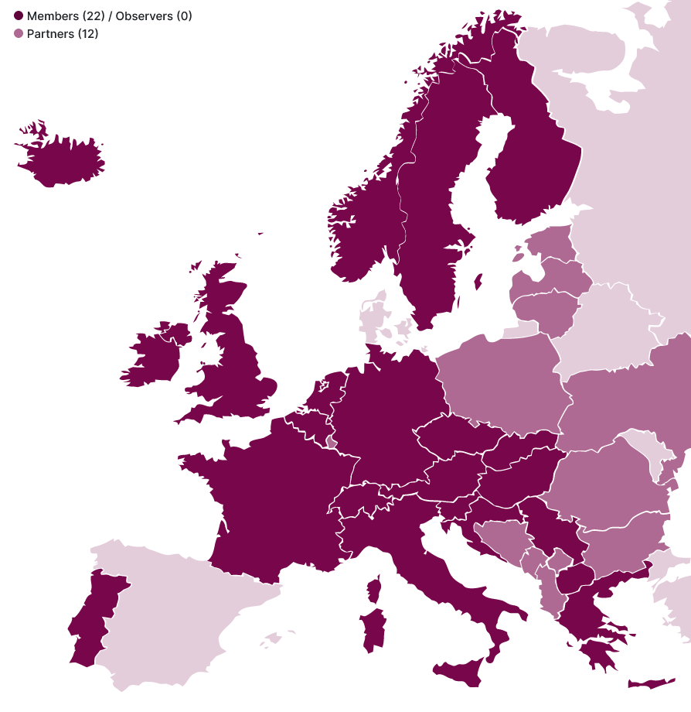
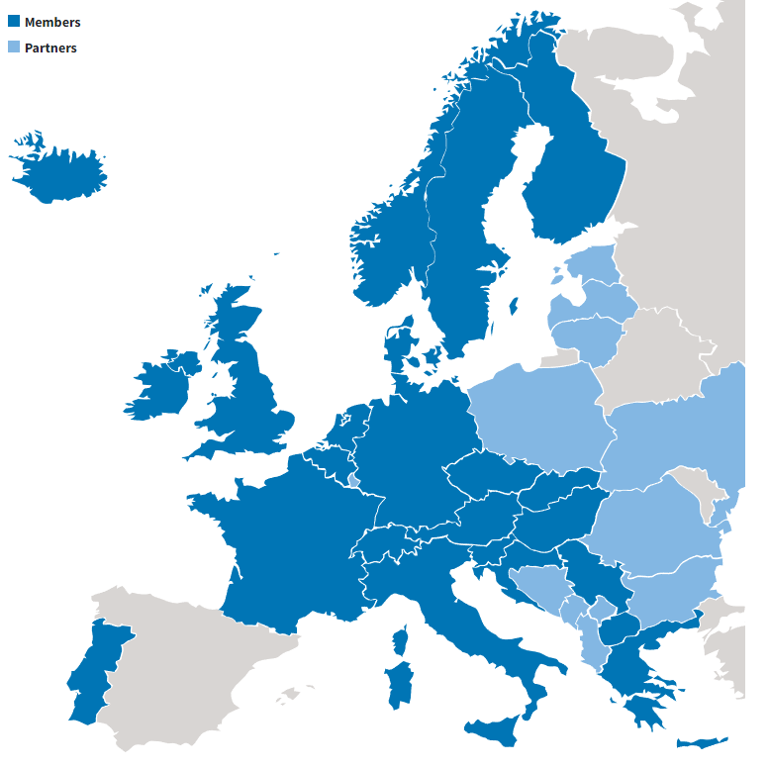
CESSDA Members
The CESSDA consortium is currently composed of 22 member countries.
Several European countries are in the process of becoming a member or observer.
CESSDA also has partners in a number of contries outside of the consortium.

Slide 5






CESSDA Members
Each member country assign a national Service Provider (SP).
The SPs cooperate on providing services to researchers.
The main office is the operational hub and coordinates activites carried out with SPs.

Slide 6

CESSDA History
CESSDA was established in June 2013, owned and financed by the individual member state’s ministry of research or a delegated institution.
CESSDA was oficially launched in December 2013.
In June 2017 it became an ERIC and was established as CESSDA ERIC.
The main office in Bergen, Norway is the operational hub and coordinates activites carried out with Service Providers.

Slide 7
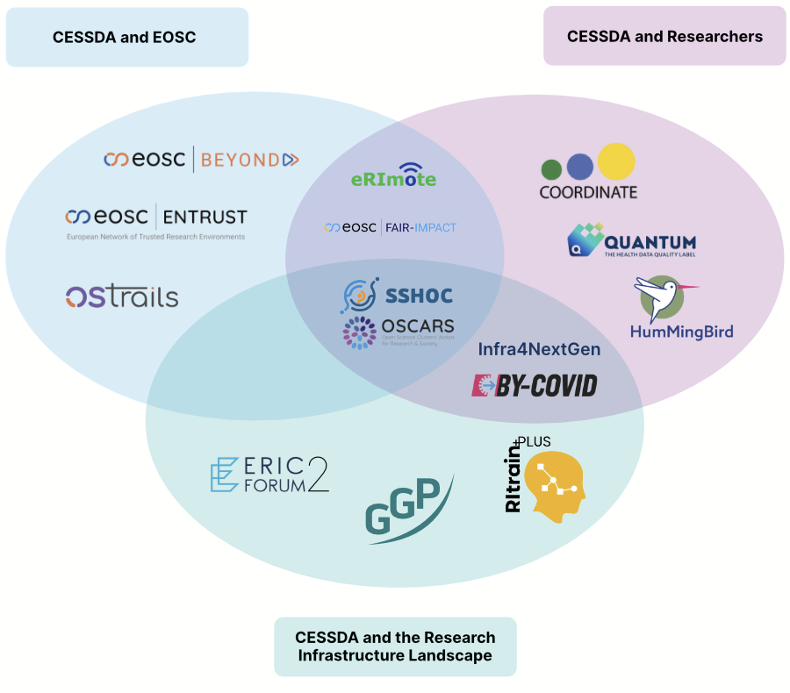
CESSDA Development & Impact
CESSDA actively contributes to the digital future of Europe through project partnerships and collaboration with social scientific communities and other ERICs.

Slide 8
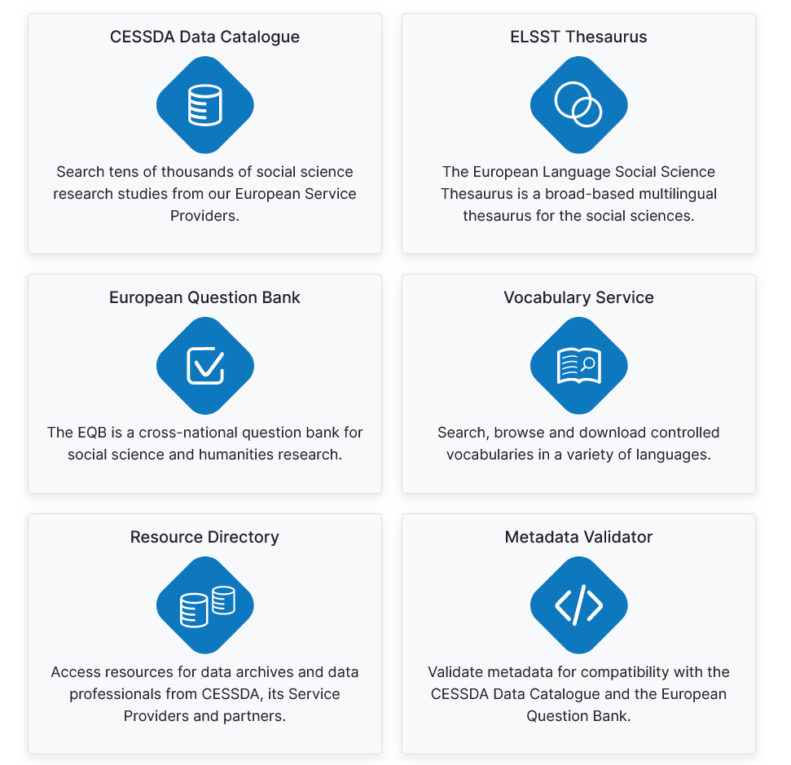
CESSDA Services & Tools
CESSDA provides several services and tools for the research community

Slide 9
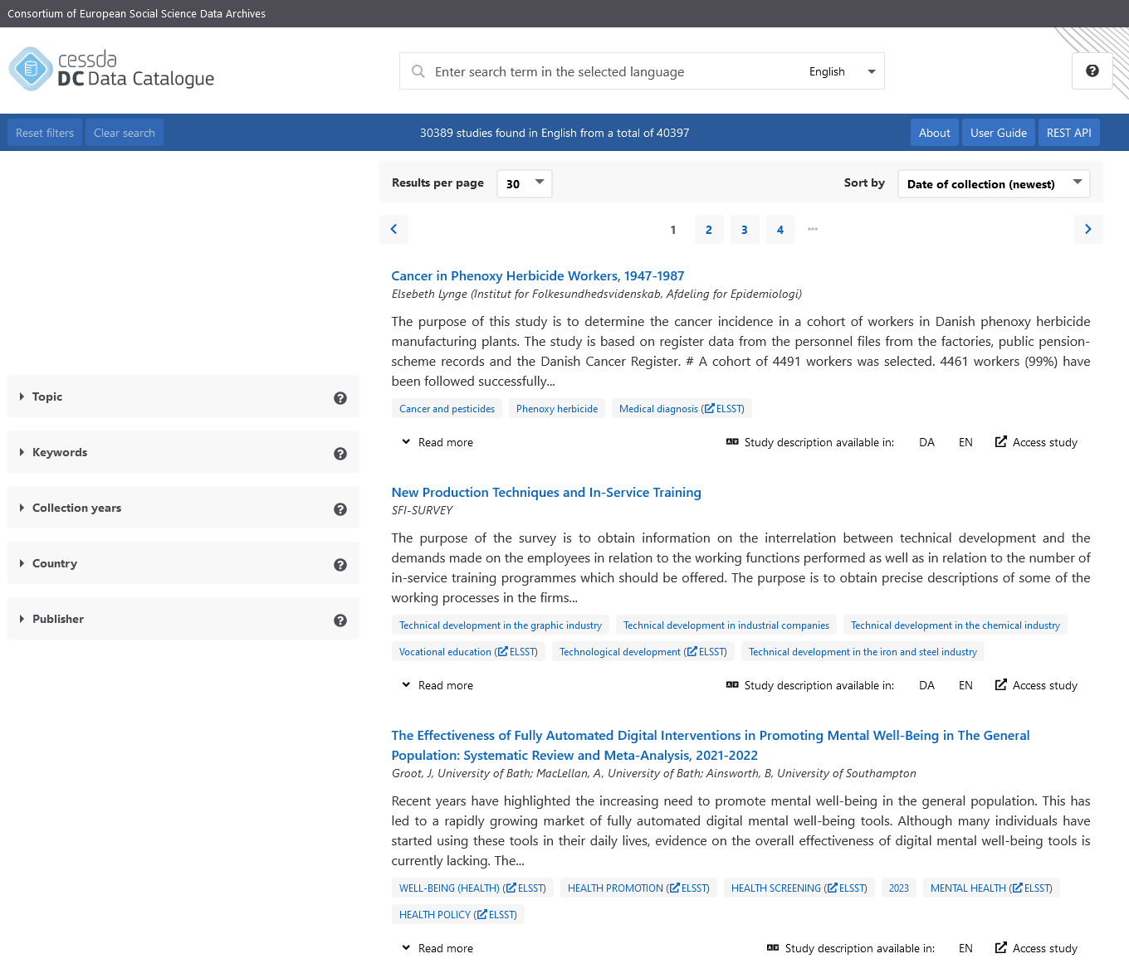
CESSDA Data Catalogue (CDC)
The CESSDA Data Catalogue is a service that enables discovery and dissemination of metadata records from CESSDA Service Providers
It contains descriptions of the more than 40,000 data collections held by the SPs
Datasets come from over 20 European countries
Metadata is primarily available in English or Service Provider language – some records have both

Slide 10
CESSDA Data Catalogue (CDC)
Developed and maintained by:
Service owner – Sikt
Technical maintainer – Finnish Social Science Data Archive (FSD)
CESSDA Main Office
CESSDA Data Catalogue User Group – members from different SPs – provide input and discuss development of CDC

Slide 11
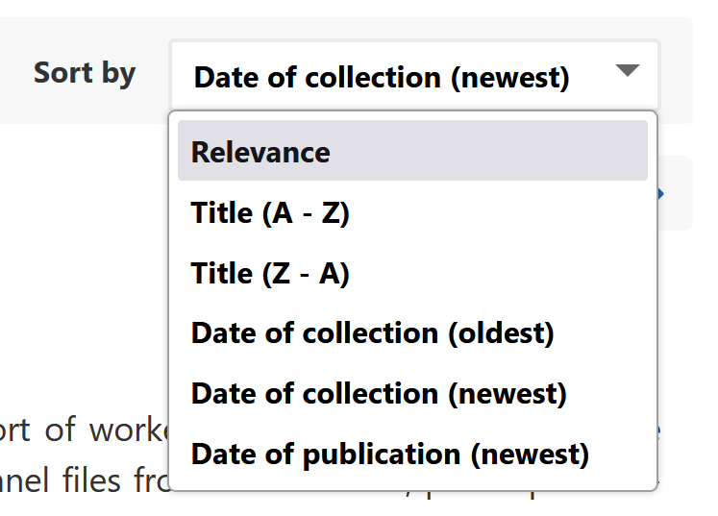
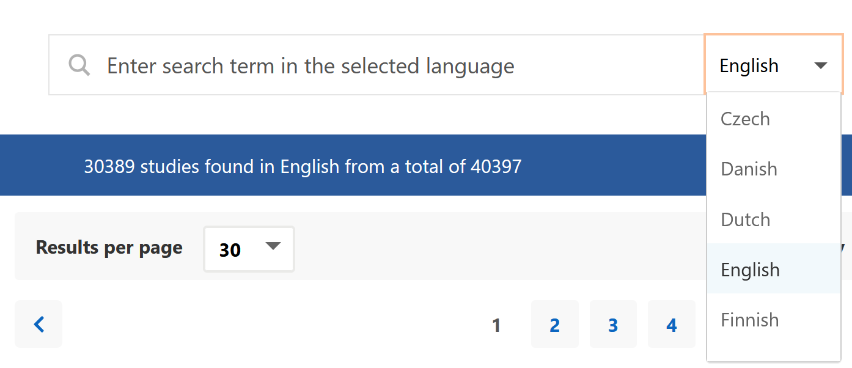
How does the catalogue work?
Multilingual text search across all metadata provided by SPs
Can sort search results using:
Relevance
Title
Date of collection
Date of publication

Slide 12
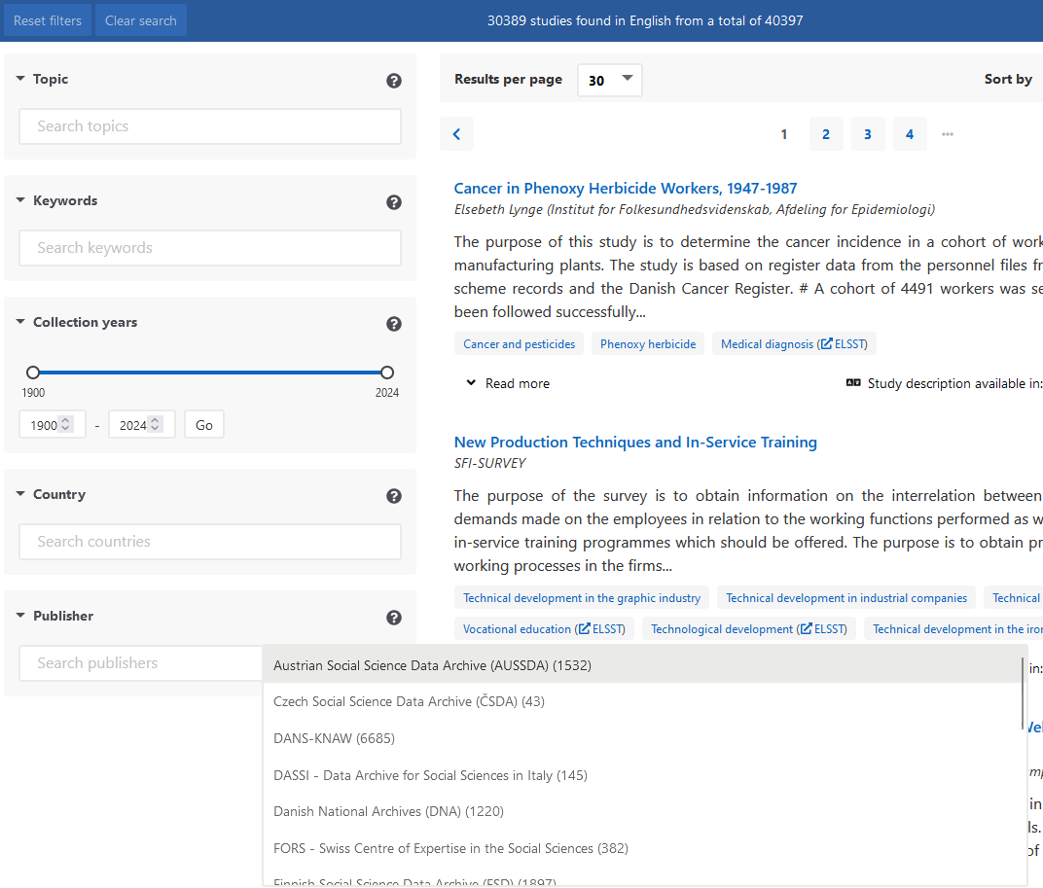
How does the catalogue work?
Can filter search results based on:
Topic (CESSDA Topic classification)
Keywords
Collection years
Country
Publisher

Slide 13
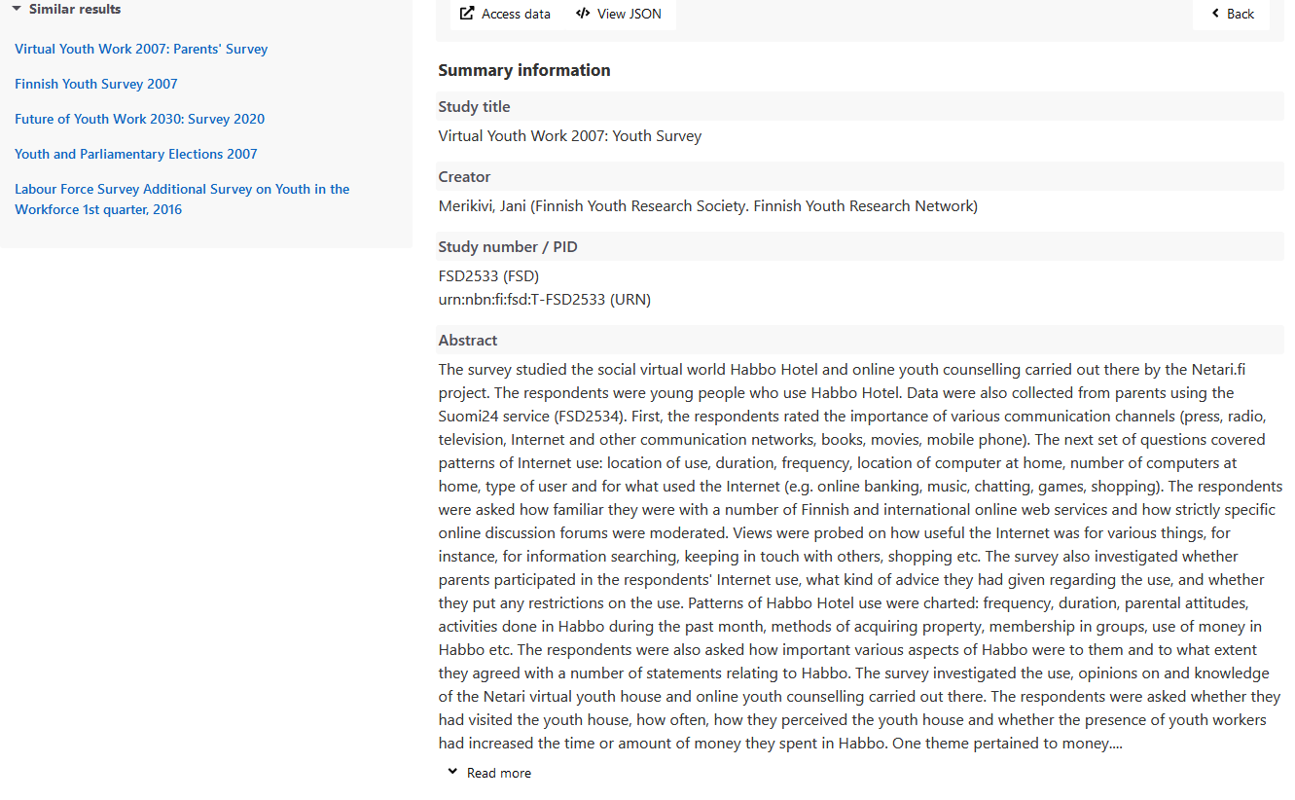
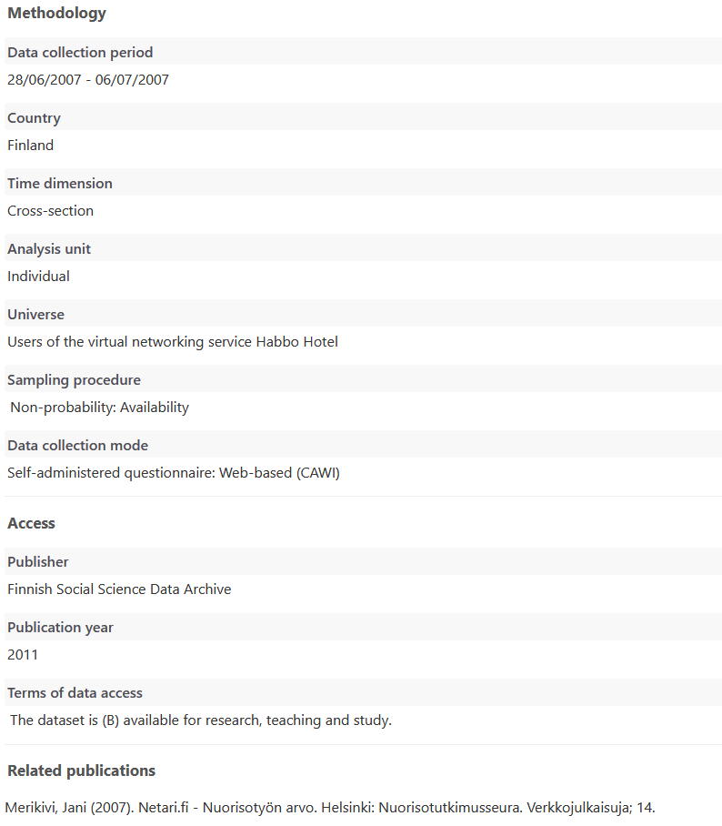
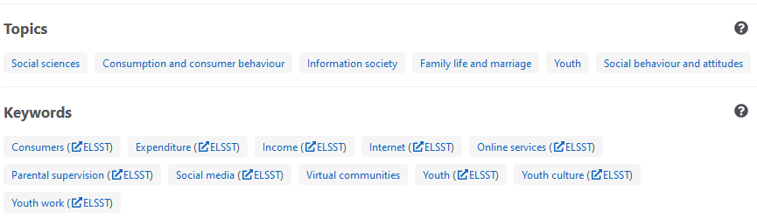
What can you find?
All studies have rich descriptions provided by Service Providers
A list of similar results is also provided, that span across all Service Providers
Users can explore topics and keywords
Every record provides a link to the Service Providers webpage where the data is located and can be accessed

Slide 14
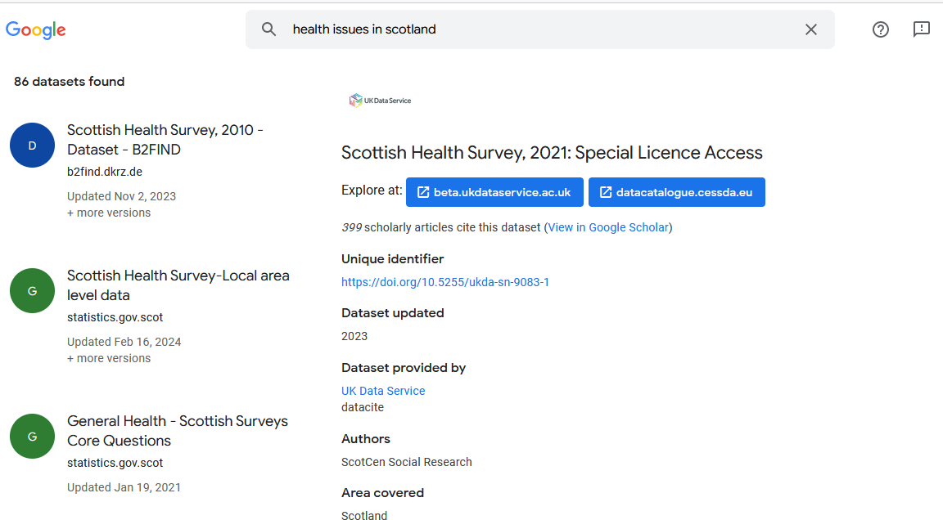
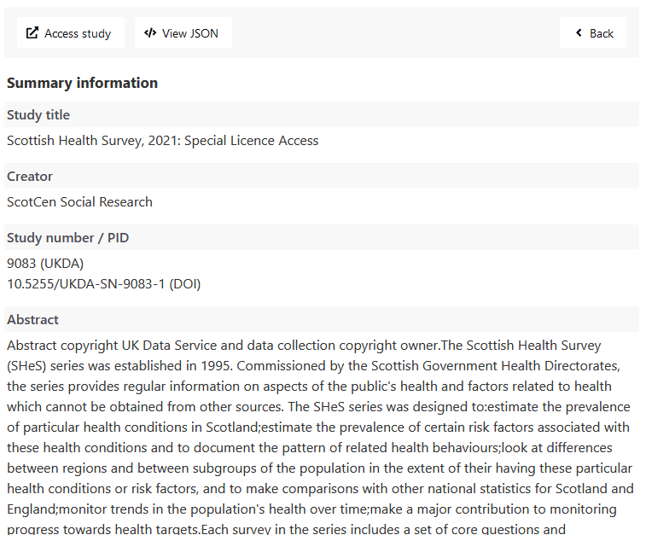
Access CDC from Google Dataset Search

Slide 15
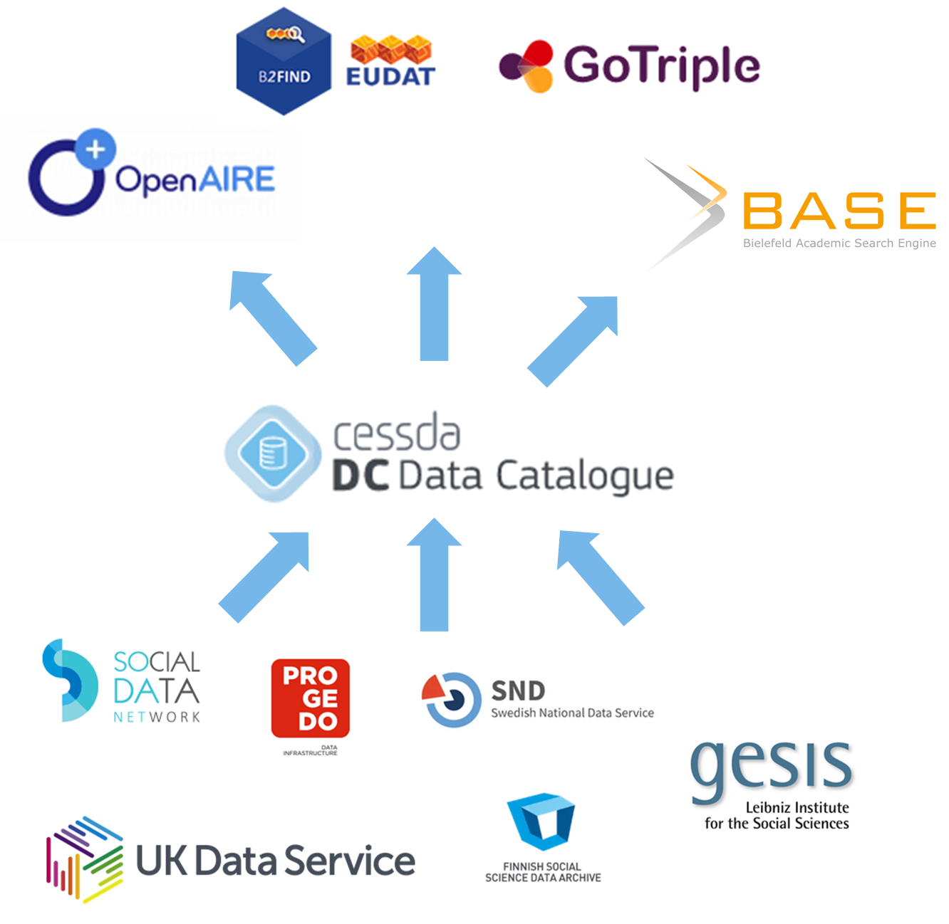
A pipeline for metadata
The CESSDA Data Catalogue harvests metadata from Service Providers by connecting to the archive’s endpoints
The metadata evaluated against metadata profiles by the CESSDA Metadata Validator
Metadata from Service Providers is made available for global catalogues through the CESSDA Data Catalogue endpoint
Variation of the requirements and structure of the global catalogues is handled by the CESSDA Aggregator
As long as Service Providers comply with the CESSDA Data Catalogue, they are automatically forwarded to the global data landscape

Slide 16
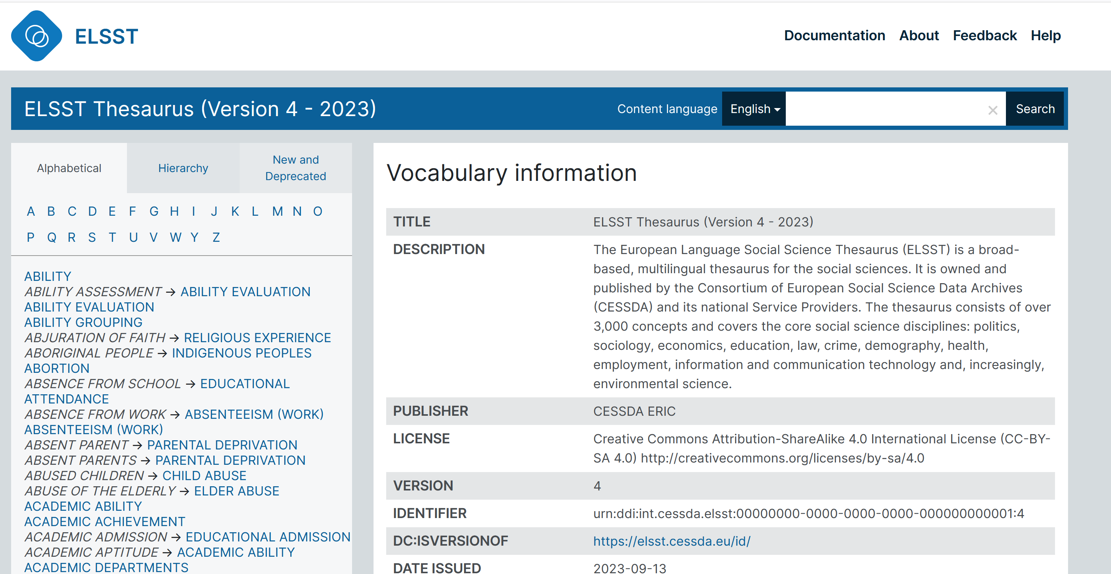
The European Language Social Science Thesaurus (ELSST)
A multilingual thesaurus for the social sciences
Consists of over 3,300 concepts
Covers the core social science disciplines: politics, sociology, economics, education, law, crime, demography, health, employment, information and communication technology, and environmental science

Slide 17
The European Language Social Science Thesaurus (ELSST)
Currently available in 16 languages: Danish, Dutch, Czech, English, Finnish, French, German, Greek, Hungarian, Icelandic, Lithuanian, Norwegian, Romanian, Slovenian, Spanish, and Swedish.
Originally based on the monolingual monolingual thesaurus, Humanities and Social Science Electronic Thesaurus (HASSET), of the UK Data Archive at the University of Essex.

Slide 18
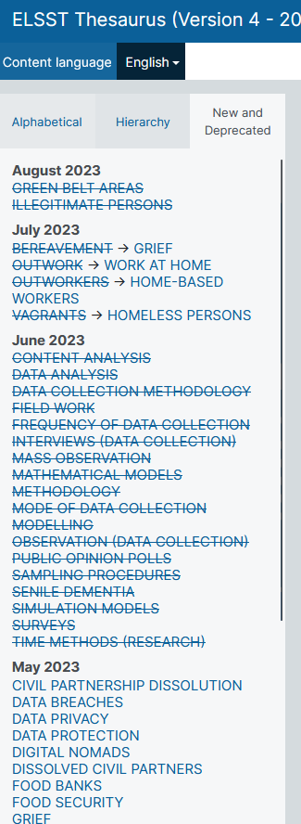
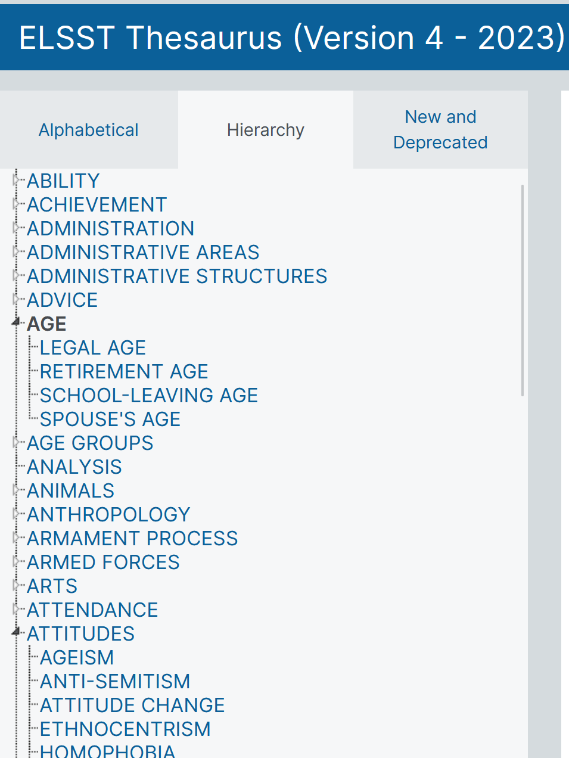
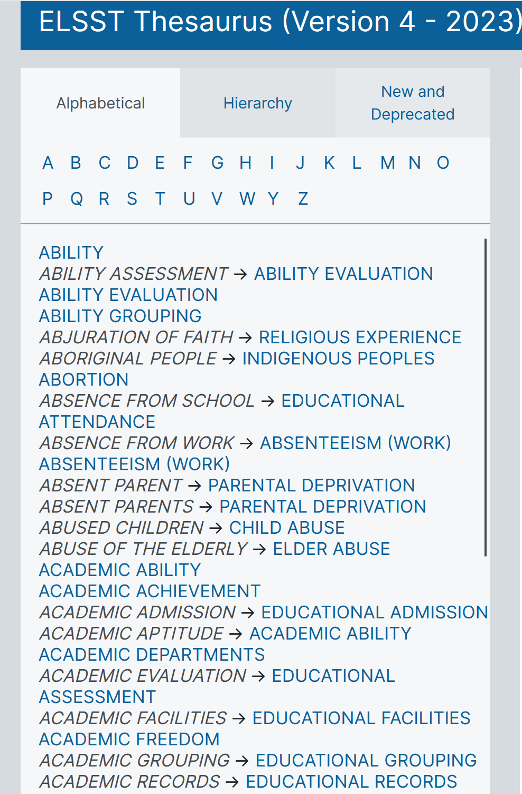
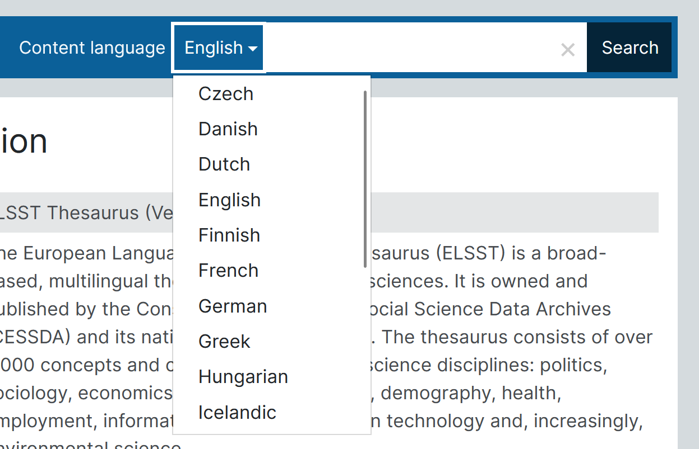
ELSST search
Explore content in different languages
Alphabetical list of concepts
Hierarchal list of concepts
Changes to concepts

Slide 19
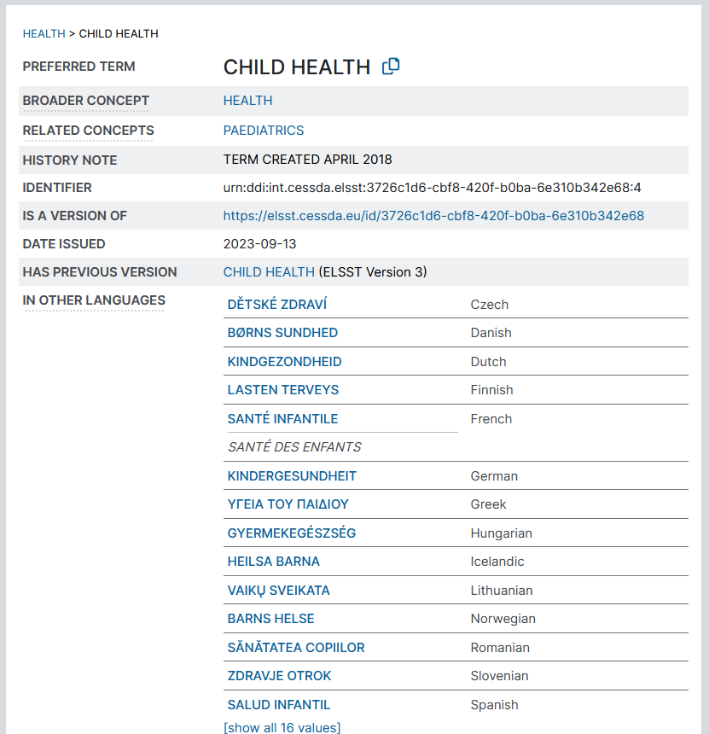
ELSST concept page
Broader and related concepts
History note: when term was created
A unique identifier
Previous versions
Other languages – clicking on these words will take user to the concept in the selected language

Slide 20
CDC – ELSST integration
In 2022 it was suggested to integrate the two CESSDA services, CDC and ELSST
The keywords found in CDC are concepts in ELSST
Idea: an ELSST user want to search for an ELSST concept in CDC
Further: also establish a link from a keyword in CDC to the concept in ELSST

Slide 21
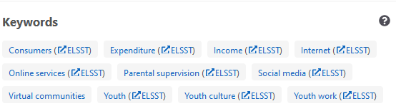
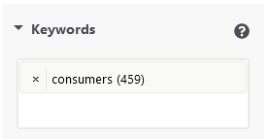
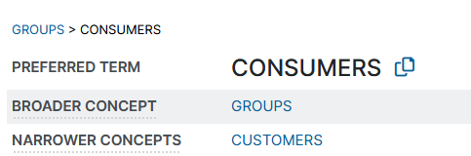
How it works – link from CDC
We wanted to keep the possibility for users to click on a keyword on a detailed study page to be able to do a keyword search, but also to be able to go to ELSST
User can click on keyword to be taken to a keyword search
Or the user can click on “ELSST” and a new window opens with the ELSST concept page
1
CDC
2
ELSST

Slide 22
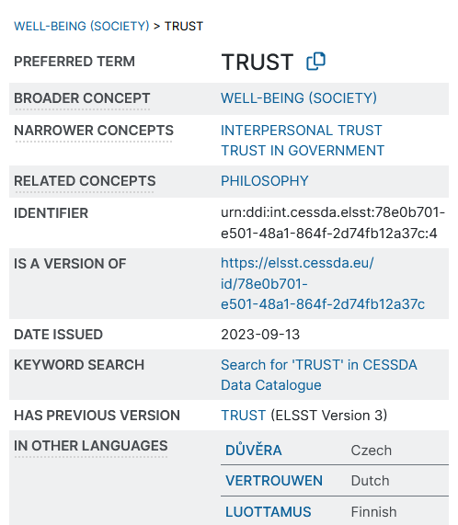
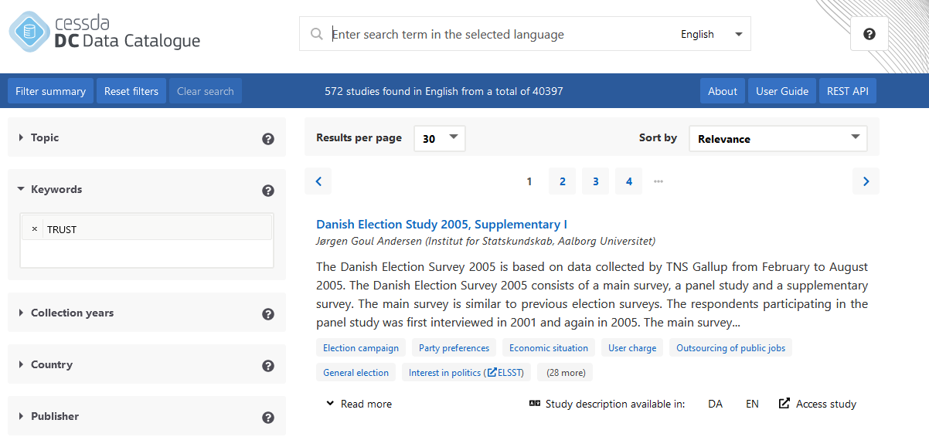
How it works – link from ELSST

Slide 23
How it works – vocabularies and languages
Some SPs use ELSST as their keyword vocabulary
Some use other vocabularies, however, these often contain the same concepts found in ELSST
Language tags to take the user to the right language page in CDC/ELSST

Slide 24
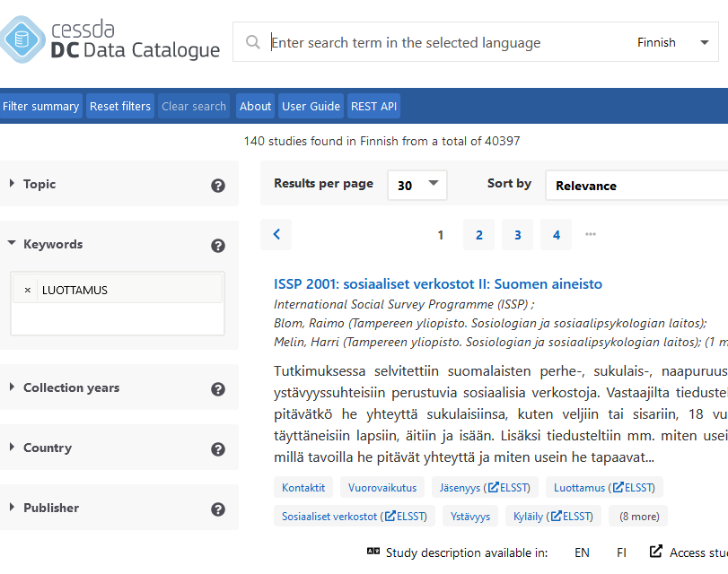
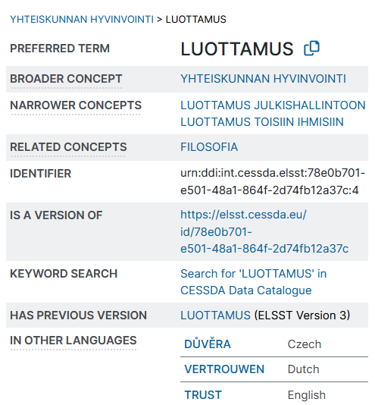
Languages

Slide 25
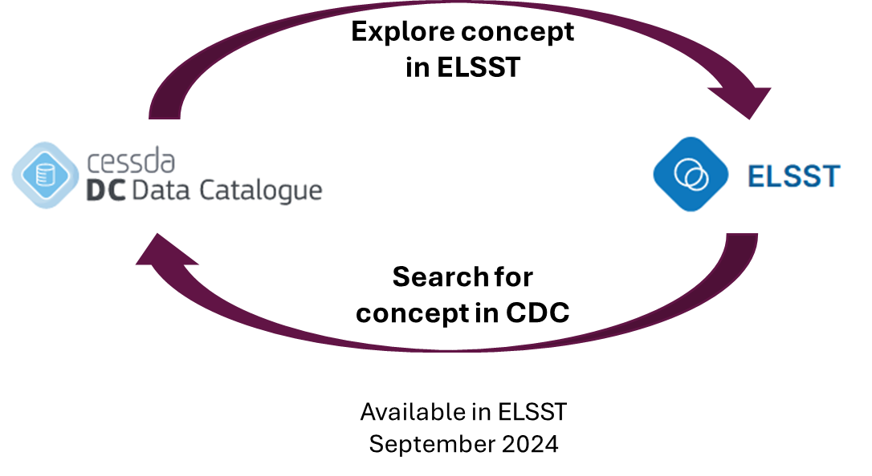
CESSDA Data Catalogue and ELSST integration

Slide 26


Explore concept in ELSST
Search for concept in CDC
Available in ELSST September 2024

Slide 27

Thank you for your attention!
CESSDA Data Catalogue Service Owner: kristina.strand@sikt.no
www.cessda.eu
@CESSDA_Data

