Slide 1


Small Communities and Anonymization-
Challenges in Data Protection in Qualitative Research
Dr. Rebekka Rieser 07 February 2025
Bild: Lizenz CC0

Slide 2
Why am I here?

Slide 3

How to do meaningful research and protect data in qualitative research and especially in small communities?
R.Rieser - Anonymization in" Mastering RDM - Qualitative Research Data" University of Lucerne

Slide 4
The Research Project
in a Nutshell

Slide 5
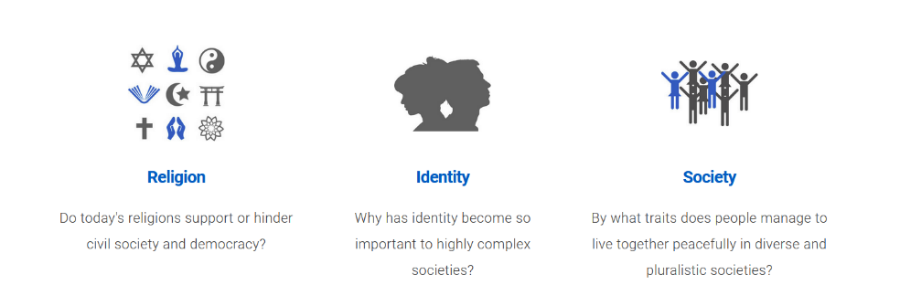


Project and Research Aims
«Religious and Social Identity in Civil Society»
SNF /DFG Lead-Agency project (2018-2021)
Two sub-projects
“Migrant Communities, Religious Identities and Integration in Civil Society (MIE)”
“Configurations of Individual and Collective Identities and their Potentials in Civil Society: Representative Results for Germany and Switzerland in Comparison (KONID)”
Research Aims
"The project “Social Groups and Religious Identities in Civil Society (RESIC)” investigates the structure and prerequisites of social identities, the impact of religious immigrant communities on the individual and organizational level as well as the overall causal effects of religious social identities in civil society and politics. “ (A. Liedhegener)
"We expect from the research new findings on adapted self-presentations of religious immigrants communities in view of the socially constructed myth of a "good religion”.” (M. Baumann)
R.Rieser - Anonymization in" Mastering RDM - Qualitative Research Data" University of Lucerne

Slide 6
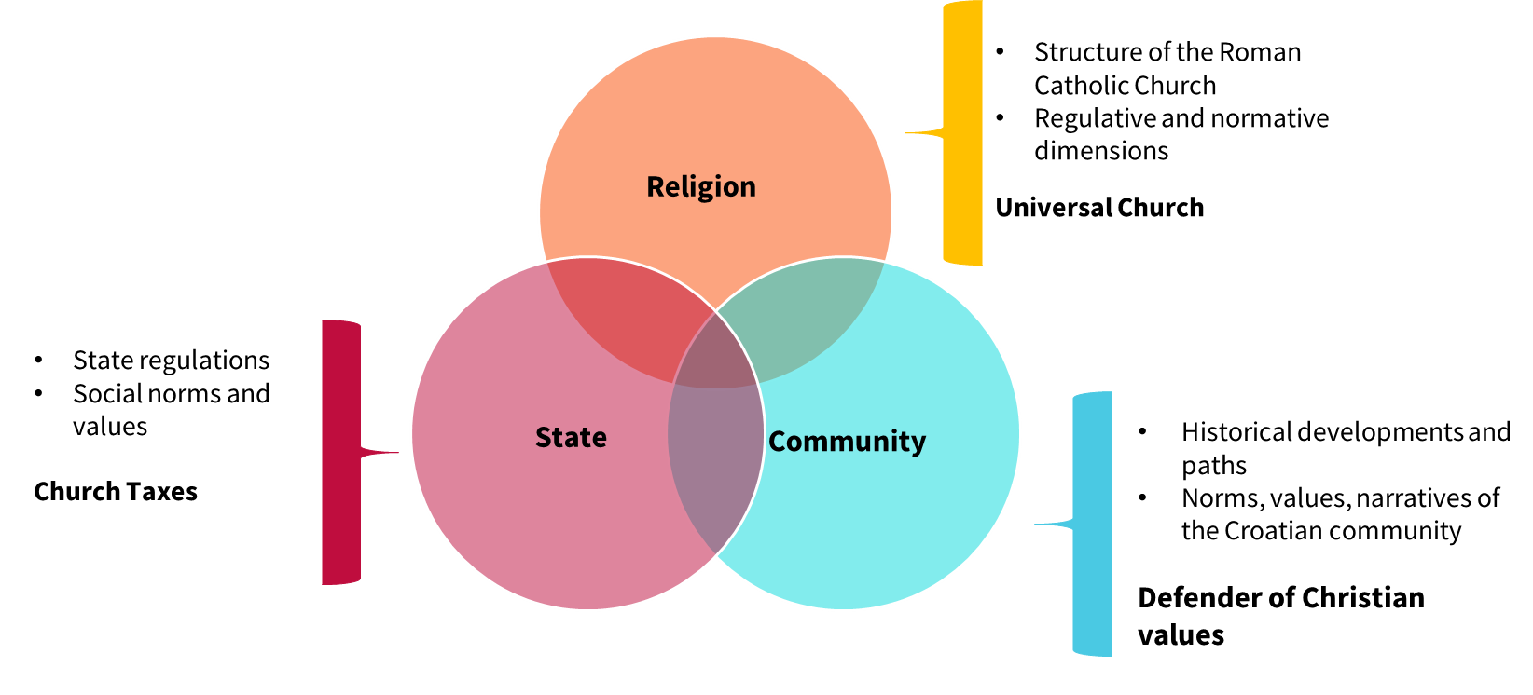
Theoretical frames and research questions
RQ: What are the expectations and roles of religious organizations in the diaspora and what are the consequences for the community, society and the individual?
cf. e.g: Lambert, 2014; Pollack et al, 2014; Stolz et al, 2014; Zurlinden, 2015
R.Rieser - Anonymization in" Mastering RDM - Qualitative Research Data" University of Lucerne

Slide 7
Investigated Areas
Individual Practices and Memberships in Clubs
Migration Biography / History
Collective Identity, Religiosity, and Practices
Individual Religiosity and Practices
Organizational Structures and Roles
Organizational Environments
Individual Political Behavior
Community History
R.Rieser - Anonymization in" Mastering RDM - Qualitative Research Data" University of Lucerne

Slide 8
Sample and Data
Field
Two each in Switzerland (de / fr) / Two each in Germany
Two in larger cities / Two in more rural areas
40 interviews (33 members and 7 with priests)
Topic-focused Interviews
Guided for the priests
Guide for the members
Structured Qualitative Content Analysis
Deductive approach: e.g. expectation management, legitimacy,
Inductive approach: e.g.: Charity, holidays
R.Rieser - Anonymization in" Mastering RDM - Qualitative Research Data" University of Lucerne

Slide 9
The Challenge

Slide 10
Sensitive Areas?
Individual Practices and Memberships in Clubs
Migration Biography / History
Collective Identity, Religiosity, and Practices
Individual Religiosity and Practices
Organizational Structures and Roles
Organizational Environments
Individual Political Behavior
Community History
Names of Clubs, Dates, Descriptions of Clubs […]
Party Affiliation
Description of «Religious Routine»
Geographical Touchpoints, Biographical and Historical Key events, Dates […]
Geographical Locations, Dates, Historical Key events […]
Time, Locations, Descriptions of Others […]
Locations, Names of Others, Hierarchical Dependencies […]
Locations, Dates, Name of Others, Descritiption of Neighborhoods […]
R.Rieser - Anonymization in" Mastering RDM - Qualitative Research Data" University of Lucerne

Slide 11
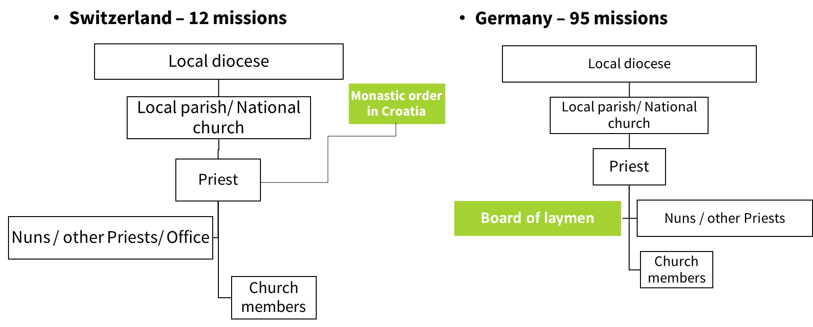
Croatian Diaspora – a very small communtiy and a strict hierarchy
Approx. 63,000 Croatians in Switzerland and 414,000 Croatians in Germany (see SBK /RKZ 2019, Graf 2019)
The Croatian missions are a sub-organization of the Roman Catholic Church in DE and CH
R.Rieser - Anonymization in" Mastering RDM - Qualitative Research Data" University of Lucerne

Slide 12
Data Protection

Slide 13
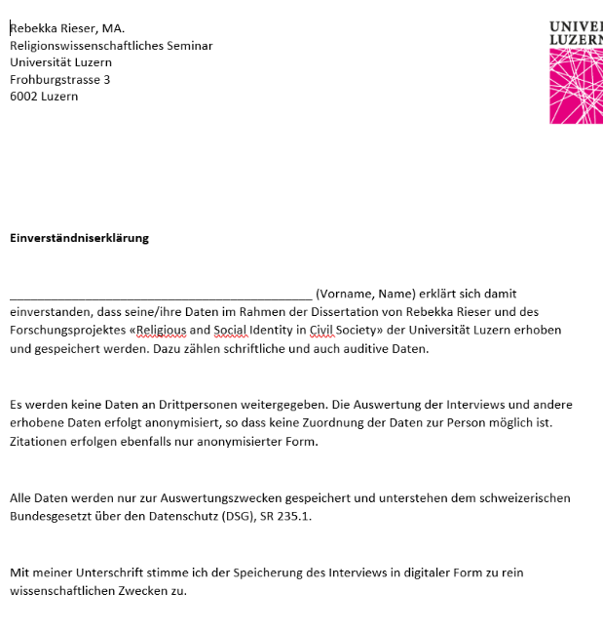


Measures
Declaration of Consent
Signature
Verbal confirmation
Digital Encryption
Cloud / NAS
Passwords
Anonymization
Data Description
Interviews
Foto: Unsplash
Foto: Unsplash
R.Rieser - Anonymization in" Mastering RDM - Qualitative Research Data" University of Lucerne

Slide 14
Good Examples
1 B: Um (...) I think that everything that is done in the congregation, um, just in terms of the church service and how people are with each other, I think it's quite similar. What I think makes this congregation special, which is also a difference, in Croatia below it's all Croats and um, in a village it's all Croats, and in a village everyone comes to the village church and it's just that not everyone from [town in Switzerland] comes to this church now, but there are also people, who come from [big city in Switzerland], who come from [city in Switzerland] and what makes this community special, I think, are these events that are organized to promote cohesion, because they are all a bit spread out, not all in one place, like in Croatia now. Um, yes, I just think it's nice that they try to stick together, to show: "Hey, look, we're more than just this here now", um, yes, so just (.) that they try to bring everything together, all in one place (.) and so yes. (..) #00:17:17-8#
I: Are you still planning to maybe join a club here in Switzerland? #00:30:52-5#
G: I would like to, but [proper name university] takes up my free time. I'm trying to play at least [sport] with my friend or go to the gym. That's- or sometimes go to the movies but yes that's […]
R.Rieser - Anonymization in" Mastering RDM - Qualitative Research Data" University of Lucerne

Slide 15
Critical Examples
B: Mhm. Yes, so my name is [proper name] and I was born in 1980. I moved to Switzerland during the war in my home country, Croatia. Because my father worked there, didn't he? And uh before I needed (hobby) ne? Because I also worked in the Franciscan monastery in [Swiss city] //Mhm.//. I wanted to become a priest myself, didn't I?
B: I was born in Switzerland in 1992. My parents arrived in Switzerland at the end of the 1980s, in 1987, 1988. They were working as seasonal workers at the time. That means they worked at certain times of the year and then returned to Croatia.
G: No, unfortunately not. I used to - I was in a robot club or whatever you call it and even before that I was - I mean I built robots for a few years. And that's actually my connection with technology and I was also in a sports club for a few years and was the fourth best in Croatia.
R.Rieser - Anonymization in" Mastering RDM - Qualitative Research Data" University of Lucerne

Slide 16
Challenges with Quotes
If we do not succeed in recognizing the signs of the times, then that will thus-. […] the whole holy history is the history of migration. There, so the God from Abraham to Moses to Jesus, who also had to flee and so on […]. God leads his people […] So we probably won't be able to do that with our human rules and laws. But I think the story of salvation is still valid. So all the migrants, it has a purpose. We may see it all the way through in the generations after us. “Priest (Coordinator), 1950, Gen. 1, GE”
R.Rieser - Anonymization in" Mastering RDM - Qualitative Research Data" University of Lucerne

Slide 17
Learnings and Conclusions

Slide 18
Opportunity costs – finding a balance
Protection
Personal information
Description of network/organizational dependencies
Doing Research
Framing/Contextualizing of quotes
Analysis of network/organizational dependencies
Aspects of migration as independent variables
Multi-levelled aspects of migration
R.Rieser - Anonymization in" Mastering RDM - Qualitative Research Data" University of Lucerne

Slide 19
And..
Individuals between private persons and official roles
Ethical dilemma in finding answers in letting them tell their stories but possible professional consequences
R.Rieser - Anonymization in" Mastering RDM - Qualitative Research Data" University of Lucerne

Slide 20


Contact
Rebekka Rieser
IKMZ / Universität Zürich
UFSP Digital Religion(s)
Forschungszentrum Öffentlichkeit und Gesellschaft (fög)
Andreasstrasse 15
8050 Zürich
Tel. +41 44 635 20 85 Raumbezeichnung: AND 2.88
rebekka.rieser@uzh.ch
www.foeg.uzh.ch

