Slide 1

Reusable Qualitative Data
https://doi.org/10.5281/zenodo.14931741
Notes:
You can find the latest version of this presentation at https://doi.org/10.5281/zenodo.14931741
Topics covered in this presentation include: Qualitative Data; FAIR principles; good practices
This work is licensed under a Creative Commons Attribution 4.0 International License

Slide 2
Goal of this meeting
Finding common ground between different disciplines
FAIR principles
Qualitative data
2. Identifying (shared) challenges
Research planning
Data organisation
Data publishing
Ongoing developments
3. Deciding how to proceed

Slide 3
Common ground

Slide 4
FAIR principles
Notes:
Data-related aspects need to be taken into account from the earliest project stage and fully incorporated in project plans, funding requests and reporting. Taking the research workflow as a sequence of stages, FAIRness needs to be considered throughout the research process in the form of a set of questions relating to data, which should be a basis to define the data management plan:

Slide 5
What is F A I R ?
Notes:
This slide gives participants a chance to discuss with the group what they consider the meaning of FAIR.

Slide 6
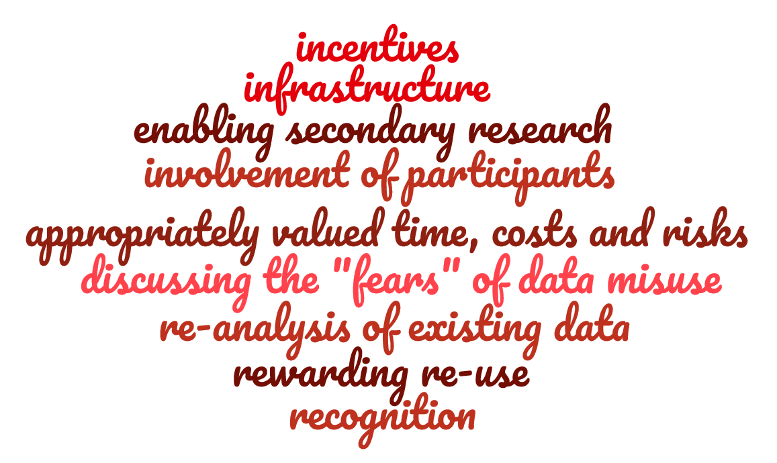






FAIR is a culture change
Data as byproduct
Data as key output
Notes:
FAIR can be interpreted in many ways, but at the most abstract level it is a cultural change. Data is no longer a byproduct of doing research, but becomes a key output that is as important as the publications associated with them. In the wake of this cultural change a wide range of other changes are necessary to make FAIR data possible. This includes for example infrastructure, recognition, and a new appreciation for data re-use.

Slide 7








FAIR ≠ open
FAIR:
Findable
Accessible
Interoperable
Re-usable
Open Access:
As open as possible,
as closed as necessary
under well-defined conditions
= a process
= an ethical view
Notes:
To avoid misunderstandings, FAIR is not the same as open access. FAIR does include accessibility, but this means accessibility under well-defined conditions. This can also be other levels of accessibility than open access. Generally this is summed up as the mantra “as open as possible, as closed as necessary”.
FAIR is fundamentally a process of making data available, whereas open access is an ethical view of how data should survive society.

Slide 8

History of FAIR
2007: Principles and Guidelines for Access to Research Data from Public Funding (OECD)
2016: The FAIR Guiding Principles for scientific data management and stewardship (Wilkinson et al.)
2013: G8 Science Ministers’ Statement
2019: CARE Principles
Data upon request…
See my personal website…
Repository XYZ
2014: Term FAIR was launched
2020: Sorbonne declaration on research data rights
2012: Science as Open Enterprise (Royal Society)
2017: Opriching GO FAIR
Notes:
FAIR is not something new. It follows trends in research where data was once only available upon personal request, then was hosted on personal websites, after which professional repositories were developed that could guarantee long-term and secure access to data.
Policy-wise FAIR is the result of a string of global developments, going back as far as 2007. Support grew over time, while FAIR was better defined and became more practical to implement.
Meanwhile the scope of research data, both in type and in quantity increased explosively, as datasets became bigger, new forms of data became relevant and computers could process more data.

Slide 9
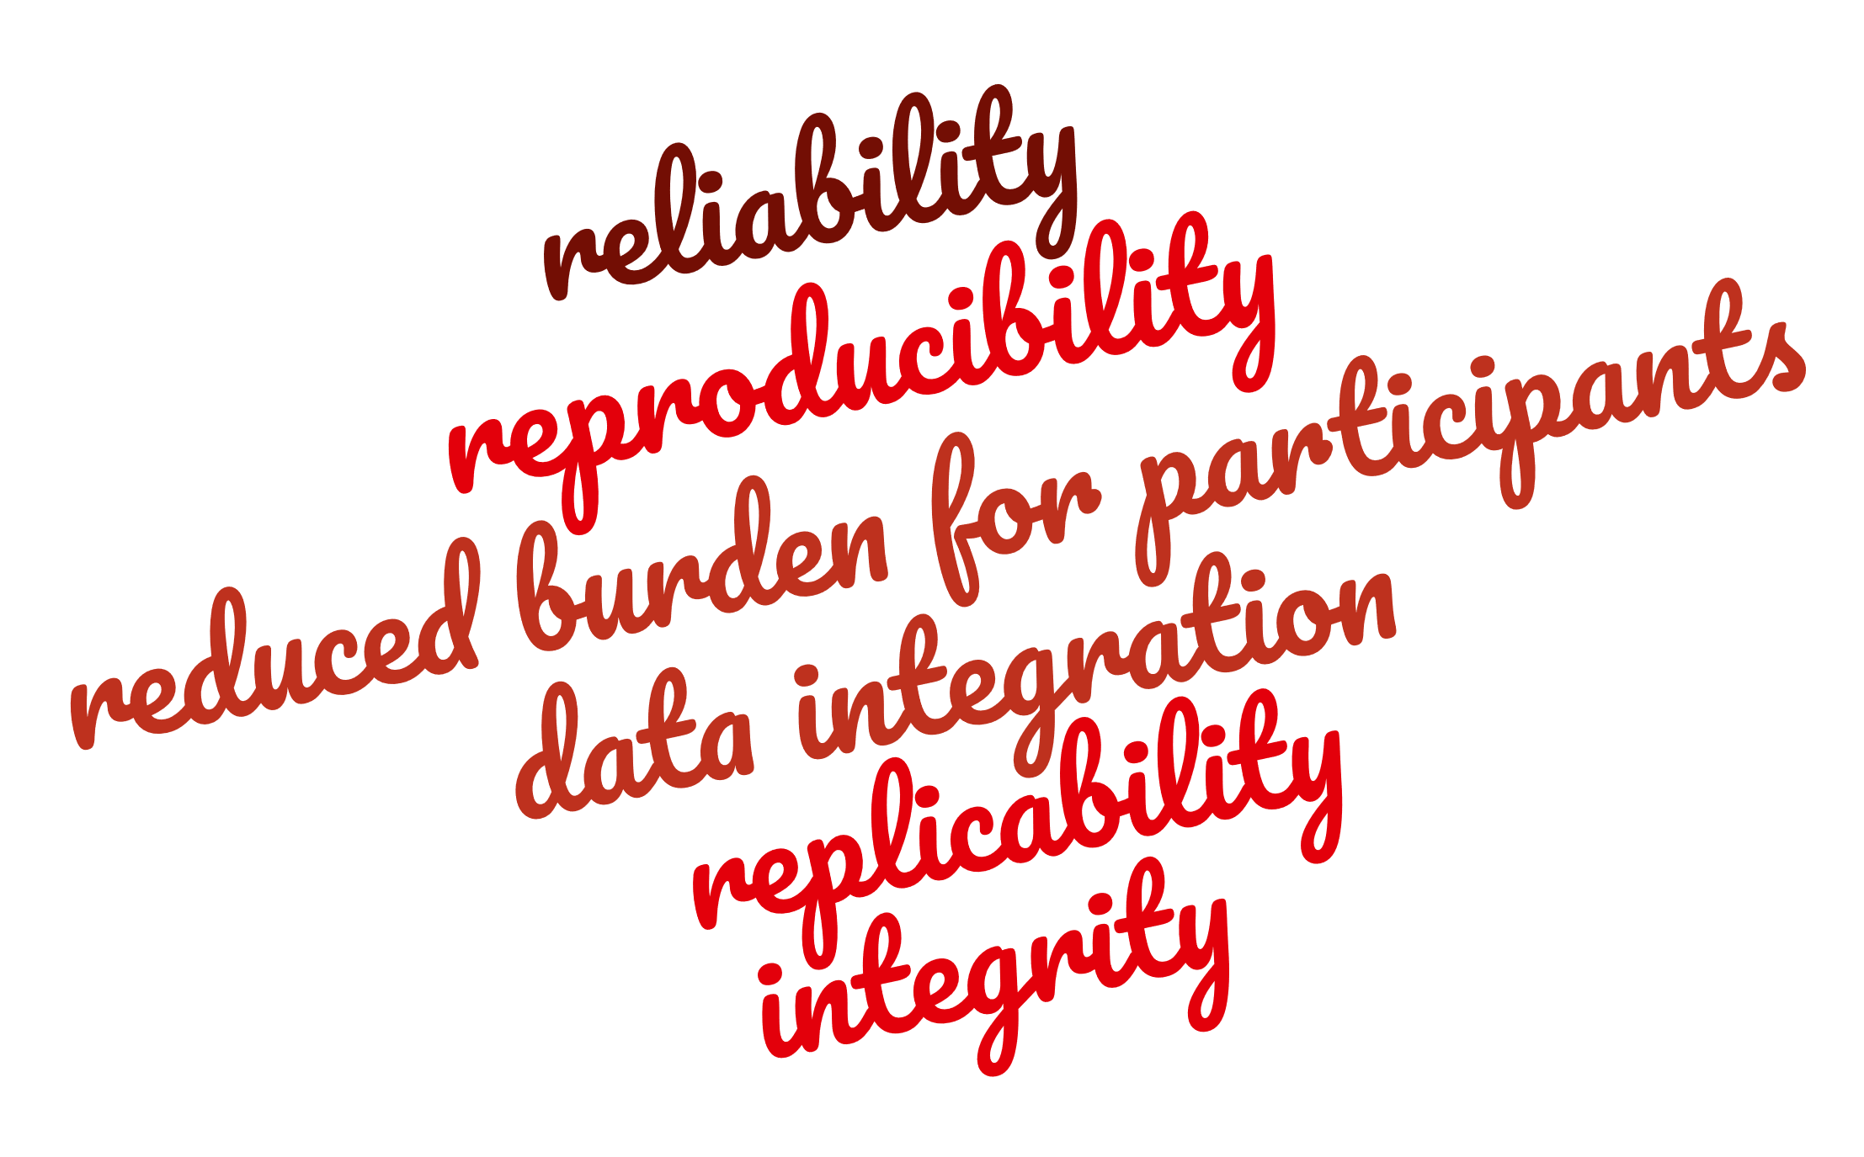
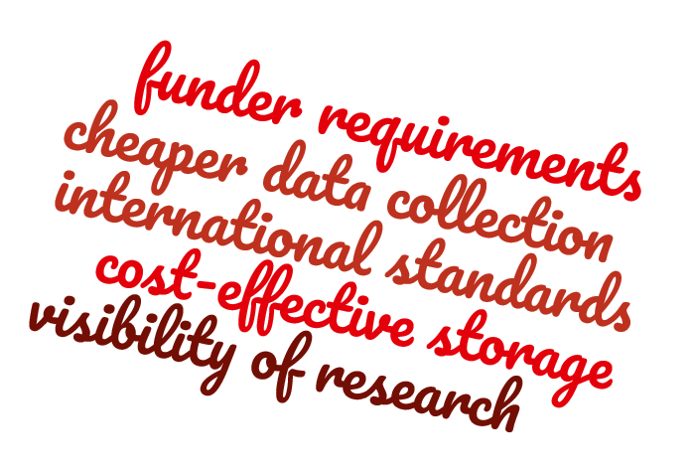
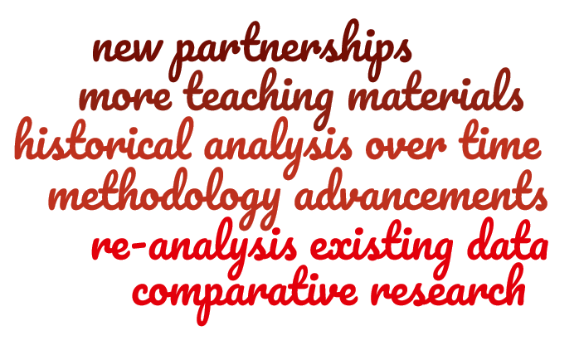
Why is FAIR important to you?
Notes:
FAIR can be important to you as a researcher for a variety of reasons. Depending on how you look at it these can be grouped under three categories.
FAIR is a standard that improves research: it increases reliability, reproducibility, integrity and replicability, while it also reduces the burden for participants and improves the integration of data.
FAIR is a requirement that enables research: FAIR is increasingly demanded by funders, because it lowers the cost of data, meets international standards or increases the visibility of research.
FAIR creates new opportunities for research: FAIR data enables new partnerships, more teaching materials, new forms of analysis and methodological advancements.

Slide 10




FAIR principles
F
Metadata and data should be easy to find for both humans and computers.
A
The user needs to know how the data can be accessed, possibly including authentication and authorisation.
I
The data need to be integrated with other data and need to interoperate with applications or workflows for analysis, storage, and processing.
R
Metadata and data should be well-described so that they can be replicated and/or combined in different settings.
Notes:
FAIR breaks down in four terms. Findable, Accesible, Interoperable and Reusable. But what do these terms mean?
1. Findable means that both the data and metadata should be easily findable for both humans and computers.
2. Accessible means that users need to know how data can be accessed.
3. Interoperable means that the data needs to be integrated with other data, applications and workflows.
4. Reusable means that data is well-described, to the point where it can be replicated and/or combined with other data.

Slide 11
















How FAIR is your data?
F
A persistent identifier is assigned to your data
There are rich metadata, describing your data
The metadata are online in a searchable resource
The metadata record specifies the persistent identifier
A
Following the persistent ID will take you to the data or associated metadata
The protocol by which data can be retrieved follows recognised standards
The access procedure includes authentication and authorisation steps
Metadata are accessible, wherever possible, even if the data aren’t
I
Data is provided in commonly understood and preferably open formats
The metadata provided follows relevant standards
Controlled vocabularies, keywords, thesauri or ontologies are used
Qualified references and links are provided to other related data
R
The data are accurate and are well described with many relevant attributes
The data have a clear and accessible data usage license
It is clear how, why, when and by whom the data have been created and processed
The data and metadata meet relevant domain standards
Notes:
If you want to make it even more hands-on, there exist various tools and checklists that tell you how FAIR your data is. They break the four key terms down into very explicit and practical checks that you can do to see if you meet the standards of FAIR.

Slide 12
qualitative data
Notes:
Data-related aspects need to be taken into account from the earliest project stage and fully incorporated in project plans, funding requests and reporting. Taking the research workflow as a sequence of stages, FAIRness needs to be considered throughout the research process in the form of a set of questions relating to data, which should be a basis to define the data management plan:

Slide 13
What is qualitative data ?
Notes:
This slide gives participating researchers the opportunity to share their own insights on what qualitative data is.

Slide 14



What is qualitative data?
Form:
Unstructured data describing qualities and characteristics
Expressed in non-numerical, linguistic, textual or visual form
Observations, interviews, documents, artifacts
Content:
Nuances about human experiences, behaviours and perceptions
Capturing the lived experience of the individual
Exploratory research finding new problems to be solved
Perspective:
Interpreting human phenomena unique to their context
Subjectively created from participant-researcher experience
Data that are linked to the context in which they are obtained
Notes:
Qualitative data is distinctive in its form, content and perspective on the world.
The form is unstructured, non-numerical, linguistic, textual or visual; often derived from observations, interviews, documents or artifacts.
The content describes nuances about human experiences, behaviours and perceptions in exploratory fashion.
The perspective seeks to interpret human phenomena within a subjectively created participant-researcher experience.

Slide 15
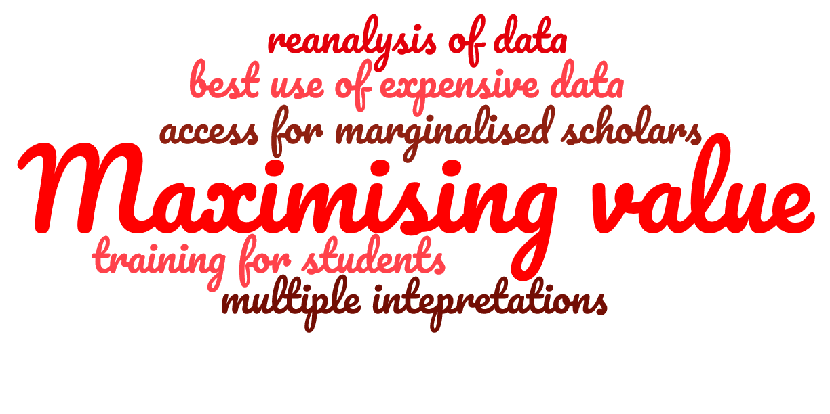

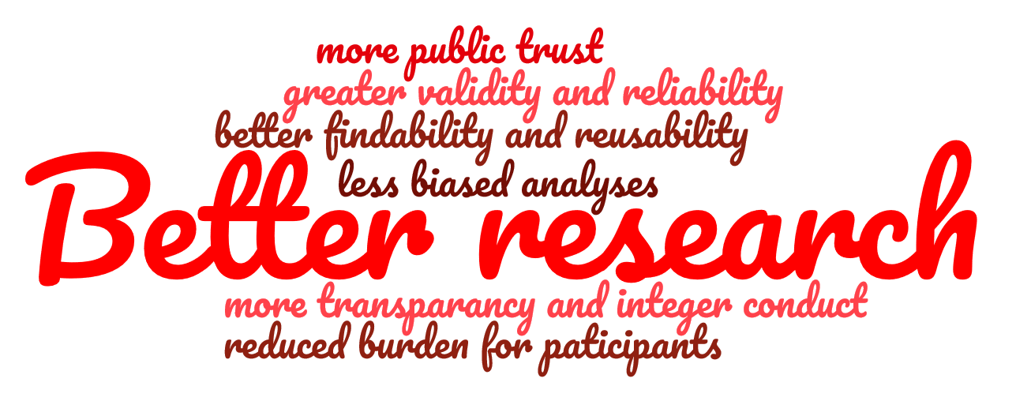
Why make qualitative data reusable?
Notes:
What is the benefit of making specifically qualitative research FAIR? There are many reasons, but they can be grouped under three themes:
Maximising value: qualitative data is costly to collect and not commonly available for re-use, training or re-interpretations. FAIR practices would make more qualitative data available.
New opportunities: qualitative data is often underappreciated, as it relies on small samples, cannot be compared easily and is not accessible to other disciplines. FAIR practices could break down these limitations.
Better research: qualitative data can be demanding for participants and challenges ideas about integrity and public trust. FAIR practices can improve these fundamental academic values.

Slide 16
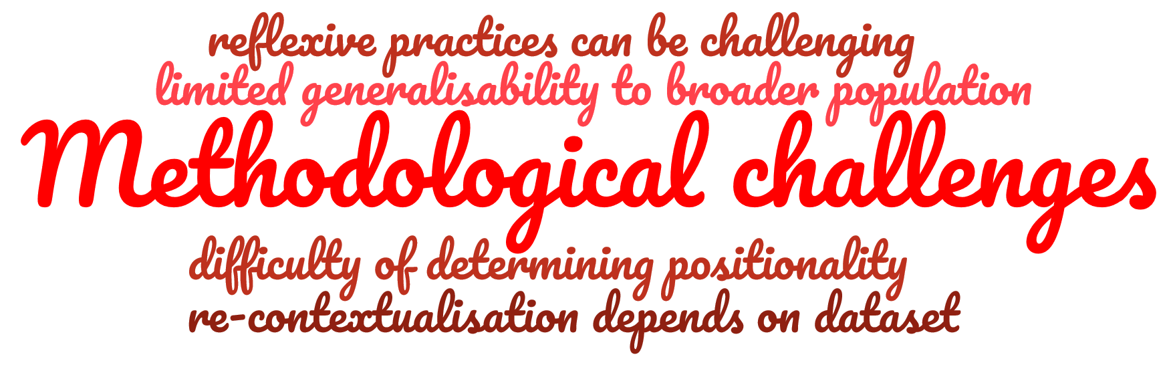
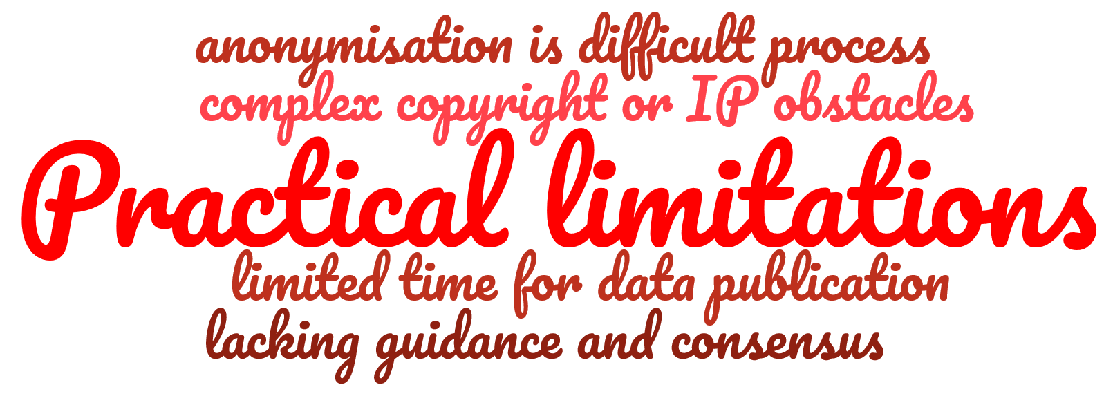
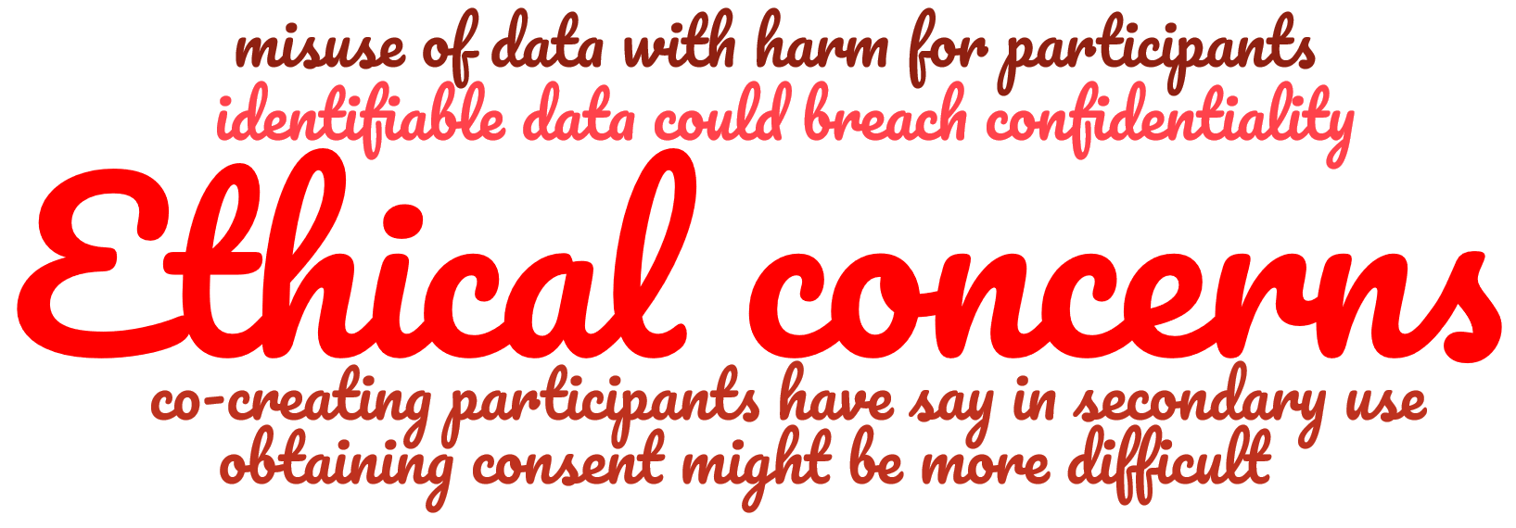
What are the challenges?
Notes:
This is not to say that there are no challenges that must be overcome on the road towards more FAIR qualitative data.
Methodological challenges: the unique context in which qualitative data is collected makes it difficult to convey the positionality of the primary researcher, the context of het field and the normal reflexive practices of this type of research.
Ethical concerns: the traditional focus on the participant, in particular with sensitive topics, challenges the possibilities of re-use in terms of informed consent, misuse of data and confidentiality.
Practical limitations: qualitative data runs into practical limitations, requiring time, training and support that might not be readily available.

Slide 17
CARE principles
Data sharing creates tensions with Indigenous efforts to assert greater control over data
CARE principles focus on people and purpose, where FAIR focuses on data
Collective benefit
Data should also benefit (Indigenous) communities
Authority to control
Informed consent, access to data and governance
Responsibility
Data practices should respect and support communities
Ethics
Data practices should minimise harm and maximise benefit
Notes:
While only tentatively related, it is also good to keep the CARE principles in mind. These seek to balance the FAIR principles with a more participant-focused perspective.
The CARE principles emphasise:
Collective benefit: meaning that the participant community should benefit from the research.
Authority to control: meaning that participants should have consent, access and governance over their data to some extent.
Responsibility: meaning that the data practices should support participant communities.
Ethics: meaning that data practices should minimize harm and maximise benefit.

Slide 18
Shared challenges

Slide 19
Research planning
Notes:
Data-related aspects need to be taken into account from the earliest project stage and fully incorporated in project plans, funding requests and reporting. Taking the research workflow as a sequence of stages, FAIRness needs to be considered throughout the research process in the form of a set of questions relating to data, which should be a basis to define the data management plan:

Slide 20
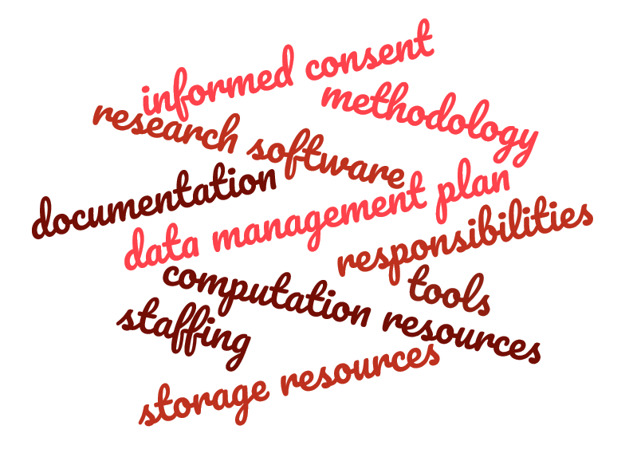
Project Planning
How can FAIR be implemented as early as possible in the data production process?
Notes:
In the planning phase research involving qualitative data does not deviate much from any other type of research. The research project requires the basic building blocks of a good informed consent procedure, data management plan, technological support and team members.
Likewise, when re-using qualitative data it is important to remember that while it might be easier to acquire the data, substantial time is required to identify available data sources and to develop an understanding of het primary data.

Slide 21














Make the project “friendly”
To be FAIR is to be friendly – for both computers and humans
This can be done by adding sufficient metadata:
}
FAIR
Terms of Use
Data Description
Data Access Protocols
Data Archiving
Rich Metadata
Data Reusing
RDR
More information
Notes:
This explains how researchers should aim to make their data “friendly”, which can be done by adding sufficient metadata. For the Radboud University this is largely guaranteed through the use of the Radboud Data Repository. For more information on good metadata practices for qualitative data you can consult the linked website of Maastricht University.

Slide 22
Data organisation

Slide 23



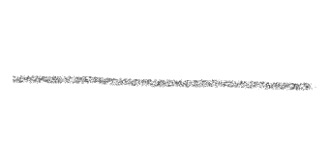






Data collection
Which FAIR data are available to conduct the project?
Generate new data
Re-use FAIR data
Non-FAIR data
FAIR data
Data preserved
Data discarded
New data
Superceding existing data
Notes:
During the data collection various decisions must be made. This can be a trade-off between generating new data and re-using existing FAIR data, or an effort to make existing non-FAIR data FAIR. It can also be the balancing act between data that must be preserved and data that can be discarded, or the decision when new data ends up superceding existing data.

Slide 24





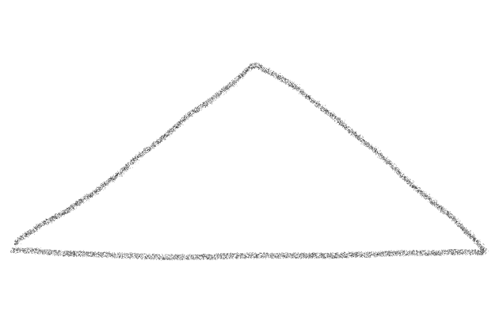




Data preparation
Redacting identifiable and sensitive data
Documentation
Provide contact details
Conveying the human voice of participants
Raw data that allows re-coding and reanalysis
Notes:
Preparing qualitative data involves various steps, but often comes down to process the raw data into a textual form, for example a transcript. This is a balancing act, where the researcher tries to not just convey the human voice of the participants, but also might redact identifiable or sensitive information. For re-use it is important to organise data in such away that it enables re-coding and re-analysis without the “noise” of the primary research getting in the way. This requires clear documentation of who said what to which question, while it also might require contact with the primary research team.

Slide 25
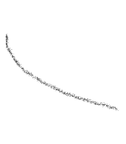


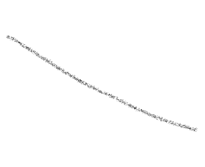






Data anonymisation
Anonymisation
Pre-designed anonymisation scheme
Ethical obligations and informed consent
Record of modifications
Archive raw data?
Restricted publishing
Notes:
The decision to anonymise is first and foremost depending on the ethical concerns and informed consent that was obtained. From there it becomes a question of anonymisation versus restrictive archiving. If the decision is made to anonymise, the modifications should at the very least be documented in order to make it clear what information was removed from the dataset. A final decision is whether to archive the raw data. While there is a legitimate argument for protecting the privacy of participants, for re-use the archived raw data can be relevant too, especially if this captures subtle nuances that are lost in the processed data.

Slide 26

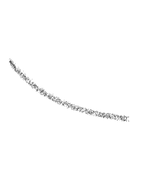

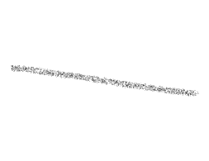
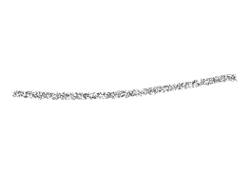



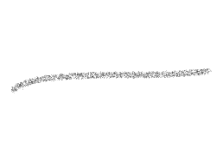

Data organisation
Metadata
Version numbers
Persistent identifier
Project
Keywords
Ontologies
Open software
Interoperability
Naming conventions
Metadata standards
Notes:
As with any research project the organisation of the data is critical, especially when the goal is to make data available for re-use. Good practices such as persistent identifiers, file names, versioning, good metadata, accessible open software are the key to a good data collection that can be re-used.

Slide 27
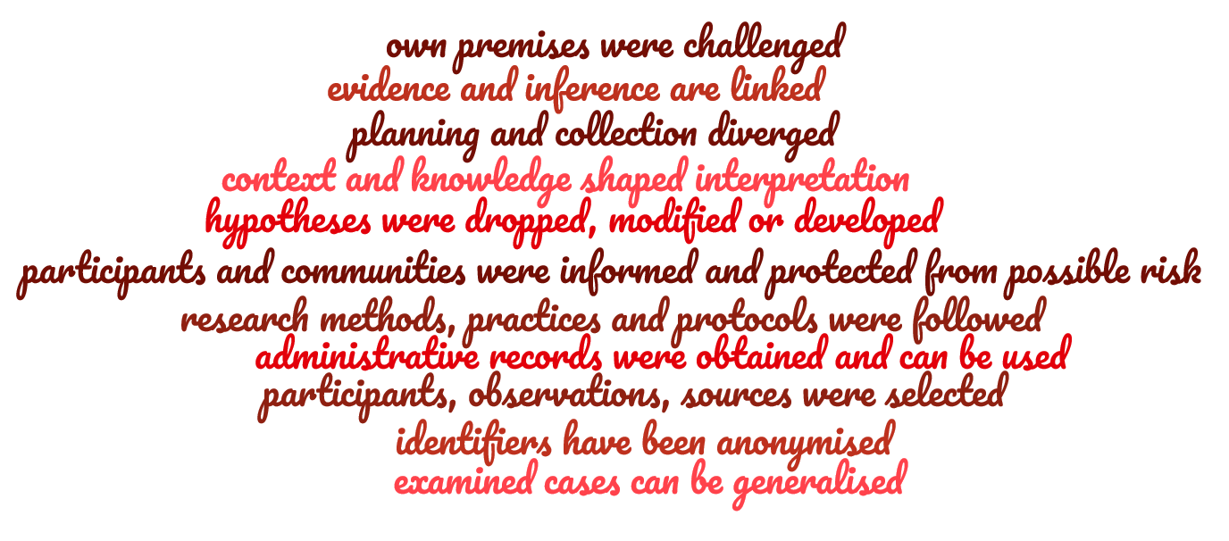
Data documentation
Explain HOW:
Notes:
Documentation is important as always, but extra important with qualitative research data. Besides the typical information on the context of the research, the content of the data collection and the codes that are used in the analysis good documentation should answer the HOW questions. How did data come into existence, how did decisions affect the research process, how was the data processed and analysed? This is best done in a dedicated appendix or manual. This is a process that starts on day one of the research and must be followed diligently to enable an easy write-up at the time when data is deposited.

Slide 28




Documentation in publications
In publications: discuss empirical data and the analytical process in detail.
In footnotes: provide additional information to support analytical claims.
In appendices: describe methodology, fieldwork logistics, interview protocols, etc.
Discussions: explicitly discuss the researcher position in relation to participants.
Notes:
One classic form of documentation is included in the publications that result from qualitative research. Footnotes, appendices, or discussion sections can be used to make potential re-users aware of the research process and the perspective of the primary researcher.

Slide 29
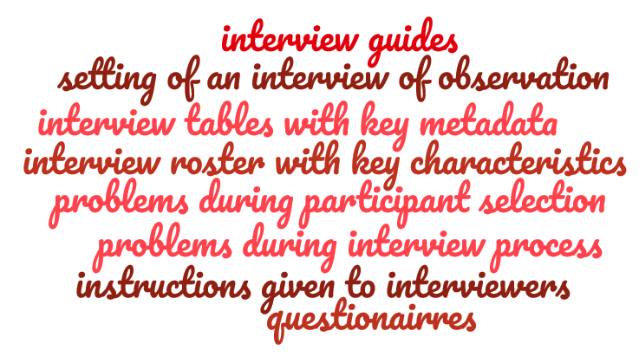




Interview documentation
Notes:
Whenever video or audio data is processed into transcripts, it is important to include as much context information as possible. Interview guides, metadata, instructions, etc. can all help a re-user to make sense of the interview and the time, place and circumstances in which it occurred.

Slide 30
Code documentation
Code information:
Coding process:
definitions
descriptive meanings
decision process
relations between codes
visual network of codes
who codes what
when was it coded
coder reliability
coding guidelines
coding training
Notes:
When coding qualitative research data it is vital that these codes can be understood and interpreted by re-users. One the one hand this reflects on the content of the codes, meaning that definitions, relationships, and meanings must be made as clear as possible. The same concerns the context in which the data was coded; what training, guidelines and decisions were involved? Especially in larger teams it is also important to verify the coder reliability, did everyone code in a similar way? This can be done by an independent researcher, by team members who check each others work, or by the team as a whole at the end of the coding process.
According to Gibbs (2007) several techniques to control coder reliability exist:
» Checking the transcription An independent researcher goes through coded texts and considers the degree to which coders differed from each other.
» Checking for definitional drift in coding If you code a large dataset the data at the beginning may be coded slightly different than material coded later. Check the whole dataset for the definitional drift. Have good notes with descriptions of individual codes.
» Working in a team If there are multiple people working in a team, individual members can check each other ́s coding.

Slide 31
File formats
Generic formats:
.txt, .rtf, .pdf
Software export, supplemented with generic formats
Repository preferences
.qdpx as universal project exchange format with limited information
Notes:
Unlike numerical data, qualitative research data is often rather difficult to convert to other file formats. This makes the decision on what file formats to use an important one.
A very safe option is to use generic file formats with a very broad adaptation, for example .txt, .rtf or .pdf
Often times repositories have their own preferred formats, based on an analysis of the most future proof and most accessible file formats for a certain type of data
Most qualitative data software allows researchers to make exports of the entire project, including raw or processed data, codes, analysis, metadata and memos. This is a very practical way of storing and archiving a project, however it does limit the reusability whenever proprietary formats are used. A good practice is therefore to also include separate exports of the project content in more generic software. The project exports can be supplemented with tables, documentation and raw data that can be accessed even without the proprietary software.
A more niche solution is to use .QDPX, which is universal project exchange format for qualitative research data. This has however the downside of only storing the “lowest common denominator”, meaning that it is easy to lose relevant information that is retained in proprietary project exports.

Slide 32
Data publishing

Slide 33
Data publishing
What?
Selecting the data
Explain why data cannot be published
Policies of funders, universities, publishers
Trusted, high-quality repositories
As open as possible, as closed as necessary
Where?
Phase of the research project
As soon as possible or embargo
When?
Access level
Data license
Formats and standards
How?
Notes:
When publishing data, there a four fundamental questions that must be answered:
What data can be published, what cannot be published, and why?
Where can the data be published? This can depend on funder requirements and university policies. The best publishing options are trusted, high-quality repositories that guarantee long-term access and have experience with qualitative research data.
When to publish the data? Publishing should be considered its own phase in the research project, with adequate resources. A decision must be made between immediate availability or the necessity of an embargo period.
How should te data be published? Decisions must be made about access levels, data licenses, best practices and standards.

Slide 34
FAIR archiving
Findable for humans
Totally UNFAIR
FAIR data with restricted access
FAIR data with open access
FAIR metadata
Persistent identifier
Research data
Metadata
Provenance
Notes:
There are different levels of FAIR archiving to consider.
Totally UNFAIR: nothing is made available to the outside world.
Findable for humans: a persistent identifier assures that a human can find the location of the data.
FAIR metadata: here the persistent identifier, metadata and provenance is established to provide at least context information.
FAIR data with restricted access: in addition to the metadata here the data itself becomes available, but under restricted access conditions.
FAIR data with open access: here the data becomes entirely open available. This is often only possible with anonymous data and with explicit informed consent.

Slide 35
Access levels
Restricted Access
Secure environment
Decentralised Reanalysis
Publish metadata & documentation
Open Access
As open as possible…
…. as closed as necessary
No personal data
No sensitive data
CC license
Controlled access
Blind analysis
SANE project
Documentation
Materials
Metadata
Conditional access
Individual request
Embargo
Original researcher analyses data and shares outcome rather than data
Notes:
For access levels there is a range of choices on the spectrum between open and closed.
Open Access: suitable for non-personal data, non-sensitive data that only requires a CC-license.
Restricted Access: this constitutes conditional access, requiring an individual request for the data.
Secure environment: this is a relatively new approach that gives controlled access for a blind analysis.
Decentralised reanalysis: here the original researcher analyses the data and shared the outcome.
Publish metadata & documentation: this is a closed form of data publishing, limiting itself to metadata and documentation.

Slide 36
Y
Open Access
N
Anonymisation possible?
Reuse limited in informed consent?
N
Y
Restricted Access
Y
Y
Contains personal data?
Sharing in informed consent?
Secure Environment
Start
N
N
Decentralised Reanalysis
Y
N
Reanalysis possible without losing control?
Only metadata & documentation
Y
Sensitive of legally protected?
N
Notes:
Decisions about access levels can be made with this decision chart. It is a simplified version of a more elaborate review of different publishing options for qualitative data.

Slide 37


Promote your data!
Professional :
Informal :
Always cite your data
Link publications to data
Publish in data journals
Use repositories that promote data
Teach students with your data
Write a blog about your data
Share your data on social media
… ?
Notes:
A final and often overlooked step of publishing research data is to promote its use. There are many ways to do this, ranging from formal publishing strategies and informal promotion through blogs and social media. People will be more likely to reuse your data if they know that it exists and where it can be found.

Slide 38
Future developments

Slide 39
Secure ANalysis Environment (SANE)
Virtual computer that is sealed off from the outside world
Data provider retains absolute control
Researchers can safely work with sensitive datasets
Data owner
Owner sets up SANE
Owner makes data available
Secure storage Secure computing
Owner checks and releases results
Agreement is signed
Researcher analyses data and deposits results
Secondary researcher
Notes:
A new approach for the analysis of sensitive data is called Secure ANalysis Environment (SANE). This allows secure analysis of data in a closed environment. The primary researcher has absolute control, while researchers can safely work with sensitive data.
This starts with an agreement that is signed between the data owner and secondary researcher. The owner sets up the SANE and makes the data available. He researcher analyses this data and deposits the results. Only after the owner verifies the results will they be released out of the secure environment.

Slide 40
Decentralised reuse of data
Instead of sharing the data, only information about the data is shared.
Intepreted data (case descriptions)
Contributing researcher(s)
Dataset
Secondary Analysis
Lead researchers
Analysis Protocol
Contributing researcher(s)
Dataset
Secondary Analysis
Contributing researcher(s)
Dataset
Secondary Analysis
Notes:
Another method involves decentralised reuse of data. Using this method, researchers can offer information about their qualitative data (but not the data itself) for sharing. Based on this, interested reusers can approach the original researchers with an analysis protocol that fits their proposed study. The original researchers can then execute this protocol on their data and send back the results of this, so that the reuser has new data for their study without the original sensitive data leaving the environment of the original researcher. This method allows for reuse of qualitative data when sharing data is not an option. The projects also aim to improve the FAIRness of qualitative data by asking researchers to provide metadata on their research and describe the studies in such a way that their reuse potential can easily be evaluated by other researchers. Such approaches of decentralised re-analysis and reuse can facilitate cross-case analysis and prevent qualitative researchers from uselessly repeating studies already executed previously, thus saving valuable time and resources.

Slide 41
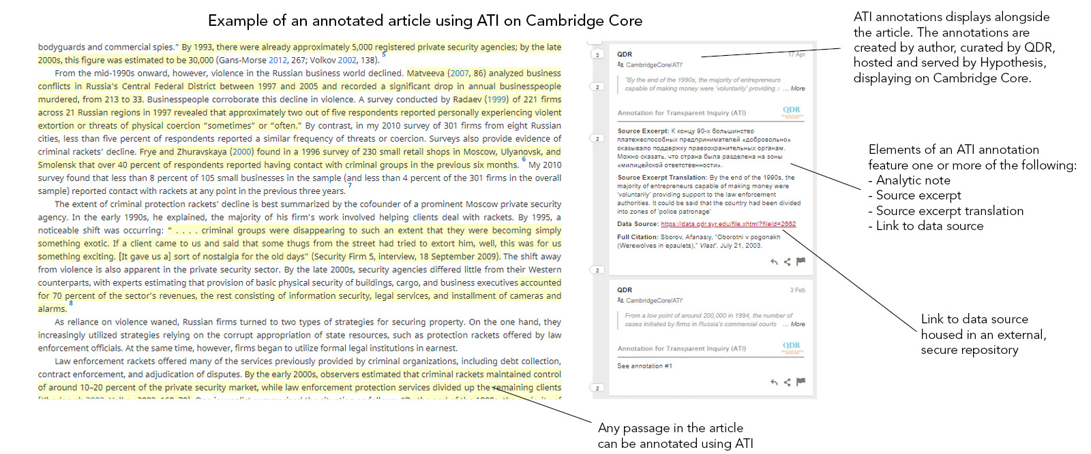
Annotation for Transparent Inquiry
Annotate publications with information about data generation and analysis
Notes:
A third technological solution could be Annotation for Transparent Inquiry (ATI). This is a new tool designed to facilitate transparency in qualitative and mixed-methods research. It allows scholars to “annotate” specific passages in a publication with additional information, explaining how they generated and analysed their data, along with links to a wide variety of underlying data sources. These annotations are displayed alongside their articles on the publisher’s website.

Slide 42
The end

Slide 43
How to proceed ?
Notes:
This slide gives participants a chance to discuss how they would like to proceed with the promotion of FAIR Qualitative Data.

Slide 44



Questions?
www.ru.nl/rdm
Data steward
dcc@ru.nl
Notes:
In case you have questions or need support you can first check out the DCC website of the Radboud University to see if you can find more information. For more specific questions related to your research project it is best to ask your local datasteward, since they have expertise in your field, the practices that are common and the software options that can make your life easier. For questions about specifically this presentation, you can reach out to the Digital Competence Centre via e-mail.

Slide 45
Sources
Slide | Source
Icons | All icons are created by Eucalyp and can be found on www.flaticon.com
7 | Barend, B., Neylon, C., Veltop, J., Dumontier, M, da Silva Santos, L. Wilkinson, M. (2017). Cloudy, increasingly FAIR; revisiting the FAIR Data guiding principles for the European Open Science Cloud. Information Services & Use 37(1): 49-56.
10 | Wilkinson, M., Dumontier, M., Aalbersberg, I. et al. (2016). The FAIR Guiding Principles for scientific data management and stewardship. Scientific Data 3. https://doi.org/10.1038/sdata.2016.18
11 | Jones, S., & Grootveld, M. (2017). How FAIR are your data? Checklist. National Coordination Point Research Data Management. Australian Research Data Commons (2024). FAIR Data Self Assessment Tool. https://ardc.edu.au/resource/fair-data-self-assessment-tool
17 | Research Data Alliance International Indigenous Data Sovereignty Interest Group. (2019). CARE Principles for Indigenous Data Governance. Research Data Alliance International Indigenous Data Sovereignty Interest Group.
21 | Hernández Serrano, P. & Vivas Romero, M (2022) Library Carpentries: “Circular Research Data Bootcamp”. Maastricht University Library. https://maastrichtu-library.github.io/circular-research-data-bootcamp
34 | Barend, B., Neylon, C., Veltop, J., Dumontier, M, da Silva Santos, L. Wilkinson, M. (2017). Cloudy, increasingly FAIR; revisiting the FAIR Data guiding principles for the European Open Science Cloud. Information Services & Use 37(1): 49-56. https://doi.org/10.3233/ISU-170824
35-36 | Verburg, M., Braukmann, R., & Mahabier, W. (2023). Making Qualitative Data Reusable. A Short Guidebook For Researchers And Data Stewards Working With Qualitative Data. DANS.
40 | Berends, H., Pour, K. K., Braukmann, R., Haynes, E., & Deken, F. (2023, October 5). OPEN-QUAL. Innovating Methods for Open Science in Qualitative Management Research. I want to be FAIR - How to deal with my qualitative data?, Rotterdam. https://zenodo.org/doi/10.5281/zenodo.10044494
41 | Cambridge University Press. Annotation for Transparent Inquiry (ATI). https://www.cambridge.org/core/services/authors/annotation-for-transparent-inquiry-ati

