Slide 1
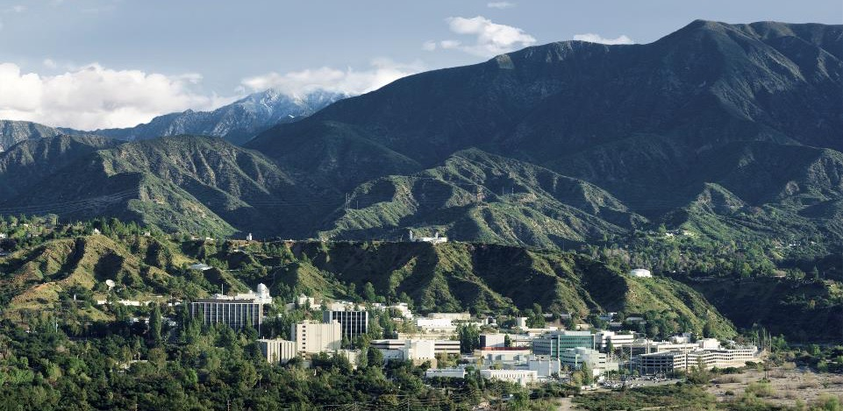
PO.DAAC Virtual Datasets
Michael Gangl, Jet Propulsion Laboratory, California Institute of Technology (michael.e.gangl@jpl.nasa.gov)

Slide 2


Earth Science Data Archive Projected Growth
What’s the Problem?
600
13 new missions
to be added
400
NASA Archive Volume (PB)
FY24:
144.4 PB
200
Current archive holdings continue to grow (~95 missions)
0
2019 2020 2021 2022 2023 2024 2025 2026 2027 2028 2029
Fiscal Year

Slide 3
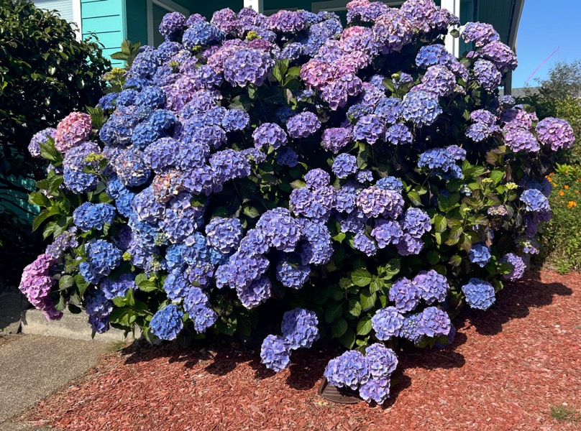


Many Users don’t need ALL the data
Credit to dean.c.henze@jpl.nasa.gov
Notes:
Many users have small, hummingbird bellies and cannot eat too much at once (disk space, processing)
They float around only taking bits and pieces from the right flower, not the entire bush (dataset)

Slide 4
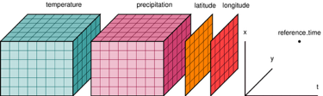

Many Users don’t need ALL the data
VDS
{JSON}
=
https://xarray.dev/
+

Slide 5
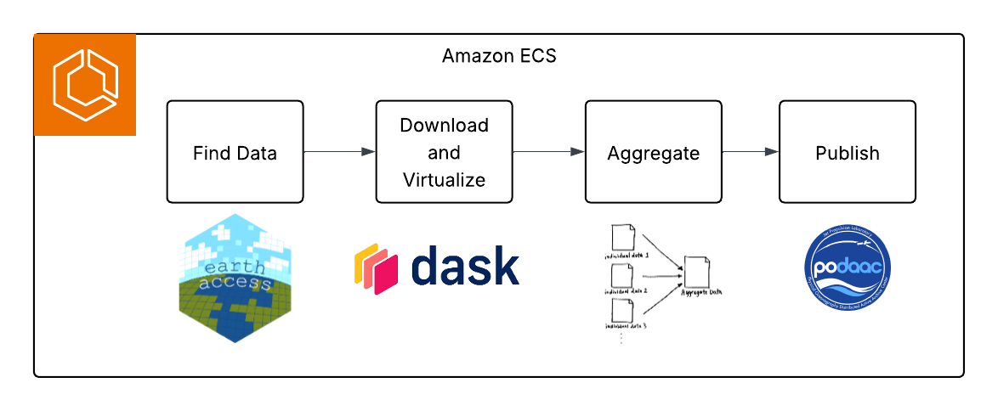
Virtual Dataset Generation
AWS Deployable (Docker + ECR)
Open Source: https://github.com/podaac/virtualzarr-gen
DAAC re-usable ready, easily extensible to ”any” http data
Optional Airflow integration and monitoring
On-going improvements
Icechunk integration for ongoing datasets
Level 2 datasets

Slide 6
Virtual Dataset Generation
We envision this…
Allow us to provide efficient, democratized access to data
Do more with less: Reduce explicit need for tools and services in favor of programmatic access
Move from ‘file based’ operations to collection/dataset level operations
And more… (ask!)
Notes:
And More:
Reduce data egress (e.g. don’t just download a ton of data that isn’t usable)
Infuse into AI and discovery- plot datasets and compare them for regions of interest in real time for user education
Infuse into other tools for visual ‘charting’- e.g. Worldview

Slide 7
Special Thanks
Dean Henze
Ed Armstrong
Celia Ou
Links
User Tutorials: https://podaac.github.io/tutorials/quarto_text/UsingVirtualDatasets.html
Source Code: https://github.com/podaac/virtualzarr-gen

