Slide 1

The Matter of Meta in Research Data Management
Introducing the CESSDA Metadata Office Project
André Förster, GESIS – Leibniz Institute for the Social Sciences Kerrin Borschewski, GESIS – Leibniz Institute for the Social Sciences Sharon Bolton, UK Data Service Taina Jääskeläinen, Finnish Social Science Data Archive Jeannine Beeken, UK Data Service
European DDI User Conference December 3-4, 2019 | Tampere, Finland
This work is licensed under a
Creative Commons 4.0 license.

Slide 2
Research data management and metadata
Increased importance of research data management (RDM), technical requirements most active field, including metadata (German Research Foundation 2013)
Quantitative social sciences established DDI as main standard of metadata documentation (Green & Humphrey 2014, Hoyle et al. 2011; Rasmussen 2014; Vardigan 2014; Vardigan et al. 2008; Zenk-Möltgen 2012)
DDI is an elaborate metadata standard in the social sciences, uptake and application vary between institutions → need for common semantic understanding of metadata issues
Consortium of European Social Science Data Archives – CESSDA (est. 1976, an ERIC since 2017) provides large-scale, integrated and sustainable data services to the social sciences and supports national and international research and cooperation (CESSDA 2019).

Slide 3
CESSDA ERIC and the Metadata Office Project
CESSDA Metadata Office (MDO) project started in 2019
Core conceptual and strategic group consisting of six partner institutions: to maintain and manage CESSDA’s metadata-related assets and tools, monitor metadata developments and the metadata community, support CESSDA SPs to provide and improve metadata
Builds on previous CESSDA projects: CESSDA Metadata Model (CMM), CV Manager (now CESSDA Vocabulary Service or CVS), VOICE (European Language Social Science Thesaurus (ELSST))
Work divided into two ‘Tasks’
Task 1: CESSDA Metadata Model (CMM)
Task 2: CVS (and DDI-CVG), Multilinguality Policy, ELSST, CESSDA Data Catalogue (CDC) (from 2020)
Notes:
Communication, guidance and training needed to promote metadata standards
Integration of smaller archives into the project
Establishment of metadata issue tracking system within CESSDA
Answering metadata related requests from Service Providers, projects etc.
Incorporation of submissions into development and improvement of metadata materials
Cooperation with CESSDA Training pillar
Liaising with metadata experts from other organisations

Slide 4
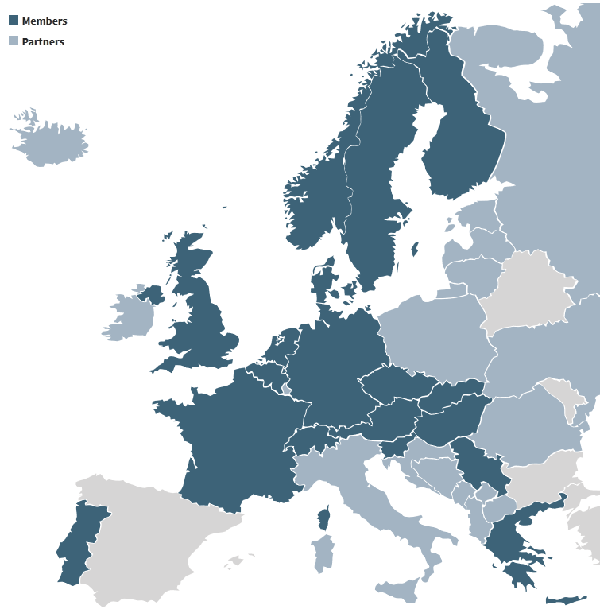






CESSDA Metadata Office Project Partners
DCS
Illustration: pixabay

Slide 5
Task 1: the CESSDA Metadata Model (CMM)
Helps CESSDA SPs make their quantitative social science data more discoverable and comprehensible; based on DDI Lifecycle and accompanied by documentation (Storviken et al. 2019)
Contains metadata elements, definitions, examples of use, information on requirements (mandatories, repeatability, use of controlled vocabularies), DDI X-Paths
Supports multilingualism by providing translated controlled vocabularies (e.g. DDI)
Improved technical representation by developing an XML Schema Definition (XSD) and DDI profiles derived from the CMM (DDI Lifecycle and Codebook – many SPs use Codebook)
Published CMM: https://doi.org/10.5281/zenodo.3236171 User Guide: https://doi.org/10.5281/zenodo.3236193
Notes:
3.2, 2.5 to be added

Slide 6
Covered in the CMM
Study
Persons
Institutions
Dataset
Instrument
Q & A
CMM: https://doi.org/10.5281/zenodo.3236171
User Guide: https://doi.org/10.5281/zenodo.3236193
Concepts
Documents
DDI-L Resource Package
Publications
Group Studies
Doc Descript.
Notes:
The spreadsheet covers:
Information on Study – general (ID), bibliographic (title, principle investigator), PIDs & Versioning (resource type, version number), further contributor (person name, institution), content information (abstract, classification, keywords), methodical information (study area, survey period), legal information (access information), related resources (literature),
Information on Person – general (ID, name)
Information on Institution – general (ID, name, contact)
Information on Dataset – general (ID), content information (description, name), technical information (file size, file format), variables (name, label, value, show cards, variable group)
Information on survey instrument – content information, technical information (file size, file format)
Information on Question and Responses– general (question text, label), answers (answer list, answer value)
Information on Concepts – general (name, label, description etc.)
Information on Group of Studies – general (ID, name)
Information on Further Documents - general (ID), content information (name)
Information on Literature – general (author, year, publisher)
Information on Document Description – general (title, date)
The CMM Metadata Schema structure is based on the principle for reusibility of metadata elements. To do this, we are using the DDI Lifecycles possibilities for referencing and re-using information. Whereever possible, we used elements within ResourcePackage.
(A resource package is a means of packaging any maintainable that is not being published as part of a StudyUnit or Group. ResourcePackage structures materials for publication that are intended to be reused by multiple studies such as various schemes and modules. Note that the modules StudyUnit, Group, and PhysicalInstance cannot be published as resources packages. StudyUnit and Group are packaging structures in and of themselves and therefore do not require ResourcePackage for publication. PhysicalIntance cannot be reused as it is the metadata for a specific external data file and its identical copies. Data that is published inline as either DataSet or PhysicalDataStructure_NCube_Inline could be published an object within a RecordLayoutScheme as both of these structures are substitutions for the RecordLayout structure that comprises the contents of a RecordLayoutScheme.)

Slide 7
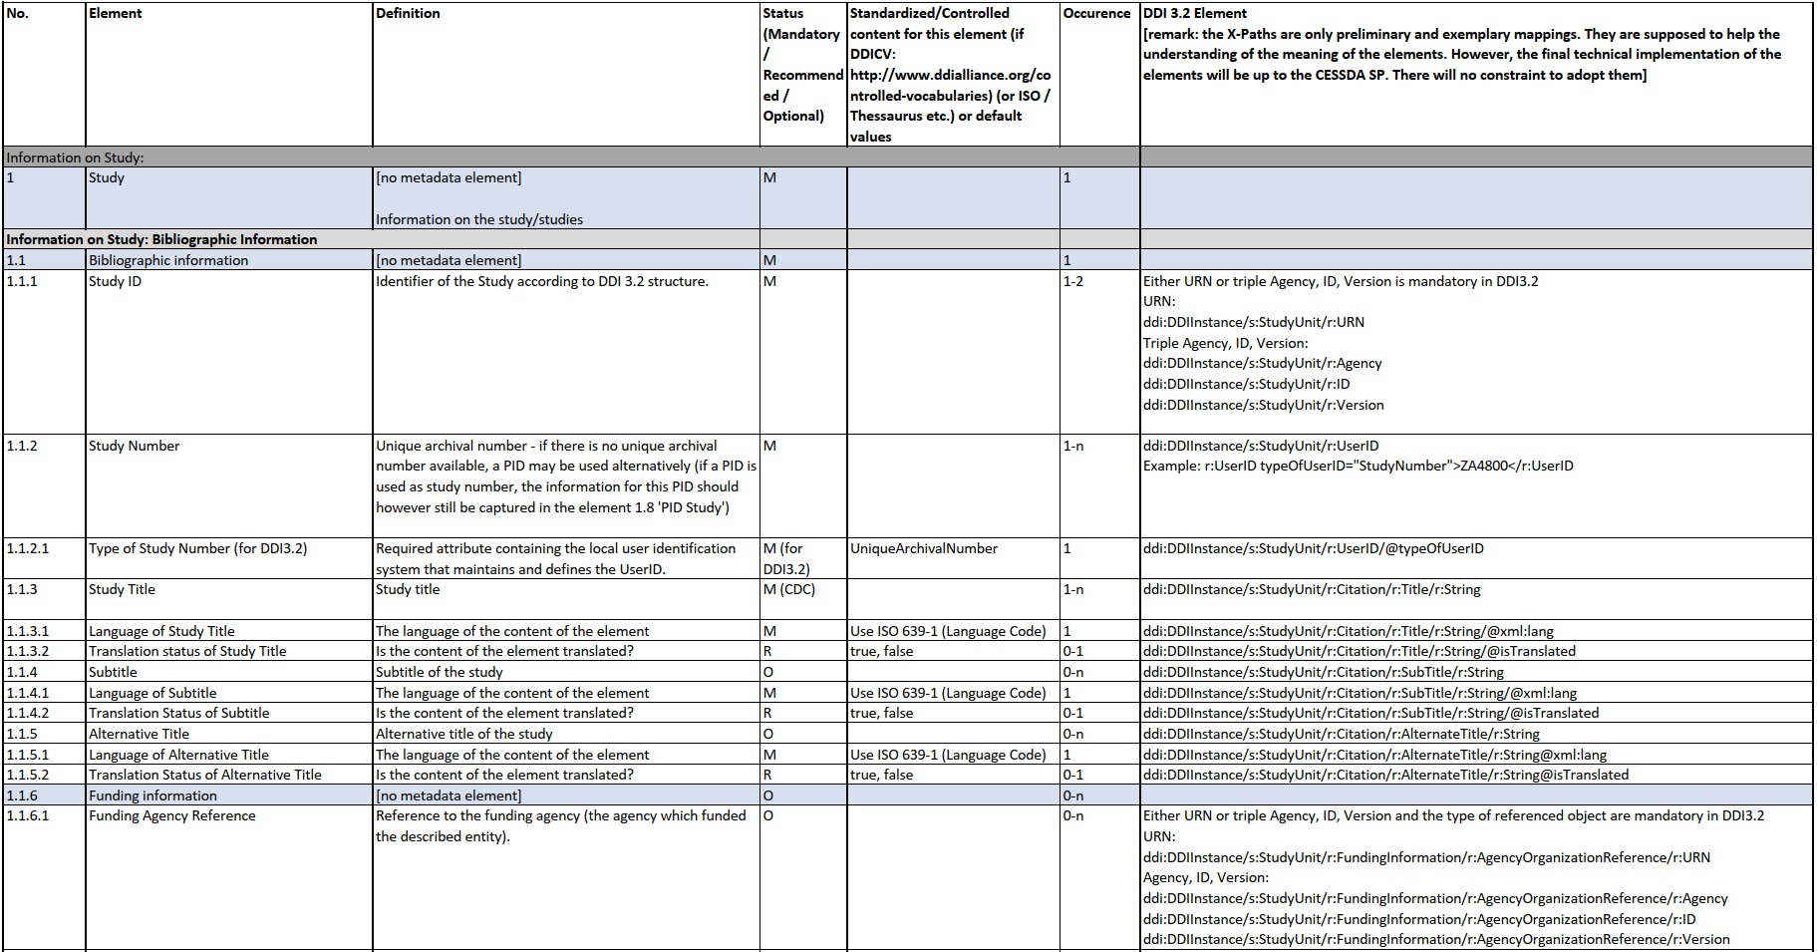
The CESSDA Metadata Model (CMM)
Characteristics of the CMM elements. Note that only a selection of elements is shown.

Slide 8
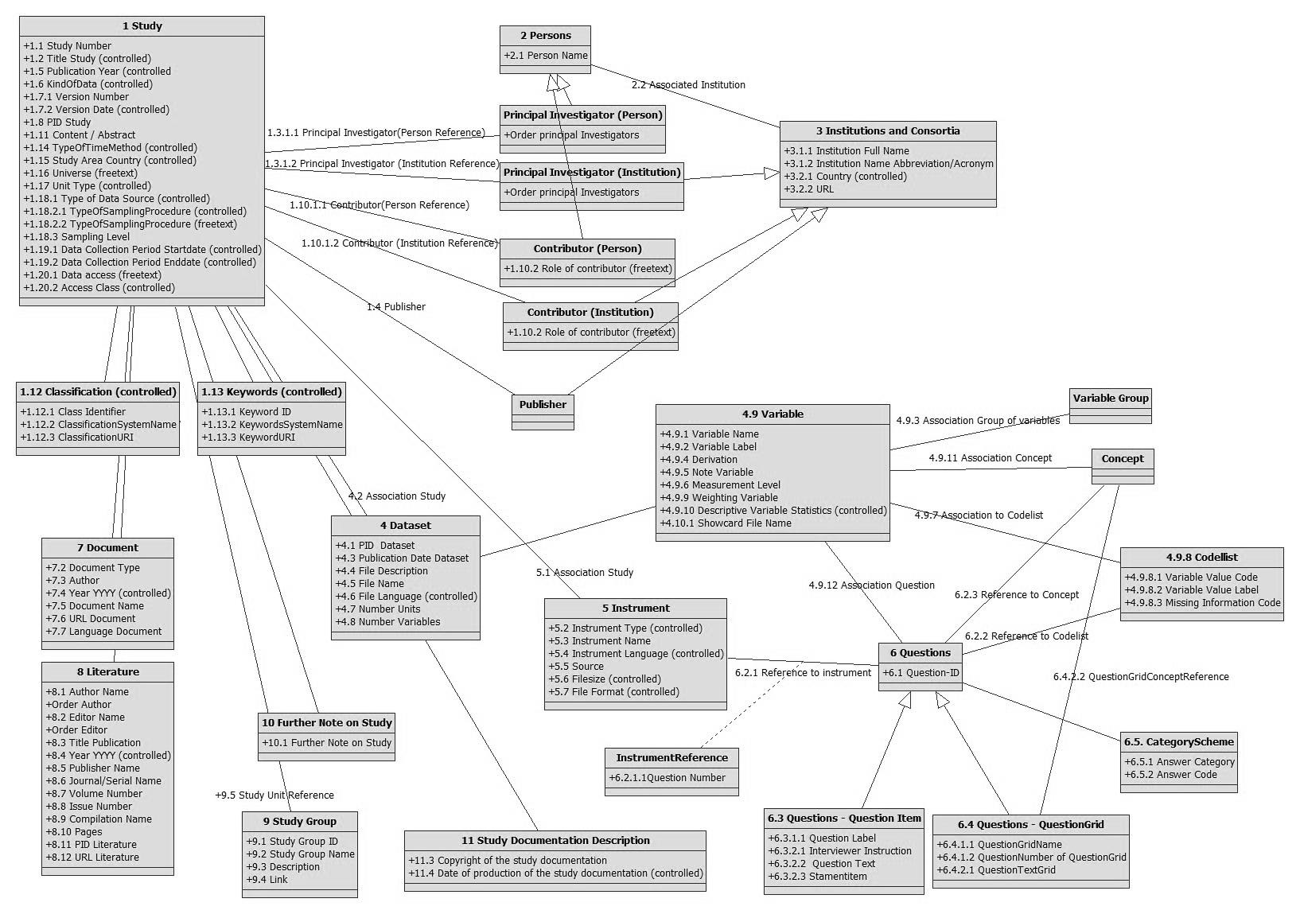
The CESSDA Metadata Model (CMM)

Slide 9
Task 2: the CESSDA Vocabulary Service
CESSDA Vocabulary Service (CVS): user-friendly source of standardised controlled vocabularies (search and browse, download in different formats including SKOS, REST API)
Vocabulary management done in CVS Editor, accompanied by extensive training
CVS ensures systematic metadata and description for data assets
Collaboration with DDI Alliance Controlled Vocabularies Group (DDI-CVG) – uses CVS Editor to manage its vocabularies and translations
https://vocabularies.cessda.eu/#!discover

Slide 10
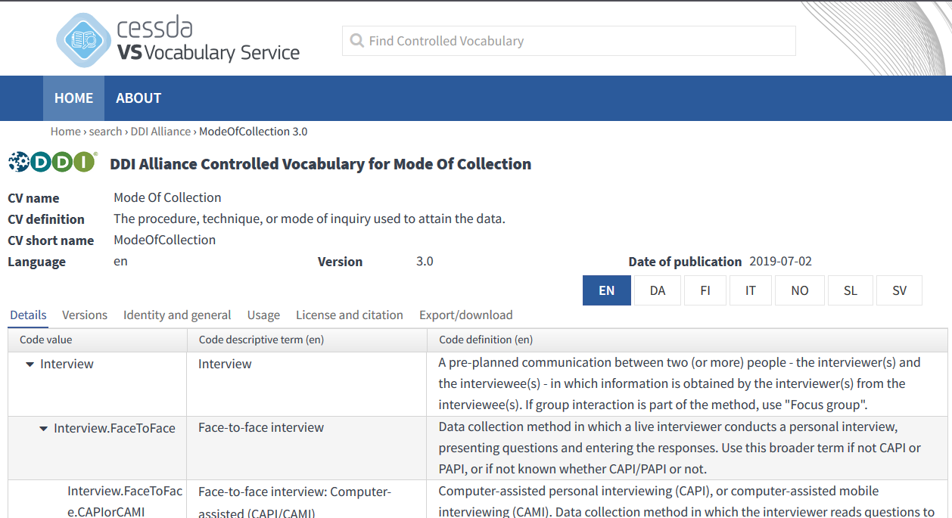
Detailed view of a specific vocabulary

Slide 11
Task 2: the European Language Social Science Thesaurus (ELSST)
Broad-based, multilingual thesaurus for the social sciences
Currently available in 14 languages, maintained within the Metadata Office, in close cooperation with expert translators
Regular updates to improve functionality, currency and utility
Provides an indexing resource for data producers to aid in the curation and publishing of their data
Moving to a new platform in 2020, improved SKOS, mapping and Linked Open Data facilities

Slide 12
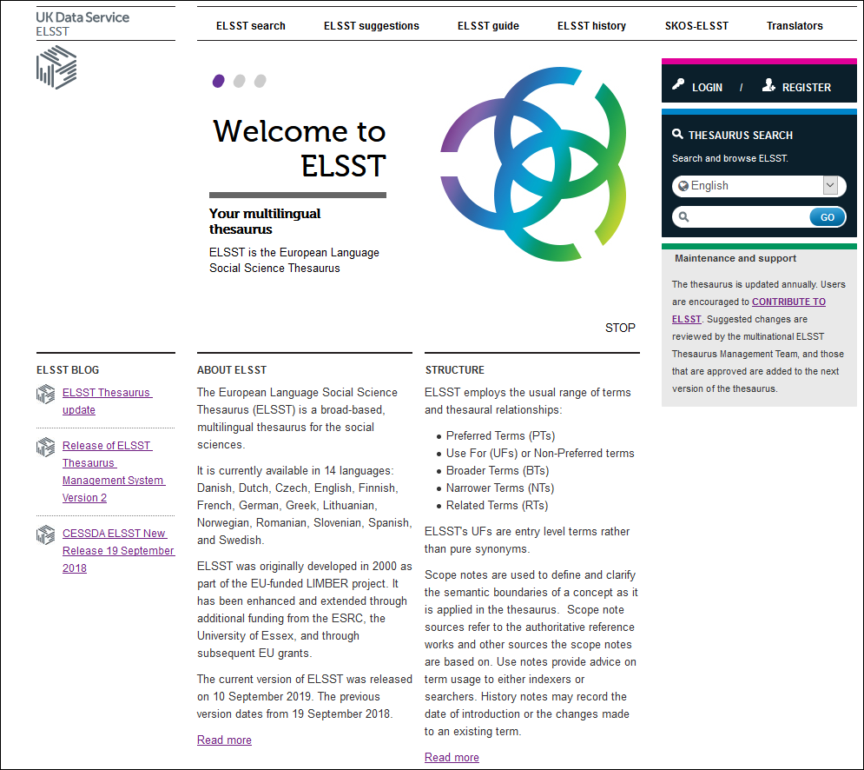

Slide 13
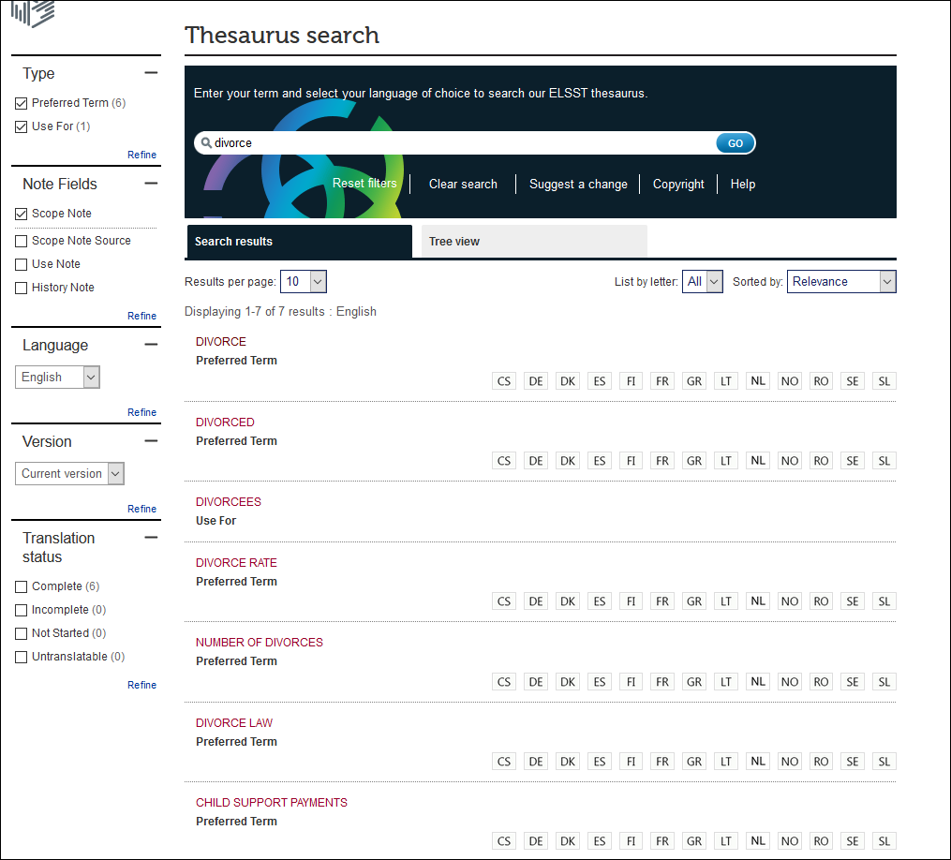

Slide 14
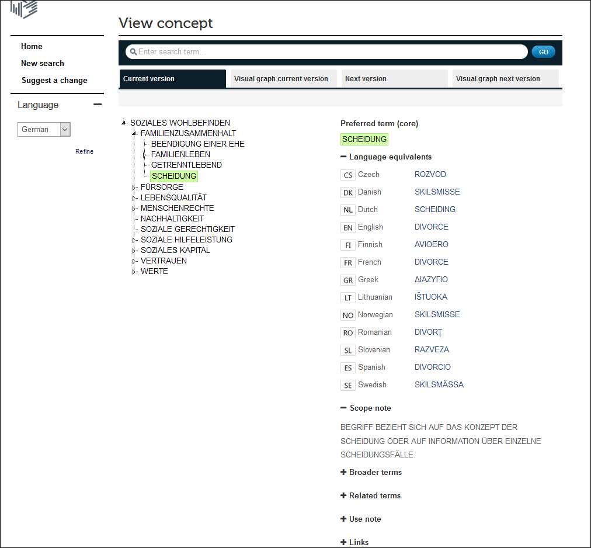

Slide 15
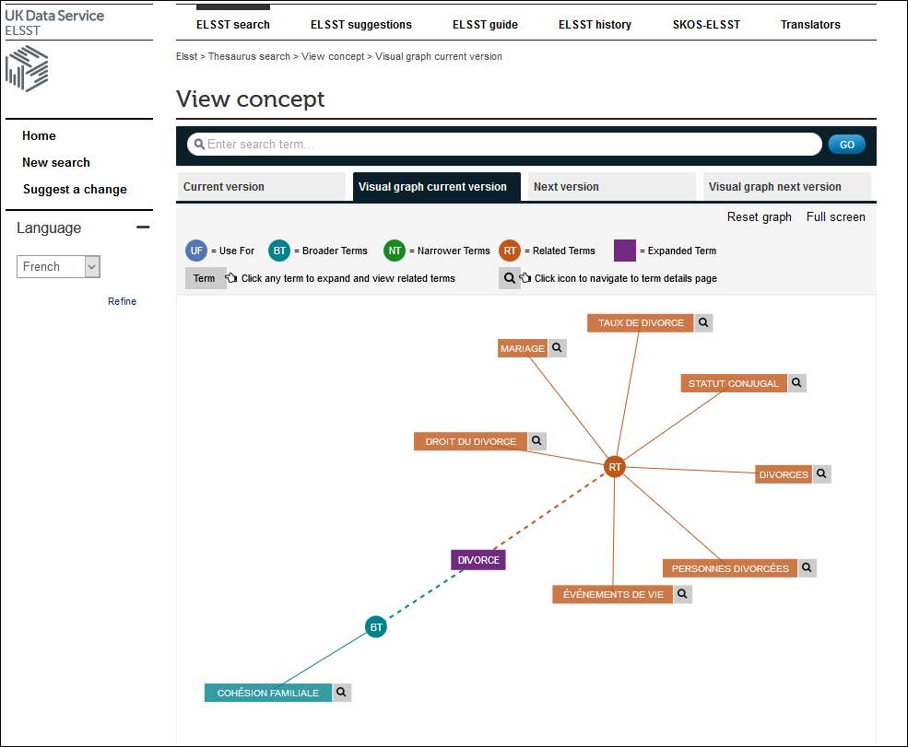

Slide 16
Task 2: the CESSDA Data Catalogue
CESSDA Data Catalogue (CDC) is ‘a a one-stop shop for search and discovery of social science and humanities research data’: https://datacatalogue.cessda.eu/
Now part of EOSC Marketplace, high international visibility: https://marketplace.eosc-portal.eu/services/cessda-data-catalogue
Will include records from organisations outside CESSDA
Improve usability by helping participating SPs and other contributors refine and validate their metadata against DDI profiles for CDC harvesting
Track metadata issues, advise and support contributors, establish CDC user group

Slide 17
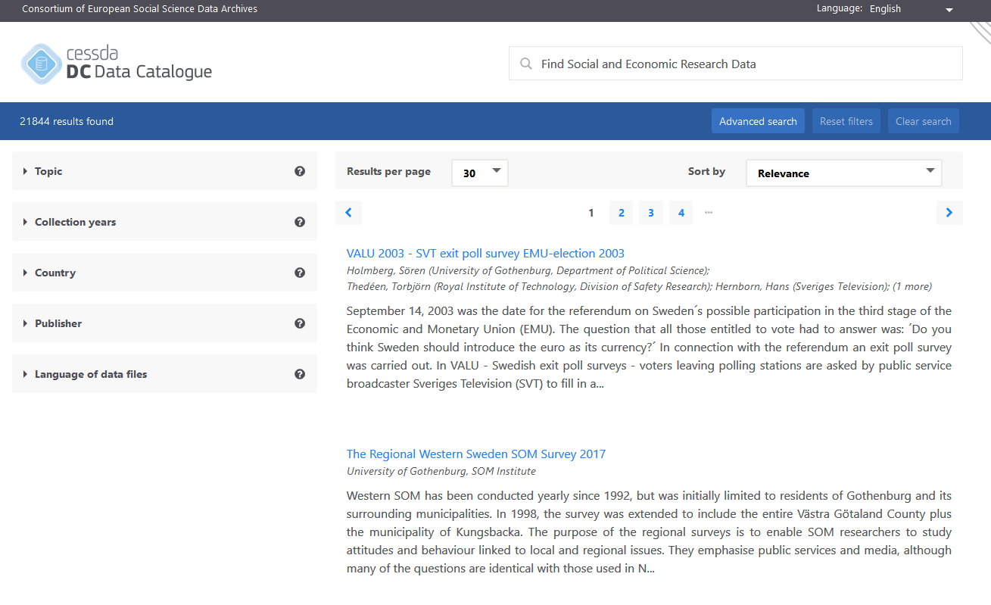

Slide 18
Future plans
Extensive summary of various metadata developments in consortia, institutions and projects
Metadata survey
Further alignment with FAIR principles and Core Trust Seal
Promote the CMM and support CESSDA SPs in its use
Support and enhance CESSDA metadata tools and assets
Exploration of DDI 4

Slide 19
Thank you.
This work is licensed under a Creative Commons 4.0 license.

Slide 20
References
Deutsche Forschungsgemeinschaft (DFG) (2013): Vorschläge zur Sicherung guter wissenschaftlicher Praxis. Proposals for Safeguarding Good Scientific Practice. Available online at https://www.dfg.de/download/pdf/dfg_im_profil/reden_stellungnahmen/download/empfehlung_wiss_praxis_1310.pdf, checked on 7/18/2019.
Hoyle, Larry; Castillo, Fortunato; Clark, Benjamin; Kashyap, Neeraj; Perpich, Denise; Wackerow, Joachim; Wenzig, Knut (2011): Metadata For The Longitudinal Data Life Cycle. Available online at http://www.ddialliance.org/sites/default/files/MetadataForTheLongitudinalDataLifeCycle.pdf, checked on 8/7/2019.
Storviken, Silje; Hagen, Sunniva; Bockaj, Brigita; Bolko, Irena; Vipavc Brvar, Irena; Fink Kjeldgaard, Anne Sofie et al. (2019): User Guide for the CESSDA Metadata Model. Available online at https://zenodo.org/record/3236194#.XbLyP6_gqHs , checked on 25/10/2019.
Vardigan, Mary (2014): The DDI Matures: 1997 to the Present. In IASSIST Quarterly, pp. 45–50. Available online at https://iassistquarterly.com/pdfs/iqvol371_4_vardigan.pdf, checked on 7/19/2019.
Vardigan, Mary; Heus, Pascal; Thomas, Wendy (2008): Data Documentation Initiative: Toward a Standard for the Social Sciences. In International Journal of Digital Curation 3 (1), pp. 107–113. DOI: 10.2218/ijdc.v3i1.45.
Zenk-Möltgen, Wolfgang (2012): Metadaten und die Data Documentation Initiative. In R. Altenhöner, C. Oellers (Eds.): Langzeitarchivierung von Forschungsdaten. Standards und disziplinspezifische Lösungen. Berlin: Scivero, pp. 111–126. Available online at https://www.ssoar.info/ssoar/bitstream/handle/document/46679/Zenk-Moeltgen_Metadaten%20und%20die%20Data%20Documentation%20Initiative.pdf?sequence=1, checked on 8/7/2019.

