Slide 1

SSHOC metadata interoperability aspects
Mari Kleemola, CESSDA/FSD, Tampere University, SSHOC WP3
Realising the European Open Science Cloud conference
17 November 2020

Slide 2








Project:
Type of action & funding:
Research and Innovation action
(INFRAEOSC-04-2018)
Partners: 45 (20 beneficiaries + 25 LTPs)
SSH ESFRI Landmarks and Projects & international SSH data infrastructures
Project budget: € 14,455,594.08
Project website: www.SSHopencloud.eu
Duration: 40 months (January 2019 – 30 April 2022)
Objectives:
creating the social sciences and humanities (SSH) part of European Open Science Cloud (EOSC)
maximising re-use through Open Science and FAIR principles (standards, common catalogue, access control, semantic techniques, training)
interconnecting existing and new infrastructures (clustered cloud infrastructure)
establishing appropriate governance model for SSH-EOSC

Slide 3
Metadata format diversity within SSH
Metadata: data used to describe, to give a meaning to other data (research data) so that we can take action on it; these actions may be human or machine mediated.
SSHOC metadata landscape is heterogeneous: in our interviews, 19 metadata standards were explicitly mentioned as being used.
When asked to limit to the two most important metadata standards, the informants still gave 11 different standards.
Broeder, Daan, Trippel, Thorsten, Degl'Innocenti, Emiliano, Giacomi, Roberta, Sanesi, Maurizio, Kleemola, Mari, … Ďurčo, Matej. (2019). SSHOC D3.1 Report on SSHOC (meta)data interoperability problems (Version v1.0). Zenodo. https://doi.org/10.5281/zenodo.3569867

Slide 4
The use cases
Domain, community or discipline specific use of data (R in FAIR)
Need expressive metadata standards with high level of detail tailored to local needs
Inter-disciplinary or discovery across systems (F and I in FAIR)
simple, clear metadata with high level of granularity (study or collection level)
Interestingly, there seems to be no “middle ground”
SSHOC recommendation is to use both: domain-specific standards for expressivity and common standards for data findability and basic interoperability

Slide 5
SSHOC Recommended standards by domain/community
All | Dublin Core, relaxed* DataCite
Social Sciences / CESSDA, ESS, SHARE | DDI Codebook, DDI Lifecycle
Heritage Sciences / E-RIHS | CIDOC-CRM (and its extensions, especially PEM)
Language Sciences / CLARIN | CMDI
Arts and Humanities / DARIAH | CIDOC-CRM (and its extensions), EDM, TEI (teiHeader)
* with the relaxation of the rule of the accepted PID types so that ARK, Handle, PURL, URN and URL are acceptable in addition to DOI (as in OpenAIRE)
In addition, recommended format for expressing vocabularies: SKOS

Slide 6
Challenges
Deviations from standards
Different “dialects” especially when standard is flexible
Mapping between standards is not straightforward
Loss of information in conversing from one standard to another
Non-compatibility with older versions of standards
Boundary of data and metadata can be unclear and depend on the actor’s perspectives

Slide 7
SSHOC Task 3.5 take on interoperability
Our approach: pragmatism
Accept the diversity
Focus on metadata formats (syntactic interoperability)
Find conversions solutions that are useful for researchers especially in a cross-disciplinary research setting

Slide 8
Forthcoming: Conversion Hub
Data format and metadata format conversions for SSH research
Based on inventory of existing interoperability solutions (MS14, June 2020)
Inventory contains 44 solutions:
Accessible, ready-to-use conversion services
Installable software
Recipes (complex solutions)
Solutions will be described with a number of attributes mostly from schema.org (and mapped to SSCHOro)
SSHOC Switchboard can provide support in building up conversion paths and managing adaptations in-between, e.g. if a conversion service does not exist or is broken.

Slide 9
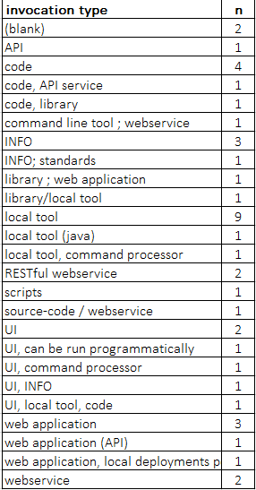
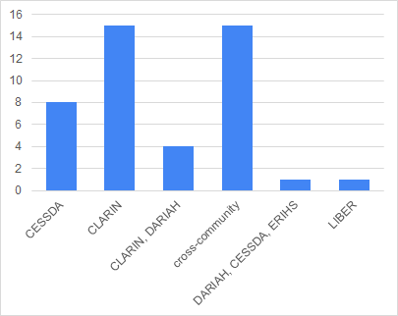
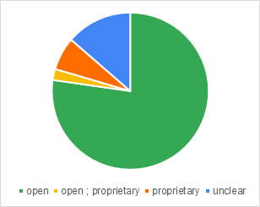
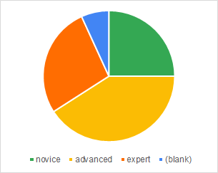
Conversion Hub solutions overview

Slide 10
The final selection of new solutions to be developed by T3.5 will depend on the gaps, the priorities, and on the resources the partners have available.
Currently planned: CMDI/DDI,recipe around X3ML Toolkit, DDI/standards within history, agriculture and possibly natural sciences, DDI MetadataTransform update

Slide 11
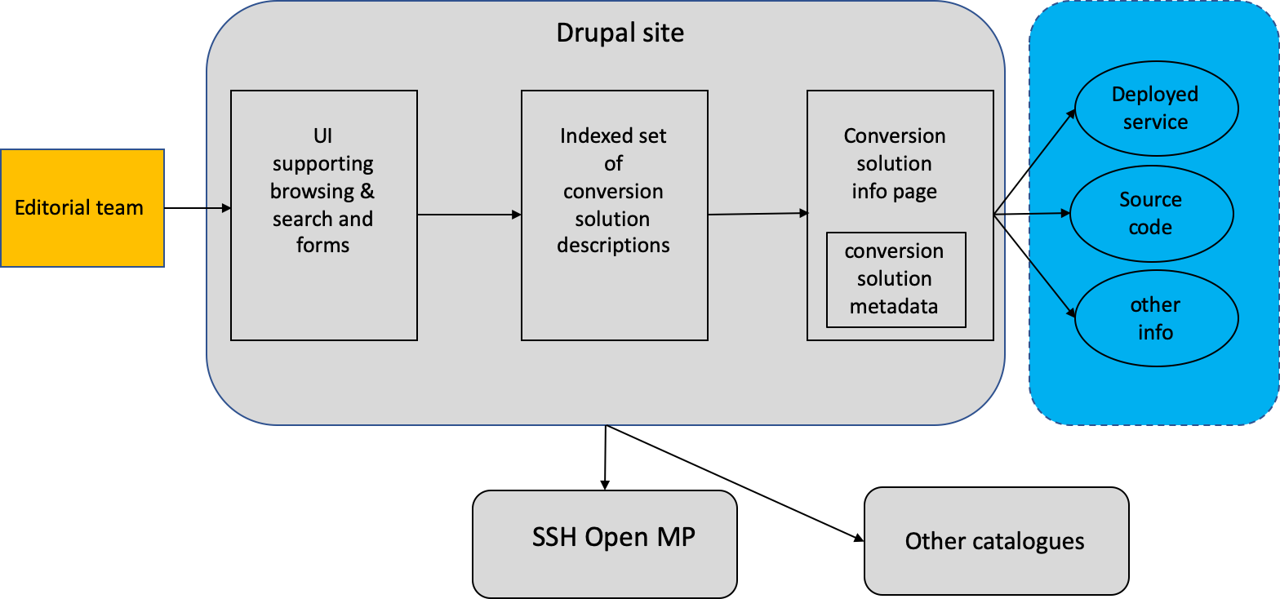
Conversion Hub Architecture

Slide 12
Metadata with respect to SSHOC Marketplace
(this slide by Klaus Illmayer, DARIAH/OEAW, SSHOC WP7)
Scope of SSHOC Open Marketplace
Collect metadata on tools, service, training material, workflows, datasets, publications (= items): a metadata catalogue by its own
Addresses researchers from the humanities and social sciences
Aims to support the usage of digital methods and allow to discover/point to (new) tools/approaches/findings
Rely on curated items: Curators generate high-quality metadata based on initial ingestions from sources (amongst others: metadata catalogues)
Relate items with each others, e.g.:
Ingest a list of tools
Ingest publications and relate to tools: if a tool is mentioned in a publication create a relation
Enrich items (by using different sources), e.g. identify research community where an item belongs to or is used

Slide 13
SSHOC Task 3.5 next steps
Define a template for ‘recipes’ i.e. the descriptions of more complex (multi-tool/service/locally deployed source code) workflows.
Provide Conversion Hub using the same technological solution as the SSHOC training toolkit: Drupal 9 and its ecosystem Search API.
Plan and organise both technical maintenance (Drupal) and content maintenance (the descriptions).
Develop new solutions depending on gaps, priorities and resources.

Slide 14




Thank you for your attention!
mari.kleemola@tuni.fi
Join our community
https://www.sshopencloud.eu
@SSHOpenCloud
info@sshopencloud.eu
/in/sshopencloud

