Slide 1
BAD RESOLUTION
doi:
Unresolving PIDs in the wild and how to catch them Nic Weber • Sebastian Karcher • Jim Myers Qualitative Data Repository

Slide 2
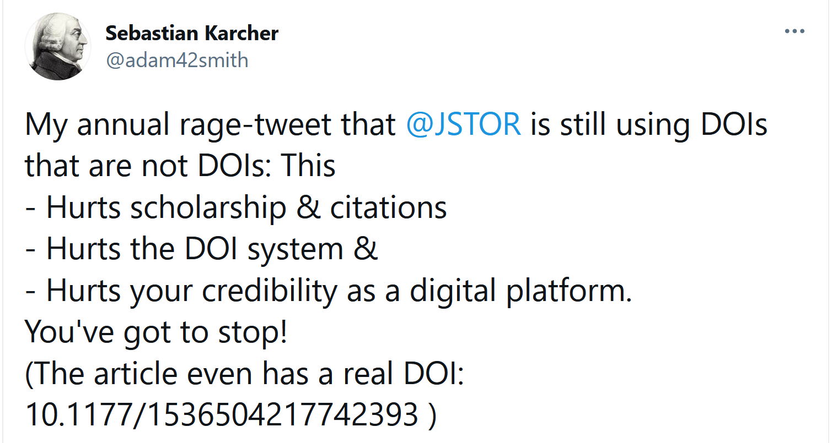

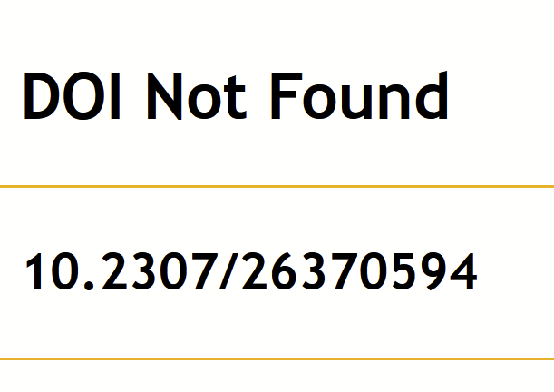
WHEN DOIs FAIL…

Slide 3
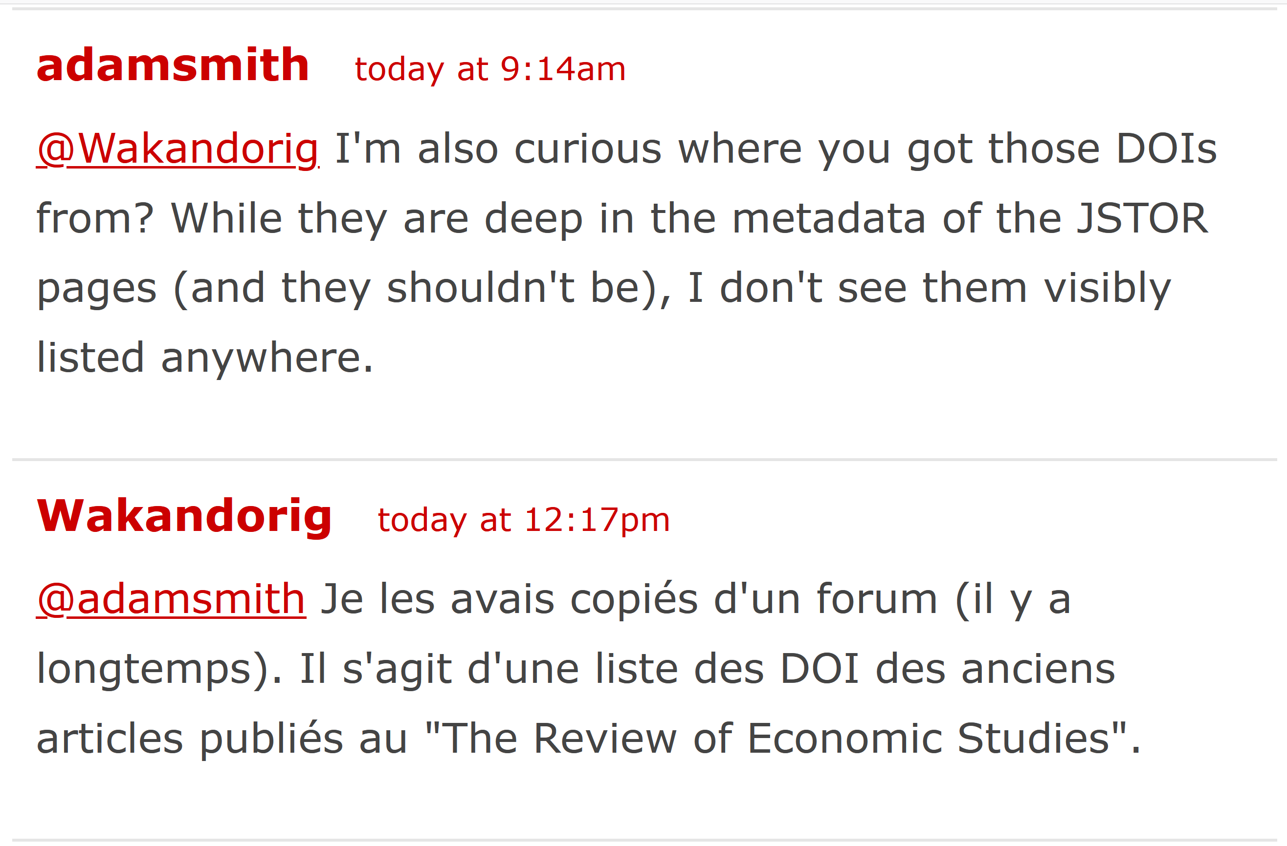
THE DAMAGE IS PERMANENT

Slide 4
WHAT ARE YOUR PID HORROR STORIES?

Slide 5





IT COULD HAPPEN TO YOU (it certainly did to us)

Slide 6
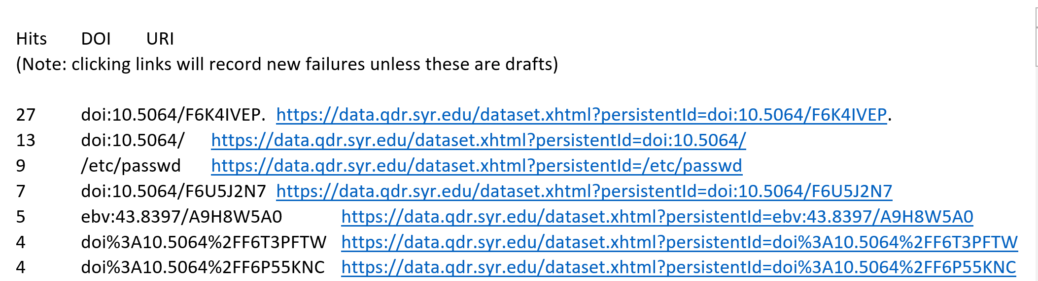
HOW TO CATCH A PID
STEP 1: CHECK YOUR LOGS

Slide 7
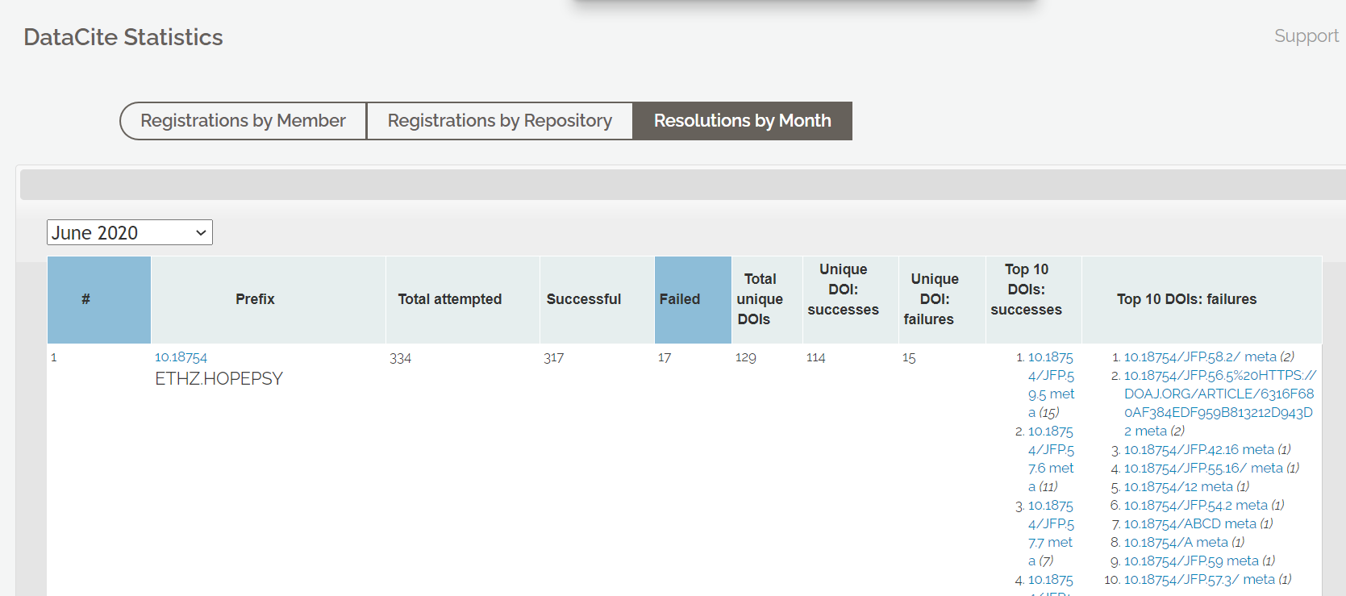
HOW TO CATCH A PID
STEP 2: CHECK YOUR PREFIX https://stats.datacite.org/resolutions.html#tab-resolution-report

Slide 8
CAUSES & CAUTIONS
Reserved and unpublished PIDs
URLs instead of PIDs
Using PIDs internally

Slide 9
TOWARDS BEST PRACTICES
REPOSITORIES
Active monitoring
Warn that DOIs are unpublished
Don’t use DOIs that aren’t DOIs
EVERYONE
Report broken PIDs. It works

