Slide 1
A recommendation to the SSH community: take a linguist on board
Jeannine Beeken

Slide 2
Overview
Human communication: non-verbal/verbal
Verbal communication: oral vs. written
Key challenges for linguistic/AI tools
Separate and Disambiguate
Cluster/Group and Extend
Control and Reduce
https://iassistquarterly.com/index.php/iassist/article/view/992

Slide 3
Verbal vs. non-verbal
Verbal: spoken (sounds) vs. written (silent)
Non-verbal: body language, symbols (silent)
Examples:
Silent films www.youtube.com/watch?v=4QrR_1NW_w4
Triple/quadruple negation ‘no’ or ‘stop’
Onomatopoeia: baby crying, rooster https://en.wikipedia.org/wiki/Cross-linguistic_onomatopoeias

Slide 4

Verbal communication: oral vs. written
Spelling: punctuation, uppercase, diacritics
Your name with/without uppercase
V. Borge phonetic punctuation https://www.youtube.com/watch?v=TIf3IfHCoiE
Homophones: seas/sees/seize; nun/none grease/Greece; knows/noes/nose
Homographs: minute, lead, object, tear
Homophone + homograph: arms, ball, spring, duck, watch, ring

Slide 5
Challenge 1 for linguistic/AI tools Separate and Disambiguate
Tokenizer (1), sentence splitter (2), POS tagger (3) parser (4), NER (5), WSD (6)
we/are, its, it/’s, were not, were/n’t
No, no!/I said: “I repeat: Stay, please.“
murder, answers, fish, whisper, clean
(the old car) (has been sold) (in Rome)

Slide 6
Challenge 1 for linguistic/AI tools: Separate and Disambiguate
5) Paris Jackson, WHO, 9 July 2019, £1, 99%
6) homonyms and polysemes (40%)
social: socialism/social media
GUS, WAS, CLOSER
Dr Black received black money to re-create the black death using black widows. Everything went black then.

Slide 7
Challenge 2 for linguistic/AI tools Cluster-Group and Extend
Spellchecker (1), lemmatizer (2), synonym ring (3) MWE (4), co-referencing (5)
labour/labor, licence/license, travel(l)er
tax/taxation/*taxis; children/childish; am/are/was/were/been; catch/caught
pretty/beautiful/attractive; pound/quid/ sterling/roll/dough/moolah/loot/dosh

Slide 8
Challenge 2 for linguistic/AI tools: Cluster-Group and Extend
Spell checker (1), lemmatizer (2), synonym ring (3) MWE (4), co-referencing (5)
4) with regard to, lily of the valley, buy time, barking up the wrong tree, having a ball
5) Warren already arrived. The presidential
candidate was accompanied by her son./
Jamaica is my home, Jamrock. I am a Yardie.

Slide 9
Challenge 3 for linguistic/AI tools: Control and Reduce
Stopwords (1), summarizers (2), keyword extraction (3)
a, an, the, in, of, I, you, going, become, was, would, can, and, or, which (160+)

Slide 10
Challenge 3 for linguistic/AI tools: Control and Reduce
Based at the University of Essex, we are the lead partner of the UK Data Service, providing researchers with support, training and access to the
UK’s largest collection of social, economic and population data. Funded by
UK Research and Innovation, through the Economic and Social Research Council, we provide a Trusted Digital Repository for national data resources including many surveys conducted by the Office for
National Statistics, national centres for social research and Census
data. (https://www.data-archive.ac.uk/about/)
2) Keywords: data/repository/innovation/ researchers/surveys/centres/resources/access/ national statistics/uk (http://www.cortical.io/extract-keywords.html)

Slide 11
Challenge 3 for linguistic/AI tools: Control and Reduce
3) Summary
Funded by UK Research and Innovation, through the Economic and Social Research Council, we provide a Trusted Digital Repository for national data resources including many surveys conducted by the Office for National Statistics, national centres for social research and Census data (http://esummarizer.com/main/summarize)

Slide 12
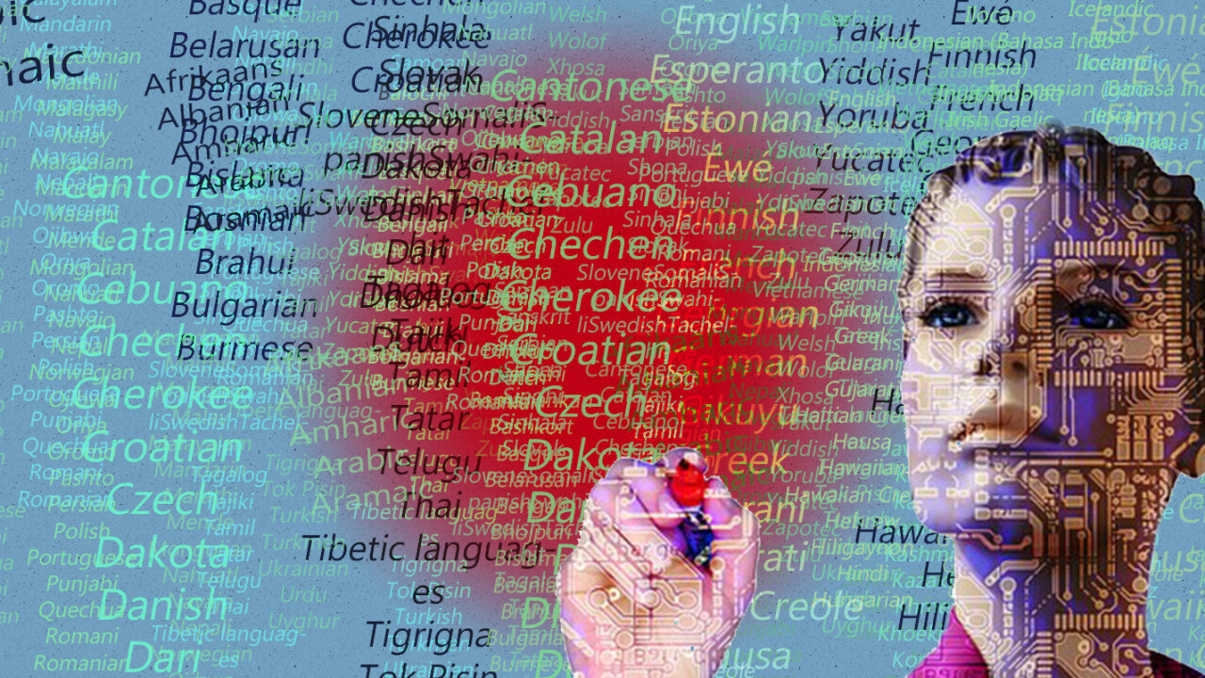
Conclusion: WE NEED YOU, AI

Slide 13
Thank you
Jeannine Beeken jeannine.beeken@essex.ac.uk
data-archive.ac.uk

