Slide 1

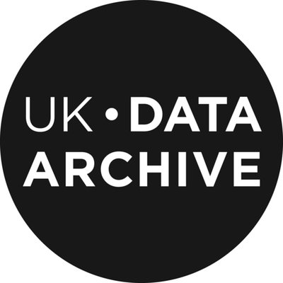
Increasing the ReUse of Data through FAIR enabling Certification of Trustworthy Digital Repositories
Benjamin Mathers
UK Data Archive
Hervé L’Hours
UK Data Archive
FAIRsFAIR WP4 team:
Maaike Verburg, Robert Huber, Jerry de Vries, Kevin Ashley, Joy Davidson, Margarita Trofimenko, Marjan Grootveld, Olivier Rouchon, Patricia Herterich, Robert Ulrich, Anusuriya Devaraju, Sarala Wimalaratne, Tina Dohna.
FAIRsFAIR “Fostering FAIR Data Practices In Europe” has received funding from the European Union’s Horizon 2020 project call H2020-INFRAEOSC-2018-2020 Grant agreement 831558

Slide 2



FAIR Data, TDR Standards and Data ReUse
The ReUsability of data is a key component within the FAIR Data Principles and a number of formal Trusted Digital Repository (TDR) certifications.
Examples of standards bodies providing TDR certification that addresses the ReUsability of Data, include:
The CoreTrustSeal
© Marjan Grootveld
ISO 16363
The nestorSeal
FAIRsFAIR “Fostering FAIR Data Practices In Europe” has received funding from the European Union’s Horizon 2020 project call H2020-INFRAEOSC-2018-2020 Grant agreement 831558
Notes:
Wilkinson et al. (2016) The Fair Guiding Principles for scientific data management and stewardship, Scientific Data, doi:10.1038/sdata.2016.18
CoreTrustSeal (2022), About. Retrieved from: https://www.coretrustseal.org/about/
ISO 16363 (2022), Home. Retrieved from: http://www.iso16363.org/
nestorSeal (2022), nestorSeal for Trustworthy Digital Archives. Retrieved from: https://www.langzeitarchivierung.de/Webs/nestor/EN/Zertifizierung/nestor_Siegel/siegel.html

Slide 3
Data ReUse and the CoreTrustSeal
The CoreTrustSeal focuses on 16 ‘Core Requirements’ covering Organizational Infrastructure, Digital Object Management and Technical Provision.
The ReUsability of data is specifically addressed in Requirement 14 (‘Data ReUse’) of the CoreTrustSeal.
To achieve a Compliance Level 4 for ‘Data ReUse’, the applicant must provide evidence of:
Appropriate metadata provision in-line with the needs and expectations of the Designated Community;
Fully implemented processes designed to mitigate format obsolescence;
an in-depth knowledge of data reuse scenarios to ensure the continued understandability of data.
FAIRsFAIR “Fostering FAIR Data Practices In Europe” has received funding from the European Union’s Horizon 2020 project call H2020-INFRAEOSC-2018-2020 Grant agreement 831558
Notes:
CoreTrustSeal Standards and Certification Board (2019). CoreTrustSeal Trustworthy Data Repositories Requirements: Extended Guidance 2020–2022 (v02.00-2020-2022). Retrieved from: https://doi.org/10.5281/zenodo.3632533

Slide 4

CoreTrustSeal, FAIR Data and the European Open Science Cloud
The value of CoreTrustSeal certification in providing assurance that data and metadata become, and remain, FAIR over time has also been recognised by projects such as the European Open Science Cloud (EOSC).
The EOSC aims to provide the research community with access to FAIR data and interoperable data services.
The EOSC has sought to align its practice, and the practice of participating institutions, with the CoreTrustSeal Requirements to ensure the Trustworthy storage of FAIR data.
FAIRsFAIR “Fostering FAIR Data Practices In Europe” has received funding from the European Union’s Horizon 2020 project call H2020-INFRAEOSC-2018-2020 Grant agreement 831558
Notes:
European Open Science Cloud (2022). EOSC. Retrieved from: https://eosc-portal.eu/about/eosc/

Slide 5

The FAIR Data Principles
First formally conceptualized in 2014 following the original Lorentz Workshop entitled, ‘Jointly Designing a Data FAIRport’.
Many of the requirements listed in the CoreTrustSeal Extended Guidance address the FAIR Data Principles indirectly, but there is currently no formal ‘FAIR Certification’ offered by the CoreTrustSeal or other Trusted Digital Repositories standards bodies.
FAIRsFAIR “Fostering FAIR Data Practices In Europe” has received funding from the European Union’s Horizon 2020 project call H2020-INFRAEOSC-2018-2020 Grant agreement 831558
Notes:
Lorentz Center (2014). Jointly Designed a data FAIRPORT. Retrieved from: https://www.lorentzcenter.nl/jointly-designing-a-data-fairport.html/

Slide 6
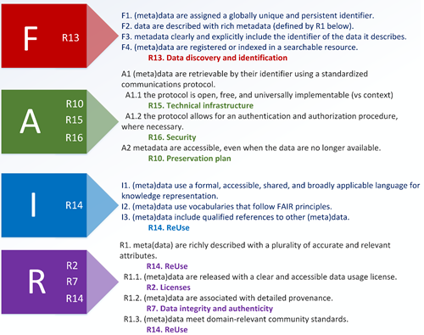
CoreTrustSeal+FAIRenabling Capability Maturity Model
The FAIRsFAIR project has developed the CoreTrustSeal+FAIRenabling Capability Maturity model (CTS+FAIR CapMat) which aligns the CoreTrustSeal Requirements and the FAIR Data Principles via a detailed mapping of the two.
FAIRsFAIR “Fostering FAIR Data Practices In Europe” has received funding from the European Union’s Horizon 2020 project call H2020-INFRAEOSC-2018-2020 Grant agreement 831558
Notes:
L'Hours, H. et al. (2022). D4.6 Report on a maturity model towards FAIR data in FAIR repositories (Version 2.0). Retrieved from: https://doi.org/10.5281/zenodo.6090389

Slide 7
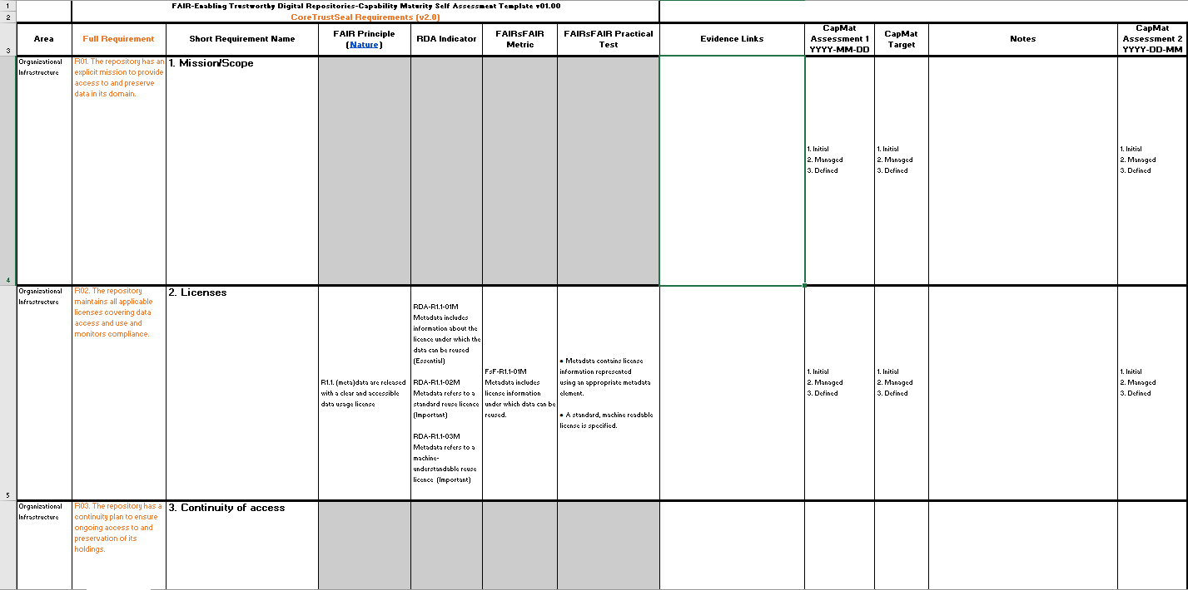
FAIR-Enabling Trustworthy Digital Repositories-Capability Maturity Self-Assessment
DOI: 10.5281/zenodo.6090389
7
FAIRsFAIR “Fostering FAIR Data Practices In Europe” has received funding from the European Union’s Horizon 2020 project call H2020-INFRAEOSC-2018-2020 Grant agreement 831558
Notes:
L'Hours, H. et al. (2022). D4.6 Report on a maturity model towards FAIR data in FAIR repositories (Version 2.0). Retrieved from: https://doi.org/10.5281/zenodo.6090389

Slide 8

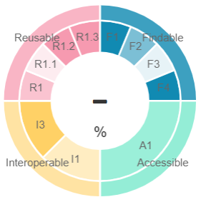
F-UJI is a web-based tool designed to programmatically assess the FAIRness of research data objects at the dataset level.
The tests utilized by F-UJI assess both the technical and content-related information embedded within the data and metadata of a given dataset.
The tests used by F-UJI are based on metrics developed by the FAIRsFAIR project
https://www.f-uji.net/
8
FAIRsFAIR “Fostering FAIR Data Practices In Europe” has received funding from the European Union’s Horizon 2020 project call H2020-INFRAEOSC-2018-2020 Grant agreement 831558
Notes:
Devaraju, A. and Huber, R. (2020). F-UJI – An Automated FAIR Data Assessment Tool. Retrieved from: https://doi.org/10.5281/zenodo.4063720

Slide 9

The FAIR Data Assessment Toolset and Badging Scheme
The tests developed within F-UJI were used to create the FAIR Data Assessment Toolset and Badging Scheme, which outlines the associated FAIRsFAIR Metrics and Practical Tests.
The CTS+FAIR CapMat, the F-UJI tool and the FAIR Data Assessment Toolset are all underpinned by the mappings conducted in the working paper entitled ‘FAIR Principles: Baseline Comments’.
FAIR Principles: Baseline Comments maps the FAIR Data Principles, RDA Indicators, and the Metrics and Practical tests developed by the FAIRsFAIR project.
9
FAIRsFAIR “Fostering FAIR Data Practices In Europe” has received funding from the European Union’s Horizon 2020 project call H2020-INFRAEOSC-2018-2020 Grant agreement 831558
Notes:
L'Hours, H. et al. (2022). D4.6 Report on a maturity model towards FAIR data in FAIR repositories (Version 2.0). Retrieved from: https://doi.org/10.5281/zenodo.6090389
Devaraju, A. and Huber, R. (2020). F-UJI – An Automated FAIR Data Assessment Tool. Retrieved from: https://doi.org/10.5281/zenodo.4063720
Huber, R. et al. (2021). D4.5 Report on FAIR Data Assessment Toolset and Badging Scheme. Retrieved from: https://doi.org/10.5281/zenodo.5336159
L’Hours, H. et al. (2022). FAIR Principles: Baseline Comments (Version 2.00). Retrieved from: https://doi.org/10.5281/zenodo.6472149

Slide 10




A Network of FAIR enabling Trusted Digital Repositories
A possible way of achieving community consensus on the best way to increase the ReUsability of Data and the uptake of the FAIR Data Principles would be through the creation of a network of FAIR-enabling Trusted Digital Repositories, as proposed by the FAIRsFAIR Coordination Plan for a Sustainable Network of FAIR-enabling Trusted Digital Repositories.
A collaborative working paper, FAIR+Time: Preservation for a Designated Community, was published by members of the CESSDA-Trust, SSHOC, EOSC-Nordic and FAIRsFAIR projects which highlighted the need for an interoperable ecosystem of FAIR data preserved by FAIR-enabling Trusted Digital Repositories, along with a statement of support towards such a network.
10
FAIRsFAIR “Fostering FAIR Data Practices In Europe” has received funding from the European Union’s Horizon 2020 project call H2020-INFRAEOSC-2018-2020 Grant agreement 831558
Notes:
von Stein, I. et al. (2021), D4.4 Coordination Plan for a sustainable network of FAIR-enabling Trustworthy Digital Repositories. Retrieved from: https://doi.org/10.5281/zenodo.5726691
L'Hours, H. et al. (2022). FAIR + Time: Preservation for a Designated Community (Version 2.00). Retrieved from: https://doi.org/10.5281/zenodo.5797776

Slide 11
Conclusion
Due to the complexities associated with increasing Data ReUse and implementing the FAIR Data Principles, a multi-pronged approach is needed.
The CTS+FAIR CapMat, the F-UJI tool and the FAIR Data Assessment Toolset and Badging Scheme provide a clear and accessible means for repositories to increase both the ReUsability and FAIRness of their data, but should be viewed as part of a wider movement towards FAIR Data, with Data ReUse being a key component.
Increasing the ReUse of data and implementation of the FAIR Data Principles depends on collective community action, uptake, input and consensus, alongside the continued availability of the necessary tools, resources, standards, and practices for FAIR data to become a reality.
11
FAIRsFAIR “Fostering FAIR Data Practices In Europe” has received funding from the European Union’s Horizon 2020 project call H2020-INFRAEOSC-2018-2020 Grant agreement 831558

Slide 12
Bibliography
Lorentz Center (2014). Jointly Designed a data FAIRPORT. Retrieved from: https://www.lorentzcenter.nl/jointly-designing-a-data-fairport.html/
Wilkinson et al. (2016). The Fair Guiding Principles for scientific data management and stewardship, Scientific Data. Vol.3. doi:10.1038/sdata.2016.18
CoreTrustSeal Standards and Certification Board. (2019) CoreTrustSeal Trustworthy Data Repositories Requirements: Extended Guidance 2020–2022 (v02.00-2020-2022). Retrieved from: https://doi.org/10.5281/zenodo.3632533
Devaraju, A. and Huber, R. (2020). F-UJI – An Automated FAIR Data Assessment Tool. Retrieved from: https://doi.org/10.5281/zenodo.4063720
von Stein, I. et al. (2021), D4.4 Coordination Plan for a sustainable network of FAIR-enabling Trustworthy Digital Repositories. Retrieved from: https://doi.org/10.5281/zenodo.5726691
Huber, R. et al. (2021). D4.5 Report on FAIR Data Assessment Toolset and Badging Scheme. Retrieved from: https://doi.org/10.5281/zenodo.5336159
European Commission, Directorate-General for Research and Innovation (2021) Recommendations on certifying services required to enable FAIR within EOSC. Retrieved from: https://data.europa.eu/doi/10.2777/127253
L'Hours, H. et al. (2022). D4.6 Report on a maturity model towards FAIR data in FAIR repositories (Version 2.0). Retrieved from: https://doi.org/10.5281/zenodo.6090389
L'Hours, H. et al. (2022). FAIR + Time: Preservation for a Designated Community (Version 2.00). Retrieved from: https://doi.org/10.5281/zenodo.5797776
F-UJI: Automated FAIR Data Assessment Tool (2022). F-UJI. Retrieved from: https://www.f-uji.net/
L’Hours, H. et al. (2022). FAIR Principles: Baseline Comments (Version 2.00). Retrieved from: https://doi.org/10.5281/zenodo.6472149
L'Hours, H. et al. (2022). D4.6 Report on a maturity model towards FAIR data in FAIR repositories (Version 2.0). Retrieved from: https://doi.org/10.5281/zenodo.6090389
FUJI (2022). F-UJI: Automated FAIR Data Assessment Tool. Retrieved from: https://www.f-uji.net/
European Open Science Cloud (2022). EOSC. Retrieved from: https://eosc-portal.eu/about/eosc/
CoreTrustSeal (2022). About. Retrieved from: https://www.coretrustseal.org/about/
ISO 16363 (2022). Home. Retrieved from: http://www.iso16363.org/
nestorSeal (2022). nestorSeal for Trustworthy Digital Archives. Retrieved from: https://www.langzeitarchivierung.de/Webs/nestor/EN/Zertifizierung/nestor_Siegel/siegel.html
12
FAIRsFAIR “Fostering FAIR Data Practices In Europe” has received funding from the European Union’s Horizon 2020 project call H2020-INFRAEOSC-2018-2020 Grant agreement 831558

