Slide 1



Open Science and Data Management Planning: Key Concepts, Tools and Resources
Johana Chylíková, Ph.D. Researcher, Data Manager, Czech Social Science Data Archive (CSDA)
27. October 2022
How to Ensure Researchers Share Their FAIR Data
DOI: 10.5281/zenodo.7296982

Slide 2
Overview
What is Open Science and why it is important?
Data Management Plan and why is it a must!
Perspective: How to explain the concepts of Open Science and Data Management to Researchers?
Notes:
Short introduction and reinforcing presentation is about the basics of open science and data management including key concept of open science and data management planning from a trainer’s perspective.

Slide 3
What is Open Science?
Open Science = Removing the barriers to share science (results, methods, theory...)
Open Science According to OECD = "to make the primary outputs of publicly funded research results – publications and the research data – publicly accessible in digital format with no or minimal restriction” (OECD, 2015:7)
Open Science involves:
Open access to publications and research data
Open source software
Open collaboration
Open notebooks
Open educational resources
Prerequisite of OS: digital technology that is broadly accessible

Slide 4

Closed science vs. Open science
Current goal: Moving from the situation of the “closed science” towards the system where science is open to everyone who is interested
Ultimate goal: Change of the system, science is open as possible
Notes:
The current goal is to move from the of close science towards a system where science is open to everybody who is interested in it; and the ultimate goal is, then the change of system in which science is as open as possible.

Slide 5
Why do we want Open Science?
Main reasons:
Helps create high standards for scientific work (exchange of know-how and information)
Driver for innovation (consequence of the fast exchange)
Saves resources (time + money)
Why should we want it?
Sociological perspective: Scientific knowledge is a product of social collaboration and its ownership belongs to the community
Public perspective: Science must be made public so that citizens have access to it
Democratic perspective: Access to knowledge must be equally distributed
Economic perspective: Scientific outputs generated by public research are a public good that everyone should be able to use at no cost
Infrastructural perspective: Efficient research needs available tools, data, applications etc.
Pragmatic perspective: Production of knowledge will be more efficient if scientists work together
Notes:
Provide examples such as the ones in the brackets in order to increase understanding of researchers that attend the session.

Slide 6
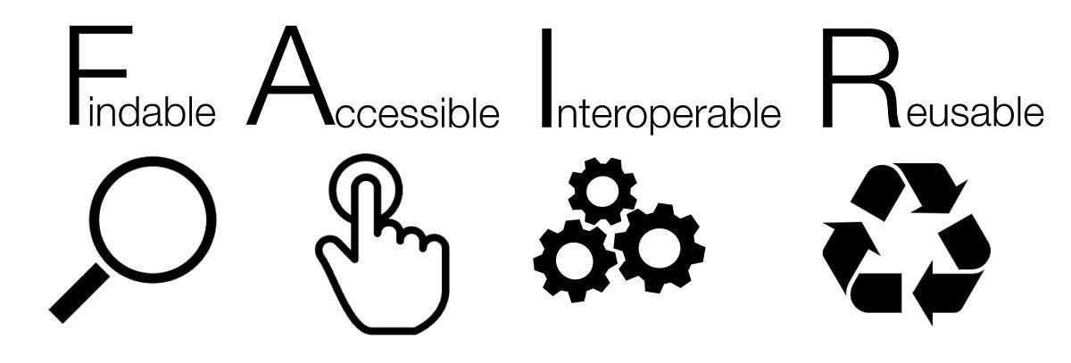
Institutional and individual actors of Open Science
Institutions:
Universities, scholarly journals, project funders etc.
Individuals:
Researchers, project managers, administrators etc.
How can an individual do open science in real life?
Be FAIR!
What is FAIR? The well-know mantra =>
Notes:
Presenting FAIR in the context of Open Science and importance of FAIR in the research community overall.

Slide 7
Being FAIR with Data and Metadata:
Findability
Assigned PID
Rich metadata
Published metadata
Accessibility
Retrievable by PID
Metadata available forever (even after data are not available)
Interoperability
Formal and broadly applicable language
Use vocabularies
References to other data
Reuse
Rich metadata
Licensed
Meet domain standards
Notes:
Providing key example of how to ensure FAIR data helps researchers understand the benefits of using responsible repositories and following guidance from these.

Slide 8

FAIR In the research cycle
Data collection:
clarify usage rights
cite the data and instruments involved in data collection
Processing:
use open-source software
Storing the data:
for a long-term preservation use a data repository
attach persistent identifier to your data
make sufficient metadata and publish them with open licence
ensure links between publications, data and methods
Reuse:
clear citation
assign all necessary credits
Notes:
Introducing the FAIR principles from a data lifecycle ensures further understanding of benefits.

Slide 9
Obstacles in Open Access to data
Researchers feel the need to protect the data they produced with their own know-how
Sometimes for understandable reasons:
Science as a competitive environment
Researchers building credit and prestige for themselves
Researcher (natural sciences) on a meeting for the project where it is mandatory to make data publicly accessible:
“These are data from experiments we will have worked for several years. We will not be able to have fully analyzed them in many years to follow. If we make them publicly available, someone else can take them and practically steal our work”.
How to deal with the clash of perspectives (Open Science vs. Being competitive in the field)?
=> Embargo on data sharing
Notes:
Whenever possible provide examples of situations where initially data sharing was not considered, but with help from your repository i.e. setting embargos made data sharing possible.

Slide 10
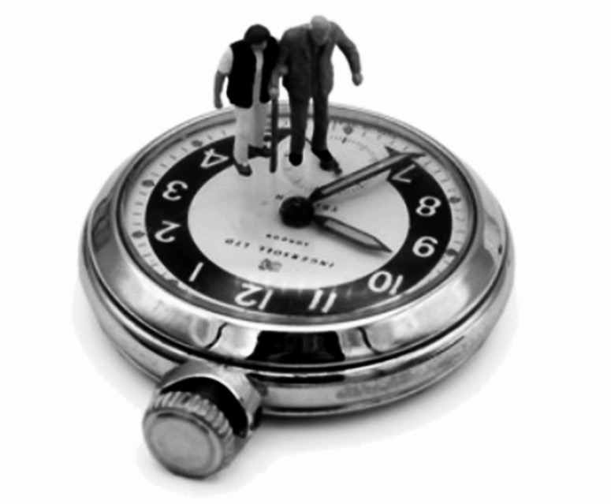
The SSH Training Discovery Toolkit
Directory of platforms for education and skills training
https://training-toolkit.sshopencloud.eu/
Knowledge platforms, courses, videos, workshops, lessons
For researchers, data archivists, students
Most of 100 listed services/platforms in English
Topics: Research data management, survey data, quanti/quali data analysis, software and programming, data visualisation
Disciplines: social sciences, humanities, history, linguistics etc.

Slide 11
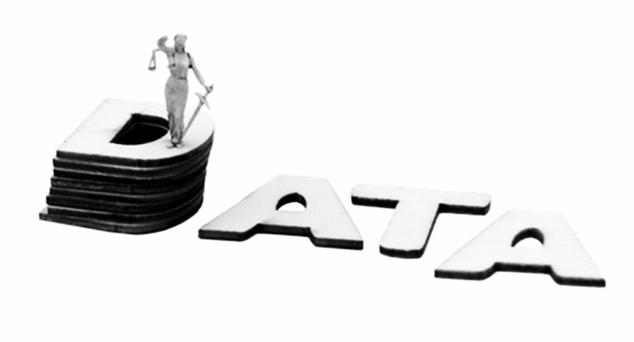
DMP Data Management Plan
Formal document that provides a framework for how to handle the data material during and after the research project.
But!
DMP is not only a FORMAL document required by the funder!
Researchers must understand that DMP is an extremely practical tool.
It is the job of archivists to convince researchers that:
DMP is a must
it is not just something that funders want
DMP substantially improves the workflow in the project
Notes:
Key focus on data management planning during the entire data lifecycle. Reinforcing that the DMP is more than an additional document researchers must prepare, and more the skeleton of their research project.

Slide 12

Data Management Plan is:
Practical
Has considerable benefits
Not difficult to make
Allows for easy project management
Makes data FAIRer
What researchers must know about DMP
Notes:
Always provide examples on how a DMP enhances a research project. Is the job of the trainers to explain how a DMP improves the quality of the research project while not being resource intensive. Always provide practice examples such as easy project management, ensuring FAIRness of data..

Slide 13
DMP is a look into the future
When the project runs over several years, the DMP is absolutely necessary.
With DMP researchers will know in advance:
When the data will be collected and how
How to handle the protection of respondents
How to manage the data during and after the project
Who will be responsible for what in the project
The budget for everything related to data
What researchers must know about DMP
Notes:
Always highlight to attendees how a DMP substantially improves the workflow of research projects, and enables researchers to keep track of their work. Use examples as provided on the slide.

Slide 14
A lot of diversity exists in DMPs because DMPs are built around the particular needs of the research project
=>
Researchers are sometimes uncertain about preparing the DMP
Worried they would put in the DMP something wrong
But they should not be afraid of being creative
They should put in the DMP all the important information without worrying about doing something wrong
They should bear in mind that the DMP is mainly for them to not get lost in their own project
But should take into consideration requirements of the funder of the research project
What researchers must know about DMP
Notes:
Avoid any potential misunderstanding by explaining how DMP requirements can be different from one project to another and one funder to another. However highlight again, that even if a a funder does not require a formal DMP, the plan is more to help them during the project.

Slide 15
Where is DMP strongly recommended or mandatory?
Not all funders in European countries want the DMP
Look into the DMEG, the country diversity in DMP
see https://dmeg.cessda.eu/Data-Management-Expert-Guide/1.-Plan/European-diversity
DMP required:
Horizon 2020
DMP online via https://dmponline.dcc.ac.uk/
DMP in European countries
In many European countries not mandatory yet
It is recommended or mandatory by some funding institutions in the following countries:
Finland, Netherlands, Norway, Switzerland, UK
Notes:
Provide examples of mandatory DMPs. Include information available in the DMEG about DMP diversity from one country to another. Provide key tools to help researchers with DMPs such as DMP Online from the Data Curation Centre.

Slide 16
Recommended content of DMP for social sciences
Following the DMP in DMEG
dmeg.cessda.eu/
DMP questions DMEG
Editable version DM DMEG material – The handout for this presentation
Overview
Organising and documenting your data
Processing your data
Storing your data and metadata
Protecting your data
Archiving and publishing your data
Discovering data
Notes:
There are different types of learners, especially for visual learners providing a quick glance at the structure of a DMP can alleviate potential worries. If the training is a general DMP training, not focused on specific funders or project requirements, the DMEG provides the best brief overview on the structure of a standard DMP.

Slide 17
DMP Content
1. Overview
Title of the project, Description, Principal Researchers, Funder, Owner, Data Producer, Contacts, Roles in the project, Costs and resources
2. Organising and documenting data
Data collection, Data organisation, Data type and size, File format, Folder structure and names, File structure and names, Documentation, Metadata, Metadata standard
3. Processing data
Versioning, Interoperability, Data Quality
4. Storing data and metadata
Storage, Backup, Security
5. Protecting data
Ethical review, Informed consent, Personal data /confidential information, Intellectual property rights, Agreements with other stakeholders, Restrictions on data
6. Archiving and publishing your data
Archiving, Data formats, Access
7. Discovering data
Identification of needs, Search for data, Evaluation of data quality, Gaining access to data
Notes:
Providing practical examples has always proved to help attendees better understand what is required. Use the slides examples, or depending on the audience provide more in depth information for each section of the DMP as needed.

Slide 18
References:
Go Fair https://www.go-fair.org/fair-principles/
CESSDA Data Management Expert Guide https://dmeg.cessda.eu/
Foster Open Science https://www.fosteropenscience.eu/
OECD (2015). Making Open Science a Reality. (OECD Science, Technology and Industry Policy Papers, 25). Paris: OECD Publishing.

Slide 19
THANK YOU!
johana.chylikova@soc.cas.cz
Licence: CC-BY 4.0

Slide 20
Next on is a 10 minutes break, followed by “Consent and ethical protocols in an Open Science landscape”
Licence: CC-BY 4.0

