Slide 1

Train the Trainer Workshop: How to Ensure Researchers Share Their FAIR Data: Practical Tips and Tools
Data protection considerations and anonymisation in the GDPR context
Cristina Magder / UK Data Service
27 October 2022
DOI: 10.5281/zenodo.7296982

Slide 2
Training on open science: anonymisation
During your sessions consider including the following:
Objectives of the session
Context
Key concepts
Tools
Exercises
Notes:
Especially with the implementation of GDPR more and more focus is given to anonymisation. Anonymisation can be a hard to cover topic, with many implications. It is advisable that trainers always carefully consider setting up anonymisation training and taking into account the 5 key elements presented in the slide.

Slide 3
Setting Objectives
Anonymisation in the context of data protection legislation can be a difficult and wide topic
When setting objectives always consider:
Participants’ level of understanding
Focus of the session (quantitative/qualitative or both)
Length of the session
Notes:
Trainers should always consider i) who is the training for and are they going to ask for a minimum level of understanding ii) is the session covering different types of data (and making this clear in the promotion of the event) iii) how long will the session last, with key considerations on exercises and providing sufficient time for questions from the audience

Slide 4
Examples of Objectives
Gain awareness of issues and considerations of data protection legislation and statistical disclosure for quantitative/qualitative data
Gain basic knowledge of key concepts, techniques and tools in statistical disclosure control for quantitative/qualitative data
(if tool introduced) Be able to implement semi-automated tools in your anonymisation process
Notes:
Example of objectives.

Slide 5
Setting the Context
More and more research is now crossing country boundaries => leading to implications on data protection legislation
When setting the context of your training session try to provide practical examples on how different legislation applies (worksheet available on the shared drive)
Notes:
Trainers should consider first introducing the context of the problem i.e. why is anonymisation needed. Including information about GDPR and domestic legislation, ideally with clear examples, helps attendees better understand the importance of anonymisation from a legal perspective.

Slide 6
Example of Data Protection Considerations
When personal information about people is collected or used in research data protection regulations apply such as:
EU GDPR (2018) & country specific laws
a researcher based in a country from the European Union (country that adheres to EU GDPR) collects personal data about people living in a country from the European Union
e.g. DPA (2018) & the UK GDPR applies when
a researcher based in the UK collects personal data about people anywhere in the world
a researcher outside the UK collects personal data on UK citizens
e.g. DPA (2018), EU GDPR (2018) & the UK GDPR applies when
a researcher based in the UK collects personal data about people across Europe
Notes:
Examples of legal considerations.

Slide 7
Examples of Key Concepts
Types of identifiers: direct (names, address etc.) vs indirect (education level, occupation, age etc.)
Types of disclosure: identity vs attribute
De-identification/Pseudonymisation: Process of removing or masking direct identifiers in personal data
Anonymisation: Process of ensuring that the risk of somebody being identified in the data is negligible; more than simply de-identifying the data, and often requires that indirect identifiers be further altered or masked
Types of anonymisation: Formal Anonymisation, Guaranteed Anonymisation , Statistical Anonymisation, Functional Anonymisation
Notes:
Trainers should keep in mind that introducing key concepts differs from one type of audience to another. If for example the training is for early career researchers providing in depth definitions and multiple examples is a must. If however the session is for more experienced researchers a more brief overview of key concepts can be provided. However key concepts should be included in all sessions.

Slide 8
Anonymisation and the DMEG
The CESSDA Data Management Expert Guide covers key anonymization topics including:
Anonymisation methods
Expert tips
Case studies
Anonymisation in practice
Notes:
Using the DMEG to provide attendees with i) anonymisation methods ii) expert tips iii) case studies and iv) anonymisation in practice

Slide 9
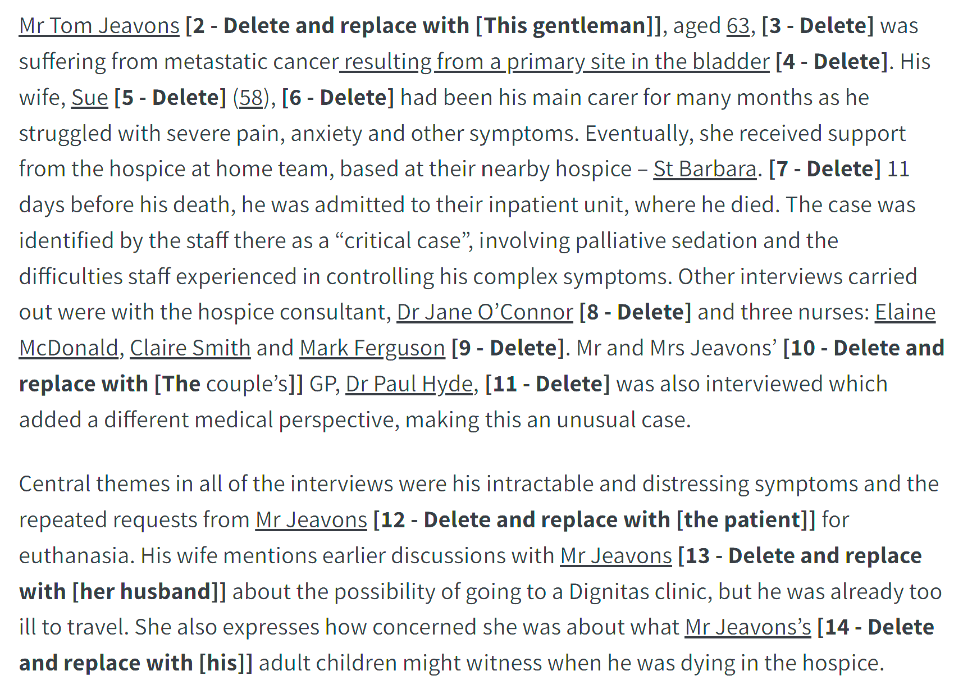
Qualitative Anonymisation Exercise Example
` Source: DMEG Anonymisation
Notes:
Example of qualitative anonymisation exercise

Slide 10
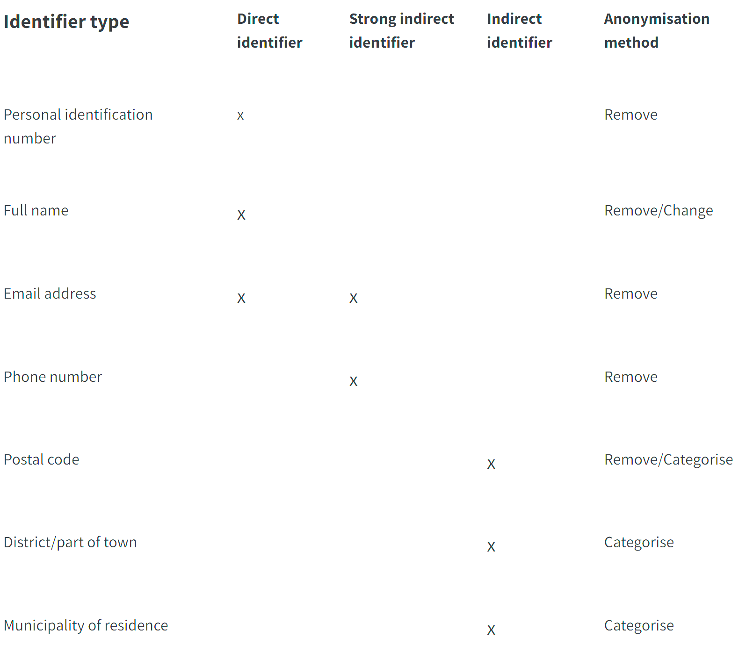
Quantitative Anonymisation Exercise Example
Create a dummy dataset and ask participants to identify direct and indirect identifiers, as well as methods to reduce the risk of disclosure
Source: DMEG Anonymisation
Further open access exercises on assessing disclosure control are available in Magder, Cristina. (2021, August 24). Facilitating Onwards Sharing of Safe and Clean Microdata [Train the Trainer Workshop]. Zenodo. https://doi.org/10.5281/zenodo.5566858
Notes:
Example of quantitative anonymisation exercise

Slide 11
Introducing Tools in Your Training
A variety of useful open source tools are available for providing comparison between statistical disclosure control methods for quantitative data.
Tools should always come with the disclaimer that while quick and easy to explore what changes have biggest effect these can be more problematic when trying to define absolute risk i.e. the numbers might have no real meaning, and they can be time consuming and skill-intensive.
Notes:
Trainers should carefully consider introducing semi-automated tools for anonymisation of quantitative data. If a tool is used in an institution and in depth knowledge of using the tool is available trainers should consider demos and exercises with the audience.

Slide 12
Example of Anonymisation Freeware
sdcMicro – R scripting + GUI, reference manual; new Shiny GUI – in detailed vignette, SDC methods and sdcMicro; in depth guide for SDC and sdcMicro
QAMyData – provides functionality for identifying direct identifiers with the use of regular expressions (RegEx)
Amnesia anonymisation tool – standalone tool, locally run with comprehensive documentation
μ-Argus – standalone tool recommended by Eurostat for government statisticians; software and manual
ARX – comprehensive open source software for anonymizing sensitive personal data; software and documentation
Notes:
Example of quantitative anonymisation freeware.

Slide 13
Main Takeaways
Set clear target group and expected knowledge level from audience
Set clear objectives and describe them when promoting your session
Explain key concepts giving easily understandable examples and keep the audience engaged using mini exercises throughout the session (using Zoom polls, Menti exercises etc.)
Allow time for questions and clarifications (ensure these can be submitted anonymously if the training is online)
If introducing a tool chose the tool you are using and are most familiar with
Always consider a short introduction to licences and how access levels is dependent on data contents
Notes:
The main aim of the presentation was to reinforce considerations when it comes to anonymisation training including setting up the session and objectives, taking into account time depending on the audience and types of exercises used.

Slide 14
Next Session: Licence frameworks @CESSDA archives
Licence: CC-BY 4.0

