Slide 1
Licensing Models for Research Data @ AUSSDA
Open Access and Scientific Use
Dimitri Prandner, MA PhD Senior Scientist at Faculty of Social Sciences, Economics & Business of the Johannes Kepler University
Date: Oct. / 27 / 2022 Event: How to Ensure Researchers Share Their FAIR Data: Practical Tips and Tools
DOI: 10.5281/zenodo.7296982

Slide 2
Guideline within AUSSDA: As open as possible, as secure as necessary! 🡪 Societal responsibility

Slide 3
Open Access | OA
Scientific Use | SUF
Metadata is licensed via CC 0
Research data is licensed via CC BY.
Documentation is (typically) licensed via CC BY.
Datasets are meant to be used by students and educators (outside of tertiary education), policymakers, the interested public outside academia.
Datasets typically do not include sensitive data.
Datasets are reduced, to meet GDPR demands and fulfill ethical consideration.
Research data is restricted, and academic credentials need to be provided for access (Account based).
Restrictions for manually controlled access can be put in place in special cases, when sensitive data is included.
Documentation is typically licensed via CC BY.
Datasets are meant to be used for academic research (scientific purpose) as well as higher education and learning.
Datasets are GDPR compliant but take special regulations for scientific work into account.
Embargo

Slide 4
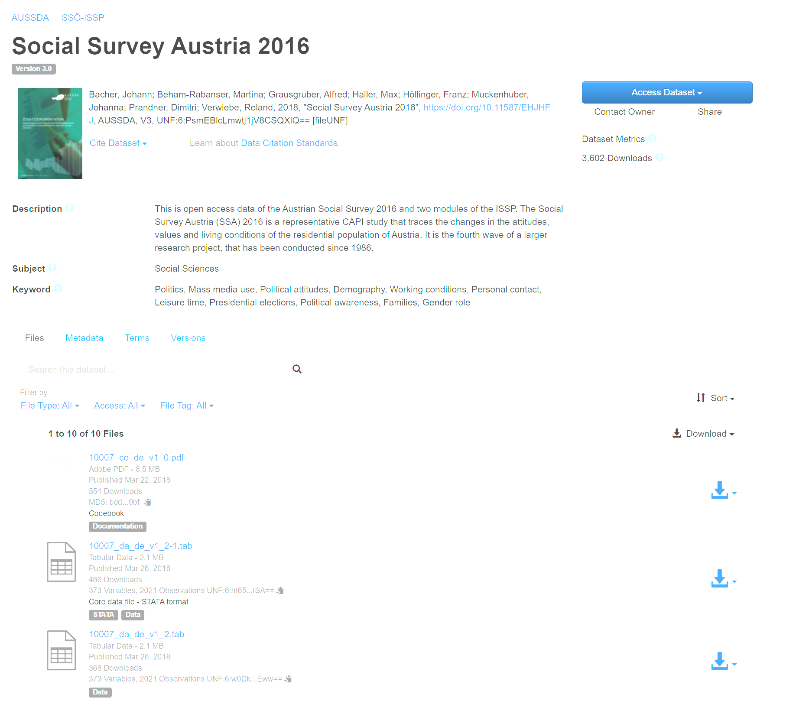
Open Access | OA
Reduced dataset, some variables are not included, others are recoded into broad categories
“Click to download”

Slide 5
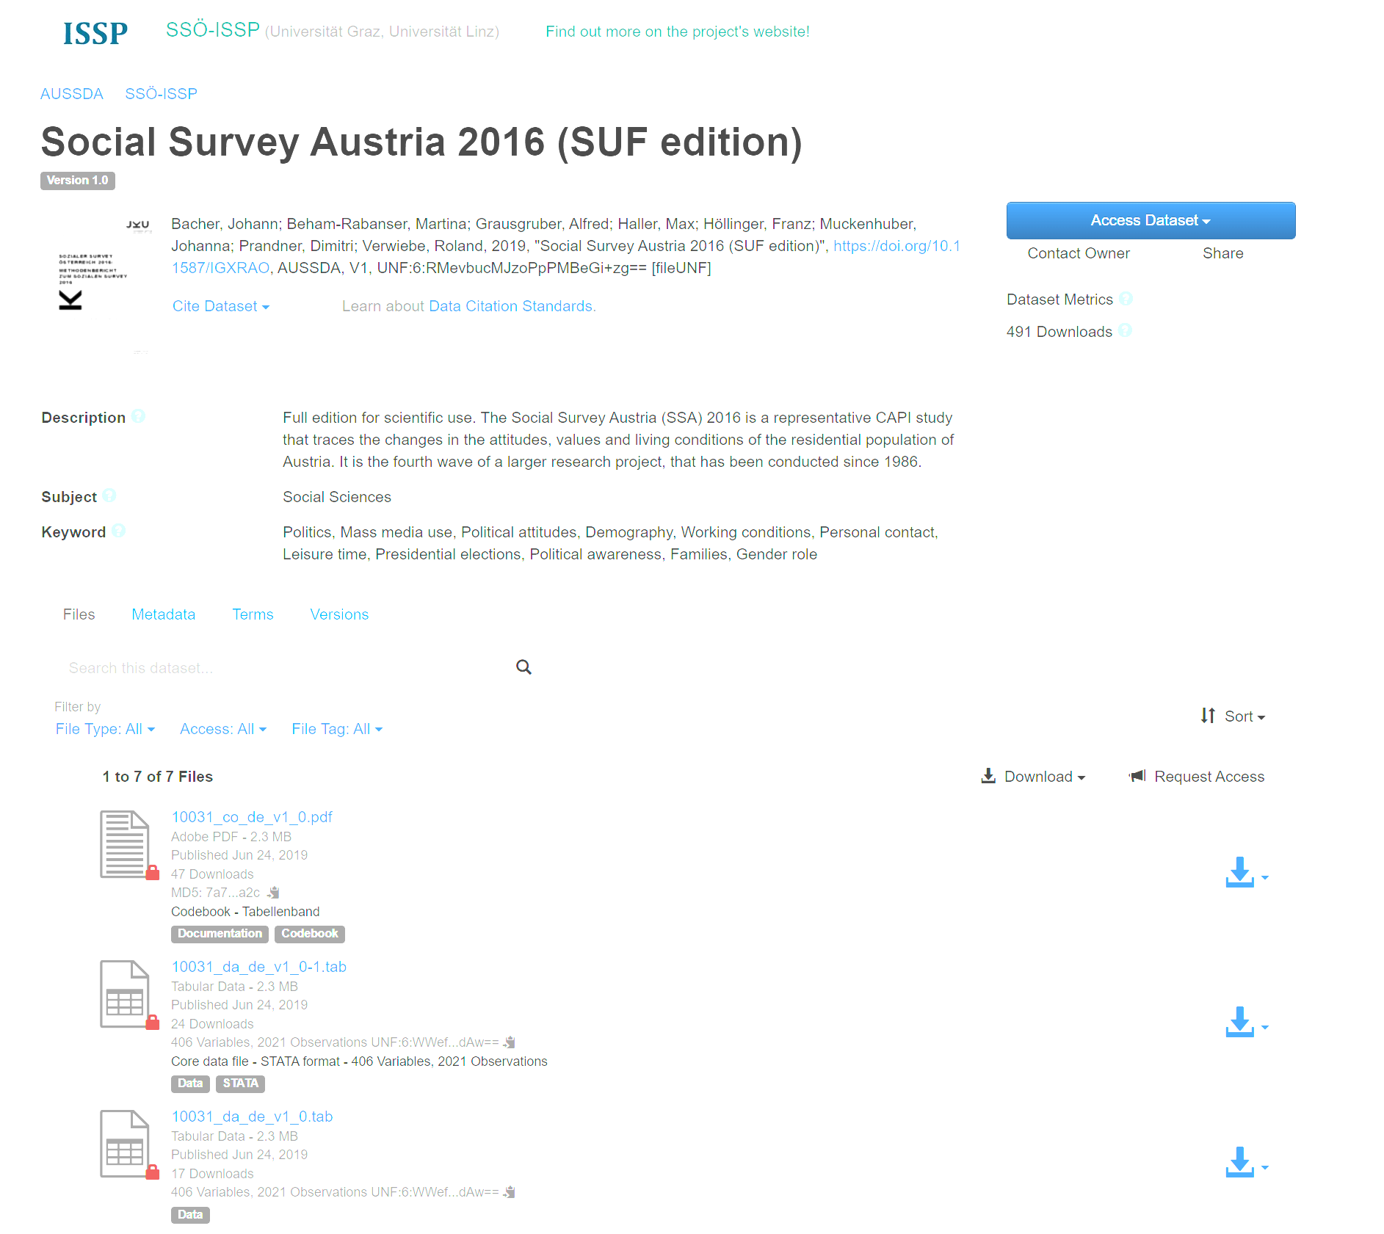
Scientific Use | SUF
Nearly full dataset, all variables are included.
However, some information is slightly recoded to ensure protection of participants (e.g.: specific combination of job & sociodemographics)

Slide 6
Open Access | OA
Scientific Use | SUF
Metadata is licensed via CC 0
Research data is licensed via CC BY.
Documentation is (typically) licensed via CC BY.
Datasets are meant to be used by students and educators (outside of tertiary education), policymakers, the interested public outside academia.
Datasets typically do not include sensitive data.
Datasets are reduced, to meet GDPR demands and fulfill ethical consideration.
Research data is restricted, and academic credentials need to be provided for access (Account based).
Restrictions for manually controlled access can be put in place in special cases, when sensitive data is included.
Documentation is typically licensed via CC BY.
Datasets are meant to be used for academic research (scientific purpose) as well as higher education and learning.
Datasets are GDPR compliant but take special regulations for scientific work into account.
Embargo

