Slide 1
Train the Trainer Workshop: How to Ensure Researchers Share Their FAIR Data: Practical Tips and Tools
Licence frameworks @CESSDA archives
Marijana Glavica / CROSSDA
27 October 2022
DOI: 10.5281/zenodo.7296982

Slide 2
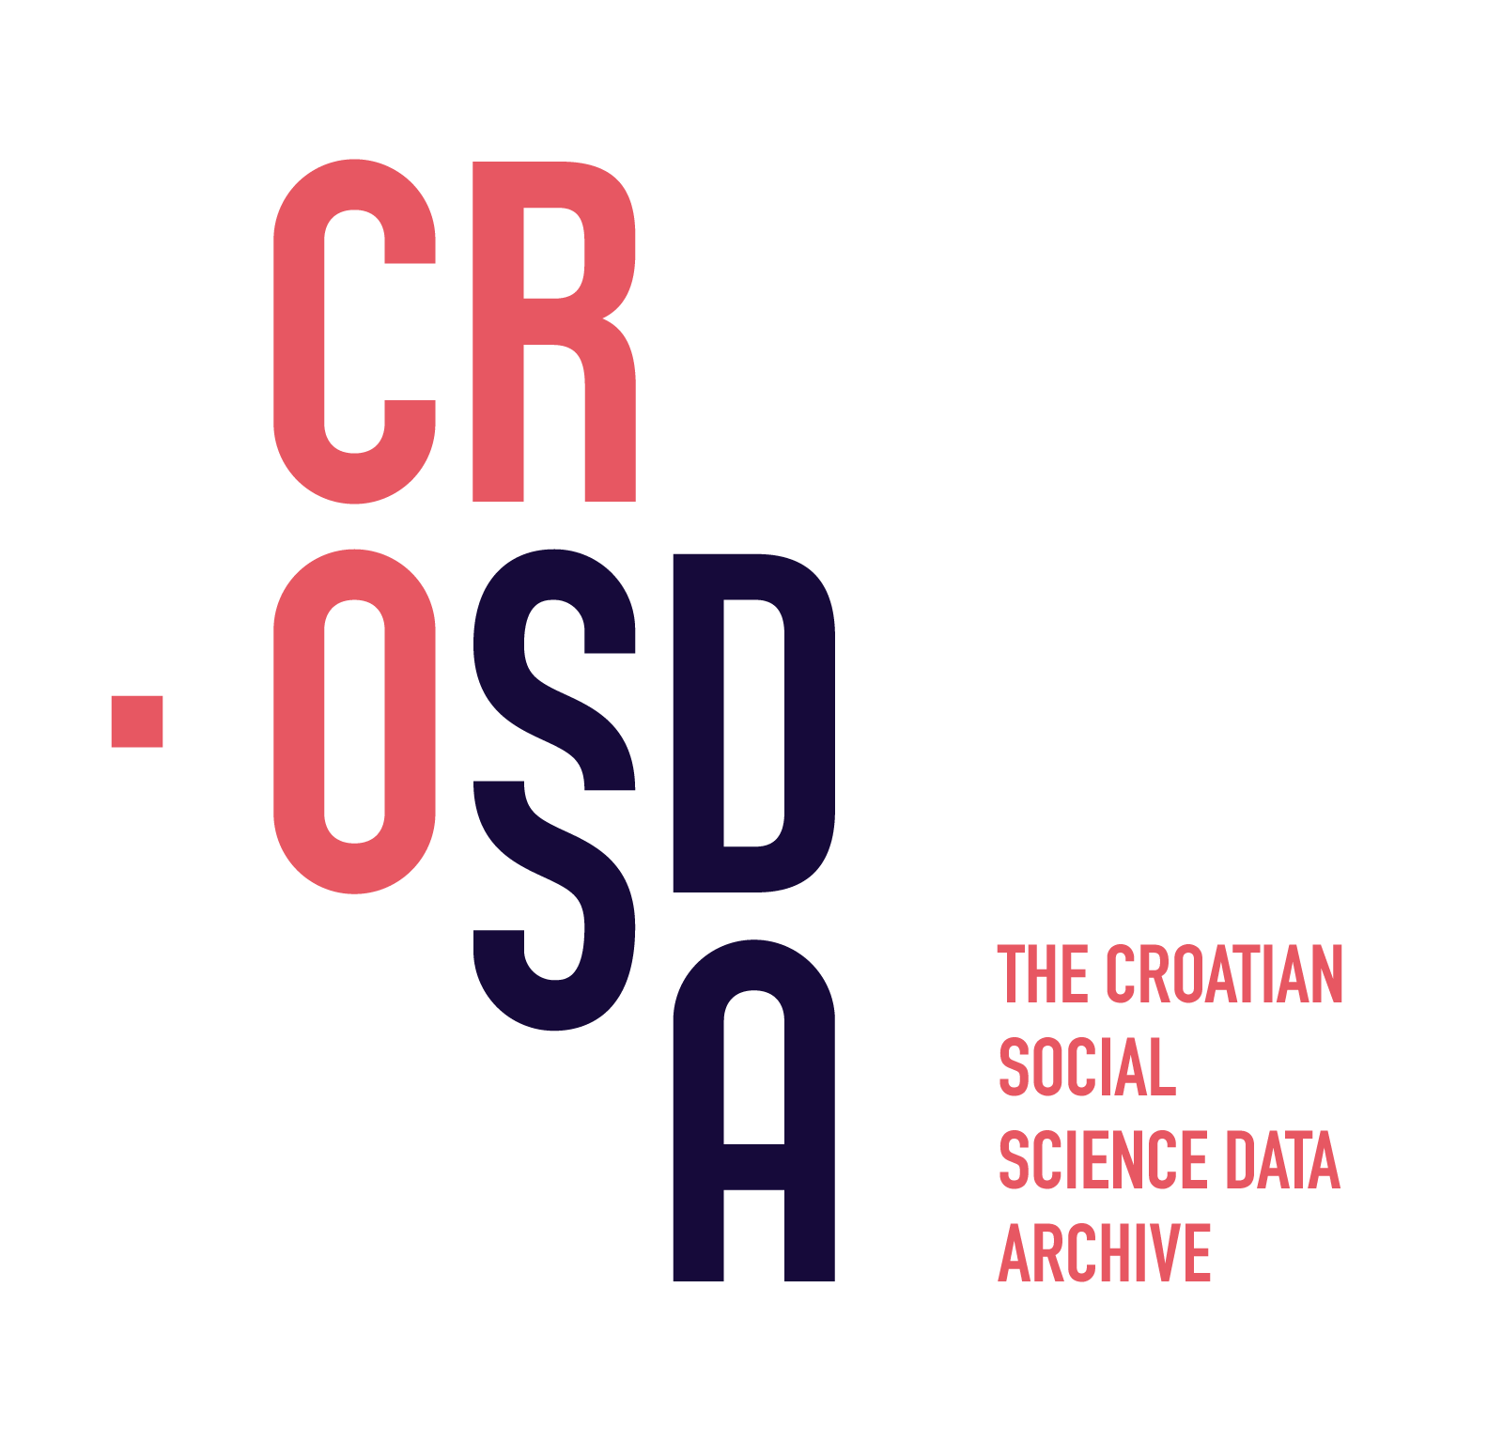
Croatian Social Science Data Archive (CROSSDA)
Croatia become a member of CESSDA ERIC in 2019
Faculty of Humanities and Social Sciences, University of Zagreb (FFZG) was appointed by the Ministry of Science and Education to serve as a national coordinating institution for CESSDA ERIC
CROSSDA was established in 2020 as a separate organisational unit at FFZG to serve as a Service Provider for CESSDA
Dataverse is used as for data publishing

Slide 3
Licence Framework
A. Freely available data (Open Access)
data is available under the terms of the Creative Commons Attribution 4.0 International license (CC BY 4.0)
no registration is required
B. Data available only for specific purposes
for scientific use only
for scientific use and teaching purposes
registration and accepting General Terms and Conditions for Data Use is required

Slide 4
Scientific purpose
preparation and implementation of scientific research (projects, scientific papers, conference presentations, doctoral dissertations)
postgraduate specialist theses
theses at the level of graduate studies
checking the results presented in the scientific work (reviewers or other researchers)

Slide 5
Why scientific use and teaching are separated?
Croatia is a small country; representative samples can have about 1000 participants
We can not be sure that undergraduate and graduate students fully acquired ethical norms
If research is conducted on students - they could know each other - re-identification is possible not only by combining demographic variables, but also by knowing some answers

Slide 6
Lessons Learnt/Next Steps
monitoring usage statistics is hard for Open Access data
no information about the purpose of data use
no information about who is using data (researchers, students, journalist, ... )
implementation of a "guestbook" is possible in Dataverse
it can be optional for Open Access data

