Slide 1
Train the Trainer Workshop: How to Ensure Researchers Share Their FAIR Data: Practical Tips and Tools
Licence frameworks @CESSDA archives
Oliver Watteler / GESIS – Leibniz Institute for the Scoial Sciences
27 October 2022
DOI: 10.5281/zenodo.7296982

Slide 2

Introduction to GESIS
Social science research data infrastructure
Covers the entire life-cycle of empirical research (similar to ICPSR (USA) or FORS (CH)
Is data collecting and data providing institution
Offers a broad spectrum of research-based services for empirical social research
“Archive”: Dept. Data Services for the Social Sciences (first founded in 1960)
Offers access to ~6,500 ‘studies’; mostly survey data
Access via download off-site
Secure data access on-site (Secure Data Center)
Data Services:
Archiving BASIC / PLUS / PREMIUM
Research Data Management Training

Slide 3

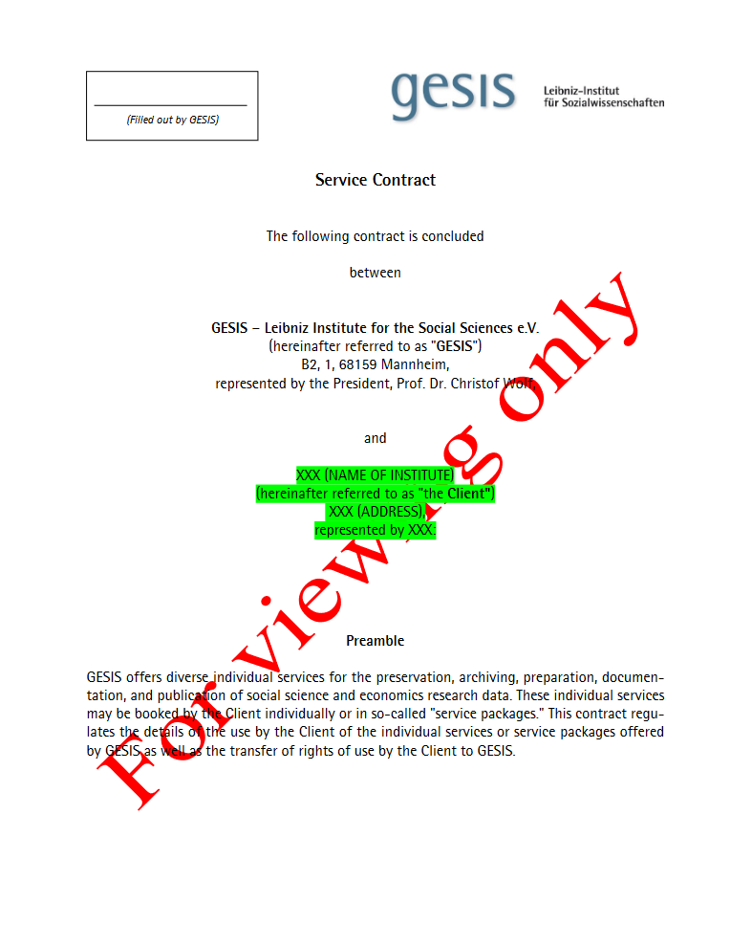

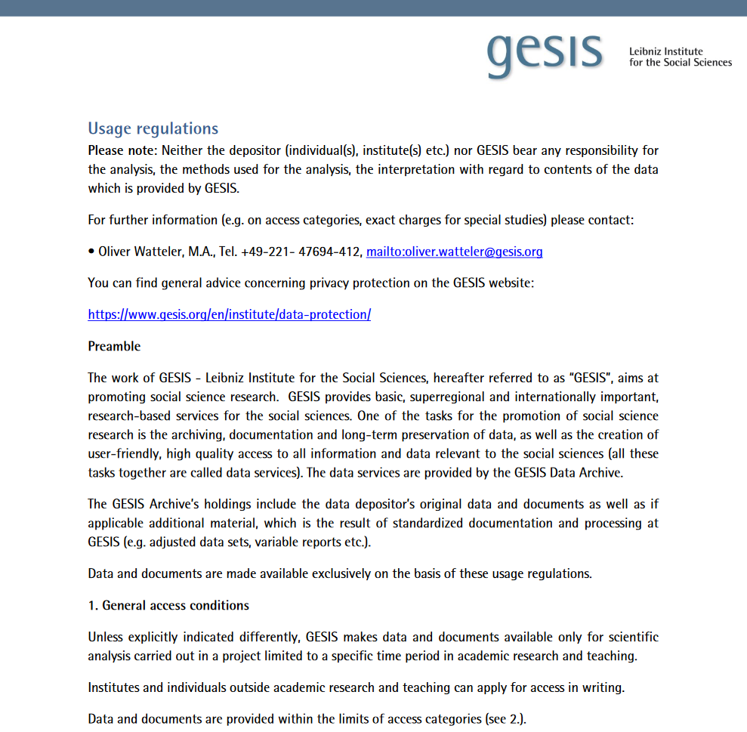


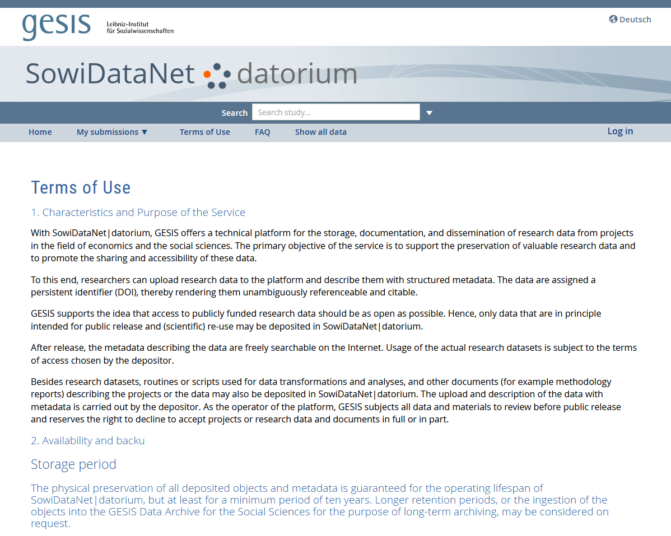
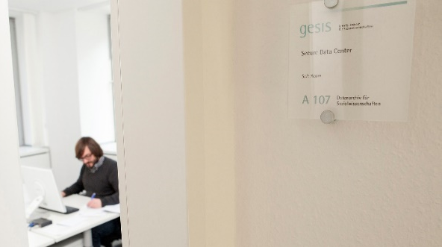

Licence Framework
Different
access classes
Archiving PLUS / PREMIUM (for cost)
Usage regulations
Archiving BASIC (free of charge)

Slide 4
Lessons Learnt and Next Steps
Current setup of data ingest at GESIS too complex
Setting up a “one door” (= single ingest point) for studies
Harmonize licenses for data deposition
Planning an online portal for demanding access restricted studies
Harmonize licenses for data access
Remodel access classes
Opening Secure Data Center for remote access

