Slide 1


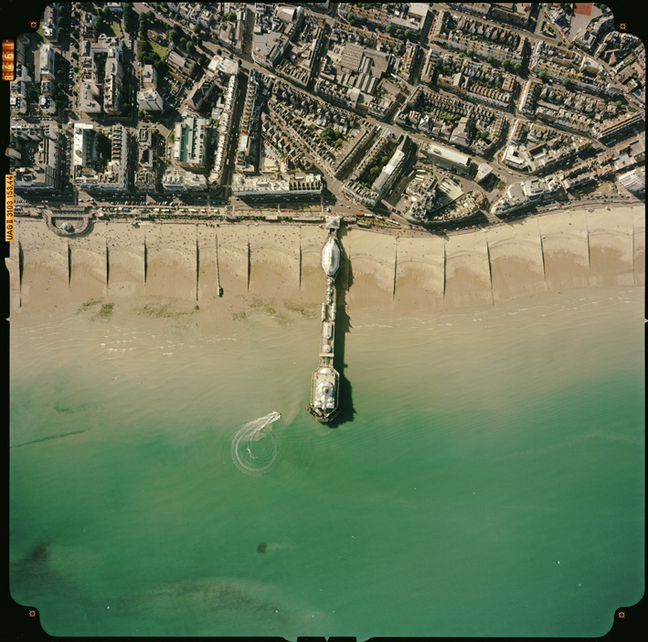
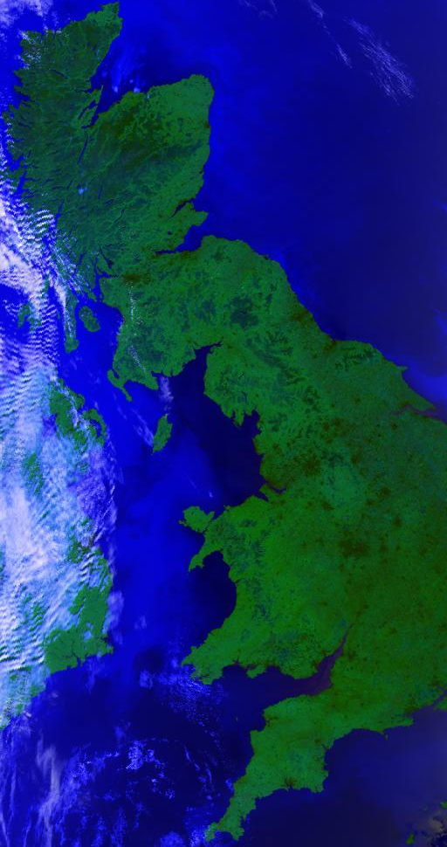
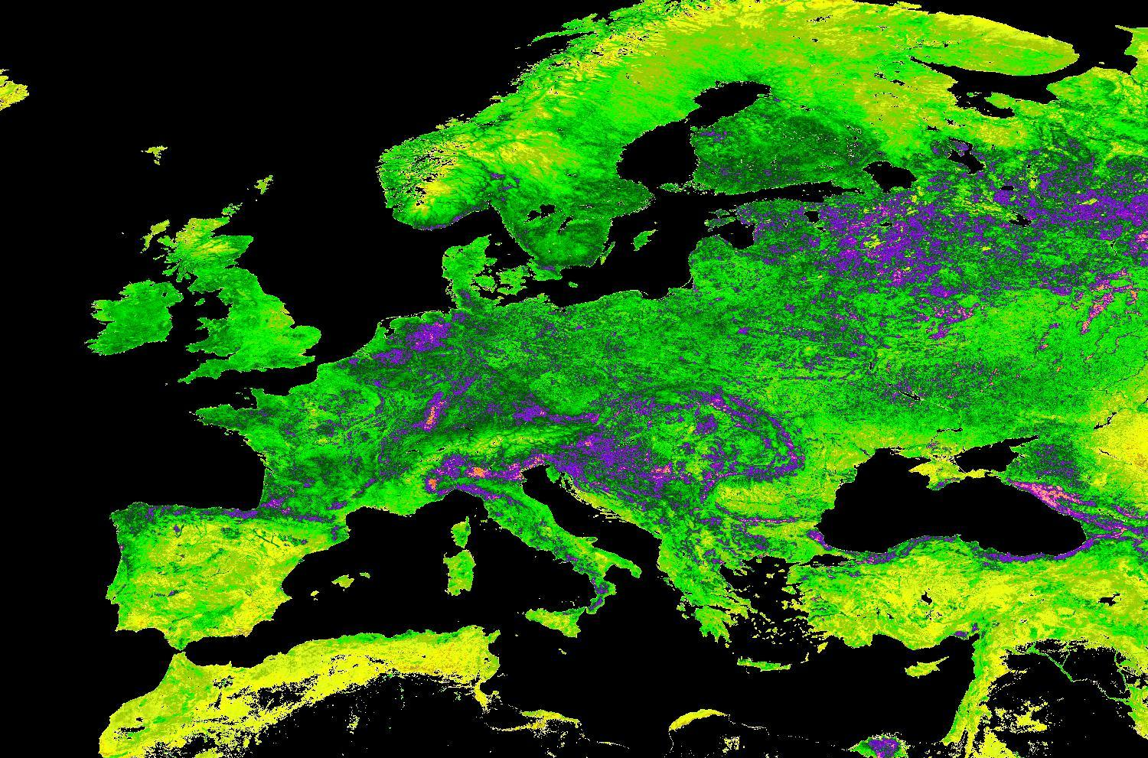
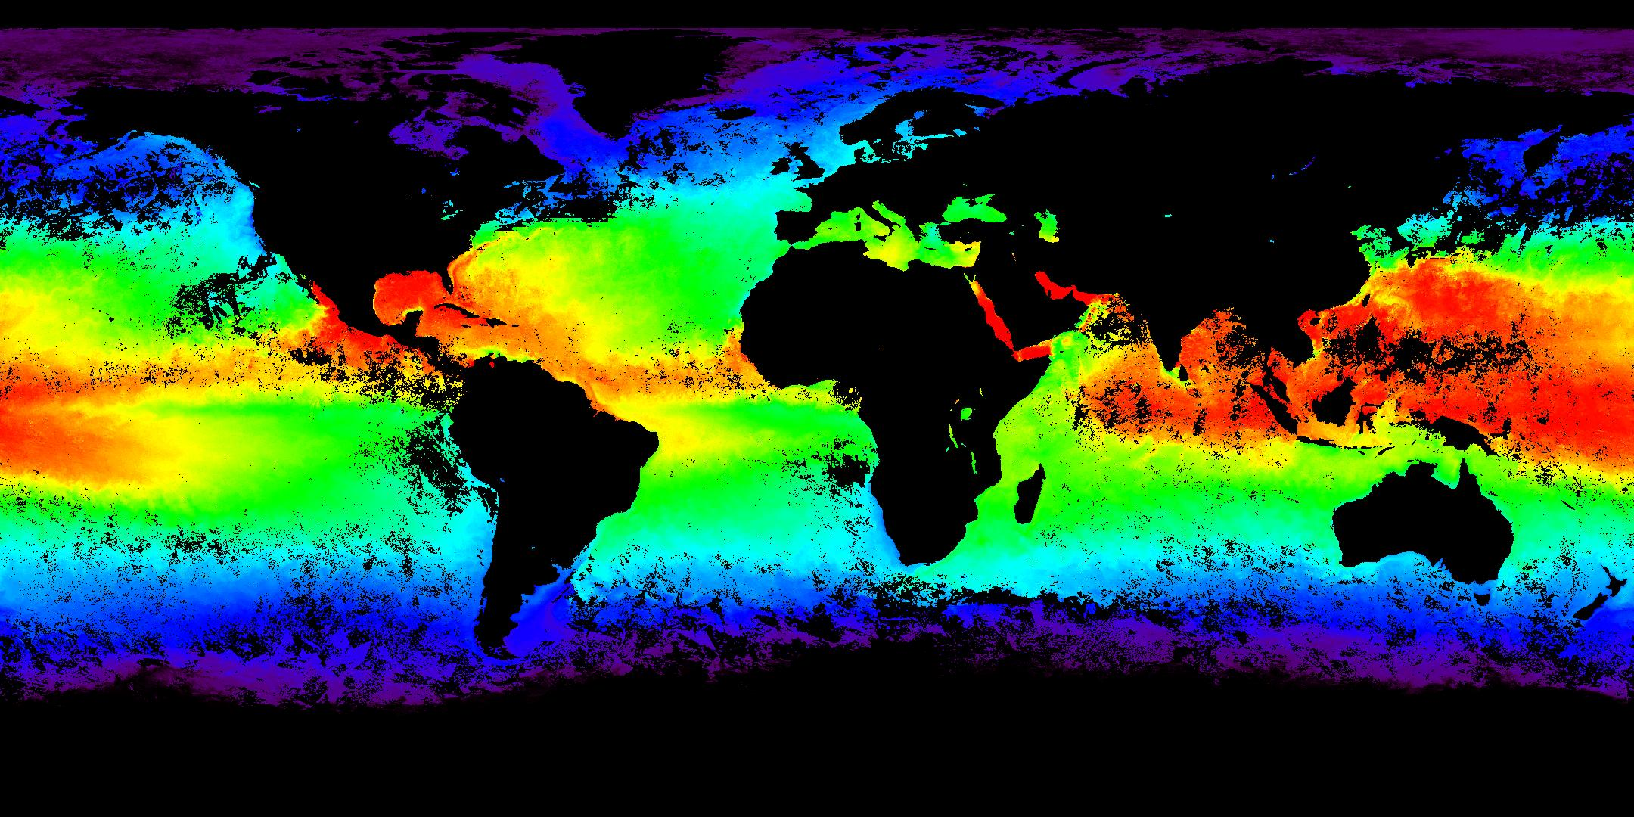
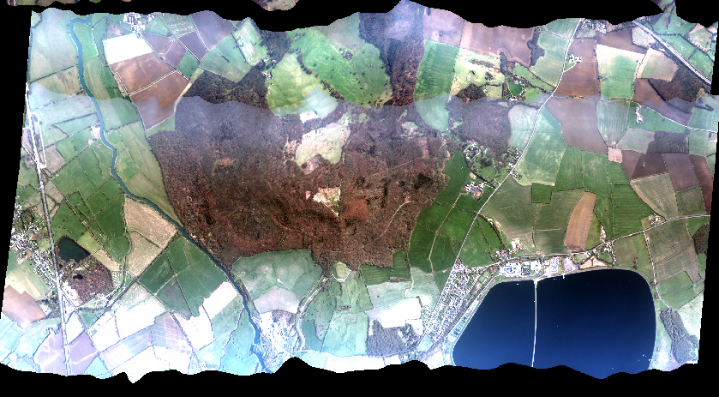

NERC Earth Observation Data Centre
NEODC Data Archive
NEODC datasets are available for free download to registered users:
Airborne:
Remote sensing data & aerial photography from the NERC ARSF
NEXTMap Britain digital elevation data
Satellite:
LANDSAT, Envisat MERIS, SCIAMACHY, MIPAS MetOp IASI, GOME-2, AVHRR-3
Derived EO datasets: MERIS MTCI, AVHRR FASIR
(A)ATSR data – 17 years of global Sea Surface Temperature
Campaigns:
SHAC 2000 SAR and Hyperspectral Airborne Campaign
NCAVEO 2006 field experiment
MERIS MTCI, ESA/Infoterra
ARSF aerial photograph, NERC
ARSF ATM, NERC
AATSR, STFC/Defra/ESA/NERC
AATSR Global SST, STFC/Defra/ESA/NERC
NEODC Services
Data management support for the National Centre for Earth Observation and the wider community of EO data users
Register, search the catalogue and request access to data on www.neodc.rl.ac.uk
Web services for on-line data manipulation
We welcome email enquiries : neodc@rl.ac.uk
NEW

