Slide 1
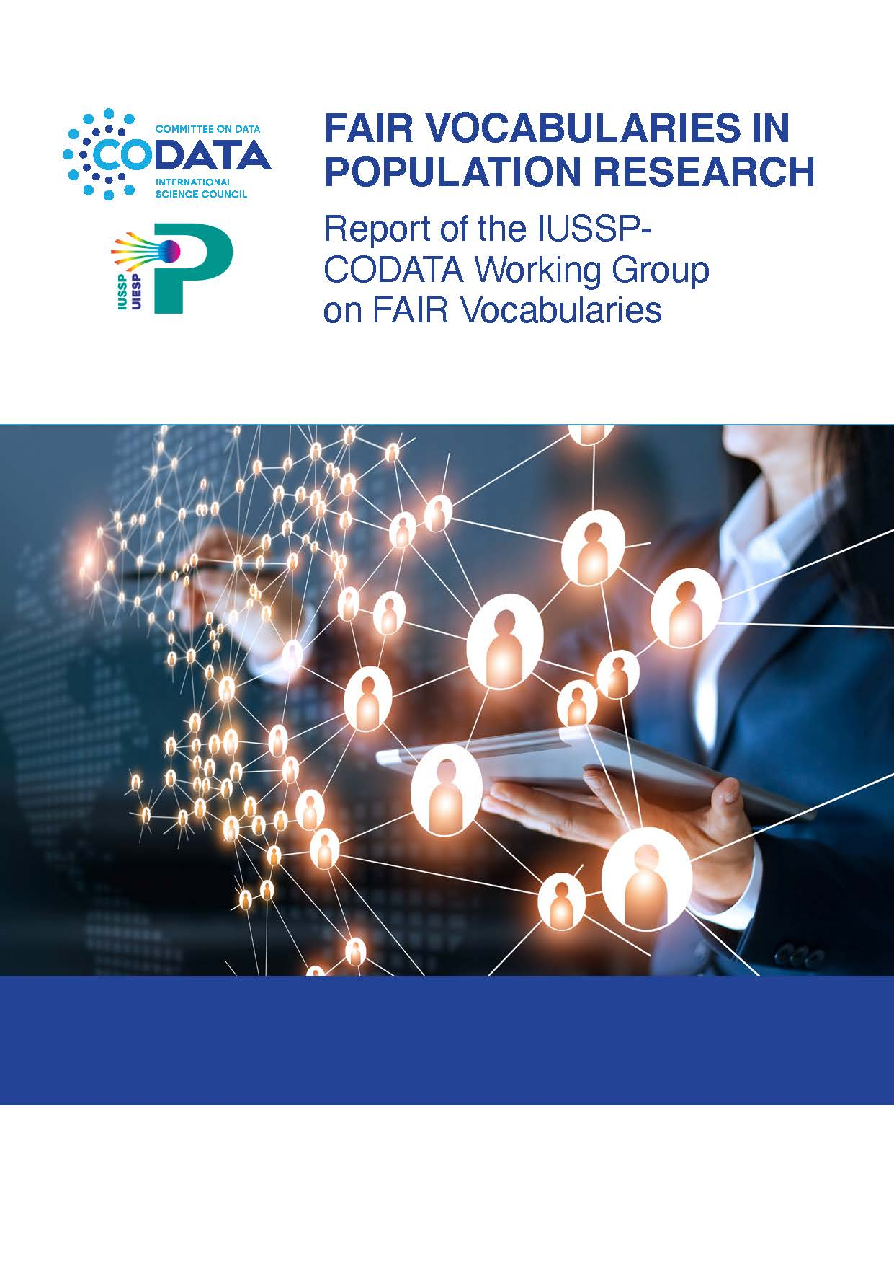

IUSSP-CODATA FAIR Vocabularies Working Group
George Alter
University of Michigan

Slide 2
IUSSP-CODATA FAIR Vocabularies Working Group
Goal:
Make demographic data more interoperable by publishing controlled vocabularies that can be found and acted upon by software.
Jointly sponsored by
IUSSP – International Union for the Scientific Study of Population
CODATA – Committee on Data of the International Science Council
Co-chairs
George Alter (University of Michigan)
Arofan Gregory (DDI Alliance / CODATA)
Steven McEachern (Australian National University)
With more than 20 demographers, statisticians, and data specialists around the world

Slide 3
Introducing FAIR Data and Demography
Two Sponsors: IUSSP and CODATA
Two Scientific Communities: Demography and Data Science
Two narratives:
Explain FAIR data to demographers
Explain infrastructure of demographic data to data scientists
Recommendations for IUSSP, CODATA and other stakeholders

Slide 4

What is FAIR ?
Findable The first step in (re)using data is to find them. Metadata and data should be easy to find for both humans and computers. Machine-readable metadata are essential for automatic discovery of datasets and services, so this is an essential component of the FAIRification process.
Accessible Once the user finds the required data, she/he/they need to know how can they be accessed, possibly including authentication and authorization.
Interoperable The data usually need to be integrated with other data. In addition, the data need to interoperate with applications or workflows for analysis, storage, and processing.
Reusable The ultimate goal of FAIR is to optimize the reuse of data. To achieve this, metadata and data should be well-described so that they can be replicated and/or combined in different settings.

Slide 5
FAIR is about making data machine-friendly
FAIR aims to automate the process of combining data from multiple sources
“Data wrangling” is the most labor intensive part of empirical research
FAIR is about metadata
Metadata (e.g., a codebook) describes the content and meaning of data
FAIR data and metadata are available online with “globally unique and persistent identifiers”
Persistent identifiers tell machines where to look and what they will find
Persistent identifiers point to “landing pages” that are human- and machine-readable

Slide 6
Why focus on FAIR vocabularies?
“Controlled vocabularies” create standards for terms and measurements
Controlled vocabularies are pervasive, e.g. industrial classifications, ICDs, geocodes (NUTS, FIPS, UN/LOCODE,…)
FAIR vocabularies allow machines to answer basic questions
How do we know when two data sets are measuring the same thing?
If two variables have the same persistent identifier, a machine knows they are the same
How does a machine know the difference between the Crude Birth Rate, the General Fertility Rate, the Total Fertility Rate, …?
Machines cannot read the PDF
Machines can use standards (e.g., RDF, SKOS) to navigate relationships

Slide 7
Use Cases for FAIR Vocabularies
Data discovery
Improve navigation of data catalogs with concept hierarchies
Link concepts to data
Data integration
Identify which variables and value schemas are the same
Data harmonization
Use crosswalks to convert different value schemas to a common standard
Data production
Use variable registries to build new questionnaires and other instruments

Slide 8
Use cases for Controlled Vocabularies in Population Science
Data discovery
Example: Find data showing the level of infant mortality
Data merging
Example: Compare infant mortality across countries
Data harmonization
Combine data sets that are coded in different ways
Example:
Data set A: Infant mortality (ages 0 to one year)
Data set B: Neo-natal (0 to 28 days) and Post-neonatal (28 to 365 days) infant mortality
Data merging and data harmonization are very time consuming.
FAIR data can lead to automation.

Slide 9
Levels of Controlled Vocabularies in Population Science
Concept | Age
Measure / Variable | Age at last birthday | Age group
Code list / Value domain | (0, 1, 2, … 100) | (0-4, 5-9, 10-14, … 90 or older)
Code mapping / Crosswalk | (0-4, 5-9, 10-14, … 65+) (0-14, 15-64, 65-85, 85+) | (0-14, 15-64, 65+)

Slide 10
Data harmonization is becoming more necessary and more difficult
Response schemas are becoming more diverse
Example: Marital status
There used to be 4 categories: Single, Married, Divorced, Widowed
Eurostat now has 27 categories, including “Registered partnership” and “Consensual union”

Slide 11
FAIR Vocabularies make automation possible
Suppose that you want to know the population aged 18 to 24 in as many countries as possible
You will use a computer program to
Find persistent identifiers for “Population” and “Age”
Search metadata files for data with dimensions “Population” and “Age”
Filter results for data sets that can be aggregated to ages 18 to 24
Codelists (e.g., [“0”, “1”, “2”,…] or [“0-4”, “5-9”,…]) will have persistent identifiers in the metadata file
In other words, FAIR vocabularies will automate “data wrangling”

Slide 12
The Ecosystem of Demographic Data
Demographic data is produced by two communities
Each has its own metadata standard: SDMX and DDI
National and international statistical agencies (SDMX)
Standardized on Statistical Data and Metadata eXchange (SDMX)
SDMX is supported by the UN, OECD, ILO, IMF, World Bank, Eurostat, European Central Bank, Bank for International Settlements, and national statistical offices
International agreements on standards and content are expressed in SDMX
Surveys and other microdata (DDI)
Data Documentation Initiative (DDI)
Data production is highly decentralized and uncoordinated
Use of DDI in data production is limited but growing
Data repositories are coordinated and standardized on DDI
CESSDA, DataPASS, Dataverse

Slide 13
FAIR Vocabularies in the SDMX community
SDMX was created to standardize the exchange of data
SDMX is endorsed by international authorities, like the UN Statistical Commission, and is an ISO standard
SDMX registries share data and metadata
Registries are at international organizations (UN, OECD, ILO, World Bank…)
Distribute SDMX concepts, codelists, and data structure definitions
Aggregate data from national statistical offices, national banks, etc.
SDMX Global Registry shares global and “cross domain” artifacts
E.g., UN Sustainable Development Goals (SDGs) as well as code lists for the Degree of Urbanisation, Civil Status, etc.
SDMX is close to FAIR
Open source software for SDMX registries deploys common APIs
Most SDMX registries assign URNs but could move to resolvable URIs
Community is moving toward federated registries
SDMX is still more rooted in data exchange than data sharing
Codelists are not always coordinated across data aggregators
Extracting metadata from SDMX APIs requires detailed knowledge of SDMX conventions and practices

Slide 14
FAIR Vocabularies in the DDI Community (1)
DDI Metadata is mostly created (re-created) at data repositories
Controlled vocabularies for concepts, variables, and coding are difficult to apply retroactively
Comparability of international surveys varies widely
Some are designed for comparability (e.g., Demographic and Health Surveys)
Harmonization of similar but uncoordinated surveys requires considerable effort
Vocabularies and tools are developing
DDI-Lifecycle uses schemas for metadata-driven survey design
CESSDA is developing vocabularies and a question bank
European Language Social Science Thesaurus (ELSST) is a FAIR multilingual thesaurus of social science concepts

Slide 15
FAIR Vocabularies in the DDI Community (2)
IPUMS occupies a unique position in the social science data world
IPUMS harmonizes census microdata from 100+ countries
Has developed hundreds of crosswalks between different coding schemas
Census microdata at IPUMS is also distributed as aggregate data in SDMX
IPUMS crosswalks could be used to harmonize SDMX dataflows

Slide 16
If we don’t define demographic terms, someone else will
We searched for definitions “fertility” and “fecundity” in 19 online vocabularies
7 vocabularies followed the conventions in demography
12 vocabularies reversed the meanings of the terms
Fertility | Fecundity
Demopaedia (IUSSP’s online thesaurus) Fertility and infertility refer to reproductive performance rather than capacity, and are used according to whether there was actual childbearing or not during the period under review. | The capacity of a man, a woman or a couple to produce a live child is called fecundity.
Wikidata natural capability to produce offspring | actual reproductive rate of an organism or population, measured by the number of gametes (eggs), seed set, or asexual propagules.
Gender, Sex, and Sexual Orientation Ontology (GSSO) The ability of an individual to produce offspring. | A reproductive quality inhering in an organism or population by virtue of the bearer's potential reproductive capacity and measured by the number of gametes.
Medical Subject Headings (MESH) The capacity to conceive or to induce conception. It may refer to either the male or female.
Notes:
One of the areas of concern for the working group is the representation of demographic concepts and measures in existing online vocabularies
We can illustrate the problem with the concepts of “fertility” and “fecundity”
The English language meanings of “fertility” and “fecundity” were established in the 1930s
Fertility refers to measurable reproductive performance
Fecundity refers to the potential reproduction
However, the bio-medical community uses the same terms in the opposite way
I consulted 19 online vocabularies, and most of them used the bio-medical definitions

Slide 17
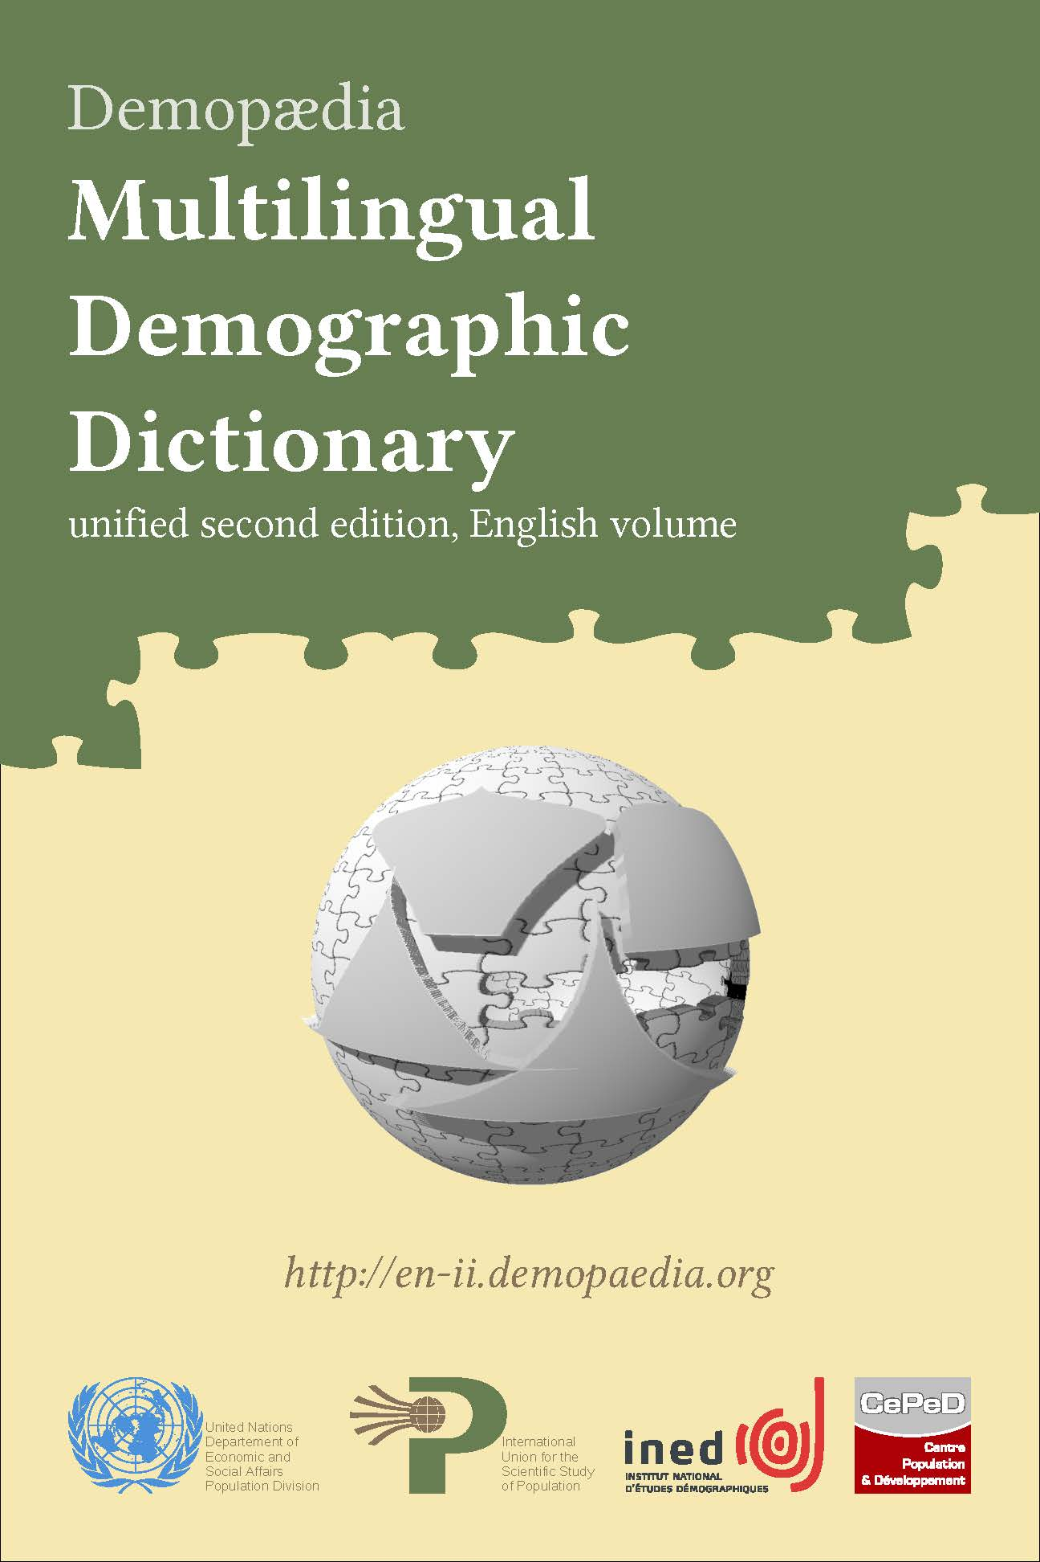
Recommendations for IUSSP
IUSSP should create a “FAIR Vocabulary of Demography”
A FAIR Vocabulary of Demography will be an authoritative resource that other services can rely on
IUSSP has a long history of producing multilingual dictionaries of demography
Partnership between IUSSP and UN Population Division
A FAIR vocabulary can be built on existing online resources
Demopaedia
DemoVoc
Outreach to SDMX and DDI
The FAIR Vocabulary of Demography should export content in SDMX and DDI formats
The aim is to lower the cost of adoption of IUSSP definitions by other communities
Promote data harmonization
Facilitate and publicize standards for concepts, measures, and classifications in demography
Appendix on Governance of a FAIR vocabulary

Slide 18
Recommendations for SDMX
SDMX registries should become fully FAIR
Adopt resolvable identifiers
Adopt semantic web standards
RDF, SKOS, XKOS
Promote best practices to simplify data dissemination
SDMX was developed for data exchange
Differences in implementation will hinder use of SDMX APIs

Slide 19
Recommendations for the DDI Alliance
Develop guidelines and practices for DDI-based registries of vocabularies, variables, and value domains
Encourage the use of persistent identifiers from the beginning of the data lifecycle
Facilitate data harmonization
Encourage use of tools like SKOS/XKOS
Contribute to research and development of linking persistent identifiers

Slide 20
Recommendations for IPUMS
Make IPUMS metadata FAIR
Assign persistent identifiers to variables, codelists, and codelist mappings
Provide APIs for access to IPUMS metadata
Link IPUMS persistent identifiers to other registries, such as SDMX and ELSST

Slide 21
Harmonizing Vocabularies to Harmonize Data
Expect a proliferation of persistent identifiers
A centralized registry for the social sciences is very unlikely
Both SDMX and DDI are moving toward federated registries
Identical concepts, variables, and codelists will have different persistent identifiers in different places
FAIR will not work if there is no way to link objects in different places
IUSSP and CODATA should encourage research and development on automated tools for linking items across vocabularies
A large body of research on this problem already exists, especially in bioinformatics

Slide 22
Thanks to:
Leadership of IUSSP and CODATA
Co-chairs
Consultants
Members of the WG
George Alter, Co-chair (University of Michigan, IUSSP) Arofan Gregory, Co-chair (DDI Alliance, CODATA) Steven McEachern, Co-chair (Australian National University, DDI Alliance, CODATA) Darren S Bell (UK Data Archive) Derek Burk (University of Minnesota, Institute for Social Research and Data Innovation (ISRDI), IPUMS) Robert Chen (Center for International Earth Science Information Network (CIESIN), Columbia University) Alessio Cardacino (Italian National Statistical Institute) Nada Chaya (Arab Council for the Social Sciences ) David Barraclough (OECD and SDMX) Rowan Brownlee (Australia Research Data Commons) Tom Emery (Erasmus University Rotterdam) Patrick Gerland (United Nations) Cristina Giudici (Sapienza University of Rome) Abdulla Gozalov (Statistics Division, United Nations) | Edgardo Greising (International Labour Organization) Sanda Ionescu (ICPSR) Taina Jääskeläinen (Finnish Social Science Data Archive and CESSDA Vocabulary Service) Chifundo Kanjala (ALPHA Network) Vladimira Kantorova (United Nations) Joseph Larmarange (CEPED and Demopaedia) Pablo Lattes (United Nations) Jared Lyle (ICPSR) Diana Magnuson (University of Minnesota, Institute for Social Research and Data Innovation (ISRDI), IPUMS) Melissa Meinhart (Equality Insights) Santosh Kumar Mishra (S.N.D.T. Women’s University) Romesh Silva (United Nations, UNFPA) Thomas Spoorenberg (United Nations) Philipp Ueffing (United Nations) Jay Winkler (ICPSR)

Slide 23

Thank you!
George Alter
altergc@umich.edu
IUSSP-CODATA FAIR Vocabularies Working Group
https://iussp.org/en/iussp-codata-fair-vocabularies-working-group

