Slide 1
Statistical Data and Metadata eXchange (SDMX)
IUSSP-CODATA FAIR Vocabularies Working Group
Abdulla Gozalov
United Nations Statistics Division

Slide 2
What is SDMX?
Statistical Data and Metadata eXchange is a standard
Initiated and maintained by seven international agencies
Bank for International Settlements, European Central Bank, Eurostat, Organization for Economic Cooperation and Development, International Monetary Fund, United Nations, and World Bank
Endorsed by the United Nations Statistical Commission as a preferred standard for data and metadata exchange
ISO Standard 17369
First version of the standard released in 2004, current version 3.0 in 2021
https://sdmx.org

Slide 3
How is SDMX used?
Global data exchange and dissemination of statistical data using standardized structures in various subject-matter domains including National Accounts, Balance of Payments, Foreign Direct Investment, SEEA, Sustainable Development Goals, and others.
Joint Eurostat-UNSD demographic data collection for the Europe/former USSR region
Dissemination by international and national statistical agencies
The publication of standardized concepts and code lists at the Global Registry promotes their use in dissemination and other contexts
Dissemination platforms based on SDMX gaining more and more widespread use at national and international level
Thanks to their power, efficiency, and support for multi-lingualism

Slide 4
What does SDMX offer?
Technical standards
Specifications of protocols, data and metadata formats, registry APIs, etc
Statistical guidelines
Standardized terminology, code lists and subject-matter domains (content-oriented guidelines)
Guidelines for structure design and maintenance
Tools
Developed by various organizations in the community
Most are free to use
Structure design and maintenance, data mapping and conversion, APIs, dissemination platforms

Slide 5
Global and Cross-Domain Artefacts
Content-oriented guidelines facilitate mutual understanding of the content of the SDMX data and metadata files through the use of common statistical concepts in the underlying metadata.
Not part of the ISO Standard
Guidelines not requirements
Cross-domain artefacts – concepts and code lists – are recommended for use in a large number of statistical subject-matter domains
Sex, Age, Reference Area, Observations Status, …
As much as possible, are based on international classifications
Global structures are developed for the exchange of statistical data and metadata for specific subject-matter domains
May include both cross-domain and domain-specific concepts and code lists

Slide 6
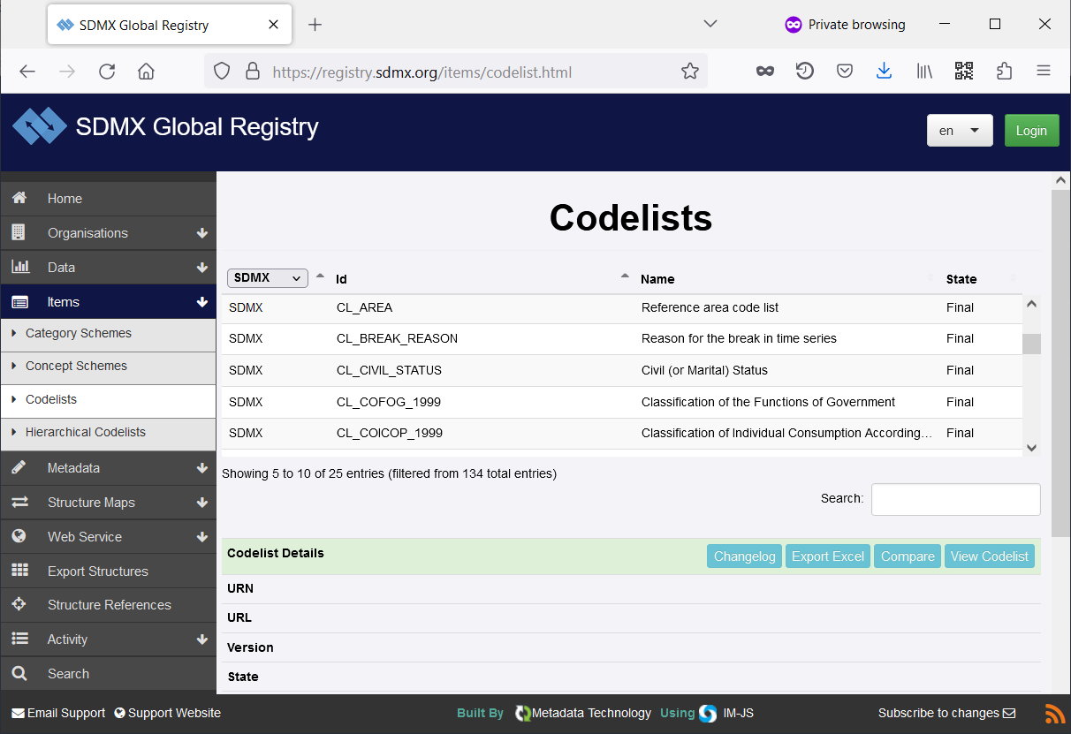
SDMX Global Registry
A repository of global and cross-domain artefacts
Concepts
Code lists
Data Structures
Dataflows, constraints, …..
https://registry.sdmx.org

Slide 7
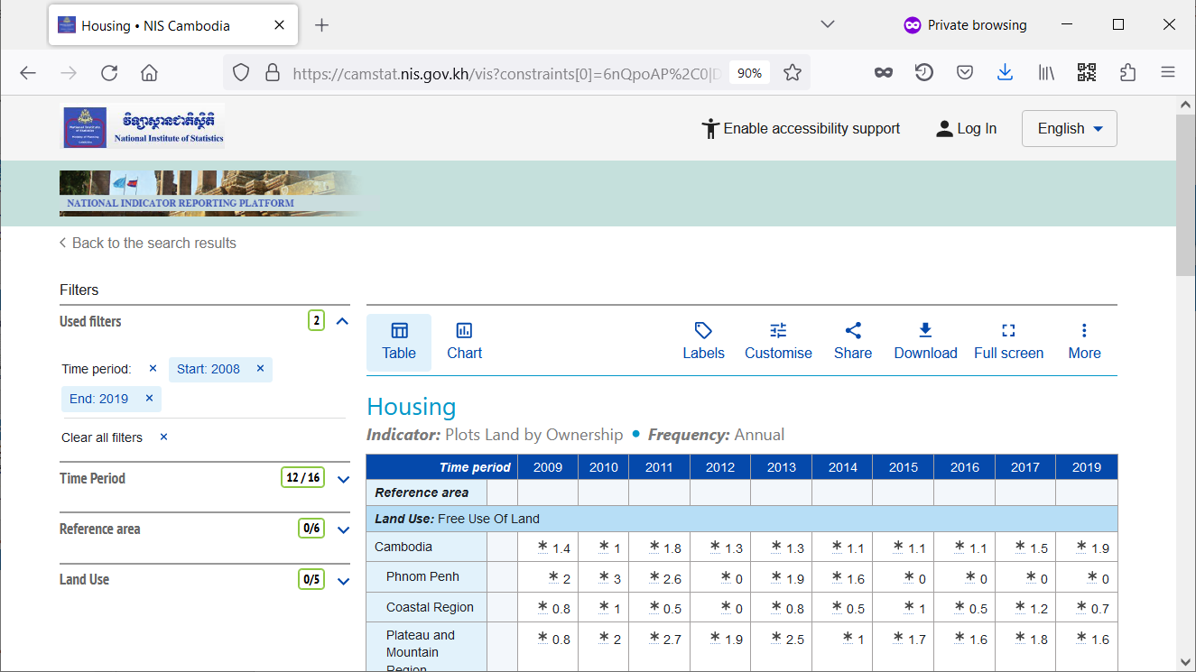
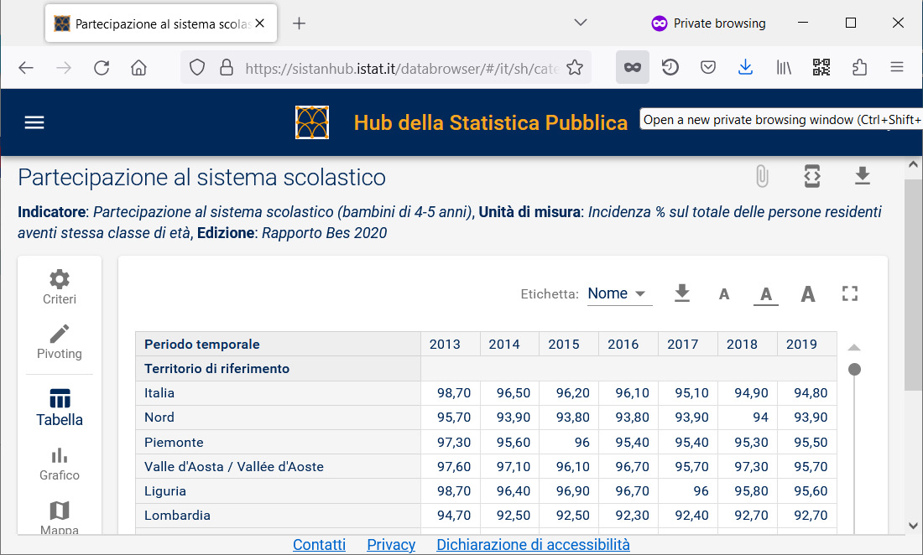
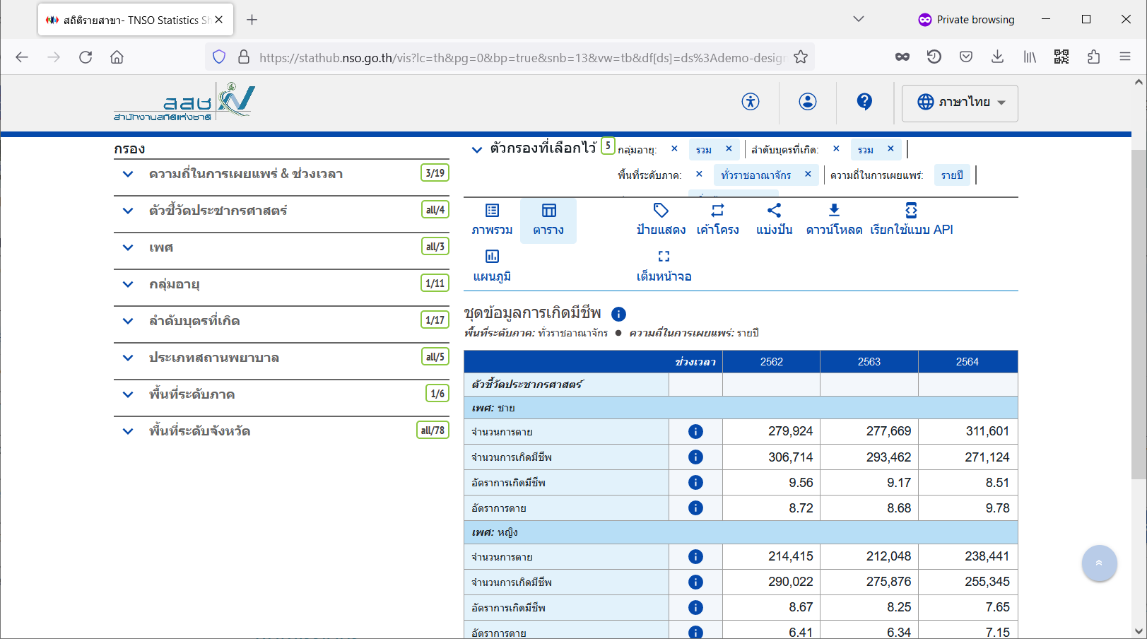
SDMX-based Data Dissemination
https://camstat.nis.gov.kh/
Based on open-source .Stat Suite (Cambodia, Thailand) and IStat SDMX Toolkit (Italy)
Fully multi-lingual
Variety of visualiations
All data available at SDMX API
https://sistanhub.istat.it/
https://stathub.nso.go.th/

Slide 8
Is SDMX Metadata FAIR?
Findable
Accessible
Interoperable
Reusable
But… the devil is in the details

Slide 9
Identifiers
SDMX artefact identifiers are generally not resolvable
URNs applicable to both artefacts and individual items, such as code lists and codes, follow a specific format but are not Web addresses
Global and cross-domain artefacts, such as code lists stored at the Global Registry can be said to have resolvable globally unique identifiers
A by-product of the RESTful registry API
But this does not apply to individual items such as codes
Implementation of unique resolvable identifiers in the standard is the most important step to making the SDMX artefacts FAIR

Slide 10
Semantic Web
SDMX community would greatly benefit from better integration of data and metadata with the Semantic Web
SKOS/XKOS
RDF Data Cube
Promising collaboration between the UN Statistics Division and Google on exposing UN datasets at Data Commons

Slide 11
Benefits of making SDMX FAIR
Improved interoperability
Improved discovery
More efficient design of structures for data exchange and dissemination

Slide 12
2023 SDMX Global Conference
To take place in from 29 Oct – 2 Nov 2023 in Bahrain
2023 Conference theme: Empowering Data Communities
Brings together National Statistical Offices, Central Banks, international agencies, academia, private sector
Focus on
Implementation of SDMX 3.0
Open-source software tools
Validation and Transformation Language (VTL)
Data and metadata governance
SDMX and other standards
https://sdmx2023.org

Slide 13
Thank you!

