Slide 1
FAIR Vocabularies in Data Collection and Management
Assoc. Prof. Steve McEachern
Director, Australian Data Archive
Australian National University
https://ada.edu.au

Slide 2
Context
I’m a national co-investigator on a cross-national data collection – the International Social Survey Programme (http://www.issp.org/menu-top/home/ )
This includes responsibility for data collection, as well as data harmonisation
I direct the Australian Data Archive (https://ada.edu.au), where we manage and disseminate survey and aggregate data collections
I teach survey data collection methods at the Australian National University
(Acknowledgement: in my spare time I’m a member of the DDI Alliance and CODATA executive committees)

Slide 3
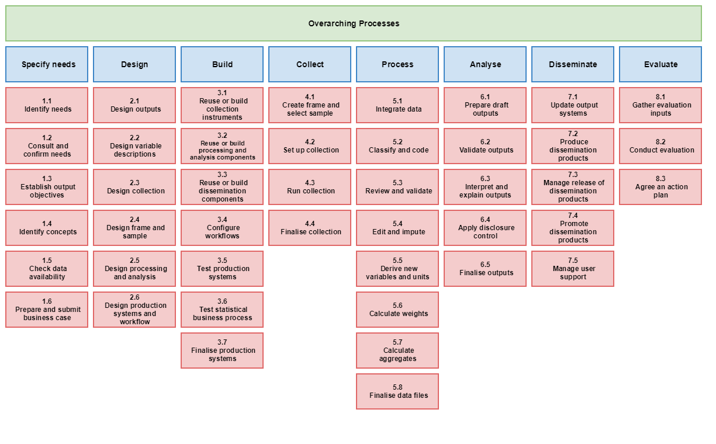
A model of survey data collection (GSBPM)

Slide 4
Where do we use vocabularies?
Research design
Research questions: concepts and hypotheses
Design/collection:
Design of instruments:
Response domains
Variable and question banks
Sampling:
Stratification for sample design
Sample frame creation/extraction
Processing
Data coding – aligned to statistical classifications
Analysis
In creation of aggregates
Subsetting
Modelling – covariates, control variables, etc.

Slide 5
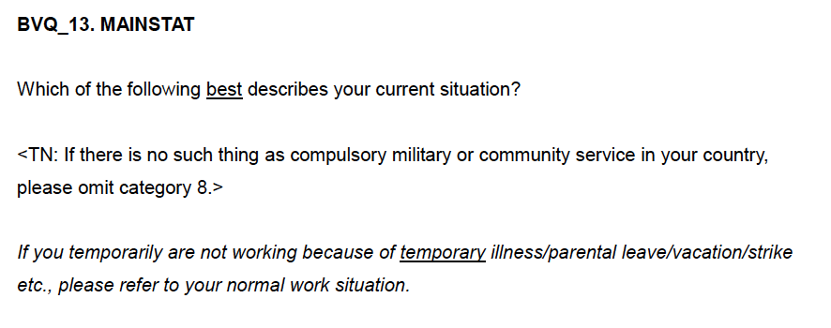
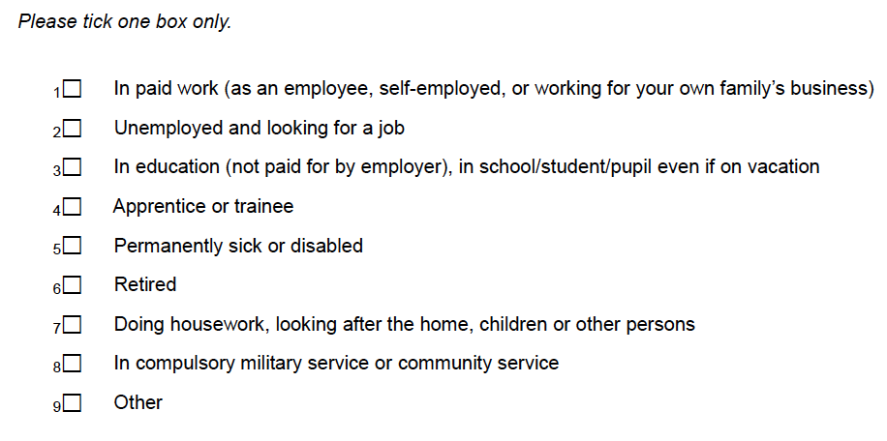
Questionnaire specification – International Social Survey Programme
https://issp.org/

Slide 6
Questionnaire specification - ISSP
Response domain
(Categories and codes)
Variable
Question
Plus?
Concept: Employment status

Slide 7
Concepts, concepts everywhere
Research question / measurement concept
Employment status
Response domain (code lists and categories)
Paid work
Unemployed
In education
Apprenticeship/traineeship
Permanently sick or disabled
Retired
Doing housework, looking after the home
Military service
Community service
….
But how to connect the dots?
We can use DDI – but it needs more

Slide 8
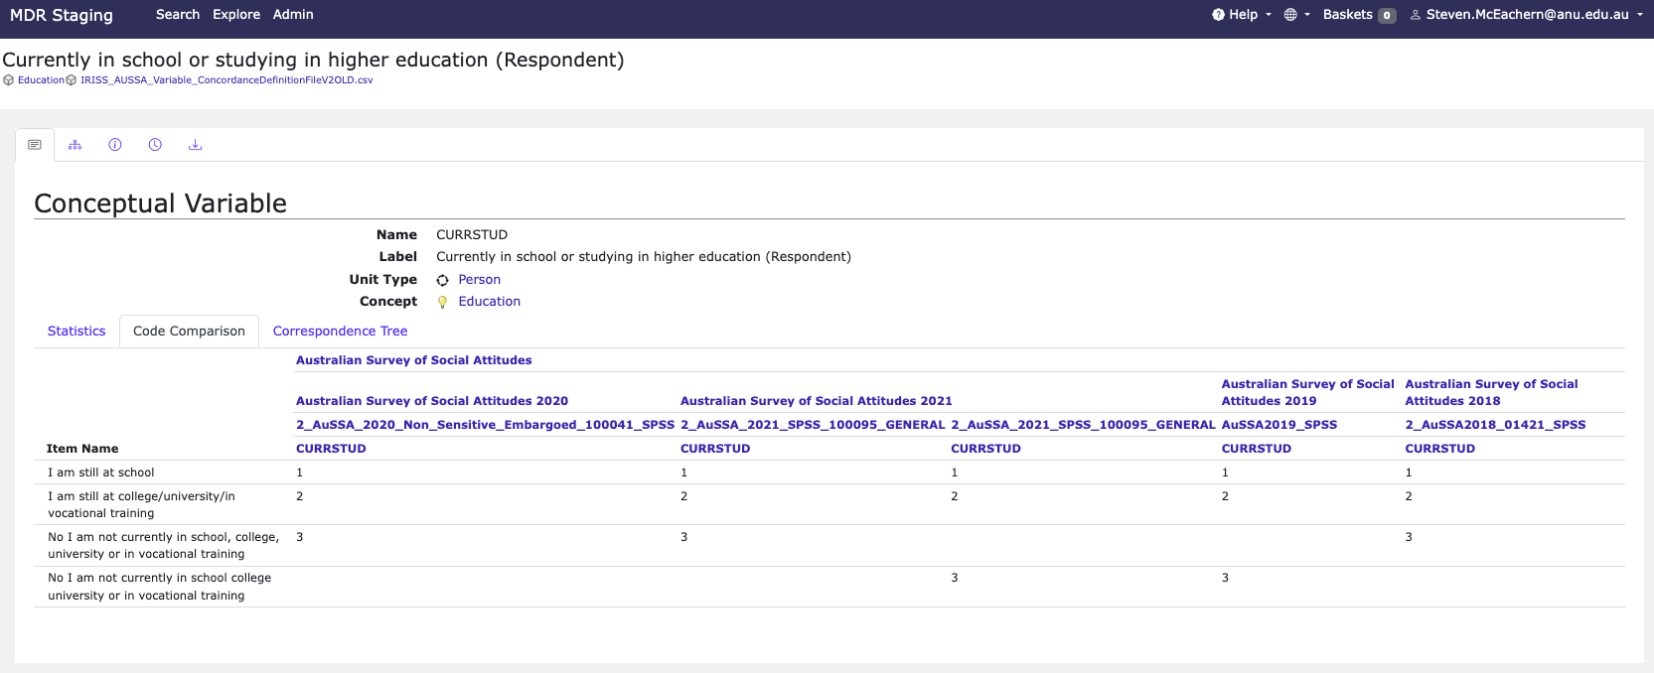
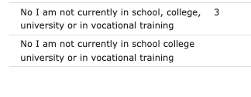
Need to connect humans to machines, and machines to each other
Humans make errors in process
Machines can identify differences
But they cannot interpret differences (at least not yet)

Slide 9
Content is not accessible in machine-processable form
PDF data dictionaries: easy to read, printable
Great for humans
Useless for machines
ABS Census Data Dictionary: HTML
nicely formatted for humans, easily readable, content-rich
HTML is not consistent - for machines – NOT REUSEABLE

Slide 10
Recommendations for the DDI Alliance
Develop guidelines and practices for DDI-based registries of vocabularies, variables, and value domains
Encourage the use of persistent identifiers from the beginning of the data lifecycle
Facilitate data harmonization
Encourage use of tools like SKOS/XKOS
Contribute to research and development of linking persistent identifiers

Slide 11
1. Develop guidelines and practices for DDI-based registries of vocabularies, variables, and value domains

Slide 12
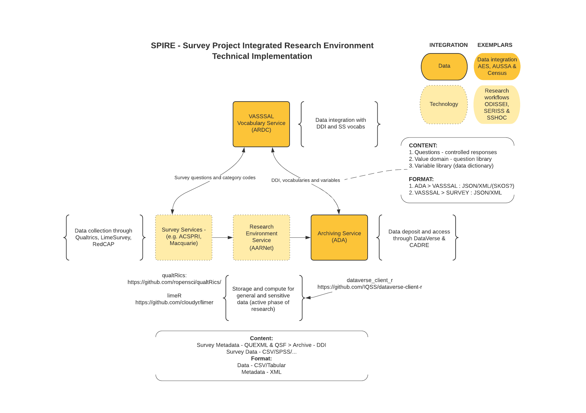
A model of data and metadata exchange
https://ausiriss.org.au

Slide 13
Vocabulary registries
CESSDA
ELSST
Research Vocabularies Australia
Australian Politics Vocabulary:
Australian Bureau of Statistics Census Dictionary: https://demo.vocabs.ardc.edu.au/viewById/955
Human readable:
Plus SKOS, JSON, Turtle, …
Including codes and categories:
Australian Census Dictionary, Age in 5 year age groups, Category Age 0-4 https://demo.vocabs.ardc.edu.au/repository/api/lda/ands-nc/a-subset-of-the-2021-abs-census-data-dictionary/3/resource?uri=http%3A%2F%2Fexample.com%2Fcensus%2FAGE5P%2F01

Slide 14
Variable and value domain registries
DDI Lifecycle: Colectica-based services
For data harmonization across series or variable collections
DDI Cross-Domain Integration – extends to other data formats (e.g. long, wide, …)
All use the DDI Variable Cascade model
Need to look carefully at how we persist identifiers
Speaking of which….

Slide 15
2. Encourage the use of persistent identifiers from the beginning of the data lifecycle

Slide 16
Where can we do this?
Concept identifiers
Designing survey questions
Data cleaning – applying external classifications

Slide 17
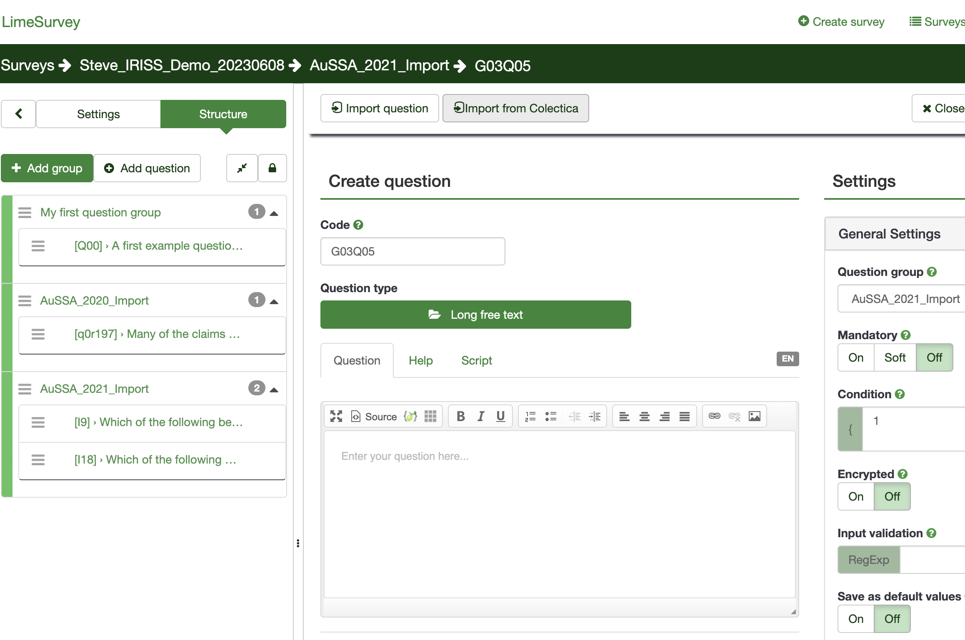
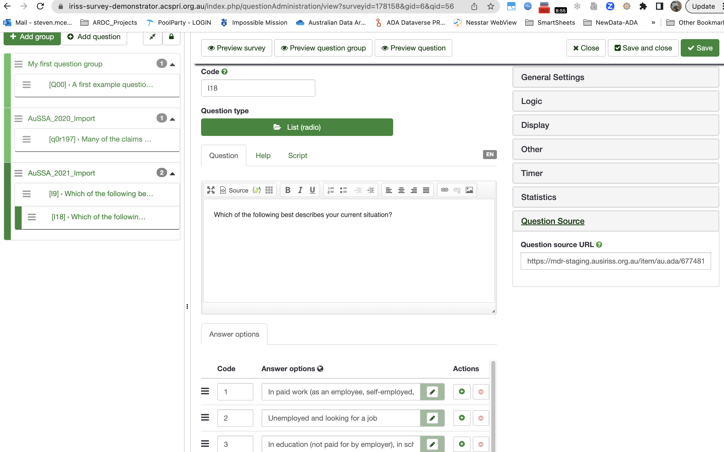
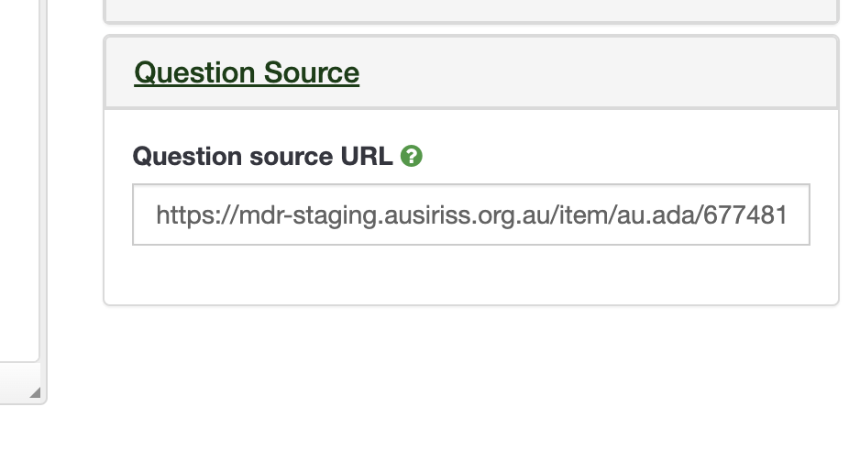
A simple example – Australian Survey of Social Attitudes (AU ISSP)

Slide 18
3. Facilitate data harmonization a) Encourage use of tools like SKOS/XKOS b) Contribute to research and development of linking persistent identifiers

Slide 19
Linking data
Concept (SKOS:Concept)
To
Question (DDI:QuestionItem)
To
Categories (DDI/SKOS/SDMX) (each a SKOS:Concept )
To
Code List (DDI/SDMX)
To
Variable (DDI)
To
Harmonisation (DDI - Represented/Conceptual Variable)
To
Concept (SKOS:Concept)
We have the standards
We now need the implementations in the software we use (in data collection and analysis)
And to reuse what others have already done (reuse of persisted information available in services)

