Slide 1
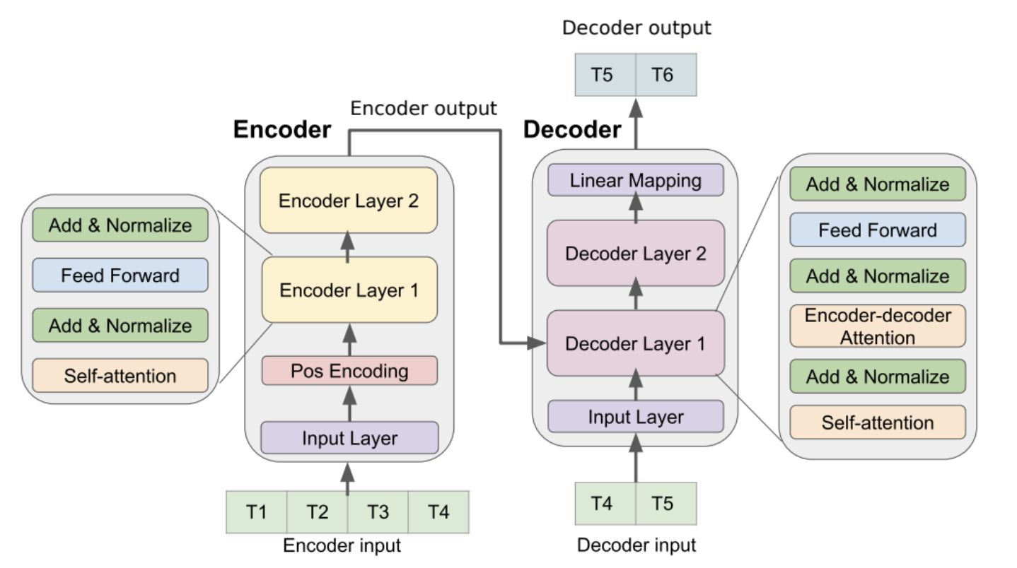
48x512
48x512
48x512
1x512
1x512
48x1

