Slide 1
Weak Lensing:
Why do we measure (science!)
Tom Kitching
t.kitching@ucl.ac.uk
@tom_kitching
http://msslcosmology.org/
In science almost every idea is wrong, either trivially wrong (there is a mathematical error) or more substantially wrong… if that were not the case it would be almost to easy
Lawrence Krauss

Slide 2



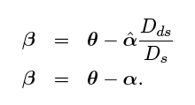

What
do we
want to
measure
What
do we
measure
How
do we
measure
Why
do we
measure

Slide 3
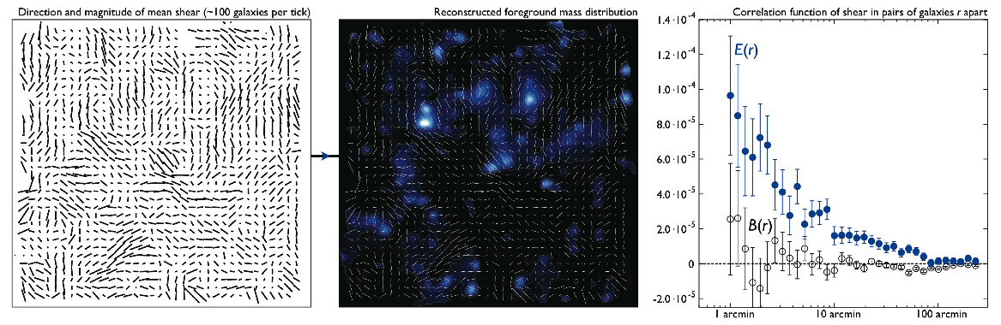
Here is a shear catalogue…
  What do you do with it?
Three typical things that people have done with weak lensing data
  1) Make maps of mass
  2) Look at lensing signal around individual galaxies
  3) Measure the variance of the shear field
Plot credit: Euclid Definition Study Report

Slide 4
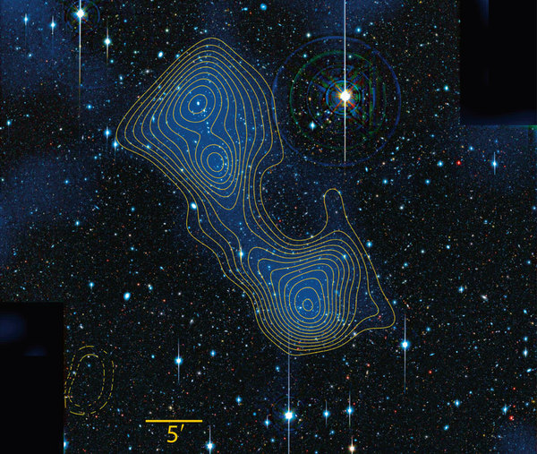
Mass Maps
How do we make
such a map?
Dietrich et al., (2010)

Slide 5
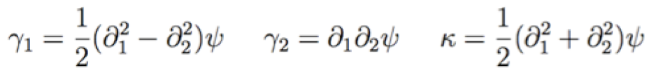
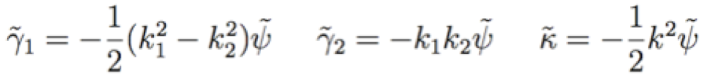
Mass Maps
Standard way is called the “Kaiser-Squires” method/approach
Kaiser & Squires (1992)
Imagine you have a catalogue of shear and convergence values
binned on a grid
We know that
and we can take the FFT of this grid

Slide 6
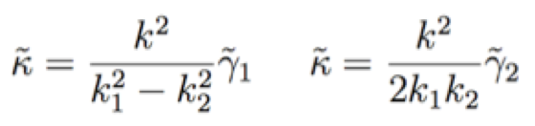
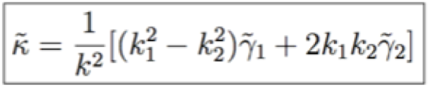


Mass Maps
So we can solve for κ
And take an optimal combination of the two shear values
Finally then FFT back to get the real-space convergence field
So we have a map of the derivative of the lensing potential i.e. “mass”

Slide 7
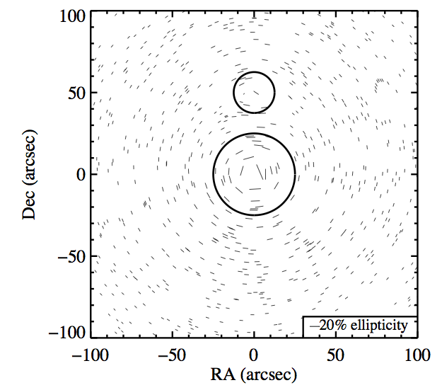
Mass Maps
Alternatively fit a functional profile to the data
  e.g. an SIS with free parameters (size, ellipticity of cluster, position)
  Can use Bayesian methods to create a density map
Plot credit: Harvey et al (2013)

Slide 8
Galaxy-galaxy lensing
Take galaxies, bin in angle and measure the tangential shear
θ
Foreground galaxies with spectroscopic redshift
Can bin in stellar-mass, redshift etc.
Easy to measure, but interpretation involves halo-model

Slide 9
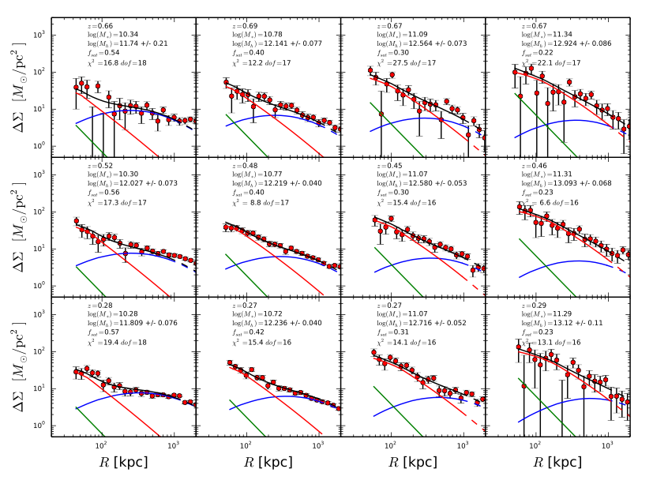
Galaxy-galaxy lensing
Hudson et al. (2013)

Slide 10
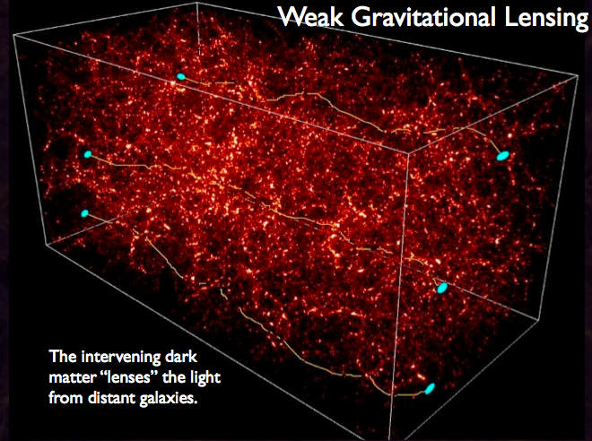
“Cosmic” Shear
Is the shear produced by the large scale structure and geometry of the Universe

Slide 11
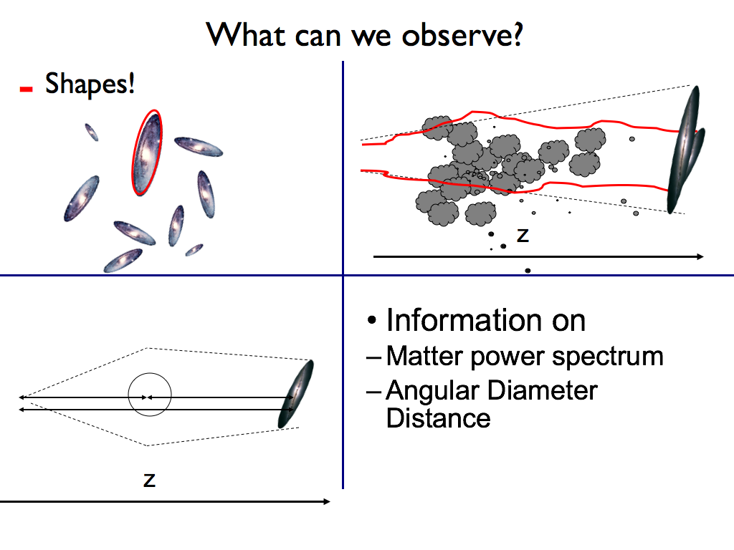
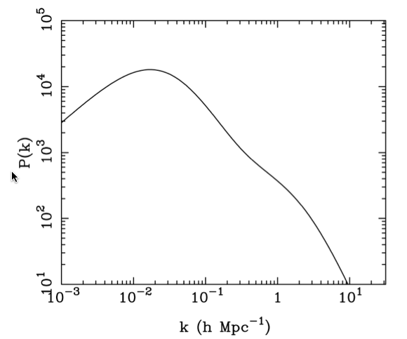
Expected to be sensitive to both the geometry and the matter power spectrum

Slide 12
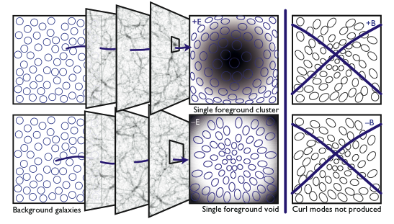
When averaged over sufficient area the shear field has a mean of zero
Use 2 point correlation function or power spectra which contains cosmological information
Plot credit: Kitching et al. (2012)

Slide 13
2 varieties several flavors
Correlation functions
  Top-hat
  Map
  COSEBIs
Power spectra
  3D
  Tomography
Crucial differences:
  Information loss – averaging & assumptions
  Treatment of scales

Slide 14

Correlation function measures the tendency for galaxies at a chosen separation to have preferred shape alignment

Slide 15

Correlation Functions
Lensing induced distortions perpendicular (i.e. tangential to the line of sight)
Can create two correlation functions from the spin-2 ellipticities
What weight function to use?
  Want one that will separate E-mode from B-mode

Slide 16
θ

Slide 17

The 2PCFs are the Hankel transforms of the convergence power spectrum or, more precisely, of linear combinations of the E- and B-mode spectra
Proof is rather involved
Importantly this mixes
  E- and B-modes
  All scales are mixed together
Theory
Bessel

Slide 18

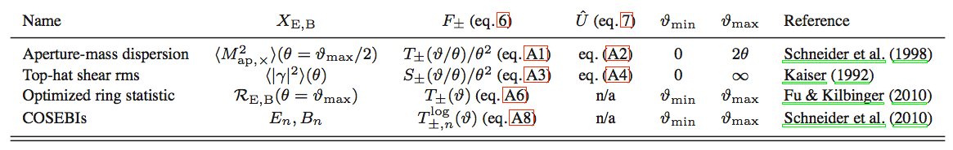
Want to “filter” the raw correlation functions to extract pure E- and B-mode
A few possibilities
Note (very important) that the indefinite integral needs to be approximated
Filter choice
Table from Kilbinger et al. (2013)

Slide 19
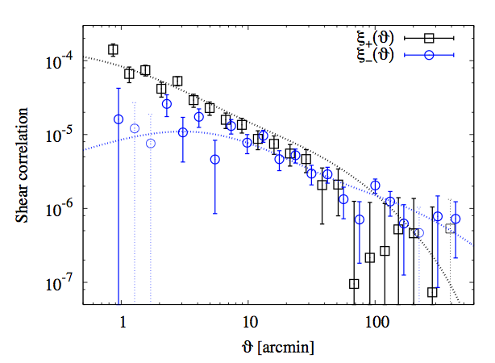
Kilbinger et al. (2013): Athena and Nicea
Raw Correlations

Slide 20
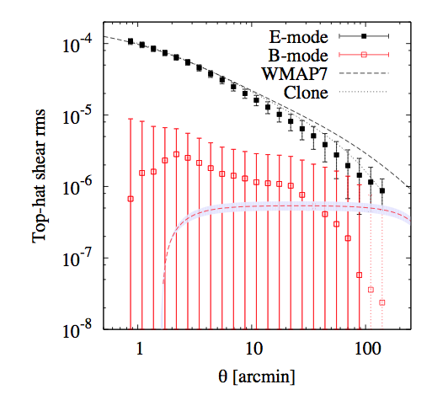
Kilbinger et al. (2013)

Slide 21
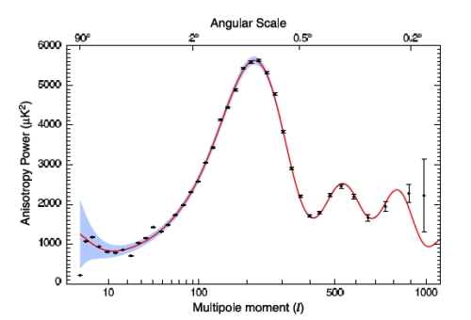
What we really want equivalent of the CMB power spectrum
But:
CMB is a 2D field
Shear is a 3D field
Plot credit: WMAP7

Slide 22


Spherical Harmonics
Normal Fourier Transform
What we really want is the 3D power spectrum for cosmic shear
  So need to generalise to spherical harmonics for spin-2 field

Slide 23

Spherical Harmonics
Describes general transforms on a sphere for any spin-weight quantity s
k = radial wavenumber
l and m = angular wavenumbers

Slide 24

Spherical Harmonics
For flat sky approximation
  Y’s->exponentials
  Isotropy
Covariances of the flat sky coefficients related to the power spectrum (what we want)
For full details see Kitching et al. (2013)
  Some approximations made in the following

Slide 25



Derivation of the power spectrum
How to we theoretically predict γ(r)?
From Lecture 2 we know that shear is related to the 2nd complex-derivative of the lensing potential
And that lensing potential is the projected Newtons potential

Slide 26

Derivation of CS power spectrum
Can related the Newtons potential to the matter overdensity via Poisson’s Equation

Slide 27
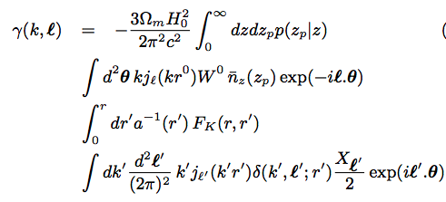
Derivation of CS power spectrum
Generate theoretical shear estimate:
3d integral split
Distances
From complex derivatives
acting on exponentials

Slide 28
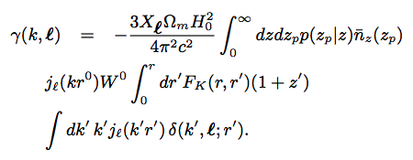

Simplifies to
Directly relates underlying matter to the observable coefficients that are simple spherical harmonic sums of the shears

Slide 29


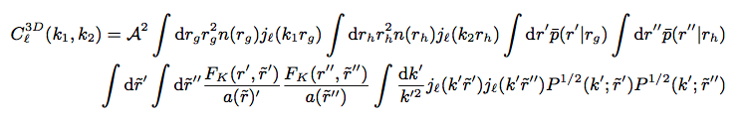
Derivation of CS power spectrum
Finally we need to take the covariance of this to generate the power spectrum

Slide 30
The full 3D cosmic shear power spectrum
Geometry
Theory
Large Scale Structure
Data
Note: can make a clean cut in scales
Heavens (2003)
Kitching, Heavens, Miller (2012)
New code: 3Dfast to do this; send me an email

Slide 31
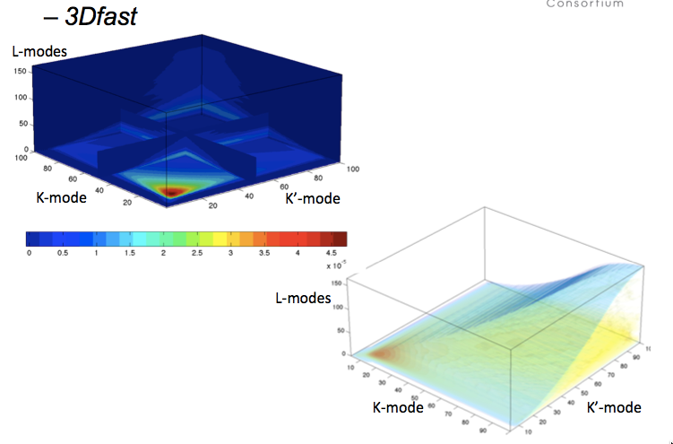

Slide 32
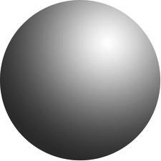
“Tomography”
What is “Cosmic Shear Tomography” and how does it relate to the full 3D shear field?
The Limber Approximation
  (k_{x},k_{y},k_{z}) projected to (k_{x},k_{y})

Slide 33

“Tomography”
Limber may be ok at very small scales
Very useful Limber Approximation formula (LoVerde & Afshordi, 2010)

Slide 34

Note that k-mode is now linked to l-mode
k=l/r

Slide 35
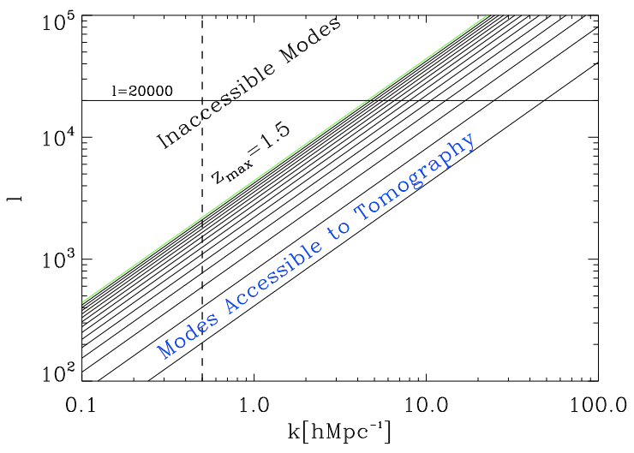
l_{max} < k_{max} r[z]
z
At low z only low l
Should be used
Kitching & Taylor, 2011

Slide 36
“Tomography”
  1) Limber Approximation (lossy)
    Mixes angular and radial scales
Make two more approximations:
  2) Transform to Real space (~benign)
  3) Discretisation in redshift space (lossy)
First proposed by Hu (1999)

Slide 37




Tomography
  Generate 2D shear correlation in redshift bins
  Can “auto” correlate in a bin
  Or “cross” correlate between bin pairs
  i and j refer to redshift bin pairs
z

Slide 38
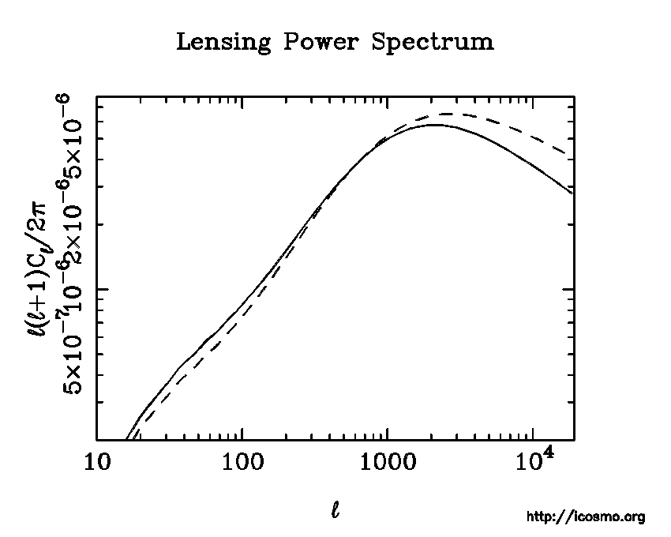
Tomographic power spectrum C(l)
BUT this does not account for l<kr Limber
w₀=-0.45
w₀=-0.95

Slide 39
Tomographic power spectrum C(l)
w₀=-0.45
w₀=-0.95
We cannot interpret this because k_{max}~infinity used

Slide 40
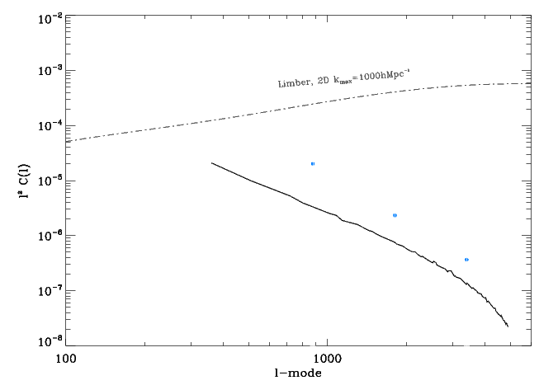
Easy to cut in theory-space, much more difficult in data-space
l²C(l)
k_{max}=1.5hMpc⁻¹
If k (radial selection) is not accounted for
Power can catastrophically overestimated
100
1000
10,000
l-mode

Slide 41
Conclusion
t.kitching@ucl.ac.uk
@tom_kitching
Lensing is a simple cosmological probe
  Directly related to General Relativity
  Simple linear image distortions
But measurement from data is challenging
  Need lots of galaxies and very sophisticated, very large, very expensive experiments
Lensing is a powerful probe of cosmology
  In particular dark energy and dark matter

Slide 42


