Slide 1
Network of Trust
social aspects of network traffic

Slide 2
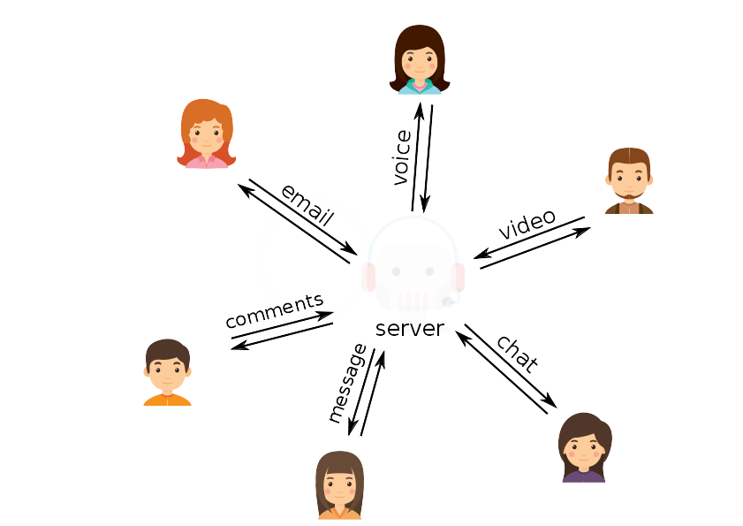
Big server is watching you

Slide 3
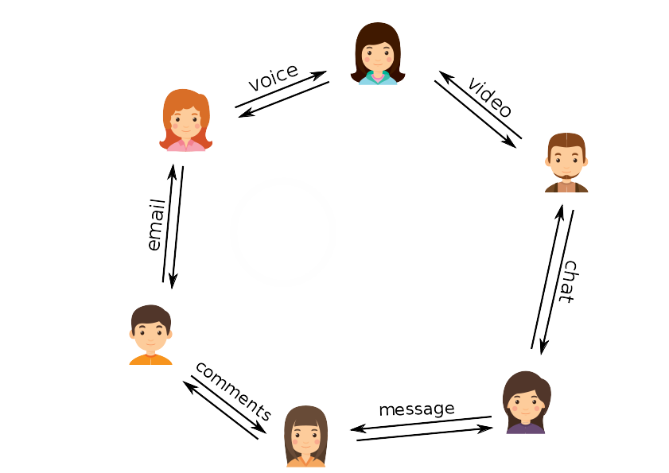
Peer-to-Peer network

Slide 4
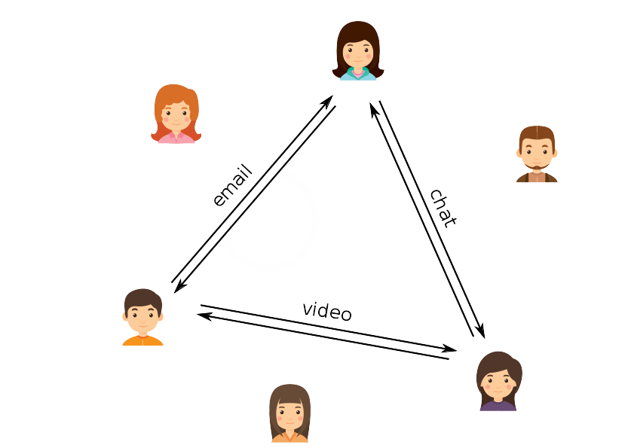
No server involved

Slide 5
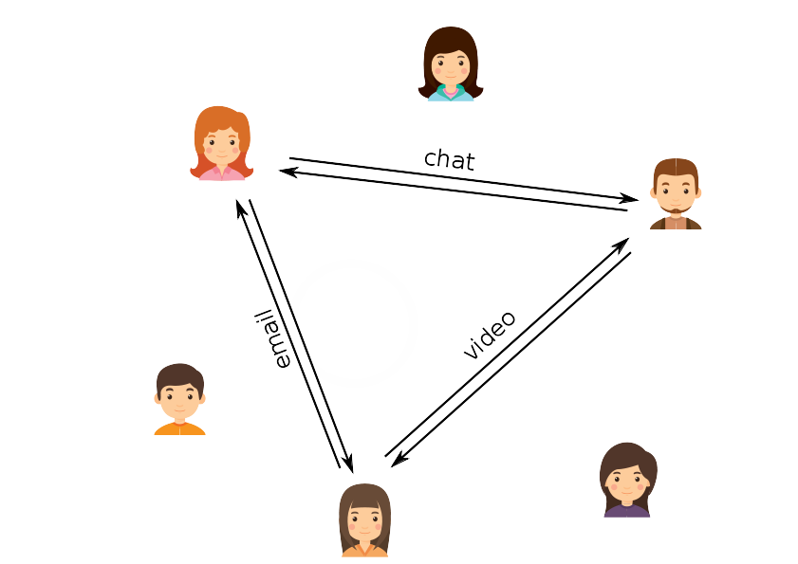
Direct communication

Slide 6
Attribution
Icons made by Freepik
www.freepik.com
www.flaticon.com
Creative Commons BY 3.0 – thank you.

