Slide 1
How secure communication works

Slide 2
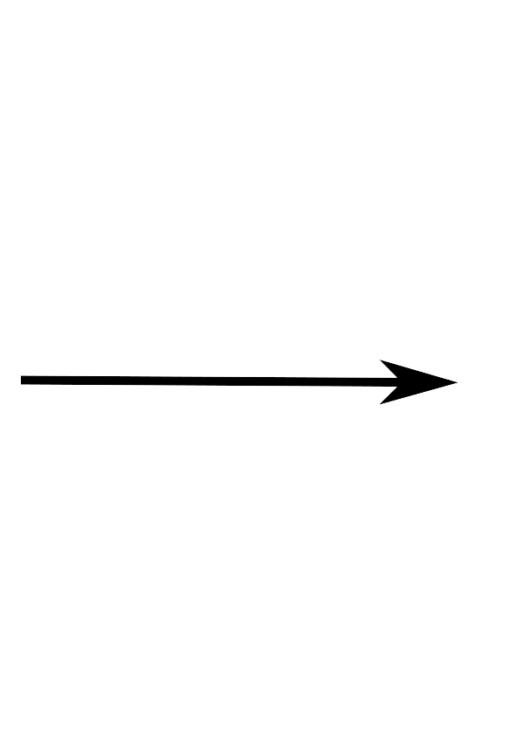
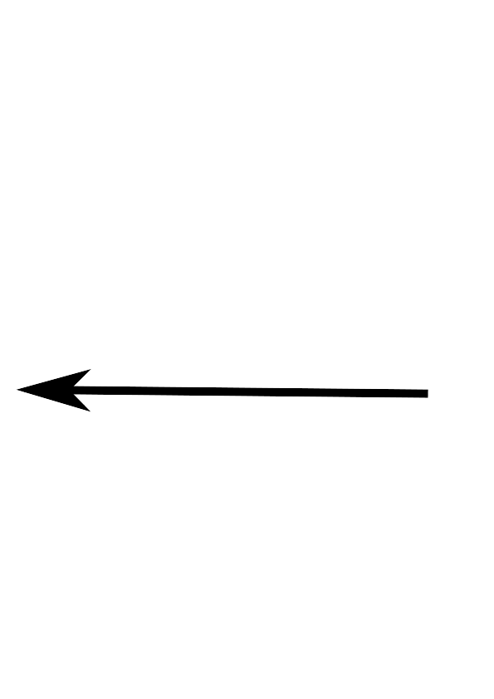



Is this connection secure ?

Slide 3
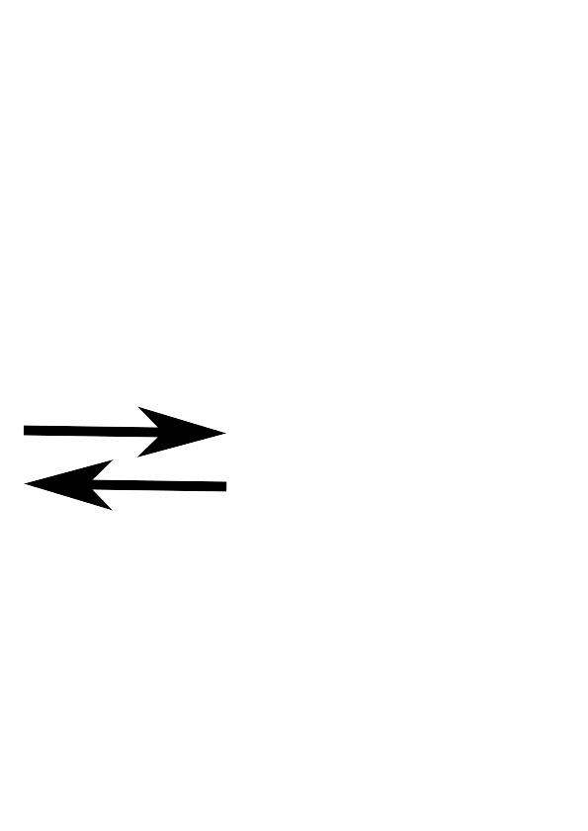


How to make sure there is no Man in the Middle?

Slide 4



Certificate Authority

Slide 5



Out of Band communication
A cryptographically secure point to point connection without any certificate authority has been established.

