Slide 1
Ring of Trust
How to establish a ring of trust

Slide 2




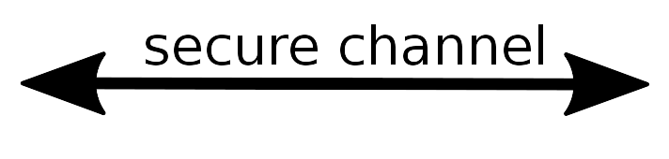



Ring of Trust established

Slide 3
Attribution
Icons made by Freepik
www.freepik.com
www.flaticon.com
DinosoftLabs
Twitter
surang
Creative Commons BY 3.0 – thank you.

