Slide 1
7.0 – Power ENGR-E 399/599: VLSI Design Prof. Daniel Loveless, dlovele@iu.edu, 812-856-0703
INDIANA UNIVERSITY – Reliable Electronics and Systems
Center for Reliable and Trusted Electronics (CREATE)
Notes:
Hello and welcome to the CMOS VLSI Design course.

Slide 2
Learning Objectives
At the end of this lecture, you should be able to:
Use equations to explain the sources of power dissipation in a chip.
Estimate dynamic and static power consumption.
Describe methods to reduce dynamic and static power losses.
Notes:
By the end of this course, you should be able to:
Use equations to explain the sources of power dissipation in a chip.
Estimate dynamic and static power consumption.
Describe methods to reduce dynamic and static power losses.

Slide 3
Power and Energy
Power is drawn from a voltage source attached to the V_{DD} pin(s) of a chip.
Instantaneous Power:
Energy:
Average Power:
Notes:
The power is drawn from a voltage source attached to vdd pin(s) of a chip.
The amount of power in a circuit at a given instant in time is called the instantaneous power and can be calculated by the current times voltage in T time
Energy is the ability to do work or apply force to move an object. In electrical circuits, energy is measured as power over time or as integral of instantaneous power.
The average power is the amount of work done or energy converted per unit time; it can be calculated by dividing the energy over time.

Slide 4

Power in Circuit Elements
Notes:
Power in circuit elements:
Instantaneous power is Idd(t) X Vdd. Where Idd is the current through the element and Vdd is the voltage across the element.
The power consumed by a resistor. This power is converted to heat and is given by Ir X Ir X R. Where Ir is the current through the resistor.
The charge stored in a capacitor which is given by the formula for Ec.
We can calculate the energy stored in a capacitor by taking the integral of the current times V in t times for the interval zero to infinity, which is the same as the integral of the capacitance times change of voltage over time by the same limits that implies. Ec is equal to C times integral V from the limits 0 to Vc or ½ of the capacitance times square voltage capacitance.

Slide 5
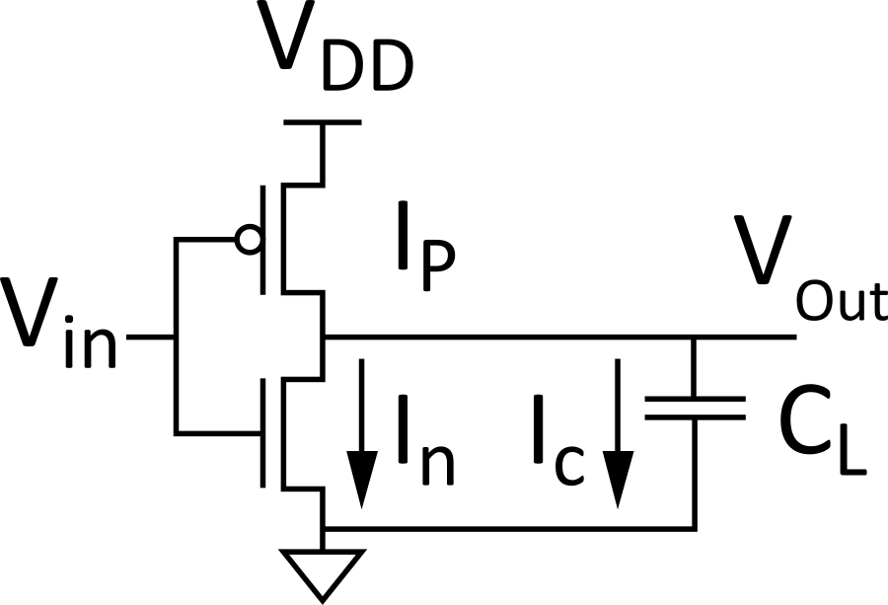
Charging a Capacitor
When the gate output rises
Energy stored in the capacitor is
But energy drawn from the supply is
Half the energy from V_{DD} is dissipated in the pMOS transistor as heat and other half stored in capacitor
When the gate output falls
Energy in the capacitor is dumped to GND
Dissipated as heat in the nMOS transistor
Notes:
Look at this load capacitance in the CMOS circuit, when the gate output rises the capacitor charges, and this energy can be calculated by Ec equals to ½ of CL times square VDD.
Half the energy from Vdd will be dissipated in the pMOS transistor as heat and other half stored in the capacitor
When the gate output falls, the energy in the capacitor is dumped to GND and dissipated as heat in the nMOS transistor.

Slide 6
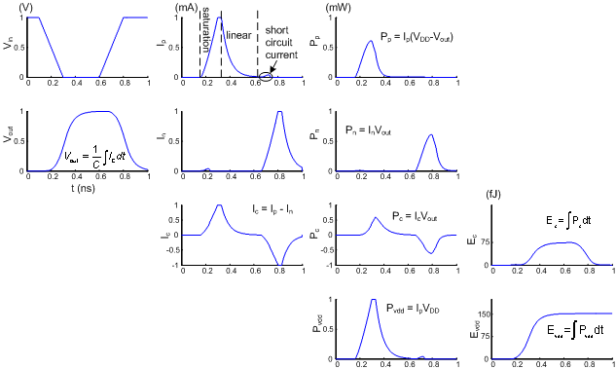
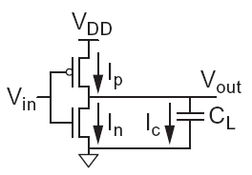
Switching Waveforms
Example: V_{DD} = 1.0 V, C_{L} = 150 fF, f = 1 GHz
Notes:
Let’s assume that cmos inverter has a vdd of 1 volt, a load capacitance of 150 femtofarads, its switching frequency is 1 GHz.
With this, we can plot different switching waveforms and compare the power related to nmos, pmos, and loading capacitance.

Slide 7
Switching Power
Notes:
Slide derives the power consumed by a switching inverter.
The main factors are the load capacitance C, the operating voltage Vdd and the switching frequency.

Slide 8
Activity Factor
Suppose the system clock frequency = f
Let f_{sw} = α f, where α = activity factor
If the signal is a clock, α = 1
If the signal switches once per cycle, α = ½
Dynamic power:
Notes:
Activity factor is the fraction of the system clock frequency in which the gate changes output.

Slide 9
Short Circuit Current
When transistors switch, both nMOS and pMOS networks may be momentarily ON at once
Leads to a blip of “short circuit” current.
<10% of dynamic power if rise/fall times are comparable for input and output
We will generally ignore this component
Notes:
When transistors switch, both nMOS and pMOS networks may be momentarily ON at once; this can lead to a blip of “short circuit” current. This value is less than 10% of dynamic power if the rise/fall times are comparable for input and output, so we will generally ignore this component.

Slide 10
Power Dissipation Sources
P_{total} = P_{dynamic} + P_{static}
Dynamic power: P_{dynamic} = P_{switching} + P_{short circuit}
Switching load capacitances
Short-circuit current
Static power: P_{static} = (I_{sub} + I_{gate} + I_{junct} + I_{contention})V_{DD}
Subthreshold leakage
Gate leakage
Junction leakage
Contention current
Notes:
Total power dissipated in a circuit is the sum of dynamic and static power.
Dynamic power is equal to switching power plus the short circuit power.
Static power is equal to the product of the operating voltage and the total of subthreshold, gate leakage, junction leakage, contention currents.

Slide 11
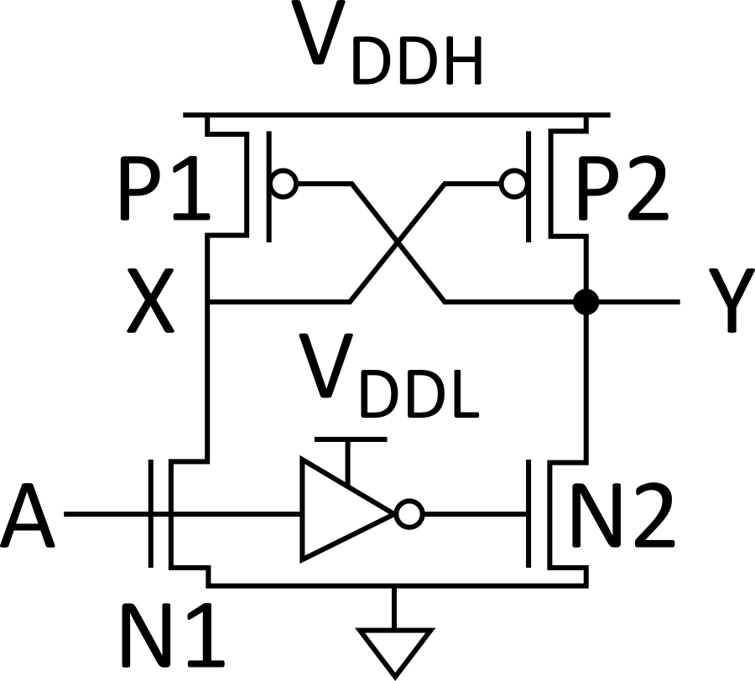
Dynamic Power Example
1 billion transistor chip
50 M logic transistors
Average width: 12 λ
Activity factor = 0.1
950 M memory transistors
Average width: 4 λ
Activity factor = 0.02
1.0 V 65 nm process
C = 1 fF/μm (gate) + 0.8 fF/μm (diffusion)
Estimate dynamic power consumption @ 1 GHz. Neglect wire capacitance and short-circuit current.

Slide 12
Solution
Notes:
Calculate the total logic and memory capacitance of the system. Calculate the switching power for the logic and memory and add them to obtain the total dynamic power.

Slide 13
Dynamic Power Reduction
Try to minimize:
Activity factor
Capacitance
Supply voltage
Frequency
Notes:
In order to reduce the switching power, you can try to minimize:
the activity factor
capacitance
supply voltage and
frequency

Slide 14
Activity Factor Estimation
Let P_{i} = Prob(node i = 1)
P_{i} = 1-P_{i}
α_{i} = P_{i} * P_{i}
Completely random data have P = 0.5 and α = 0.25
Data are often not completely random
e.g., upper bits of 64-bit words representing bank account balances are usually 0
Data propagating through ANDs and ORs have lower activity factor
Depends on design, but typically α ≈ 0.1

Slide 15
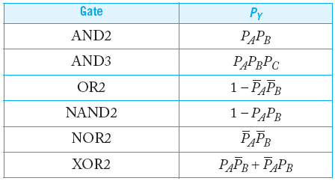
Switching Probability
Notes:
Switching probability calculation for different gates.

Slide 16
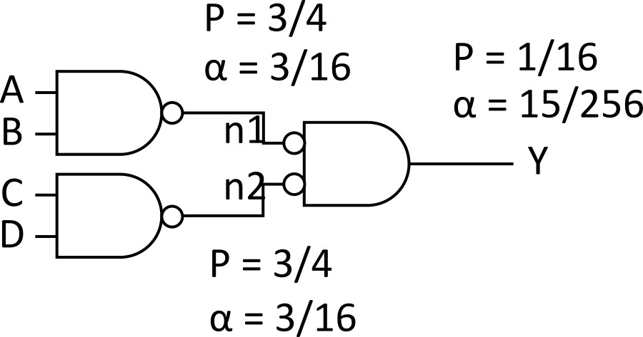
Example
A 4-input AND is built out of two levels of gates
Estimate the activity factor at each node if the inputs have P = 0.5
Notes:
Example, a 4-input AND is built out of two levels of gates. Estimate the activity factor at each node if the inputs have a probability of 0.5 when switching.
So let’s look at the first two nodes (NAND2); the same process is applied to both.
The probability of getting 1 as an output is ¾ and 0 is ¼ (1 - ¾)
The switching probability for NAND2 = ¾ X ¼ = 3/16.
For the NOR2, switching probability = multiplication of the not probability of two NAND2 (¼ X ¼ ). The not switching probability of the NOR2 = 1 – 1/16 = 15/16
Therefore, the switching probability = 1/16 X 15/16 = 15/256.

Slide 17
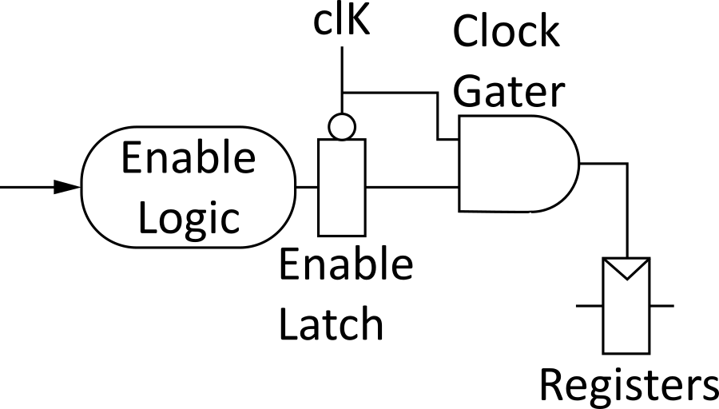
Clock Gating
The best way to reduce the activity is to turn off the clock to registers in unused blocks
Saves clock activity (α = 1)
Eliminates all switching activity in the block
Requires determining if block will be used
Notes:
Clock gating is used to turn off the clock to registers in unused block. This method is applied to reduce dynamic power consumption.

Slide 18
Capacitance
Gate capacitance
Fewer stages of logic
Small gate sizes
Wire capacitance
Good floor planning to keep communicating blocks close to each other
Drive long wires with inverters or buffers rather than complex gates
Notes:
Reduced stages of logic and gate sizing (small gate size) can be used to save dynamic power consumption.
Wires have capacitance too. Proper floor planning of the layout can ensure that communicating blocks are close to each other and long wires are driven with inverters.

Slide 19
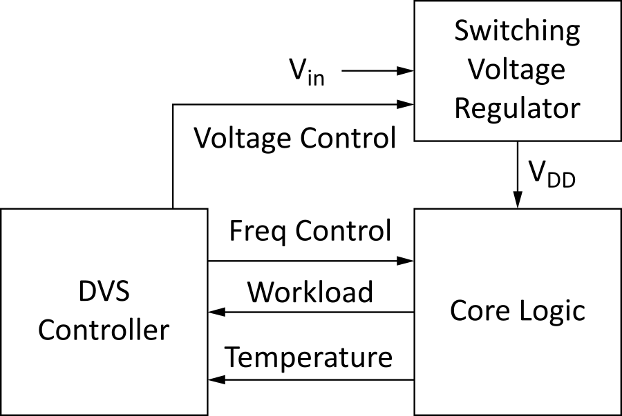
Voltage/Frequency
Run each block at the lowest possible voltage and frequency that meets performance requirements
Voltage Domains
Provide separate supplies to different blocks
Level converters required when crossing
from low to high V_{DD} domains
Dynamic Voltage Scaling
Adjust V_{DD} and f according to
workload
Notes:
To minimize dynamic power consumption, the voltage and frequency of operation can be scaled.

Slide 20
Static Power
Static power is consumed even when chip is quiescent.
Leakage draws power from nominally OFF devices
Ratioed circuits burn power in fight between ON transistors
Notes:
Static power is consumed even when chips are inactive.

Slide 21
Static Power Example
Revisit power estimation for 1 billion transistor chip
Estimate static power consumption
Subthreshold leakage
Normal V_{t}: 100 nA/μm
High V_{t}: 10 nA/μm
High Vt used in all memories and in 95% of logic gates
Gate leakage 5 nA/μm
Junction leakage negligible

Slide 22
Solution

Slide 23
Subthreshold Leakage
For V_{ds} > 50 mV
I_{off} = leakage at V_{gs} = 0, V_{ds} = V_{DD}
Typical values in 65 nm
I_{off} = 100 nA/μm @ V_{t} = 0.3 V
I_{off} = 10 nA/μm @ V_{t} = 0.4 V
I_{off} = 1 nA/μm @ V_{t} = 0.5 V
η = 0.1
k_{γ} = 0.1
S = 100 mV/decade

Slide 24
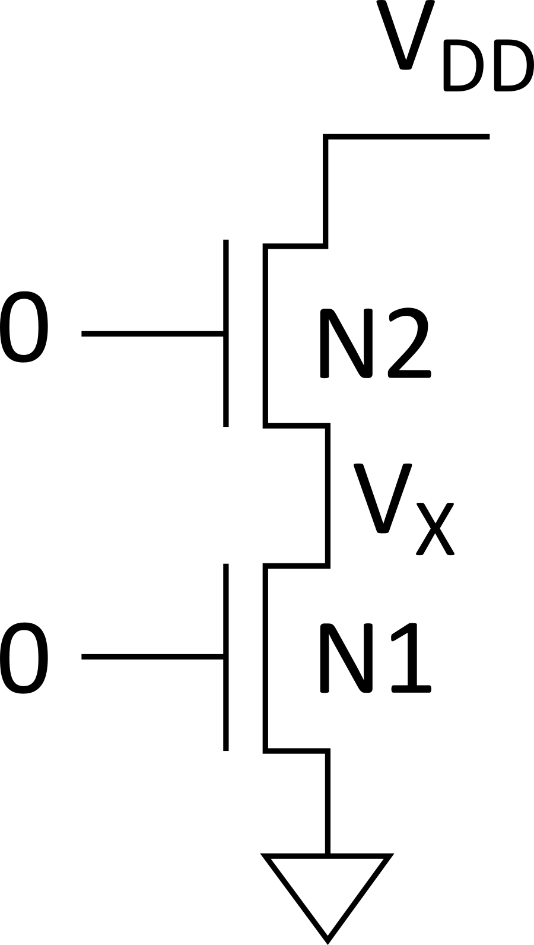
Stack Effect
Series OFF transistors have less leakage
V_{x} > 0, so N2 has negative V_{gs}
Leakage through 2-stack reduces ~10x
Leakage through 3-stack reduces further
Notes:
The stack effect is when series OFF transistors have less leakage, so x voltage > 0, so nmos transistor 2 has negative ground source voltage.

Slide 25
Leakage Control
Leakage and delay trade off
Aim for low leakage in sleep and low delay in active mode
To reduce leakage:
Increase V_{t}: multiple V_{t}
Use low V_{t} only in critical circuits
Increase V_{s}: stack effect
Input vector control in sleep
Decrease V_{b}
Reverse body bias in sleep
Or forward body bias in active mode
Notes:
There is a leakage and delay trade off; we aim for low leakage in sleep and low delay in active mode.
To reduce leakage:
Increase the threshold voltage and use low threshold voltage only in critical circuits.
Increase the source voltage so you can have a stack effect.
Decrease the body voltage by reversing body bias in sleep or forward body bias in active mode.

Slide 26
Gate Leakage
Extremely strong function of t_{ox} and V_{gs}
Negligible for older processes
Approaches subthreshold leakage at 65 nm and below in some processes
An order of magnitude less for pMOS than nMOS
Control leakage in the process using t_{ox} > 10.5 Å
High-k gate dielectrics help
Some processes provide multiple t_{ox}
e.g., thicker oxide for 3.3 V I/O transistors
Control leakage in circuits by limiting V_{DD}

Slide 27
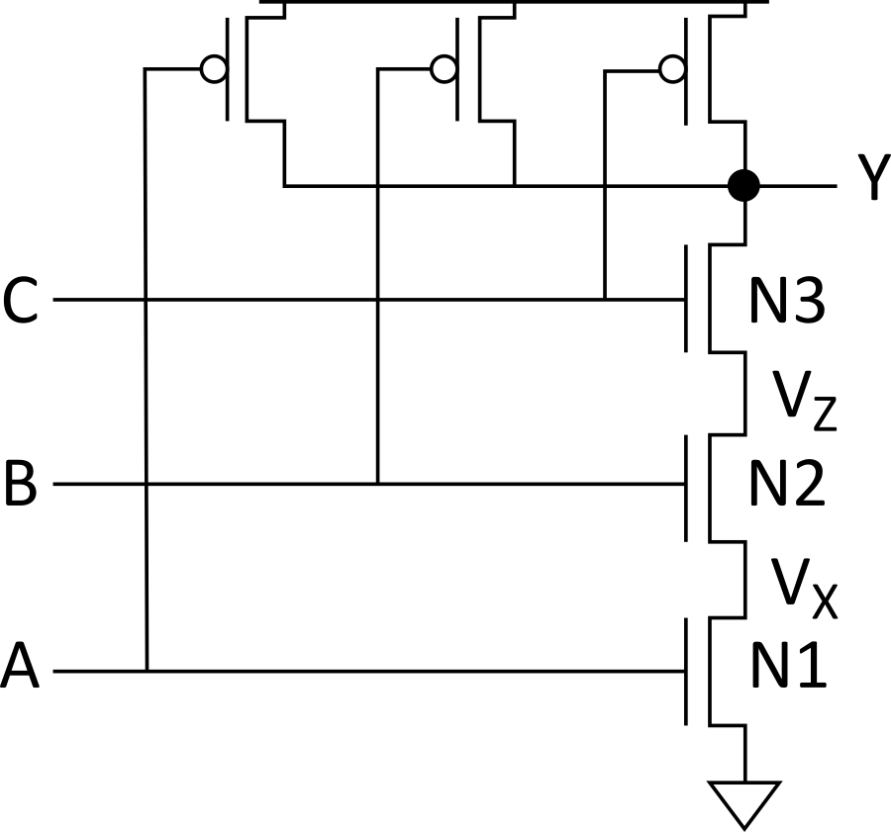
NAND3 Leakage Example
100 nm process
I_{gn} = 6.3 nA I_{gp} = 0
I_{offn} = 5.63 nA I_{offp} = 9.3 nA
Data from [Lee03]

Slide 28
Junction Leakage
From reverse-biased p-n junctions
Between diffusion and substrate or well
Ordinary diode leakage is negligible
Band-to-band tunneling (BTBT) can be significant
Especially in high-V_{t} transistors where other leakage is small
Worst at V_{db} = V_{DD}
Gate-induced drain leakage (GIDL) exacerbates
Worst for V_{gd} = -V_{DD} (or more negative)
Notes:
Junction leakage occurs into the substrate/well from the reverse-biased p-n junction between diffusion and substrate/well.

Slide 29
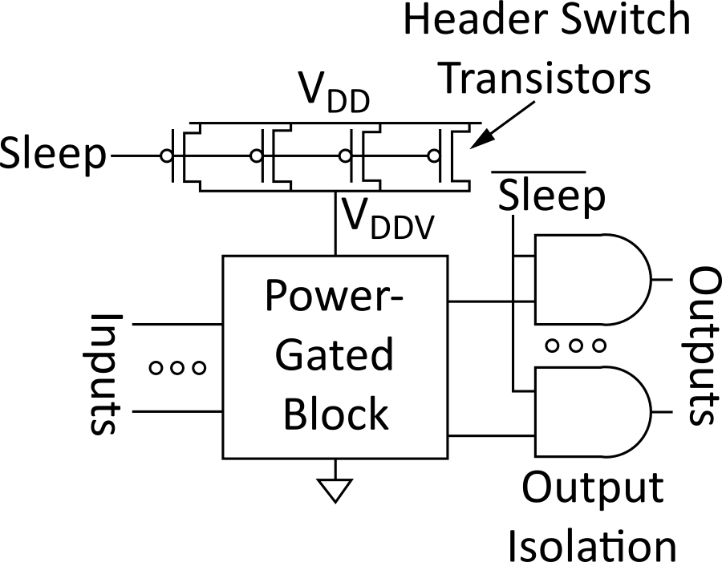
Power Gating
Turn OFF power to blocks when they are idle to save leakage
Use virtual V_{DD} (V_{DDV})
Gate outputs to prevent
invalid logic levels to next block
Voltage drop across sleep transistor degrades performance during normal operation
Size the transistor wide enough to minimize impact
Switching wide sleep transistor costs dynamic power
Only justified when circuit sleeps long enough
Notes:
To reduce leakage, turn off power to blocks when they are idle. Use virtual VDD, gate outputs to prevent invalid logic levels to next block.
Voltage drops occurs across sleep transistors. This degrades performance during normal operation, size the transistor wide enough to minimize this impact.
Reduce using switching wide sleep transistors due to its cost of dynamic power.

