Slide 1
5.0 – DC and Transient Response ENGR-E 399/599: VLSI Design Prof. Daniel Loveless, dlovele@iu.edu, 812-856-0703
INDIANA UNIVERSITY – Reliable Electronics and Systems
Center for Reliable and Trusted Electronics (CREATE)

Slide 2
Learning Objectives
At the end of this lecture, you should be able to:
Explain threshold drop in pass transistor circuits.
Graphically derive the DC response of a CMOS logic gate.
Estimate the delay of logic gates using RC delay models.
Notes:
By the end of this lecture, you should be able to:
Explain threshold drop in pass transistor circuits.
Graphically derive the DC response of a CMOS logic gate.
Estimate the delay of logic gates using RC delay models.

Slide 3
Outline
Pass Transistors
DC Response
Logic Levels and Noise Margins
Transient Response
RC Delay Models
Delay Estimation

Slide 4
Pass Transistors
We have assumed source is grounded
What if source is >0?
e.g., pass transistor passing V_{DD}
V_{g} = V_{DD}
If V_{s} > V_{DD}-V_{t}, then V_{gs} < V_{t}
Hence, transistor would turn itself off
nMOS pass transistors pull no higher than V_{DD}-V_{tn}
Called a degraded “1”
Approach degraded value slowly (low I_{ds})
pMOS pass transistors pull no lower than V_{tp}
Transmission gates are needed to pass both 0 and 1
Notes:
When both nMOS and pMOS are used as pass transistors, nMOS transistors will pass a degraded 1, while pMOS transistors will pass a value no lower than Vtp.

Slide 5
Pass Transistor Ckts
Notes:
Transistor circuits show the value of the voltage at the source.

Slide 6
DC Response
DC Response: V_{out} vs. V_{in} for a gate
E.g., Inverter
When V_{in} = 0 -> V_{out} = V_{DD}
When V_{in} = V_{DD} -> V_{out} = 0
In between, V_{out} depends on
transistor size and current
By KCL, must settle such that
I_{dsn} = |I_{dsp}|
We could solve equations
But graphical solution gives more insight
Notes:
In this slide, the DC response of the inverter is considered.
The inverters operates thus:
When Vin = 0, Vout = Vdd and when Vin = Vdd, Vout = 0.
The operation of the inverter depends on the size of the pMOS and nMOS transistors.
By Kirchhoff's law, nMOS drain to source current must be equal to the absolute value of pMOS drain to source current.

Slide 7
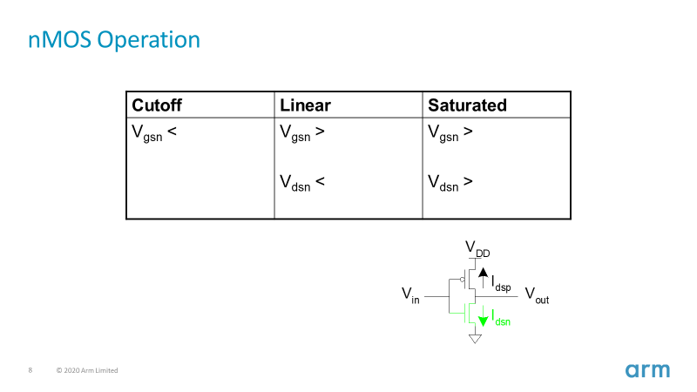
Transistor Operation
Current depends on region of transistor behavior
For what V_{in} and V_{out} are nMOS and pMOS in
Cutoff?
Linear?
Saturation?
Notes:
Current depends on the region of transistor behavior.
Therefore, we need to figure out for what Vin and Vout voltages are the nMOS and pMOS in cutoff, linear or saturation region.

Slide 8
nMOS Operation
Cutoff | Linear | Saturated
V_{gsn} < V_{tn} V_{in} < V_{tn} | V_{gsn} > V_{tn} V_{in} > V_{tn} V_{dsn} < V_{gsn} – V_{tn} V_{out} < V_{in} - V_{tn} | V_{gsn} > V_{tn} V_{in} > V_{tn} V_{dsn} > V_{gsn} – V_{tn} V_{out} > V_{in} - V_{tn}
V_{gsn} = V_{in}
V_{dsn} = V_{out}
Notes:
Table shows the operating regions of the nMOS transistor.

Slide 9
pMOS Operation
Cutoff | Linear | Saturated
V_{gsp} > V_{tp} V_{in} > V_{DD} + V_{tp} | V_{gsp} < V_{tp} V_{in} < V_{DD} + V_{tp} V_{dsp} > V_{gsp} – V_{tp} V_{out} > V_{in} - V_{tp} | V_{gsp} < V_{tp} V_{in} < V_{DD} + V_{tp} V_{dsp} < V_{gsp} – V_{tp} V_{out} < V_{in} - V_{tp}
V_{gsp} = V_{in} - V_{DD}
V_{dsp} = V_{out} - V_{DD}
V_{tp} < 0
Notes:
Table shows the operating regions of the pMOS transistor.

Slide 10
I-V Characteristics
Make pMOS wider than nMOS such that β_{n} = β_{p}
Notes:
pmos will need to be wider than nMOS such that beta parameter from nMOS will be equal to the one from pMOS. Thus, current flowing to the transistors will be of the same magnitude but in different directions, and we can plot this against voltage.
nMOS (green)
pMOS (blue)

Slide 11
Current vs. V_{out}, V_{in}

Slide 12
Load Line Analysis
For a given V_{in}:
Plot I_{dsn}, I_{dsp} vs. V_{out}
V_{out} must be where |currents| are equal in

Slide 13
Load Line Analysis
V_{in} = 0
V_{in} = 0
0.2V_{DD}
0.4V_{DD}
0.6V_{DD}
0.8V_{DD}
V_{DD}

Slide 14
DC Transfer Curve
Transcribe points onto V_{in} vs. V_{out} plot
Notes:
The five red points show the regions of operation of the inverter.
In these regions, the nMOS AND pMOS transistors are:
Region A: nMOS is OFF, pMOS pulls the output to Vdd.
Region B: nMOS is STARTS turning ON. There is a drop in output.
Region C: nMOS and pMOS are in saturation
Region D: pMOS is partially ON.
Region E: nMOS is ON, pMOS is OFF. nMOS pulls the output to 0.

Slide 15
Operating Regions
Revisit transistor operating regions
Region | nMOS | pMOS
A | Cutoff | Linear
B | Saturation | Linear
C | Saturation | Saturation
D | Linear | Saturation
E | Linear | Cutoff

Slide 16
Beta Ratio
If β_{p} / β_{n} ≈ 1, switching point will move from V_{DD}/2
Called skewed gate
Other gates: collapse into equivalent inverter
Notes:
It was assumed that β_{p} = β_{n} to create the transfer curve. At this ratio β_{p} / β_{n}, when β_{p} = β_{n}, the inverter is unskewed, it can charge and discharge a capacitive load at equal times.
The ratio β_{p} / β_{n} can be altered to create a skewed gate. When the ratio is greater than 1 the inverter is HI-skewed (strong pMOS) and when the ratio is less than 1, then the inverter is LO-skewed.

Slide 17
Noise Margins
How much noise can a gate input see before it does not recognize the input?
Notes:
Noise margin refers to the range of noisy input that will still produce a non-corrupted output.
The formula to know the tolerance to noise:
Low noise margin:
NML = VIL – VOL
High noise margin:
NMH= VOH – VIH
The input is indeterminate if its value is between VIL and VIH.

Slide 18
Logic Levels
To maximize noise margins, select logic levels at
unity gain point of DC transfer characteristic
Notes:
VOL, VOH, VIL, and VIH are defined by selecting the point where NML and NMH both have the same value in the curves, by selecting where the slopes are equal to -1.
If we were to define this High and Low values in other locations of the graph, then one value would decrease significantly while the increment of the other would be minimal because of the shape of the graph.
The slope -1 holds the most efficient positions for maximum tolerances of noise.

Slide 19
Transient Response
DC analysis tells us V_{out} if V_{in} is constant
Transient analysis tells us V_{out}(t) if V_{in}(t) changes
Requires solving differential equations
Input is usually considered to be a step or ramp
From 0 to V_{DD} or vice versa
Notes:
With DC analysis, the output can be known if the input is constant.
Transient analysis is different. Change in input value is not instantaneous but goes through a rise/fall time before it gets to a steady state. This change in input Vin(t) is reflected in the output transition Vout(t).

Slide 20
Inverter Step Response
E.g., find step response of inverter driving load cap

Slide 21
Delay Definitions
t_{pdr}: rising propagation delay
From input to rising output crossing V_{DD}/2
t_{pdf}: falling propagation delay
From input to falling output crossing V_{DD}/2
t_{pd}: average propagation delay
t_{pd} = (t_{pdr} + t_{pdf})/2
t_{r}: rise time
From output crossing 0.2 V_{DD} to 0.8 V_{DD}
t_{f}: fall time
From output crossing 0.8 V_{DD} to 0.2 V_{DD}

Slide 22
Delay Definitions
t_{cdr}: rising contamination delay
From input to rising output crossing V_{DD}/2
t_{cdf}: falling contamination delay
From input to falling output crossing V_{DD}/2
t_{cd}: average contamination delay
t_{pd} = (t_{cdr} + t_{cdf})/2
Notes:
Contamination delay is the minimum time from when the input changes to 50% of its value to when the output changes to 50% of its value.

Slide 23
Simulated Inverter Delay
Solving differential equations by hand is too hard
SPICE simulator solves the equations numerically
Uses more accurate I-V models too!
But simulations take time to write, may hide insight
Notes:
Instead of solving the differential equations in slide 20, we could use tools like SPICE simulator to model designs and obtain an estimate of the delays just like in the graph shown.

Slide 24
Delay Estimation
We would like to be able to easily estimate delay
Not as accurate as simulation
But easier to ask “What if?”
The step response usually looks like a 1st order RC response with a decaying exponential.
Use RC delay models to estimate delay
C = total capacitance on output node
Use effective resistance R
So that t_{pd} = RC
Characterize transistors by finding their effective R
Depends on average current as gate switches
Notes:
Step response use RC delay models to estimate delay.
C=strain capacitance and R is the equivalent resistance of the transistors, depending on its average current.

Slide 25
Effective Resistance
Shockley models have limited value
Not accurate enough for modern transistors
Too complicated for much hand analysis
Simplification: treat transistor as resistor
Replace I_{ds}(V_{ds}, V_{gs}) with effective resistance R
I_{ds} = V_{ds}/R
R averaged across switching of digital gate
Too inaccurate to predict current at any given time
But good enough to predict RC delay
Notes:
To find the effective resistance of a transistor, the Shockley model can be used, however this model is limited because it is not suitable for modern transistors.
The designer can treat the transistor as a resistor. This approach is good enough to predict RC delay of the transistor.

Slide 26
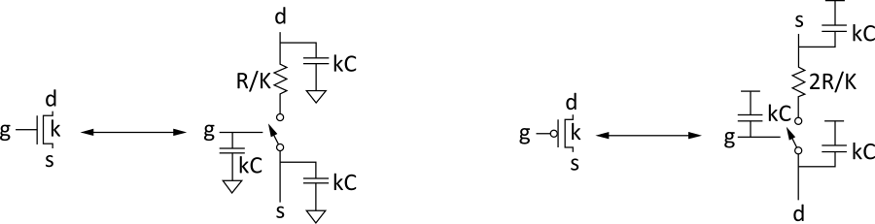
RC Delay Model
Use equivalent circuits for MOS transistors
Ideal switch + capacitance and ON resistance
Unit nMOS has resistance R, capacitance C
Unit pMOS has resistance 2R, capacitance C
Capacitance proportional to width
Resistance inversely proportional to width
Notes:
Here, we have some guidelines to transform transistors into equivalent circuits.
Treat the transistor as an ideal switch with Resistance (in on condition) and Capacitance (all connected to 0V/Vdd).
nMOS has resistance R (between the gate to source) divided by the constant of the transistor and capacitance C (connected to Vdd) multiplied by the constant of the transistor.
pMOS has resistance 2R (between the gate to the drain) divided by the constant of the transistor and capacitance C (connected to 0 V) multiplied by the constant of the transistor.

Slide 27
RC Values
Capacitance
C = C_{g} = C_{s} = C_{d} = 2 fF/μm of gate width in 0.6 μm
Gradually decline to 1 fF/μm in nanometer techs.
Resistance
R ≈ 6 kΩ*μm in 0.6 μm process
Reduces with shorter channel lengths
Unit transistors
May refer to minimum contacted device (4/2 λ)
Or maybe 1 μm wide device
Doesn’t matter as long as you are consistent

Slide 28
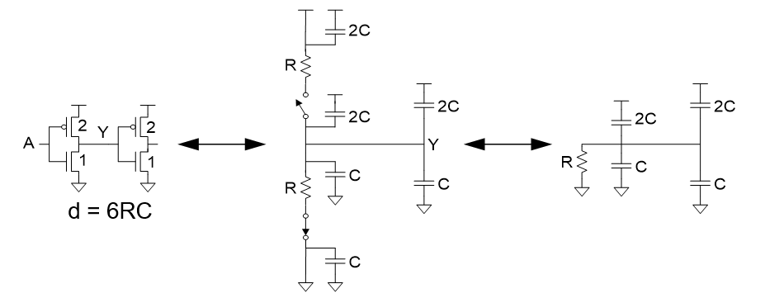
Inverter Delay Estimate
Estimate the delay of a fanout-of-1 inverter
Notes:
First, transform the transistors into the ideal switch with resistances and capacitances.
Next consider only the active network based on the input value. The delay through the active network can be calculated by multiplying the total resistance (R) with the total capacitance (6C because capacitances are in parallel).
tpd=6RC.

Slide 29
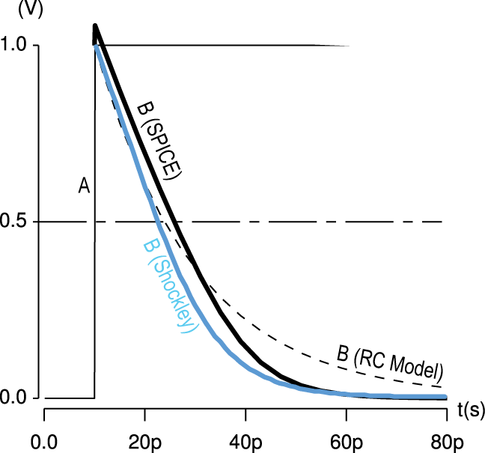
Delay Model Comparison

Slide 30
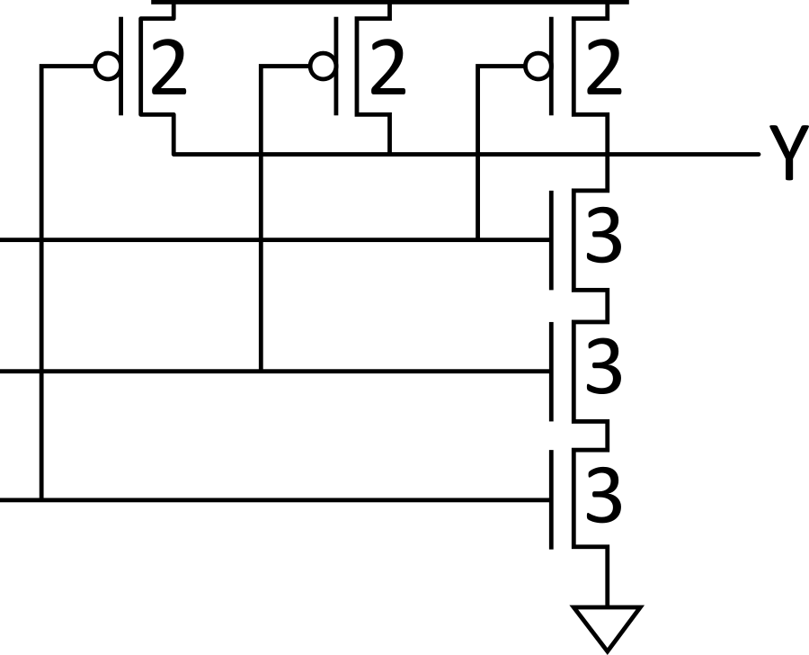
Example: 3-input NAND
Sketch a 3-input NAND with transistor widths chosen to achieve effective rise and fall resistances equal to a unit inverter (R).
Notes:
Example of a 3-input NAND gate with gate sizing to achieve effective rise and fall resistance equal to a unit inverter.
All the pMOS have constant k=2 and all the nMOS have constant k=3.

Slide 31
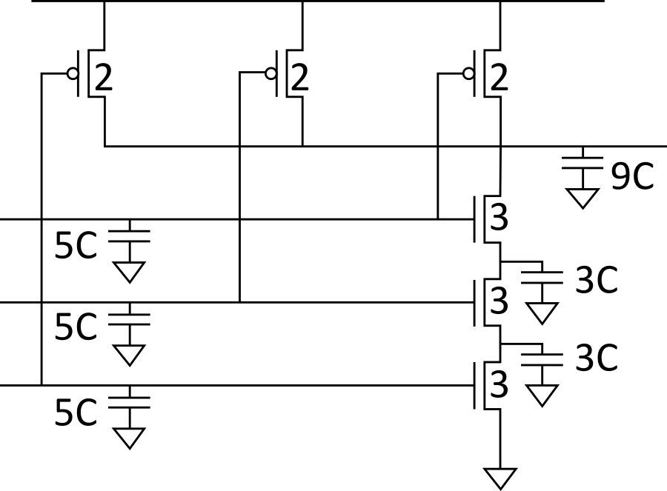
3-input NAND Caps
Annotate the 3-input NAND gate with gate and diffusion capacitance.

Slide 32
Elmore Delay
ON transistors look like resistors
Pullup or pulldown network modeled as RC ladder
Elmore delay of RC ladder
Notes:
Elmore Delay: It is usually used for tree-structured networks where the formula is similar to the tpd where it is the sum of RC.
Pullup and Pulldown network can be modeled as RC ladders.
We can use this theory to continue working with the 3 input NAND CAPS and calculate the equivalent delay.

Slide 33
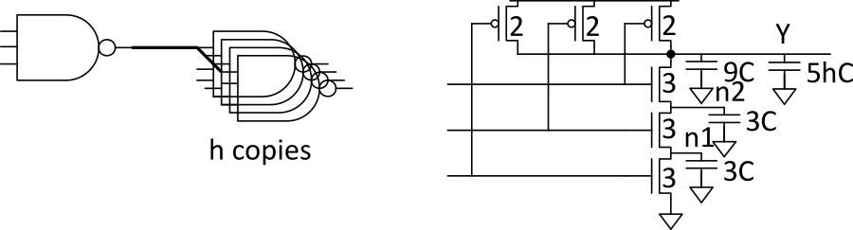
Example: 3-input NAND
Estimate worst-case rising and falling delay of 3-input NAND driving h identical gates.
Notes:
Draw the RC equivalent of the transistors to estimate the rising and falling delay.

Slide 34
Delay Components
Delay has two parts
Parasitic delay
9 or 11 RC
Independent of load
Effort delay
5h RC
Proportional to load capacitance
Notes:
Delay in gates have two components:
Parasitic delay. This is independent of the load as shown in previous examples modeling the RC equivalent of the transistors.
The effort delay is mainly or directly proportional to the load capacitance.

Slide 35
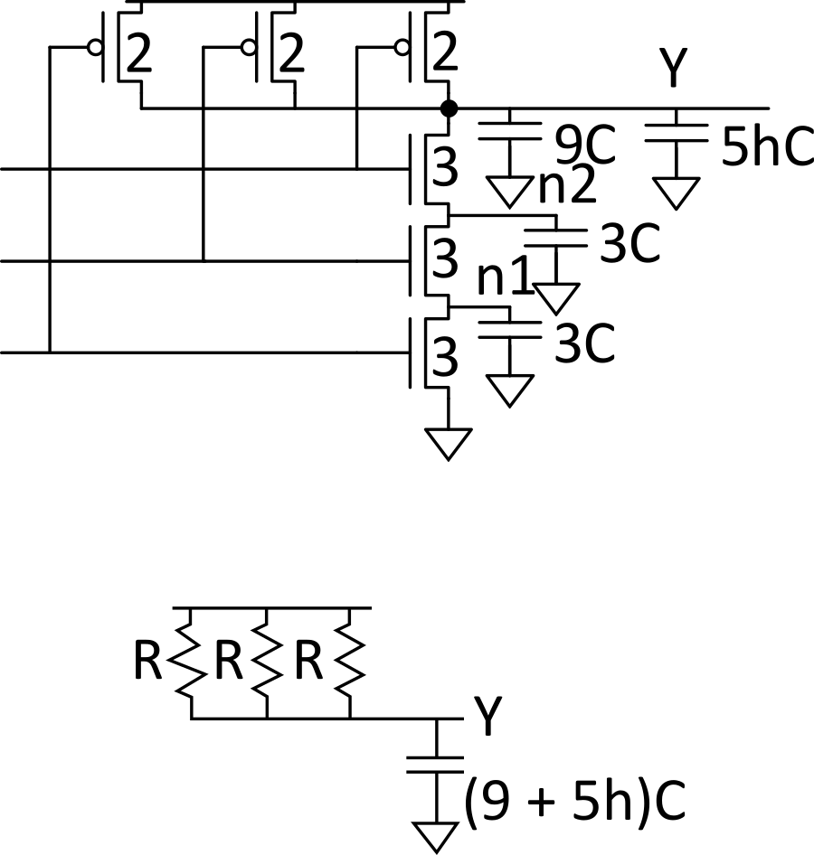
Contamination Delay
Best-case (contamination) delay can be substantially less than propagation delay.
E.g., if all three inputs fall simultaneously

Slide 36
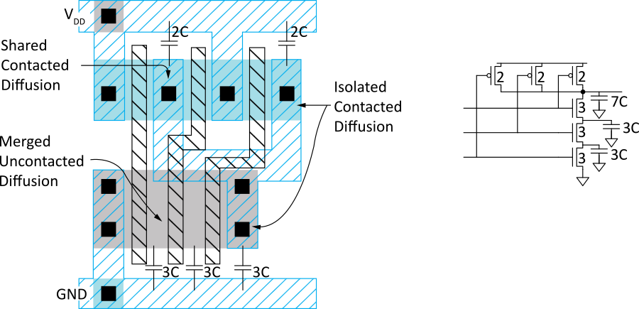
Diffusion Capacitance
We assumed contacted diffusion on every s/d.
Good layout minimizes diffusion area
E.g., NAND3 layout shares one diffusion contact
Reduces output capacitance by 2C
Merged uncontacted diffusion might help too
Notes:
It is possible for transistor to share diffusion area to minimize diffusion capacitance. This is an optimization of the layout.

Slide 37
Layout Comparison
Which layout is better?
Left has less diffusion capacitance on Y

