Slide 1
6.0 – Logical Effort ENGR-E 399/599: VLSI Design Prof. Daniel Loveless, dlovele@iu.edu, 812-856-0703
INDIANA UNIVERSITY – Reliable Electronics and Systems
Center for Reliable and Trusted Electronics (CREATE)
Notes:
Hello and welcome to the CMOS VLSI Design course. Our focus today will be on logical effort

Slide 2
Learning Objectives
At the end of this lecture, you should be able to:
Use Logical Effort to estimate the delay of a logic gate and a combinational circuit path.
Apply the method of Logical Effort to determine the best number of stages and best topology to minimize delay of a path.

Slide 3
Introduction
Chip designers face a bewildering array of choices
What is the best circuit topology for a function?
How many stages of logic give least delay?
How wide should the transistors be?
Logical effort is a method to make these decisions
Uses a simple model of delay
Allows back-of-the-envelope calculations
Helps make rapid comparisons between alternatives
Emphasizes remarkable symmetries
Notes:
Why use Logical Effort?
This method gives the ability to estimate a delay so that we can design with the least propagation delay.

Slide 4
Example
Design the decoder for a register file.
Decoder specifications:
16-word register file
Each word is 32 bits wide
Each bit presents load of 3 unit-sized transistors
True and complementary address inputs A[3:0]
Each input may drive 10 unit-sized transistors
You need to decide:
How many stages to use?
How large should each gate be?
How fast can decoder operate?
Notes:
Near the end of the slides, we will be revisiting this example to solve it with the theory learned.

Slide 5
Delay in a Logic Gate
Express delays in process-independent unit
Delay has two components: d = f + p
f: effort delay = gh (aka stage effort)
Again has two components
g: logical effort
Measures relative ability of gate to deliver current
g =1 for inverter
h: electrical effort = C_{out} / C_{in}
Ratio of output to input capacitance
Sometimes called fanout
p: parasitic delay
Represents delay of gate driving no load
Set by internal parasitic capacitance
τ = 3RC
≈ 3 ps in 65 nm process
60 ps in 0.6 μm process
Notes:
Delay is expressed as dimensionless units to isolate the effect of fabrication process.
Delay in a logical gate have two components.
The effort delay f: due to the load, which can be calculated with the logic effort and electric effort.
and the parasitic delay p: due to the parasitic capacitance.

Slide 6
Delay Plots
d = f + p
= gh + p
What about
NOR2?
Notes:
Here we have a plot of the Normalized Delay vs. Electrical Effort for 2-input NAND gate and inverter.

Slide 7
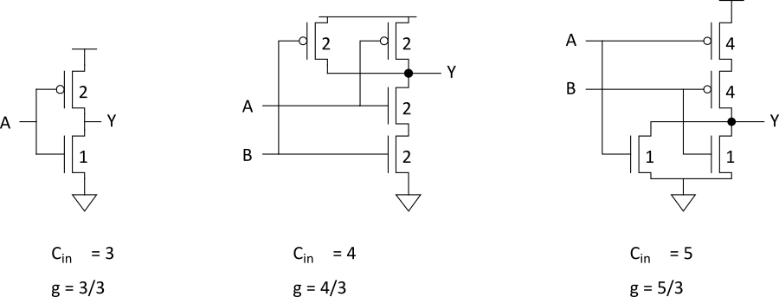
Computing Logical Effort
DEF: Logical effort is the ratio of the input capacitance of a gate to the input capacitance of an inverter delivering the same output current.
Measure from delay vs. fanout plots
Or estimate by counting transistor widths
Notes:
Here we practice with an example how to estimate the logical effort for gates.
The circuits shown in this slide have their gate widths sized for uniform rise and fall time of the output.
Logical effort g = Cin_gate / Cin_inverter.
In the first example, the two transistors are in series. The input capacitance of the inverter is 3 (2 + 1). Therefore, the logical effort of the inverter is g=3/3=1.
The second circuit is a NAND gate. The input capacitance of the NAND gate is 2+2 = 4 (consider the PMOS and NMOS gates). Therefore, the logical effort for the 2-input NAND gate is g = 4/3 (remember Logical effort g = Cin_gate / Cin_inverter).
The third circuit is an OR gate. The input capacitance of the OR gate is 4+1 = 5 (consider the PMOS and NMOS gates for an input). Therefore, the logical effort for the 2-input OR gate is g = 5/3.

Slide 8
Catalog of Gates
Logical effort of common gates
Gate type | Number of inputs
 | 1 | 2 | 3 | 4 | n
Inverter | 1
NAND |  | 4/3 | 5/3 | 6/3 | (n+2)/3
NOR |  | 5/3 | 7/3 | 9/3 | (2n+1)/3
Tristate/mux | 2 | 2 | 2 | 2 | 2
XOR, XNOR |  | 4, 4 | 6, 12, 6 | 8, 16, 16, 8
Notes:
Here is a logical effort reference table for common gates with n number of inputs.

Slide 9
Catalog of Gates
Parasitic delay of common gates
In multiples of p_{inv} (≈1)
Gate type | Number of inputs
 | 1 | 2 | 3 | 4 | n
Inverter | 1
NAND |  | 2 | 3 | 4 | n
NOR |  | 2 | 3 | 4 | n
Tristate/mux | 2 | 4 | 6 | 8 | 2n
XOR, XNOR |  | 4 | 6 | 8
Notes:
Table shows an estimate for the parasitic delay of common logic gates with n number of inputs.

Slide 10
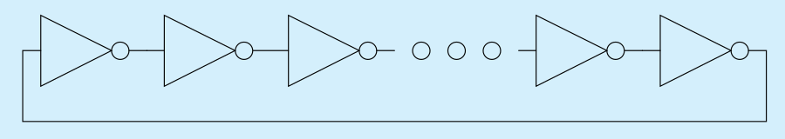
Example: Ring Oscillator
Estimate the frequency of an N-stage ring oscillator
Logical Effort: g = 1
Electrical Effort: h = 1
Parasitic Delay: p = 1
Stage Delay: d = 2
Frequency: f_{osc} = 1/(2*N*d) = 1/4N
31 stage ring oscillator in 0.6 μm process has frequency of ~ 200 MHz
Notes:
In this example, the frequency of the ring oscillator is inversely proportional to the stage delay. The stage delay = gh+p= 1*1+1=2.

Slide 11
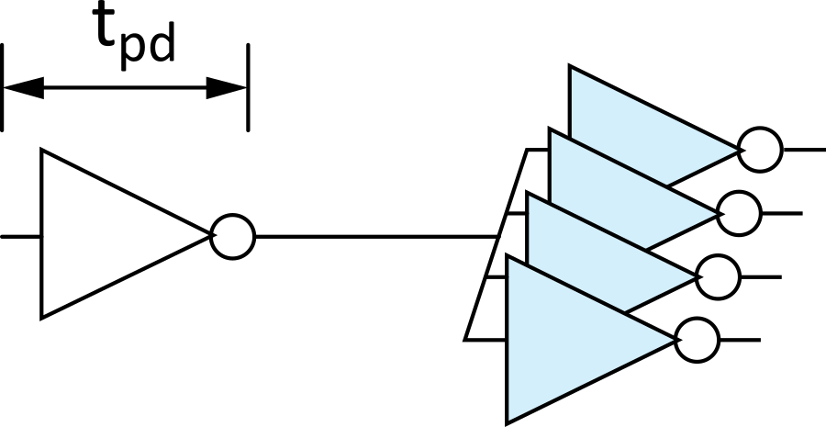
Example: FO4 Inverter
Estimate the delay of a fanout-of-4 (FO4) inverter
Logical Effort: g = 1
Electrical Effort: h = 4
Parasitic Delay: p = 1
Stage Delay: d = 5
The FO4 delay is about
300 ps in 0.6 μm process
15 ps in a 65 nm process
Notes:
Here, in this example, the delay of a fanout-of-4 inverter is estimated.
Stage delay = gh+p= 1*4+1=5.

Slide 12
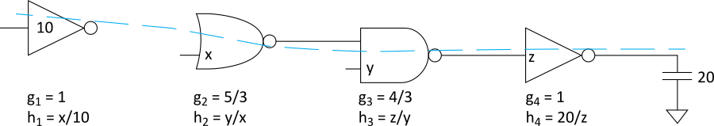
Multistage Logic Networks
Logical effort generalizes to multistage networks
Path Logical Effort
Path Electrical Effort
Path Effort
Notes:
Path logical effort G is the product of the individual logical effort of the gates in the path.
Path electrical effort H is the ratio of the output capacitance of the path to the input capacitance of the path.
Path effort F is the product of the path logical effort and path electrical effort.
G = g1*g2*g3*g4 =20/9
H=Cout/Cin=20/10=2
F=Path Effort=g_i*h_i=20/9*2=40/9

Slide 13
Multistage Logic Networks
Logical effort generalizes to multistage networks
Path Logical Effort
Path Electrical Effort
Path Effort
Can we write F = GH?
Notes:
From the result of the previous slide, it may seem that F = GH. In the next slide, we will see if this is true.

Slide 14
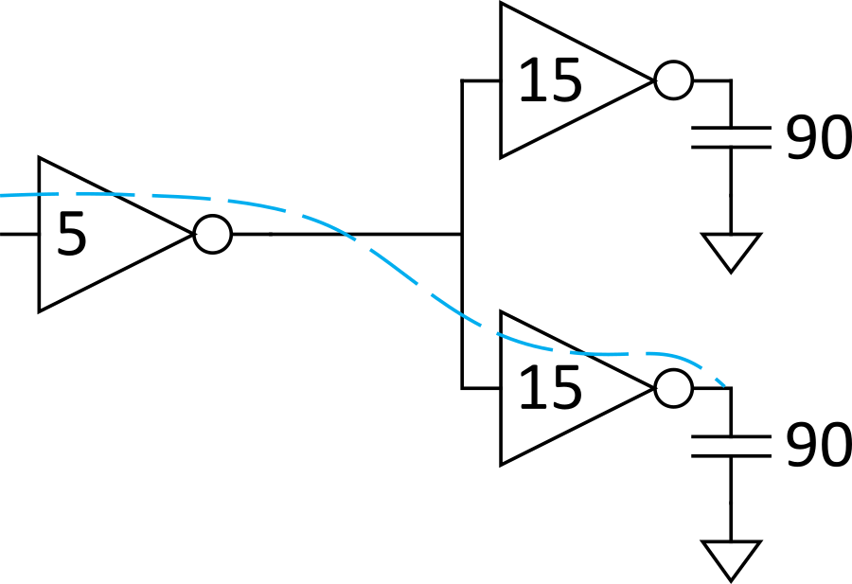
Paths that Branch
No! Consider paths that branch:
G = 1
H = 90 / 5 = 18
GH = 18
h₁ = (15 +15) / 5 = 6
h₂ = 90 / 15 = 6
F = g₁g₂h₁h₂ = 36 = 2GH
Notes:
In the case of a path with a branch as shown in this slide, the path effort can be calculated thus:
For the branch
G = 1 (1*1)
H = C_output/C_input
Therefore GH = 18
Input Inverter:
h = 30/5 = 6. (The output capacitance of 30 is the total load capacitance driven by the inverter).
Ouput Inverter
H = 90/15 = 6
Therefore, F = g_1 * g_2 * h_1 * h_2 = 1*1*6*6 = 36
Thus, F = GH is not always correct.

Slide 15
Branching Effort
Introduce branching effort
Accounts for branching between stages in path
Now we compute the path effort
F = GBH
Note:
Notes:
Introducing the Branching effort formula. The branch effort takes into account the branching stages in the path.

Slide 16
Multistage Delays
Path Effort Delay
Path Parasitic Delay
Path Delay

Slide 17
Designing Fast Circuits
Delay is smallest when each stage bears the same effort
Thus, minimum delay of N stage path is
This is a key result of logical effort
Find fastest possible delay
Doesn’t require calculating gate sizes

Slide 18
Gate Sizes
How wide should the gates be for the least delay?
Working backward, apply capacitance transformation to find input capacitance of each gate given load it drives.
Check work by verifying input cap spec is met.
Notes:
Gate sizing can be applied to reduce the delay in a path.

Slide 19
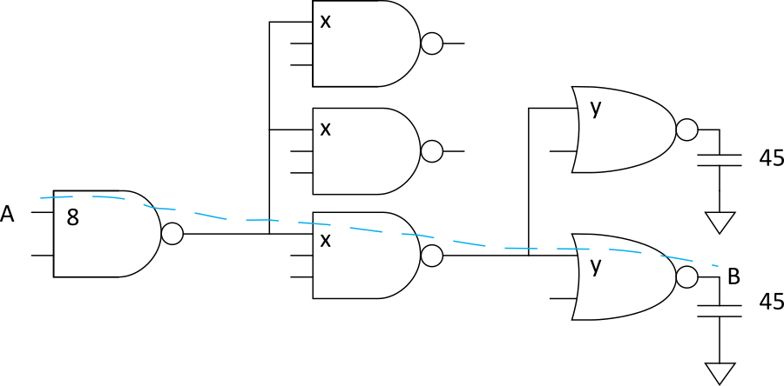
Example: 3-stage path
Select gate sizes x and y for least delay from A to B
Notes:
Consider the following example. Try to estimate the gate sizes x and y.

Slide 20
Example: 3-stage path
Logical Effort G = (4/3)*(5/3)*(5/3) = 100/27
Electrical Effort H = 45/8
Branching Effort B = 3 * 2 = 6
Path Effort F = GBH = 125
Best Stage Effort
Parasitic Delay P = 2 + 3 + 2 = 7
Delay D = 3*5 + 7 = 22 = 4.4 FO4

Slide 21
Example: 3-stage path
Work backward for sizes
y = 45 * (5/3) / 5 = 15
x = (15*2) * (5/3) / 5 = 10

Slide 22
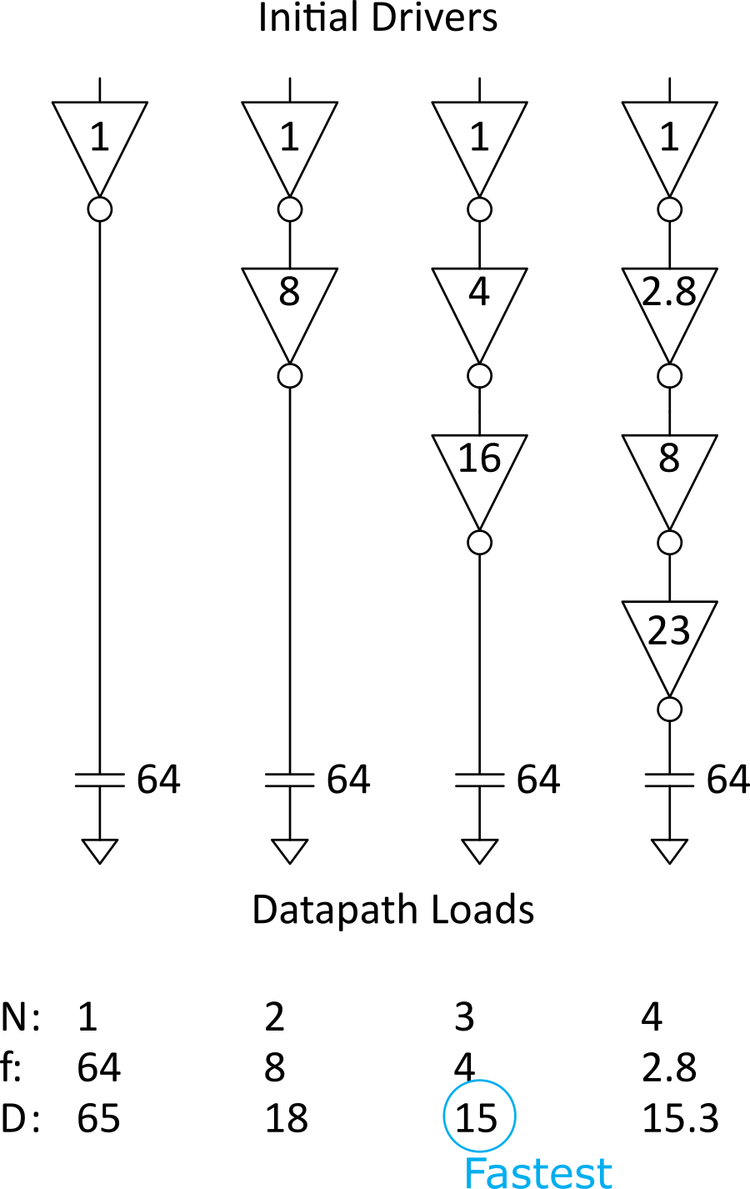
Best Number of Stages
How many stages should a path use?
Minimizing number of stages is not always fastest
Example: drive 64-bit datapath with unit inverter
D = NF^{1/N} + P
= N(64)^{1/N} + N

Slide 23
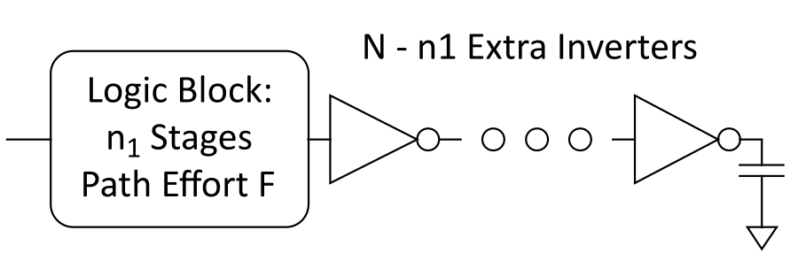
Derivation
Consider adding inverters to end of path
How many give least delay?
Define best stage effort
Notes:
Slide derives formula to find the minimum stage effort.

Slide 24
Best Stage Effort
has no closed-form solution
Neglecting parasitics (p_{inv} = 0), we find ρ = 2.718 (e)
For p_{inv} = 1, solve numerically for ρ = 3.59

Slide 25
Sensitivity Analysis
How sensitive is the delay to using exactly the best number of stages?
2.4 < ρ < 6 gives delay within 15% of optimal
We can be sloppy!
I like ρ = 4

Slide 26
Example, Revisited
Design the decoder for a register file.
Decoder specifications:
16-word register file
Each word is 32 bits wide
Each bit presents a load of 3 unit-sized transistors
True and complementary address inputs A[3:0]
Each input may drive 10 unit-sized transistors
You needs to decide:
How many stages to use?
How large should each gate be?
How fast can the decoder operate?

Slide 27
Number of Stages
Decoder effort is mainly electrical and branching
Electrical Effort: H = (32*3) / 10 = 9.6
Branching Effort: B = 8
If we neglect logical effort (assume G = 1)
Path Effort: F = GBH = 76.8
Number of Stages: N = log₄F = 3.1
Try a 3-stage design

Slide 28
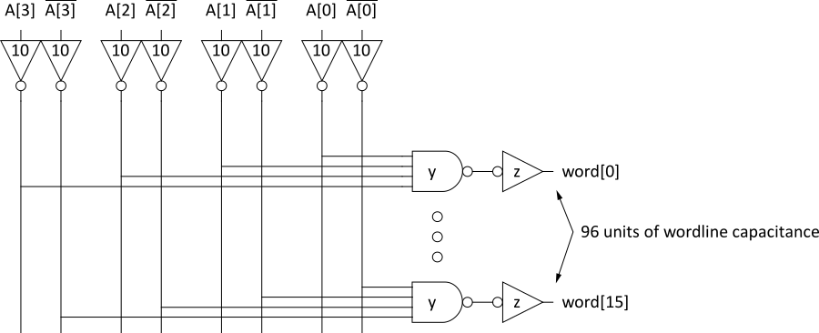
Gate Sizes & Delay
Logical Effort G = 1 * 6/3 * 1 = 2
Path Effort: F = GBH = 154
Stage Effort:
Path Delay:
Gate sizes: z = 96*1/5.36 = 18; y = 18*2/5.36 = 6.7

Slide 29
Comparison
Compare many alternatives with a spreadsheet
D = N(76.8 G)^{1/N} + P
Design | N | G | P | D
NOR4 | 1 | 3 | 4 | 234
NAND4-INV | 2 | 2 | 5 | 29.8
NAND2-NOR2 | 2 | 20/9 | 4 | 30.1
INV-NAND4-INV | 3 | 2 | 6 | 22.1
NAND4-INV-INV-INV | 4 | 2 | 7 | 21.1
NAND2-NOR2-INV-INV | 4 | 20/9 | 6 | 20.5
NAND2-INV-NAND2-INV | 4 | 16/9 | 6 | 19.7
INV-NAND2-INV-NAND2-INV | 5 | 16/9 | 7 | 20.4
NAND2-INV-NAND2-INV-INV-INV | 6 | 16/9 | 8 | 21.6

Slide 30
Review of Definitions
Term | Stage | Path
number of stages
logical effort
electrical effort
branching effort
effort
effort delay
parasitic delay
delay
Notes:
Here is the summary of Logical Effort notation.

Slide 31
Method of Logical Effort
Compute path effort
Estimate best number of stages
Sketch path with N stages
Estimate least delay
Determine best stage effort
Find gate sizes
Notes:
Step-by-step method of logical effort.

Slide 32
Limits of Logical Effort
Chicken and egg problem
Need path to compute G
But don’t know the number of stages without G
Simplistic delay model
Neglects input rise time effects
Interconnect
Iteration required in designs with wire
Maximum speed only
Not minimum area/power for constrained delay
Notes:
Logical Effort is based on the linear delay model and the simple premise that making the
effort delays of each stage equal minimizes path delay.
This simplicity is the method’s greatest strength, but also has several limitations:
It is very time consuming for complex circuits.
It limits the system modes with low power consumption.

Slide 33
Summary
Logical effort is useful for thinking of delay in circuits
Numeric logical effort characterizes gates
NANDs are faster than NORs in CMOS
Paths are fastest when effort delays are ~4
Path delay is weakly sensitive to stages, sizes
But using fewer stages doesn’t mean faster paths
Delay of path is about log₄F FO4 inverter delays
Inverters and NAND2 best for driving large caps
Provides language for discussing fast circuits
But requires practice to master

