Slide 1
8.0 – Scaling ENGR-E 399/599: VLSI Design Prof. Daniel Loveless, dlovele@iu.edu, 812-856-0703
INDIANA UNIVERSITY – Reliable Electronics and Systems
Center for Reliable and Trusted Electronics (CREATE)
Notes:
Hello and welcome to CMOS VLSI Design course; today, our focus will be in Scaling.

Slide 2
Learning Objectives
At the end of this lecture, you should be able to:
Describe the effects of technology scaling on the number and cost of transistors power dissipation in devices.
Notes:
By the end of this lecture, you should be able to:
Describe the effects of technology scaling on the number and cost of transistors power dissipation in devices.

Slide 3
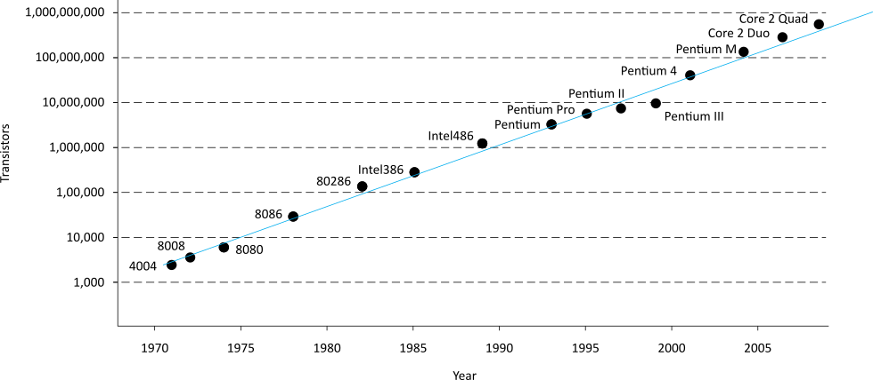
Moore’s Law
Recall that Moore’s Law has been driving CMOS
1965: Gordon Moore plotted transistor on each chip
Fit a straight line on semilog scale
Transistor counts have doubled every 26 months
Year | Clock Speed (Hz) | Processor name
1971 | 740K | 4004
1972 | 500K | 8008
1982 | 6M | 80186
1982 | 8M | 80188
1993 | 66M | Pentium
1999 | 600M | Pentium III
2000 | 2G | Pentium 4
2006 | 2.33K | Core 2 Duo
2008 | 3.2G | Core i7
2011 | 2.67G | Xeon E7
2013 | 4.4G | Intel "Haswell"
Intel Processors, year and clock speed
Moore’s Law today
Corollary: clock speeds have improved
Notes:
Recall that Moore’s law has been driving CMOS. The number of transistors packed in a chip kept growing as feature size reduced. Over the years, clock speed of processing blocks also increased.

Slide 4
Why?
Why more transistors per IC?
Smaller transistors
Larger dice
Why faster computers?
Smaller, faster transistors
Better microarchitecture (more IPC)
Fewer gate delays per cycle
Notes:
So why are there more transistor per integrated circuits?
That is because we have smaller transistors and larger dice
Computers are becoming faster because smaller and faster transistors enable better microarchitecture and reduced gate delays per cycle.

Slide 5
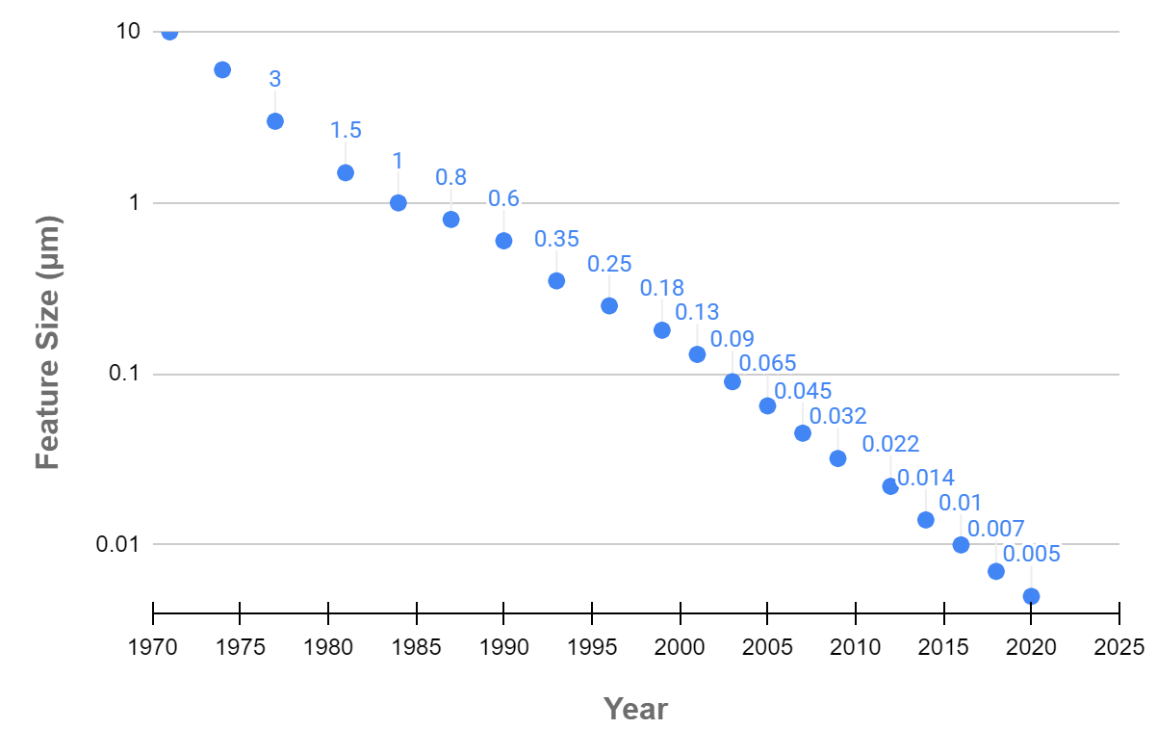
Scaling
The only constant in VLSI is constant change
Feature size shrinks by 30% every 2-3 years
Transistors become cheaper
Transistors become faster
Transistors require lower power
Wires do not improve
(and may get worse)
Scale factor S
Typically
Technology nodes
Notes:
In VLSI, every 2-3 years, the feature size of transistors is being reduced by 30%. Transistors are now faster, cheaper and can now work with low power.
The scale factor S depends on the process technology used to fabricate the transistors.

Slide 6
Dennard Scaling
Proposed by Dennard in 1974
Also known as constant field scaling
Electric fields remain the same as features scale
Scaling assumptions
All dimensions (x, y, z => W, L, t_{ox})
Voltage (V_{DD})
Doping levels
Notes:
Dennard in 1974, proposed the Dennard scaling also known as constant field scaling, which says that electric fields remain the same as features scale.
Dennard assumed that all dimensions, voltage, and doping levels will scale as well.

Slide 7
Device Scaling
Parameter | Sensitivity | Dennard Scaling
L: Length |  | 1/S
W: Width |  | 1/S
t_{ox}: gate oxide thickness |  | 1/S
V_{DD}: supply voltage |  | 1/S
V_{t}: threshold voltage |  | 1/S
NA: substrate doping |  | S
β | W/(Lt_{ox}) | S
I_{on}: ON current | β(V_{DD}-V_{t})² | 1/S
R: effective resistance | V_{DD}/I_{on} | 1
C: gate capacitance | WL/t_{ox} | 1/S
τ: gate delay | RC | 1/S
f: clock frequency | 1/τ | S
E: switching energy/gate | CV_{DD}² | 1/S³
P: switching power/gate | Ef | 1/S²
A: area per gate | WL | 1/S²
Switching power density | P/A | 1
Switching current density | I_{on}/A | S
Notes:
Dennard scaling shows how much the parameters of a transistor can shrink in base to S (the scale factor).

Slide 8
Observations
Gate capacitance per micron is nearly independent of process
But ON resistance * micron improves with process
Gates get faster with scaling (good)
Dynamic power goes down with scaling (good)
Current density goes up with scaling (bad)
Notes:
Some observation of scaling is that gate capacitance per micron is almost not affected of process.
But ON resistance times micron improves with the process.
It is important to remember that with good scaling, gates get faster, dynamic power is reduced, and current density increases.

Slide 9
Example
Gate capacitance is typically about 1 fF/μm
The typical FO4 inverter delay for a process of feature size f (in nm) is about 0.5f ps
Estimate the ON resistance of a unit (4/2 λ) transistor.
FO4 = 5 τ = 15 RC
RC = (0.5f) / 15 = (f/30) ps/nm
If W = 2f, R = 16.6 kΩ
Unit resistance is roughly independent of f
Notes:
First, we know that delay FO4 inverter is five times its RC constant gate, and therefore is equal to 5 times the constant gate or 15 times Resistance times Capacitance.
Now replace FO4 inverter and gate capacitance by 0.5f picoseconds and 1 femtofarads/micrometer, respectively, reorder the equation to obtain R, and replace f by W/2.
So the result will be 16.6 kilo-ohms.

Slide 10
Real Scaling
t_{ox} scaling has slowed since 65 nm
Limited by gate tunneling current
Gates are only about 4 atomic layers thick!
High-k dielectrics have helped continued scaling of effective oxide thickness
V_{DD} scaling has slowed since 65 nm
SRAM cell stability at low voltage is challenging
Dennard scaling predicts cost, speed, power all improve
Below 65 nm, some designers find they must choose just two of the three
Notes:
Oxide thickness and VDD scaling have slowed since the 65-nanometer process. In the case of tox, we are limited by tunneling current, 4 atomic layers thick for gates, and high-k dielectrics have helped continued scaling of effective oxide thickness.
Due to challenges with SRAM cell stability at low Vdd, the rate of Vdd scaling has slowed down since 65nm .
In Dennard scaling, cost, speed, power will all improve. For processes below 65 nm, some designers are left to choose just two out of the three (cost, speed, power).

Slide 11
Wire Scaling
Wire cross-section
w, s, t all scale
Wire length
Local/scaled interconnect
Global interconnect
Die size scaled by D_{c} ≈ 1.1
Notes:
Wires scale as well.
For wire cross-section, the width, spacing, and thickness scale equally to maintain an aspect ratio close to 2.
For wire length, local and scaled wires scale with feature size, but global interconnect do not scale with feature size. The die size is increasing and thus, the global wires may get longer.

Slide 12
Interconnect Scaling
Parameter | Sensitivity | Scale Factor
w: width |  | 1/S
s: spacing |  | 1/S
t: thickness |  | 1/S
h: height |  | 1/S
D_{c}: die size |  | D_{c}
R_{w}: wire resistance/unit length | 1/wt | S²
C_{wf}: fringing capacitance/unit length | t/s | 1
C_{wp}: parallel plate capacitance/unit length | w/h | 1
C_{w}: total wire capacitance/unit length | C_{wf} + C_{wp} | 1
t_{wu}: unrepeated RC delay/unit length | R_{w}C_{w} | S²
t_{wr}: repeated RC delay/unit length | sqrt(RCR_{w}C_{w}) | sqrt(S)
Crosstalk noise | w/h | 1
E_{w}: energy per bit/unit length | C_{w}V_{DD}² | 1/S²
Notes:
Here you can find the interconnect scaling of the parameter along with its sensitivity and scale factor.

Slide 13
Interconnect Delay
Parameter | Sensitivity | Local / Semiglobal | Global
l: length |  | 1/S | D_{c}
Unrepeated wire RC delay | l²t_{wu} | 1 | S²D_{c}²
Repeated wire delay | lt_{wr} | sqrt(1/S) | D_{c}sqrt(S)
Energy per bit | lE_{w} | 1/S³ | D^{c}/S²
Notes:
We have an interconnect delay table as well for getting the sensitivity, local/semiglobal, and global.

Slide 14
Observations
Capacitance per micron is remaining constant
About 0.2 fF/μm
Roughly 1/5 of gate capacitance
Local wires are getting faster
Not quite tracking transistor improvement
But not a major problem
Global wires are getting slower
No longer possible to cross chip in one cycle
Notes:
Something that we can appreciate about wire scaling:
Capacitance per micron is still constant, which is about 0.2 femtofarads per micrometer or a fifth of the gate capacitance.
Local wires are getting faster and global wires are getting slower.

Slide 15
ITRS
Semiconductor Industry Association forecast
Intl. Technology Roadmap for Semiconductors
Notes:
The International Technology Roadmap for Semiconductors is a set of documents in which we can find the prediction of the evolution of the market for the IC production.

Slide 16
Scaling Implications
Improved Performance
Improved Cost
Interconnect Woes
Power Woes
Productivity Challenges
Physical Limits
Notes:
Scaling has some implication like the improved performance, interconnect and power woes, productivity challenges, and physical limits.

Slide 17
Cost Improvement
In 2003, $0.01 bought you 100,000 transistors
Moore’s Law is still going strong
[Moore03]
Notes:
In the case of the cost, this has been improving due to the Moore’s law. For instance, in the 1968, you will pay $1 for 1 transistor, but in 2003, $0.01 bought you 100,000 transistors.

Slide 18
Interconnect Woes
SIA made a gloomy forecast in 1997
Delay would reach minimum at 250 – 180 nm and then get worse because of wires
But…
Misleading scale
Global wires
100 kgate blocks OK
Notes:
In 1997, the Semiconductor Industry Association forecasted that delay would reach a minimum at 250-180 nanometer process, and then, it will become worse because of wires. This scale is misleading for global wires.

Slide 19
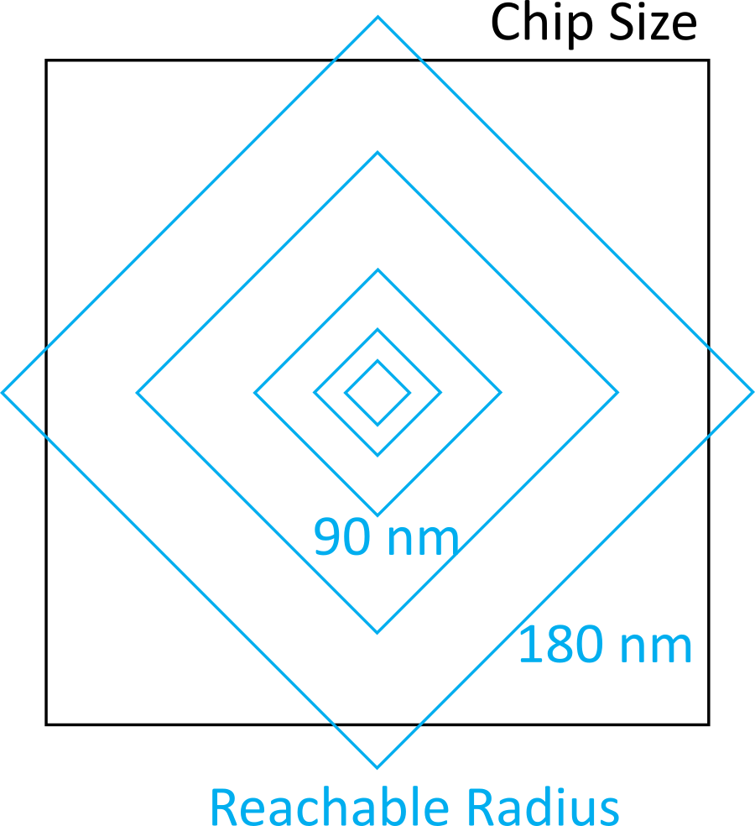
Reachable Radius
We can’t send a signal across a large fast chip in one cycle anymore
But the microarchitect can plan around this
Just as off-chip memory latencies were tolerated
Notes:
Due to issues such as clock skew and timing requirements a signal cannot be sent across a large fast chip in one clock cycle anymore, but by careful design and planning, this can be achieved.

Slide 20
Dynamic Power
Attention to power is increasing as scaling improves
[Intel]
Notes:
Dynamic power required for these ICs is increasing.

Slide 21
Static Power
V_{DD} decreases
Save dynamic power
Protect thin gate oxides and short channels
No point in high value because of velocity sat.
V_{t} must decrease to
maintain device performance
But this causes exponential
increase in OFF leakage
Major future challenge
Notes:
Due to the decreased vdd, we are able to reduce dynamic power consumption, protect thin gate oxides from tunneling and short channels.
To maintain the device performance, the threshold voltage must decrease, but the downside of reducing the threshold voltage is that it results in an exponential increase leakage current when the transistor is OFF. This is a major challenge that must be addressed in the future as feature size reduces.

Slide 22
Productivity
Transistor count is increasing faster than designer productivity (gates/week)
Bigger design teams
Up to 500 for a high-end microprocessor
More expensive design cost
Pressure to raise productivity
Rely on synthesis, IP blocks
Need for good engineering managers
Notes:
Speaking of productivity, the transistor count is increasing at a faster rate than the productivity of designers. Thus there is a necessity for bigger design team like up to 500 people to design a high-end microprocessor.
The design cost is more expensive, there is also the pressure to raise productivity and thus designers now rely on synthesis tools, IP block reuse, and the need for engineering managers.

Slide 23
Physical Limits
Will Moore’s Law run out of steam?
Can’t build transistors smaller than an atom…
Many reasons have been predicted for end of scaling
Dynamic power
Subthreshold leakage, tunneling
Short channel effects
Fabrication costs
Electromigration
Interconnect delay
Rumors of demise have been exaggerated
Notes:
One of the biggest questions that is asked everywhere in this field is if the Moore's law will run out of steam; there is no clear answer for this, but if people manage to build transistor smaller than atoms, maybe this might continue.
Dynamic power, subthreshold leakage, short channel effect, fabrication costs, electromigration, interconnect delay have been sighted as factors that will limit or end scaling.

Slide 24
VLSI Economics
Selling price S_{total}
S_{total} = C_{total} / (1-m)
m = profit margin
C_{total} = total cost
Nonrecurring engineering cost (NRE)
Recurring cost
Fixed cost
Notes:
Away from the technical stuff and into another perspective VLSI business.
Selling price S total is equal to total cost over 1 minus the profit margin where C total is nonrecurring engineering cost or NRE, recurring cost, and fixed cost.

Slide 25
NRE
Engineering cost
Depends on size of design team
Includes benefits, training, computers
CAD tools:
Digital front end: $10K
Analog front end: $100K
Digital back end: $1M
Prototype manufacturing
Mask costs: $5M in 45 nm process
Test fixture and package tooling
Notes:
NRE or nonrecurring engineering:
Is divided into the engineering cost that depends on size of the design team, if the work includes benefits, training, computer as well as CAD tools.
It is important to know that digital front-end CAD tool could cost about $10K, analog front end 100K, and a digital back end 1M.
And the other part of NRE is the prototype manufacturing, whose mask costs about $5M in 45 nm process.

Slide 26
Recurring Costs
Fabrication
Wafer cost/(Dice per wafer * Yield)
Wafer cost: $500 - $3000
Dice per wafer:
Yield: Y = e^{-AD}
For small A, Y ≈ 1, cost is proportional to area
For large A, Y ≈ 0, cost increases exponentially
Packaging
Test
Notes:
Fabrication, packaging, and test are recurring costs in the case of fabrication; the price is given by wafer cost/dice per wafer times yield.

Slide 27
Fixed Costs
Data sheets and application notes
Marketing and advertising
Yield analysis
Notes:
In the case of fixed cost we have data sheets, application notes, marketing, advertising and yield analysis.

Slide 28
Example
You want to start a company to build a wireless communications chip. How much venture capital must you raise?
Because you are smarter than everyone else, you can get away with a small team in just two years:
Seven digital designers
Three analog designers
Five support personnel

Slide 29
Solution
Digital designers:
$70k salary
$30k overhead
$10k computer
$10k CAD tools
Total: $120k * 7 = $840k
Analog designers
$100k salary
$30k overhead
$10k computer
$100k CAD tools
Total: $240k * 3 = $720k
Support staff
$45k salary
$20k overhead
$5k computer
Total: $70k * 5 = $350k
Fabrication
Back-end tools: $1M
Masks: $5M
Total: $6M/year
Summary
2 years @ $7.91M/year
$16M design & prototype

