Slide 1
4.0 – Non-Ideal Transistor Theory ENGR-E 399/599: VLSI Design Prof. Daniel Loveless, dlovele@iu.edu, 812-856-0703
INDIANA UNIVERSITY – Reliable Electronics and Systems
Center for Reliable and Trusted Electronics (CREATE)
Notes:
Hello and welcome. Today, in the CMOS VLSI Design, our focus will be on Nonideal transistor theory.

Slide 2
Learning Objectives
At the end of this lecture, you should be able to:
Use suitable equations to describe the nonideal transistor characteristics due to High field effects, Channel length modulation, Threshold voltage effects and Leakage.
Explain sources and impacts of process and environmental variations on the transistor operation.
Notes:
By the end of this lecture, you should be able to
Use suitable equations to describe the nonideal transistor characteristics due to High field effects, Channel length modulation, Threshold voltage effects and Leakage.
Explain sources and impacts of process and environmental variations on the transistor operation.

Slide 3
Outline
Nonideal Transistor Behavior
High Field Effects
Mobility Degradation
Velocity Saturation
Channel Length Modulation
Threshold Voltage Effects
Body Effect
Drain-Induced Barrier Lowering
Short Channel Effect
Leakage
Subthreshold Leakage
Gate Leakage
Junction Leakage
Process and Environmental Variations

Slide 4
Ideal Transistor I-V
Shockley long-channel transistor models

Slide 5
Ideal vs. Simulated nMOS I-V Plot
65 nm IBM process, V_{DD} = 1.0 V
Notes:
Plot shows Simulated vs Ideal I-V characteristics of the nMOS transistor. This plot highlights the difference between the ideal and non-ideal transistor. In the plot, it can be seen that the velocity saturation and mobility degradation for the simulated model is lower than that of the ideal transistor.

Slide 6
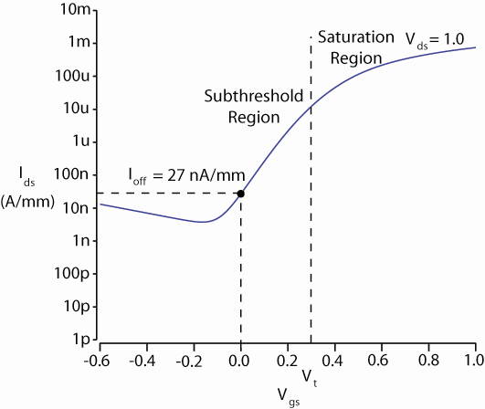
ON and OFF Current
I_{on} = I_{ds} @ V_{gs} = V_{ds} = V_{DD}
Saturation
I_{off} = I_{ds} @ V_{gs} = 0, V_{ds} = V_{DD}
Cutoff
Notes:
For the transistor to operate in saturation, the following conditions have to be met: V_{gs} = V_{ds} = V_{DD.}
For the transistor to operate in cutoff, the following conditions have to be met: V_{gs} = 0, V_{ds} = V_{DD.}

Slide 7
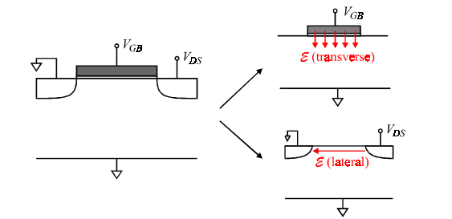
Electric Fields Effects
Vertical electric field: E_{vert} = V_{gs} / t_{ox}
Attracts carriers into channel
Long channel: Q_{channel} proportional to E_{vert}
Lateral electric field: E_{lat} = V_{ds} / L
Accelerates carriers from drain to source
Long channel: v = µE_{lat}
Singh, 2017
Notes:
There are two different types of electric field effects for our transistors.
The first one is the vertical electrical field, which is equal to:
Voltage from gate to source over the gate oxide thickness. This field attracts carriers into the channel. In long channel MOSFETs the charge in the channel is proportional to the vertical electric field.
The second electric field is the lateral one which is equal to:
Voltage from drain to source over the space between them. This field accelerates carriers from drain to source. In long channel MOSFETs v = ∝E_{lat}.

Slide 8
Free Pizza Analogy
A tired student runs from VLSI lab to quad lawn where there is free pizza!
Freshmen are pouring out of the Dorsey lecture hall
V_{ds} described how long you have been up
Your velocity = fatigue × mobility
V_{gs} is a wind blowing you against the edge of the walkway (SiO₂)
At high V_{gs}, students align at the edge in a straight line
Mobility degradation
At high V_{ds}, you scatter off freshmen, fall down, get up
Velocity saturation
Don’t confuse this with the saturation region

Slide 9
Mobility Degradation
High E_{vert} effectively reduces mobility
Collisions with oxide interface
Notes:
A high vertical electric field effectively reduces mobility because there are more collisions with the oxide interface.
Equation to calculate μ eff for either n or p transistors.

Slide 10
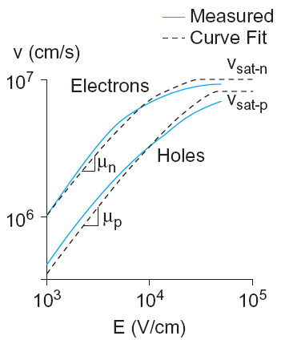
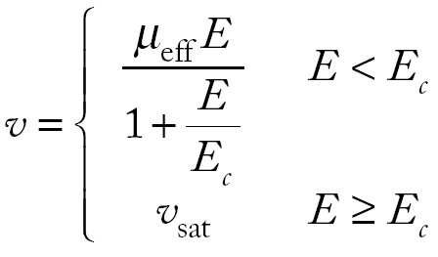
Velocity Saturation
At high E_{lat}, carrier velocity rolls off
Carriers scatter off atoms in silicon lattice
Velocity reaches v_{sat}
Electrons: 10⁷ cm/s
Holes: 8 x 10⁶ cm/s
Better model

Slide 11

Vel Sat I-V Effects
Ideal transistor ON current increases with V_{DD}²
Velocity-saturated ON current increases with V_{DD}
Real transistors are partially velocity saturated
Approximate with α-power law model
I_{ds} scales with V_{DD}^{α}
1 < α < 2 determined empirically (≈ 1.3 for 65 nm)

Slide 12
α-Power Model
Notes:
The α-Power model is used to determine the drain-current for short channel MOSFETs.
The α-Power model is based on four parameters: Vth (threshold voltage), α (velocity saturation index), Vdsat (drain saturation voltage) and ldsat (drain current).
The concept behind the α-Power model for short-channel MOSFETs is that the drain current of is proportional to ${\text{(}\text{Vgs}\text{ − }\text{Vth}\text{ )}}^{\text{α}}$.
With the α-power model, the curves are more linear as the value of α changes, which could be between 1 and 2.

Slide 13
Channel Length Modulation
Reverse-biased p-n junctions form a depletion region
Region between n and p with no carriers
Width of depletion, L_{d}, region grows with reverse bias
L_{eff} = L – L_{d}
Shorter L_{eff} gives more current
I_{ds} increases with V_{ds}
Even in saturation
Notes:
A channel length modulation is a shortening of the length of the inverted channel.
Reverse-biased p-n junctions form a depletion region with no carriers, and the width of depletion region grows with reverse bias so that the effective channel length is equal to total channel length minus width of depletion.
A shorter effect channel length gives more current and Ids increases with Vds.

Slide 14
Chan Length Mod I-V
λ = channel length modulation coefficient
not feature size
Empirically fit to I-V characteristics
Notes:
Channel length modulation or CML can be represented by current and voltage.
We can calculate the drain source current with following formula where lambda is equal to the channel length modulation coefficients.

Slide 15
Threshold Voltage Effects
V_{t} is V_{gs} for which the channel starts to invert
Ideal models assumed V_{t} is constant
Really depends (weakly) on almost everything else:
Body voltage: Body Effect
Drain voltage: Drain-Induced Barrier Lowering
Channel length: Short Channel Effect
Notes:
Threshold voltage is equal to gate source voltage for which the channel starts to invert. Ideal models assumed that threshold voltage is constant.
It really depends (weakly) on almost everything else, like:
Body voltage: Body effect
Drain voltage: Drain-Induced Barrier Lowering
And Channel length: Short Channel Effect
Next, we will examine how these affect the threshold voltage.

Slide 16
Body Effect
Body is a fourth transistor terminal
V_{sb} affects the charge required to invert the channel
Increasing V_{s} or decreasing V_{b} increases V_{t}
V_{t0} = nominal threshold voltage
φ_{s} = surface potential at threshold
Depends on doping level N_{A}
And intrinsic carrier concentration n_{i}
γ = body effect coefficient
Notes:
The body is the fourth transistor terminal.
Source to body voltage affects the charge required to invert the channel. Thus, when the source voltage is increased or the body voltage is decreased, the threshold voltage increases.

Slide 17
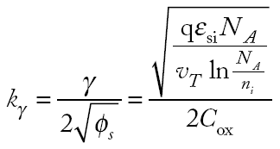
Body Effect Cont.
For small source-to-body voltage, treat as linear
Notes:
For a small source to body voltage, the formula to calculate the threshold is treated as linear.

Slide 18
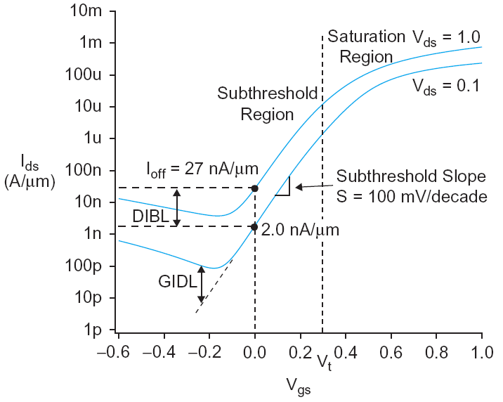
DIBL
Electric field from drain affects channel
More pronounced in small transistors where the drain is closer to the channel
Drain-Induced Barrier Lowering
Drain voltage also affect V_{t}
High drain voltage causes current to increase.
Notes:
Electric fields due to drain voltage affect the channel. This is more pronounced in small transistors where drain is closer to the channel. This effect is called the Drain-Induced barrier lowering or DIBL (the drain voltage affects the threshold voltage).
A high drain voltage causes current Ids to increase when the transistor is operating in saturation region.
We can model the effect of DIBL on the threshold voltage with the formula shown in the slide where Eta(η) is the DIBL coefficient.

Slide 19
Short Channel Effect
In small transistors, source/drain depletion regions extend into the channel
Impacts the amount of charge required to invert the channel
And thus makes V_{t} a function of channel length
Short channel effect: V_{t} increases with L
Some processes exhibit a reverse short channel effect in which V_{t} decreases with L
Notes:
In small transistors, the source/drain depletion region extends into a significant part of the channel. This could increase the amount of charge required to create an inversion region between the source and drain. Thus Vt becomes a function of the channel length.
Some processes exhibit a reverse short channel effect in which Vt decreases with L.

Slide 20
Leakage
What about current in cutoff?
Simulated results
What differs?
Current doesn’t
go to 0 in cutoff
Notes:
Leakage can occur when a transistor is OFF.
In the simulated model, the current doesn’t go to zero in the cutoff region.

Slide 21
Leakage Sources
Subthreshold conduction
Transistors can’t abruptly turn ON or OFF
Dominant source in contemporary transistors
Gate leakage
Tunneling through ultrathin gate dielectric
Junction leakage
Reverse-biased PN junction diode current
Notes:
There are different types of leakage sources, such as:
Subthreshold conduction makes transistor unable to abruptly turn ON or OFF; this leakage source is dominant in the contemporary transistors.
Gate leakage caused by tunneling through the gate dielectric due to being extremely thin.
Junction leakage: here current flows through the reverse biased p-n junction between the source/drain and the body.

Slide 22
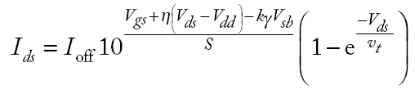
Subthreshold Leakage
Subthreshold leakage exponential with V_{gs}
n is process dependent
typically 1.3-1.7
Rewrite relative to I_{off} on log scale
S ≈ 100 mV/decade @ room temperature
Notes:
When the gate falls below Vt , i.e Vgs < Vt weak inversion occurs. In this state, the subthreshold leakage current increases with Vds because of DIBL.
In the equation, Ids0 is dependent on process and device geometry. This is the current at threshold.
n is a process-dependent term typically ranges from 1.3–1.7 for CMOS processes and is affected by the depletion region characteristics.

Slide 23
Gate Leakage
Carriers tunnel through very thin gate oxides
Exponentially sensitive to t_{ox} and V_{DD}
A and B are tech constants
Greater for electrons
So nMOS gates leak more
Negligible for older processes (t_{ox} > 20 Å)
Critically important at 65 nm and below (t_{ox} ≈ 10.5 Å)
From [Song01]
Notes:
Gate leakage can be due to direct tunneling in which carriers tunnel through very thin gate oxides resulting in leakage current through the gate.
Gate leakage is sensitive to the thickness of the gate oxide and it increases as the oxide thickness is reduced.
You can calculate the current leakage with the formula below, where a and b are physical parameters, which can become greater for electrons, so nMOS gates leak more.
This leakage is important at 65 nanometers and below because the thickness of gates is approximately 10.5 angstrom.

Slide 24
Junction Leakage
Reverse-biased p-n junctions have some leakage
Ordinary diode leakage
Band-to-band tunneling (BTBT)
Gate-induced drain leakage (GIDL)
Notes:
In the diagram, the p-n junction is shown between:
Source/drain diffusions and substrate/ well.
n well – p substrate .
reverse-biased p-n junctions have some leakage like the ordinary diode leakage, band-to-band tunneling or BTBT, and gate-induced drain leakage (GIDL).

Slide 25
Diode Leakage
Reverse-biased p-n junctions have some leakage
At any significant negative diode voltage, I_{D} = -I_{s}
I_{s} depends on doping levels
And area and perimeter of diffusion regions
Typically <1 fA/µm² (negligible)
Notes:
The n well – p substrate junction is reversed biased. However, small current ID can still flow through this junction.
In the case of the diode leakage, we can calculate its current with the formula given.
A significantly reversed biased junction (negative diode voltage) more than the thermal voltage, the leakage current ID = –IS,
IS depends on doping levels and area and perimeter of diffusion regions and is negligible.

Slide 26
Band-to-Band Tunneling
Tunneling across heavily doped p-n junctions
Especially sidewall between drain & channel
when halo doping is used to increase V_{t}
Increases junction leakage to significant levels
X_{j}: sidewall junction depth
E_{g}: bandgap voltage
A, B: tech constants
Notes:
Band-to-Band Tunneling affects heavily doped drains. BTBT occurs on the p-n junctions formed between the drain/source and the body when reversed biased. High halo doping is used to increase Vt, however, this instead causes BTBT to grow.
Leakage due to BTBT can be modeled with the formula shown in the slide.

Slide 27
Gate-Induced Drain Leakage
Occurs at overlap between gate and drain
Most pronounced when drain is at V_{DD}, gate is at a negative voltage
Thwarts efforts to reduce subthreshold leakage using a negative gate voltage
Notes:
Gate-induced drain leakage occurs at overlap between gate and drain.
This leakage is the most pronounced when the drain is at Vdd/high voltage and the gate is at negative/low.

Slide 28
Temperature Sensitivity
Increasing temperature
Reduces mobility
Reduces V_{t}
I_{ON} decreases with temperature
I_{OFF} increases with temperature
Notes:
Transistors are temperature sensitive, increasing its temperature can reduce its mobility and its threshold voltage.
When transistor is ON, the current decreases with temperature.
When transistor is OFF, its current increases with temperature.

Slide 29
So What?
So what if transistors are not ideal?
They still behave like switches.
But these effects matter for…
Supply voltage choice
Logical effort
Quiescent power consumption
Pass transistors
Temperature of operation

Slide 30
Parameter Variation
Transistors have uncertainty in parameters
Process: L_{eff}, V_{t}, t_{ox} of nMOS and pMOS
Vary around typical (T) values
Fast (F)
L_{eff}: short
V_{t}: low
t_{ox}: thin
Slow (S): opposite
Not all parameters are independent
for nMOS and pMOS
Notes:
Transistors have uncertainty in parameters such as Process (effective channel length, threshold voltage, or thickness of gate oxide of nMOS and pMOS) These parameters vary around typical (T) values.
The parameters for a fast transistor are short effective channel length, low threshold voltage and thin thickness of the gate oxide. The opposite will give a slow transistor.

Slide 31
Environmental Variation
V_{DD} and T also vary in time and space
Fast:
V_{DD}: high
T: low
Corner | Voltage | Temperature
F | 1.98 | 0 C
T | 1.8 | 70 C
S | 1.62 | 125 C
Notes:
There is also a variation because of the environment. Sources of environmental variation are Vdd and temperature.

Slide 32
Process Corners
Process corners describe worst case variations
If a design works in all corners, it will probably work for any variation.
Describe corner with four letters (T, F, S)
nMOS speed
pMOS speed
Voltage
Temperature
Notes:
Process corners describe worst case variation that helps us to know whether a design will work for any variation of the corners.
The corners are described with four letters, T for typical, F for fast, and S for slow. And these are assigned to each of the parameter of our transistor as:
nMOS or pMOS speed, voltage, and temperature.

Slide 33
Important Corners
Some critical simulation corners include
Purpose | nMOS | pMOS | V_{DD} | Temp
Cycle time | S | S | S | S
Power | F | F | F | F
Subthreshold leakage | F | F | F | S

