Slide 1
12.0 – CLOCKING ENGR-E 399/599: VLSI Design Prof. Daniel Loveless, dlovele@iu.edu, 812-856-0703
INDIANA UNIVERSITY – Reliable Electronics and Systems
Center for Reliable and Trusted Electronics (CREATE)
Notes:
Hello and welcome.

Slide 2
Learning Objectives
At the end of this lecture, you should be able to:
Describe the implications of clock distribution networks on skew and clock power
Design clock generators using delay and phase-locked loops

Slide 3
Clock Distribution
On a small chip, the clock distribution network is just a wire
And possibly an inverter for clkb
On practical chips, the RC delay of the wire resistance and gate load is very long
Variations in this delay cause clock to get to different elements at different times
This is called clock skew
Most chips use repeaters to buffer the clock and equalize the delay
Reduces but doesn’t eliminate skew
Notes:
Good clock distribution network ensures that data signals are synchronized among synchronous datapaths to avoid skew.

Slide 4
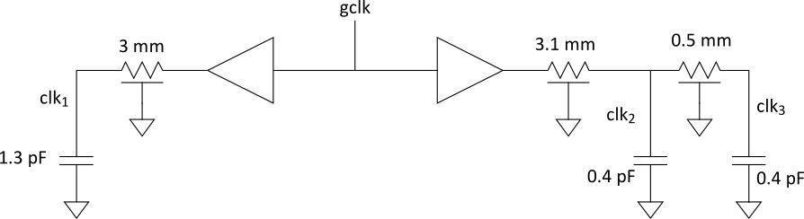
Example
Skew comes from differences in gate and wire delay
With right buffer sizing, clk₁ and clk₂ could ideally arrive at the same time.
But power supply noise changes buffer delays
clk₂ and clk₃ will always see RC skew
Notes:
Skew can be as a result of mismatched wires, mismatched buffers, gate delay, and variable loads, which may result delayed clock arrival times.

Slide 5
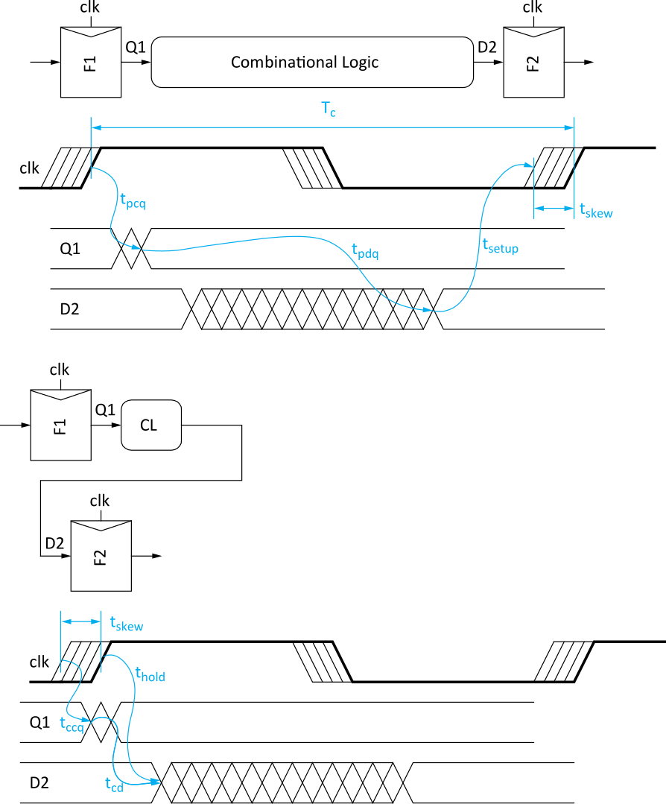
Review: Skew Impact
Ideally full cycle is
available for work
Skew adds sequencing
overhead
Increases hold time too
Notes:
Skew adds to sequencing overhead and also increases hold time. Therefore, the aim would be to minimize clock skew.

Slide 6
Solutions
Reduce clock skew
Careful clock distribution network design
Plenty of metal wiring resources
Analyze clock skew
Only budget actual, not worst-case skews
Local vs. global skew budgets
Tolerate clock skew
Choose circuit structures insensitive to skew
Notes:
Clock skew can be reduced by careful design of clock distribution network.
Also, circuit structure can be chosen such that they are tolerant to clock skew.

Slide 7
Clock Dist. Networks
Ad hoc
Grids
H-tree
Hybrid

Slide 8
Clock Grids
Use grid on two or more levels to carry clock
Make wires wide to reduce RC delay
Ensures low skew between nearby points
But possibly large skew across die

Slide 9
Alpha Clock Grids
Notes:
Alpha clock grids are divided into driver panes
– 21064 is a one driver pane clock grid
– 21164 is a two driver panes clock grid
– 21264 is a sixteen driver panes clock grid

Slide 10
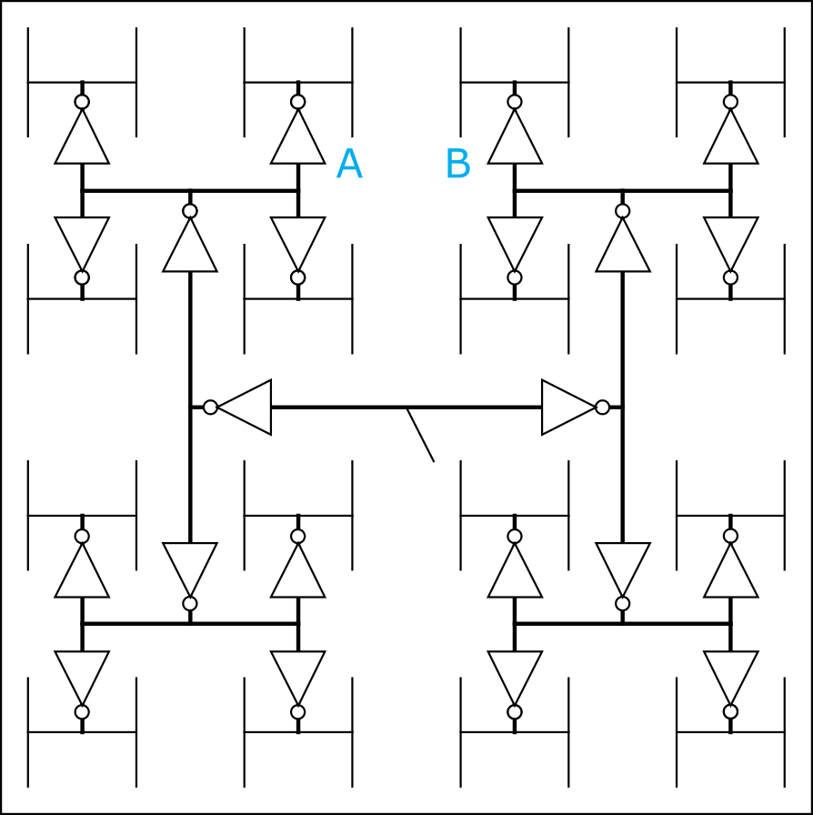
H-Trees
Fractal structure
Gets clock arbitrarily close to any point
Matched delay along all paths
Delay variations cause skew
A and B might see big skew
Notes:
Clock gets close to any point, which means low routing resources needed. However, this system can suffer from skew due to variations in branches delay.

Slide 11
Itanium 2 H-Tree
Four levels of buffering:
Primary driver
Repeater
Second-level
clock buffer
Gater
Route around
obstructions

Slide 12
Hybrid Networks
Use H-tree to distribute clock to many points
Tie these points together with a grid
E.g., IBM Power4, PowerPC
H-tree drives 16-64 sector buffers
Buffers drive total of 1024 points
All points shorted together with grid
Notes:
Hybrid combines both H-tree and Grid.

Slide 13
Clock Generation
Low frequency:
Buffer input clock and drive to all registers
High frequency
Buffer delay introduces large skew relative to input clocks
Makes it difficult to sample input data
Distributing a very fast clock on a PCB is hard

Slide 14
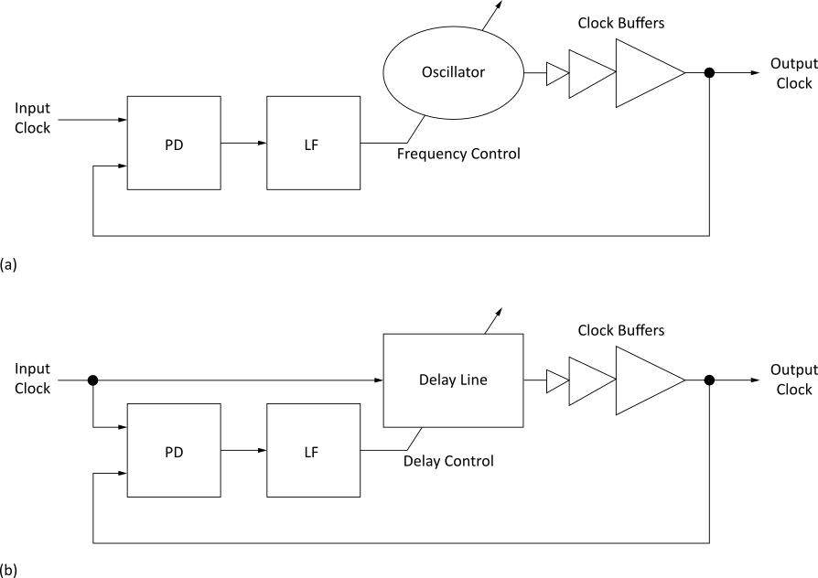
Zero-Delay Buffer
If the periodic clock is delayed by T_{c}, it is indistinguishable from the original clock
Build feedback system to guarantee this delay
Phase-Locked
Loop (PLL)
Delay-Locked
Loop (DLL)
Notes:
PLL and DLL employ a feedback system to match or change the phase of a clock signal.

Slide 15
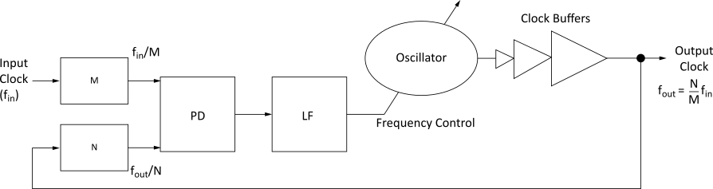
Frequency Multiplication
PLLs can multiply the clock frequency
Notes:
From the output equation, it can be seen that N/M if not equal to 1 means the output frequency is derived from multiplying the input signal.

Slide 16
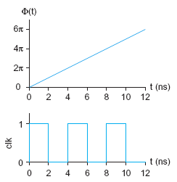
Phase and Frequency
Analyze PLLs and DLLs in term of phase Φ(t) rather than voltage v(t)
Input and output clocks may
deviate from locked phase
Small signal analysis

Slide 17
Linear System Model
Treat PLL/DLL as a linear system
Compute deviation DF from locked position
Assume small deviations from locked
Treat system as linear for these small changes
Analysis is not valid far from lock
e.g., during acquisition at startup
Continuous time assumption
PLL/DLL is really a discrete time system
Updates once per cycle
If the bandwidth << 1/10 clock freq, treat as continuous
Use Laplace transforms and standard analysis of linear continuous-time feedback control systems

Slide 18
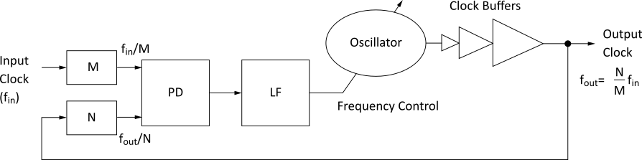
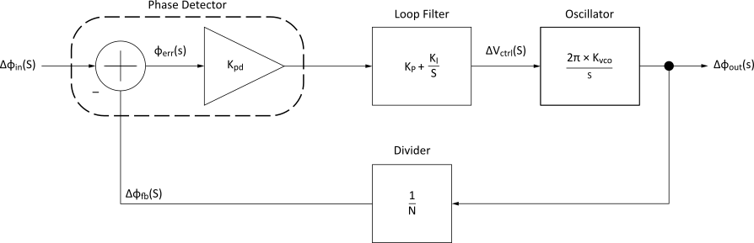
Phase-Locked Loop (PLL)
System
Linear Model
Notes:
A phase-locked loop (PLL) contains a voltage-driven oscillator whose output is monitored and controlled to match the frequency of an input signal.

Slide 19
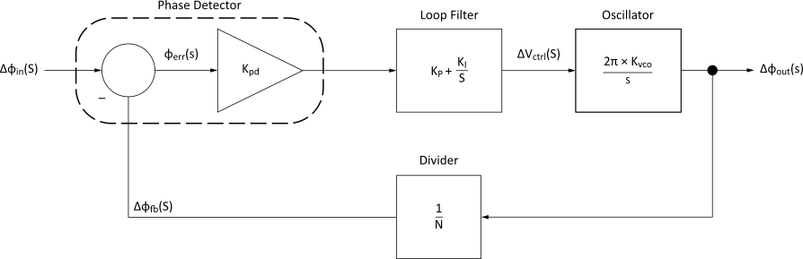
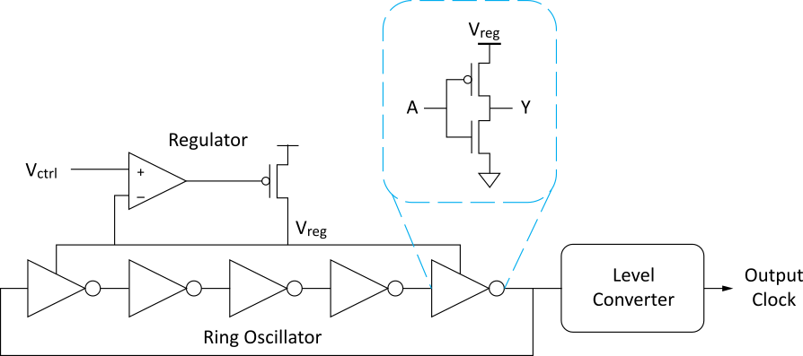
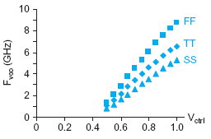
Voltage-Controlled Oscillator
VCO
Notes:
From the circuit Vctrl is used to control the power supplied to the ring oscillator, which ultimately controls the output frequency.

Slide 20
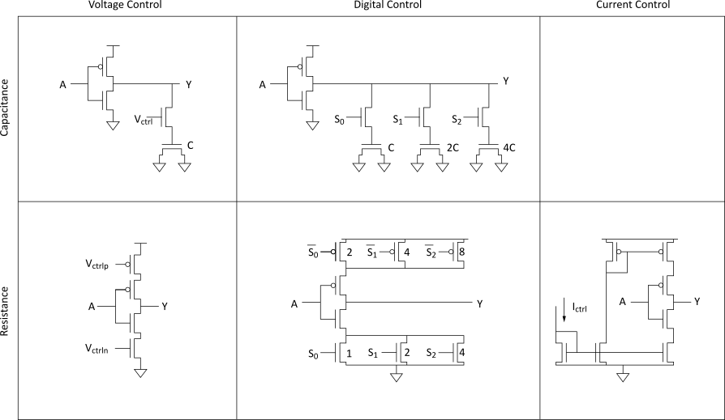
Alternative Delay Elements
Notes:
There are other alternative delay elements that could replace the inverters used in the ring oscillator in the pervious slide. This slide shows delay elements can be formed using transistor circuits, which can take in voltage, digital or current controls depending on the circuit architecture.

Slide 21
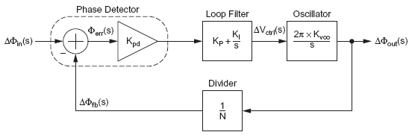
Frequency Divider
Divide clock by N
Use mod-N counter
Notes:
The frequency divider feeds (reference frequency) the phase detector with a frequency derived by dividing the output frequency by a factor of N. The VCO can be controlled by changing N.

Slide 22
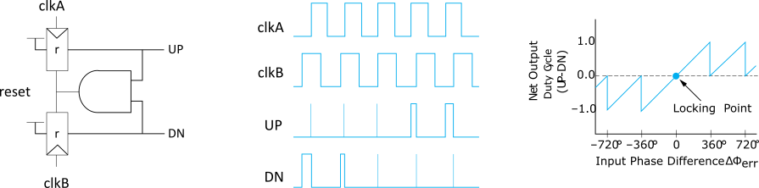
Phase Detector
Difference of input and
feedback clock phase
Often built from phase-frequency detector (PFD)
Notes:
The phase detector compares the input signal and the output from the feedback function to determine the appropriate control signal to apply to the Vco.

Slide 23
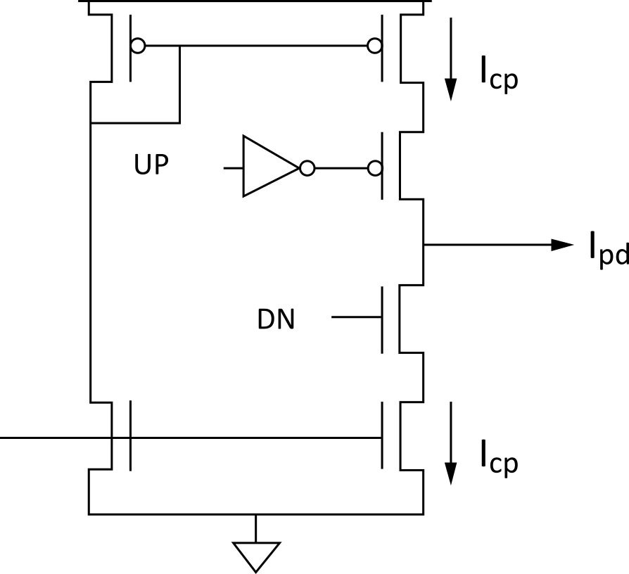
Phase Detector
Convert up and down pulses into current proportional to phase error using a charge pump
Notes:
A charge pump is used between the phase detector and the loop filter. Its function is to convert the voltage fluctuations from the phase detector to current.

Slide 24
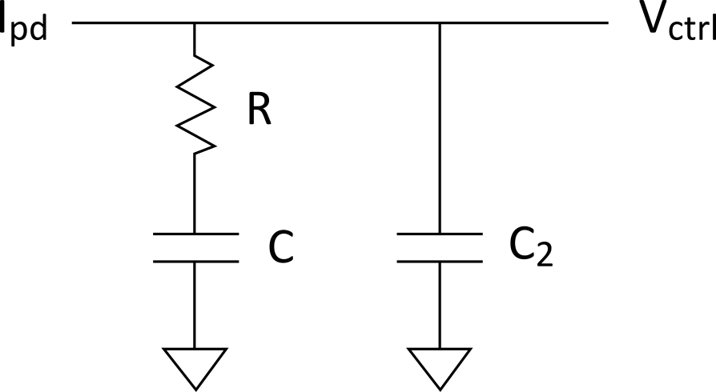
Loop Filter
Convert charge pump
current into V_{ctrl}
Use proportional-integral control (PI) to generate a control signal dependent on the error and its integral
Drives error to 0
Notes:
One of the major functions of the loop filter is to remove high-frequency noise components from the phase detector output and outputs a voltage control for the Vco.

Slide 25
PLL Loop Dynamics
Closed loop transfer function of PLL
This is a second order system
ω_{n} indicates loop bandwidth
ζ indicates damping; choose 0.7 – 1 to avoid ringing

Slide 26
Delay Locked Loop
Delays input clock rather than creating a new clock with an oscillator
Cannot perform frequency multiplication
More stable and easier to design
1st order rather than 2nd
State variable is now time (T)
Locks when loop delay is exactly T_{c}
Deviations of ΔT from locked value
Notes:
A DLL negatively delays the input signal using series of delay elements whose delay effect can be controlled.

Slide 27
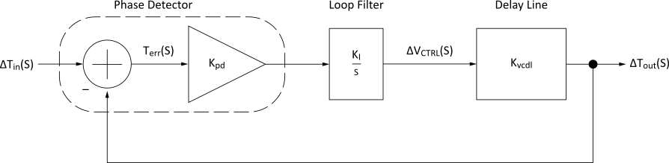
Delay-Locked Loop (DLL)
System
Linear Model
Notes:
Linear model shows that the output of the DLL is a delayed version of the input signal.

Slide 28
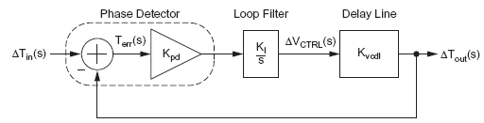
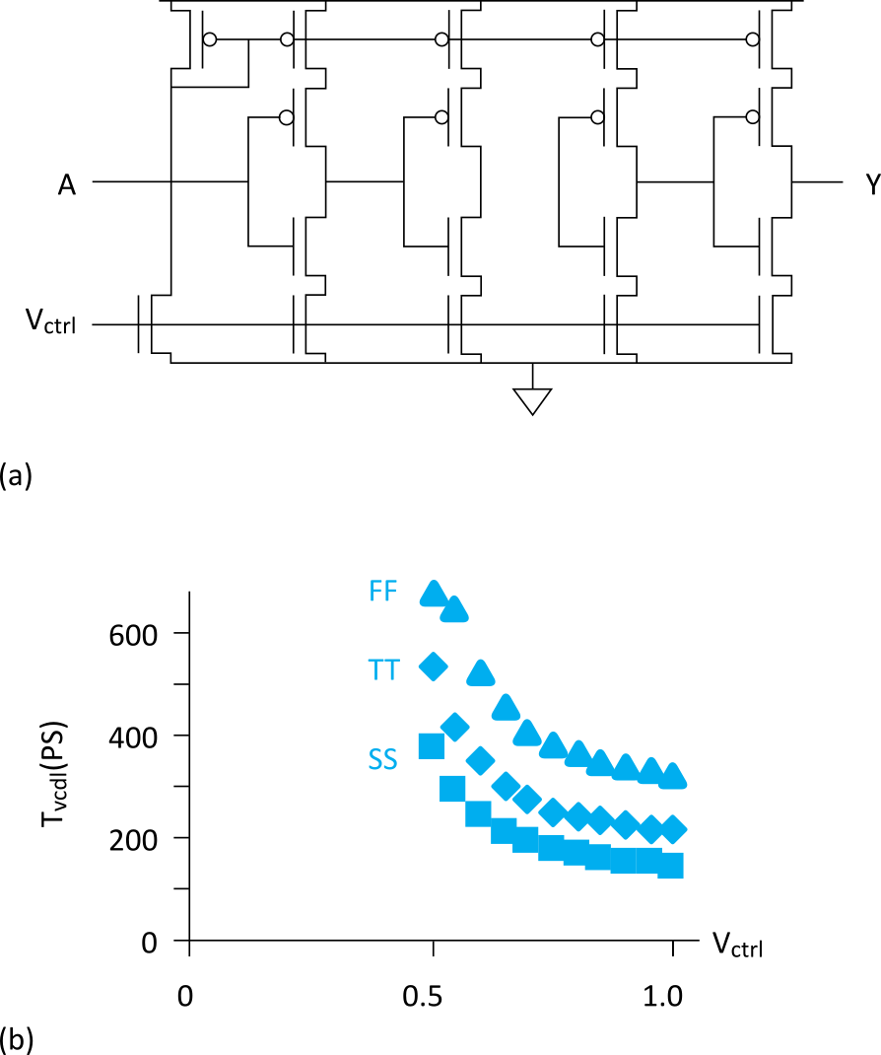
Delay Line
Delay input clock
Typically use voltage-controlled delay line
Notes:
Slide talks about the delay line and shows that a change in control voltage results in a change in time of input to output (overall time of the delay elements).

Slide 29
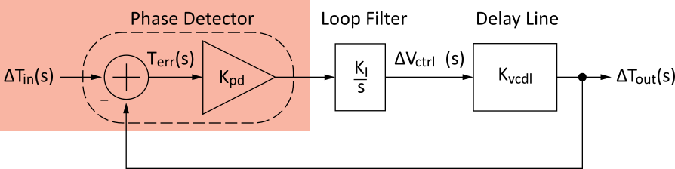
Phase Detector
Detect phase error
Typically use PFD and charge pump, as in PLL
Notes:
The phase detector compares the input signal and the output from the feedback function to determine the appropriate control signal to apply to the delay elements.
A charge pump is used between the phase detector and the loop filter. Its function is to convert the voltage fluctuations from the phase detector to current, which is then used to control the delay elements operation.

Slide 30
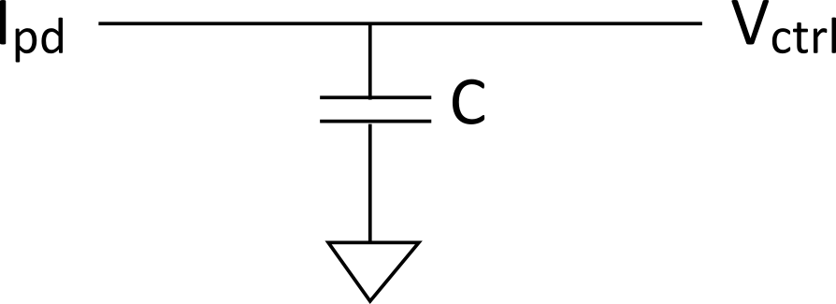
Loop Filter
Convert error current
into control voltage
Integral control is sufficient
Typically use a capacitor as the loop filter
Notes:
One of the major functions of the loop filter is to remove high-frequency noise components from the phase detector output and outputs a voltage control for the delay elements.

Slide 31
DLL Loop Dynamics
Closed loop transfer function of DLL
This is a first-order system
τ indicates time constant (inverse of bandwidth)
Choose at least 10T_{c} for continuous time approx.

