Slide 1
Highlight Reel: Slide Decks 3.0 – 5.0
ENGR-E 399/599: VLSI Design
Prof. Daniel Loveless, dlovele@iu.edu, 812-856-0703
INDIANA UNIVERSITY – Reliable Electronics and Systems
Center for Reliable and Trusted Electronics (CREATE)
Notes:
Hello and welcome. Today, our focus will be on the CMOS transistor theory.

Slide 2
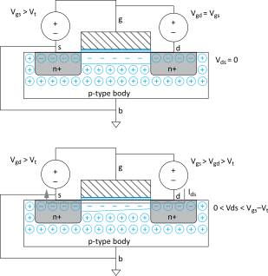
nMOS Linear I-V
Now we know
  How much charge Q_{channel} is in the channel
  How much time (t) each carrier takes to cross
V_{gs} > V_{t}
But V_{ds} small
Channel forms
Current flows from d to s
  e⁻ from s to d
I_{ds} increases with V_{ds}
Similar to linear resistor

Slide 3
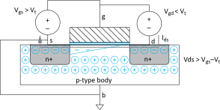
nMOS Saturation I-V
If V_{gd} < V_{t}, channel pinches off near drain
  When V_{ds} > V_{dsat} = V_{gs} – V_{t}
Now drain voltage no longer increases current
V_{gs} > V_{t}
V_{ds} > V_{gs} - V_{t}
Channel pinches off
I_{ds} independent of V_{ds}
We say current saturates
Similar to current source

Slide 4


I-V Summary
Shockley 1st order transistor models
nMOS
pMOS
$$I_{ds}=\left\{\begin{matrix}0 & V_{gs}<V_{t} & \text{cutoff} \\ β\left(V_{gs}−V_{t}−\frac{V_{ds}}{2}\right)V_{ds} & V_{ds}<V_{dsat} & \text{linear} \\ \frac{β}{2}{\left(V_{gs}−V_{t}\right)}^{2} & V_{ds}>V_{dsat} & \text{saturation}\end{matrix}\right.$$
$$I_{sd}=\left\{\begin{matrix}0 & V_{sd}<{|V}_{t}| & \text{cutoff} \\ β\left(V_{sg}−{|V}_{t}|−\frac{V_{sd}}{2}\right)V_{sd} & V_{sd}<V_{sdat} & \text{linear} \\ \frac{β}{2}{\left(V_{sg}−{|V}_{t}|\right)}^{2} & V_{sd}>V_{sdat} & \text{saturation}\end{matrix}\right.$$
Notes:
The equation for Ids current can be expressed for the three operating regions cutoff, linear and saturation.

Slide 5
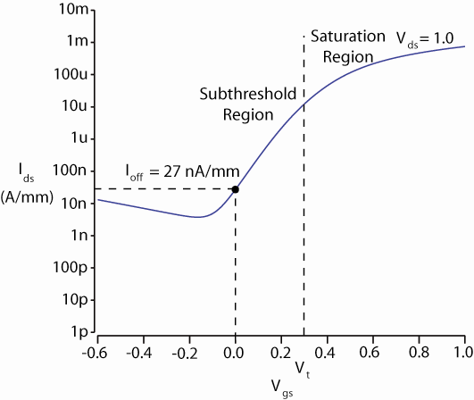
Non-Ideal Transistors
Non-ideal effects include:
  Short channel effect
  Leakage:
    Subthreshold conduction
    Gate
    Junction
  Temperature sensitivity
  Parameter variation
Notes:
Plot shows Simulated vs Ideal I-V characteristics of the nMOS transistor. This plot highlights the difference between the ideal and non-ideal transistor. In the plot, it can be seen that the velocity saturation and mobility degradation for the simulated model is lower than that of the ideal transistor.

Slide 6
Operation
Region | nMOS | pMOS
A | Cutoff | Linear
B | Saturation | Linear
C | Saturation | Saturation
D | Linear | Saturation
E | Linear | Cutoff
Notes:
Plot shows Simulated vs Ideal I-V characteristics of the nMOS transistor. This plot highlights the difference between the ideal and non-ideal transistor. In the plot, it can be seen that the velocity saturation and mobility degradation for the simulated model is lower than that of the ideal transistor.

Slide 7
Matching
Notes:
Plot shows Simulated vs Ideal I-V characteristics of the nMOS transistor. This plot highlights the difference between the ideal and non-ideal transistor. In the plot, it can be seen that the velocity saturation and mobility degradation for the simulated model is lower than that of the ideal transistor.

Slide 8
Inverter Step Response
E.g., find step response of inverter driving load cap

Slide 9
Delay Definitions
t_{pdr}: rising propagation delay
  From input to rising output crossing V_{DD}/2
t_{pdf}: falling propagation delay
  From input to falling output crossing V_{DD}/2
t_{pd}: average propagation delay
  t_{pd} = (t_{pdr} + t_{pdf})/2
t_{r}: rise time
  From output crossing 0.2 V_{DD} to 0.8 V_{DD}
t_{f}: fall time
  From output crossing 0.8 V_{DD} to 0.2 V_{DD}

Slide 10
Delay Definitions
t_{cdr}: rising contamination delay
  From input to rising output crossing V_{DD}/2
t_{cdf}: falling contamination delay
  From input to falling output crossing V_{DD}/2
t_{cd}: average contamination delay
  t_{pd} = (t_{cdr} + t_{cdf})/2
Notes:
Contamination delay is the minimum time from when the input changes to 50% of its value to when the output changes to 50% of its value.

Slide 11
Delay Estimation
We would like to be able to easily estimate delay
  Not as accurate as simulation
  But easier to ask “What if?”
The step response usually looks like a 1st order RC response with a decaying exponential.
Use RC delay models to estimate delay
  C = total capacitance on output node
  Use effective resistance R
  So that t_{pd} = RC
Characterize transistors by finding their effective R
  Depends on average current as gate switches
Notes:
Step response use RC delay models to estimate delay.
C=strain capacitance and R is the equivalent resistance of the transistors, depending on its average current.

Slide 12
Effective Resistance
Shockley models have limited value
  Not accurate enough for modern transistors
  Too complicated for much hand analysis
Simplification: treat transistor as resistor
  Replace I_{ds}(V_{ds}, V_{gs}) with effective resistance R
    I_{ds} = V_{ds}/R
  R averaged across switching of digital gate
Too inaccurate to predict current at any given time
  But good enough to predict RC delay
Notes:
To find the effective resistance of a transistor, the Shockley model can be used, however this model is limited because it is not suitable for modern transistors.
The designer can treat the transistor as a resistor. This approach is good enough to predict RC delay of the transistor.

Slide 13
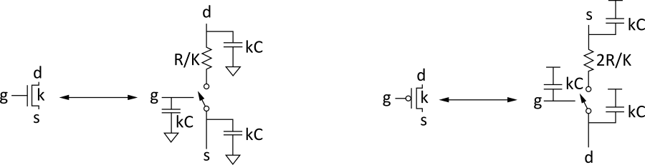
RC Delay Model
Use equivalent circuits for MOS transistors
  Ideal switch + capacitance and ON resistance
  Unit nMOS has resistance R, capacitance C
  Unit pMOS has resistance 2R, capacitance C
Capacitance proportional to width
Resistance inversely proportional to width
Notes:
Here, we have some guidelines to transform transistors into equivalent circuits.
Treat the transistor as an ideal switch with Resistance (in on condition) and Capacitance (all connected to 0V/Vdd).
nMOS has resistance R (between the gate to source) divided by the constant of the transistor and capacitance C (connected to Vdd) multiplied by the constant of the transistor.
pMOS has resistance 2R (between the gate to the drain) divided by the constant of the transistor and capacitance C (connected to 0 V) multiplied by the constant of the transistor.

Slide 14
RC Values
Capacitance
  C = C_{g} = C_{s} = C_{d} = 2 fF/μm of gate width in 0.6 μm
  Gradually decline to 1 fF/μm in nanometer techs.
Resistance
  R ≈ 6 kΩ*μm in 0.6 μm process
  Reduces with shorter channel lengths
Unit transistors
  May refer to minimum contacted device (4/2 λ)
  Or maybe 1 μm wide device
  Doesn’t matter as long as you are consistent

Slide 15
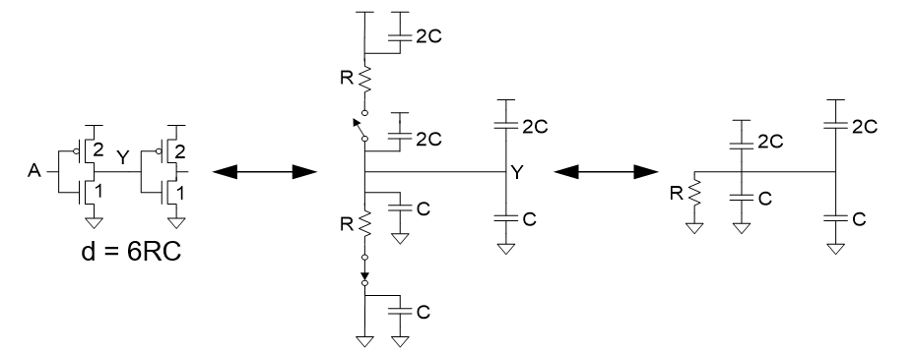
Inverter Delay Estimate
Estimate the delay of a fanout-of-1 inverter
Notes:
First, transform the transistors into the ideal switch with resistances and capacitances.
Next consider only the active network based on the input value. The delay through the active network can be calculated by multiplying the total resistance (R) with the total capacitance (6C because capacitances are in parallel).
tpd=6RC.

Slide 16
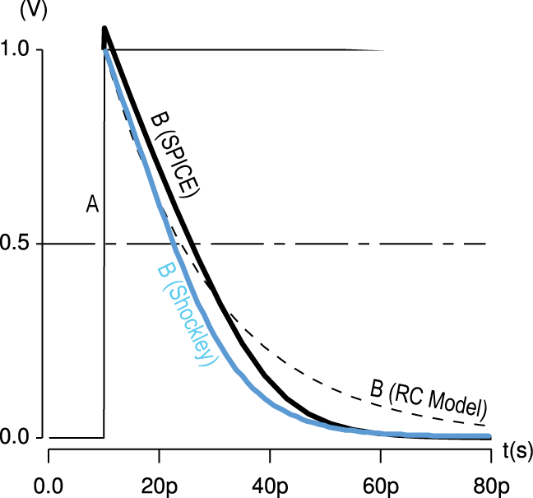
Delay Model Comparison

Slide 17
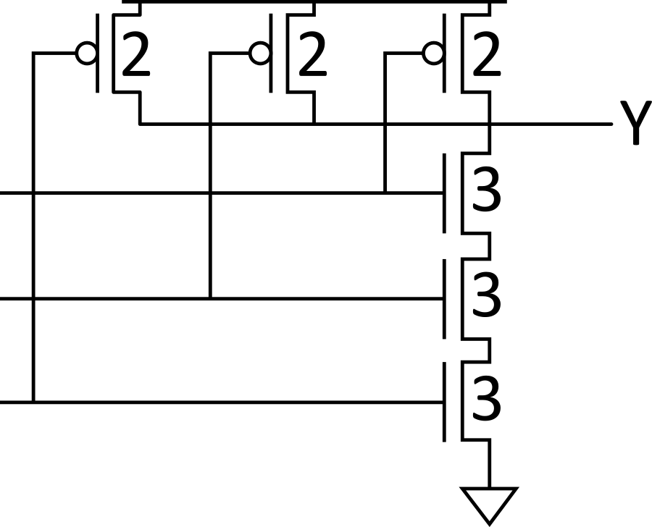
Example: 3-input NAND
Sketch a 3-input NAND with transistor widths chosen to achieve effective rise and fall resistances equal to a unit inverter (R).
Notes:
Example of a 3-input NAND gate with gate sizing to achieve effective rise and fall resistance equal to a unit inverter.
All the pMOS have constant k=2 and all the nMOS have constant k=3.

Slide 18
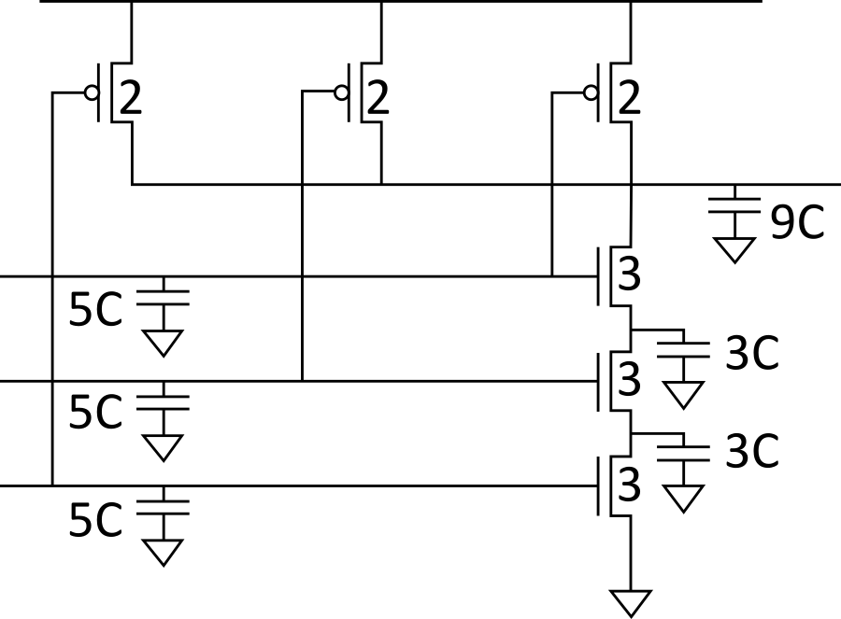
3-input NAND Caps
Annotate the 3-input NAND gate with gate and diffusion capacitance.

Slide 19
Elmore Delay
ON transistors look like resistors
Pullup or pulldown network modeled as RC ladder
Elmore delay of RC ladder
Notes:
Elmore Delay: It is usually used for tree-structured networks where the formula is similar to the tpd where it is the sum of RC.
Pullup and Pulldown network can be modeled as RC ladders.
We can use this theory to continue working with the 3 input NAND CAPS and calculate the equivalent delay.

Slide 20
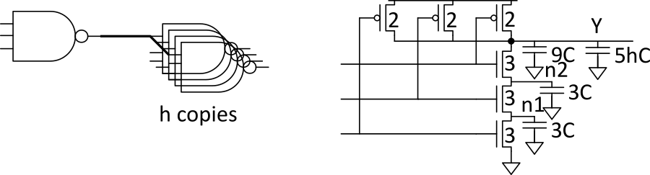
Example: 3-input NAND
Estimate worst-case rising and falling delay of 3-input NAND driving h identical gates.
Notes:
Draw the RC equivalent of the transistors to estimate the rising and falling delay.

Slide 21
Delay Components
Delay has two parts
  Parasitic delay
    9 or 11 RC
    Independent of load
  Effort delay
    5h RC
    Proportional to load capacitance
Notes:
Delay in gates have two components:
Parasitic delay. This is independent of the load as shown in previous examples modeling the RC equivalent of the transistors.
The effort delay is mainly or directly proportional to the load capacitance.

Slide 22
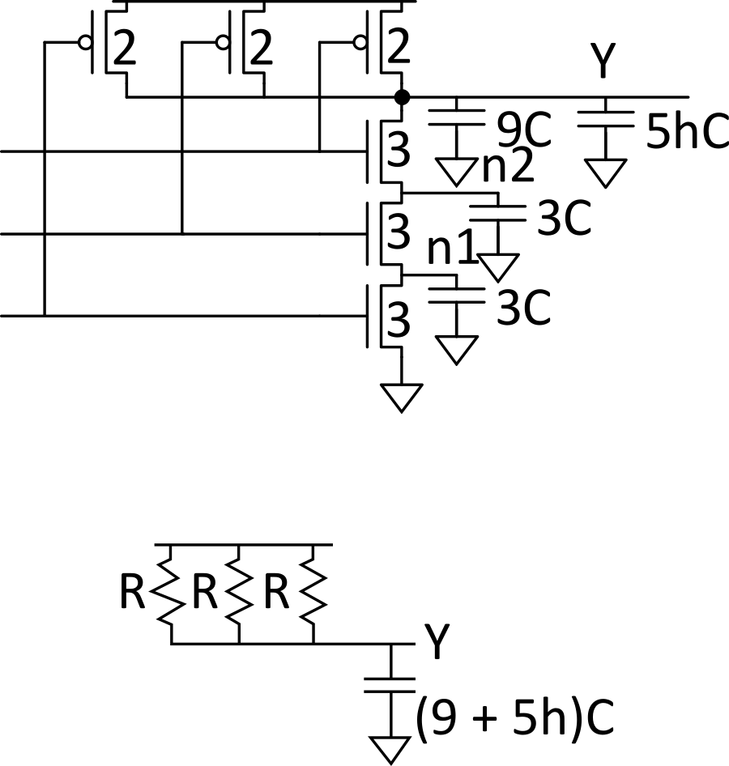
Contamination Delay
Best-case (contamination) delay can be substantially less than propagation delay.
E.g., if all three inputs fall simultaneously

Slide 23
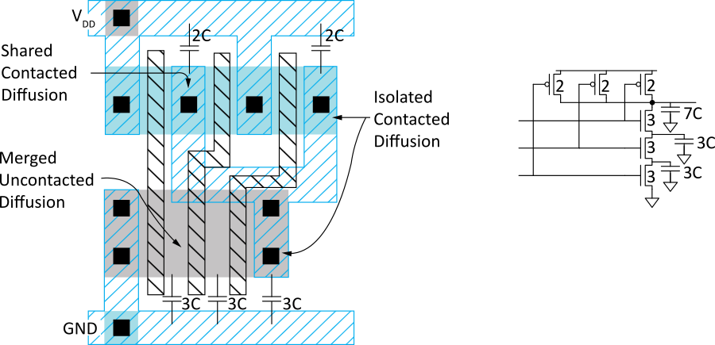
Diffusion Capacitance
We assumed contacted diffusion on every s/d.
Good layout minimizes diffusion area
E.g., NAND3 layout shares one diffusion contact
  Reduces output capacitance by 2C
  Merged uncontacted diffusion might help too
Notes:
It is possible for transistor to share diffusion area to minimize diffusion capacitance. This is an optimization of the layout.

Slide 24
Layout Comparison
Which layout is better?
Left has less diffusion capacitance on Y

