Slide 1

1.1 – Circuits & Layout ENGR-E 399/599: VLSI Design Prof. Daniel Loveless, dlovele@iu.edu, 812-856-0703
INDIANA UNIVERSITY – Reliable Electronics and Systems
Center for Reliable and Trusted Electronics (CREATE)

Slide 2
Learning Objectives
At the end of this lecture, you should be able to:
Draw transistor-level schematics and layouts for complementary CMOS standard cells.
Use time diagrams to describe the operation of D latch and D Flip-flop.
Use stick diagrams to sketch and plan cell layouts.
Notes:
By the end of this lecture, you should be able to:
Draw transistor-level schematics and layouts for complementary CMOS standard cells.
Use time diagrams to describe the operation of D latch and D Flip-flop.
Use stick diagrams to sketch and plan cell layouts.

Slide 3
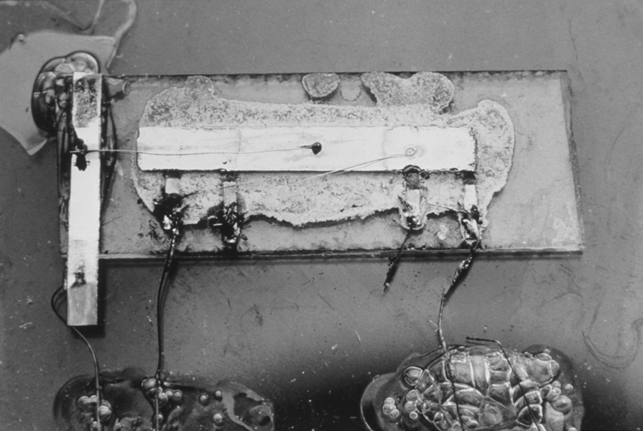
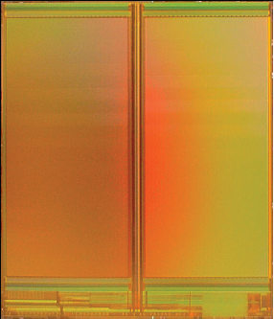
A Brief History
1958: First integrated circuit
Flip-flop using two transistors
Built by Jack Kilby at Texas Instruments
2019
Apple A13 microprocessor
8.5 billion transistors
Samsung 8 TB Flash memory
2 trillion stacked transistors
Courtesy Texas Instruments
[Trinh09]
© 2009 IEEE.
Notes:
On 12 September 1958, the first integrated circuit was built. A flip-flop using two transistors designed by Jack Kilby at Texas Instruments.
On 2019, Apple A13 microprocessor contained 8.5 billion transistors. Also, a Samsung 8 Terabyte flash memory contained 2 trillion stacked transistors.

Slide 4
Growth Rate
53% compound annual growth rate over 50 years
No other technology has grown so fast so long
Driven by miniaturization of transistors
Smaller is cheaper, faster, lower in power!
Revolutionary effects on society
Notes:
Over 50 years, there has been a 53% increase in the compound annual growth rate, and this was particularly driven by the miniaturization of transistors.

Slide 5
Annual Sales
>10²⁰ transistors manufactured in 2017
56 billion for every human on the planet
Notes:
Annual sales between 1962 and 2017 show that there are more than 10^20 transistors manufactured in 2017.

Slide 6
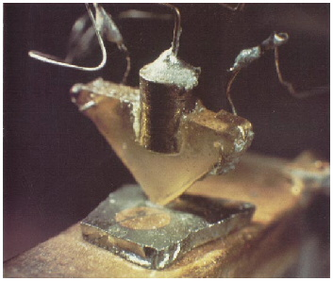
Invention of the Transistor
Vacuum tubes ruled in first half of 20th century Large, expensive, power-hungry, unreliable
1947: first point contact transistor
John Bardeen and Walter Brattain at Bell Labs
See Crystal Fire
by Riordan, Hoddeson
AT&T Archives. Reprinted with permission.
Notes:
Before the invention of the transistor, vacuum tubes ruled the first half of 20th century, but they were large, expensive, power-hungry, and unreliable.
In December 1947, John Bardeen and Walter Brattain at Bell Labs built the first point contact transistor.

Slide 7
Transistor Types
Bipolar transistors
npn or pnp silicon structure
Small current into very thin base layer controls large currents between emitter and collector
Base currents limit integration density
Metal Oxide Semiconductor Field Effect Transistors
nMOS and pMOS MOSFETS
Voltage applied to insulated gate controls current between source and drain
Low power allows very high integration
Notes:
There are two types of transistor: bipolar and mosfets
Bipolar transistors are characterized by their npn or pnp silicon structure. In this type of transistors, small current in the very thin base layer controls large currents between emitter and collector. Base currents limit integration density.
Metal Oxide Semiconductor Field Effect Transistors are characterized by nMOS and pMOS MOSFETS. In this transistor, voltage applied to insulated gate controls current between source and drain. These transistors are low power and allow very high integration.

Slide 8
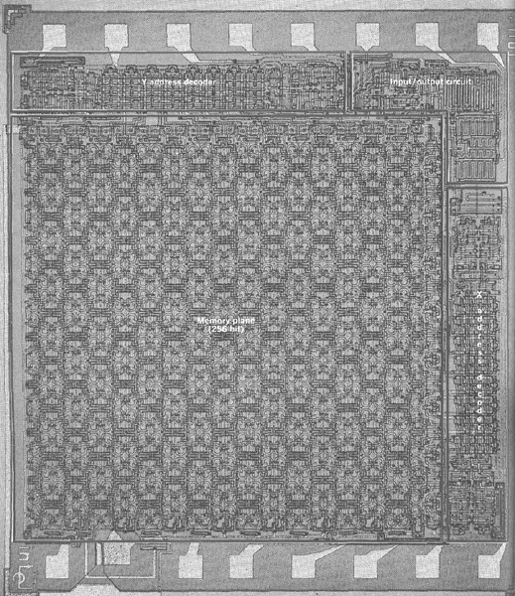
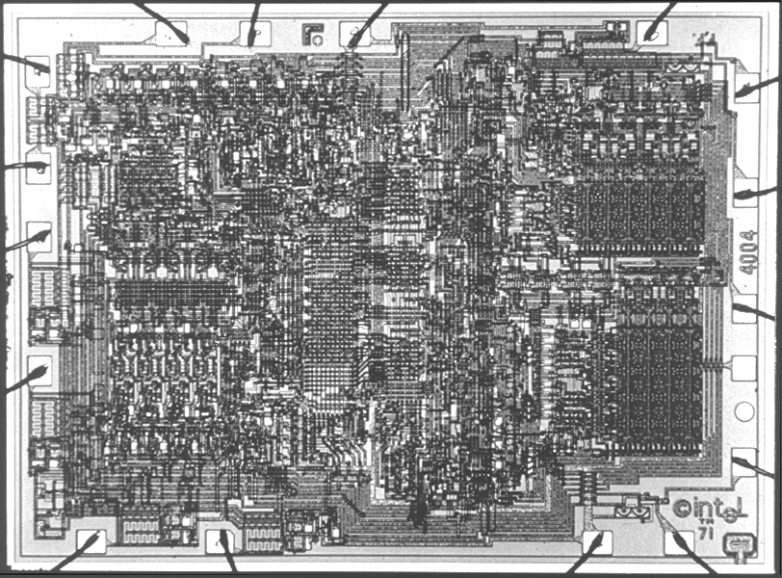
MOS Integrated Circuits
1970’s processes usually had only nMOS transistors
Inexpensive, but consumed power while idle
1980s-present: CMOS processes for low idle power
Intel Museum.
Reprinted with permission.
[Vadasz69]
© 1969 IEEE.
Intel 1101 256-bit SRAM
Intel 4004 4-bit μProc
Notes:
During 1970’s, processes usually had only nMOS transistors; they were inexpensive, but consumed power when idle.
From 1980s to the present, CMOS processes are used because of its low power consumption when idle.

Slide 9
Moore’s Law: Then
1965: Gordon Moore plotted transistor on each chip
Fit a straight line on semilog scale
Transistor counts have doubled every 26 months
Integration Levels
SSI: 10 gates
MSI: 1000 gates
LSI: 10,000 gates
VLSI: >10k gates
Notes:
In 1965, Gordon Moore plotted several transistors on each chip against dates of introduction.
From this graph, we obtained a fit straight line on semilog scale showing that transistor’s counts are nearly doubling every 26 months.

Slide 10
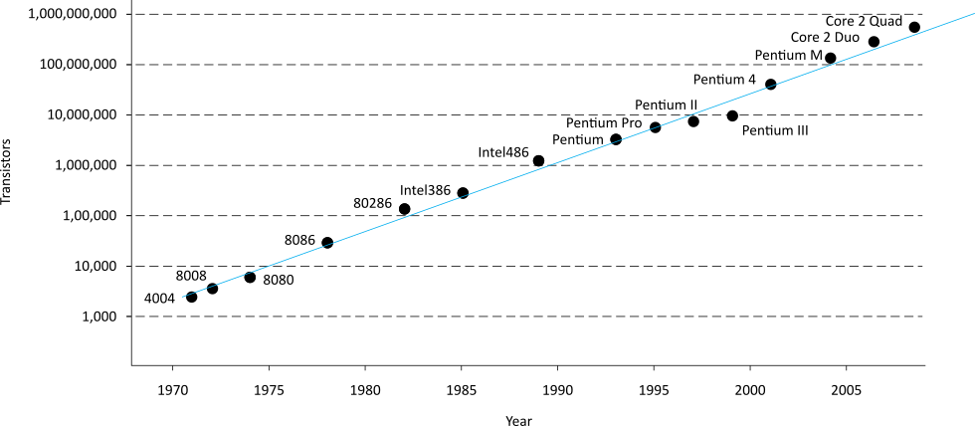
And Now…
Notes:
Moore's law trend saw an increased number of transistors packed in a chip.

Slide 11
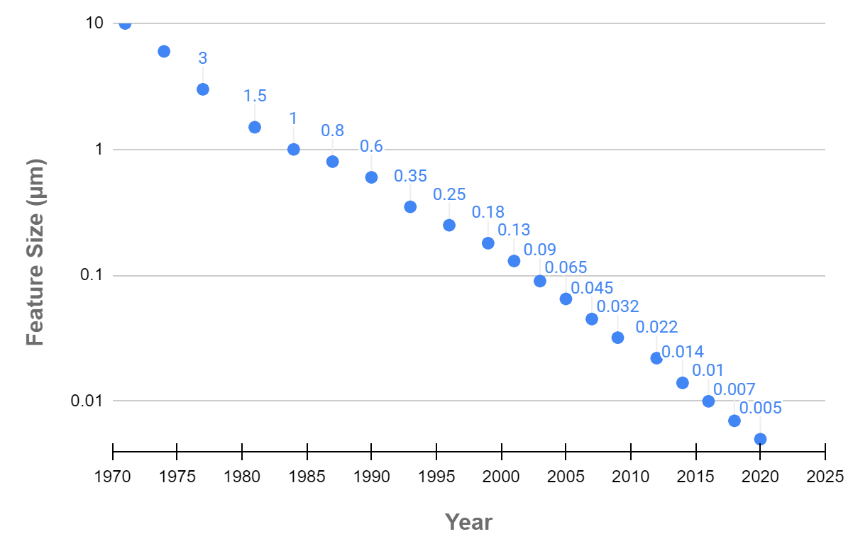
Feature Size
Minimum feature size shrinking 30% every 2-3 years
Notes:
Feature size of transistors kept been shrinking 30% every 2-3 years.

Slide 12
Corollaries
Many other factors grow exponentially
E.g., clock frequency, processor performance
Year | Clock Speed (Hz) | Processor name
1971 | 740K | 4004
1972 | 500K | 8008
1982 | 6M | 80186
1982 | 8M | 80188
1993 | 66M | Pentium
1999 | 600M | Pentium III
2000 | 2G | Pentium 4
2006 | 2.33K | Core 2 Duo
2008 | 3.2G | Core i7
2011 | 2.67G | Xeon E7
2013 | 4.4G | Intel "Haswell"
Intel Processors, year and clock speed
Notes:
Because of this, other factors grow exponentially like clock frequency or processor performance.

Slide 13
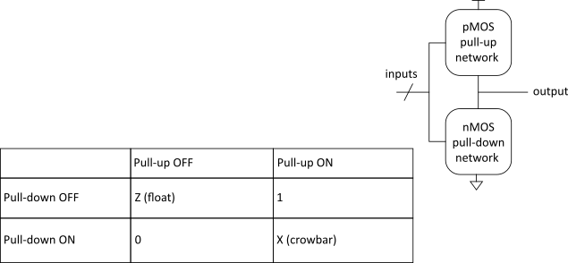
Complementary CMOS
Complementary CMOS logic gates
nMOS pull-down network
pMOS pull-up network
a.k.a. static CMOS
Notes:
Complementary CMOS logic gates also known as static CMOS uses both pMOS and nMOS transistors in their design.
The nMOS transistor is used as the pull-down network (make output as logic Low) and pMOS is used as the pull-up network (make output as logic High).

Slide 14
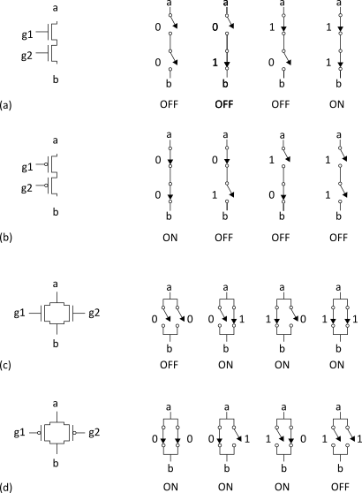
Series and Parallel
nMOS: 1 = ON
pMOS: 0 = ON
Series: both must be ON
Parallel: either can be ON
Notes:
Behavior of nMOS and pMOS transistors when connected in series and parallel.
Assume the transistors are placed in the middle of the connection between a and b.
The nMOS transistor will be ON when a logic 1 is applied to its gate, while pMOS will be ON when a logic 0 is applied to its gate.
To have a connection between a and b i.e create a path between a and b the following applied:
When both transistors are in series, then, both transistors must be turned ON.
When both transistors are in parallel, either transistor can be ON.

Slide 15
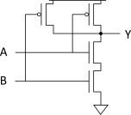
Conduction Complement
Complementary CMOS gates always produce 0 or 1
E.g., NAND gate
Series nMOS: Y=0 when both inputs are 1
Thus, Y=1 when either input is 0
Requires parallel pMOS
Rule of Conduction Complements
Pull-up network is a complement of pull-down
Parallel -> series, series -> parallel
Notes:
Complementary CMOS gates will either produce a 0 (low state) or 1 (high state). For example.
A NAND gate will output 0 when both inputs are 1 because the series nMOS transistors are turned ON. It will produce a 1 when one or both inputs is 0 because one or both parallel pMOS transistors will be ON.
The rule of conduction complements tells us that a pull-up network is a complement of pull-down, thus parallel pull-up and series pull-down are paired and vice versa.

Slide 16
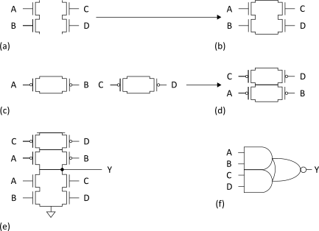
Compound Gates
Compound gates can do any inverting function
E.g.,

Slide 17
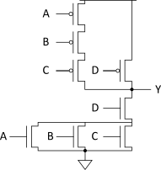
Example: O3AI

Slide 18
Signal Strength
Strength of signal
How close it approximates ideal voltage source
V_{DD} and GND rails are strongest 1 and 0
nMOS pass strong 0
But degraded or weak 1
pMOS pass strong 1
But degraded or weak 0
Thus, nMOS are best for pull-down network
Notes:
Signal strength is given by how close it approximates ideal voltage source. Vdd and GND rails are strongest 1 and 0, respectively.
nMOS transistors pass strong 0 but are degraded or weak with 1s.
pMOS pass strong 1 but are degraded or weak with 0s.
Thus, nMOS are best for pull-down network and pMOS for pull-up.

Slide 19
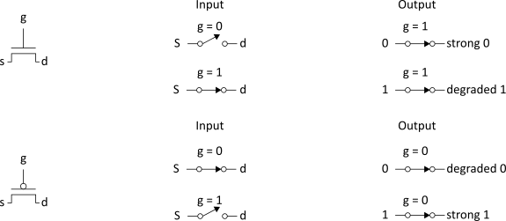
Pass Transistors
Transistors can be used as switches
Notes:
Pass transistor refer to transistors used as switches.

Slide 20
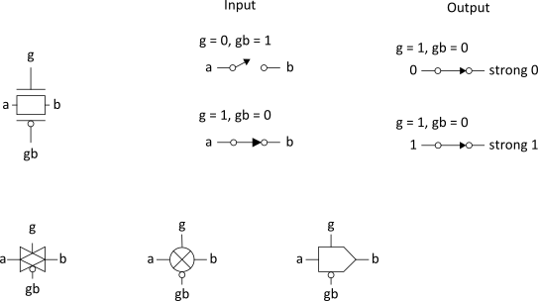
Transmission Gates
Pass transistors produce degraded outputs
Transmission gates pass both 0 and 1 well
Notes:
Although pass transistors produce degraded outputs, we can mix them to build transmission gates that pass both 0 and 1 well.

Slide 21
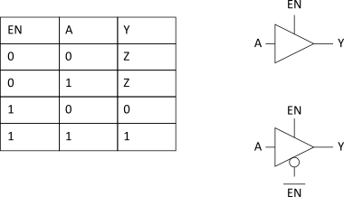
Tristates
Tristate buffer produces Z when not enabled
Notes:
A tristate buffer produces a high impedance or Z, when it is not enabled.
Notice that high impendence means that the output is not either 1 or 0.

Slide 22

Nonrestoring Tristate
Transmission gate acts as a tristate buffer
Only two transistors
But nonrestoring
Noise on A is passed on to Y
Notes:
A transmission gate acts like a tristate buffer.
It is built with two transistors, and there is no way to restore its values, in other words, the noise on A is passed on to Y.

Slide 23
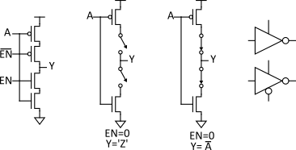
Tristate Inverter
Tristate inverter produces restored output
Violates conduction complement rule
Because we want a Z output
Notes:
A tristate inverter, on the other hand, produces a restored output and violates conduction complement rule because according to the rules CMOS circuits will need to output 1 or 0, and here, we have a Z output.

Slide 24
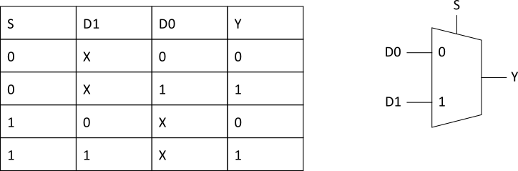
Multiplexers
2:1 multiplexer chooses between two inputs
Notes:
A multiplexer circuit is used to select between different inputs. In this case, a 2:1 multiplexer chooses between these two inputs, D1 and D0.
In the table above, X is placed where the input values don’t matter.

Slide 25
Gate-Level Mux Design
How many transistors are needed?
Notes:
Now, how many transistors are needed for a Multiplexer Design.
If we look at its gate level design, there are 4 gates in total. But not all the gates use the same number of transistors. And most of our gates need to be inverted since we are using CMOS transistors.

Slide 26
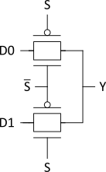
Transmission Gate Mux
Nonrestoring mux uses two transmission gates
Only 4 transistors
Notes:
But what about using transmission gates? For a nonrestoring multiplexer, two transmission gates will be enough, requiring 4 transistors.

Slide 27
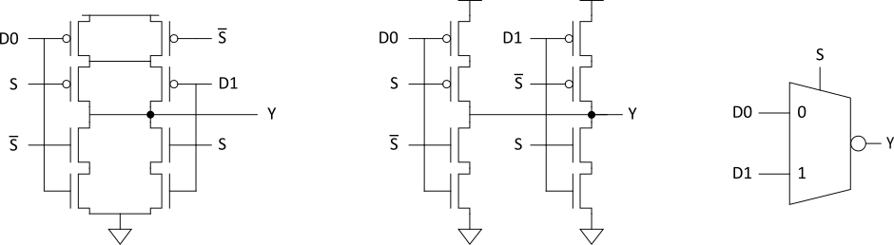
Inverting Mux
Inverting multiplexer
Use compound AOI22
Or a pair of tristate inverters
Essentially the same thing
Noninverting multiplexer adds an inverter
Notes:
What about an inverting multiplexer.
You can use the compound AOI22 or a pair of tristate inverter, which is the same thing.
Noninverting multiplexer adds an inverter.

Slide 28
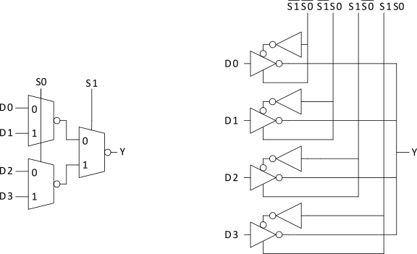
4:1 Multiplexer
4:1 mux chooses one of 4 inputs using two selects
Two levels of 2:1 muxes
Or four tristates
Notes:
4:1 Multiplexer chooses one of four inputs using two selects, SO and S1.
We can design this with two levels of 2:1 multiplexers or four tristates.

Slide 29
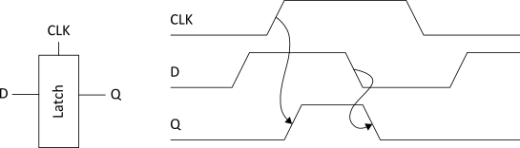
D Latch
When CLK = 1, latch is transparent
D flows through to Q like a buffer
When CLK = 0, the latch is opaque
Q holds its old value independent of D
Aka transparent latch or level-sensitive latch
Notes:
A D latch is a circuit that holds a value depending on the state of the clock.
When the clock is in a high state, the latch is transparent, so D flows through Q like a buffer.
When the clock is in a low state, the latch is opaque, and Q holds its old value independent of D.

Slide 30
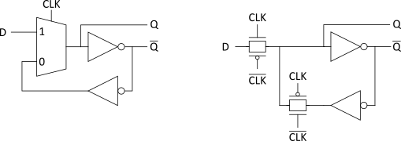
D Latch Design
Multiplexer chooses D or old Q
Notes:
D latch design contains a multiplexer that chooses D or old Q and two inverters.

Slide 31
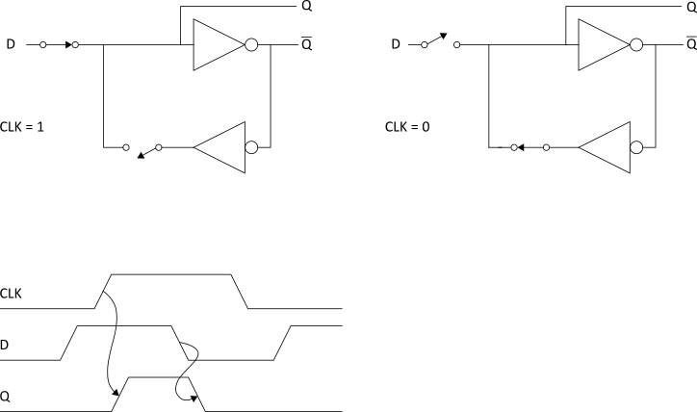
D Latch Operation
Notes:
For D latch operation, if we replace the transmission gates with switches, we can observe how the value of D is passed through Q when the clock is high. Otherwise, the old value fed back as the output through the second inverter network (feedback).

Slide 32
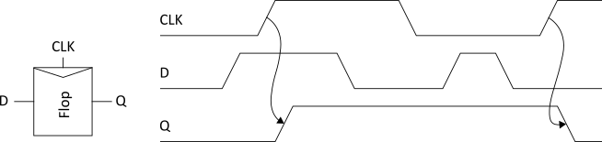
D Flip-flop
When CLK rises, D is copied to Q
At all other times, Q holds its value
aka positive edge-triggered flip-flop, master-slave flip-flop
Notes:
D flip-flop
When the clock signal rises, D is copied to Q, but Q will conserve its value until the next positive transition of the clock.
Also known as positive edge-triggered flip-flop, master-slave flip-flop.

Slide 33
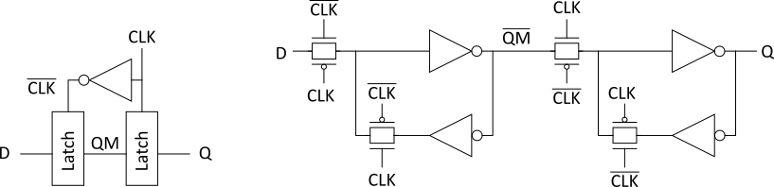
D Flip-flop Design
Built from two D latches, a primary and secondary D latches
Notes:
The D flip-flop design is built from primary and secondary D latches.

Slide 34
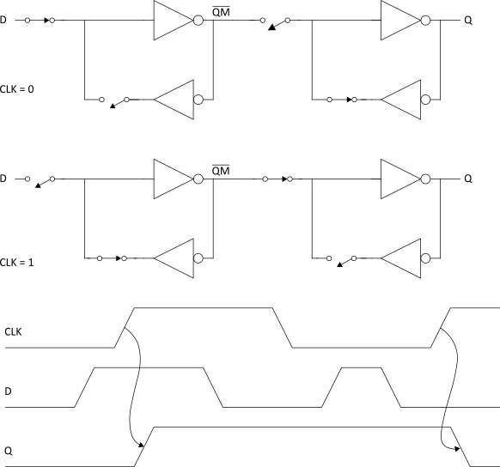
D Flip-flop Operation
Notes:
Let’s replace the transmission gate by switches, and then we can observe how the only way to update the value of Q is when the clock rises.

Slide 35
Race Condition
Back-to-back flops can malfunction from clock skew
Second flip-flop fires late
Sees first flip-flop change and captures its result
Called hold-time failure or race condition
Notes:
Back-to-back flop can malfunction from clock skew.
For example, second flip-flop fires late, sees first flip-flop change, and captures its result.
This is called hold-time failure or race condition.

Slide 36
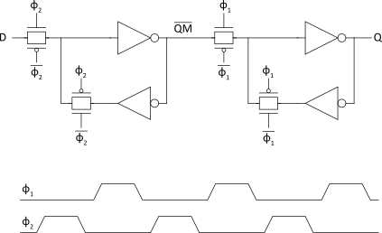
Nonoverlapping Clocks
Nonoverlapping clocks can prevent races
As long as nonoverlap exceeds clock skew
We will use them in this class for safe design
Industry manages skew more carefully instead
Notes:
Nonoverlapping clock can prevent races, as long as nonoverlap exceeds clock skew.

Slide 37
Gate Layout
Layout can be very time consuming
Design gates to fit together nicely
Build a library of standard cells
Standard cell design methodology
V_{DD} and GND should abut (standard height)
Adjacent gates should satisfy design rules
nMOS at bottom and pMOS at top
All gates include well and substrate contacts
Notes:
The gate layout can be very time consuming because:
Design gates need to fit together nicely.
Sometimes we need to build a library of standard cells.
Another thing about gate layout is its standard cell design methodology like VDD and GND being about the same height.
Adjacent gates that should satisfy design rules,
nMOS at bottom and pMOS at top and that all gates include well and substrate contracts.

Slide 38
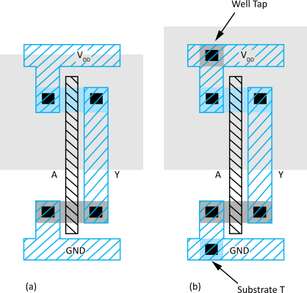
Example: Inverter
Notes:
Example shown for a CMOS inverter

Slide 39
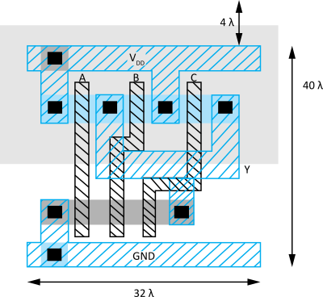
Example: NAND3
Horizontal n-diffusion and p-diffusion strips
Vertical polysilicon gates
Metal 1 V_{DD} rail at top
Metal 1 GND rail at bottom
32 λ by 40 λ
Notes:
Example shown for OR NAND3

Slide 40
Stick Diagrams
Stick diagrams help plan layout quickly
Need not be scaled
Draw with color pencils or dry-erase markers
Notes:
Layout can be time consuming. Stick diagrams are used to plan layout.

Slide 41
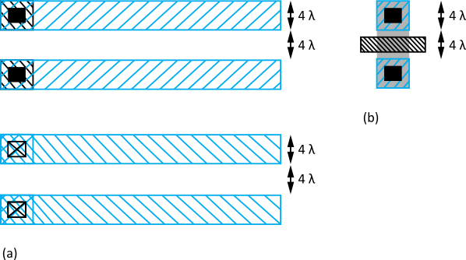
Wiring Tracks
A wiring track is the space required for a wire
4 λ width, 4 λ spacing from neighbor = 8 λ pitch
Transistors also consume one wiring track
Notes:
A wiring track is the space required for a wire, for example, for 4 lambda width and 4 lambda spacing from neighbor will be equal to 8 lambda pitch
Transistors also consume one wiring track
Remember that λ(lambda) = feature size/2 in which feature size is the distance between the source and drain.

Slide 42
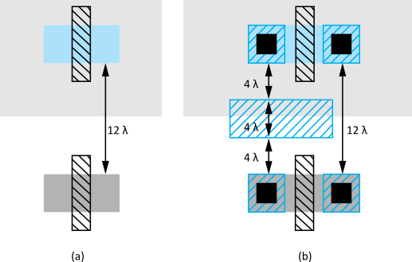
Well spacing
Wells must surround transistors by 6 λ
Implies 12 λ between opposite transistor flavors
Leaves room for one wire track
Notes:
Wells must surround transistors by 6 lambda spaces. This implies 12 lambdas between opposite transistor flavors.

Slide 43
Area Estimation
Estimate area by counting wiring tracks
Multiply by 8 to express in λ
Notes:
We can estimate the area of the gate layout by counting the horizontal and vertical wiring tracks and multiplying this value by 8 to express in lambda.

Slide 44
Example: O3AI
Sketch a stick diagram for O3AI and estimate area
Notes:
Example of a stick diagram for 03AI.

Slide 45
Modern Design Rules
Rules are expressed in nanometers, not λ
Lithography becomes difficult when feature size is less than the wavelength of light
At 16 nm and below, design rules are highly restrictive
Layers have preferred directions, and no bends are allowed
Only certain widths are allowed
Minimum area of each rectangle
Complex rules for power busses
Thousands of design rules
Layout becomes the domain of full-time experts
But the principles of layout remain valid
Notes:
Modern design rules are expressed in nanometers, not lambda.
It is important to know that Lithography becomes difficult when feature size is less than the wavelength of light.
When we approach 16 nm and below, design rules are highly restrictive, but the principles of the layout remain valid.

