Slide 1
10.0 – Metal Interconnect ENGR-E 399/599: VLSI Design Prof. Daniel Loveless, dlovele@iu.edu, 812-856-0703
INDIANA UNIVERSITY – Reliable Electronics and Systems
Center for Reliable and Trusted Electronics (CREATE)
Notes:
Hello and welcome to CMOS VLSI Design course; today, our focus will be in Scaling.

Slide 2
Learning Objectives
At the end of this lecture, you should be able to:
Use lumped element models to estimate the resistance and capacitance of on-chip wires.
Describe the issues of diffusion barrier resistance and dishing with copper wire and their effect on the overall resistance of the wire.
Use equations and diagrams to describe wire resistance and capacitance.
Describe crosstalk and its effects on nearby wires.
Optimize wire delay, power, and crosstalk using width, spacing, shielding, and repeaters.

Slide 3
Introduction
Chips are mostly made of wires called interconnect
In stick diagram, wires set size
Transistors are little things under the wires
Many layers of wires
Wires are as important as transistors
Speed
Power
Noise
Alternating layers run orthogonally
Notes:
Connections between components, gates etc. in a chip are done with wires called interconnect.

Slide 4
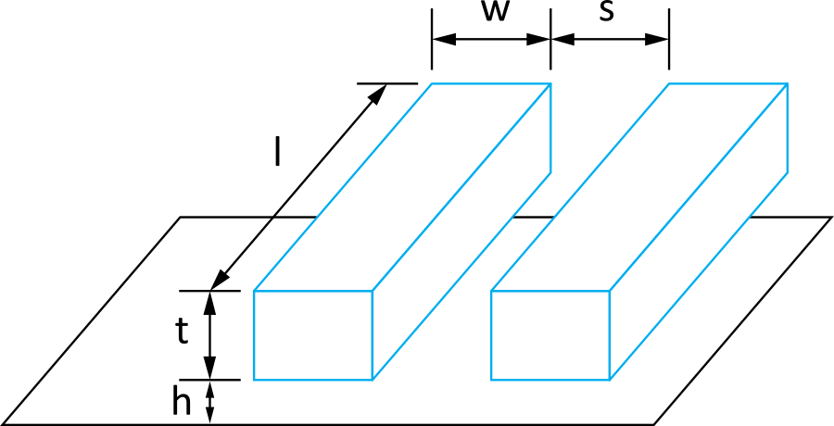
Wire Geometry
Pitch = w + s
Aspect ratio: AR = t/w
Old processes had AR << 1
Modern processes have AR ≈ 2
Pack in many skinny wires
Notes:
Wires are characterized by their geometry.
The pitch is equal to the width of the wire plus its required spacing.

Slide 5
Layer Stack
AMI 0.6 μm process has 3 metal layers
M1 for within-cell routing
M2 for vertical routing between cells
M3 for horizontal routing between cells
Modern processes use 6-10+ metal layers
M1: thin, narrow (< 3λ)
High-density cells
Mid-layers
Thicker and wider (density vs. speed)
Top layers: thickest
For V_{DD}, GND, clk
Notes:
Some libraries implement wires in different layers. Each layer could be best used for a specific function. For example, M1 in AMI 0.6 μm process is for within-cell routing.
Modern process uses 6–10+ metal layers. The top layers are usually the thickest and are used for power, ground, and clock.

Slide 6
Example
Intel 90 nm Stack
Intel 45 nm Stack
[Thompson02]
[Moon08]

Slide 7
Interconnect Modeling
Current in a wire is analogous to current in a pipe
Resistance: narrow size impedes flow
Capacitance: trough under the leaky pipe must fill first
Inductance: paddle wheel inertia opposes changes in flow rate
Negligible for most
wires
Notes:
The size of the wire affects its resistance to current flow.
Other factors like capacitance and inductance also affect the characteristics of the wire. While capacitance affects the signal delay, inductance opposes change in signal speed. For most wires, inductance is negligible.

Slide 8
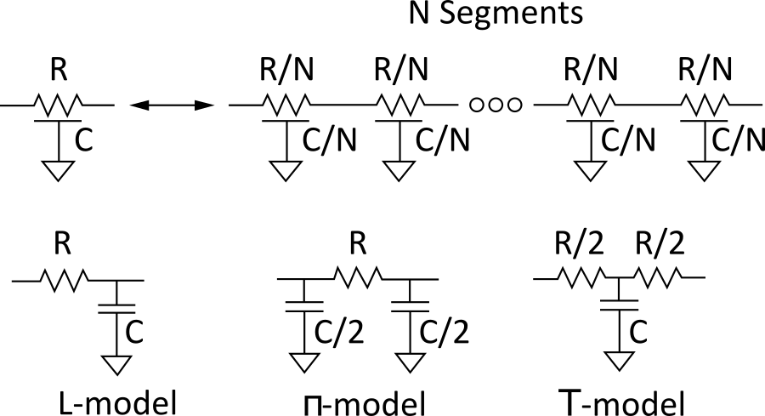
Lumped Element Models
Wires are a distributed system
Approximate with lumped element models
3-segment π-model is accurate to 3% in simulation
L-model needs 100 segments for same accuracy!
Use single segment π-model for Elmore delay
Notes:
A simple RC model of a wire can be broken down into the equivalent number of N distributed RC segments of smaller resistance and capacitance. The characteristics of the wire can be modelled with lumped element such as L-model, π-model and T-model using the distributed RC segments.
While a 3-segment π-model is accurate to 3%, the L-model would require more segments (100) for the same accuracy.

Slide 9
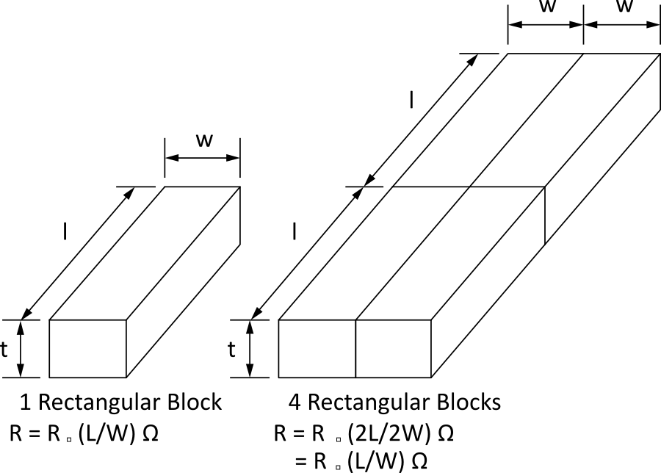
Wire Resistance
ρ = resistivity (Ω *m)
R□ = sheet resistance (Ω/□)
□ is a dimensionless unit(!)
Count number of squares
R = R□ * (# of squares)
Notes:
This resistance R of a uniform wire is expressed in this slide.

Slide 10
Choice of Metals
Until 180 nm generation, most wires were aluminum
Contemporary processes normally use copper
Cu atoms diffuse into silicon and damage FETs
Must be surrounded by a diffusion barrier
Metal | Bulk resistivity (μΩ • cm)
Silver (Ag) | 1.6
Copper (Cu) | 1.7
Gold (Au) | 2.2
Aluminum (Al) | 2.8
Tungsten (W) | 5.3
Titanium (Ti) | 43.0
Notes:
Copper offers more conductivity compared to aluminum; however, copper needs a shield metal to prevent it from poisoning the silicon.

Slide 11
Contacts Resistance
Contacts and vias also have 2-20 Ω
Use many contacts for lower R
Many small contacts for current crowding around periphery
Notes:
More contacts increase the surface area of the joint, thus lowering resistance and increasing conductivity.

Slide 12
Copper Issues
Copper wires diffusion barrier has high resistance
Copper is also prone to dishing during polishing
Effective resistance is higher
Notes:
While copper offers better conductivity, the needed barrier increases its resistance.
Copper also suffers from dishing during polishing. Dishing results from over-polishing. This reduces the height or thickness of the copper.
Due to barrier resistance and dishing, the effective resistance is higher when copper is used.

Slide 13
Example
Compute the sheet resistance of a 0.22 μm thick Cu wire in a 65 nm process. Ignore dishing.
Find the total resistance if the wire is 0.125 μm wide and 1 mm long. Ignore the barrier layer.

Slide 14
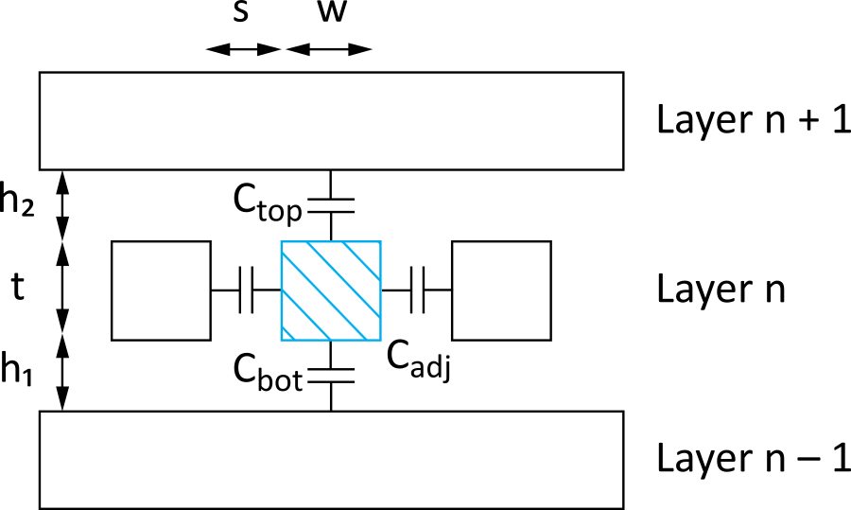
Wire Capacitance
Wire has capacitance per unit length
To neighbors
To layers above and below
C_{total} = C_{top} + C_{bot} + 2C_{adj}
Notes:
These capacitances occur due to the proximity of the wires, thus electric charges are stored (as a result of the electric field) when there is a difference in their voltages (adjacent wires). This capacitance is called parasitic capacitance.

Slide 15
Capacitance Trends
Parallel plate equation: C = ε_{ox}A/d
Wires are not parallel plates, but obey trends
Increasing area (W, t) increases capacitance
Increasing distance (s, h) decreases capacitance
Dielectric constant
ε_{ox} = kε₀
ε₀ = 8.85 x 10⁻¹⁴ F/cm
k = 3.9 for SiO₂
Processes are starting to use low-k dielectrics
k ≈ 3 (or less) as dielectrics use air pockets
Notes:
A parallel plate capacitor is formed using two identical plates separated by a distance. In this case, our plates are the adjacent wires.
Dielectric constant is the ratio of the ability of the substance to store electrical energy in an electric field to the ratio of free space to store electrical energy in an electric field.
The ability of the substance to store electrical energy in an electric field is called permittivity.

Slide 16
Capacitance Formula
Capacitance of a line without neighbors can be approximated as
T
his empirical formula is accurate to 6% for AR < 3.3

Slide 17
M2 Capacitance Data
Typical dense wires have ~ 0.2 fF/μm
Compare to 1-2 fF/μm for gate capacitance

Slide 18
Diffusion & Polysilicon
Diffusion capacitance is very high (1-2 fF/μm)
Comparable to gate capacitance
Diffusion also has high resistance
Avoid using diffusion runners for wires!
Polysilicon has lower C but high R
Use for transistor gates
Occasionally for very short wires between gates

Slide 19
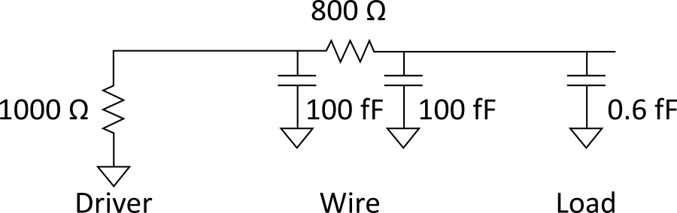
Wire RC Delay
Estimate the delay of a 10x inverter driving a 2x inverter at the end of the 1 mm wire. Assume wire capacitance is 0.2 fF/µm and that a unit-sized inverter has R = 10 KΩ and C = 0.1 fF.
t_{pd} = (1000 Ω )(100 fF) + (1000 Ω + 800 Ω)(100 fF + 0.6 fF) = 281 ps

Slide 20
Wire Energy
Estimate the energy per unit length to send a bit of information (one rising and one falling transition) in a CMOS process.
E = (0.2 pF/mm)(1.0 V)² = 0.2 pJ/bit/mm
= 0.2 mW/Gbps/mm
Notes:
In a communication link, the energy can sometimes be expressed as power per gigabit per second, hence the second answer with the unit (mW/Gbps).

Slide 21

Cross talk
A capacitor does not like to change its voltage instantaneously.
A wire has high capacitance to its neighbor.
When the neighbor switches from 1-> 0 or 0->1, the wire tends to switch too.
Called capacitive coupling or cross talk.
Cross talk effects
Noise on nonswitching wires
Increased delay on switching wires
Notes:
Wires have capacitance with neighbors and also with ground. Wire-to-wire capacitance is called capacitive coupling. When a wire switches, those wires it shares capacitive coupling with tends to switch with it. This is called crosstalk.

Slide 22
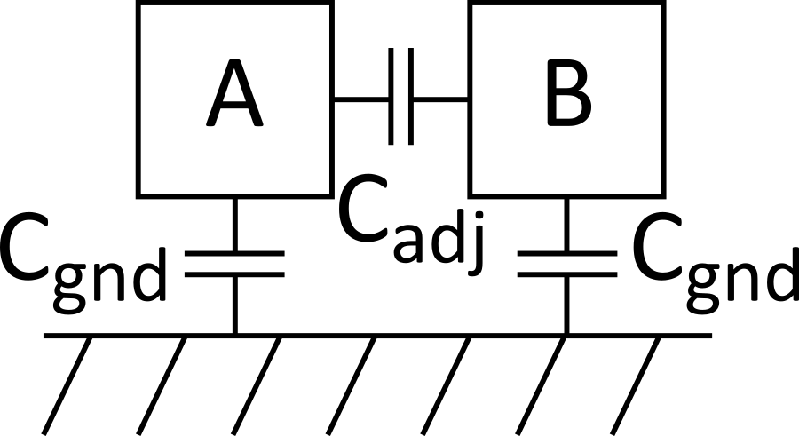
Cross talk Delay
Assume layers above and below on average are quiet
Second terminal of capacitor can be ignored
Model as C_{gnd} = C_{top} + C_{bot}
Effective C_{adj} depends on behavior of neighbors
Miller effect
B | ΔV | C_{eff(A)} | MCF
Constant | V_{DD} | C_{gnd} + C_{adj} | 1
Switching with A | 0 | C_{gnd} | 0
Switching opposite A | 2V_{DD} | C_{gnd} + 2 C_{adj} | 2
Notes:
In the circuit model shown in this slide, wire A and B each have capacitance to the ground and also have adjacent capacitance to each other (capacitive coupling).
The capacitive coupling between the two wires may result in noise on one of the wires when the other switches. There could also be an increase or decrease in switching delay when both wires switch simultaneously.

Slide 23
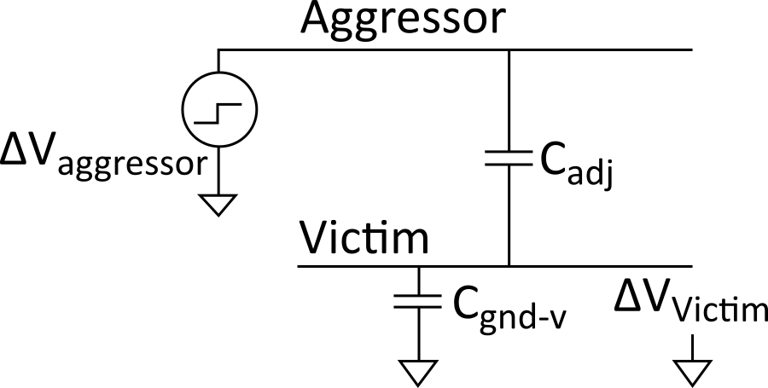
Cross talk Noise
Cross talk causes noise on nonswitching wires
If victim is floating:
model as capacitive voltage divider
Notes:
Using the model of two adjacent wires A and B, we can label A as the aggressor or perpetrator when there is some switching activity in A while B is supposed to be constant. In this situation, B is the victim as switching activity in A introduces noise in B.
The circuit models the wire system in which A is the aggressor and B is the victim which is floating.

Slide 24
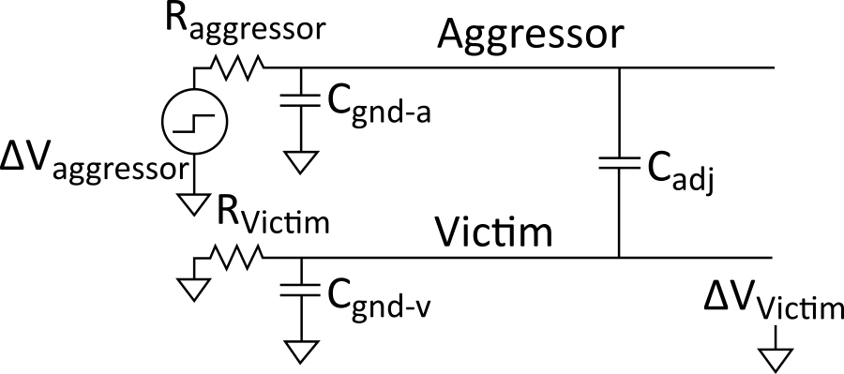
Driven Victims
Usually victim is driven by a gate that fights noise
Noise depends on relative resistances
Victim driver is in linear region, agg. in saturation
If sizes are same, R_{aggressor} = 2-4 x R_{victim}
Notes:
The circuit models the wire system in which A is the aggressor and B is the victim which is driven.

Slide 25
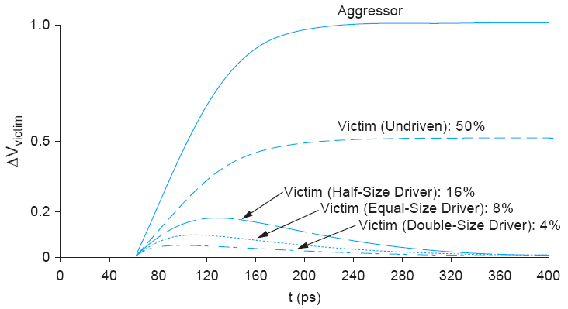
Coupling Waveforms
Simulated coupling for C_{adj} = C_{victim}
Notes:
From the plot, it is shown that when the victim is floating; the noise follows the switching of the aggressor. In the case of a driven victim, the driver restores the victim and also the noise effect is lesser with increased driver strength.

Slide 26
Noise Implications
So what if we have noise?
If the noise is less than the noise margin, nothing happens
Static CMOS logic will eventually settle to correct output even if disturbed by large noise spikes
But glitches cause extra delay
Also cause extra power from false transitions
Dynamic logic never recovers from glitches
Memories and other sensitive circuits also can produce the wrong answer

Slide 27
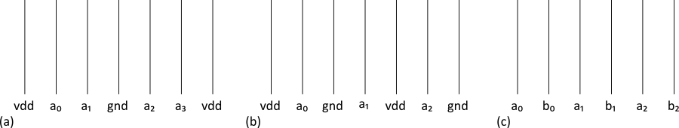
Wire Engineering
Goal: achieve delay, area, power goals with acceptable noise
Degrees of freedom:
Width
Spacing
Layer
Shielding
Notes:
Wire engineering is the method used to control cross talk.
Some methods include increasing the spacing of adjacent wires and shielding critical wires by surrounding them with power or ground wires on both sides to eliminate coupling.

Slide 28
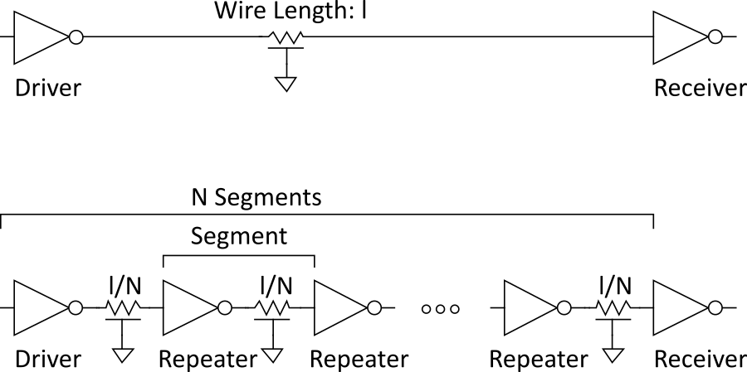
Repeaters
R and C are proportional to l
RC delay is proportional to l²
Unacceptably great for long wires
Break long wires into N shorter segments
Drive each one with an inverter or buffer
Notes:
R and C increase with wire length $l$and the RC delay of the wire increases in proportion with $l^{2}$. This can result in great delay for long wires. To reduce this delay due to RC in long wires, break the wire into N short segments and inserting an inverter or buffer to drive the wire. The buffers/inverters are called repeaters.

Slide 29
Repeater Design
How many repeaters should we use?
How large should each one be?
Equivalent Circuit
Wire length l/N
Wire Capacitance C_{w}*l/N, Resistance R_{w}*l/N
Inverter width W (nMOS = W, pMOS = 2W)
Gate Capacitance C’*W, Resistance R/W

Slide 30
Repeater Results
Write equation for Elmore Delay
Differentiate with respect to W and N
Set equal to 0, solve
~40 ps/mm
in 65 nm process

Slide 31
Repeater Energy
Energy/length ≈ 1.87C_{w}V_{DD}²
87% premium over unrepeated wires
The extra power is consumed in the large repeaters
If the repeaters are downsized for minimum EDP:
Energy premium is only 30%
Delay increases by 14% from min delay

