Slide 1
9.0 – Sequential Logic Design ENGR-E 399/599: VLSI Design Prof. Daniel Loveless, dlovele@iu.edu, 812-856-0703
INDIANA UNIVERSITY – Reliable Electronics and Systems
Center for Reliable and Trusted Electronics (CREATE)
Notes:
Hello and welcome to CMOS VLSI Design course; today, our focus will be in Scaling.

Slide 2
Learning Objectives
At the end of this lecture, you should be able to:
Describe input data timing constraint limits in relation to setup and hold time requirements in sequential circuits.
Describe output data timing constraint limits in relation to propagation delay and contamination delay requirements in sequential circuits.
Describe the impact of skew on timing
Explain time borrowing and describe how it can be applied using latches.

Slide 3
Sequencing
Combinational logic
output depends on current inputs
Sequential logic
output depends on current and previous inputs
requires separating previous, current, future
called state or tokens
E.g., FSM, pipeline
Notes:
Combinational logic is implemented using Boolean circuits; they operate without the need of a clock signal and do not contain any form of memory. Thus, their outputs are a function of only their inputs.
Sequential logic, on the other hand, is a circuit whose output tracks its present input value and the sequence of its past inputs.
Such circuits use state machine or tokens in a pipeline to differentiate the previous, current, and future inputs to the system.

Slide 4
Sequencing Cont.
If tokens moved through pipeline at a constant speed, no sequencing elements would be necessary
E.g., fiber-optic cable
Light pulses (tokens) are sent down the cable
Next pulse is sent before the first reaches the end of cable
No need for hardware to separate pulses
But dispersion sets min time between pulses
This is called wave pipelining in circuits
In most circuits, dispersion is high
Delay fast tokens so they don’t catch slow ones.
Notes:
Wave pipelining is a circuit design technique to improve the throughput of a logic circuit design without the use of intermediate latches or registers. This allows circuits to be clocked at higher rates.
In digital design, extra circuit is used to maintain the sequence of tokens.

Slide 5
Sequencing Overhead
Use flip-flops to delay fast tokens so they move through exactly one stage each cycle.
Inevitably adds some delay to the slow tokens
Makes circuit slower than just the logic delay
Called sequencing overhead
Some people call this clocking overhead
But it applies to asynchronous circuits too
Inevitable side effect of maintaining sequence
Notes:
Flip-flops or latch are used to delay fast tokens. These flip-flops also adds delay to the slow tokens. This makes the sequential circuit slower than just the logic delay. This is known as sequencing overhead.

Slide 6
Sequencing Elements
Latch: Level sensitive
transparent latch, D latch
Flip-flop: edge-triggered
master-slave flip-flop, D flip-flop, D register
Timing Diagrams
Transparent
Opaque
Edge-trigger
Notes:
Two elements used in sequencing circuits are Latch and Flip-Flops.
Latches are level sensitive, while flip-flops are edge triggered.
For latches, the output Q will follow the input D when the clock is active state/high (the latch is open i.e transparent), and the output Q will retain its current value irrespective of a change in input value when the clock is inactive/low.
The output of a Flip-Flop, on the other hand, will change state only when the clock signal is changing (low to high or high to low, depending on if it is +ve edge- or –ve edge-triggered, respectively).

Slide 7
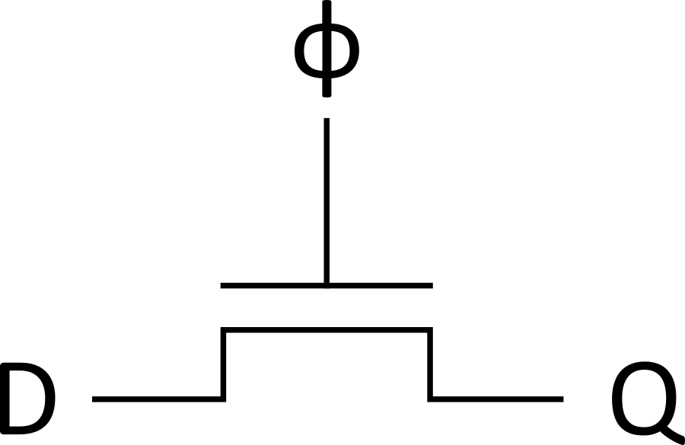
Latch Design
Pass Transistor Latch
Pros
+ Tiny
+ Low clock load
Cons
V_{t} drop
nonrestoring
backdriving
output noise sensitivity
dynamic
diffusion input
Used in 1970’s
Notes:
In this setup, the output Q will follow the input D when the control input on the transistor gate is high. When the control input is low, the output Q will be in impedance state Z.
This circuit suffers from voltage variation due to threshold drop (Vt), which is the result of the series resistance between the input and the output.
Nonrestoring here refers to the inability of the circuit to produce a strong output as the input. Depending on the type of pass transistor used, it may result in degraded output leading to reduced noise margins.

Slide 8
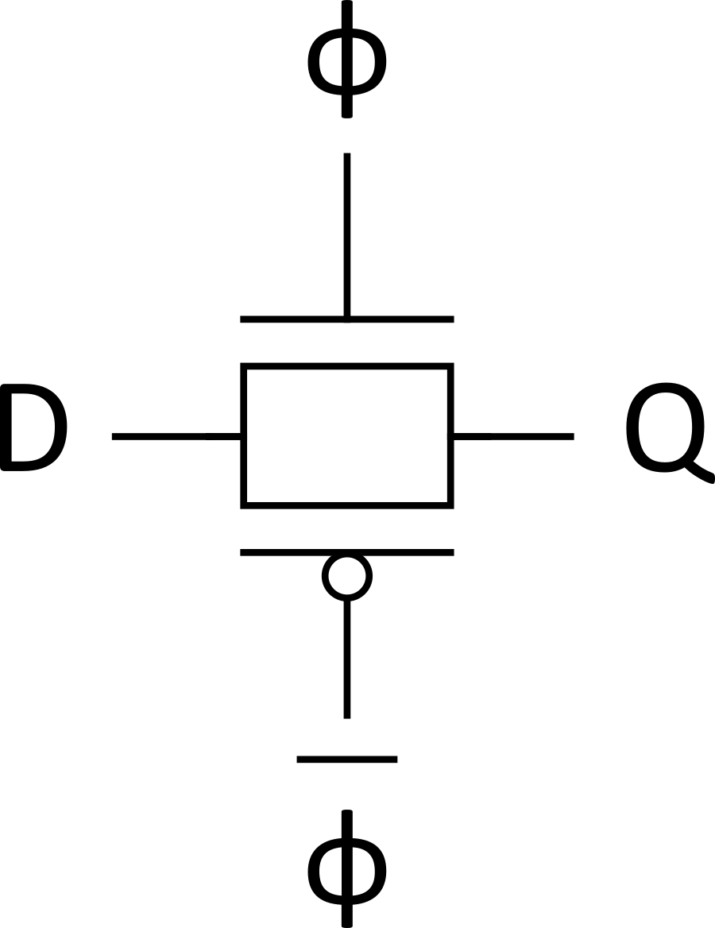
Latch Design
Transmission gate
+ No V_{t} drop
- Requires inverted clock
Notes:
Pass transistors can be used to form transmission gates.
In this setup, the output Q will follow the input D when the control input is high. When the control input is low, the Q will be in impedance state Z.
In this setup, the disadvantage of Vt drop in the output in single pass transistor is avoided. However, the second transistor (pmos) requires the inverted input of the control signal.

Slide 9
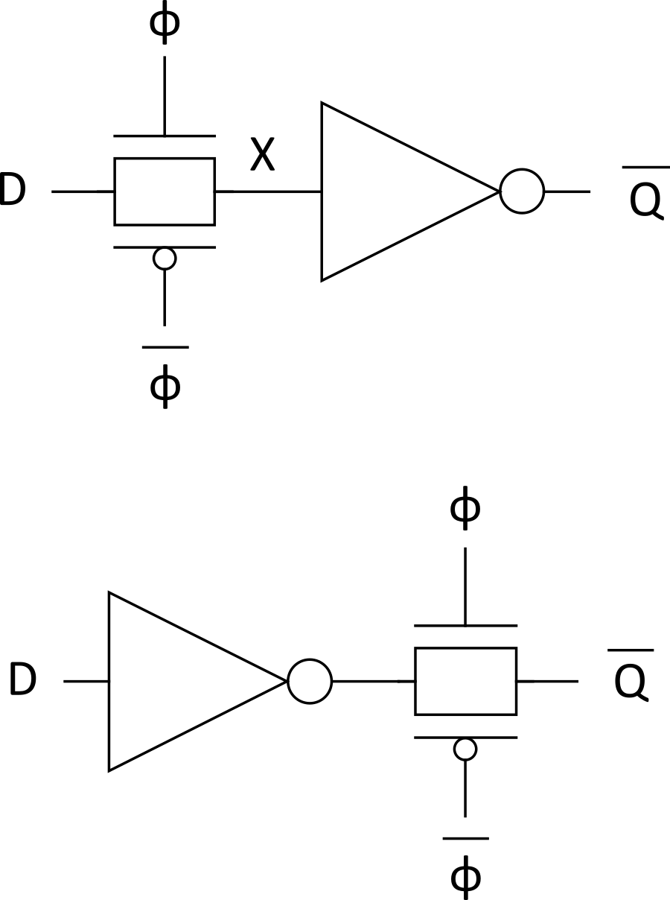
Latch Design
Inverting buffer
+ Restoring
+ No backdriving
+ Fixes either
Output noise sensitivity
Or diffusion input
Inverted output
Notes:
Using a transmission gate with an inverting buffer has its advantages in restoring the output signals (fixing output noise sensitivity if the inverting buffer is at the output) and also stopping backdriving (fixing diffusion input issue).
In the first circuit, node X can change state, if for example when the clock is low, Input D is not driving X. Over time the value of X starts degrading across the parasitic capacitance. If the clock is kept low for a long enough time, that X degrades greatly, the output Q_bar may lose its correct value.

Slide 10
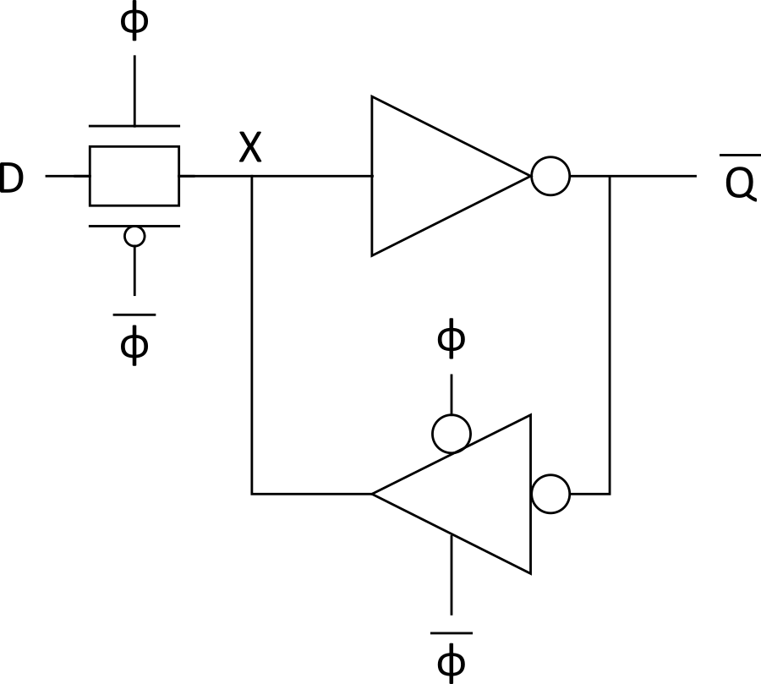
Latch Design
Tristate feedback
+ Static
Backdriving risk
Static latches are now essential
because of leakage
Notes:
In this setup, a latch with inverting output is designed by adding a tristate buffer (inverted input) feedback between the output of the inverter and its input.
The tristate buffer serves to maintain the input of the inverting buffer when the clock signal goes low and puts the transmission gate’s output in high impedance state.
This circuit suffers from backdriving i.e noise at the output can affect the input D.

Slide 11
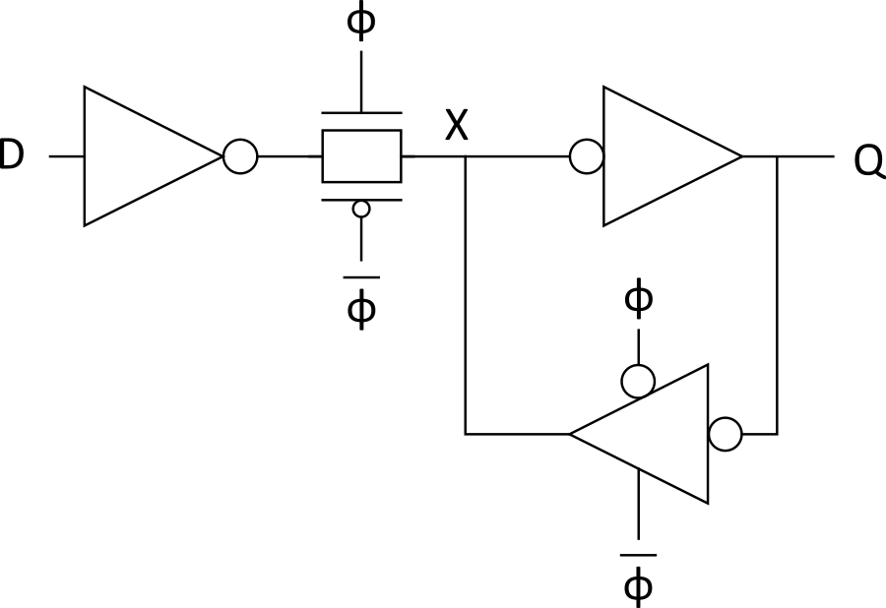
Latch Design
Buffered input
+ Fixes diffusion input
+ Noninverting
Notes:
In this setup, a latch is designed by adding an inverting buffer at the input of the transmission gate of the previous latch.
This setup also has an advantage in that the input to the circuit is through the gates and not diffusion inputs to the transistors.

Slide 12
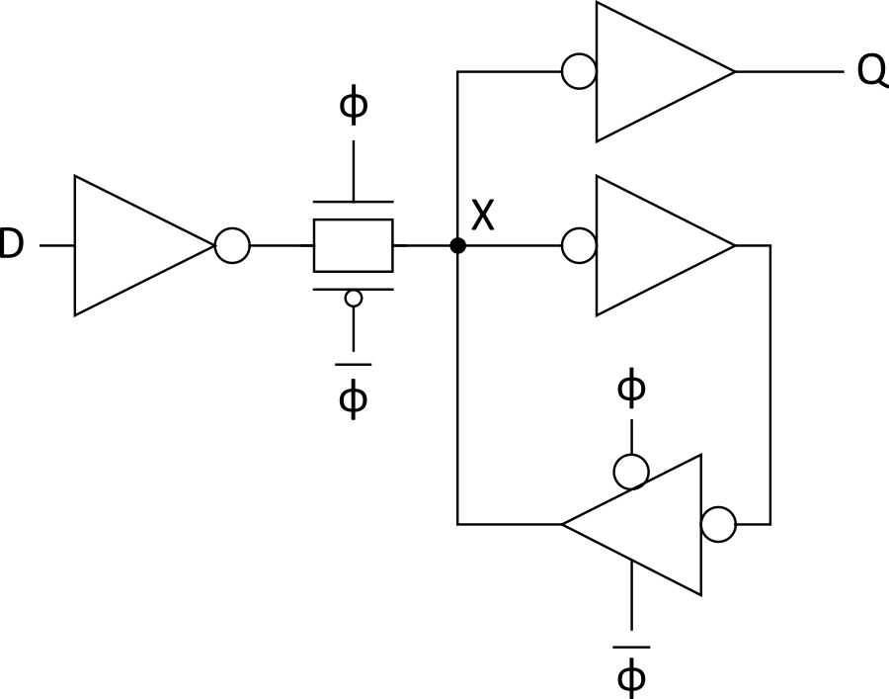
Latch Design
Buffered output
+ No backdriving
Widely used in standard cells
+ Very robust (most important)
Rather large
Rather slow (1.5 – 2 FO4 delays)
High clock loading
Notes:
This circuit is robust, since the output Q is generated using a separate buffer, which eliminates issues with backdriving. The output Q is maintained by the loop which includes the tristate buffer.
The extra buffer and its inverted input increases area of the circuit.

Slide 13
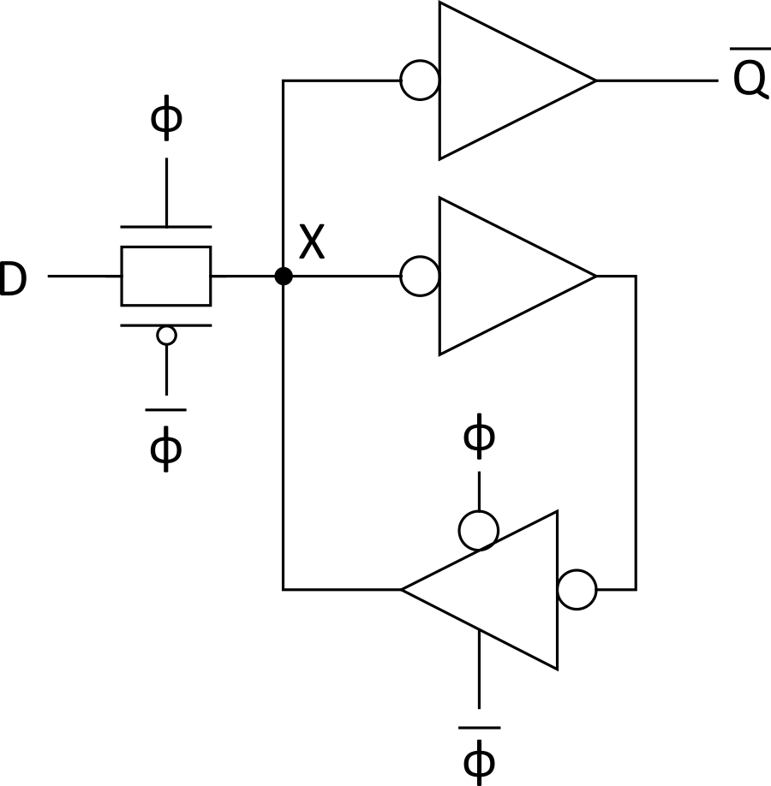
Latch Design
Datapath latch
+ smaller
+ faster
- unbuffered input
Notes:
This datapath latch has the advantage of being smaller and faster, but the input is unbuffered, thus providing diffusion input to the transistors.

Slide 14
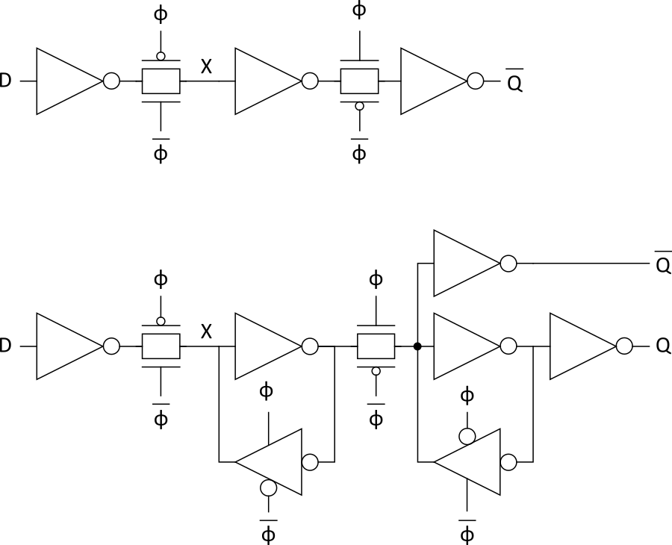
Flip-Flop Design
Flip-flop is built as a pair of back-to-back latches
Notes:
A flip-flop can be designed using back-to-back latches.
In the first circuit, D – X is one latch. Note the change in clock to the inputs of the transmission gates in the both latches.

Slide 15
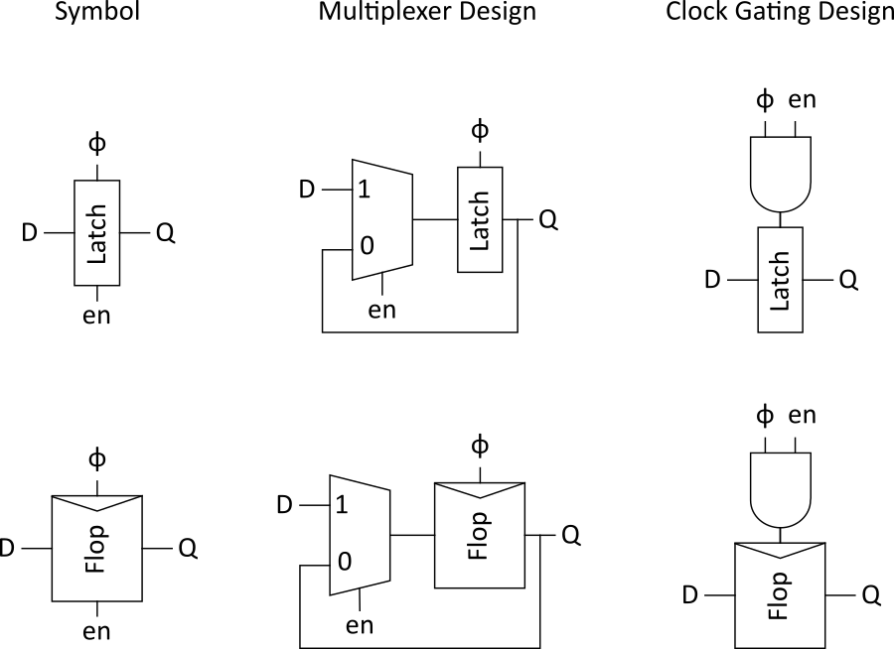
Enable
Enable: ignore clock when en = 0
Mux: increase latch D-Q delay
Clock Gating: increase en setup time, skew
Notes:
With a multiplexer, the data input to a latch or flip-flop can be controlled with an enable signal. In this setup, the output of the latch/FF is fed into input 0 (input selected when en = 0). This ensures that the output state is maintained, even when input is disabled, and the Latch/FF is triggered by the clock.
The use of a multiplexer to gate the input increases the delay from input D to output Q.
Enable input can be used to gate the clock; however, this can result in increased clock skew and setup time for the flip-flop/latch.

Slide 16
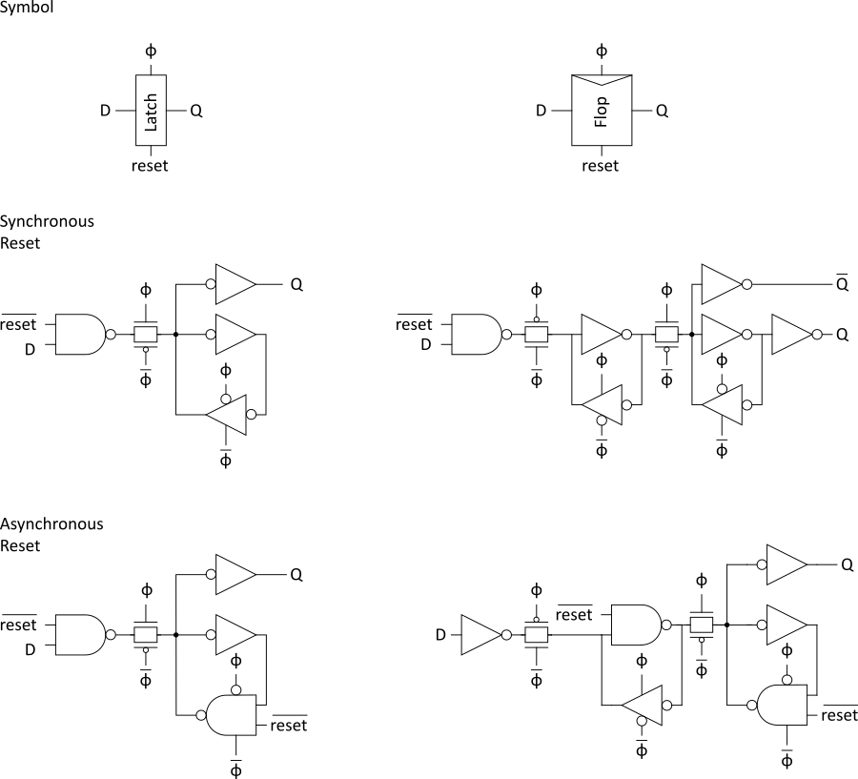
Reset
Force output low when reset asserted
Synchronous vs. asynchronous
Notes:
Reset input is used to force the output of the latch low. For asynchronous design, this control is independent of the clock.

Slide 17
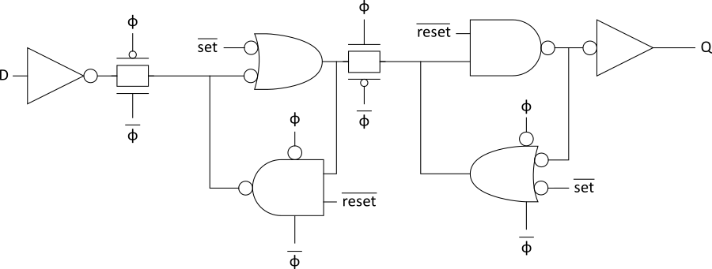
Set/Reset
Set forces output high when enabled
Flip-flop with asynchronous set and reset
Notes:
Just like reset input was added, the circuit can be further modified to include a set input. The set input is used to force the output high.
In this circuit, set and reset cannot be asserted at the same time. It will lead to an invalid state.

Slide 18
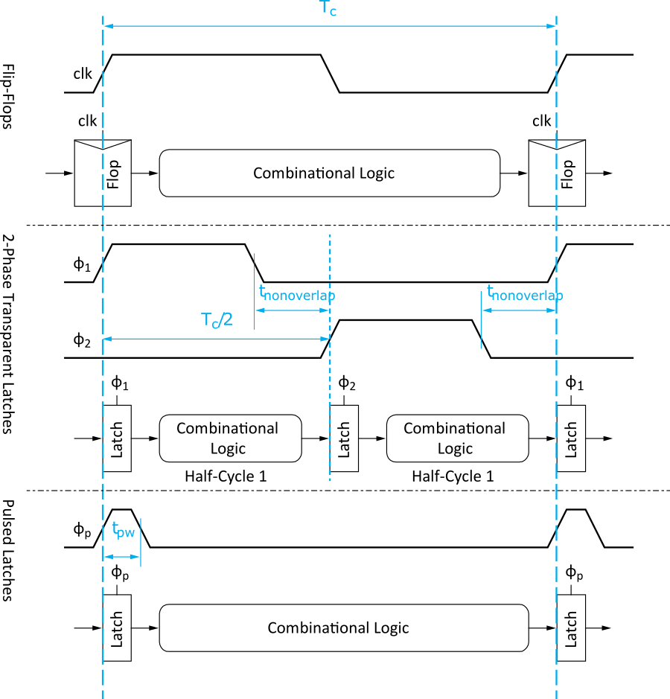
Sequencing Methods
Flip-flops
2-Phase Latches
Pulsed Latches
Notes:
Sequencing can be achieved using:
Flip-flops: here the flip-flops are sensitive to the edge of the clock. However, there are factors that must be considered when choosing the minimum clock period to ensure the circuit operates correctly.
Two-phase transparent latch can be used in sequencing. Here, the phase difference of both clocks must meet certain conditions for the system to operate correctly.
With pulsed latches, since the latch is active at the +ve state of the clock, in this setup, the clock stays briefly at this state and transitions to a low. The pulse should stay long enough for the latch to capture the value of the data at its input.

Slide 19
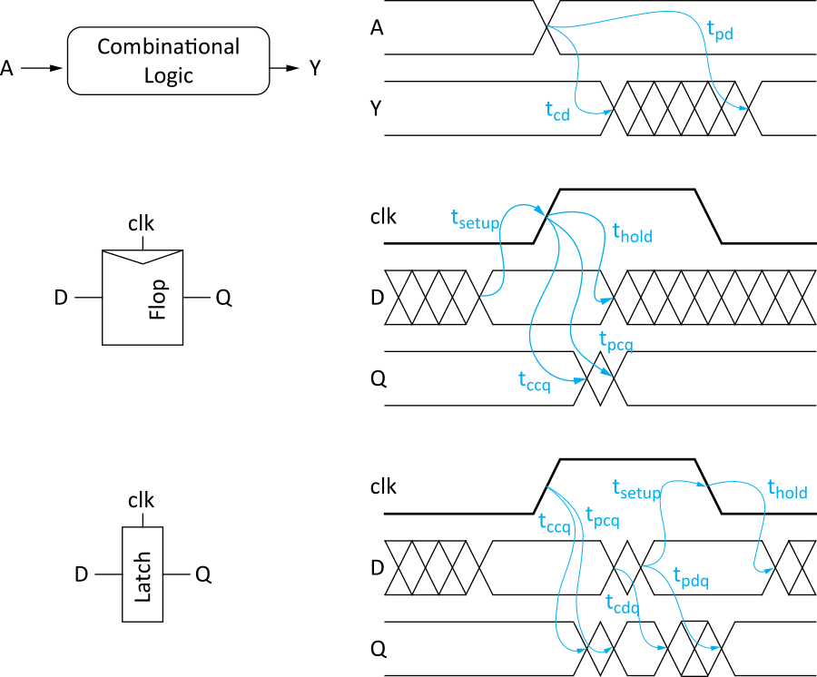
Timing Diagrams
Contamination and Propagation Delays
t_{pd} | Logic Prop. Delay
t_{cd} | Logic Cont. Delay
t_{pcq} | Latch/Flop Clk->Q Prop. Delay
t_{ccq} | Latch/Flop Clk->Q Cont. Delay
t_{pdq} | Latch D->Q Prop. Delay
t_{cdq} | Latch D->Q Cont. Delay
t_{setup} | Latch/Flop Setup Time
t_{hold} | Latch/Flop Hold Time
Notes:
Let’s first define contamination delay and propagation delay.
Contamination delay is the minimum time it takes for the output to start changing its value in response to an input signal. At this stage, the output has not fully settled to its correct state.
Propagation delay is the minimum time it takes for the output to fully settle at its correct state in response to an input signal.
In the table above:
tpd and tcd refers to the propagation and contamination delays of the combinational circuit, respectively.
tpcq and tccq, respectively, refer to the propagation and contamination delays of the latch/FF output when the clock transitions to a +ve state.
tpdq and tcdq, respectively, refer to the propagation and contamination delays of the latch output Q when a change occurs in its input D during the period the clock is high.
tsetup for latch/FF refers to the minimum time between when the input signal at D has settled to the time the clock occurs.
thold for latch/FF refers to the minimum time that must pass after clock transitions to a low before the input D can change.
For the three figures above including their timing diagrams
The first figure is a combinational circuit with input A and output Y.
The timing diagram shows that the output Y starts responding to a change in A at time t_{cd}. This is called the logic contamination delay.
The timing diagram shows that the output Y will settle at the correct state in response to a change in input A at time t_{pd}.This is called the logic propagation delay.
During the time between t_{cd} and t_{pd}, the output Y is not stable.
The second figure is a Flip-flop with input D and output Q.
The timing diagram shows that the data at D must be stable for a minimum time t_{setup} before the clock transitions high after which the data at D must not change for at least t_{hold} time after the clock transitions high.
The timing diagram shows that the output Q will start changing after t_{ccq}, although not stable until after t_{pcq}. The timings t_{ccq} and t_{pcq} are FFs Clock-to-Q contamination and Clock-to-Q propagation delays, respectively. Both timings are relative to the rising edge of the clock.
The third figure is a Latch with input D and output Q.
The timing diagram shows that when the clock transitions high, the output Q begins to change from t_{ccq} to t_{pcq} before Q becomes stable. Both contamination and propagation delays are relative from clock rising to Q.
The timing diagram shows that when the clock is high and input D begins to change, Q output gets contaminated at time t_{cdq}, and after D has settled, Q will settle to the new value at t_{pdq}.
If D changes when the clock is high, the clock should remain high for at least t_{setup} time and D must remain stable for at least t_{hold} after the clock goes low.

Slide 20
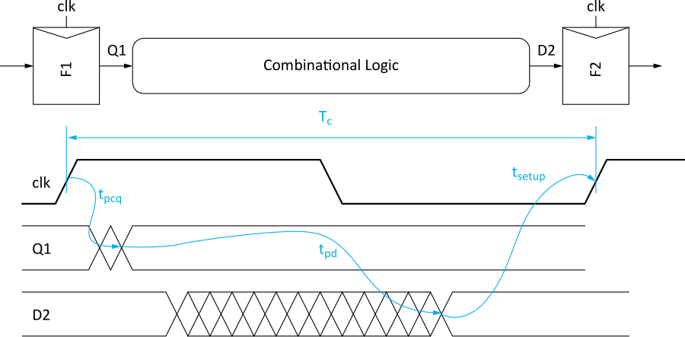
Max Delay: Flip-Flops
Notes:
Timing diagram illustrates the sequencing overhead associated with this type of circuit. The two factors are tpcq, which is the clock-to-Q1 propagation delay, and tsetup, which is the minimum time output D2 must be stable with the new data before the next positive transition of the clock occurs.
The clock period must be larger than or equal to total delay due to the sequencing overhead (tpcq – F1 and tsetup – F2) and the propagation delay tpd of the combinational logic for the circuit to function correctly.

Slide 21
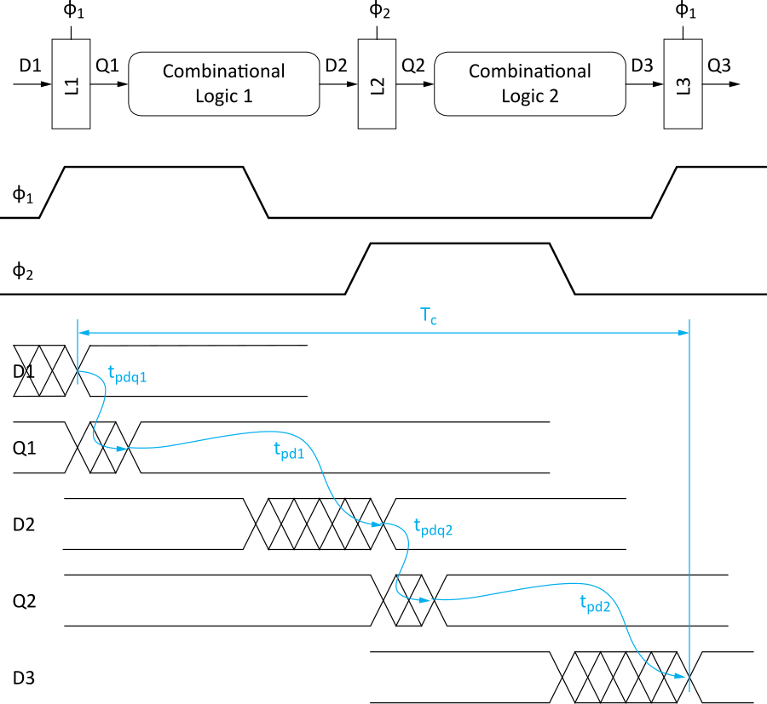
Max Delay: 2-Phase Latches
Notes:
Using the timing diagram, when the data D1 arrived at L1, L1 was transparent since clock 1 was high.
The sequence of operation is shown thus:
Latch 1 - Data propagates from D1 to Q1 after time t_{pdq1},
Combinational Logic 1 - D2 correctly responds to a change in Q1 after time t_{pd1}
Latch 2 - Data propagates from D2 to Q2 after time t_{pdq2},
Combinational Logic 2 – D3 correctly responds to a change in Q2 after timet_{pd2}
If D3 arrives when clock 1 has gone high, but early enough to meet L3 setup time before the clock starts transitioning to a low, then L3 will correctly capture D3.
However, with careful design, D3 can arrive within a single clock period of clock 1. That is the period of the first clock cannot be less than the sum of $t_{pd1}$ + ${2t}_{pdq}$ +$t_{pd2}$.

Slide 22
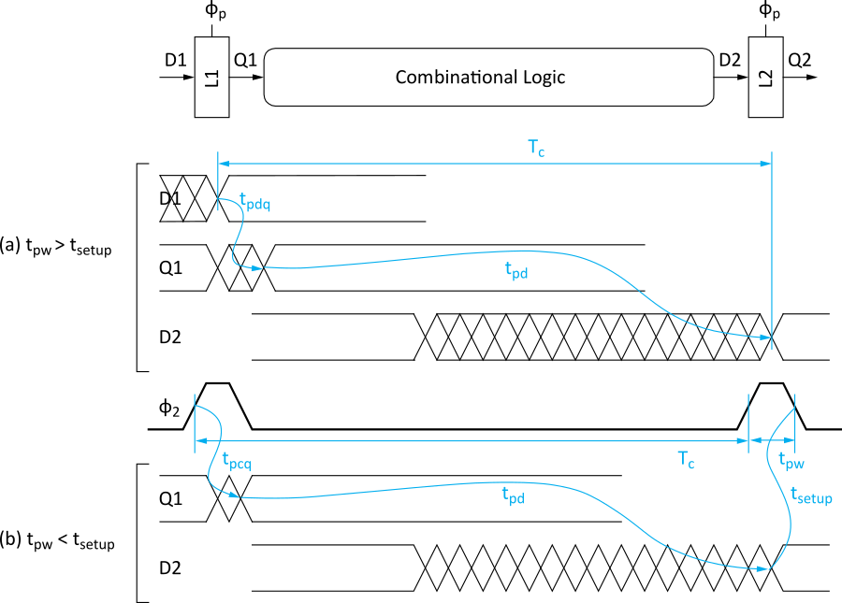
Max Delay: Pulsed Latches
Notes:
In timing diagram (a), the critical path consists of L1 and combinational logic, and since the pulse width is greater than the setup time, L2 will capture the new data on D2.
In timing diagram (b), the pulse width is less than the setup time; therefore, the data at D2 must be present and stable before the pulse rises.

Slide 23
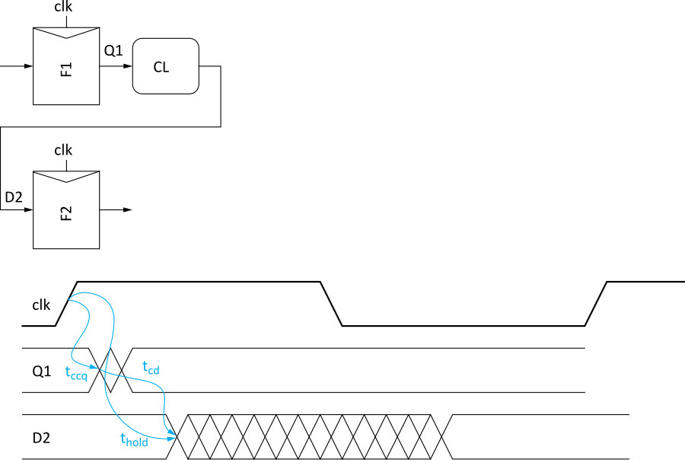
Min-Delay: Flip-Flops
Notes:
Input data at D2 must satisfy hold time of F2.
That is, when the clock transition results in a change in Q1, the now soon to be old value of D2 stable, long enough to the hold time requirement of F2 i.e the contamination delay of CL should meet the hold time requirement of F2
Therefore, the minimum logic contamination delay is given by the equation above.

Slide 24
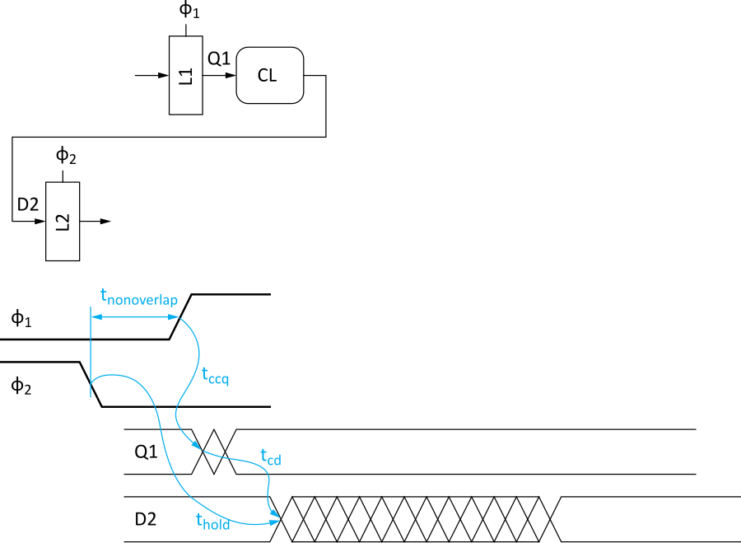
Min-Delay: 2-Phase Latches
Hold time reduced by nonoverlap
Paradox: hold applies twice each cycle vs. only once for flops.
But a flop is made of two latches!
Notes:
Input data at D2 must satisfy hold time of L2.
That is, when the clock transition results in a change in Q1, the now soon to be old value of D2 stable, long enough to the hold time requirement of L2 i.e the contamination delay of CL should meet the hold time requirement of L2
Therefore, the minimum logic contamination delay is given by the equation above.

Slide 25
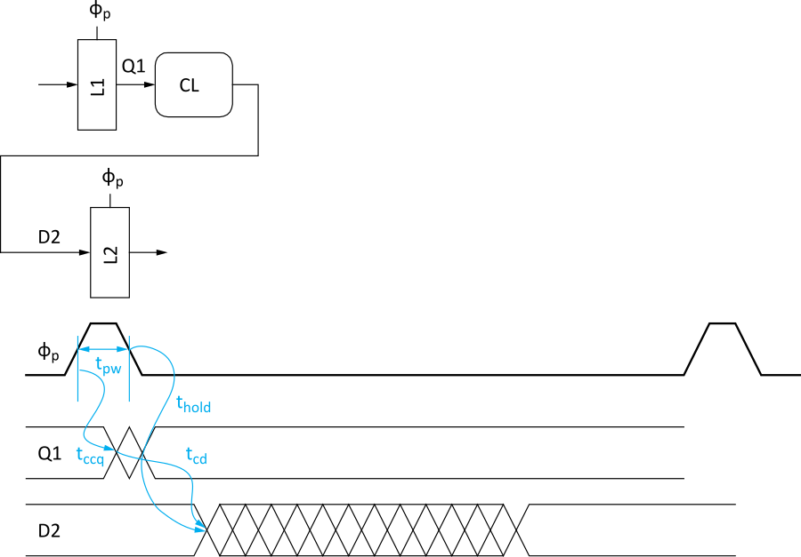
Min-Delay: Pulsed Latches
Hold time increased by pulse width
Notes:
Min-delay timing constraints on a path from one pulsed latch to the next.
Here, data at D2 must not change until after the falling edge of the pulse plus the hold time of L2.

Slide 26
Time Borrowing
In a flop-based system:
Data launches on one rising edge
Must setup before next rising edge
If it arrives late, system fails
If it arrives early, time is wasted
Flops have hard edges
In a latch-based system
Data can pass through latch while transparent
Long cycle of logic can borrow time into next
As long as each loop completes in one cycle
Notes:
Time borrowing
In a Flip-flop based system, the data is captures at the rising edge of the clock. The data must meet setup requirements before the next rising edge of the clock else the system may fail. If the data arrives very early, then time will be wasted.
In latch-based design, data can pass through latch while transparent. Using multiple clocks, the designer can ensure that time is not wasted.

Slide 27
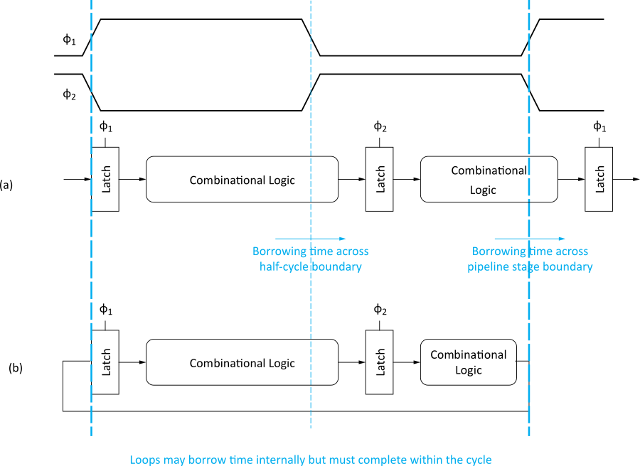
Time Borrowing Example
Notes:
Timing diagram illustrates time borrowing.
In the illustration above, notice that the two clocks are complements of each other.
In system (a), latch 1 captures the data at its input when clock 1 is high. If the propagation delay in the first combinational logic is high, such that its output is valid when clock 1 becomes low, then the second latch which is now transparent will correctly capture the new data. If the propagation delay of the second combinational logic is small enough and the setup time requirement of the third latch is met before clock 1 transitions high again the system will operate correctly. Note that the combined propagation delay of the system must be less than the period of clock 1.
In system (b) latch 1 will capture the new data at the output of combinational logic 2 so if the total propagation delay of the system is less than the period of clock 1.

Slide 28
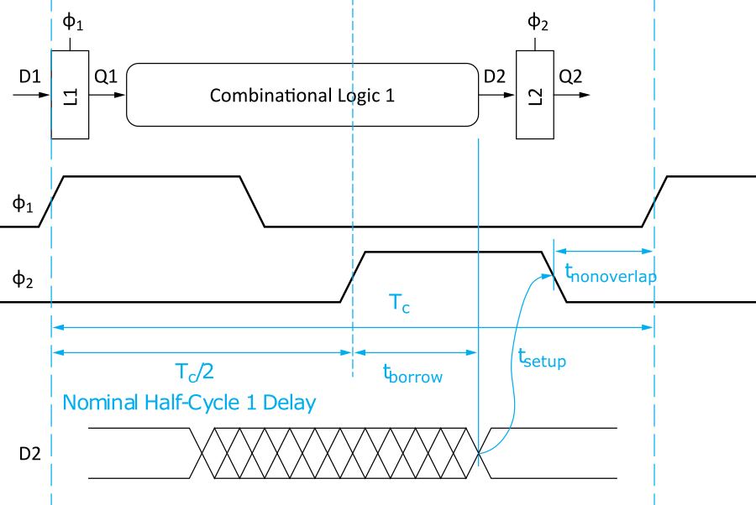
How Much Borrowing?
2-Phase Latches
Pulsed Latches
Notes:
Figure illustrates a two-phase latch system and the time it can borrow.

Slide 29
Clock Skew
We have assumed zero clock skew
Clocks really have uncertainty in arrival time
Decreases maximum propagation delay
Increases minimum contamination delay
Decreases time borrowing
Notes:
Uncertainty at clock arrival times for different components must be considered when designing circuits. This certainly affects the calculations of minimum, maximum delays and time borrowing.

Slide 30
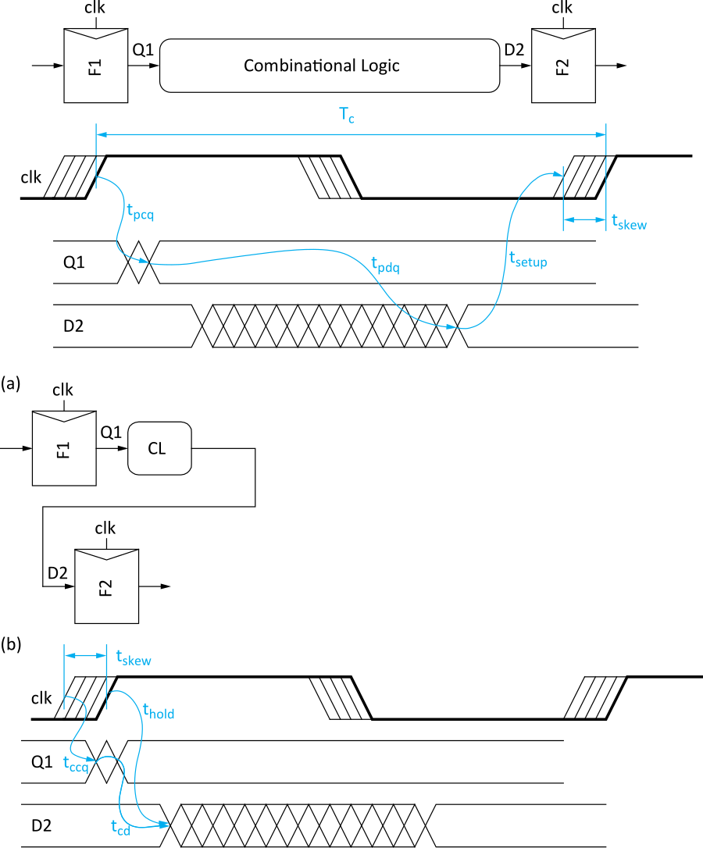
Skew: Flip-Flops
Notes:
Clock skew can also affect the contamination delay of FF-based sequential circuits.

Slide 31
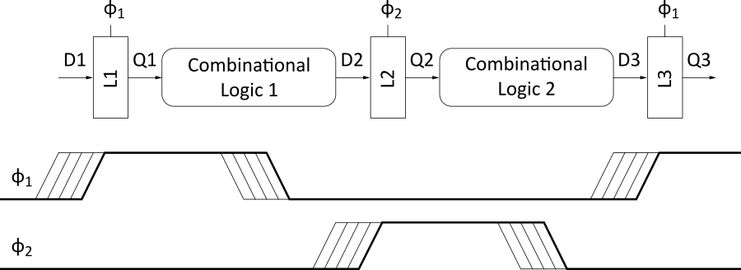
Skew: Latches
2-Phase Latches
Pulsed Latches
Notes:
Clock skew can also affect the contamination delay of 2-phase latch and pulsed latch-based sequential circuits.

Slide 32
Two-Phase Clocking
If setup times are violated, reduce clock speed
If hold times are violated, chip fails at any speed
In this class, working chips are most important
No tools to analyze clock skew
An easy way to guarantee hold times is to use 2-phase latches with big nonoverlap times
Call these clocks φ₁, φ ₂ (ph1, ph2)

Slide 33
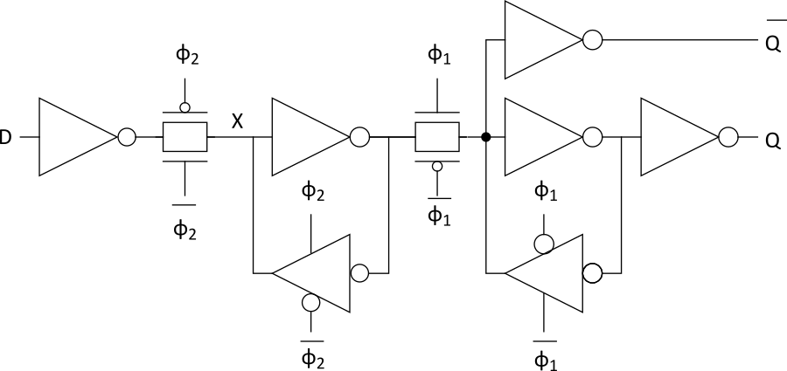
Safe Flip-Flop
Past years used flip-flop with nonoverlapping clocks
Slow – nonoverlap adds to setup time
But no hold times
In industry, use a better timing analyzer
Add buffers to slow signals if hold time is at risk

Slide 34
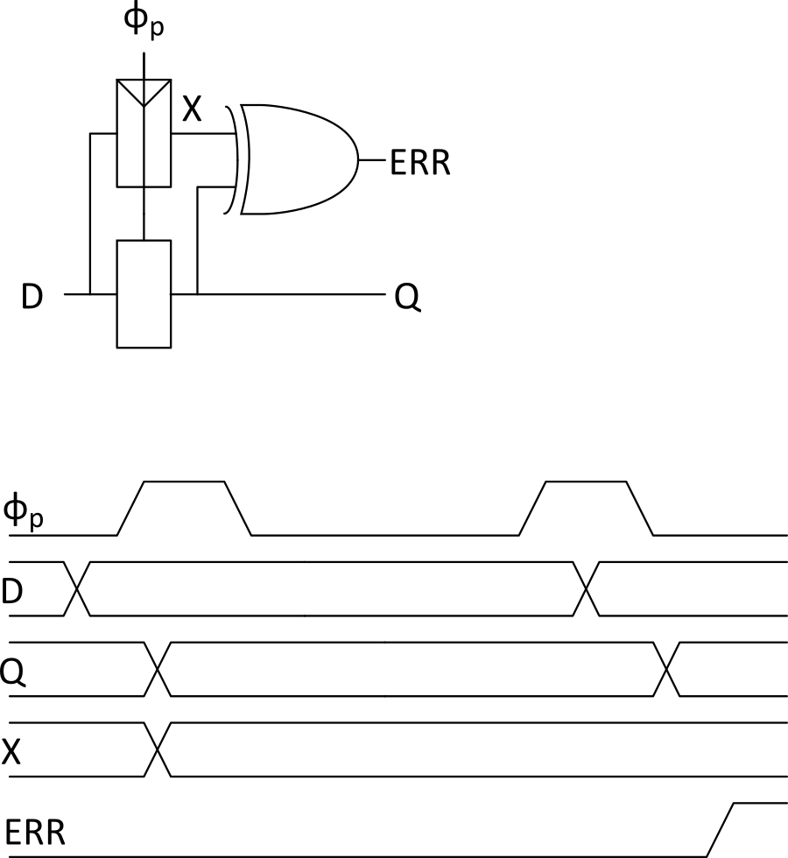
Adaptive Sequencing
Designers include timing margin
Voltage
Temperature
Process variation
Data dependency
Tool inaccuracies
Alternative: run faster and check for near failures
Idea introduced as “Razor”
Increase frequency until at the verge of error
Can reduce cycle time by ~30%
Notes:
Timing margins can be affected by voltage, temperature, process variation, data dependency, and tool inaccuracies. These factors are considered by designers, so time margins are included in design specification.
Another method is a run a faster clock and then check for near failures.
The circuit in this slide will indicate an error in the instance where the clock is high and D input changes to a new value. This is because the latch will update its output, while the FF will still maintain its output until next rising edge of the clock.

Slide 35
Timing Analysis
Design tools perform timing analysis given frequency targets
Generate a report of setup and hold time failures
Logic synthesis includes timing analysis
Selection and placement of gates is done to minimize area while satisfying timing constraints
Notes:
CAD tools can be used to generate a report of setup and hold time failures. These tools optimize the placement of gates to minimize area while satisfying timing constraints.

Slide 36
Timing Closure
Timing closure is the process of modifying a design to satisfy timing constraints.
Manual or automated
Optimizations include
Circuit topology (e.g., tree adders vs. ripple carry adders)
Gate selection (e.g., many stages of simple gates vs. fewer stages of complex gates)
Gate placement (e.g., keep gates on the critical path near each other)
Gate sizing (e.g., larger gates on the critical path)
Leakage family selection (e.g., low-Vt cells on the critical path)
Buffer insertion
Wire optimization
Clock skew optimization
Also includes adding delay to fix hold time problems

Slide 37
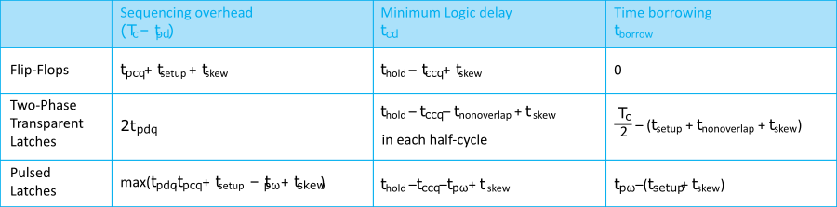
Summary
Flip-Flops:
Very easy to use, supported by all tools
2-Phase Transparent Latches:
Lots of skew tolerance and time borrowing
Pulsed Latches:
Fast, some skew tol & borrow, hold time risk

