Slide 1
11.0 – SRAM ENGR-E 399/599: VLSI Design Prof. Daniel Loveless, dlovele@iu.edu, 812-856-0703
INDIANA UNIVERSITY – Reliable Electronics and Systems
Center for Reliable and Trusted Electronics (CREATE)
Notes:
Hello and welcome.

Slide 2
Learning Objectives
At the end of this lecture, you should be able to
Explain the operations of 6T, 12T SRAM using transistor level or gate level diagrams.
Design random access memories including: Bit cells, Row circuitry, Column circuitry Multiple ports
Design serial access memories that can perform operations such as Serial in Parallel out and Parallel in Serial out.

Slide 3
Memory Arrays

Slide 4
Array Architecture
2^{n} words of 2^{m} bits each
If n >> m, fold by 2^{k} into fewer rows of more columns
Good regularity – easy to design
Very high density if good cells are used
Notes:
Memory arrays comprise of numerous single bit memory cells usually arranged in rows and columns with decoders that decode memory location addresses.

Slide 5
12T SRAM Cell
Basic building block: SRAM Cell
Holds one bit of information, like a latch
Must be read and written
12-transistor (12T) SRAM cell
Use a simple latch connected to bitline
46 x 75 λ unit cell
Notes:
SRAM cells are memory cells that can latch in a single bit and hold it so long as the power supply stays on. They have read and write lines that are used to access and write to the cell. The cell can be implemented using fewer transistors (6T,12T) than a flipflop and hence provide a denser array of memory compared to register banks.

Slide 6
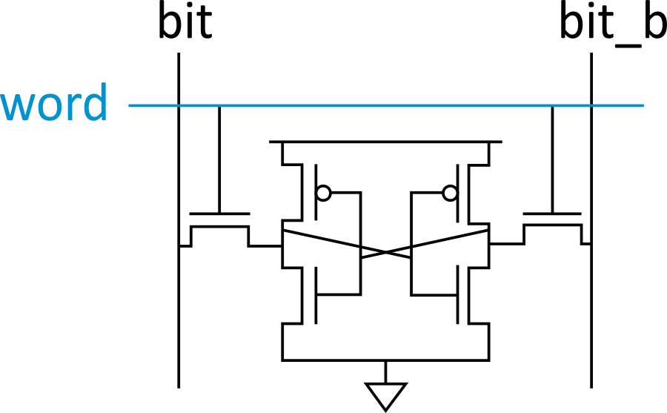
6T SRAM Cell
Cell size accounts for most of array size
Reduce cell size at expense of complexity
6T SRAM Cell
Used in most commercial chips
Data stored in cross-coupled inverters
Read:
Precharge bit, bit_b
Raise wordline
Write:
Drive data onto bit, bit_b
Raise wordline
Notes:
The 6T cell is the mostly used SRAM architecture in commercial ICs.

Slide 7
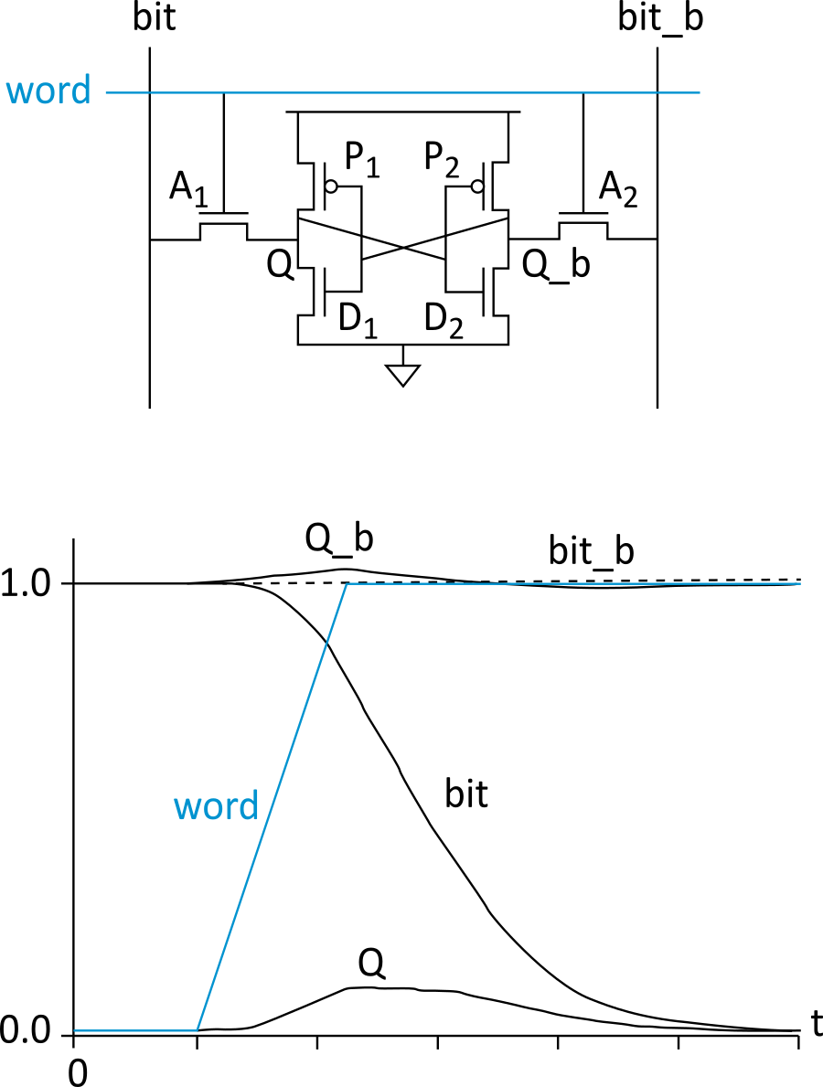
SRAM Read
Precharge both bitlines high
Then turn on wordline
One of the two bitlines will be pulled down by the cell
Ex: A = 0, A_b = 1
bit discharges, bit_b stays high
But A bumps up slightly
Read stability
A must not flip
N1 >> N2
Notes:
During read operation the bit lines “bit, bit_b” are pulled up to VDD (precharged) and one word selected. Depending on the state of the SRAM cell either “bit, bit_b” is pulled low e.g if node A=0, A_b=1, “bit” line will be pulled low through transistors N2, N1 while “bit_b” will stay high. The level at which node A is pulled low depends on the voltage drop across N1 and will be slightly above 0. If node A rises high enough it might cause the bit stored to flip, therefore N2 should be size to allow a large voltage drop across it as compared to N1.

Slide 8
SRAM Write
Drive one bitline high, the other low
Then turn on wordline
Bitlines overpower cell with new value
Ex: A = 0, A_b = 1, bit = 1, bit_b = 0
Force A_b low, then A rises high
Writability
Must overpower feedback inverter
N2 >> P1
Notes:
During write operation the input data and its complement are placed on the bit lines “bit, bit_b” respectively and one word is selected . This will force the SRAM cell to flip into the state represented on the bit-lines e.g is A=0, A_b=1 and bit=1, bit_b=0, node A will rise and A_b will be pulled low.

Slide 9
SRAM Sizing
High bitlines must not overpower inverters during reads
But low bitlines must write new value into cell

Slide 10
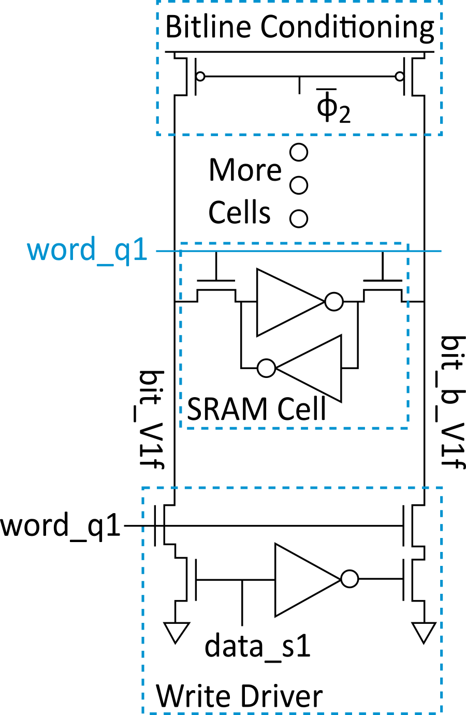
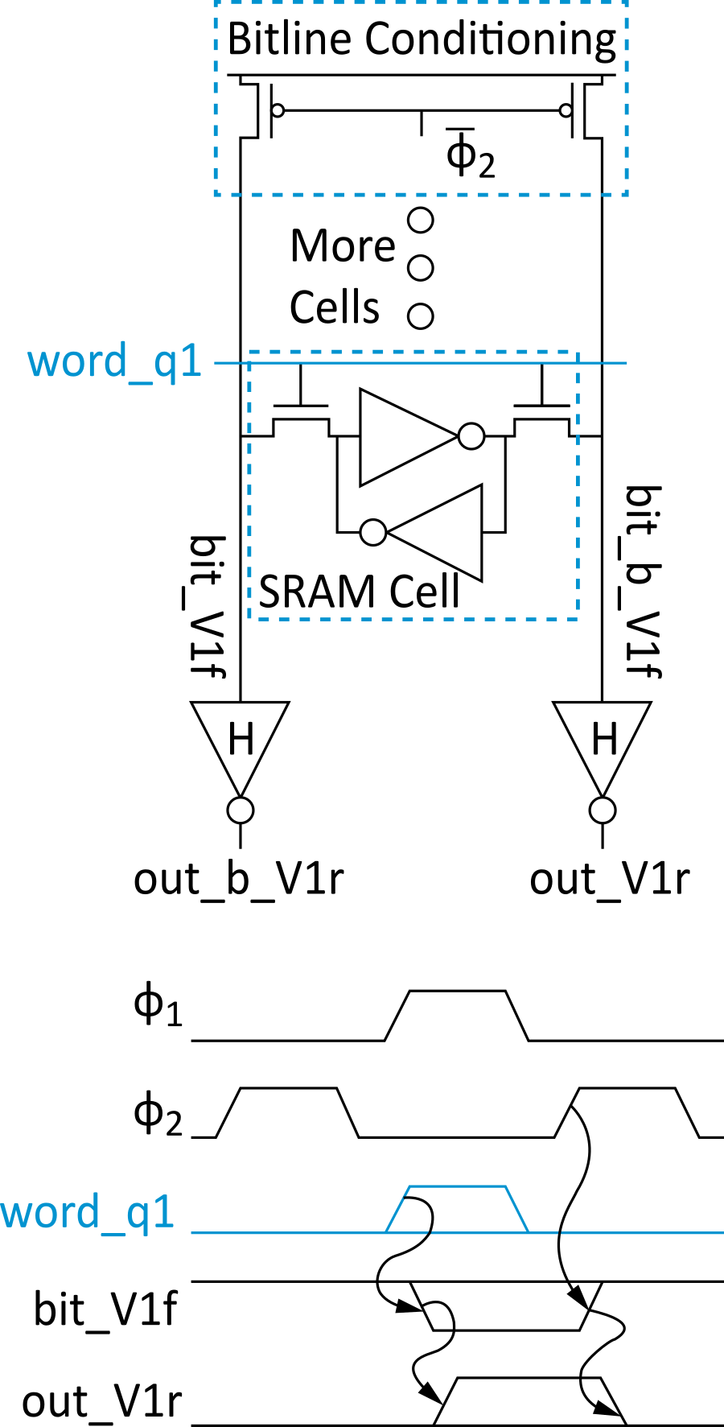
SRAM Column Example
Read Write

Slide 11
SRAM Layout
Cell size is critical: 26 x 45 λ (even smaller in industry)
Tile cells sharing V_{DD}, GND, bitline contacts
Notes:
SRAM cells are laid out as compact as possible to minimize chip area. A stick diagram is used as a representation of the actual layout. The cell is laid out in such a way that the BIT, BIT_B, WORD, VDD and GND abut.

Slide 12
Thin Cell
In nanometer CMOS
Avoid bends in polysilicon and diffusion
Orient all transistors in one direction
Lithographically friendly or thin cell layout fixes this
Also reduces length and capacitance of bitlines
Notes:
Bends in polysilicon cause lithography issues in processes where feature size is smaller than the wavelength of light. In order to mitigate these issues polysilicon is drawn in the horizontal direction while the diffusion region runs in the vertical direction.

Slide 13
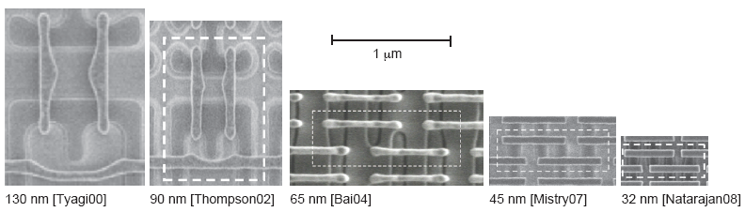
Commercial SRAMs
Five generations of Intel SRAM cell micrographs
Transition to thin cell at 65 nm
Steady scaling of cell area
Notes:
Thin cell layout adopted at 65nm and below.

Slide 14
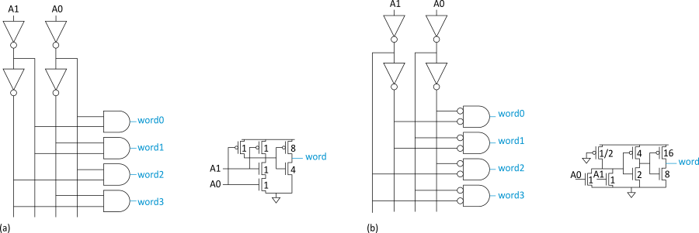
Decoders
n:2^{n} decoder consists of 2^{n} n-input AND gates
One needed for each row of memory
Build AND from NAND or NOR gates
Static CMOS Pseudo-nMOS
Notes:
Decoders are used to address a given word (row) of the SRAM array.

Slide 15
Decoder Layout
Decoders must be pitch-matched to SRAM cell
Requires very skinny gates
Notes:
The decoder height should be the same as that of the SRAM cell row

Slide 16
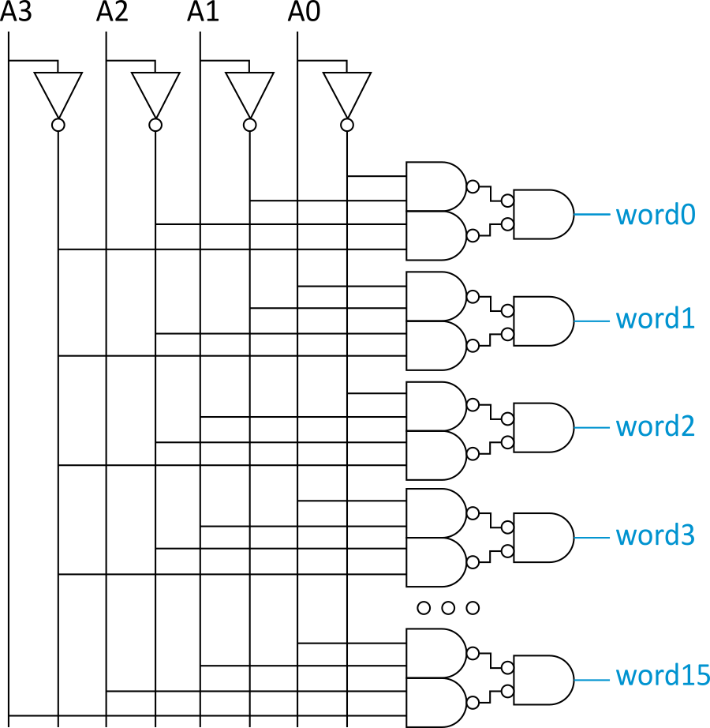
Large Decoders
For n > 4, NAND gates become slow
Break large gates into multiple smaller gates

Slide 17
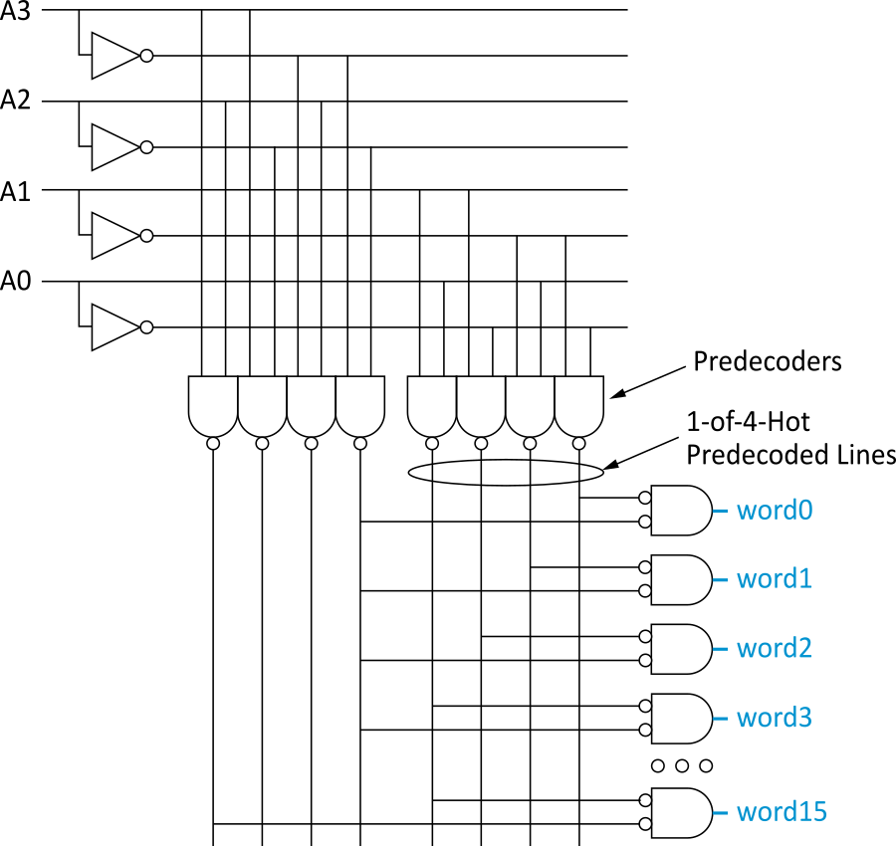
Predecoding
Many of these gates are redundant
Factor out common
gates into predecoder
Saves area
Same path effort
Notes:
NAND gates that share inputs can be factored out to reduce the number of gates .

Slide 18
Column Circuitry
Some circuitry is required for each column
Bitline conditioning
Sense amplifiers
Column multiplexing
Notes:
In order to read and write to SRAM cells Bitline conditioning circuits, sense amplifier circuits and column multiplexer circuits are required.

Slide 19
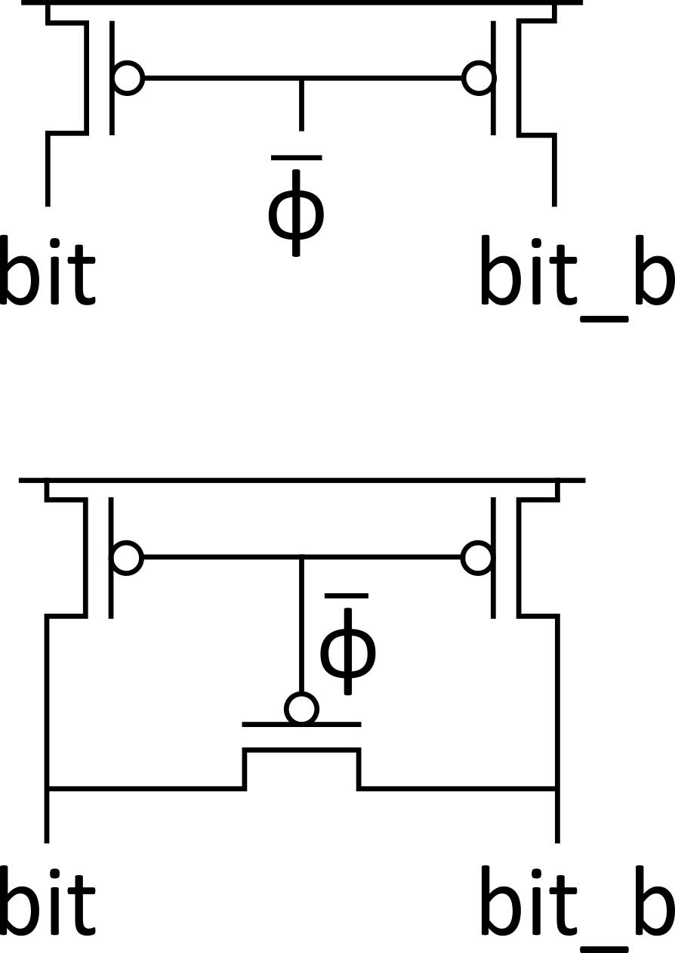
Bitline Conditioning
Precharge bitlines high before reads
Equalize bitlines to minimize voltage difference when using sense amplifiers
Notes:
Bitline conditioning are circuits used to precharge the bitline high before read operation.
In the first circuit, when the clock is low, the transistors will precharge the bit lines to Vdd.
In the second circuit, the voltage in the bitlines are equalized to minimize voltage difference. This achieved by the second transistor between the bitlines.

Slide 20
Sense Amplifiers
Bitlines have many cells attached
Ex: 32-kbit SRAM has 128 rows x 256 cols
128 cells on each bitline
t_{pd} ~ (C/I) ∆V
Even with shared diffusion contacts, 64C of diffusion capacitance (big C)
Discharged slowly through small transistors (small I)
Sense amplifiers are triggered on small voltage swing (reduce ∆V)
Notes:
The bit-line pull-down speed is very slow due to the small cell size and large bit-line load capacitance. Differential sense amplifiers are used for speed purposes because they can detect and amplify a very small level difference between two bit-lines. Thus, a fast sense amplifier is an important factor in realizing fast access time.

Slide 21
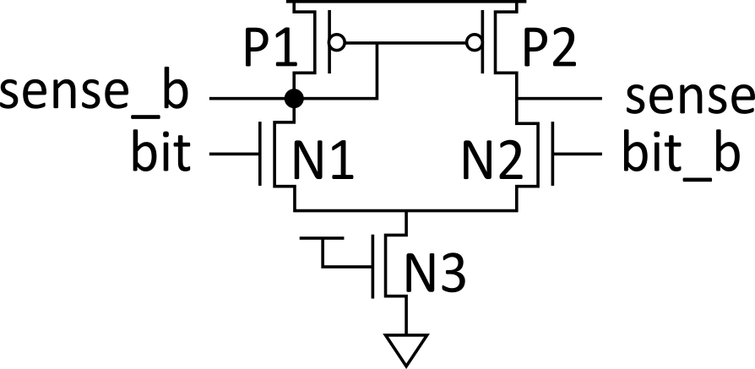
Differential Pair Amp
Differential pair requires no clock
But always dissipates static power
Notes:
Unclocked differential pair amp used as the sense amplifier. Consumes power constantly.

Slide 22
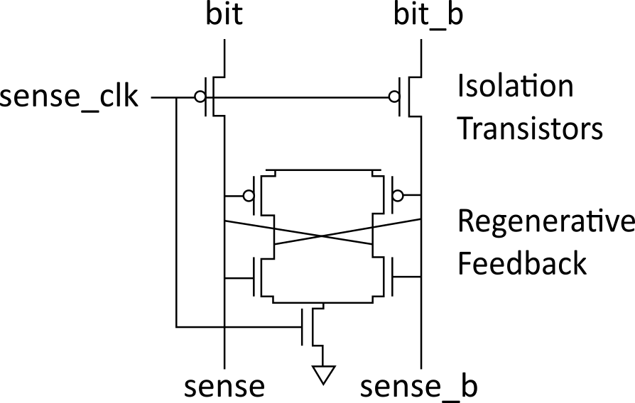
Clocked Sense Amp
Clocked sense amp saves power
Requires sense_clk after enough bitline swing
Isolation transistors cut off large bitline capacitance
Notes:
Consumes power only when active i.e sense clk is high. The cross coupled inverters form a regenerative feedback circuit that has a first response time.

Slide 23
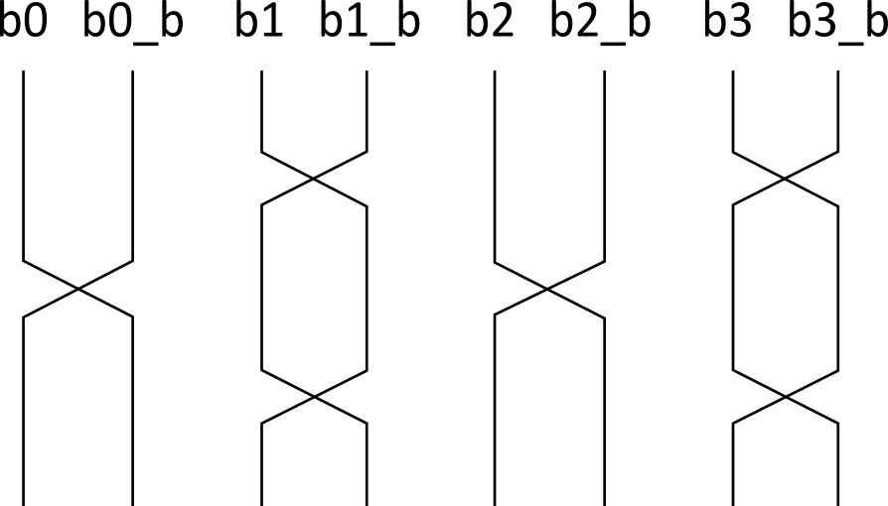
Twisted Bitlines
Sense amplifiers also amplify noise
Coupling noise is severe in modern processes
Try to couple equally onto bit and bit_b
Done by twisting bitlines
Notes:
Twisting is used to cause equal noise coupling on the bit line and its complement in order to allow cancelation of the noise at the sense amp.

Slide 24
Column Multiplexing
Recall that array may be folded for good aspect ratio
Ex: 2 kword x 16 folded into 256 rows x 128 columns
Must select 16 output bits from the 128 columns
Requires 16 8:1 column multiplexers

Slide 25
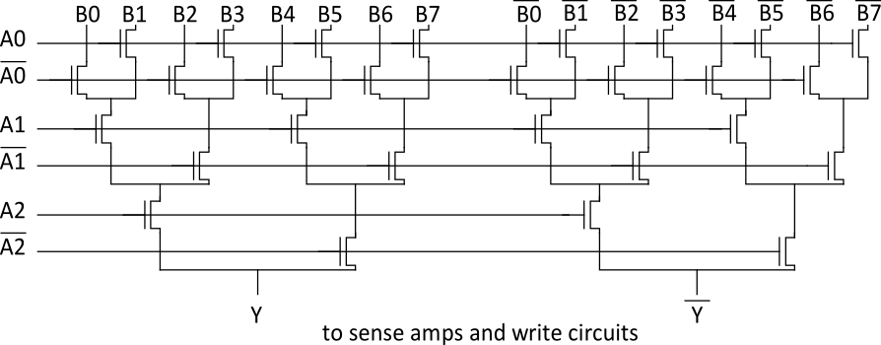
Tree Decoder Mux
Column mux can use pass transistors
Use nMOS only, precharge outputs
One design is to use k series transistors for 2^{k}:1 mux
No external decoder logic needed

Slide 26
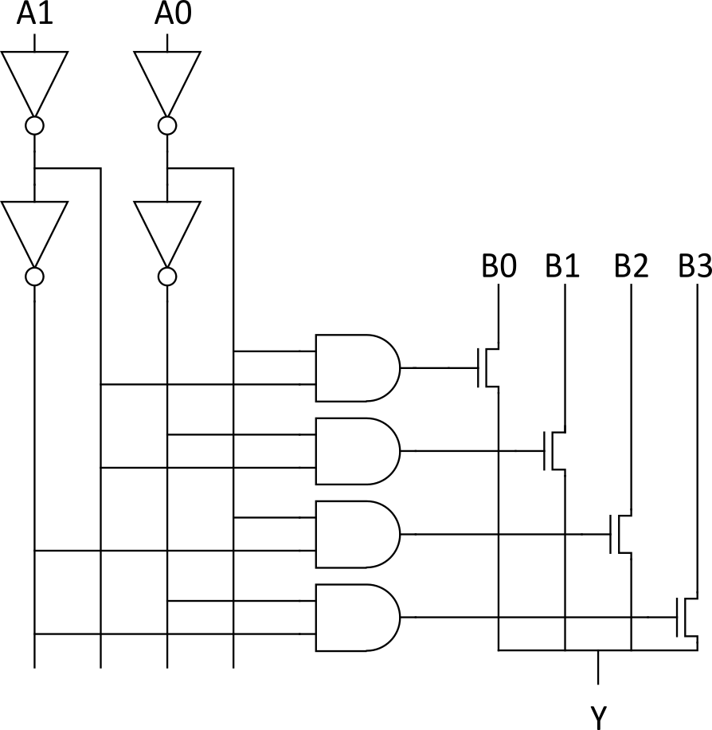
Single Pass-Gate Mux
Or eliminate series transistors with separate decoder

Slide 27
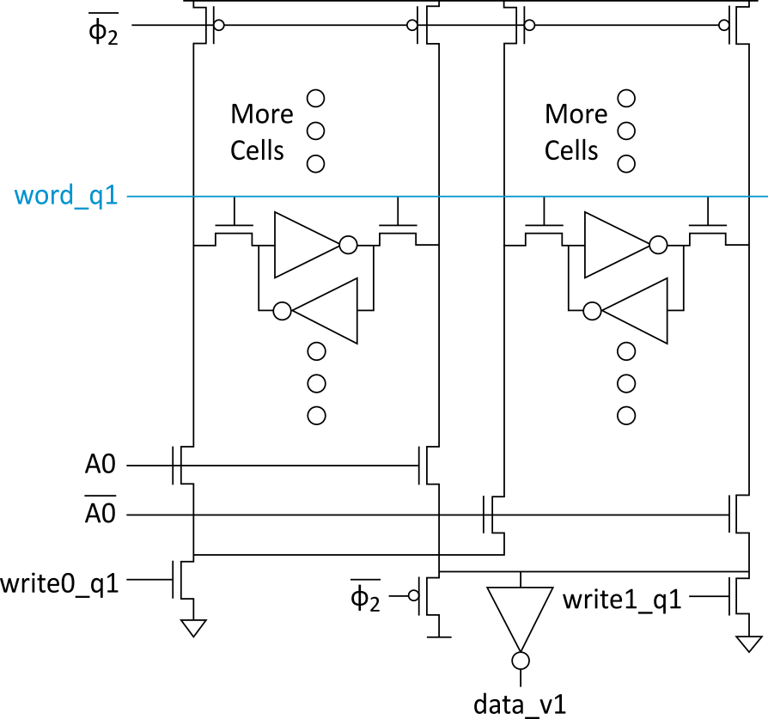
Ex: 2-way Muxed SRAM

Slide 28
Multiple Ports
We have considered single-ported SRAM
One read or one write on each cycle
Multiported SRAM are needed for register files
Examples:
Multicycle MIPS must read two sources or write a result on some cycles
Pipelined MIPS must read two sources and write a third result each cycle
Superscalar MIPS must read and write many sources and results each cycle

Slide 29
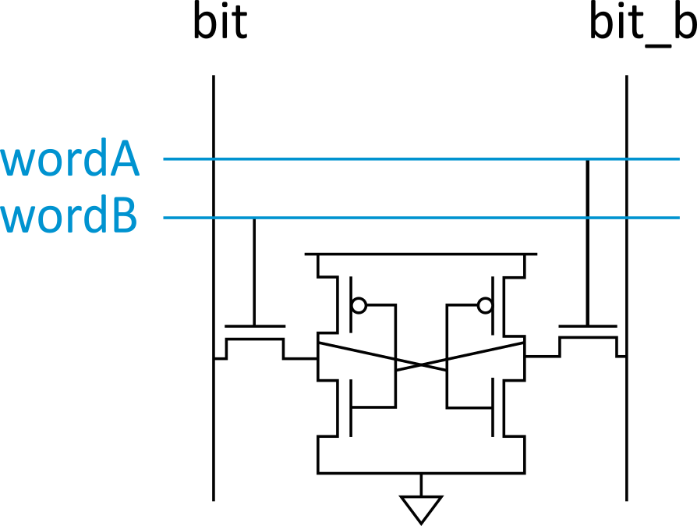
Dual-Ported SRAM
Simple dual-ported SRAM
Two independent single-ended reads
Or one differential write
Do two reads and one write by time multiplexing
Read during ph1, write during ph2
Notes:
Asserting WordA of row 1 and wordB of row 2, causes simultaneous reads the first word onto bit and the complement of the second word onto bit_b. Only one write can be performed since bit and bit_b are needed still requires for a single write.

Slide 30
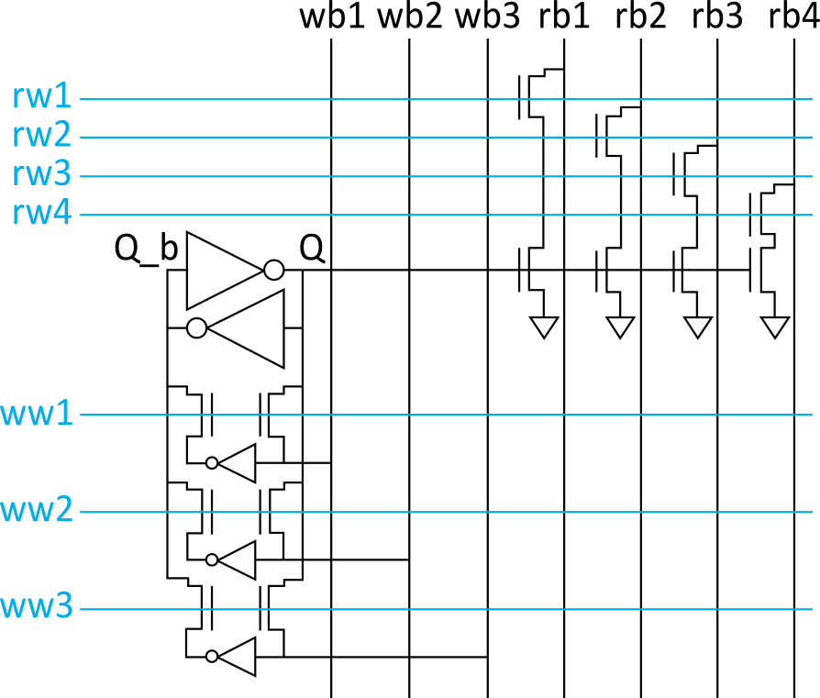
Multi-Ported SRAM
Adding more access transistors hurts read stability
Multiported SRAM isolates reads from state node
Single-ended bitlines save area

Slide 31
Large SRAMs
Large SRAMs are split into subarrays for speed
Ex: UltraSparc 512KB cache
4 128 KB subarrays
Each have 16 8KB banks
256 rows x 256 cols / bank
60% subarray area efficiency
Also space for tags & control
[Shin05]

Slide 32
Serial Access Memories
Serial access memories do not use an address
Shift Registers
Tapped Delay Lines
Serial In Parallel Out (SIPO)
Parallel In Serial Out (PISO)
Queues (FIFO, LIFO)

Slide 33
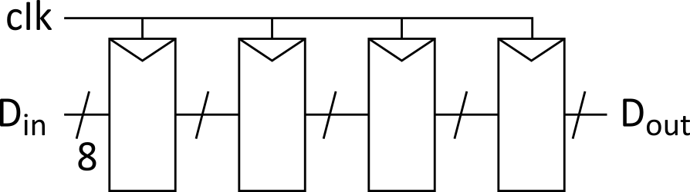
Shift Register
Shift registers store and delay data
Simple design: cascade of registers
Watch your hold times!
Notes:
Simple read and write performed by shifting in/out data using the clock.

Slide 34
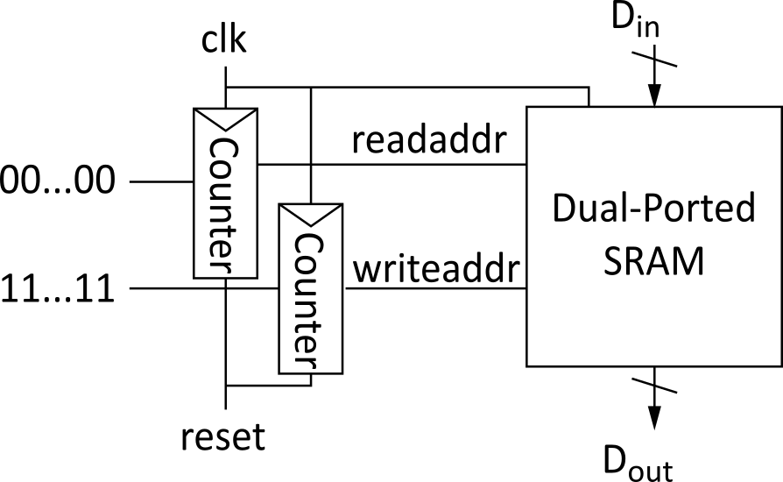
Denser Shift Registers
Flip-flops aren’t very area-efficient
For large shift registers, keep data in SRAM instead
Move read/write pointers to RAM rather than data
Initialize read address to first entry, write to last
Increment address on each cycle
Notes:
Dense shift register can be implemented using SRAM blocks with counters used to specify where data is read and written.

Slide 35
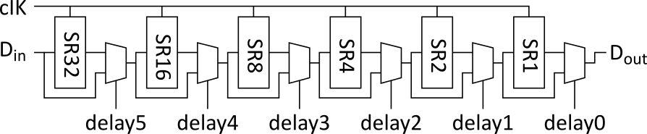
Tapped Delay Line
A tapped delay line is a shift register with a programmable number of stages
Set number of stages with delay controls to mux
Ex: 0 – 63 stages of delay

Slide 36
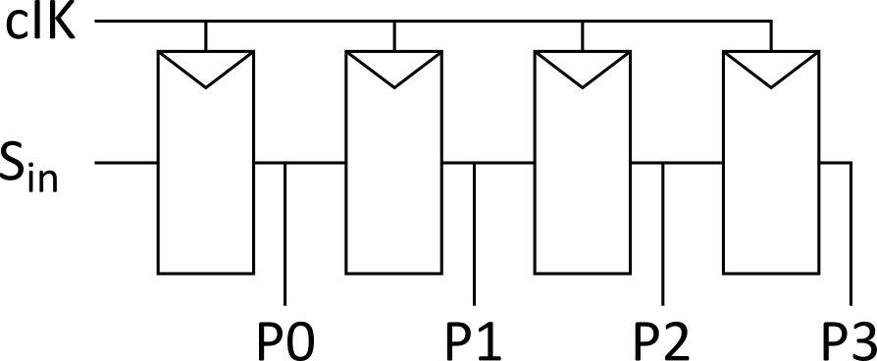
Serial In Parallel Out
1-bit shift register reads in serial data
After N steps, presents N-bit parallel output

Slide 37
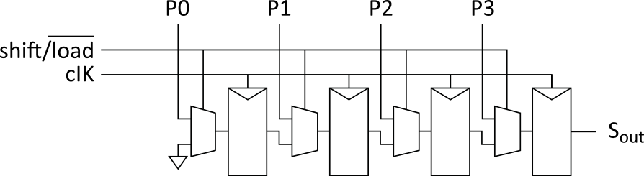
Parallel In Serial Out
Load all N bits in parallel when shift = 0
Then shift one bit out per cycle

Slide 38
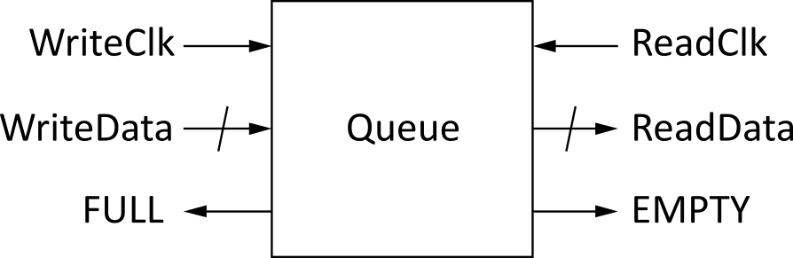
Queues
Queues allow data to be read and written at different rates.
Read and write each use their own clock, data
Queue indicates whether it is full or empty
Build with SRAM and read/write counters (pointers)
Notes:
Queues are used in situation where the rate of data being read out is different from that of data being read. They utilize flags to indicated when they are full (no space remaining) or empty (no data to be read out).

Slide 39
FIFO, LIFO Queues
First In First Out (FIFO)
Initialize read and write pointers to first element
Queue is EMPTY
On write, increment write pointer
If write almost catches read, Queue is FULL
On read, increment read pointer
Last In First Out (LIFO)
Also called a stack
Use a single stack pointer for read and write
Notes:
FIFOS are used to store data that move back and forth between asynchronous circuit blocks.

