Slide 1
3.0 – Transistor Theory ENGR-E 399/599: VLSI Design Prof. Daniel Loveless, dlovele@iu.edu, 812-856-0703
INDIANA UNIVERSITY – Reliable Electronics and Systems
Center for Reliable and Trusted Electronics (CREATE)
Notes:
Hello and welcome. Today, our focus will be on the CMOS transistor theory.

Slide 2
Learning Objectives
At the end of this lecture, you should be able to:
Use cross section diagrams to describe the characteristics of MOS transistors when operating in cut off, linear and saturation regions.
Derive the relationship between current and voltage (I-V) of the MOS device at cut off, linear and saturation modes.
Mathematically estimate the MOS gate capacitance.
Describe the effect of diffusion capacitance on the terminals
Notes:
At the end of this lecture, you should be able to:
Use cross section diagrams to describe the characteristics of MOS transistors when operating in cut off, linear and saturation regions.
Derive the relationship between current and voltage (I-V) of the MOS device at cut off, linear and saturation modes.
Mathematically estimate the MOS gate capacitance.
Describe the effect of diffusion capacitance on the terminals.

Slide 3
Introduction
So far, we have treated transistors as ideal switches
An ON transistor passes a finite amount of current
Depends on terminal voltages
Derive current-voltage (I-V) relationships
Transistor gate, source, drain all have capacitance
I = C (ΔV/Δt) -> Δt = (C/I) ΔV
Capacitance and current determine speed
Notes:
So far, we have seen transistors as ideal switches.
The amount of current that an On transistor passes is finite and depends on the terminal voltages. We can draw relations between the current and voltage also known as (I-V) relationships.
The transistor gate, source, and drain all have capacitance that can be used to calculate the current in certain regions with the formula:
Current = Capacitance in Farads * volts per seconds that implies that the capacitance and current determine the speed of the transistor.

Slide 4
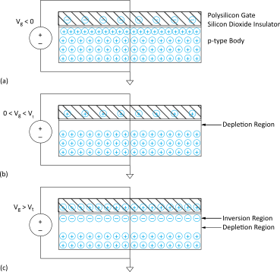
MOS Capacitor
Gate and body form MOS capacitor
Operating modes
Accumulation
Depletion
Inversion
Threshold voltage
is when inversion
begins
Notes:
The majority-carriers in MOS transistor devices enable them carry current from one terminal to another. Voltage applied to the gate controls the current in a conducting channel between the source and drain.
Figure shows a simple MOS structure.
The top layer of the structure is a polysilicon gate.
The middle layer is silicon dioxide insulator.
The bottom layer is the doped p-type body in which the carriers are holes.
The body is grounded, and a voltage is applied to the gate.
MOS transistor has 3 different operating modes:
Accumulation mode occurs when voltage gate is less than zero.
Depletion mode occurs when voltage gate is less than voltage threshold and greater than zero.
Inversion mode occurs when voltage gate is greater than voltage threshold.

Slide 5
Terminal Voltages
Mode of operation depends on V_{g}, V_{d}, V_{s}
V_{gs} = V_{g} – V_{s}
V_{gd} = V_{g} – V_{d}
V_{ds} = V_{d} – V_{s} = V_{gs} - V_{gd}
Source and drain are symmetric diffusion terminals
By convention, source is terminal at lower voltage
Hence, V_{ds} ≥ 0
nMOS body is grounded. First, assume source is 0 too.
Three regions of operation
Cutoff
Linear
Saturation
Notes:
The mode of operations depends on gate voltage Vg, drain voltage Vd and source voltage Vs.
The gate to source voltage (Vgs) is the difference between vg – vs.
The gate to drain voltage (Vgd) is the difference between vg – vd.
The drain to source voltage (Vds) is the difference between vgs – vgd
The source terminal is at lower voltage potential and drain terminal at high voltage potential. Hence, Vds ≥ 0.
In nMOS transistor, the body is grounded. First, we assume that source is 0 too.
Then the three regions of operation are Cutoff, Linear and Saturation.

Slide 6
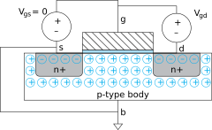
nMOS Cutoff
V_{gs} < V_{t}
No inversion, no channel
I_{ds} ≈ 0
Notes:
In Cutoff region, the gate-to-source voltage Vgs < threshold voltage. We supposed that the source is grounded. The source and drain have free electrons. Whereas, the body has free holes but no free electrons. The junctions between the body and the source or drain are zero-biased and no current flows (there is no inversion channel between drain and source). The transistor is in OFF state.

Slide 7
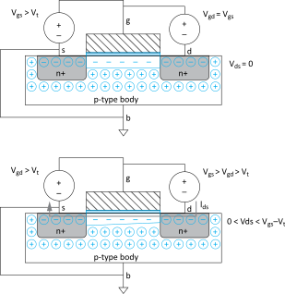
nMOS Linear
V_{gs} > V_{t}
But V_{ds} small
Channel forms
Current flows from d to s
e⁻ from s to d
I_{ds} increases with V_{ds}
Similar to linear resistor
Notes:
nMOS linear region starts when Vgs is greater than the threshold voltage; in this case, a channel forms, but Vds is small. Current flows from the drain to the source and electrons from the source to drain.
Current from drain source increases with Vds, and this kind of behavior is similar to a linear resistor.

Slide 8
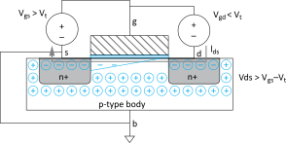
nMOS Saturation
V_{gs} > V_{t}
V_{ds} > V_{gs} - V_{t}
Channel pinches off
I_{ds} independent of V_{ds}
We say current saturates
Similar to current source
Notes:
nMOS Saturation region starts when Vgs is greater than the voltage threshold, and, at the same time, Vds is greater than the difference between Vgs – Vt.
In this case, current from drain to source is independent of Vds, and we say that the current saturates; this is similar to current source.

Slide 9
I-V Characteristics
In Linear region, I_{ds} depends on
How much charge is in the channel?
How fast is the charge moving?
Notes:
Current and voltage characteristics.
In linear region, the current from the drain to source depends on:
How much charge is in the channel and how fast these charges move.

Slide 10
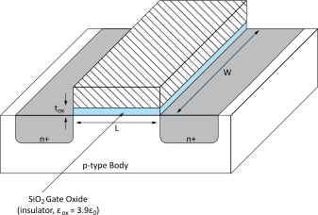
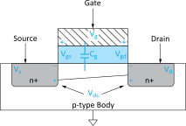
Channel Charge
MOS structure looks like a parallel plate capacitor while operating in inversions
Gate – oxide – channel
Q_{channel} = CV
C = C_{g} = ε_{ox}WL/t_{ox} = C_{ox}WL
V = V_{gc} – V_{t} = (V_{gs} – V_{ds}/2) – V_{t}
C_{ox} = ε_{ox} / t_{ox}
C_{ox} = ε_{ox} / t_{ox}
Notes:
MOS structure looks like a parallel-plate capacitor while operating in inversions.
Channel Charge is equal to capacitance times voltage.
Capacitance is equal to the gate capacitance or gate oxide capacitance times the width and length.
Voltage is equal to V from gate to channel – voltage threshold or (Vgs – Vds/2) minus voltage threshold.

Slide 11
Carrier velocity
Charge is carried by e-
Electrons are propelled by the lateral electric field between source and drain
E = V_{ds}/L
Carrier velocity v proportional to lateral E-field
v = µ E µ called mobility
Time for carrier to cross channel:
t = L / v
Notes:
Slide details relevant formulas to calculate carrier velocity and time for carrier to cross channel.

Slide 12
nMOS Linear I-V
Now we know
How much charge Q_{channel} is in the channel
How much time (t) each carrier takes to cross

Slide 13
nMOS Saturation I-V
If V_{gd} < V_{t}, channel pinches off near drain
When V_{ds} > V_{dsat} = V_{gs} – V_{t}
Now drain voltage no longer increases current

Slide 14
nMOS I-V Summary
Shockley 1st order transistor models
Notes:
The equation for Ids current can be expressed for the three operating regions cutoff, linear and saturation.

Slide 15
Example
AMI 0.6 μm process
t_{ox} = 100 Å
µ = 350 cm²/V*s
V_{t} = 0.7 V
Plot I_{ds} vs. V_{ds}
V_{gs} = 0, 1, 2, 3, 4, 5
Use W/L = 4/2 λ
Notes:
In this example, the 0.6 µm process will be used.
This process is from AMI semiconductor.
The gate oxide thickness is 100 Angstrom or 0.1 nanometer.
The mobility of electrons is equal to 350 cm square over Voltage times seconds.
Voltage threshold = 0.7 V
Given the following values for Vgs, 0, 1, 2, 3, 4, 5, and assuming W/L = 4/2 lambda, we can calculate Ids and plot it against Vds.

Slide 16
pMOS I-V
All dopings and voltages are inverted for pMOS
Source is the more positive terminal
Mobility µ_{p} is determined by holes
Typically 2-3x lower than that of electrons µ_{n}
120 cm²/V•s in AMI 0.6 µm process
In advanced nodes, µ_{p} ≈ µ_{n}
Thus, pMOS must be wider to
provide same current
In this class, assume
µ_{n} / µ_{p} = 2
Notes:
For pMOS transistors, all doping and voltages become inverted.
So the source is the more positive terminal.
The mobility ${\text{µ}}_{p}$ is determined by holes, and it is typically 2 to 3 times slower than of electrons in ${\text{µ}}_{n}$.
So the mobility ${\text{µ}}_{p}$ = 120 cm square over Voltage times seconds in AMI 0.5 micrometer process
In advanced nodes, ${\text{µ}}_{p}$ is close to ${\text{µ}}_{n}$.
Thus, pMOS needs to be wider to provide the same current. In this class, assume that mobility in ${\text{µ}}_{n}$/${\text{µ}}_{p}$ is equal to 2.

Slide 17
Capacitance
Any two conductors separated by an insulator have capacitance
Gate to channel capacitor is very important
Creates channel charge necessary for operation
Source and drain have capacitance to body
Across reverse-biased diodes
Called diffusion capacitance because it is associated with source/drain diffusion
Notes:
When two conductors are separated by an insulator, they have a capacitance.
Gate to channel capacitance is very important because it creates channel charge necessary for an operation.
The diffusion capacitance formed by the source/drain to body junctions.

Slide 18
Gate Capacitance
Approximate channel as connected to source
C_{gs} = ε_{ox}WL/t_{ox} = C_{ox}WL = C_{permicron}W
C_{permicron} is typically about 2 fF/μm
Notes:
To calculate gate capacitance, approximate channel as connected to source:
If we want to calculate Capacitance from the gate to a source, it is equal to the capacitance gate oxide times the width and length of the transistor.

Slide 19
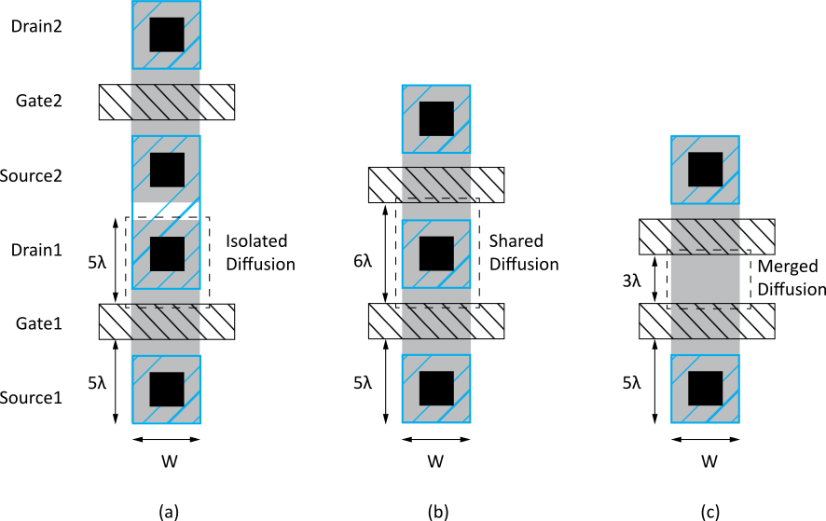
Diffusion Capacitance
Source/drain diffusion to body C_{sb}, C_{db}
Undesirable, called parasitic capacitance
Capacitance depends on area and perimeter
Use small diffusion nodes
Comparable to C_{g}
for contacted diff
½ C_{g} for uncontacted
Varies with process
Notes:
Parasitic capacitance is the Source/drain diffusion to body capacitance, and this is undesirable.
Since capacitance depends on area and perimeter, it is best that the diffusion nodes are small.
Their capacitance is comparable to the gate capacitance for contacted diffusion, and half of the gate capacitance for uncontacted.
This can vary with the process.

