Slide 1
Lab 2 Prep

Slide 2
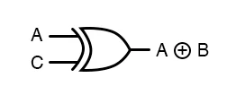
XOR
A | B | Y
0 | 0 | 0
0 | 1 | 1
1 | 0 | 1
1 | 1 | 0
0
1
AB / Y
0 | 1
1 | 0
0
1
Y = A B + B A

Slide 3
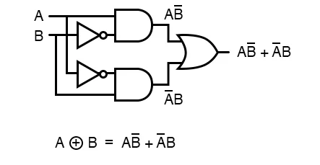
XOR
A | B | Y
0 | 0 | 0
0 | 1 | 1
1 | 0 | 1
1 | 1 | 0
0
1
AB / Y
0 | 1
1 | 0
0
1
Y = A B + B A

Slide 4
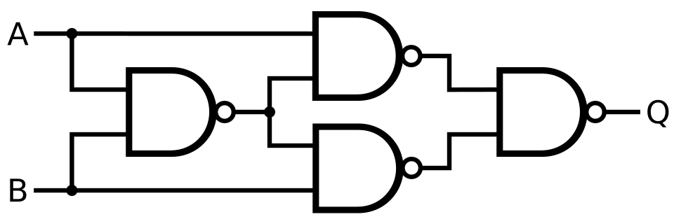
XOR
A | B | Y
0 | 0 | 0
0 | 1 | 1
1 | 0 | 1
1 | 1 | 0
0
1
AB / Y
0 | 1
1 | 0
0
1
Y = A B + B A

Slide 5
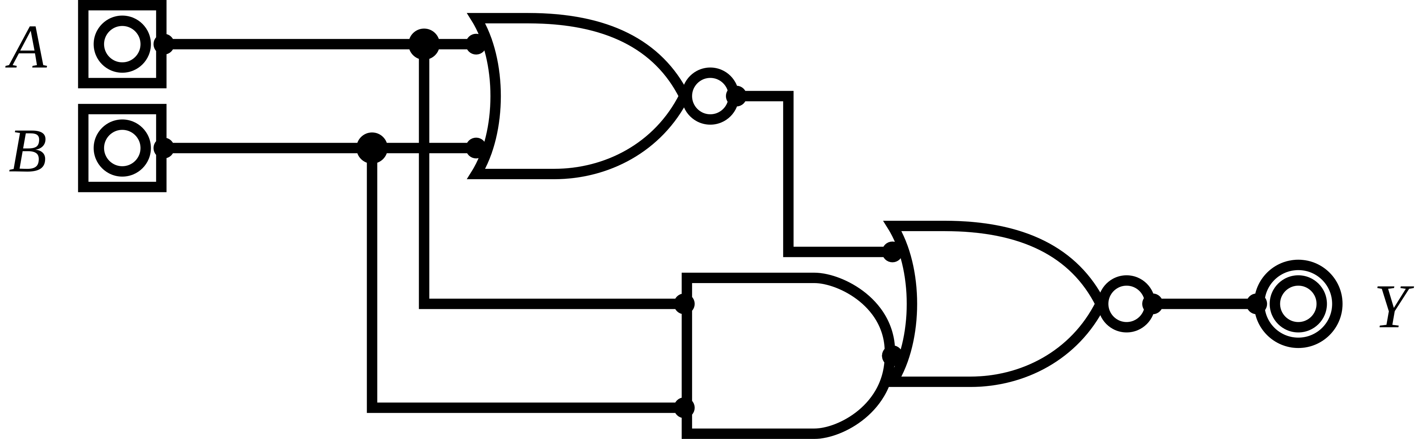
XOR
A | B | Y
0 | 0 | 0
0 | 1 | 1
1 | 0 | 1
1 | 1 | 0
A + B
0
1
AB / Y
0 | 1
1 | 0
(AB) +(A + B)
AB + AB
0
AB
1
Y = A B + B A

Slide 6
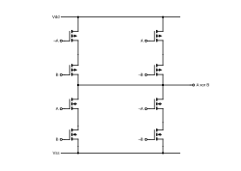
XOR
A | B | Y
0 | 0 | 0
0 | 1 | 1
1 | 0 | 1
1 | 1 | 0
0
1
AB / Y
0 | 1
1 | 0
0
1
Y = A B + B A

