Slide 1




02A – The Natural Space Radiation Environment
Guided Activity
ENGR-E 399/599
Microelectronics Radiation Effects and Reliability
Notes:
Portions of this presentation were developed by Alex Boyd, Aerospace Corp. and Justin Likar, Johns Hopkins Applied Physics Laboratory

Slide 2

Sign in to SPENVIS
https://www.spenvis.oma.be/

Slide 3
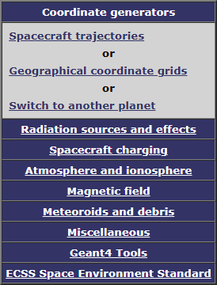
Use the Coordinate Generator to create a trajectory

Slide 4
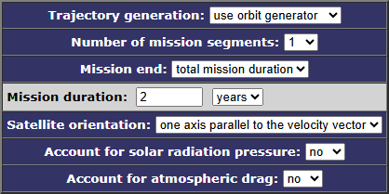
Use the Coordinate Generator to create a trajectory

Slide 5
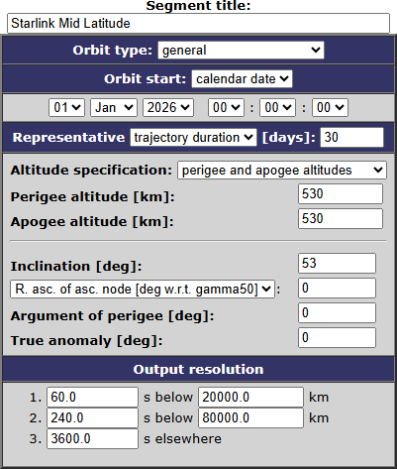
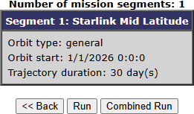
Use the Coordinate Generator to create a trajectory

Slide 6
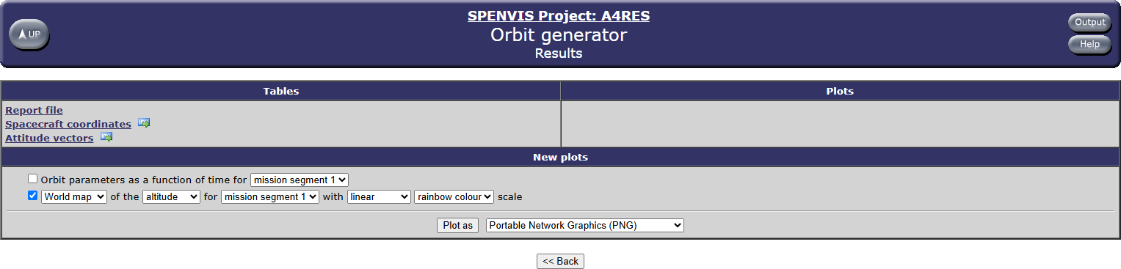
Explore the outputs

Slide 7
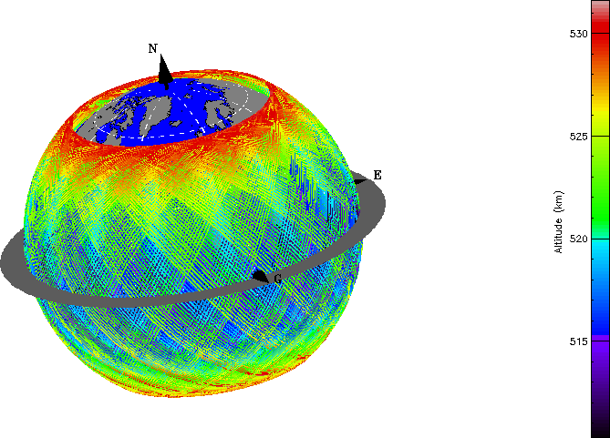
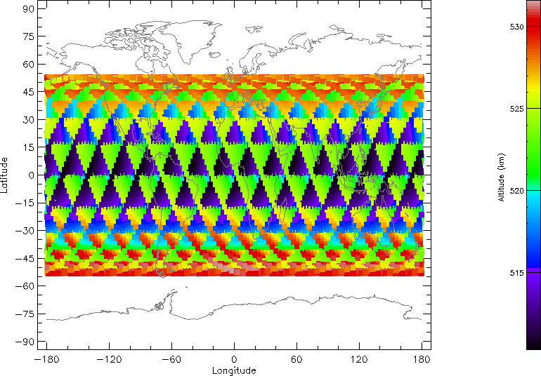
Explore the outputs

Slide 8
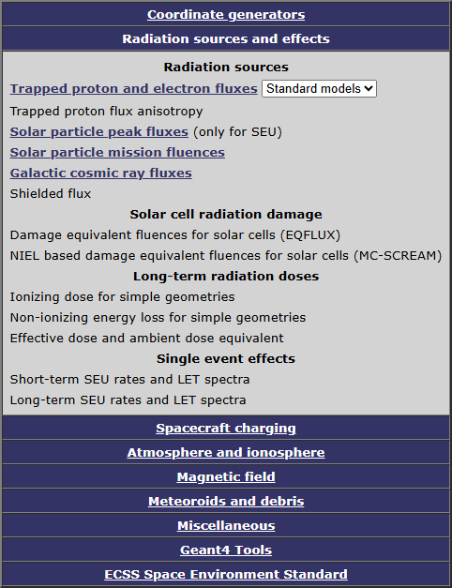
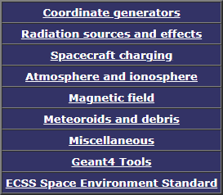
Modeling charged particle populations
Click UP and return to Main Menu
Click RADIATION SOURCES AND EFFECTS
Let’s start with Trapped Particles

Slide 9
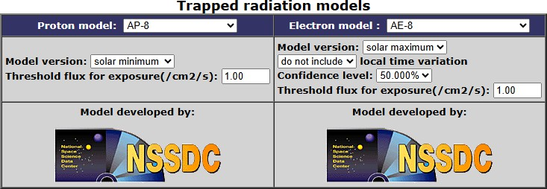
Run AP8 / AE8
SPENVIS includes options for Trapped Particles
  IRENE (Ver. 1.50), SSREM, CRRESPRO, …
  AP8 / AE8 is fast for illustrative purposes

Slide 10
Explore the outputs
Generate a Proton spectrum for this mission (flux vs. energy)
  Review the Report file
  [What sort of information is available here?]
Generate a Time plot of proton flux >200 MeV for this mission
Generate a World map of proton flux >200 MeV for this mission
  [Why 200 MeV?]
  [What sort of observations can you make?]

Slide 11
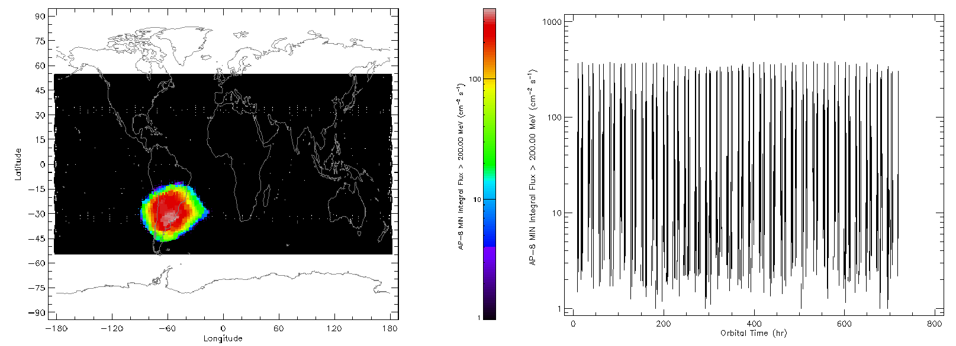
Explore the outputs

Slide 12
Modeling charged particle populations
Click UP and return to Main Menu
Click RADIATION SOURCES AND EFFECTS
Let’s add Solar particles

Slide 13
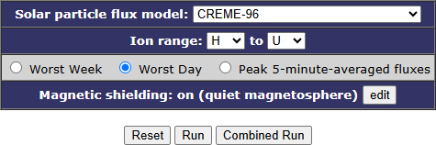
Run CREME-96 Worst Day (WD)
Other options available (SAPPHIRE, CREME-86, …)
Why CREME-96?
  Compatibility with SIRE-2, CREME-MC, …
Leave the Magnetic shielding as defaults

Slide 14
Explore the outputs
Generate a Heavy Ion spectra for Xe (Z=54) for this mission (flux vs. energy)
Generate a World map of proton attenuation factor for >200 MeV for this mission
  [Why 200 MeV?]
  [What sort of observations can you make?]

Slide 15
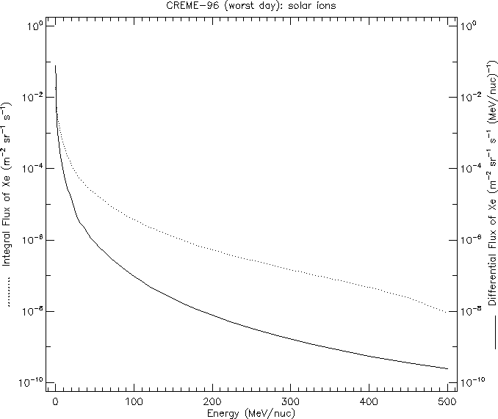
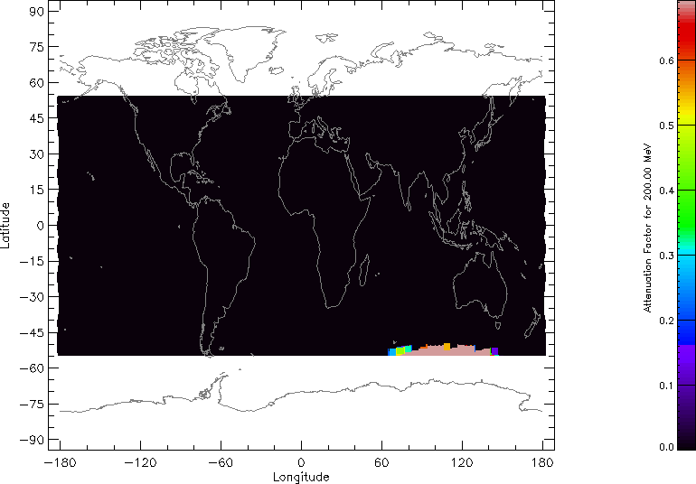
Explore the outputs

Slide 16
Modeling charged particle populations
Click UP and return to Main Menu
Click RADIATION SOURCES AND EFFECTS
Let’s add GCRs

Slide 17
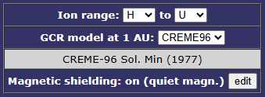
Run CREME-96
Other options available (ISO 15390, CREME-86, Nymmik, …)
Why CREME-96?
  Compatibility with SIRE-2, CREME-MC, …
Leave the Magnetic shielding as defaults

Slide 18
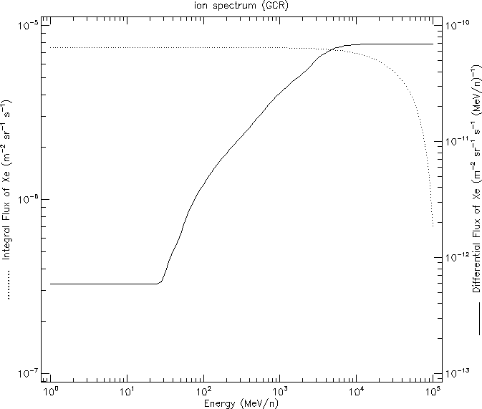
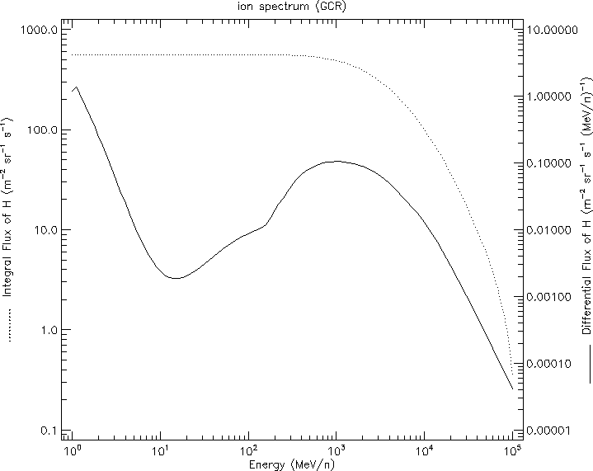
Explore the outputs
Generate a Heavy Ion spectra for Xe (Z=54) for this mission (flux vs. energy)
Generate a Heavy Ion spectra for protons (Z=1) for this mission (flux vs. energy)

Slide 19
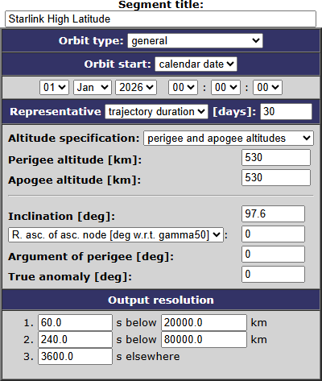
Next steps … on your own
As of now we’ve generated charged particle environments for a notional mid latitude Starlink-like mission
  Trapped protons
  SEP protons and ions
  GCR protons and ions
Repeat this process for a notional high latitude Starlink-like mission (see right)
Generate the same outputs and save so we can compare

Slide 20
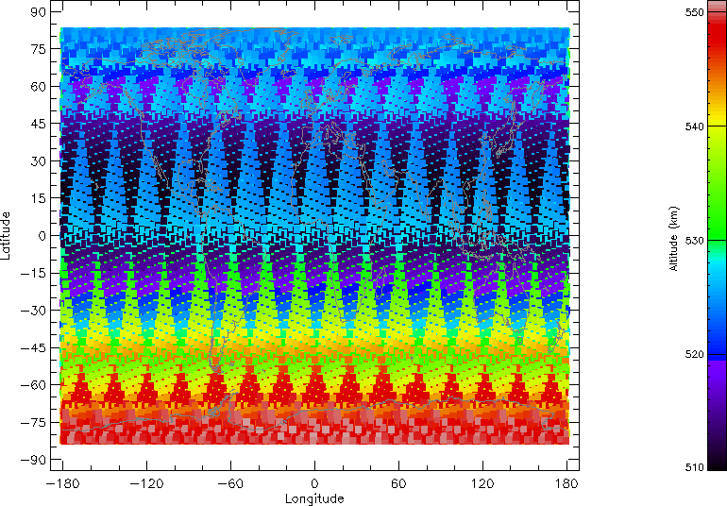
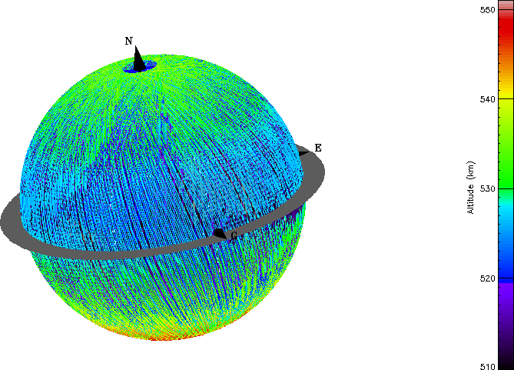
Trajectory
SOLUTION

Slide 21
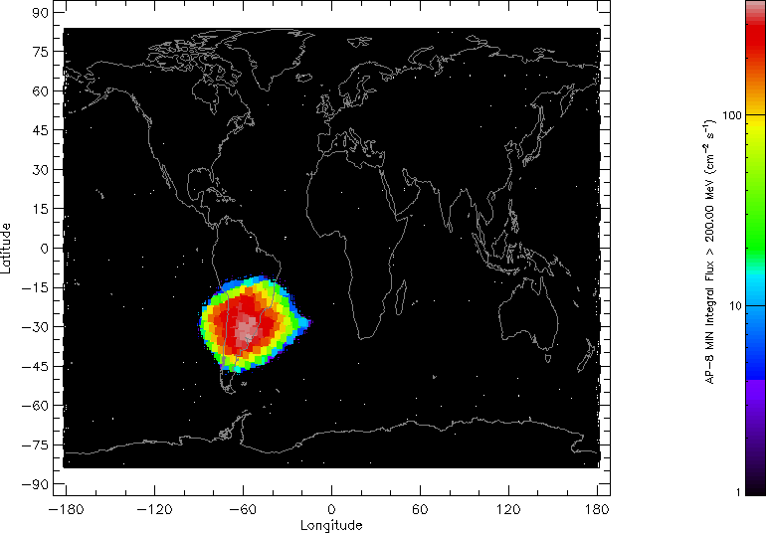
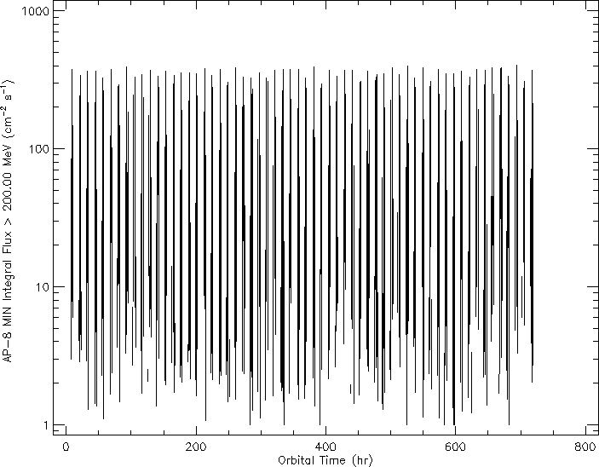
Trapped protons
SOLUTION

Slide 22
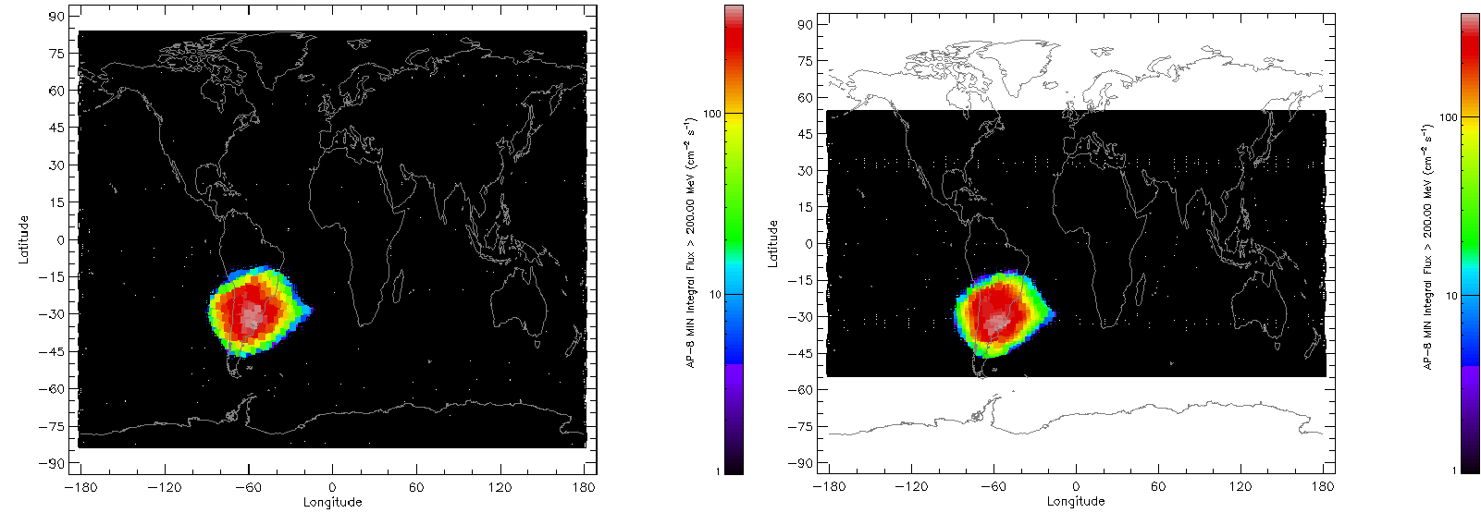
Comparisons (Trapped Protons)
SOLUTION
Make some observations about
  Mission / orbit average >200 MeV protons
  Peak >200 MeV protons

Slide 23
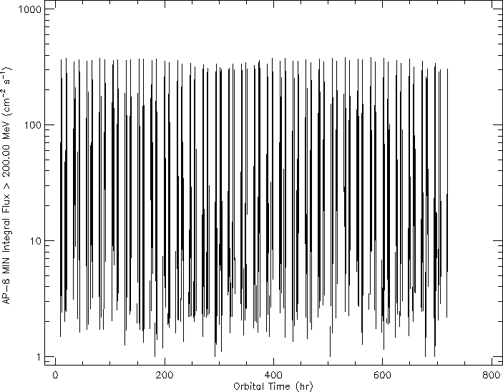
Comparisons (Trapped Protons)
SOLUTION
Make some observations about
  Mission / orbit average >200 MeV protons
  Peak >200 MeV protons

Slide 24

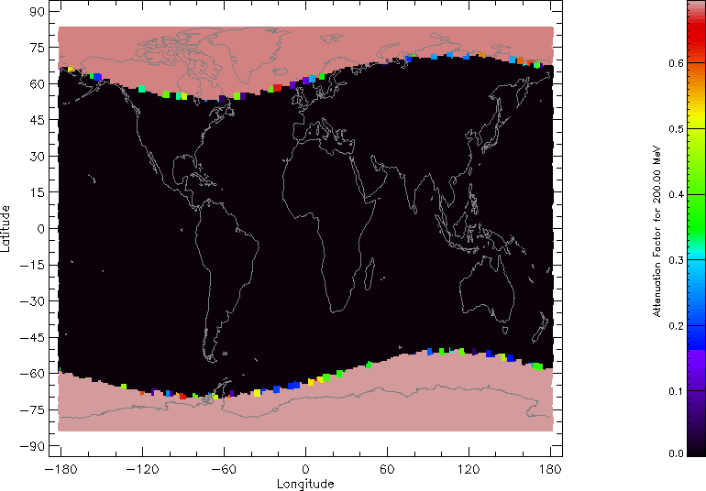
Worst Day
SOLUTION

Slide 25
Comparisons (Worst Day)
SOLUTION
Make some observations about
  Fluxes and energies of Xe ions

Slide 26
Comparisons (Worst Day)
SOLUTION
Make some observations about
  Access of >200 MeV protons
  Is the mission susceptible in a WD environment?

Slide 27
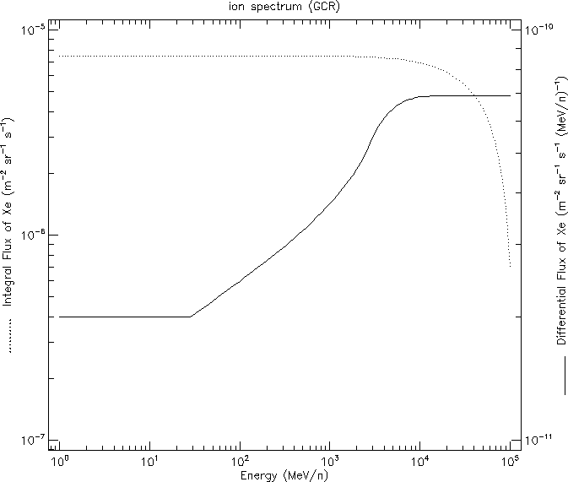
Comparisons (GCRs)
SOLUTION
Make some observations about
  Fluxes and energies of Xe ions

Slide 28
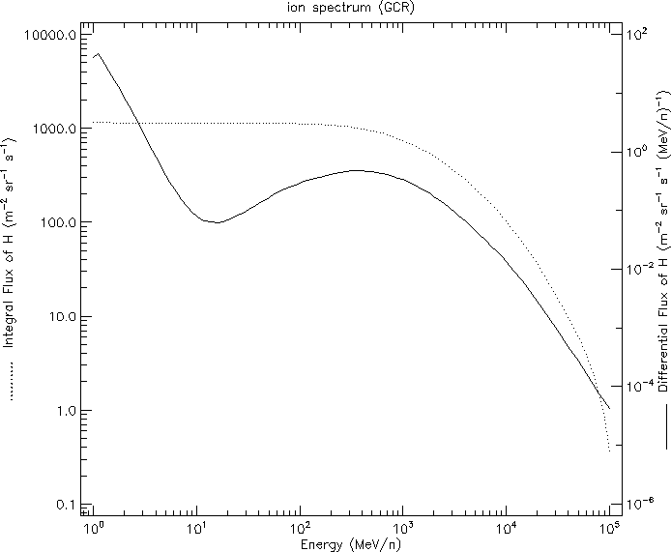
Comparisons (GCRs)
SOLUTION
Make some observations about
  Fluxes and energies of Xe ions

Slide 29
Homework 2
Using SPENVIS, model the following two orbits
  Assume a mission start date of Jan 1, 2026
  Use the following models:
    Trapped Protons and Electronics: Standard AE-8 (solar max., 50% confidence level), AP-8 (solar min.)
    CRÉME-96 solar particle model (Worst Day)
    ESP-PHYCHIC solar particle model for total fluence (95% confidence level)
    CRÉME-96 galactic cosmic ray model (solar min.)
Polar LEO (POES, IRIDIUM)
Mission Duration | 7 years
Apogee | 825 km
Perigee | 825 km
Inclination | 98.8 deg
RAAN¹ | 0 deg
Argument of Perigee | 0 deg
True Anomaly | 0 deg
HEO (Van Allen Probes, MMS)
Mission Duration | 2 years
Apogee | 70000 km
Perigee | 2500 km
Inclination | 28 deg
RAAN | 0 deg
Argument of Perigee | 0 deg
True Anomaly | 0 deg
¹Right Ascension of the Ascending Node

Slide 30
Homework 2
Provide the following charts for each mission:
  Trapped proton spectra
  World maps of the trapped proton flux (for >10 MeV and >200 MeV)
  Solar proton (Z=1) and heavy ion flux spectra for He (Z=2) and Fe (Z=26)
  World maps of the 200 MeV solar proton attenuation factor
  Mission average solar proton (Z=1) and heavy ion fluence spectra for He (Z=2) and Fe (Z=26) *from solar particle mission fluences
  GCR spectra of protons (Z=1), He (Z=2), and Fe (Z=26)

Slide 31
Homework 2
Name three differences in each of these orbits, as compared to the in-class example of a notional Starlink LEO orbit
What is the integral flux of trapped protons of energy 1 MeV or greater? What about for 200 MeV or greater?
For the life of each of these missions, how does the total fluence of solar protons of 200 MeV or greater to compare to the Starlink LEO mission? Provide the expected ratio (fluence of desired mission)/fluence of Starlink LEO.
Which mission sees the highest flux of GCR of Z=2 and higher? How about Z=26 and higher? Why?

