Slide 1





02 – The Natural Space Radiation Environment
ENGR-E 399/599
Microelectronics Radiation Effects and Reliability

Slide 2
Context
after McKenna, A4RES 25
Space Environments and Related Effects
after Barth
This presentation is only focused on the natural space exoatmospheric radiation environment around Earth
‒ Focus of this presentation will specifically be on particle radiation, since those are the kind most likely to affect advanced electronics
‒ Will not discuss Jovian or Cis Lunar environment (Jupiter, Saturn, Neptune, and Uranus)
Plasma
Particle radiation
Neutral gas particles
Ultraviolet & X-ray
Micro- meteoroids & orbital debris
Ionizing & Non-Ionizing Dose
Single Event Effects
Surface Erosion
Impacts
Charging
Drag
Biasing of instrument readings
  Pulsing
    Power drains
  Physical damage
Degradation of micro
electronics
Degradation of optical
components
Degradation of solar cells
Data corruption
Noise on Images
  System shutdowns
  Circuit damage
Torques
  Orbital decay
Degradation of thermal, electrical,
optical properties
Degradation of structural
integrity
Structural damage
Decompression
Environments
Effects
Failure Mode
Focus for Course
Notes:
Presenter Notes
2025-06-03 15:00:03
--------------------------------------------
Spacecraft must endure a number of environmental hazards, including high-energy particle radiation, x-ray and ultraviolet radiation, and low-energy plasma

Slide 3
Learning Objectives
Explain why environments are important in design
Identify the direct and indirect sources of particle radiation that affect electronics
Explain how the Sun impacts the environments that exist in space
Identify different mission regimes and the environments that will impact those missions

Slide 4
Section Topics/Outline
What are the sources of the natural space radiation environment?
What role does the Sun play on these environments?
Why do environments matter?
Summary

Slide 5
Section Topics/Outline
What are the sources of the natural space radiation environment?
‒ Direct Sources (Solar Particles, Galactic Cosmic Rays)
‒ Indirect Sources (Trapped Radiation)
What role does the Sun play on these environments?
Why do environments matter?
Summary

Slide 6
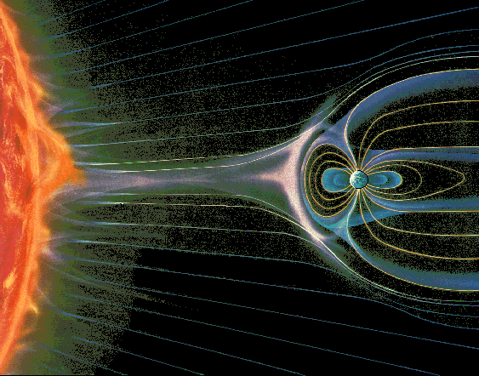
The Natural Space Radiation Environment
Galactic Cosmic Rays (GCRs)
Solar Protons &
Heavier Ions
Trapped Particles
Protons, Electrons, Heavy Ions
Depiction of the natural space radiation environment local to the Earth modified from K. Endo, Nikkei Science Inc. of Japan and J. L. Barth
DISTRIBUTION STATEMENT A. Approved for public release; distribution is unlimited.
Notes:
Presenter Notes
2025-06-03 15:00:05
--------------------------------------------
The natural space radiation environment is composed of solar particles, particles trapped in the Earth’s magnetic field, and galactic cosmic rays (GCR). These particles include electrons, protons, and every naturally-occurring element in the periodic table (also called Heavy Ions).
There are three general categories of high-energy particles found in the natural space radiation environment: Particles that are emitted from the Sun during solar particle events like solar flares and coronal mass ejections (CMEs) Background ions that originates outside our solar system, called galactic cosmic rays (GCR)

Slide 7
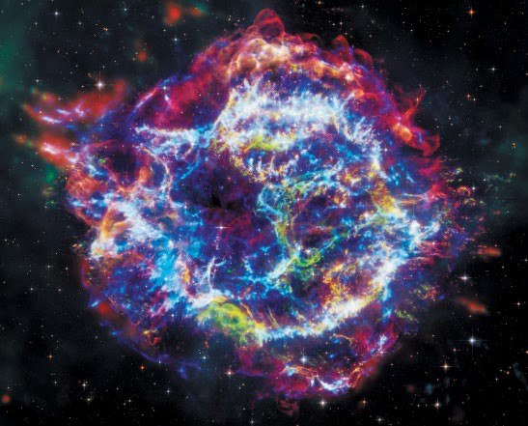
Sources of Natural Space Radiation Environment
Direct Source
GCRs
Supernova
Protons & Heavier Ions
Sun
CMEs
Solar Flares
Protons &
Heavier Ions
Coronal Mass Ejections (CMEs) Galactic Cosmic Rays (GCRs)
Depiction of the natural space radiation environment local to the Earth modified from K. Endo, Nikkei Science Inc. of Japan and J. L. Barth
DISTRIBUTION STATEMENT A. Approved for public release; distribution is unlimited.
Notes:
Presenter Notes
2025-06-03 15:00:06
--------------------------------------------
The natural space radiation environment is composed of solar particles, particles trapped in the Earth’s magnetic field, and galactic cosmic rays (GCR). These particles include electrons, protons, and every naturally-occurring element in the periodic table (also called Heavy Ions).
There are three general categories of high-energy particles found in the natural space radiation environment: Particles that are emitted from the Sun during solar particle events like solar flares and coronal mass ejections (CMEs) Background ions that originates outside our solar system, called galactic cosmic rays (GCR)

Slide 8
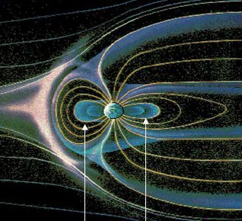
Sources of Natural Space Radiation Environment
Indirect Source
Trapped Particles
Protons, Electrons, Heavy Ions
Depiction of the natural space radiation environment local to the Earth modified from K. Endo, Nikkei Science Inc. of Japan and J. L. Barth
DISTRIBUTION STATEMENT A. Approved for public release; distribution is unlimited.
Notes:
Presenter Notes
2025-06-03 15:00:07
--------------------------------------------
The natural space radiation environment is composed of solar particles, particles trapped in the Earth’s magnetic field, and galactic cosmic rays (GCR). These particles include electrons, protons, and every naturally-occurring element in the periodic table (also called Heavy Ions).
There are three general categories of high-energy particles found in the natural space radiation environment: Particles that are emitted from the Sun during solar particle events like solar flares and coronal mass ejections (CMEs) Background ions that originates outside our solar system, called galactic cosmic rays (GCR)

Slide 9
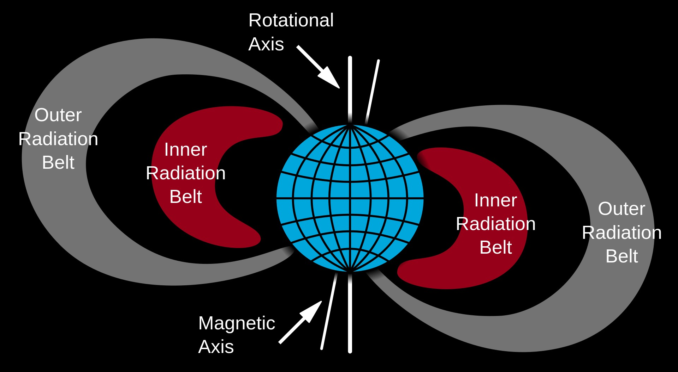
Radiation Belts
Trapped
Energetic Protons
Very stable over time
Energetic Electrons Dynamic: varies on weekly/monthly timescales
Different Orbits will sample different parts of the trapped environment
Courtesy Wikipedia

Slide 10
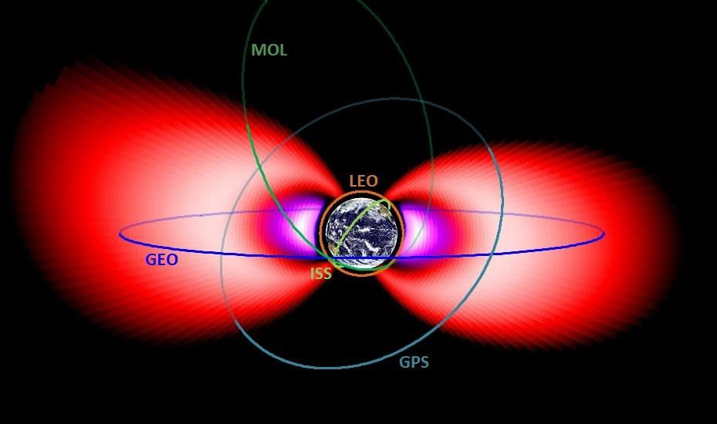
Radiation Belts

Slide 11
Section Topics/Outline
What are the sources of the natural space radiation environment?
What role does the Sun play on these environments?
‒ Source vs. Modulator
‒ Sunspots
‒ Solar Cycle
Why do environments matter?
Summary

Slide 12
Effects of the Sun on Space Environment
The Sun’s serves as both a producer and modulator of particles in the space environment
‒ Direct Source of:
‒ Protons and heavy ions
‒ Indirect Source of:
‒ Protons and electrons in Van Allen belts
‒ Modulator of:
‒ Galactic Cosmic Ray fluxes entering solar system
The solar cycle determines the frequency of solar events and which environments are most dominant
Source
Modulator
Notes:
Presenter Notes
2025-06-03 15:00:08
--------------------------------------------
As previously discussed, the sun acts as both a direct and indirect source of particle radiation. However, the sun’s magnetic activity also plays a significant effect on the radiation environment that earth experiences. The sun’s activity acts as a modulator of all energetic particles in the near earth region. What this means is that the sun’s solar activity not only determines the frequency of solar events such as solar flares but as also almost “regulates” which environment (GCRs or Solar Events) are most dominant. This makes the near earth portion of the space environment very dynamic at times.
The space environment’s dynamic behavior complicates environmental predictions for space missions and is one of the primary reasons that design margin is a necessity. Next

Slide 13
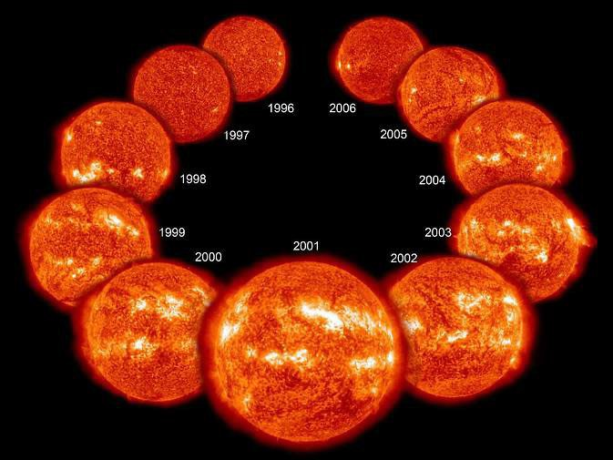
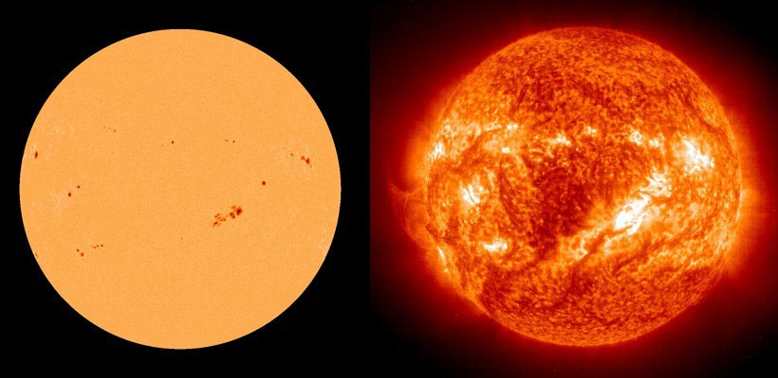
The Sun and It’s Effect on the Natural Space Environment
Sun is very active
‒ Sunspots are viewed as a proxy to solar activity
Region is cooler and appears darker when viewed in visible light
Visible Light
Ultraviolet Light
Credit: NASA
Images Taken Feb. 3, 2002 (Credit: ESA and NASA (SOHO))
Notes:
Presenter Notes
2025-06-03 15:00:08
--------------------------------------------
Sunspots are viewed as an indicator or proxy of solar activity. So, the more sunspots, the more active the sun is and vice versa.
The magnified image on the left was taken in visible light and you can see the sunspots as the darker spots. The image on the right was taken in ultraviolet light and this shows the active regions. When you compare two images, you see that the active regions correspond almost exactly to the regions of the sunspots. Next

Slide 14
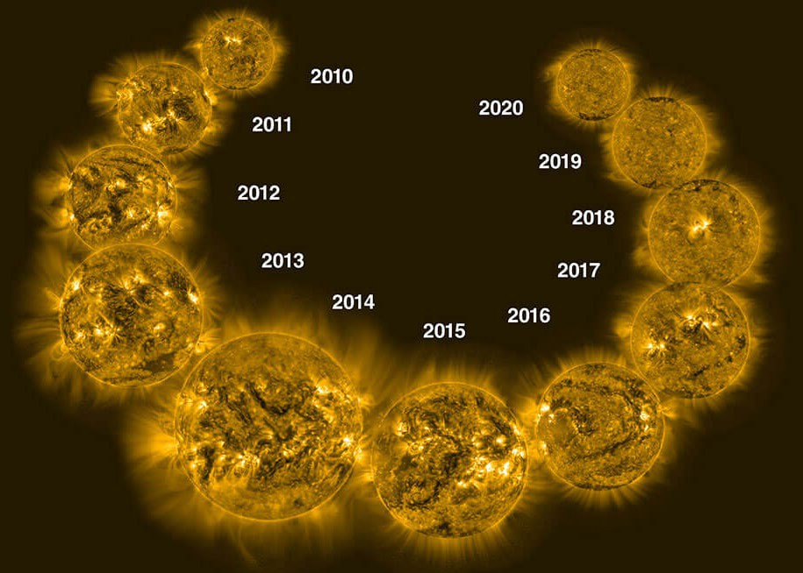
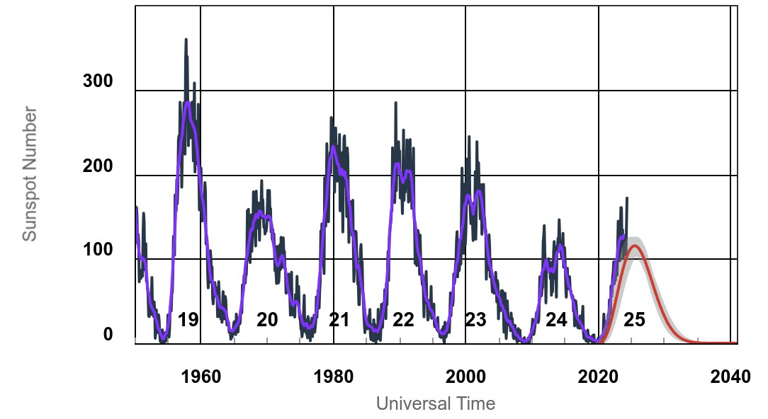
The Sunspot Cycle
Sun’s activity has a long-term, periodic behavior
Sunspot cycle indicates the sun’s magnetic activity levels
‒ Approximately 11 year cycle but can vary in amplitude and duration
‒ Solar maximum – typically 7-year period when activity levels are higher
‒ Solar minimum – typically 4-year period when activity levels are lower
Courtesy NASA
https://www.swpc.noaa.gov/
Courtesy NOAA/SWPC
Notes:
Presenter Notes
2025-06-03 15:00:09
--------------------------------------------
Solar activity has a fairly consistent periodic behavior. The solar cycle is approximately 11 years in duration. When the sun is most active this is called the solar maximum and lasts typically for 7 years. When the sun is less active this is called the solar minimum which lasts for about 4 years.
Fun fact, as you can see on the graph, we are at the peak of the solar maximum currently. And an even funner fact, is that Codie let me know that apparently there is supposed to be a large solar storm impacting earth tonight that should be visible in Indiana. So if you can find an area without light pollution you might be able to see the Auroa Borealis. I haven’t mentioned this yet but the Auroa Borealis or Northern Lights are the lights we can see when radiation particles (mainly electrons and protons) interact with the upper atmosphere. You can visit the space weather website for more details. Next

Slide 15
Section Topics/Outline
What are the sources of the natural space radiation environment?
What role does the Sun play on these environments?
‒ Active Environments (Solar Particle Events)
Why do environments matter?
Summary

Slide 16
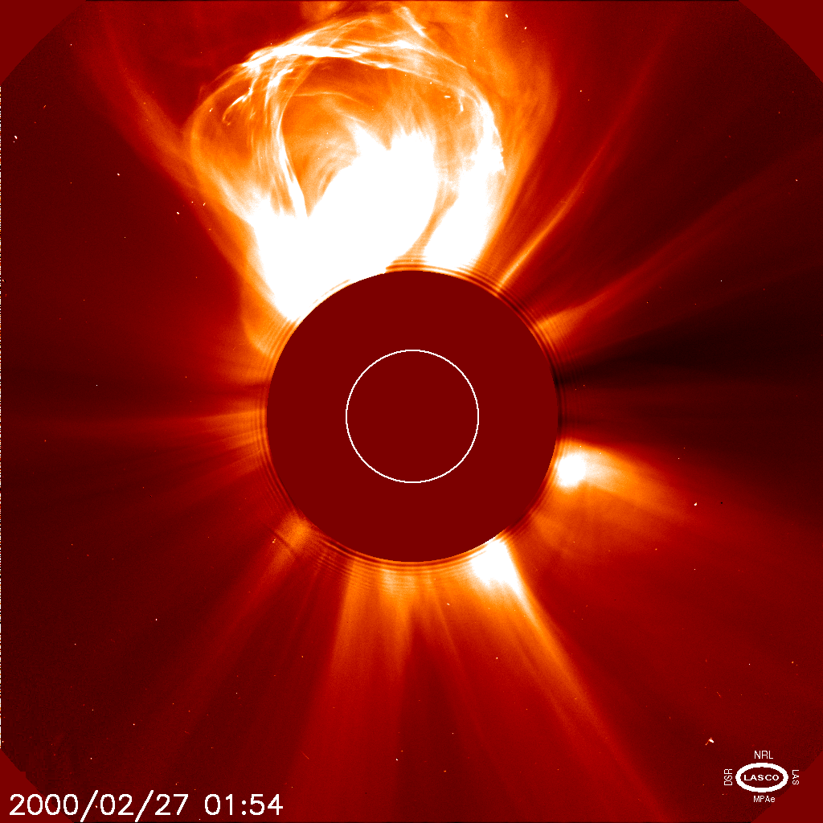
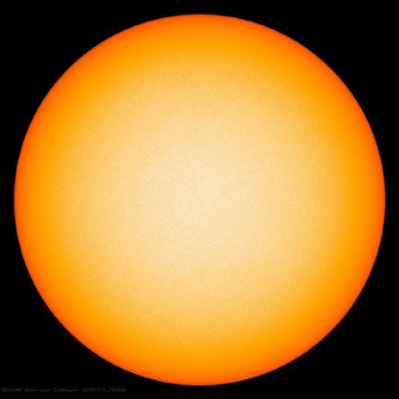
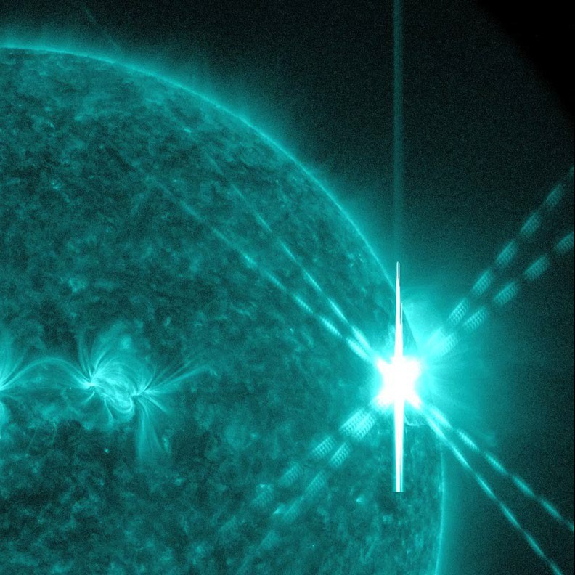
Solar Energetic Particles
Cyclical (Solar Max, Solar Min)
‒ 11-year average (9 to 13)
‒ Solar Max is more active period
Two types of events
‒ Coronal Mass Ejections (CMEs)
  More gradual
  Proton rich – 96%
  Responsible for major disturbances in Earth’s magnetosphere and interplanetary space
‒ Solar Flares
  Heavy ion rich
  Impulsive or spikes
Sun
Mass Emission
Electromagnetic
Emission
CME
Coronal Mass Ejections
Solar Wind
Solar Flares
Irradiance
(CMEs)
Solar Energetic Particles
Solar Flare
Image credits: NASA and ESA (SOHO and SDO)
Notes:
Presenter Notes
2025-06-03 15:00:10
--------------------------------------------
The sun produces mass emissions, namely Solar wind and Coronal Mass Ejections, and electromagnetic emissions, namely Solar Flares and Irradiance.
Coronal Mass Ejections and Solar Flares are the two types of solar events that are responsible for producing solar energetic particles which are primarily responsible for impacting electronics. Coronal Mass Ejections are proton rich -> are more gradual emissions -> and typically take hours to a few days to reach Earth
Solar flares are heavy ion rich and typically impulsive Next
Solar wind is always in the background, and then you have storms which can result in increased proton flux Irradiance is photons, all others particles

Slide 17
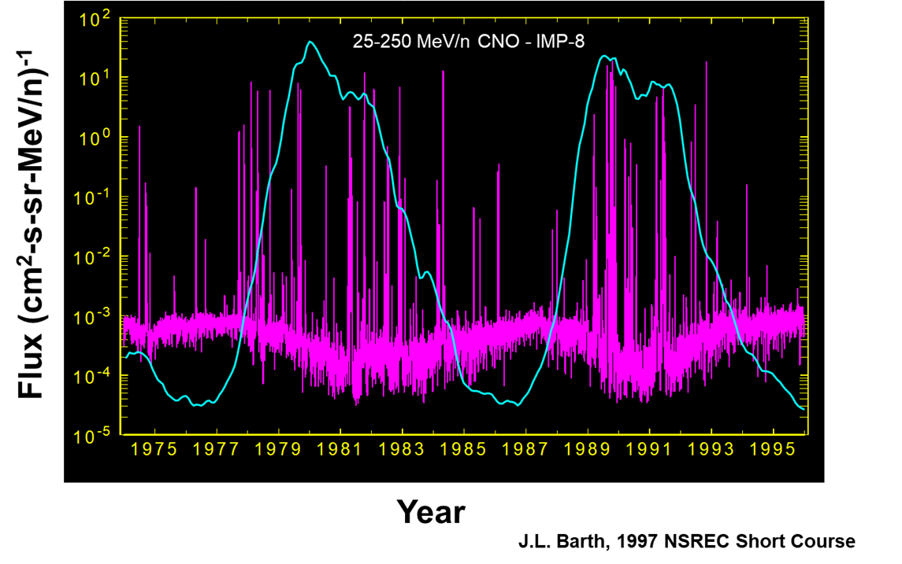
Solar Cycle Dependence
Solar Maximum
‒ Background (includes solar wind) levels lower
‒ Solar Events More Frequent & Greater Intensity
Solar Minimum
‒ Background (includes solar wind) levels higher
‒ Solar Events less frequent
  Does not mean not happening
Sun is a source of particle events
Notes:
Presenter Notes
2025-06-03 15:00:11
--------------------------------------------
As discussed previously the sun’s activity or solar cycle plays a role in determining the frequency of solar energetic particles. The graph shows the solar cycle, in blue, overlayed on top of particle events, in pink.
I hope you can see that during the Solar Maximum there is an increase in solar events and during Solar Minimum, there are fewer. However, I’d like to point out that just because the sun is less active, does not mean events aren’t happening. It’s also worth mentioning now that not all “big” events are earth facing.
We previously also talked about the Sun being a modulator. This graph shows what I meant. The more consistent pink concentration along the bottom is the background or Quiet environment, which is composed of Galactic Cosmic Rays and solar wind. You can see the increase in GCR influence in the environment during Solar Minimum and decrease during Solar Maximum. Next

Slide 18
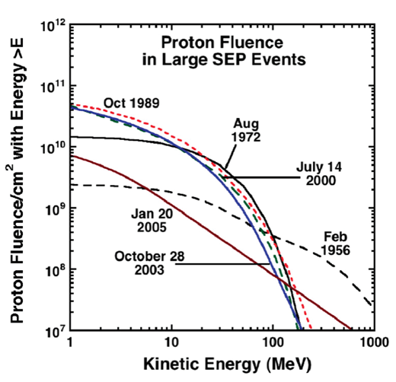
Worst Case Solar Particle Events
Most common approach is to design to a well-known large event
Events most often considered:
‒ October 2003
‒ October 1989
‒ August 1972
‒ Carrington Event 1859
Published ice core data not a reliable indicator of solar proton event magnitudes
Not used in design
First example being linked to impacts on the earth
Refer to Aerospace TOR-2022-00016 for best practices for generating space environment specifications with modern tools
R.A Mewaldt et al., Radiat. Risks., 2007
Notes:
Presenter Notes
2025-06-03 15:00:12
--------------------------------------------
I previously stated that the space environment’s dynamic behavior is one of the primary reasons that design margin is a necessity.
The most common approach when thinking about margin is to design to a well known large or Worst Case event. The graph on the right shows several events that are most often considered. Out of this list the October 2003 event is particularly interesting as it is the “most modern space age” event on this list, meaning the most satellites in orbit with the most advanced technology to date, hence comparatively lots of anomalies. You’ll note I’ve also listed the Carrington Event of 1859 on this list. Click. However, it is not used when determining design margin. I’ve listed it because it’s fascinating to me as one of the first recorded examples of a solar storm impacting earth. You should google it.
Finally, for far more detail on best practices for generating space environment specifications I’d recommend referring to the Aerospace TOR “Best Practices for Generating Space Environment Specifications with Modern Tools” Next
Design margins are tied less to environment than mission classification (more to come)
Design margin = Confidence level around the environment (I’m 95% confident I won’t exceed) + margin on the technology using ->

Slide 19
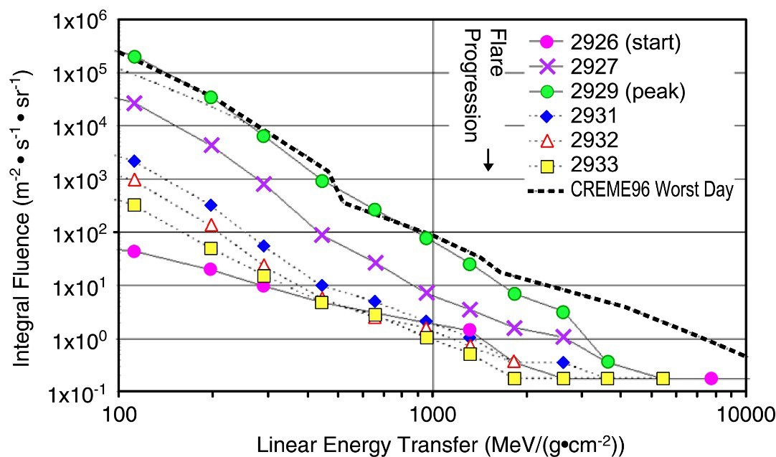
Worst Case Solar Particle Event Model
CREME96
Standard CREME96 model based on October 1989 event
‒ Peak 5 minutes
‒ Worst day
‒ Worst week
Incorporated into suite of codes including orbit generator, magnetic and material shielding
Useful for both protons and heavy ions
C.S. Dyer et al., IEEE TNS, Dec. 2002
Notes:
Presenter Notes
2025-06-03 15:00:12
--------------------------------------------
The most common model used to model solar particle events is called CREME96.
This model is based on the October 1989 event and helps determine various worst cases (peak 5 minutes, worst day, worst week, etc).
I’m not going to go very deep on this subject but I did want to make mention of this as the CREME96 model is what you will be using in the SPENVIS activities that follow this presentation today and later in the week. Next

Slide 20
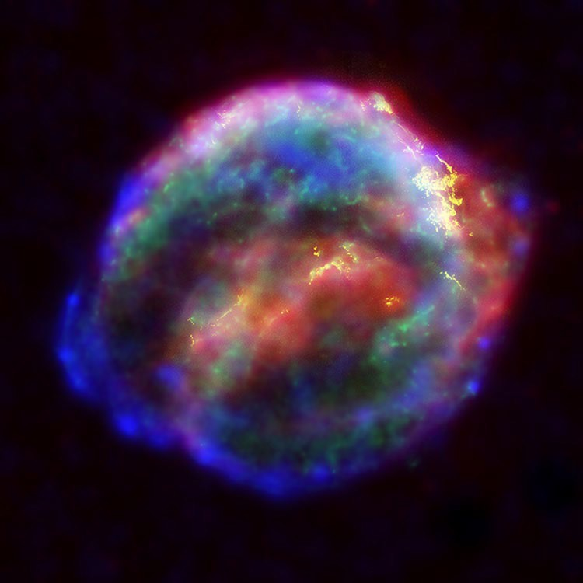
Section Topics/Outline
What are the sources of the natural space radiation environment?
What role does the Sun play on these environments?
‒ Quiet Environments (Galactic Cosmic Rays)
Why do environments matter?
Kepler’s 1604 Supernova Remnant
Summary
Credit: NASA, ESA & JHU APL (Chandra, Hubble and Spitzer)

Slide 21
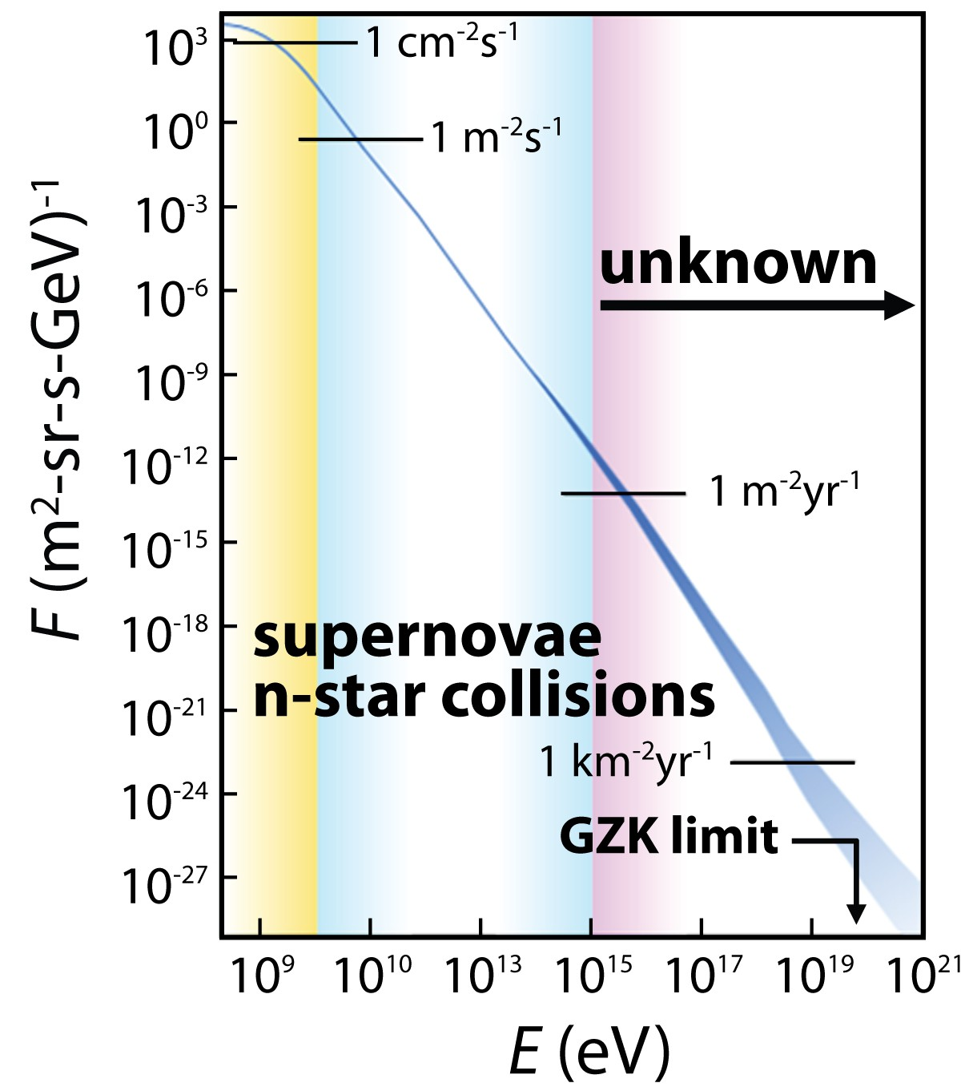
Galactic Cosmic Rays
Composed of all naturally occurring elements
‒ 90% hydrogen
‒ 9% helium
‒ 1% heavier ions
For GCR energies < 10¹⁵ electronvolt (eV):
‒ Mainly attributed to supernovae within Milky Way galaxy and neutron star collisions
‒ Most significant for effects on electronics
For GCR energies > 10¹⁵ eV:
‒ Unknown origin, especially highest energies
High energy ≠ bad
‒ Energy loss by a particle in material is key metric
CERN
not amount of energy
1
NASA Space
Ground Simulators
Radiation Lab
Data from S. Swordy, Space Sci. Rev., Oct. 2001
Notes:
Presenter Notes
2025-06-03 15:00:14
--------------------------------------------
Once more, galactic cosmic rays are ions that originate outside of our solar system.
Galactic Cosmic Rays are primarily comprised of lighter ions such as protons (hydrogen) with only 1% being made up of heavier elements.
Earlier I noted that GCRs originate from exploding stars, called supernova. I called these out because they are the most significant contributor to effects on electronics. But as you can see on the graph, there are GCRs that also originate from other start types called n-star as well as some origins being unknown.
On the graph you’ll notice that I’ve added to Ground Simulators of radiation, the NASA Space Radiation Lab and CERN. I wanted to give some context to energy levels produced by GCRs in comparison to what these facilities can produce on Earth. The NASA Space Radiation Lab was designed and built to simulate the GCR spectrum and is the highest energy radiation facility in the country…Dr. Loveless will talk more on this subject on his facility basics brief. Next Flux is plotted on the y-axis (which is the rate of beam particles passing through a unit area)
Particle energy is plotted on the x-axis

Slide 22
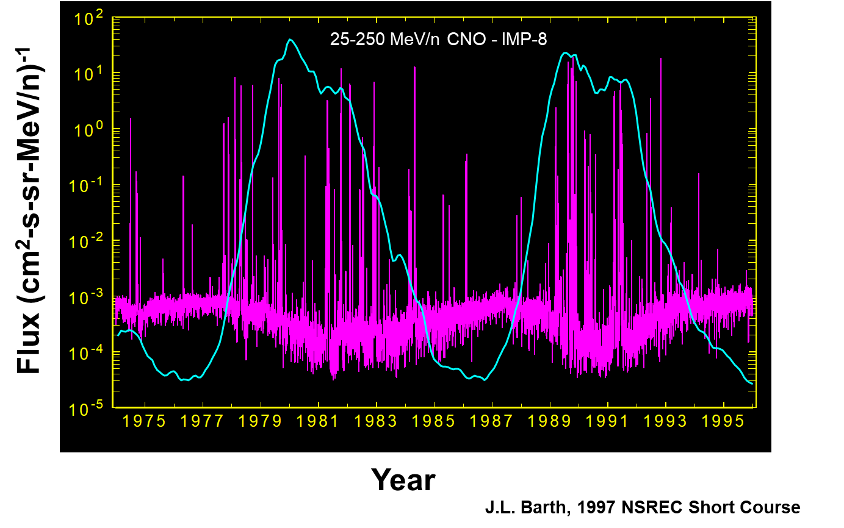
Solar Cycle Dependence
Solar Maximum
‒ Background (includes solar wind + GCRs) levels lower
Solar Minimum
‒ Background (includes solar wind + GCRs) levels higher
Sun modulates GCRs entering the solar system
Notes:
Presenter Notes
2025-06-03 15:00:15
--------------------------------------------
Just a quick reminder that the Sun modulates other environments and in this case Galactic Cosmic Rays.
Once more the thick pink line at the bottom of the graph shows this background or quiet environment which GCRs makes up. And once more during Solar Max, GCRs go down, and during Solar Min, GCRs go up.
Next

Slide 23
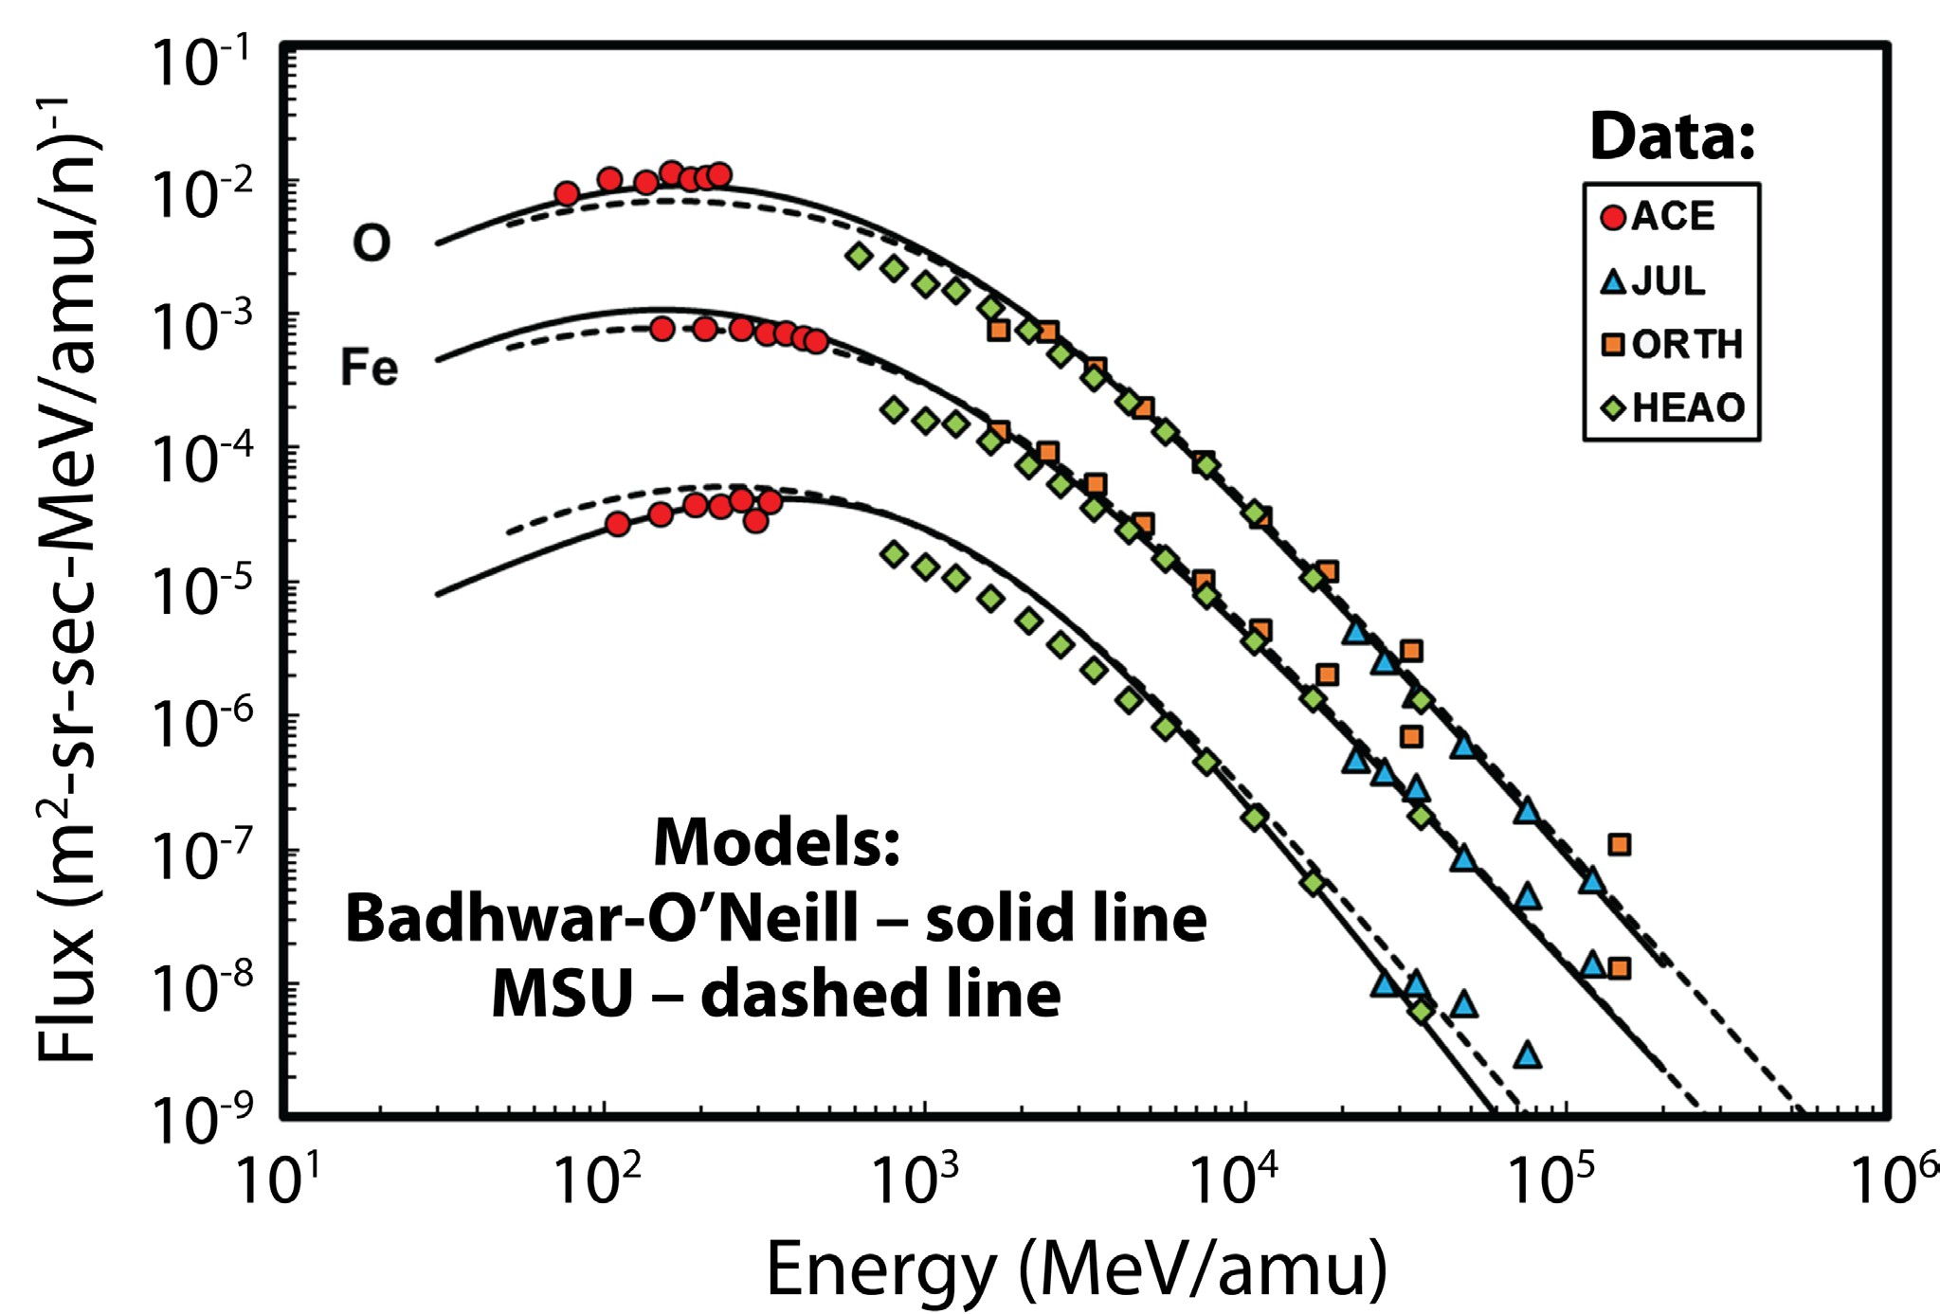
Models
Two popular models are used for SEE that parameterize solar modulation using sunspot numbers
MSU (Nymmik) model used in Cosmic Ray Effects in MicroElectronics-1996 (CREME96)
‒ Integrated with suite of programs for SEE rate calculation, including spacecraft orbit dependence
Badhwar – O’Neill 2020 Model
‒ Incorporates broader and more recent data base
₎-1
P
P.M. O’Neill, S. Golge and T.C. Slaba, NASA Tech. Paper, March 2015
Notes:
Presenter Notes
2025-06-03 15:00:17
--------------------------------------------
I’d like to briefly mention that there are are two popular models used to model GCRs.
Once more CREME96 is one and the other is the Badhwar – O’Neill 2020 Model which incorporates more recent data. For future activities in this workshop we will once more be using CREME96.
Next

Slide 24
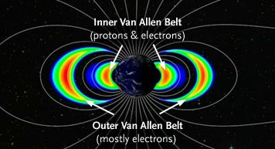
Section Topics/Outline
What are the sources of the natural space radiation environment?
What role does the Sun play on these environments?
‒ Quiet Environments (Trapped Radiation)
Why do environments matter?
Summary

Slide 25
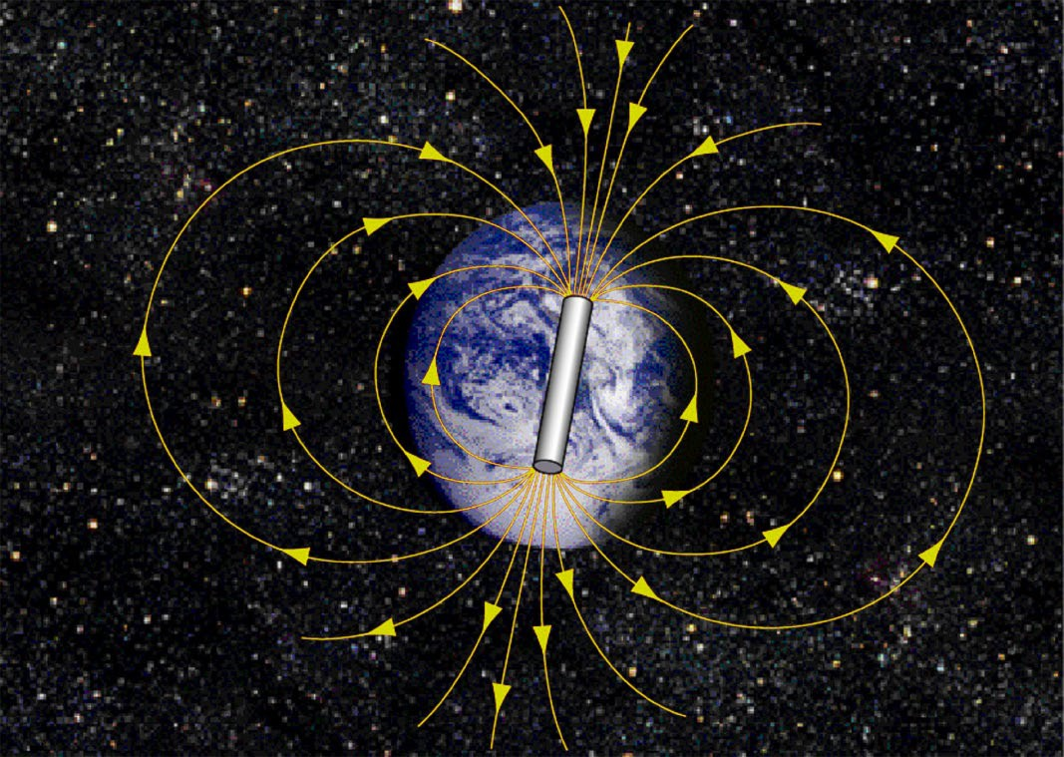
Earth’s Internal Magnetic Field
The Earth has both internal and external magnetic fields that make up its magnetosphere
Internal geomagnetic field is approximately dipolar for altitudes up to about 4 to 5 Earth radii
Dipole axis is not same as geographic North-South axis
‒ 11.5 degree tilt
‒ ~500 km displacement
Trapped particle populations conveniently mapped in dipole coordinate systems
The internal magnetic field of the Earth is approximately a dipole field, which can trap both protons and electrons
Notes:
Presenter Notes
2025-06-03 15:00:18
--------------------------------------------
The Earth has both internal and external magnetic fields that make up its magnetosphere. The external field is the result of the solar wind. The internal field originates from within the Earth and is approximately dipolar up to altitudes of about 5 Earth radii. For the non-physics people like me, dipolar refers the separation of positive and negative charges or magnetic poles. This can be described as having one side of an object or system with a positive charge and the other side with a negative charge.
This dipole field is tilted about 11° from the Earth’s north-south axis and displaced by more than 500 km from the Earth’s geocenter. This tilt of dipole creates an anomaly that I’ll talk about soon.
Finally trapped particles are mapped according to this dipole coordinate system. Next

Slide 26
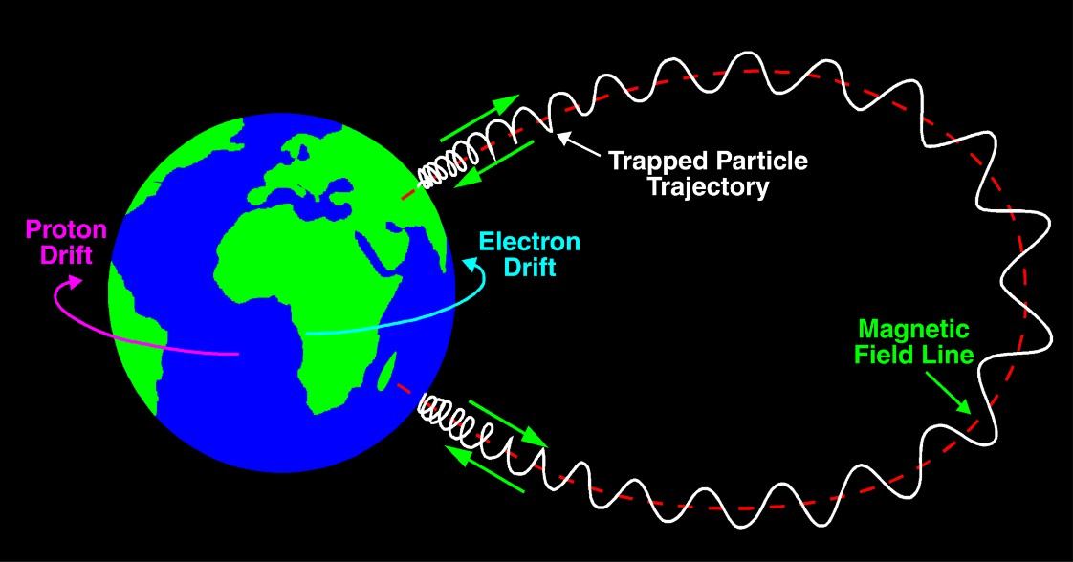
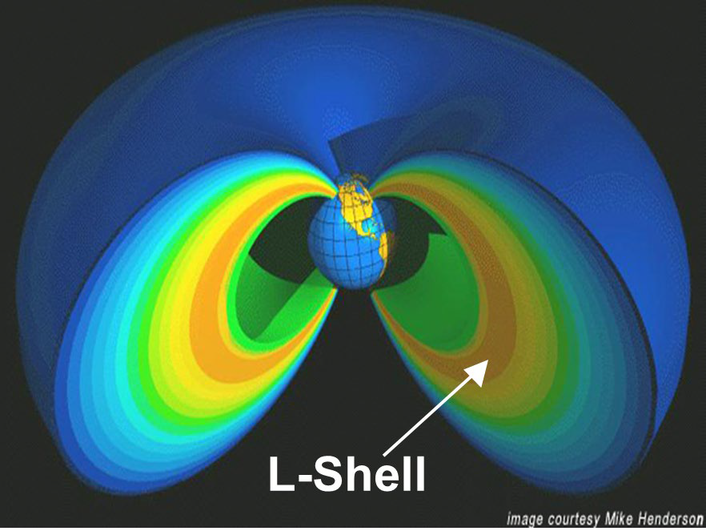
Trapped Charged Particle Motion and
L-Shells
Protons and electrons trapped in these magnetic field lines drift around the Earth and spiral along these field lines
‒ A complete azimuthal rotation of particle is called a drift shell or L-shell
L-shell parameter indicates magnetic equatorial distance from Earth’s center in number of Earth radii (6371 km) and represents the entire drift shell
Van Allen Belts
Notes:
Presenter Notes
2025-06-03 15:00:19
--------------------------------------------
Protons and electrons trapped in these magnetic field lines – which are called the Van Allen Belts – drift around the Earth and spiral along these field lines forming so-called “drift shells” or L-shells. An L-shell equates to
Increased field strength in polar region causes particle spiral to tighten and eventually reverse direction along magnetic field line at “mirror point”

Slide 27
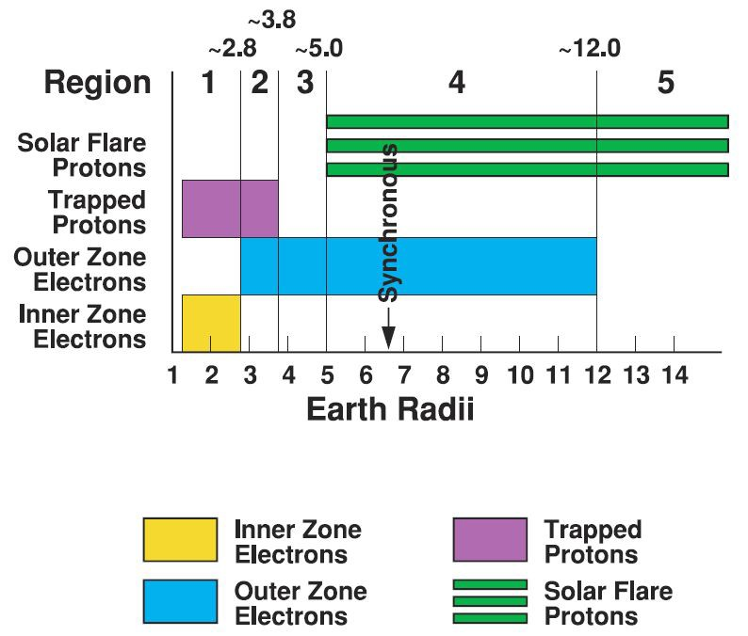
Charged Particle Distribution
An L-shell contains a subset of trapped particles peaked at a certain energy moving throughout this shell
‒ Provides convenient global parameterization for a complex population of particles
Each L-shell has a unique environment that must be accounted for in the design of a system
Earth Radii (RE) = 6371 km
Charged particle distribution in the magnetosphere as a function of Earth radii. This figure was adapted by J. R. Schwank and colleagues after the original
Notes:
Presenter Notes
2025-06-03 15:00:20
--------------------------------------------
The figure on the right shows charged particle distribution throughout the L-shells. Two things to point out:
The L-shells contain a subset of trapped particles moving throughout the shell and are generally lumped into two distinct regions, an Inner belt and an Outer belt. The inner belt contains both protons and electrons.
The outer belt consists primarily of electrons but does also see protons from solar flares.
As you can see each L-shell has a unique environment, with unique particles that have different effects, so you have to account for this is system design accordingly. Next
Region = L-Shell? 6.5 Sync = GEO?

Slide 28
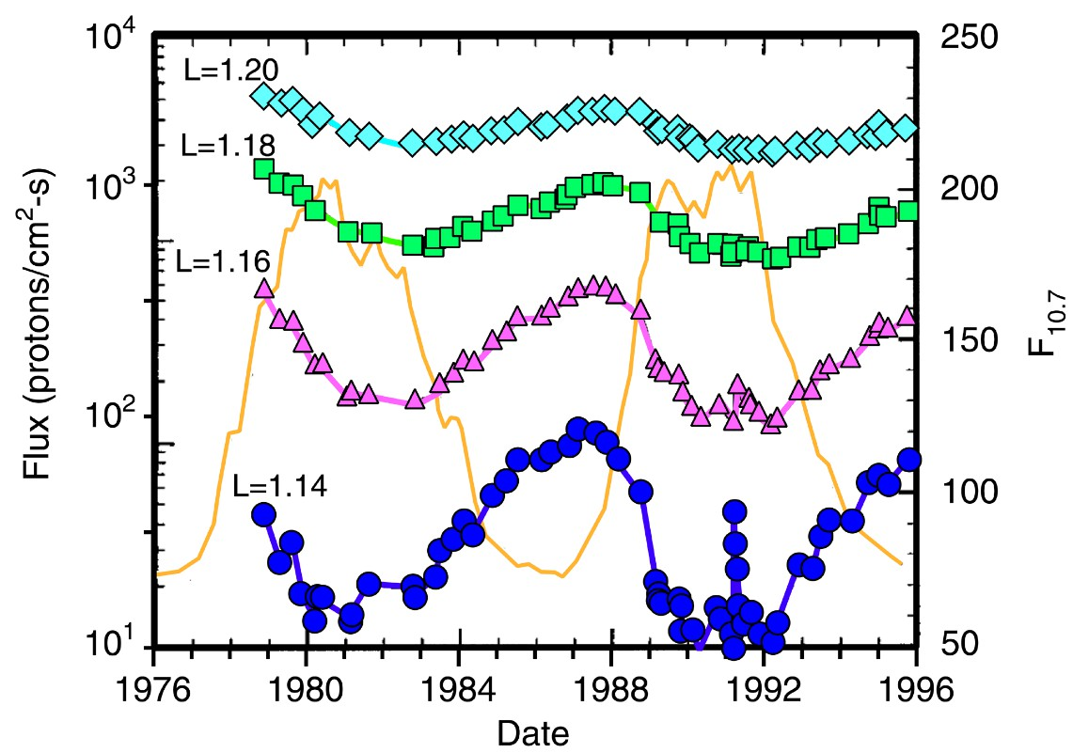
Solar Cycle Dependence
Proton fluxes generally anti- correlated with solar cycle activity
‒ Most pronounced near belt’s inner edge
During solar maximum
‒ Increased loss of protons in upper atmosphere
‒ Decreased production of protons from Cosmic Ray Albedo Neutron Decay (CRAND) process
S.L. Huston and K.A. Pfitzer, IEEE TNS, Dec. 1998
Notes:
Presenter Notes
2025-06-03 15:00:20
--------------------------------------------
Once more, I want to emphasize that the Sun acts as a modulator. You can see this on the graph on the right which shows the trapped proton environment in the light blue, green, pink, and dark blue colors superimposed on the solar cycle which is in that yellowish/orange color. Unfortunately I’m introducing a term here, flux, that is going to be explained in greater detail in Steve and Daniel’s talk later on today and tomorrow but in brief, Flux = number of particles passing through a surface per second…or another way to think of it is particle intensity.
So as solar activity increases, you can see that the proton flux in the trapped environment decreases. Also take note of the variation in flux within the inner proton belt. Also remember that as solar activity increases, you’re going to see GCRs influence decrease. The takeaway is that the trapped environment is not static or uniform and requires modeling to determine the specific environment you are designing your mission to live in. Next. When designing space craft for trapped environment, this is why we model at Solar Min.

Slide 29
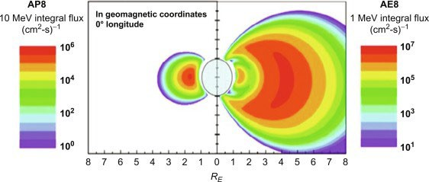
Trapped Proton and Electron Properties
Protons
‒ Single trapped proton region for “quiet” conditions
‒ Earth’s atmosphere limits belt to altitudes above
~200 km
Radiation belt fluxes during solar maximum
Equatorial Distance (Earth Radii) RE = 6371 km
Electrons
‒ Single trapped proton region for “quiet” conditions
‒ Earth’s atmosphere limits belt to altitudes above
~200 km
‒ > 10 MeV flux peaks at L-shell = 1.8 and extends to about 4.
‒ Energies up to ~GeV
‒ Nuclear reaction products from incident protons can have LET values up to 20 MeV-cm2/mg.
‒ > 10 MeV flux peaks at L-shell = 1.8 and extends to about 4.
‒ Energies up to ~GeV
‒ Nuclear reaction products from incident protons can have LET values up to 20 MeV-cm2/mg.
Notes:
Presenter Notes
2025-06-03 15:00:21
--------------------------------------------
Before I talk about this chart, I do want to point out that unfortunately I did not catch a pretty big copy and paste error, so the information under Electrons is not correct. I decided to leave this chart in the deck though because I wanted you to have a visual of what the trapped environment really looks like rather than a bar graph that I showed previously.
You can clearly see an inner trapped proton belt. The inner belt protons have energies up to about a Giga-electronvolt but you’ll note that this graph is plotted for protons only up to 10 Mega-electronvolts (MeV). When I’ve asked about this value in the past, I have been told that above 10 MeV is where devices typically become susceptible to single event effects -> below 10 MeV particles typically doesn’t penetrate packages on devices. 10 MeV protons are found between roughly L-shell 1.8 to 4. Moving on to the electron belts. Trapped electrons have energies up to 10 MeV and exist in two L-shell regions, an inner and outer belt. The inner belt is between L-shell 1 and 2.8 and the outer belt is between L-shell 2.8 and about 10. Note that electron belts are being plotted for 1 MeV electrons. This is because the equivalent dose damage (associated with Total Ionizing Dose effects…more to come this afternoon) occurs at 1 MeV electrons.
Finally, I want to draw your attention to the bottom of both the proton and electron inner belts. Notice how the belts appear to get closer to Earth near the bottom. Next

Slide 30
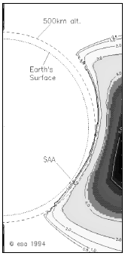
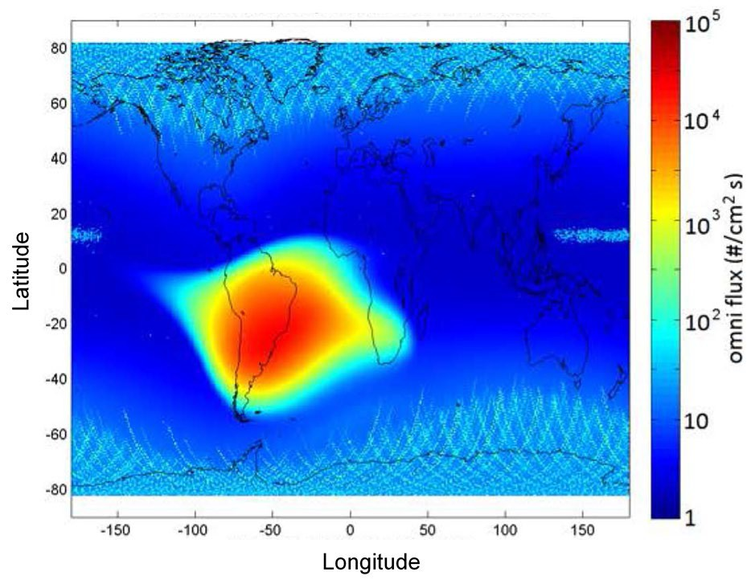
Trapped Proton Properties
South Atlantic Anomaly
Phenomenon caused by tilt and shift of geomagnetic axis relative to rotational axis
Inner edge of proton belt is at lower altitudes in vicinity of South America
Generally dominates the radiation environment for altitudes less than about 1000 km
SAA
W.R. Johnston et al., IEEE TNS, Dec. 2015
Notes:
Presenter Notes
2025-06-03 15:00:22
--------------------------------------------
This is due to a phenomenon called the South Atlantic Anomaly. The 11.5 degree tilt and offset that I talked about earlier causes this. The SAA is most pronounced in the vicinity of South America and generally dominates the radiation environment for altitudes less than 1000 km. Next. Switch off satellites as they cross the SAA
Flux = High number of particles / particle intensity

Slide 31

Trapped Proton and Electron Models
Modeling Tool
Trapped Environment Models
AP8/AE8
  Static model for mean environment
  Based on data from 1960s and 1970s
  Approximate solar cycle dependence
    Solar maximum
    Solar minimum
AP9/AE9/IRENE
  Statistical model for mean or percentile environment
  Perturbed model adds measurement uncertainty and gap-filling errors
  Monte Carlo adds space weather variations
  Based on data from 1976 – present
    ~10x that of AP8 based on instrument years
  Output averaged over solar cycle
General approach
‒ Use an orbit generator code to calculate geographical coordinates (latitude, longitude, altitude)
‒ Transform the geographical coordinates to dipole coordinate system in which particle population is mapped
‒ Determine trapped particle environment external to spacecraft
Notes:
Presenter Notes
2025-06-03 15:00:23
--------------------------------------------
There are several models that have been developed to model the trapped environment: AP8/AE8, AP9/AE9/IRENE. There are several key differences but the main difference between the is more and newer data used to anchor the A9/IRENE models. Justin will be walking you through how to model the environment with a tool called SPENVIS after this module and will touch on why he is using one model versus the others. Next.

Slide 32
Section Topics/Outline
What are the sources of the natural space radiation environment?
What role does the Sun play on these environments?
‒ Active Environments
‒ Quiet Environments
Why do environments matter?
Summary

Slide 33
Why do environments matter?
Products
System(s)
Subsystem(s) Device(s)
Material(s)
Notes:
Presenter Notes
2025-06-03 15:00:24
--------------------------------------------
Engineers build products of varying levels. For instance, one engineer may build a rocket which would be a system made up of many subsystems such as a Flight Computer which is made up of many devices such as a memory which is made up of different materials. Next

Slide 34
Why do environments matter?
Products
System(s)
Subsystem(s) Device(s)
Material(s)
Function
Perform some type of action to achieve a mission with some type of confidence
Notes:
Presenter Notes
2025-06-03 15:00:24
--------------------------------------------
These products perform some type of function which I’m defining as performing some type of action to achieve a mission with some type of confidence. Next

Slide 35
Why do environments matter?
Environments
Products
System(s)
Subsystem(s) Device(s)
Material(s)
Function
Perform some type of action to achieve a mission with some type of confidence
A products mission (and its criticality) determines environments of interest
Notes:
Presenter Notes
2025-06-03 15:00:25
--------------------------------------------
Products do not funtion in vacuums, they operate in environments.

Slide 36
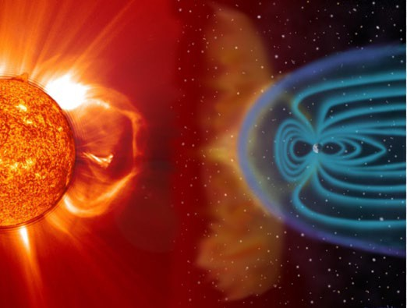
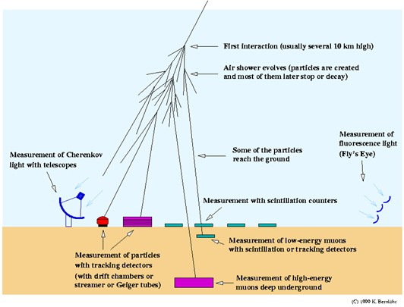
Why do environments matter?
Environments
Exoatmospheric
Products
System(s)
Subsystem(s) Device(s)
Material(s)
Function
Perform some type of action to achieve a mission with some type of confidence
Natural
Manmade
~100 km
Endoatmospheric
Natural
Manmade
Notes:
Presenter Notes
2025-06-03 15:00:25
--------------------------------------------
Environments can span from the surface of the earth to space. In context of the space radiation environment, altitudes above 100 km are considered exoatmospheric, which once more is where the focus of this workshop is going to be. Next

Slide 37
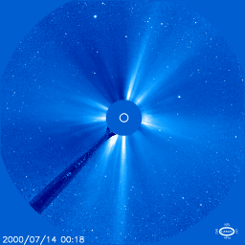
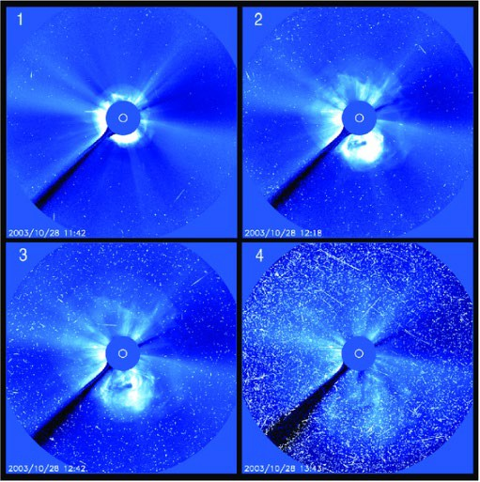
Why do environments matter?
SOHO/LASCO imager during Jul 14, 2000 solar particle event
SOHO/LASCO imager during Oct 28, 2003 solar particle event
[Credit: ESA/NASA/NRL]
Environments -> produce effects -> can cause malfunctions -> impact mission success?
Notes:
Presenter Notes
2025-06-03 15:00:26
--------------------------------------------
The video and images displayed are of a sensor called the Solar and Heliospheric Observatory/Solar and Heliospheric Observatory sensor. The SOHO is focused on observing the Sun, particularly its corona and solar wind. The video on the left shows a Solar Particle Event which you can see causes great distortions in the pixels.
Environments produce effects on products that can cause malfunctions. Depending on what malfunctions, this can be catastrophic to your mission. Justin will be talking more on mission success in his presentation tomorrow. Bottom line, if you’re operating in space, you’re going to encounter varying radiation environments and need to plan accordingly. Next.

Slide 38
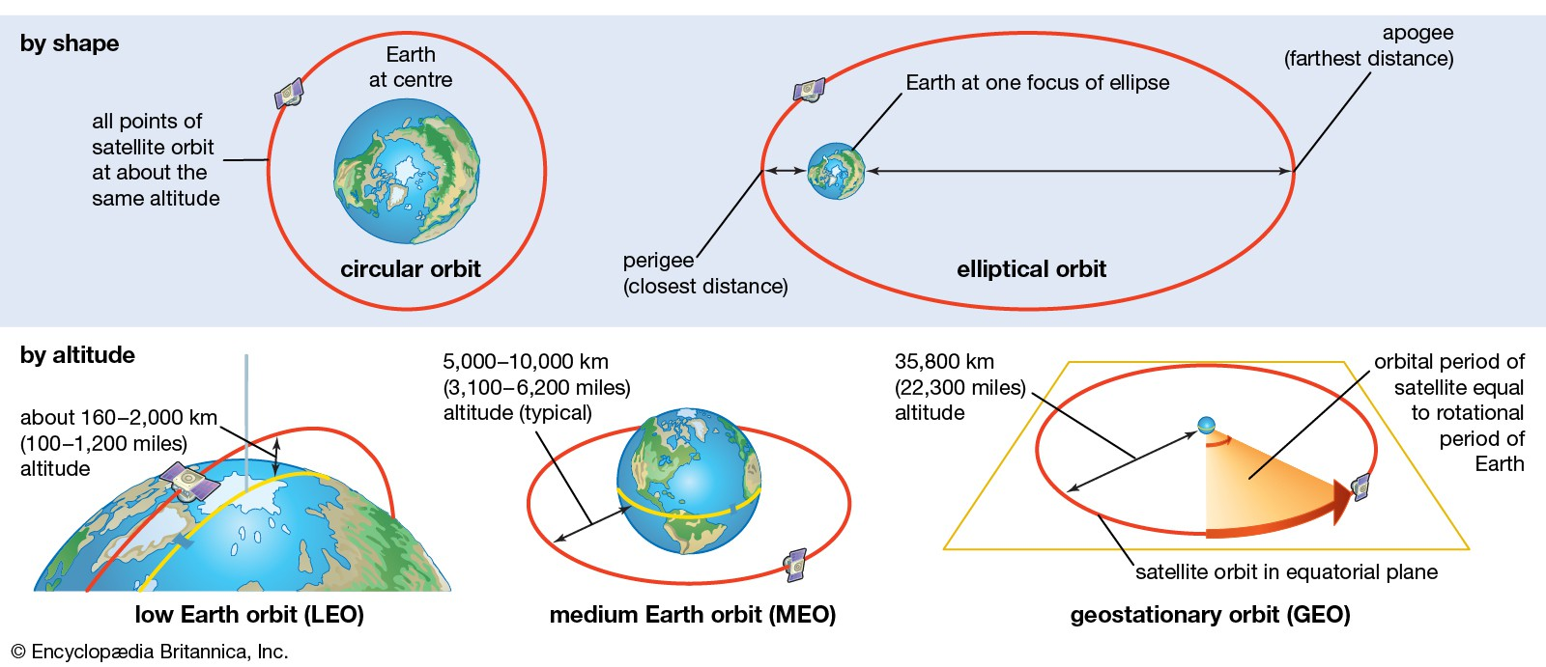
Section Topics/Outline
What are the sources of the natural space radiation environment?
What role does the Sun play on these environments?
Why do environments matter?
‒ Environmental impacts on common orbit regimes
Summary

Slide 39
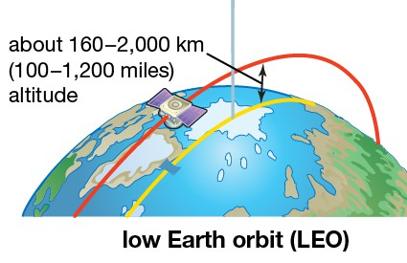
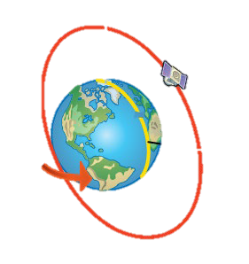
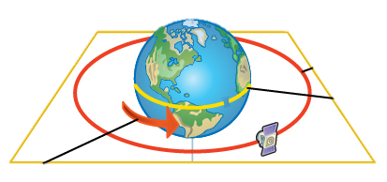
Effect of the Environment on Mission
Low Earth Orbit (LEO)
 | Levels |  | Orbits
Env | Solar Max | Solar Min | LEO (Low Inc) | LEO (Polar)
Trapped Electron | Higher | Lower | Moderate | Moderate
Trapped Protons | Lower | Higher | Yes | Yes
Solar Particle | More Frequent | Less Frequent | No | Yes
GCRs | Lower | Higher | Moderate | Yes
Low Inclination
Polar
Modeling and simulation is required to specify the environments
Notes:
Presenter Notes
2025-06-03 15:00:27
--------------------------------------------
Low Earth Orbits (LEO) are generally those less than 3,000 km. I’ve listed two LEO orbits, a low inclination (equatorial) and a polar inclination (or 90 degree) orbit.
Systems traversing a Low Inc LEO orbit are close to the equator. So lets walk through are various environments. With this orbit you’re going to be well within the Van Allen Belts which will be providing protection from Solar Particles as well as minimal exposure to GCRs. The environment that is really dominating this regime is your trapped protons, in particular from the South Atlantic Anomaly. Now let’s look at Polar. We’re still going to see roughly the same trapped environment but notice how Solar Particles and Galactic Cosmic Rays are now playing a greater factor. This is because this orbit will move across the poles where there Van Allen Belts come to a point. So systems are going to be exposed to solar protons and GCRs over the poles.
Finally to drive this home, notice that these environments are changing depending on the solar activity. Next.

Slide 40
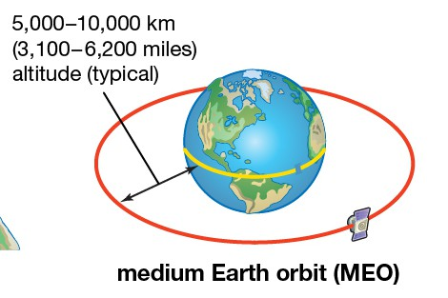
Effect of the Environment on Mission
Medium Earth Orbit (MEO)
 | Levels |  | Orbits
Env | Solar Max | Solar Min | MEO
Trapped Electron | Higher | Lower | Severe
Trapped Protons | Lower | Higher | Severe
Solar Particle | More Frequent | Less Frequent | Yes
GCRs | Lower | Higher | Yes
Modeling and simulation is required to specify the environments
Notes:
Presenter Notes
2025-06-03 15:00:28
--------------------------------------------
Medium Earth Orbits (or MEO) range between roughly 3,000 to ~35 km.
Systems traversing a MEO orbit should expect to see a severe hazard from trapped radiation and are going to see more impacts as well from both solar particles and GCRs. Once more which environments are most dominate will also depend on where you are in the solar cycle.

Slide 41
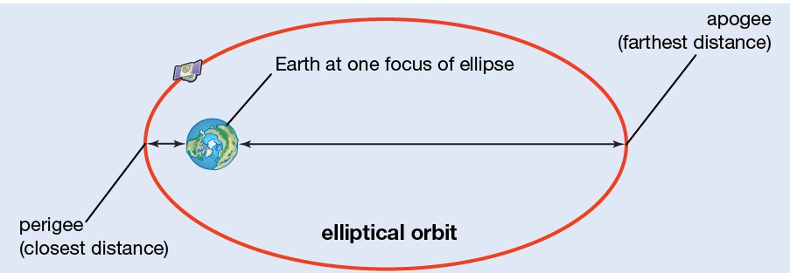
Effect of the Environment on Mission
Highly Elliptical Orbit (HEO)
 | Levels |  | Orbits
Env | Solar Max | Solar Min | HEO
Trapped Electron | Higher | Lower | Yes
Trapped Protons | Lower | Higher | Yes
Solar Particle | More Frequent | Less Frequent | Yes
GCRs | Lower | Higher | Yes
Modeling and simulation is required to specify the environments
Notes:
Presenter Notes
2025-06-03 15:00:29
--------------------------------------------
As the name suggests Highly Elliptical Orbits (or HEO) are orbits that are elliptical in shape rather than circular and off center of earth.
Systems traversing a HEO orbit should expect to see a severe hazards from all environments but truly this is going to depend on the furthest distance the system is from Earth (or apogee) and the closest distance the system is to earth (or also called perigee). Generally speaking though, one would expect a HEO system to pass through the inner belt near perigee, and be exposed to solar particle events and GCRs at apogee.
Next

Slide 42
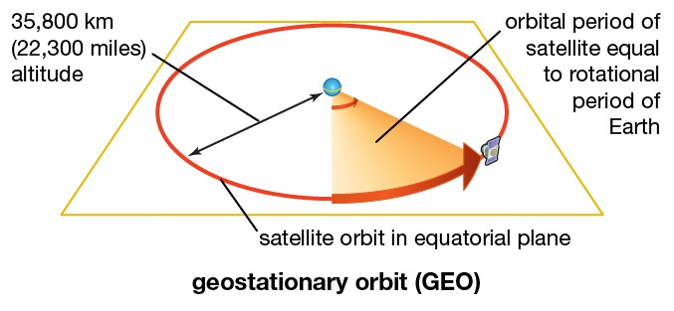
Effect of the Environment on Mission
Geosynchronous Orbit (GEO)
 | Levels |  | Orbits
Env | Solar Max | Solar Min | GEO
Trapped Electron | Higher | Lower | Severe
Trapped Protons | Lower | Higher | No
Solar Particle | More Frequent | Less Frequent | Yes
GCRs | Lower | Higher | Yes
Modeling and simulation is required to specify the environments
Notes:
Presenter Notes
2025-06-03 15:00:30
--------------------------------------------
Geosynchronous Orbits (or GEO) are at an altitude of 35,856 km.
Systems traversing a GEO orbit will not see a trapped proton environment but will see a severe trapped electron environment and once more be exposed to solar particle events and galactic cosmic rays. Once more which environments are most dominate will also depend on where you are in the solar cycle.

Slide 43
Section Topics/Outline
What are the sources of the natural space radiation environment?
What role does the Sun play on these environments?
Why do environments matter?
Summary
‒ Environment Sources
‒ Effect of the Sun on the Environments
‒ Effect of the Environment on Missions

Slide 44
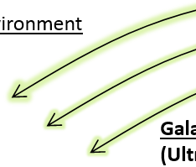
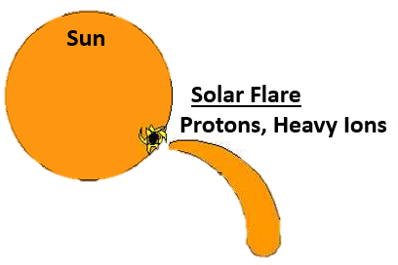
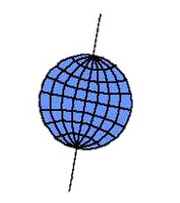

Summary
Sources of Radiation Near Earth
Other Stars / Supernova
2
1
Earth
Radiation comes from the Sun and/or other stars/supernova in the galaxy
Notes:
Presenter Notes
2025-06-03 15:00:31
--------------------------------------------
Earth sits in the natural space environment. The natural space environment is comprised of radiation. Next
The sun acts as 1 direct source of the radiation environment, producing solar particle events, to include solar flares and coronal mass ejections, that produce solar energetic particles, such as electrons, protons, and heavy ions. Next The other direct source of the radiation environment are supernova/other stars which are producing Galactic Cosmic rays which produce similar particles as the sun. Next

Slide 45
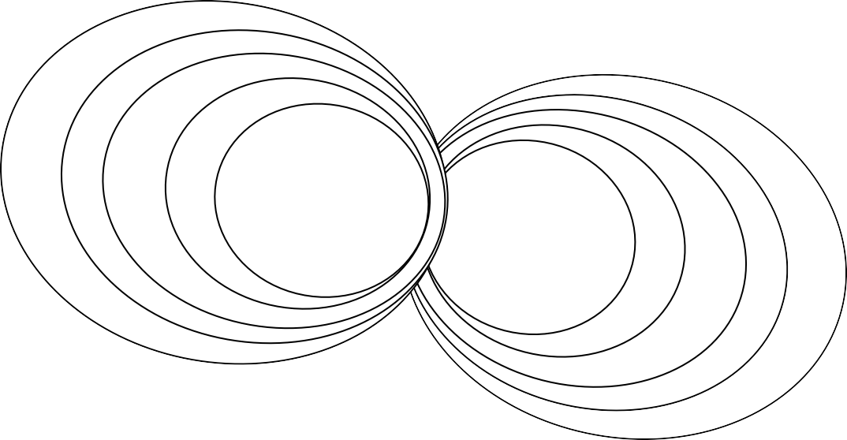
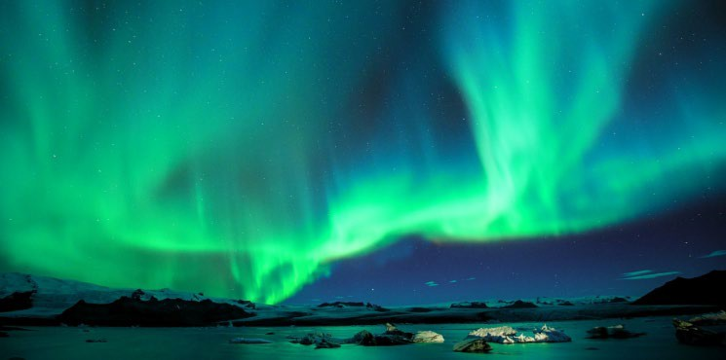
Summary
Sources of Radiation Near Earth
Van Allen Belts
Other Stars / Supernova
2
1
Earth
Earth is surrounded by a magnetic field called the Van Allen Belts that trap some radiation from the Sun and/or other stars
Notes:
Presenter Notes
2025-06-03 15:00:33
--------------------------------------------
But the Earth is not simply being bombarded from these two sources.
The Earth has a magnetic field around it, called the Van Allen Belts. Some particles will reach Earth still, but…Next Others will go around…Next
Others will enter at the poles, which is why we the Auroa Boreallis or Northern Lights are most prominent at the poles. Next And finally some particles will become trapped in the Van Allen Belts. Next

Slide 46
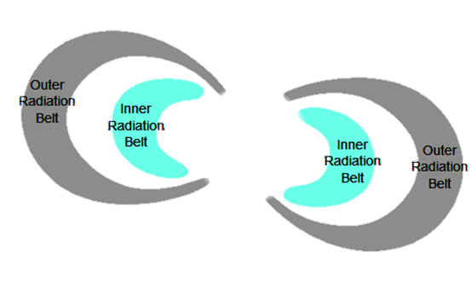
Summary
Sources of Radiation Near Earth
3 Trapped Radiation
Radiation Belts
South Atlantic Anomaly (SAA)
Earth
Trapped radiation comes in two forms: radiation trapped by the Van Allen Belts and the South Atlantic Anomaly
Notes:
Presenter Notes
2025-06-03 15:00:33
--------------------------------------------
This trapped environment becomes the third source of the natural space radiation environment albeit an indirect source. The trapped environment does not produce radiation, it just collects it. Next Particles in the trapped environment mainly fall within an outer belt and an inner belt, which also includes the south Atlantic anomaly. Next

Slide 47
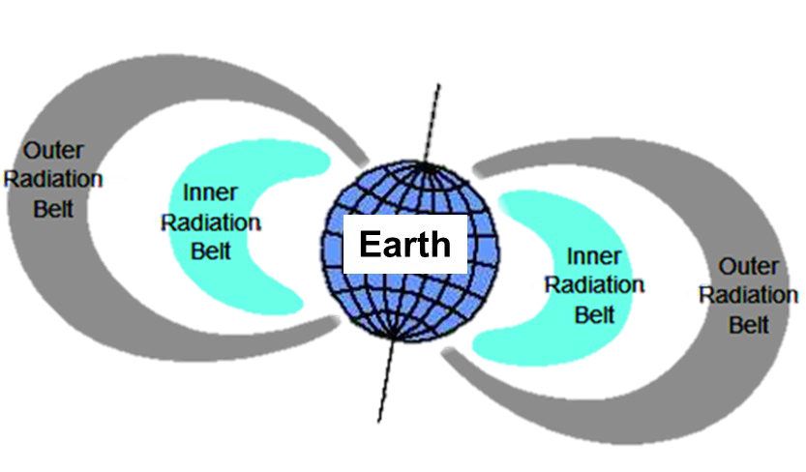

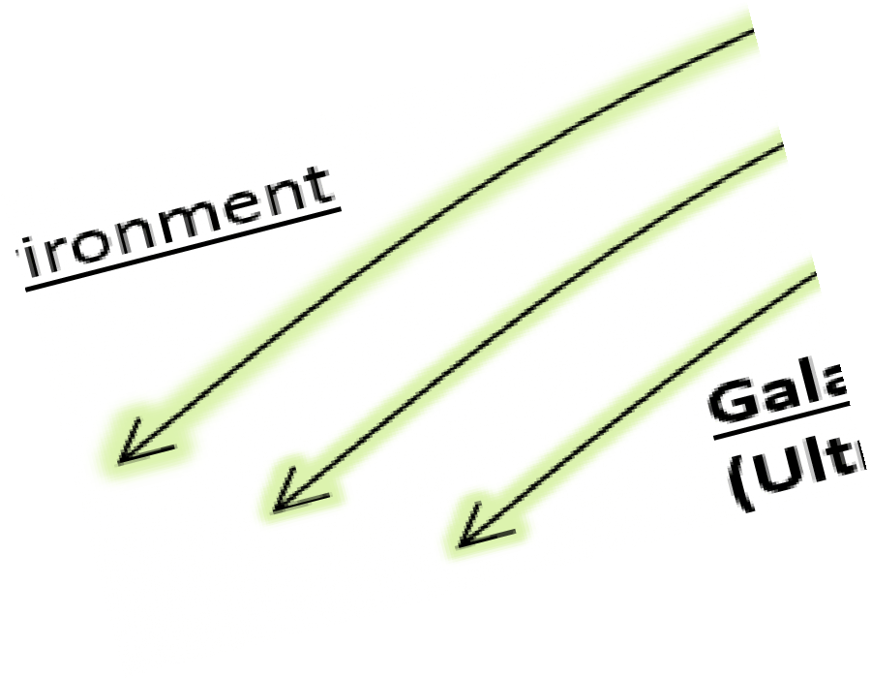
Summary
Effect of the Sun on Environment
Episodic or “Active” Environment
Continuous or “Quiet Time” Environment
Trapped Radiation
₁ Solar Energetic
₂ Galactic Cosmic Rays
₃ Radiation Belts
4
South Atlantic Anomaly (SAA)
Particles (SEPs)
(GCRs)
Other Stars / Supernova
The space environment is dynamic due to the solar cycle which determines environments that are most prominent around Earth
Notes:
Presenter Notes
2025-06-03 15:00:35
--------------------------------------------
The sun not only acts as a source of radiation but also acts as a modulator of the other sources of radiation environments. Next
The suns activity or solar cycle is 11 years long and includes about 7 years of active times where the sun is more active and 4 years where the sun is less active. When the sun is most active, Next, we call this the Active Environment which is when the sun contributes most to the space environment.
When the sun is less active, this is called the Quiet environment in which GCRs and the trapped environment are more pronounced.
The space environment is very dynamic due to the solar cycle and determines which environments are most prominent around Earth. Next

Slide 48
Summary
Effect of the Environment on Mission
 | Levels |  | Orbits
Env | Solar Max | Solar Min | LEO (Low Inc) | LEO (Polar) | MEO | HEO | GEO
Trapped Electron | Higher | Lower | Moderate | Moderate | Severe | Yes | Severe
Trapped Protons | Lower | Higher | Yes | Yes | Severe | Yes | No
Solar Particle | More Frequent | Less Frequent | No | Yes | Yes | Yes | Yes
GCRs | Lower | Higher | Moderate | Yes | Yes | Yes | Yes
Modeling and simulation is required to understand HOW, not IF, the natural space environment will affect your system.
Notes:
Presenter Notes
2025-06-03 15:00:36
--------------------------------------------
All spacecraft trajectories include some portion of the space radiation environment and should be assessed to determine how to design your system to function in them. Justin will be digging into this subject deeper tomorrow when he introduces an acronym called MEAL. The E stands for Environment and is only one aspect of designing your system for the natural space environment. Thank you for your attention, I’ll now be taking questions. I’d like to first start with the virtual participants and then take questions from Luddy. If you’re on site in Luddy and have a question please head to the nearest microphone so that the audience can hear the question.

Slide 49
Questions?

Slide 50
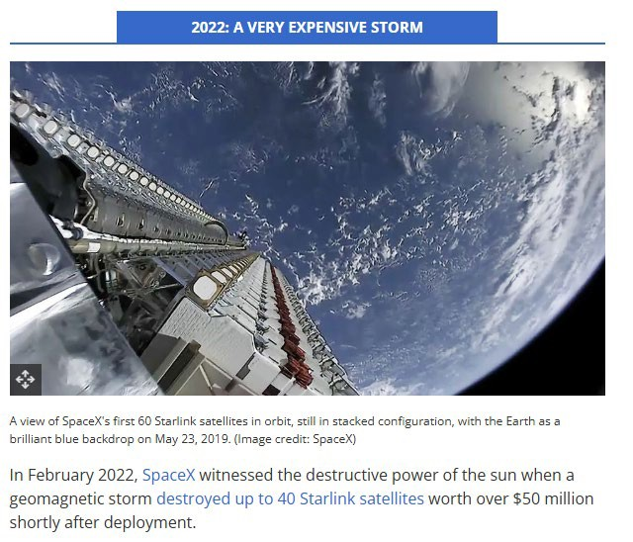
Why do environments matter?
Historical Examples
[Credit: T. Malik, July 20, 2022 The Worst Solar Storms in History]
Notes:
Presenter Notes
2025-06-03 15:00:37
--------------------------------------------
In February 2022, SpaceX witnessed the destructive power of the sun when a geomagnetic storm destroyed up to 40 Starlink satellites worth over $50 million shortly after deployment.
Starlink satellites (and other low-Earth orbit satellites) are particularly vulnerable to geomagnetic storms because they are released into very low-altitude orbits (between 60 and 120 miles (100 to 200 km), and they rely on onboard engines to overcome the force of drag, raising themselves to a final altitude of about 350 miles (550 km).
During a geomagnetic storm, Earth's atmosphere absorbs energy from the storms, heats up and expands upwards, leading to a significantly denser thermosphere that extends from about 50 miles (80 km) to approximately 600 miles (1,000 km) above the Earth's surface. A denser thermosphere means more drag which can be an issue for satellites. This is what happened in February when the batch of recently released Starlink satellites failed to overcome the increased drag caused by the geomagnetic storm and began to fall back to Earth, eventually burning up in the atmosphere.

Slide 51
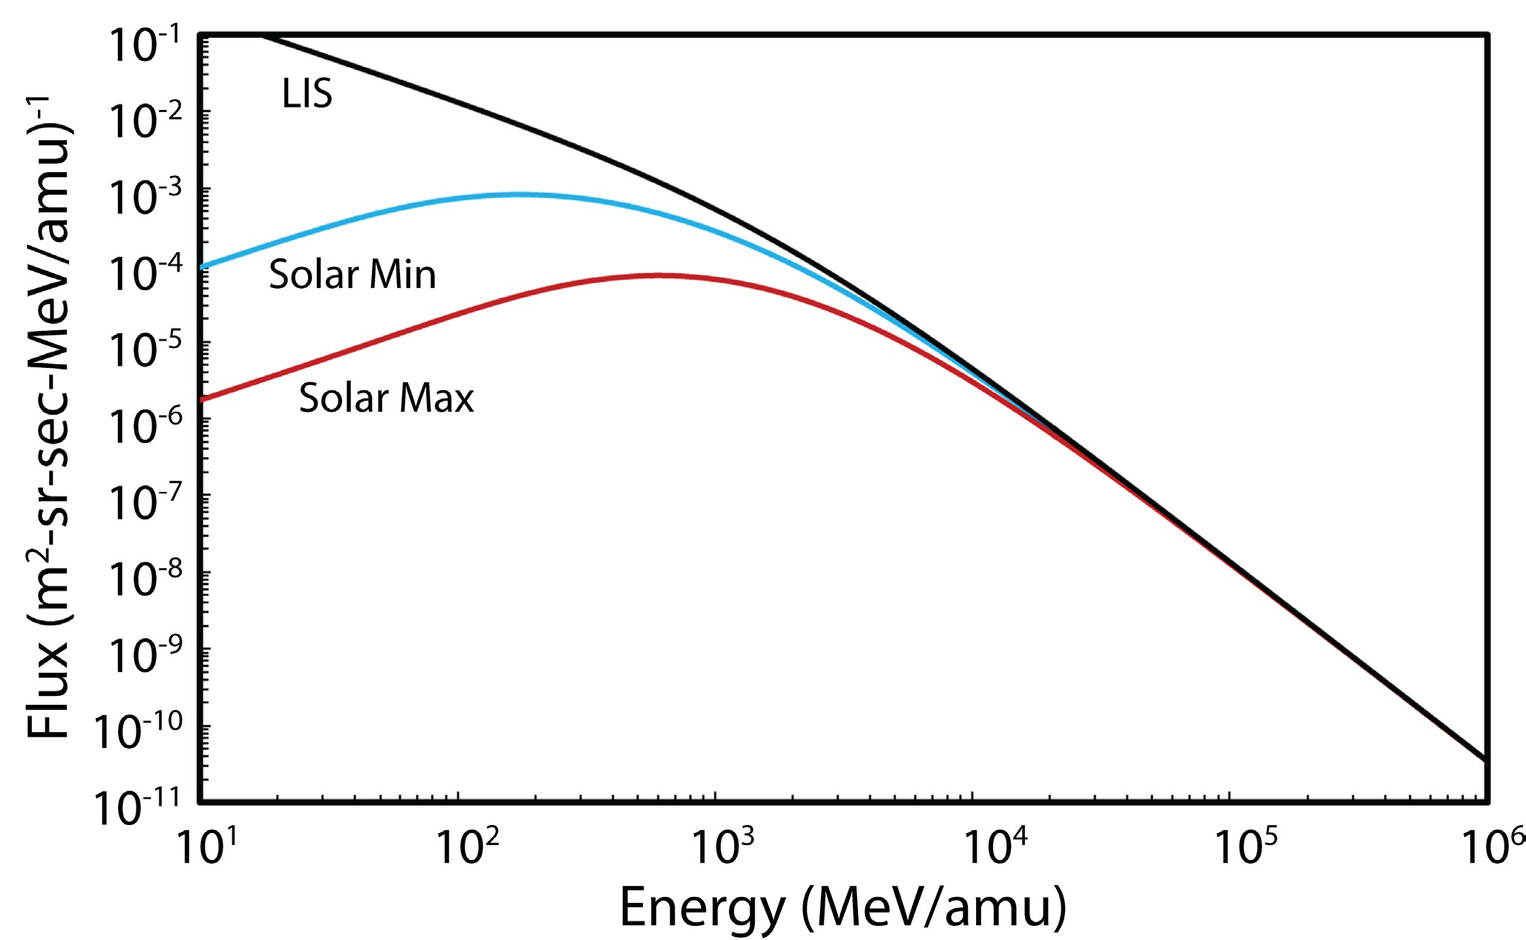
Model Variation with Solar Cycle
Models based on theory of solar modulation of GCR fluxes
Describe penetration of GCR Local Interstellar Spectra (LIS) into heliosphere and transport to near Earth
Variation over the solar cycle results from sun’s magnetic activity
‒ Higher activity during solar maximum results in lower flux
Iron
P.M. O’Neill, S. Golge and T.C. Slaba, NASA Tech. Paper, March 2015
Notes:
Presenter Notes
2025-06-03 15:00:40
--------------------------------------------
On the graph, the black line is called the Local Interstellar Spectra which is what the energy spectra would look like outside of our solar system. When the Solar activity is low, Galactic Cosmic Rays influence the space environment around earth more.
When the Solar activity is high, the Sun influences the environment around earth more.
This is one reason why GCRs are considered a part of the “Quiet” Environment due to less Solar activity. If iron energies have high energies. Stronger solar max is attenuating the iron from the GCR

