Slide 1
Intro to Git & GitHub
Jay / TDMDAL
Site for this workshop: https://tdmdal.github.io/git-workshop

Slide 2

What’s Git
A version control system
manage the evolution of a set of files (repository / repo)
usually for source code or text files
Version control?
keep track of changes: version 1, version 2, etc.
like “Track Changes” or “undo” in MS Word, but much more powerful
v1
v2
v3
v4
v5
f1

Slide 3






What’s GitHub
A git-aware online repo host
Enable repo sharing and collaboration
raise issues, pull request, etc.
Free public and private repo (*)
Other repo hosts exist
e.g. gutbucket, gitlab, etc.
Remote Repo
Your Local Repo
Your co-author’s
Local Repo
Ref: https://github.com/pricing

Slide 4
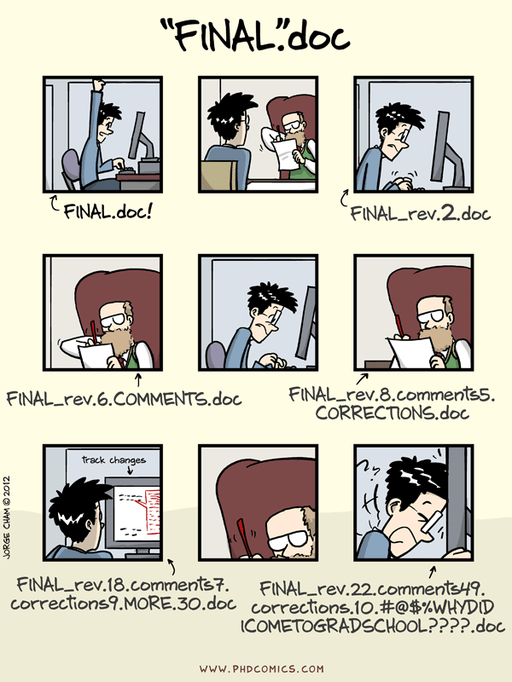
Why Git & GitHub
Organize (record keeping; traceability)
Track, compare and undo changes
Manage multiple versions/ideas at the same time efficiently
Backup your work
Share
Collaborate
co-authors
open source community

Slide 5
Other Benefits
GitHub can host your (static) website, i.e., a free web host
GitHub Pages: https://pages.github.com/
ex. https://tdmdal.github.io
Digital presence for your research or classroom work
ex. https://github.com/jesusfv/
ex. https://github.com/Computational-Content-Analysis-2018

Slide 6
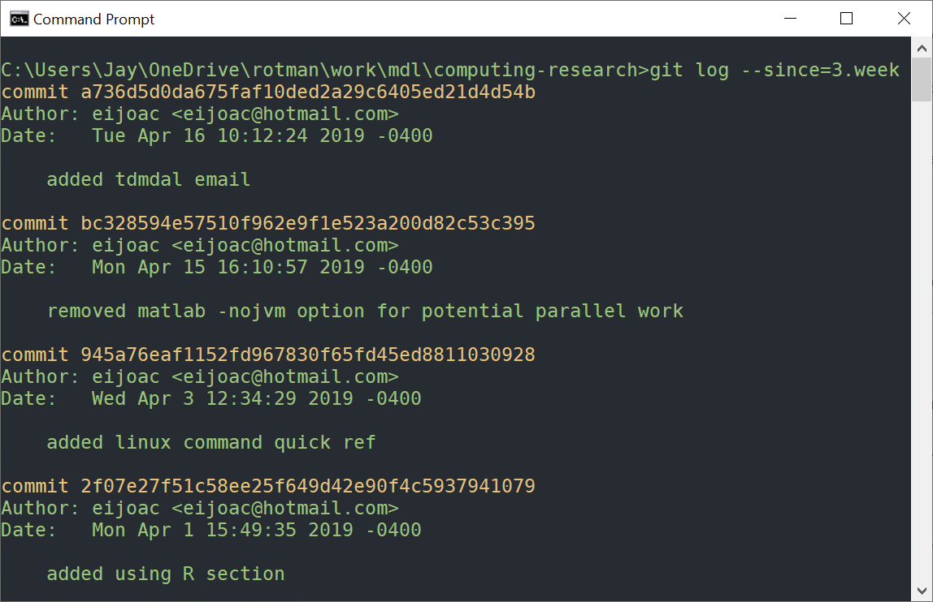
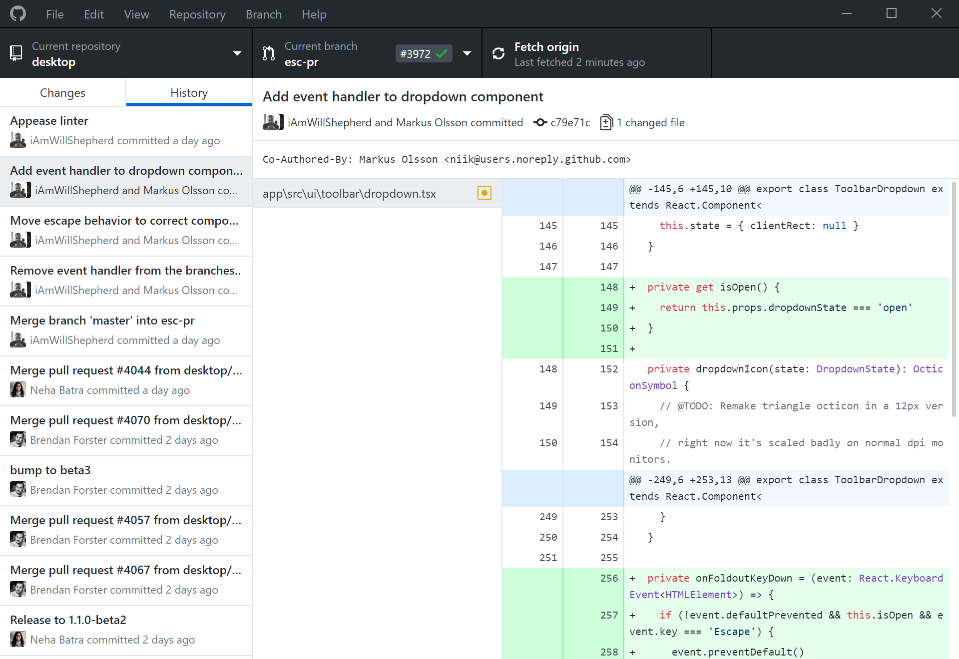
Using Git: Command Line vs GUI Clients
Installation: https://git-scm.com/downloads
Command Line vs GUI clients (many of them)

Slide 7
The simplest git workflow (demo)
make changes to your files
add/stage the changes (to the staging area): git add
commit the changes (i.e., record version history): git commit
repeat (back to 1)…
Configure git for first-time use: git config
Create a new local repo: git init
check commit history: git log; git show
compare difference between changes: git diff
https://tdmdal.github.io/git-workshop/basic-git-workflow.html
Notes:
git diff; compare files between working and repo (working relative to repo change); and between working and staging if the file is staged
git diff <commit-id>: working and repo
git diff --staged: staged and repo
git diff <commit-id1>..<commit-id2>
git log --oneline

Slide 8
Git Concepts – three trees/areas
repository
staging index
working
Source: Git Essential Training by Kevin Skoglund on lynda.com
Notes:
git add: snapshots the file in preparation for committing/versioning
git commit: records file snapshots in version history
many changes, but commit one logic block at a time using the staging area

Slide 9
Git Concepts – three trees/areas
repository
staging index
git add
working
snapshot the files in preparation for versioning
Source: Git Essential Training by Kevin Skoglund on lynda.com
Notes:
git add: snapshots the file in preparation for committing/versioning
git commit: records file snapshots in version history
many changes, but commit one logic block at a time using the staging area

Slide 10
Git Concepts – three trees/areas
repository
git commit
record file snapshots in version history
staging index
git add
working
snapshot the files in preparation for versioning
Source: Git Essential Training by Kevin Skoglund on lynda.com
Notes:
git add: snapshots the file in preparation for committing/versioning
git commit: records file snapshots in version history
many changes, but commit one logic block at a time using the staging area

Slide 11
Git Concepts – three trees/areas
repository
git commit
record file snapshots in version history
staging index
git checkout
git add
working
snapshot the files in preparation for versioning
Source: Git Essential Training by Kevin Skoglund on lynda.com
Notes:
git add: snapshots the file in preparation for committing/versioning
git commit: records file snapshots in version history
many changes, but commit one logic block at a time using the staging area

Slide 12
Hands-on?
Option 1: Install Git: https://git-scm.com/downloads
Option2: Use this in-browser Linux emulator for Git practice.
- may have problem accessing internet (i.e. when you use github)
https://tdmdal.github.io/git-workshop/basic-git-workflow.html

Slide 13
Git Concepts – First commit
HEAD
master
4a

Slide 14
Git Concepts – Second commit
HEAD
master
4a
9b

Slide 15
Git Concepts – Third commit and so on…
HEAD
master
4a
9b
3c

Slide 16
Remove and Rename Files (FYI)
Remove files (demo)
git rm <file>
Rename files
git mv <file_old> <file_new>
After removing or rename files
git commit –m "<remove or rename msg>"
Notes:
git checkout -- <file>: checkout from repo to working; use case: delete or modify the file accidently

Slide 17
Undo (1 / FYI)
Undo working directory changes
git checkout -- <file>
Retrieve old version of a file (to staging index & working dir) (demo)
git checkout <commit-id> -- <file>
Unstaging files
git reset HEAD <file>
Notes:
git checkout -- <file>: checkout from repo to working; use case: delete or modify the file accidently

Slide 18
Undo (2 / FYI)
Amending last commit
git commit –amend –m “commit message”
Reverting a commit (by adding a new commit to undo last commit)
git revert <commit-id>
Undo multiple commits
git reset [-–soft|--mixed|--hard] <commit-id>
Notes:
git checkout <commit-id> -- <file>

Slide 19
Suppress Tracking: .gitignore file
Don’t track certain files for a project
e.g. my_project/.gitignore
my_project/.gitignore
*.log
log/
data/
!data/sample.csv
A collection of useful .gitignore templates.

Slide 20
Branching (another common git workflow)
HEAD
master
4a
9b
3c
Inspiration source: Git Essential Training by Kevin Skoglund on lynda.com

Slide 21
Branch
git branch new_idea
HEAD
master
4a
9b
3c
new_idea

Slide 22
Branch
git checkout new_idea
master
4a
9b
3c
new_idea
HEAD

Slide 23
Branch
git add; git commit;
master
4a
9b
3c
4f
new_idea
HEAD

Slide 24
Branch
git checkout master
HEAD
master
4a
9b
3c
4f
new_idea

Slide 25
Branch
git add; git commit;
HEAD
master
4a
9b
3c
4c
4f
new_idea

Slide 26
Merge
git merge new_idea
HEAD
master
4a
9b
3c
4c
5d
4f
new_idea
Notes:
branch on branch is file too

Slide 27
Work with GitHub (demo)
GitHub Account
Create a GitHub project repo & push your code there
backup
collaborate with your co-authors
collaborate with open source community
Use a public repo as your project starting point
git remote add
git push
fork & git clone

Slide 28
A Simple Remote Repo Workflow
Remote Repo
Local Repo
4a
9b
3c
master
Source: Git Essential Training by Kevin Skoglund on lynda.com

Slide 29
A Simple Remote Repo Workflow
git push
master
Remote Repo
4a
9b
3c
origin/master
Local Repo
4a
9b
3c
master
Source: Git Essential Training by Kevin Skoglund on lynda.com

Slide 30
A Simple Remote Repo Workflow
master
Remote Repo
4a
9b
3c
origin/master
Local Repo
4a
9b
3c
4c
master
Source: Git Essential Training by Kevin Skoglund on lynda.com

Slide 31
A Simple Remote Repo Workflow
git push
master
Remote Repo
4a
9b
3c
4c
origin/master
Local Repo
4a
9b
3c
4c
master
Source: Git Essential Training by Kevin Skoglund on lynda.com

Slide 32
A Simple Remote Repo Workflow
master
Remote Repo
4a
9b
3c
4c
5d
origin/master
Local Repo
4a
9b
3c
4c
master
Source: Git Essential Training by Kevin Skoglund on lynda.com

Slide 33
A Simple Remote Repo Workflow
git fetch
master
Remote Repo
4a
9b
3c
4c
5d
origin/master
Local Repo
4a
9b
3c
4c
5d
master
Source: Git Essential Training by Kevin Skoglund on lynda.com

Slide 34
A Simple Remote Repo Workflow
git merge
master
Remote Repo
4a
9b
3c
4c
5d
origin/master
Local Repo
4a
9b
3c
4c
5d
master
Source: Git Essential Training by Kevin Skoglund on lynda.com
Notes:
git pull = git fetch + git merge

Slide 35
Many more to explore on your own
Git concept / command
merge conflict
remote branch
git reset
git stash, rebase, bisect
…
Git best practice
workflows
commit size / message
…

Slide 36
Resources
Git Ref Book: https://git-scm.com/book/en/v2
Git Tutorials
Version Control with Git by Software Carpentry
Git Essential Training by Kevin Skoglund at lynda.com
login from here for UofT free access
Get Started Tutorials from Bitbucket Atlassian
GitHub Guides
Git GUI (I recommend starting with command line)
dedicated GUI client: https://git-scm.com/downloads/guis
GUI integrated with IDE or code editor (e.g. RStudio, vscode, etc.)

