Slide 1
Intro to R – Data wrangling
R Workshop - 2
January 30, 2020 Prepared by Jay Cao / TDMDAL
Website: https://tdmdal.github.io/r-tutorial-201920-winter/

Slide 2
Plan
Tidy Data
Data manipulation
Filter, Select, etc.
Join datasets

Slide 3
Tidy Data
A (One) way to organize tabular data
Definition
Each variable forms a column.
Each observation, or case, forms a row.
Each type of observational unit forms a table
http://vita.had.co.nz/papers/tidy-data.html
Notes:
think deeper, what’s a variable/column; how to store data; everything in one table or more than one?

Slide 4
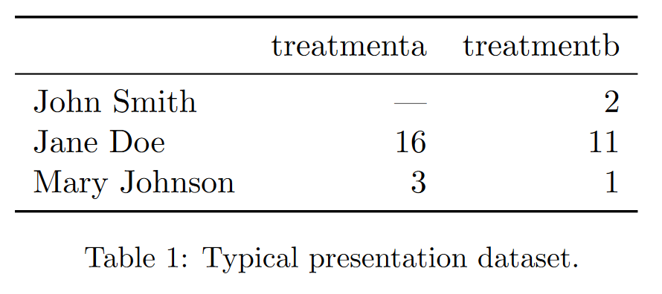
Messy Data – Example 1
http://vita.had.co.nz/papers/tidy-data.html

Slide 5
Messy Data – Example 1
http://vita.had.co.nz/papers/tidy-data.html
Notes:
value as in variable/column name; average results by a and b; average result of all and b; average result by person; in consistency;

Slide 6
Messy Data – Example 1 / Why is it Messy?
Values as column names
Hard to retrieve data and analyze them in a consistent way
how many treatments in total
get average result by person
get average result by treatment
get overall average result
http://vita.had.co.nz/papers/tidy-data.html
Notes:
value as in variable/column name; average results by a and b; average result of all and b; average result by person; in consistency;

Slide 7
Messy Data – Example 1 / Why is it Messy?
Values as column names
Hard to retrieve data and analyze them in a consistent way
how many treatments in total
get average result by person
get average result by treatment
get overall average result
http://vita.had.co.nz/papers/tidy-data.html
Notes:
value as in variable/column name; average results by a and b; average result of all and b; average result by person; in consistency;

Slide 8
Messy Data – Example 1 / Why is it Messy?
Values as column names
Hard to retrieve data and analyze them in a consistent way
how many treatments in total
get average result by person
get average result by treatment
get overall average result
http://vita.had.co.nz/papers/tidy-data.html
Notes:
value as in variable/column name; average results by a and b; average result of all and b; average result by person; in consistency;

Slide 9
Messy Data – Example 1 / Why is it Messy?
Values as column names
Hard to retrieve data and analyze them in a consistent way
how many treatments in total
get average result by person
get average result by treatment
get overall average result
http://vita.had.co.nz/papers/tidy-data.html
Notes:
value as in variable/column name; average results by a and b; average result of all and b; average result by person; in consistency;

Slide 10
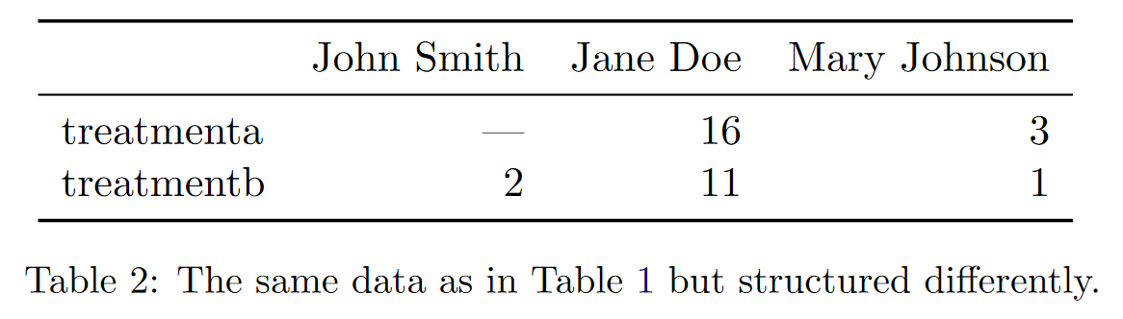
Messy Data – Example 2
http://vita.had.co.nz/papers/tidy-data.html

Slide 11
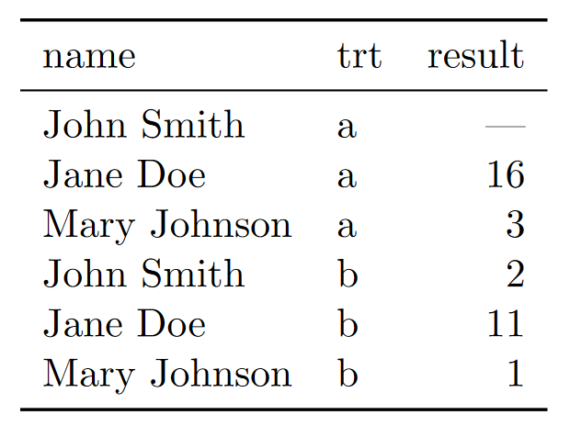
The Tidy Version
http://vita.had.co.nz/papers/tidy-data.html

Slide 12
The Tidy Version – Why is it Tidy
All column-wise operations
how many treatments in total
get average result by person
get average result by treatment
get overall average result
http://vita.had.co.nz/papers/tidy-data.html

Slide 13
Many Ways of Being Messy
Messy datasets have 5 common problems (Wickham, 2014)
Column headers are values, not variable names.
Multiple variables are stored in one column.
Variables are stored in both rows and columns.
Multiple types of observational units are stored in the same table.
A single observational unit is stored in multiple tables.
http://vita.had.co.nz/papers/tidy-data.html

Slide 14
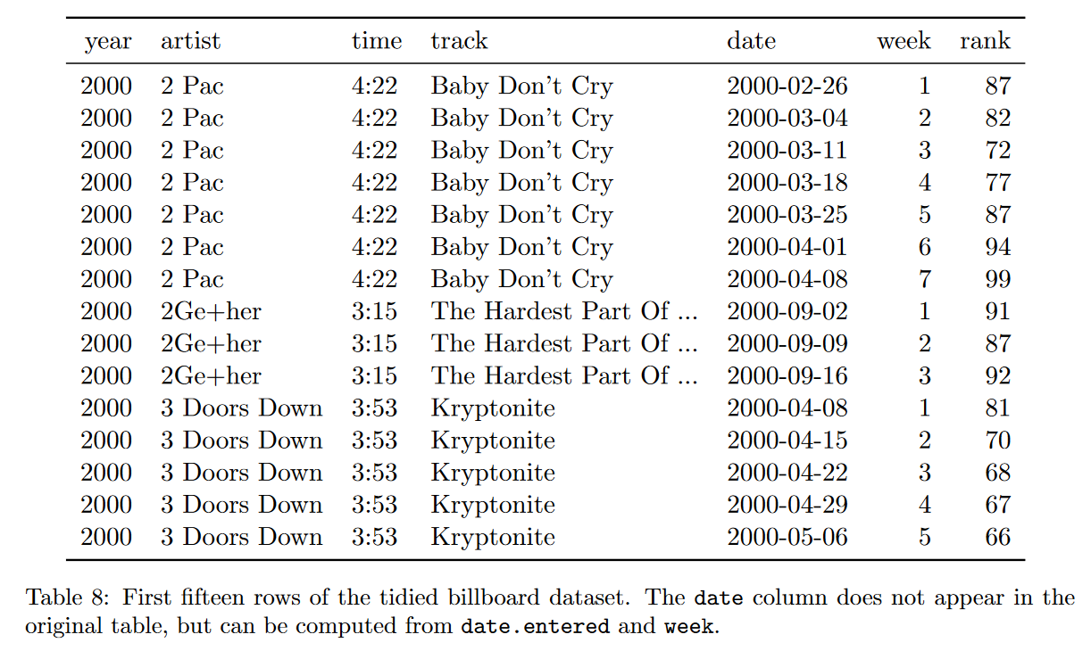
Messy Data – Example 3
http://vita.had.co.nz/papers/tidy-data.html

Slide 15
Messy Data – Example 3
http://vita.had.co.nz/papers/tidy-data.html

Slide 16
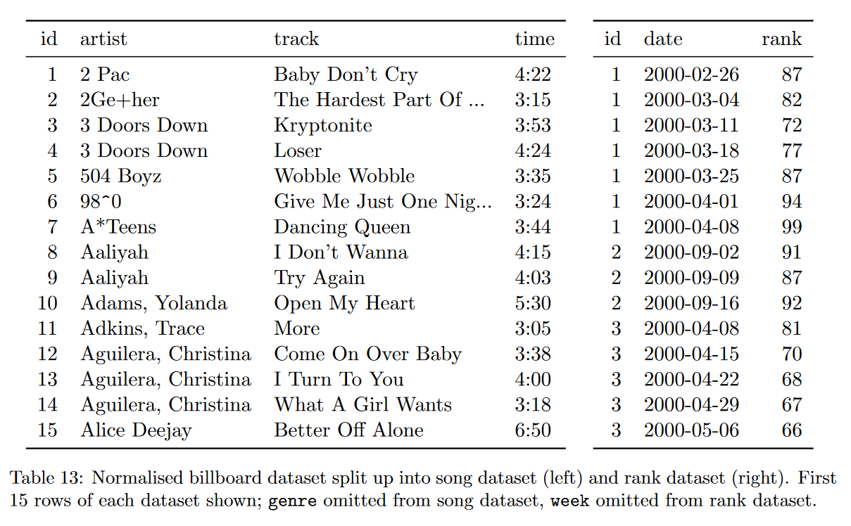
The Tidy Version
http://vita.had.co.nz/papers/tidy-data.html

Slide 17
From Messy to Tidy (One Example)

Slide 18
pivot_longer()
# A tibble: 3 x 3
name treatmenta treatmentb
<chr> <dbl> <dbl>
1 John Smith NA 2
2 Jane Doe 16 11
3 Mary Johnson 3 1
pivot_longer(df_messy, -name,
names_to = "treatment", values_to = "result")

Slide 19
pivot_longer()
# A tibble: 3 x 3
name treatmenta treatmentb
<chr> <dbl> <dbl>
1 John Smith NA 2
2 Jane Doe 16 11
3 Mary Johnson 3 1
pivot_longer(df_messy, -name,
names_to = "treatment", values_to = "result")

Slide 20
pivot_longer()
# A tibble: 3 x 3
name treatmenta treatmentb
<chr> <dbl> <dbl>
1 John Smith NA 2
2 Jane Doe 16 11
3 Mary Johnson 3 1
pivot_longer(df_messy, -name,
names_to = "treatment", values_to = "result")

Slide 21
pivot_longer()
# A tibble: 3 x 3
name treatmenta treatmentb
<chr> <dbl> <dbl>
1 John Smith NA 2
2 Jane Doe 16 11
3 Mary Johnson 3 1
pivot_longer(df_messy, -name,
names_to = "treatment", values_to = "result")

Slide 22
pivot_longer()
# A tibble: 3 x 3
name treatmenta treatmentb
<chr> <dbl> <dbl>
1 John Smith NA 2
2 Jane Doe 16 11
3 Mary Johnson 3 1
pivot_longer(df_messy, -name,
names_to = "treatment", values_to = "result")

Slide 23
pivot_longer() result
# A tibble: 6 x 3
name treatment result
<chr> <chr> <dbl>
1 John Smith treatmenta NA
2 John Smith treatmentb 2
3 Jane Doe treatmenta 16
4 Jane Doe treatmentb 11
5 Mary Johnson treatmenta 3
6 Mary Johnson treatmentb 1

Slide 24
The inverse transformation: pivot_wider()
name treatment result
<chr> <chr> <dbl>
1 John Smith a NA
2 Jane Doe a 16
3 Mary Johnson a 3
4 John Smith b 2
5 Jane Doe b 11
6 Mary Johnson b 1
pivot_wider(df_tidy,
names_from = treatment, values_from = result)

Slide 25
The inverse transformation: pivot_wider()
name treatment result
<chr> <chr> <dbl>
1 John Smith a NA
2 Jane Doe a 16
3 Mary Johnson a 3
4 John Smith b 2
5 Jane Doe b 11
6 Mary Johnson b 1
pivot_wider(df_tidy,
names_from = treatment, values_from = result)

Slide 26
The inverse transformation: pivot_wider()
name treatment result
<chr> <chr> <dbl>
1 John Smith a NA
2 Jane Doe a 16
3 Mary Johnson a 3
4 John Smith b 2
5 Jane Doe b 11
6 Mary Johnson b 1
pivot_wider(df_tidy,
names_from = treatment, values_from = result)

Slide 27
pivot_wider() result
# A tibble: 3 x 3
name a b
<chr> <dbl> <dbl>
1 John Smith NA 2
2 Jane Doe 16 11
3 Mary Johnson 3 1

Slide 28
Data manipulation: dplyr()
Filter observations: filter()
Select variables: select()
Reorder rows: arrange()
Create new variables: mutate()
Collapse column values to a single summary: summarise()
Group by: group_by()

Slide 29
The Employees Table
> employees %>% select(FirstName, LastName, Country)
# A tibble: 9 x 3
FirstName LastName Country
<chr> <chr> <chr>
1 Nancy Davolio USA
2 Andrew Fuller USA
3 Janet Leverling USA
4 Margaret Peacock USA
5 Steven Buchanan UK
…

Slide 30
Count Number of Employees By Country
> employees %>% select(FirstName, LastName, Country) %>%
group_by(Country)
# A tibble: 9 x 3
# Groups: Country [2]
FirstName LastName Country
<chr> <chr> <chr>
1 Nancy Davolio USA
2 Andrew Fuller USA
3 Janet Leverling USA

Slide 31
Count Number of Employees By Country
> employees %>% select(FirstName, LastName, Country) %>%
group_by(Country) %>%
summarise(count = n())
# A tibble: 2 x 2
Country count
<chr> <int>
1 UK 4
2 USA 5

Slide 32
Count Number of Employees By Country
> employees %>% select(FirstName, LastName, Country) %>%
group_by(Country) %>%
summarise(count = n()) %>%
arrange(desc(count))
# A tibble: 2 x 2
Country count
<chr> <int>
1 USA 5
2 UK 4

Slide 33
Relation between Datasets/Tables

Slide 34
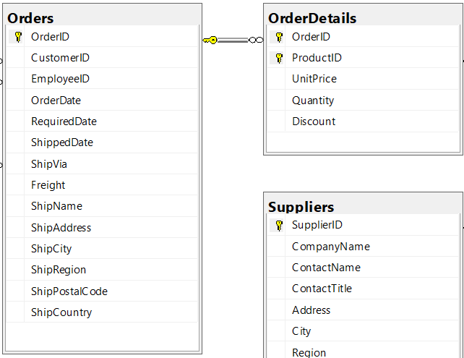
Relation between Datasets/Tables – Zoom In

Slide 35
Relation between Datasets/Tables – Zoom In
Primary key

Slide 36
Relation between datasets/tables – Zoom In
Primary key
Foreign key

Slide 37
Relation between datasets/tables – Zoom In
Primary key
Foreign key
1-to-Many Relationship

Slide 38
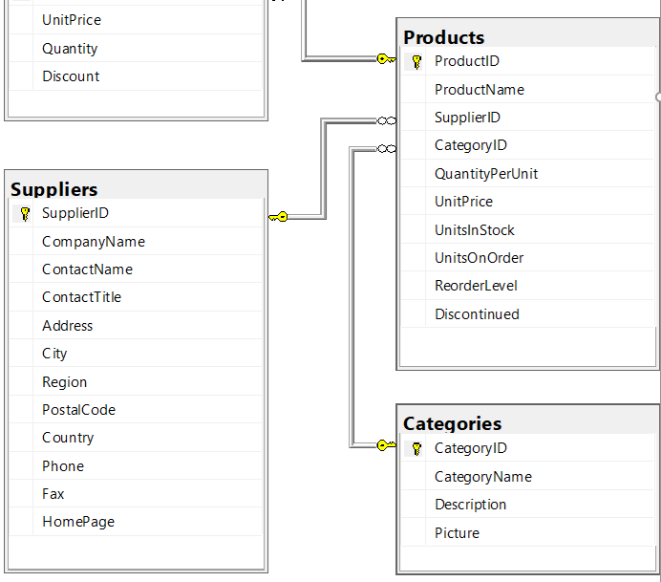
Relation between Tables – Another Example

Slide 39
Join – Inner Join
Table1
Table2
pk | t1c1
1 | a
2 | b
fk | t2c1
1 | c
1 | d
3 | e
Table1
Table2
pk | t1c1 | t2c1
1 | a | c
1 | a | d
inner_join(Table1, Table2, by = c("pk" = "fk"))

Slide 40
Join – Left (Outer) Join
Table1
Table2
pk | t1c1
1 | a
2 | b
fk | t2c1
1 | c
1 | d
3 | e
Table1
Table2
pk | t1c1 | t2c1
1 | a | c
1 | a | d
2 | b | NA
left_join(Table1, Table2, by = c("pk" = "fk"))

Slide 41
Join - Left (Outer) Join With Exclusion
Table1
Table2
pk | t1c1
1 | a
2 | b
fk | t2c1
1 | c
1 | d
3 | e
Table1
Table2
pk | t1c1 | t2c1
2 | b | NA
Table1 %>%
left_join(Table2, by = c("pk" = "fk")) %>%
filter(is.na(t2c1))

Slide 42
Join – Right (Outer) Join*
Table1
Table2
pk | t1c1
1 | a
2 | b
fk | t2c1
1 | c
1 | d
3 | e
Table1
Table2
pk | t1c1 | t2c1
1 | a | c
1 | a | d
3 | NA | e
right_join(Table1, Table2, by = c("pk" = "fk"))
Note: can use left_join as well.

Slide 43
Join - Right (Outer) Join With Exclusion*
Table1
Table2
Table1
Table2
pk | t1c1
1 | a
2 | b
fk | t2c1
1 | c
1 | d
3 | e
pk | t1c1 | t2c1
3 | NA | e
Table1 %>%
right_join(Table2, by = c("pk" = "fk")) %>%
filter(is.na(t1c1))

Slide 44
Join – Full Outer Join
Table1
Table2
pk | t1c1
1 | a
2 | b
fk | t2c1
1 | c
1 | d
3 | e
Table1
Table2
pk | t1c1 | t2c1
1 | a | c
1 | a | d
2 | b | NA
3 | NA | e
full_join(Table1, Table2, by = c("pk" = "fk"))

Slide 45
Join – Full Outer Join
Table1
Table2
pk | t1c1
1 | a
2 | b
fk | t2c1
1 | c
1 | d
3 | e
Table1
Table2
pk | t1c1 | t2c1
2 | b | NA
3 | NA | e
Table1 %>%
full_join(Table2, by = c("pk" = "fk")) %>%
filter(is.na(t1c1) | is.na(t2c1))

